Slide 1
S&T landscape analysis
The basis for a roadmap in Belgium

Slide 2
ET-EMR S&T landscape analysis
The basis for a roadmap
Valorisation
What else can we do with it?
Where are we doing it?
How are we doing it?
Why are we doing it?
EMR Environmental
ET Instrument
Science Case

Slide 3




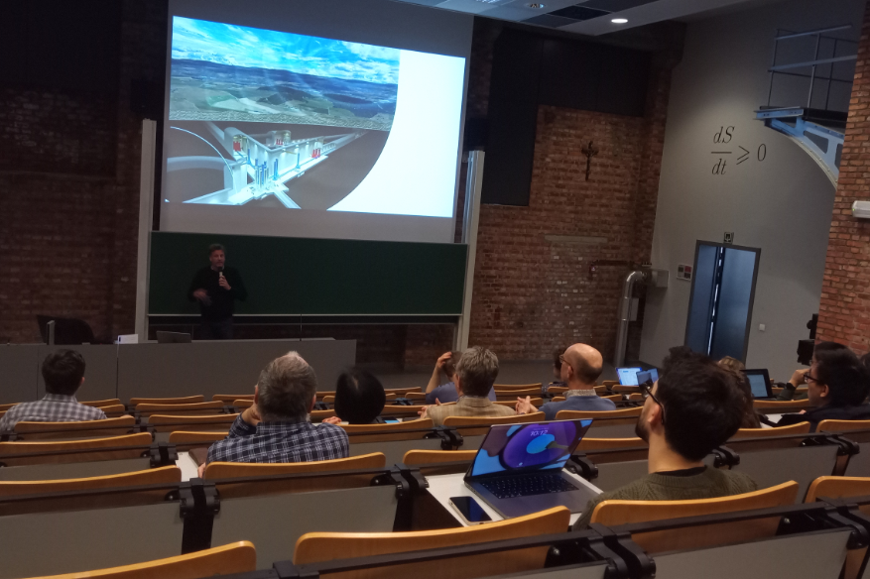
ET-EMR S&T landscape analysis
Handling the Science Case
  Algorithms
  Data Handling & Processing
  Exascale computing & Databases
  Howest
    Visualisations and Digital Twin
  Leuven Gravity Institute
Science Case

Slide 4
ET-EMR S&T landscape analysis
The ET Instrument
  Optics & Optical Metrology
  Sensors & Precision Mechanics
  Vacuum Technology
  Beampipes & Material science
  Lasers
  Civil Engineering, Modelling & Simulation
  Advanced Control Algorithms
ET Instrument
Science Case

Slide 5

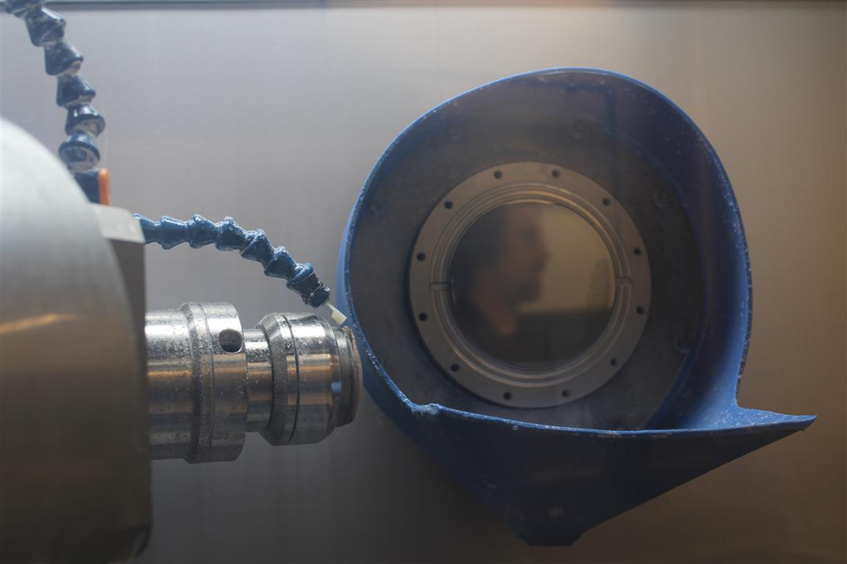
Research in Flanders
Mirror polishing for ETpathfinder
Input and Output Mode Cleaners
ET Instrument
Science Case

Slide 6

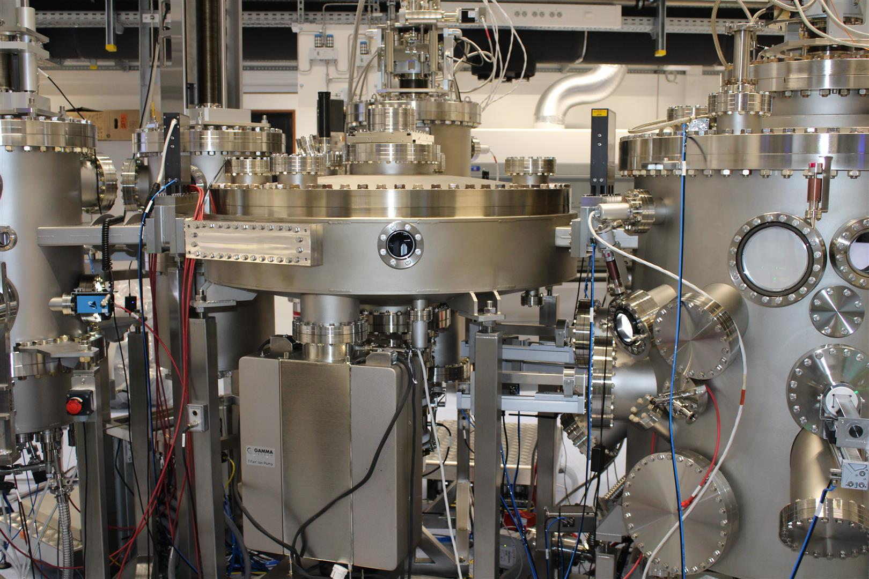

Research in Flanders
Amorphous coatings (Ghent University)
Crystalline coatings (KU Leuven)
ET Instrument
Science Case

Slide 7
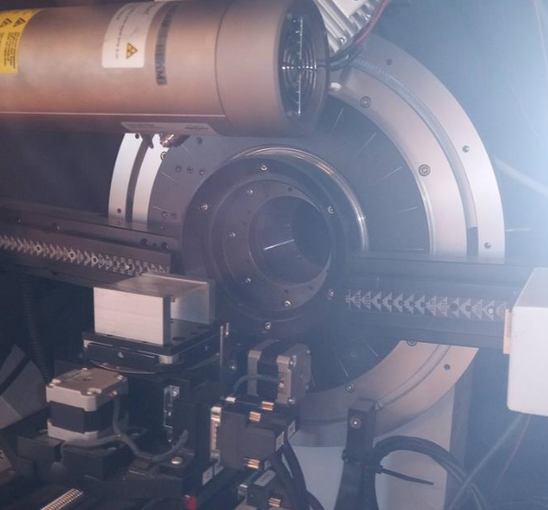
Research in Flanders
Optical and Mechanical Properties
Structural Metrology
Low-temperature metrology
Thermodynamics
ET Instrument
Science Case

Slide 8
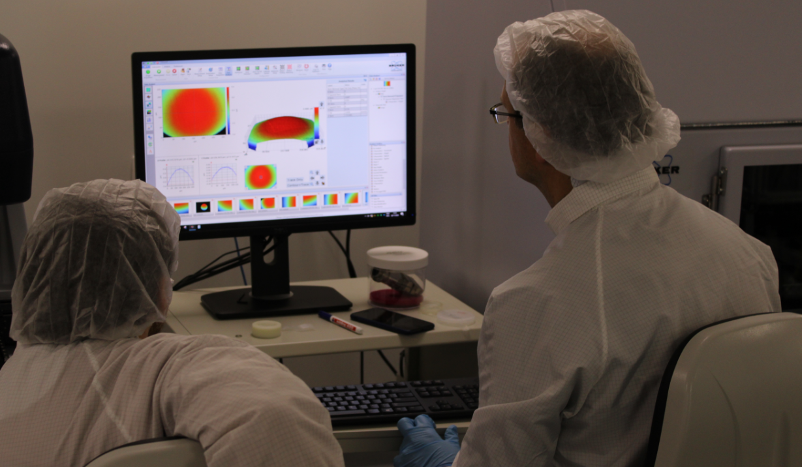
Research in Flanders
Optics and Photonics (B-PHOT, UGhent)
ET Instrument
Science Case

Slide 9

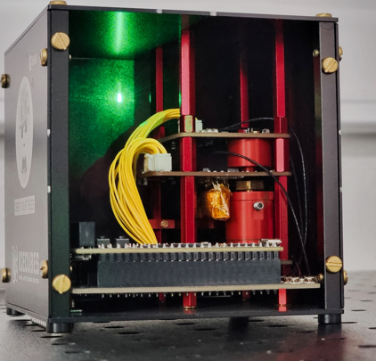
Research in Flanders
Sensors & Quantum Sensors
Cryogenic chips and components
ET Instrument
Science Case

Slide 10
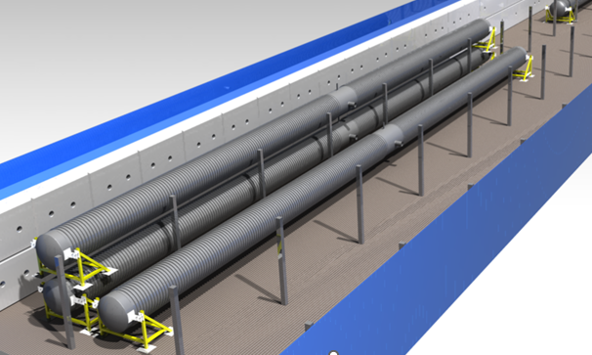
Research in Flanders
Beampipes
Vacuum System with CERN
ET Instrument
Science Case

Slide 11
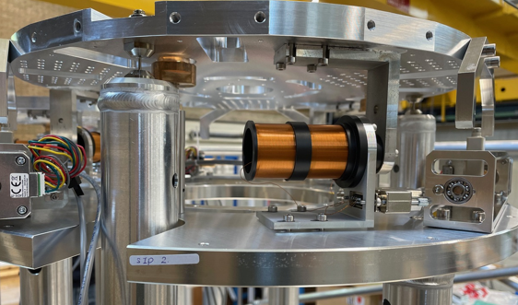
Research in Flanders
Vibration Isolation
Seismic sensors, attenuation & control
ET Instrument
Science Case

Slide 12

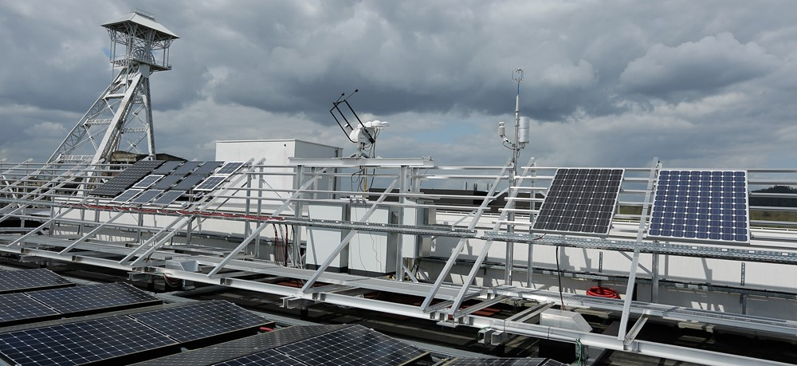
Research in Flanders
Geology & Hydrogeology
  Resource Recovery
Sustainability
Participatory Design
Energy
Legal aspects & structure
EMR Environmental
ET Instrument
Science Case

Slide 13
Research in Flanders
Interreg calls and transfer to Business
  Mechatronics and robotics
  Greentech & Wind Turbines
  Vacuum technology
  Industrial coating
  ...
Valorisation
EMR Environmental
ET Instrument
Science Case

Slide 14
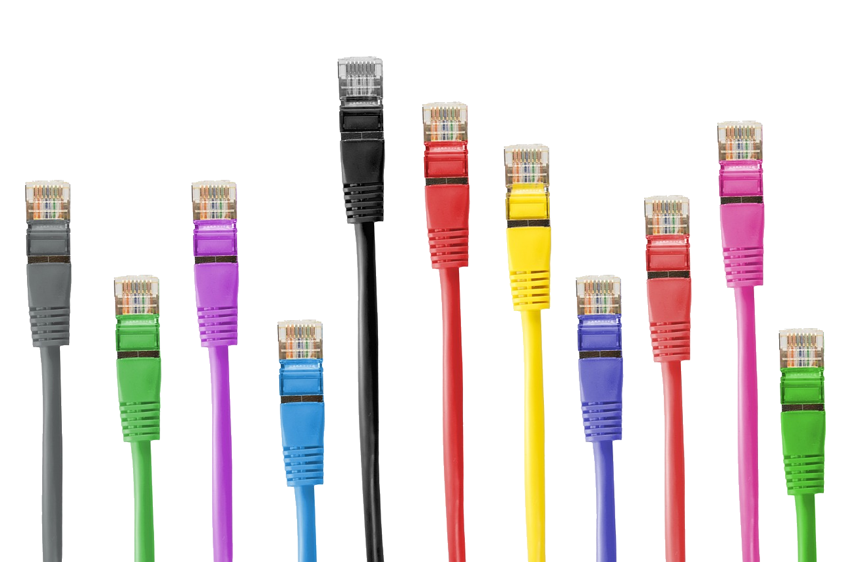
Loose ends ...

Slide 15


Brief overview of research in Flanders
KU Leuven
  Crystalline coatings
  Optical and mechanical properties
  Geological analysis
  Excavation resource recovery
  Civil studies
  Long term geological monitoring
  Large Computer Clusters
  Cryogenic sensors
University of Antwerp
  Beampipe vacuum system
  Seismic sensors, attenuation & control
  Vibration isolation & active control
Ghent University
  Amorphous coatings
  Output Mode Cleaners
  Metallic/material research
Overall
  Project Management
  ETO/ET-PP, Virgo/EGO and ETpf memberships
  Outreach and dissemination
Hasselt University
  Sustainability
  Quantum sensors
  Squeezed vacuum
  Legal risks and requirements
  Legal infrastructure
  Energy study
VUB – Free University Brussels
  Mirror polishing
  Photonic input and output filters
  Frequency dependent squeezed vacuum
  Light sources & laser amplifiers
  Hydrogeology study
VITO
  Geology study, 2D and 3D models
  Sustainability & circularity assessment
  Sustainability

