Slide 1
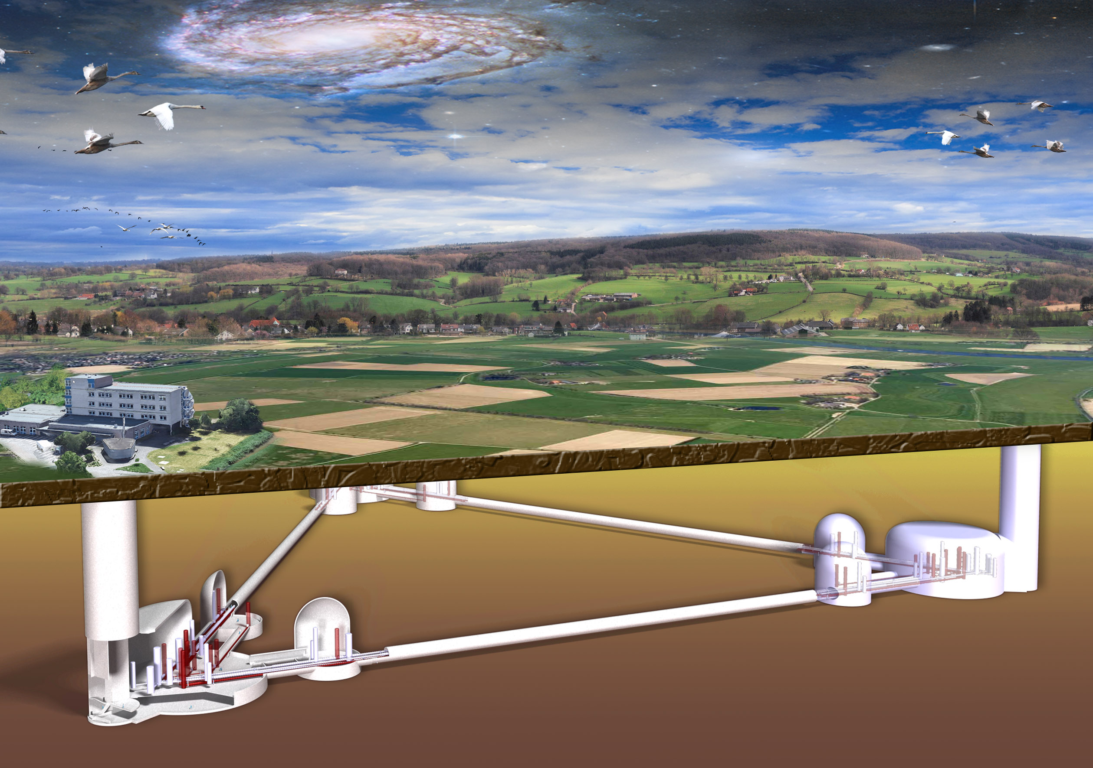
© Marco Kraan
German Community
Achim Stahl, 28. March 2025
RWTH Aachen University

Slide 2
BMBF Priorization Process
Priorization of large-scale research infrastructures
Target: A short list of projects recommended to the next government
for prioritized realization.
Declaration of interest: submitted @ August 26th, 2024.
Proposal: submitted @ October 25th, 2024.
Supporting letters: send just before Xmas, 2024.
Approximately 60 proposal were received by BMBF
BMBF will evaluate 32 proposals:
→ https://www.bmbf.de/SharedDocs/Downloads/DE/2025/FIS-Priorisierungsverfahren_Uebersicht.pdf
  Scientific potential → Scientific adivisory board of BMBF (Wissenschaftsrat)
  Potential for technologie transfer → Dedicated international board
  Cost and risiks → BMBF-internal review
Publication of the shortlist in May/June 2025.

Slide 3
Forschungsinfrastruktur zur adaptiven Aufbereitung komplexer Rohstoffe (FlexiPlant)
PETRA IV - Das ultimative 4D-Röntgenmikroskop
Open Research Center for the Exploration of Safety & Efficiency in Real Traffic (ORCHEStRa)
Deutsches Ultrahochfeld-Imaging 14 Tesla MRT-Zentrum (GUFI-14T))
Offene Sammlungs-, Informations- und Recherche Infrastruktur (OSIRIS)
NMR-Höchstfeldspektrometer für Bio- und Materialwissenschaften - Future-NMR 1.5 GHz*
CREATION: Zentrum für Gen- und Zelltherapie in Regeneration und Transplantation
Advanced Modular Reactor (AMR)
TerraNet - Auf dem Weg zu einem terrestrischen digitalen Zwilling Deutschlands für eine nachhaltige Nutzung und Bewirtschaftung der Landoberfläche
SCALA – Scale-up Green Chemistry: Forschungsplattform für Skalierung und den Transfer von innovativen nachhaltigen Prozessen der Chemie
IceCube-Gen2
High Brilliance neutron Source - Phase-I (HBS-I)
SLICES-DE
Mikroelektronik-Bauhaus Erlangen
The Karlsruhe Nuclear Magnetic Resonance Facility (KNMR)
XLZD: Ein Xenon-Observatorium für Astroteilchenphysik bei niedrigstem Untergrund (XENON-LZ-DARWIN)
Das Einstein-Teleskop – ET
Large Animal Research Center (LARC)
Deutsches Zentrum für Translationale Organoidforschung (DZTO)
National Laboratory for Photonic Science and Technology (NLP)
LEGEND 1000
Square Kilometre Array Observatory (SKAO)
European Solar Telescope (EST)
Forschungszentrum für nachhaltige Produktion und Kreislaufwirtschaft (naProKi)
Quantum Munich Labs (Q-MUC)
Dresden Advanced Light Infrastructure (DALI)
EBRAINS Deutschland (EBRAINS-D)
Präzisionsfermentation für innovative Produkte (PrecFer4innoP)
SuperCoHD: Hochleistungsrecheninfrastruktur für Gesundheitsdaten
Deutsches Forschungsinfrastrukturnetzwerk für zellbasierte Medizin (GRICE-NET)
Magdeburg Center for (Bio-)Medical Advanced X-Ray Imaging (MD-MAXI)
Research Infrastructure for Data from large Online Platforms (RIDLOP)

Slide 4
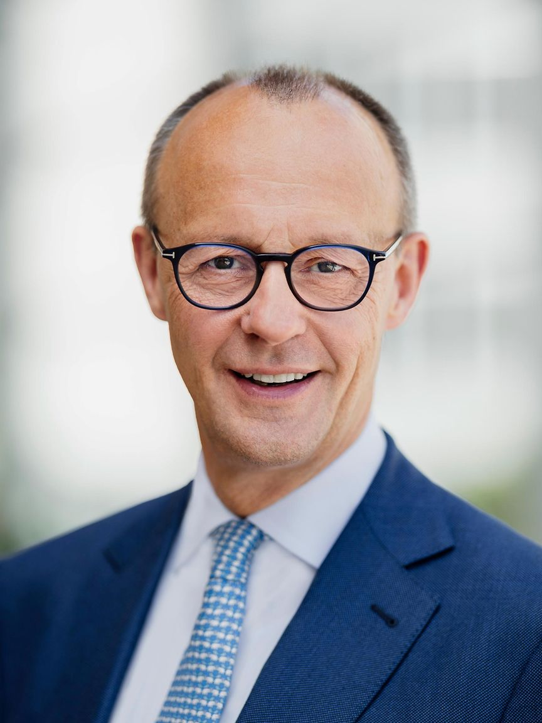
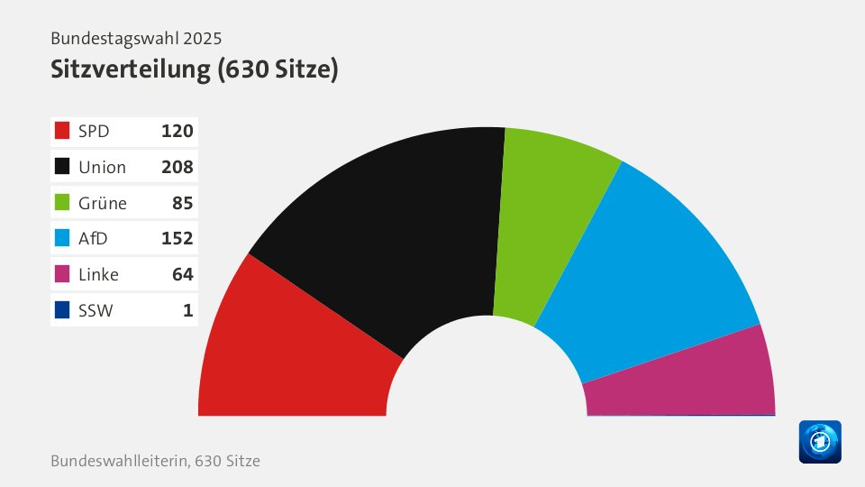
The German Government
„Old“ government:
  Coalition of social cemocrates (SPD), liberals (FDP) and the green party
  Chancelor Olaf Scholz
  Regular election was planned for September 28th, 2025
On November 6th, 2024 the government fell (liberals quit the coalition)
Early election on February 23rd, 2025
Christian democrates (CDU/CSU) won
  Coaliton with SPD in preparation
  New chancelor: Friedrich Merz (?)
  New government establisched by
  Easter ?
BMBF:
  install minister and sec. of state
  Takes a few weeks
  Operational within a few months?

Slide 5
The Einstein Telescope
Advancing Science
Driving Innovation
Strengthening European Collab.

Slide 6
The Einstein Telescope
Our request:
The highest priority of the German community is a timely realization of ET.
With our proposal, we ask BMBF to actively participate in shaping the project alongside our
European partners. We are asking for a significant financial contribution and coordination of the German contribution with the participating states and the scientific community.

Slide 7
The Einstein Telescope
Discussion of the sites:
Since decisions on the geometry and site(s) of ET are pending, we will describe the scientific objectives, innovation goals, and concepts of the research infrastructure and its utilisation
largely independent of specific configurations and locations.
However, for project planning, especially in the details of the addenda, we focus on the most advanced scenario with strong German participation: a 10 km triangle in the EMR region..

Slide 8
Schedule
Study by Tractebel & Amberg
Implenia Study
CERN
(prelim.)
guess

Slide 9
Cost and Risk
 | € 3916 mio.
additional R&D | € 16 mio. | Germany only
planning | € 32 mio. | Germany only
construction | € 2394 mio.
risk | € 353 mio.
operation | € 325 mio. € 750 mio. | during construction 15 years of operation
termination | € 40 mio.
With respect to 2024
No taxes included

Slide 10
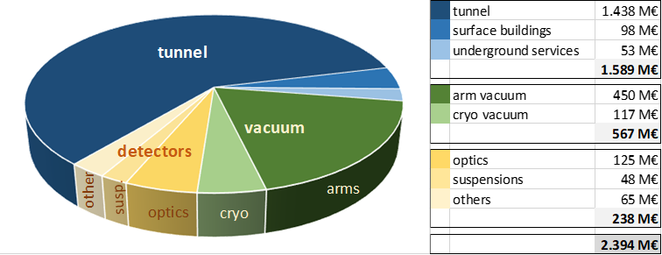
Cost Estimate
Construction cost:
Operational cost (up to 15 years): 1.075 M€ (50 M€/year)
Contingency to cover financial risks: 353 M€
Total cost (including planning, R&D, dismantling): 3.916 M€

Slide 11
Funding Concept
Disclaimer:
Decisions regarding the funding of the Einstein Telescope, including the sources and methods of
raising funds, lie with the funding agencies of the host countries. Nonetheless, we would like to
outline a potential funding scheme, and we hope that BMBF will engage in a constructive discussion
with our international partners regarding the funding of ET.
Construction cost:
Operational cost (50M€ annually):
The Netherlands: 870 M€
Belgium: 870 M€
Germany: 500 M€
(BMBF + NRW + inst. funding)
European Partners 378 M€
Common Fund: 12.5 M€
The Netherlands: 12.5 M€
Belgium: 12.5 M€
Germany: 12.5 M€
→ ET computing centre
(12.5 M€ annually)

Slide 12

© Marco Kraan
Einstein Telescope
Thanks

