Slide 1
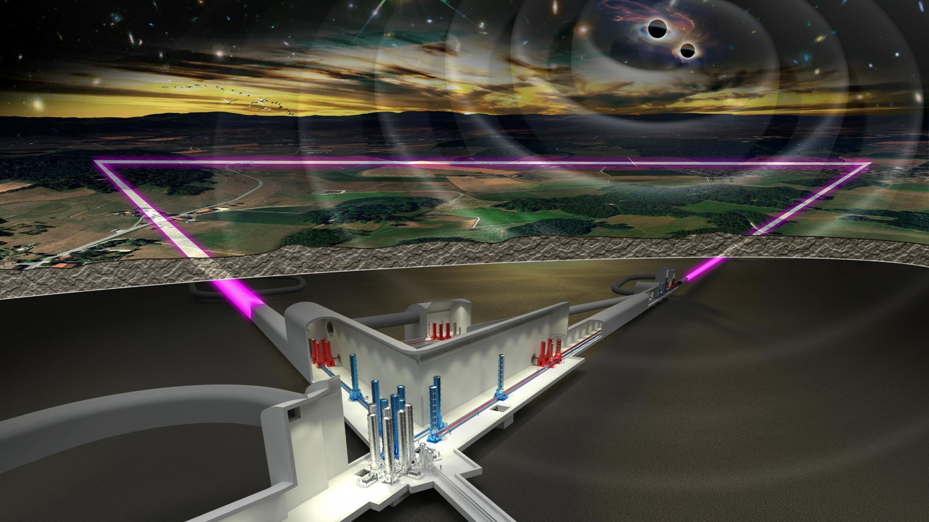




Einstein Telescope Collaboration Status
Harald Lück
AEI Hannover
Max-Planck Institute
for Gravitational Physics
Leibniz Universität Hannover,
Institute for Gravitational Physics
ET-EMR
R&D roadmap
28.3.2025

Slide 2



ETO: ET Organization
ETC: ET Collaboration
ET Proto-Council
Preparatory
Phase
Projects
Spokesperson: M. Punturo Deputy: H.Lück
CB
Collaboration Board
E. Coccia
ESFRI
Coordinators
Jorgen D‘Hondt
A. Zoccoli
BGR
Board of Government Representatives
Infradev ET-PP
Implementationplan of ET Observatory
M. Martinez
(Managed by Project Directorate)
FNR
Forum of National Representatives
BSR
Board of Scientific Representatives
EB
Executive Board
Punturo, Lück
SSB
Standard & Services Board
ISB
Instrument Science Board
S. Hild, J. Harms
Design of ET Vacuum Pipe
P. Chiggiato
(CERN Coordination)
EIB
E-Infrastructure Board
S. Bagnasco, P. Verdier
External Advisory Bodies
ET Project Directorate
A.Freise, F.Ferroni
(M. Martinez)
OSB
Observational Science Board
M. Branchesi, A. Gosh,
M. Maggiore
SPB/SCB
Site Preparation/ Characterization
D. D‘Urso, W. Walk
A. Rietbrock
Civil Engineering
(CERN advisory)
Admin. Offices
Communication
Office
D. Rosińska
Engineering Department
P. Wernecke
Project Office
A. Variola
National Host Teams
EMR Host Team
Sardiniaa Host Team
Lusatia Host Team
Sardinia Host Team
Private Companies

Slide 3
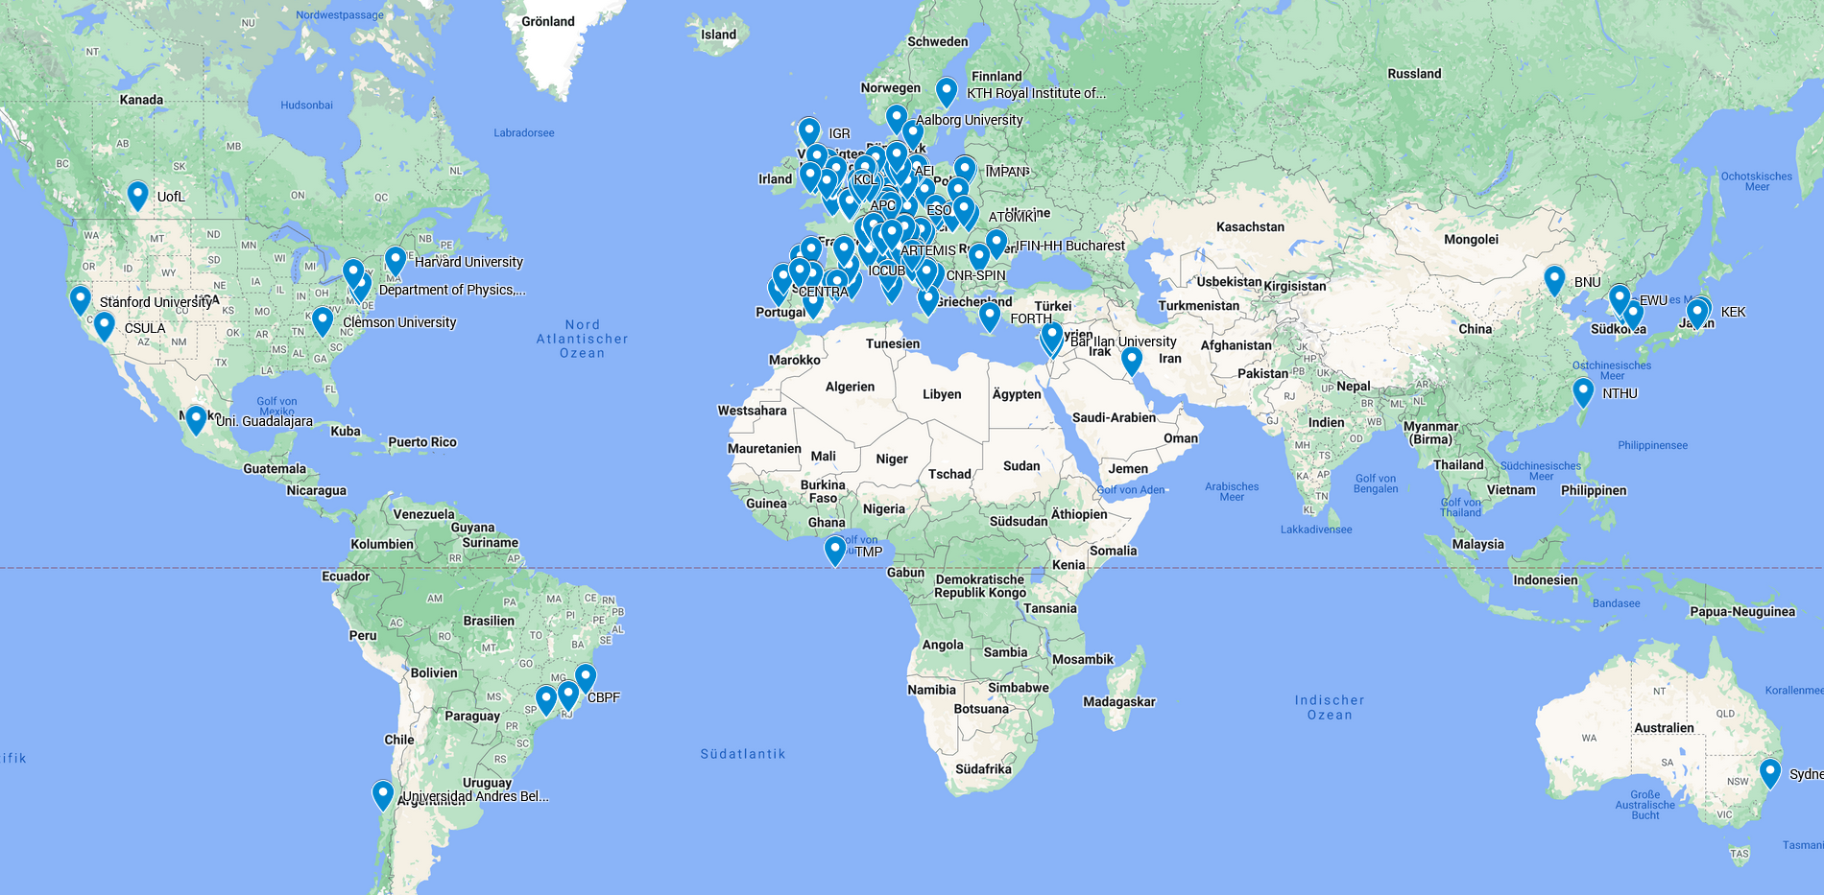
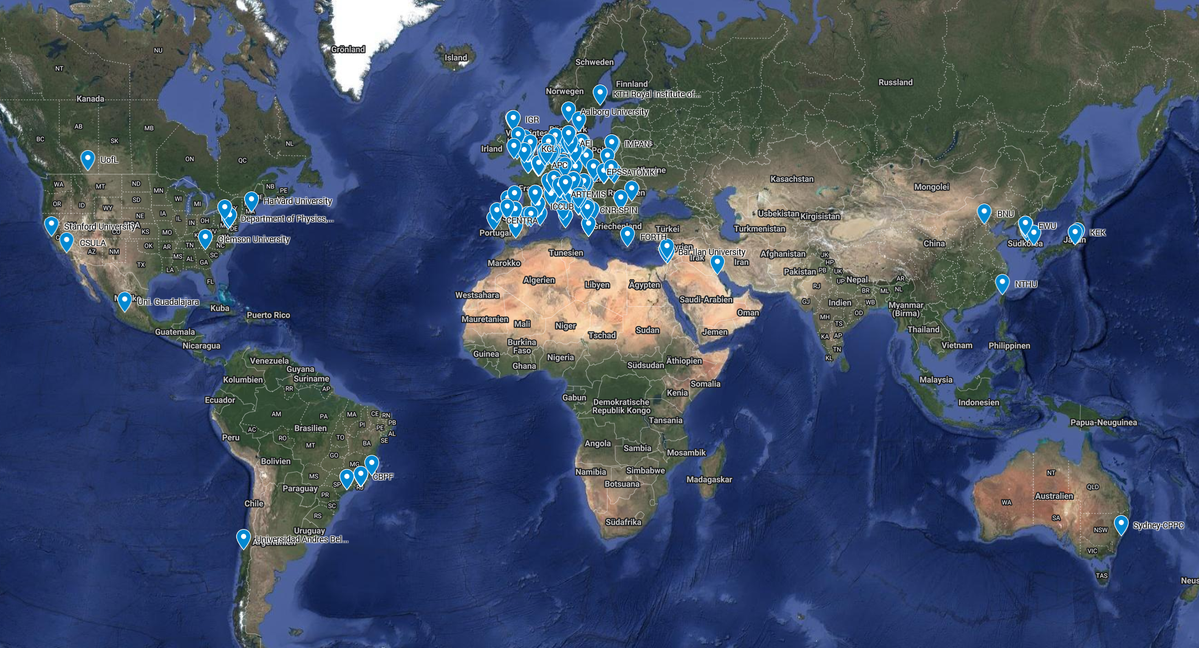
ET Collaboration Member‘s Affiliation Map
1786 members (28.3.2025)
91 Research Units
260 Institutions
in 31 Countries
https://apps.et-gw.eu/etmd/
Notes:
https://www.google.com/maps/d/u/0/edit?mid=1GZXaOjNPYvHeVi_1EKBrwX9kkploa8M&ll=3.7269142217833036%2C0&z=3

Slide 4
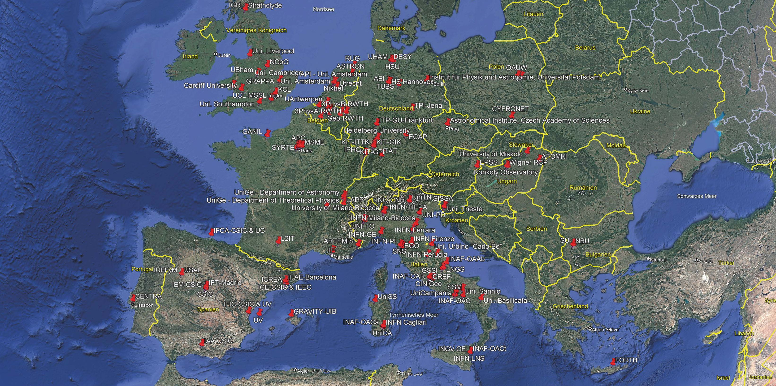
ET Institutions Europe

Slide 5
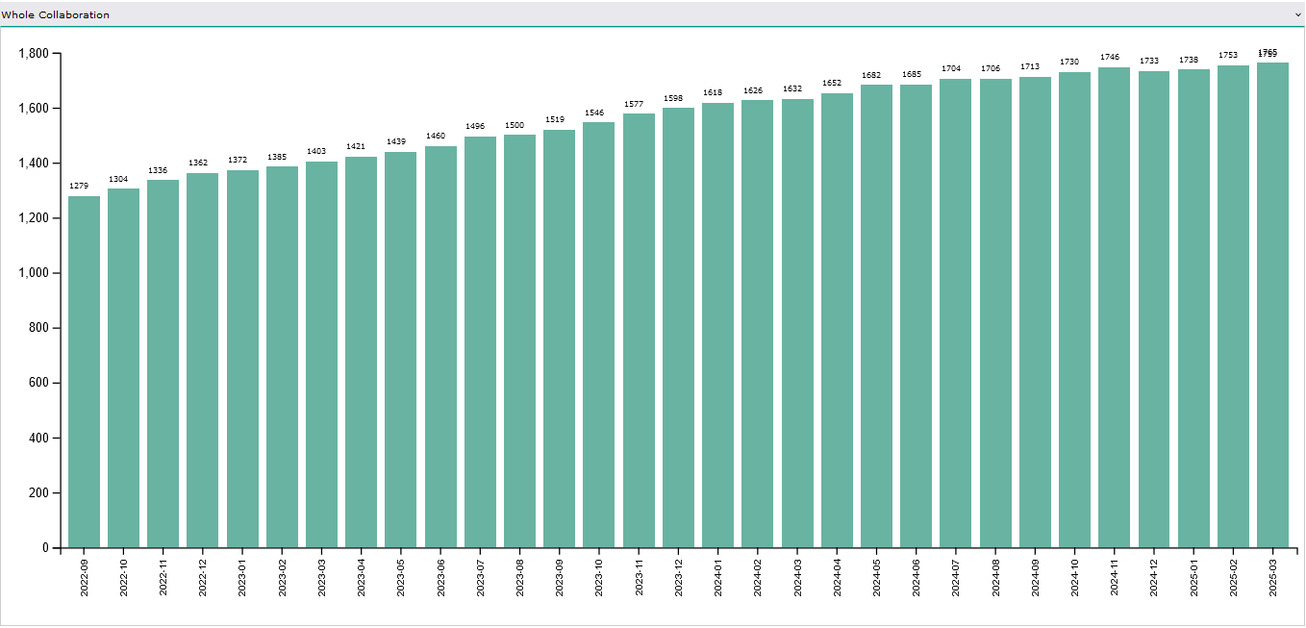
ET Collaboration growth curve

Slide 6
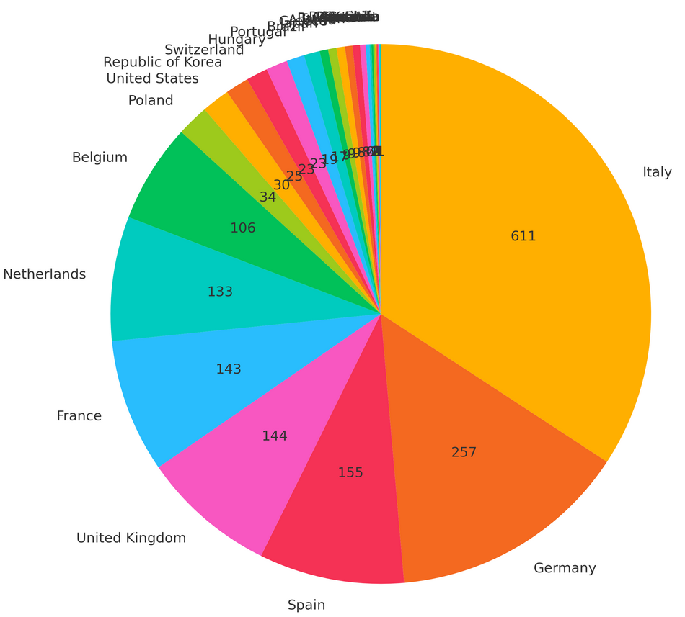
Distribution of Members by Country (27.3.2025)
Notes:
EMR (NL+BE+DE) 496
Italy 611

Slide 7
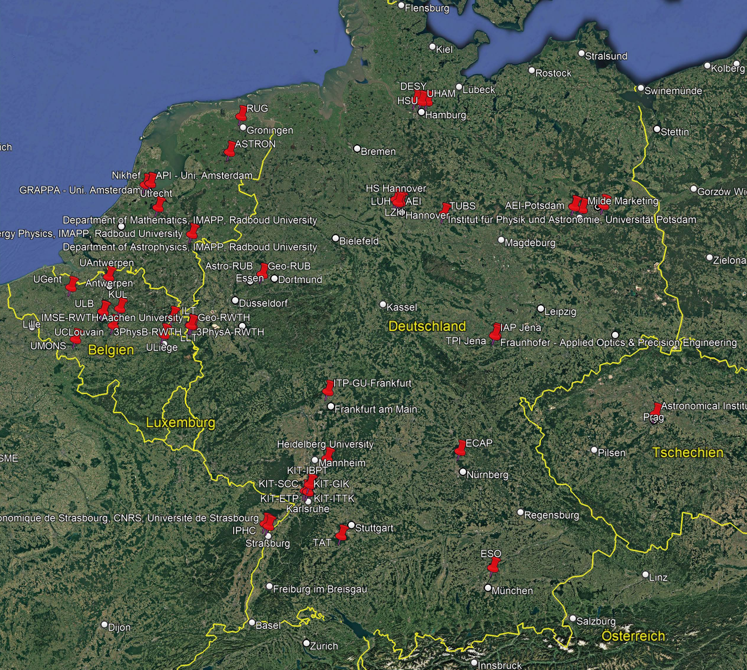
ET Institutions
39
German Institutions:
3. Physikalisches Institut A, RWTH Aachen Universität
3. Physikalisches Institut B, RWTH Aachen University
Max-Planck Institut für Gravitationsphysik - Hannover
Max Planck Institute for Gravitational Physics — Potsdam
Astronomisches Institut, Ruhr-Universität Bochum
Deutsches Elektronen-Synchrotron
Erlangen Centre for Astroparticle Physics
European Southern Observatory
Fraunhofer - Applied Optics & Precision Engineering
Fraunhofer Institute for Production Technology
Geographisches Institut der Ruhr-Universität Bochum
Consortium GEO RWTH
Heidelberg University
Hochschule Hannover - University of Applied Sciences and Arts
Helmut Schmidt Universität
IAP Jena
Leibniz-Institut für Kristallzüchtung
Fraunhofer Institute for Laser Technology
Institute for Machine Elements and Systems Engineering, RWTH Aachen University
Institut für Physik und Astronomie, Universität Potsdam
Institut für Theoretische Physik - Goethe Universität Frankfurt am Main
Karlsruhe Institute of Technology - Institute of Experimental Particle Physics
Karlsruhe Institute of Technology - Geodetic Institute
Karlsruhe Institute of Technology - Geophysical Institute
Karlsruhe Institute of Technology - Institute for Astroparticle Physics
Karlsruhe Institute of Technology - Institute for Beam Physics and Technology
Karlsruhe Institute of Technology - Institute for Technical Physics
Karlsruhe Institute of Technology - Institute of Technical Thermodynamics and Refrigeration
Karlsruhe Institute of Technology - Steinbuch Center of Computing
LLT; Fraunhofer, Chair for Laser Technology
Institut für Gravitationsphysik, Leibniz Universität Hannover
Laser Zentrum Hannover e.V.
Milde Marketing Science Communication
Eberhard Karls University of Tuebingen, Theoretical Astrophysics
Chair for Technology of Optical Systems
Theoretisch-Physikalisches Institut, Friedrich-Schiller-Universität Jena
Technische Universität Braunschweig
Universität Hamburg

Slide 8
SSB – The 9 Committees
SSB = Service and Standards Board
Committees have been formed and are taking up work
Committee | Abbr. | Chair
Program Committee | PC | Ettore Majorana
Early Career Support Committee | ECSC | Anna Green
Ethics and Member Conduct Committee | EMCC | Monique Bossi
Speakers and Awards Committee | SAC | Luca Naticchioni
Editorial Committee | EC | Paola Leaci
Election, Voting and Membership Committee | EVMC | Mariafelicia De Laurentis
Meetings and Symposia Committee | MSC | Jessica Steinlechner
Communications and Education Committee | CEC | Susanne Milde
Bylaws Updating Committee | BUC | Harald Lück

Slide 9
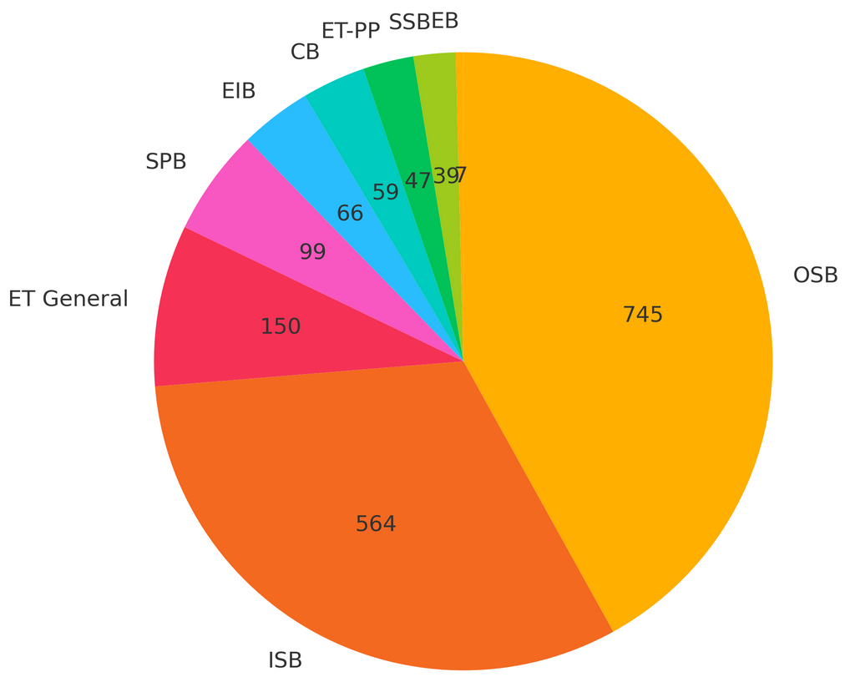
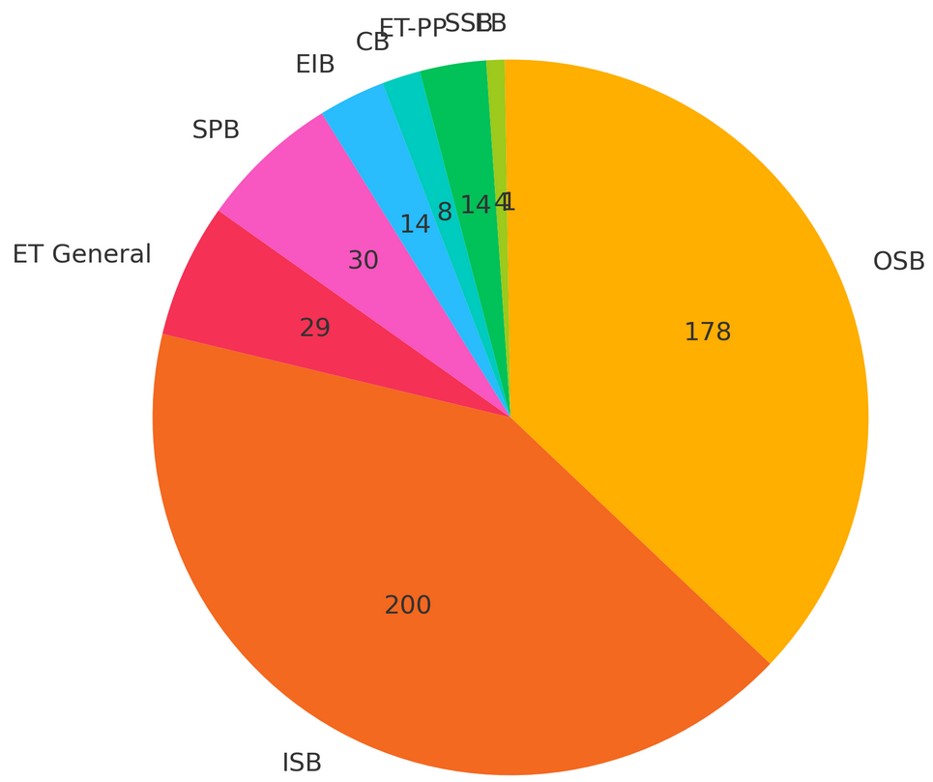
Activities of Collaboration members
Members per „Activitiy“
FRTEs per „Activitiy“
1786
480
0.27FRTE/Member

Slide 10

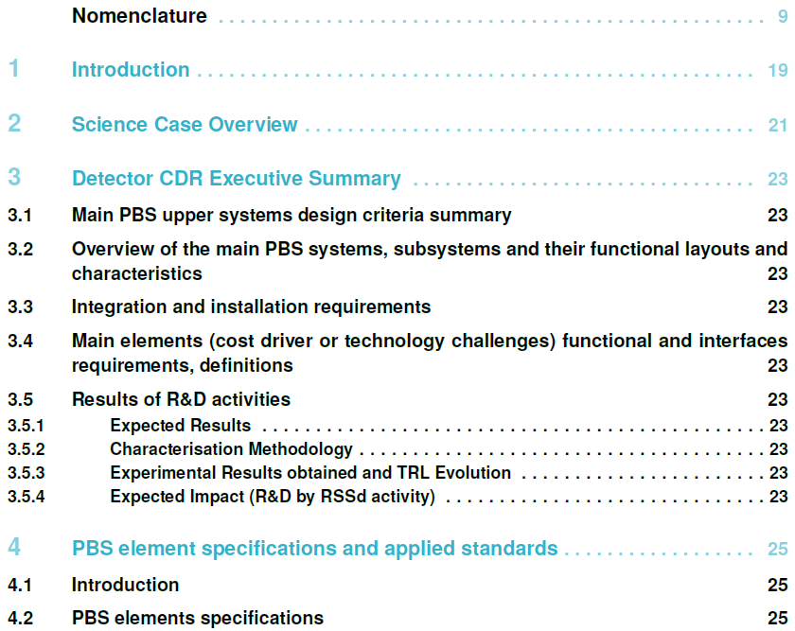
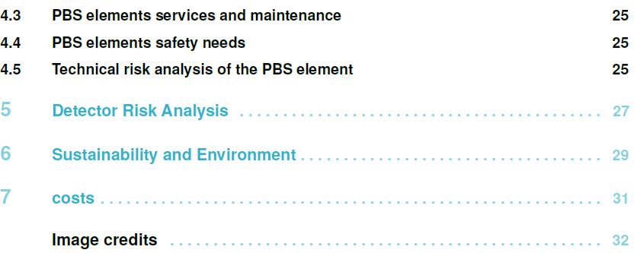
From the PBS to the Detector TDR
Detector TDR is an ET-PP deliverable.
Due date for draft was Sept. 2024
Postponed to July 2025
(very challenging)
Three inputs needed:
Product Breakdown Structure (PBS);
with parameter tables
Optical layout
Detector layout
Detector
ET-0307A-24
Vacuum System
Civil Infrastructure
E-Infrastructure
Contents
PBS (Product Breakdown Structure)
- ISB together with PO/Technical Coordinator
PBS final structure is completed
Parameter table submission
incl. description field (next week)
Transfer to ET Database & Json File (days)
Convert database → latex files (mid April)
→ Pre-TDR: Compose writing team
(asap; discussing logic of TDR structure)
Final Detector TDR due Feb. 2026 (ET-PP milestone)
Notes:
Proposal together with PO & Fiodor:
Timeline delayed
Completion of the PBS structure done
Collect all updated input files including description fields
Upload to relational database and produce json file (within one week)
Update conversion tool to Latex files within the following week

Slide 11
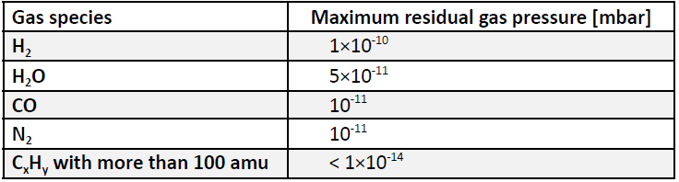
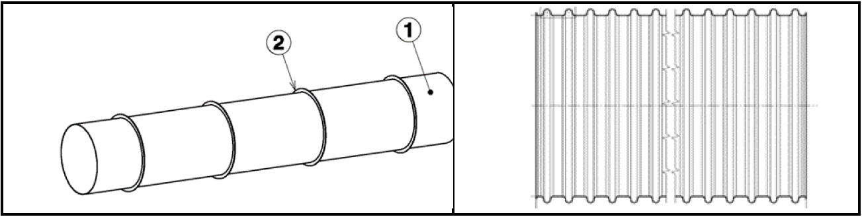
Beam Tube Pre-TDR done by CERN (ET-PP Del.)
public TDS link: https://apps.et-gw.eu/tds/?call_file=ET-0005A25_ETPPDeliverable62VacuumPipeDes.pdf
Image: CERN
ET Collaboration:
Vacuum Pipe Requirements Validation:
  Review of the design, materials, and requirements for vacuum pipes.
  Coordination with external experts and review panels to validate specifications.
  Requirements → CERN
Full Beam Pipe TDR
expected ~end 2025
New material: AISI 304 or 316L (Austenitic Stainless Steel)
→ AISI 441 (Ferritic Stainless Steel)
Image: CERN

Slide 12
ETO Task Force on detector layout
40 members
Criteria
Chair: (Fiodor Sorrentino)
Good expertise in field
Good knowledge of
Name | Institution
Anna Green | Nikhef
Antonio Perreca | Trento University
Jerome Degallaix | LN2P3
Daniel Brown | Adelaide University
Marco Vardaro | Nikhef
Giacomo Ciani | Trento University
Julia Casanueva | EGO
Nathan Holland | Nikhef
Leonardo Lucchesi | INFN Pisa
Antonino Chiummo | EGO
Francesca Spada | INFN PIsa
Sebastian Steinlechner | Maastricht University
Paolo Ruggi | EGO
Conor Mow-Lowry | Nikhef
Julien Gargiulo | EGO
Antonio Pasqualetti | EGO
Henk Jan Bulten | Nikhef
Steffen Grohman | KIT
Fulvio Ricci | Roma 1 University
Ettore Majorana | Roma 1 University
Archisman Ghosh | Gent University
Name | Institution
Piero Rapagnani | Roma 1 University
Angelo Cruciani | INFN Roma 1
Jonathan Bratanata | Nikhef
Wissam Wahbeh | Roma 1 University
Maria Marsella | Roma 1 University
Max Majoor | Nikhef
Patrik Werneke | Nikhef
Mikhail Korobko | Hamburg University
Elena Licciardello | INFN-LNS
Romano Meijer | Nikhef
Ghada Mahmoud | APC
Andreas Freise | Nikhef
Riccardo de Salvo | n.a.
Marco Galimberti | EGO
Lucia Lilli | INFN Pisa
Benoit Tuybens | Nikhef
Fiodor Sorrentino | INFN
Ulyana Dupletsa | GSSI
Francesco Iacovelli | Geneve University
Two layers: core with full availability + consultants with high level expertise
Optical layout -> 2 + 2 (ISB)
SQZ -> 1 + 1 (ISB)
INJ -> 1 (ISB)
ISC -> 1 (ISB)
Suspensions -> 2 + 2 (ISB)
Tower Vacuum -> 2 + 1 (ISB)
Pipe vacuum -> 1 + 1 (ETO & CERN)
Cryogenics -> 1÷2 + 2 (ISB)
Civil engineering -> 1 + 1 (ETO)
Technical engineering -> 1 + 1 (ETO)
TETI local team liaison -> 1
EMR local team liaison -> 1
(Lausatia local team liaison? -> 1)
Noise budget -> 1 (ISB)
PO members -> 2 (ETO)
● + extra members if needed
Secretary -> 1
OSB liaison? 1
current status of design
main design issues
main design options
Team work ability
Time availability
frequent (live) meetings
intense work (computation, design, editing) between meetings
National diversity
ET Collaboration member
Mandate: https://apps.et-gw.eu/tds/?r=19370:
provide new detector layouts for the Einstein Telescope.
The task force will source personnel and support from the ET Collaboration (ETC), ETO, the civil engineering specialists of the local teams, and from external projects or institutions as needed.
The task force should deliver the updated detector layouts to ETO three months after they start their task.

Slide 13
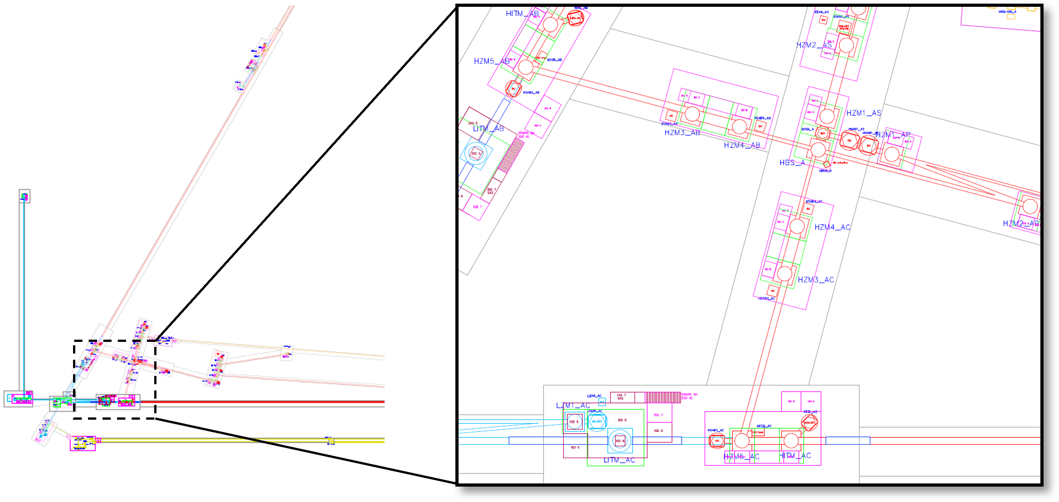
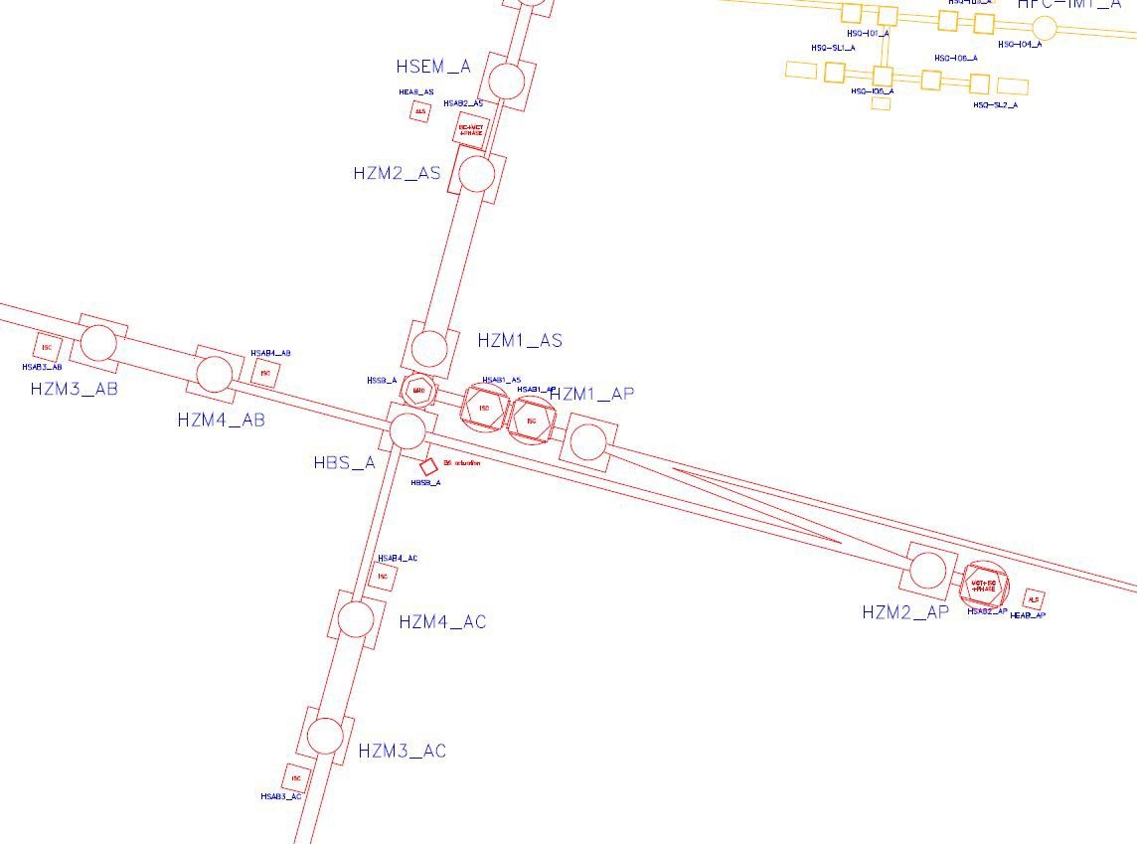
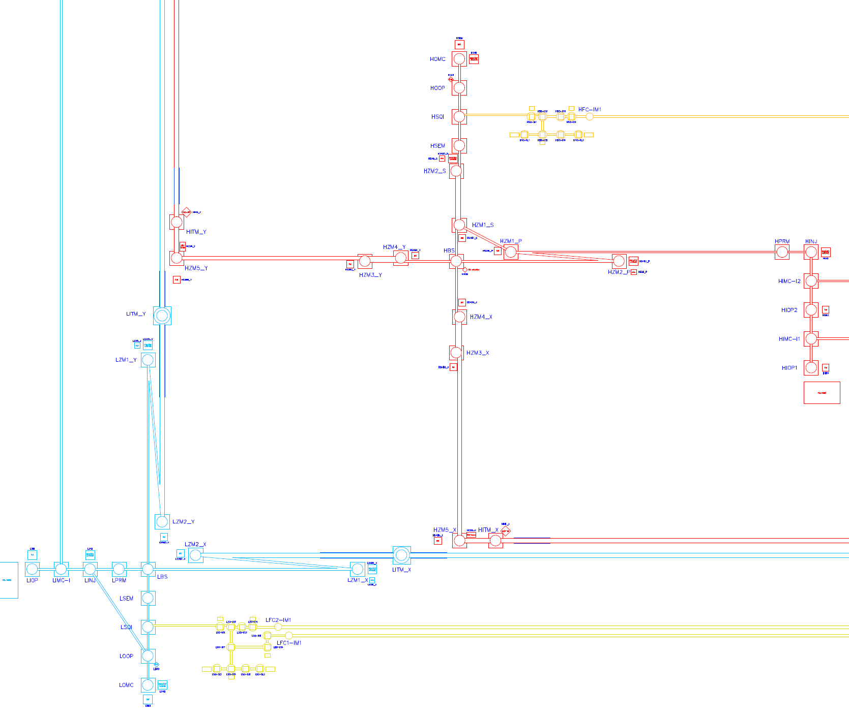
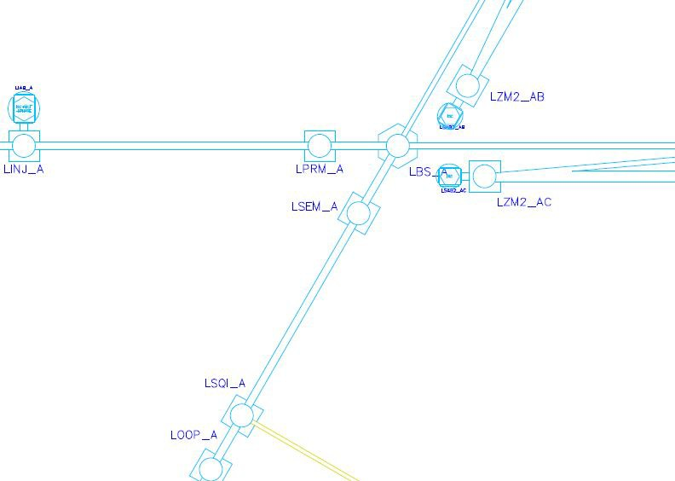
ISB: optical layouts
Preliminary Optical /Detector Layout - 10km Triangle
ET-0676A-24/3194259
ET 2L Optical Layout Update 2024
https://apps.et-gw.eu/tds/?r=19352
https://apps.et-gw.eu/tds/?r=19340

Slide 14
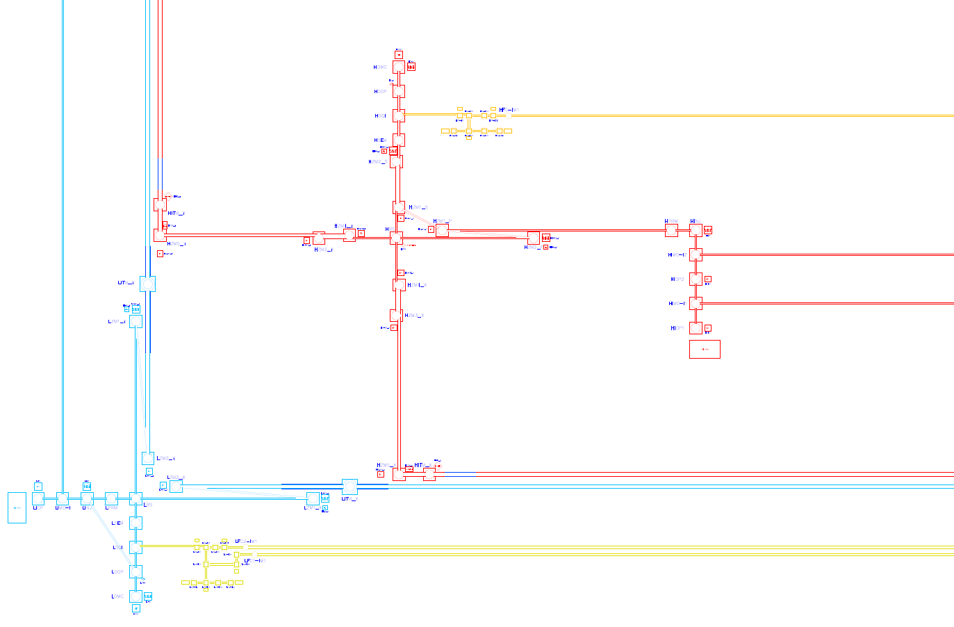
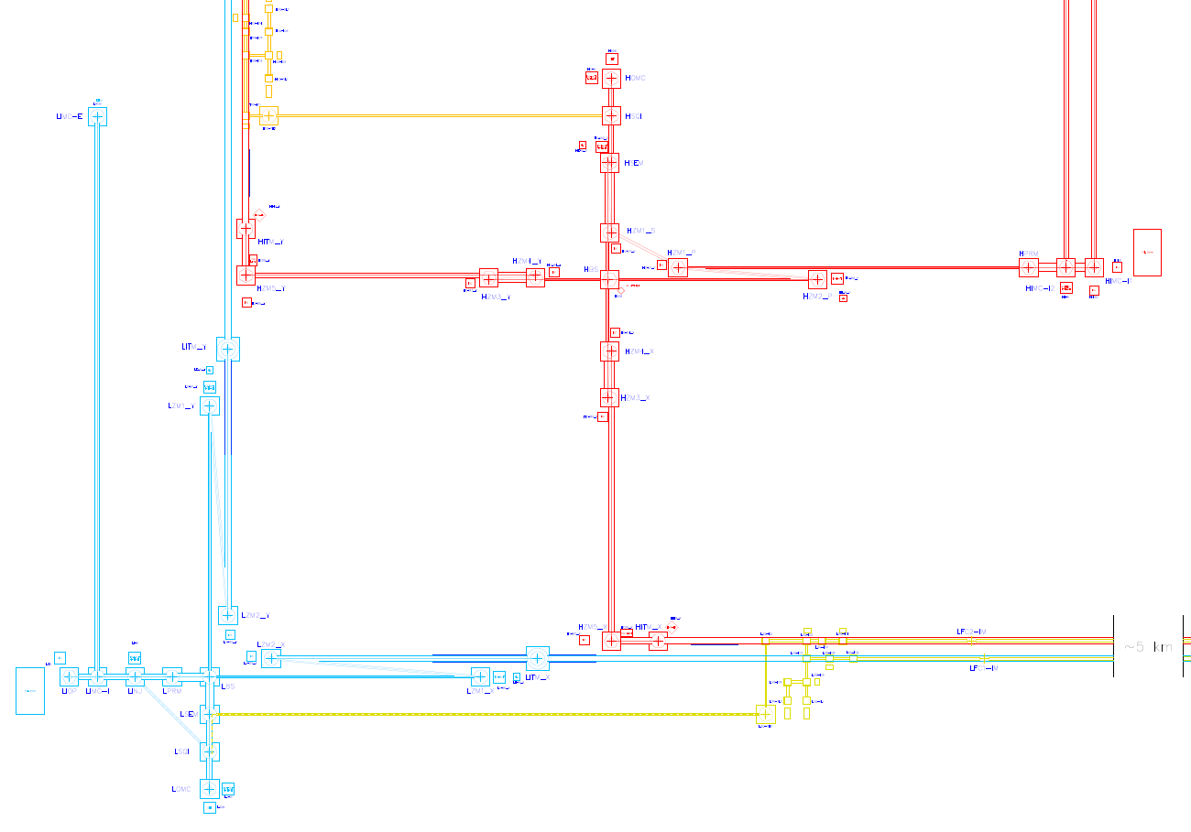
2L Optical Layout update
2024 2L Optical Layout
2025 2L Optical Layout (ETO Task Force update)
Slide taken from ET-LF Tower integration workshop
25.-27.3.2025
[Slide courtesy of J. Bratanata & M. Majoor]
Notes:
ETO Taskforce is taking the optical layout and optimising the infrastructure given the flexibility indicated by the ISB
The ISB divisions are working together with the ETO groups on defining cost, time and risk saving options.
The length of the suspension systems, lengths of required filter cavities
and input mode cleaners and their possible arrangements in the tunnels, drives costs.
Which optical layouts are possible from the detector point of view?

Slide 15

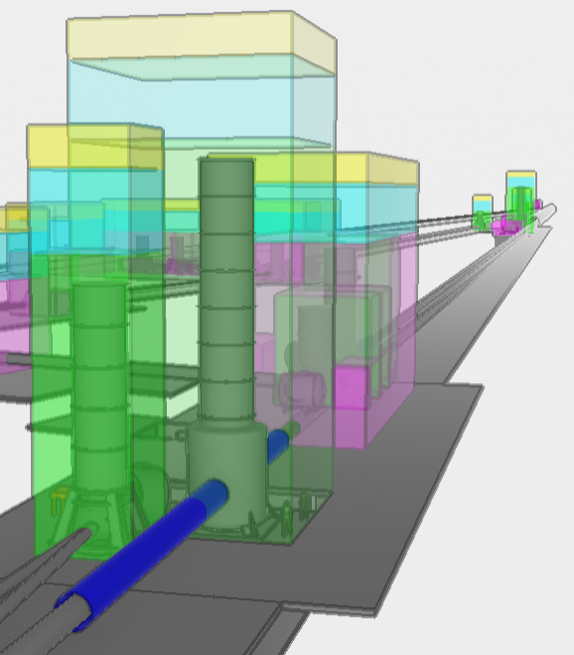
Detector layout → ET Infrastructure
Optical layout (ISB)→ Det. Layout
→ ET Infrastructure layout
done by the ETO ED in consultation with CERN,
including cost estimates, safety, …
Layout options for D and 2L, esp. exploring solutions for Filter Cavities
2L
D
Images: Max Majoor

Slide 16
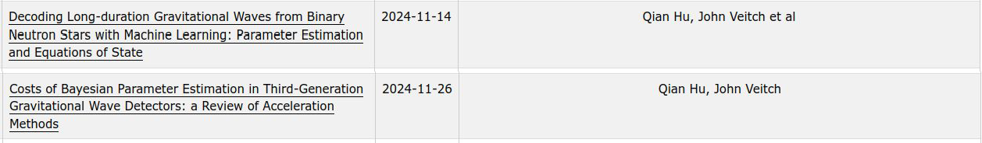
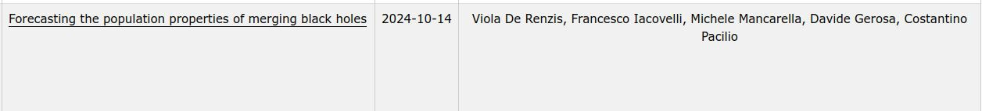
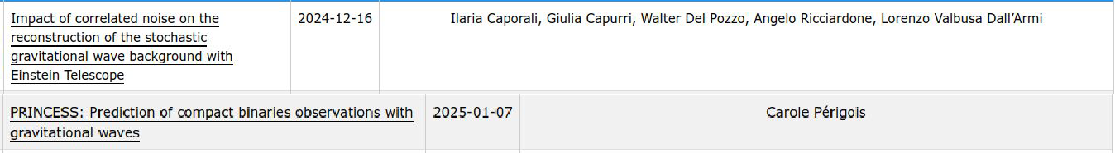
Observational Science Board (OSB)
Led by: Marica Branchesi, Archisman Ghosh, Michele Maggiore
Papers to be found on the TDS (https://apps.et-gw.eu/tds/).
Cosmography
Waveforms and numerical relativity
Multimessenger observations
Fundamental physics
Neutron stars and nuclear physics
Stochastic backgrounds
Detector configurations, tools and data analysis
Compact binary populations
Core-collapse supernovae

Slide 17
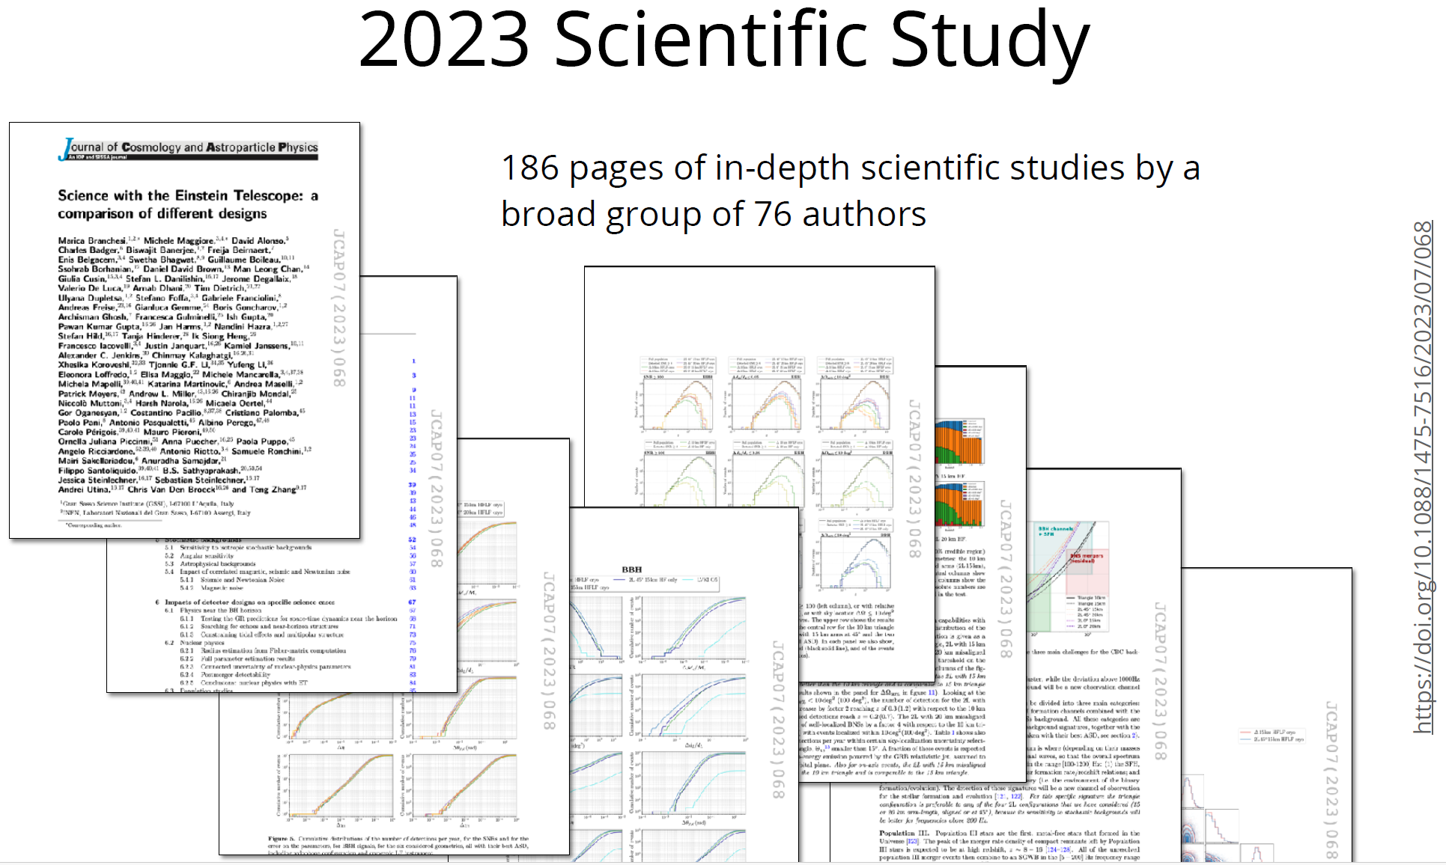
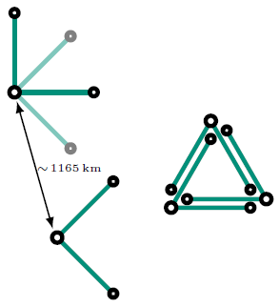
Comparison Study 2023: 10km D vs. 15km 2L
Slide Credit:
Andreas Freise
Notes:
Triangular is baseline geometry, but also the „2L“ geometry is being studied.
Italy prefers this geometry. The Netherlands preferred the triangle. Maybe Andreas can tell you something about the current dutch position.

Slide 18
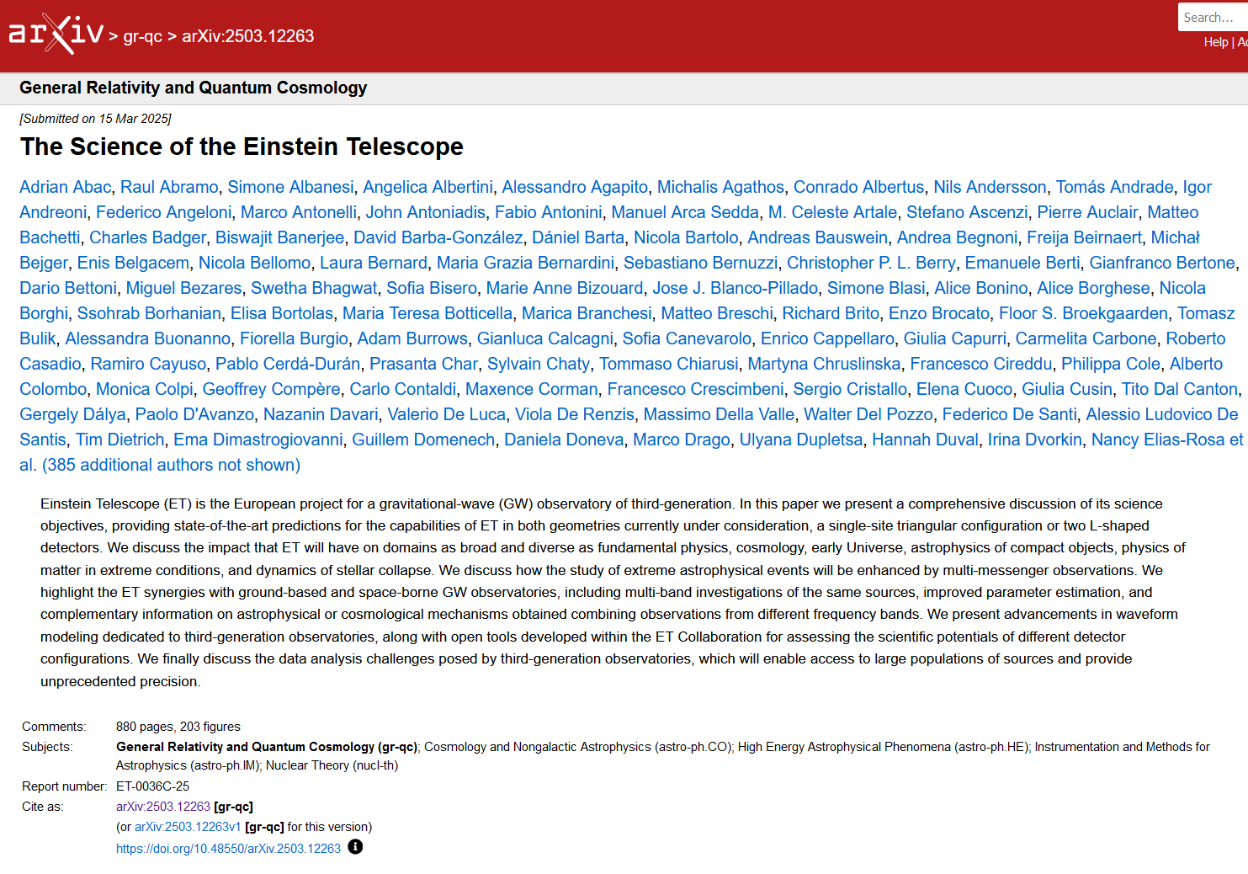
Blue Book available on archive
ET-PP deliverable.
Opt-in possibility
for ET Collaboration
Members who did not
participate in the writing
directly but made significant
contributions to ET.
OSB will develop
Post-BB visions & plans,
e.g. wave modelling, MDCs,
how to deal with
Calibration uncertainties etc

Slide 19
OSB taskforce contributing to ETO optical layout
OSB liaisons: Ulyana Dupletsa, Francesco Iacovelli, Archisman Ghosh
Regular meetings with ETO taskforce
Preliminary metrics (quantifiable figures of merit) being set up
  Detection horizon for CBCs, # of detections for BBH and BNS
  Localization for BNS premerger, SNR pileup premerger for reference events
  Postmerger SNR of BNS (with NR waveforms)
  Stochastic: power-law integrated sensitivity
  Bursts: SNe distance
  CW: TBD

Slide 20
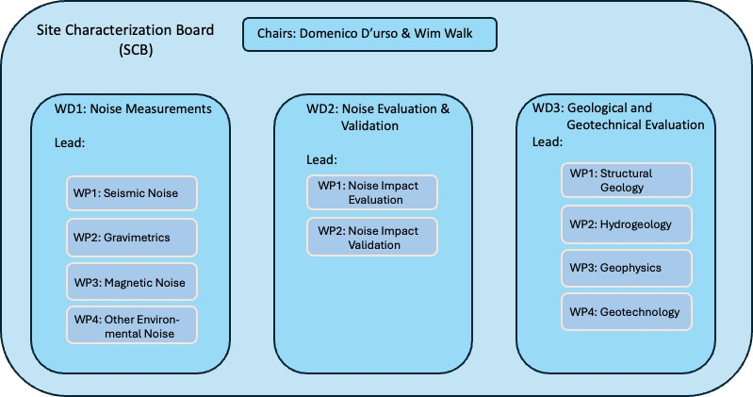
SCB: Site Characterisation Board
Site characterization at local sites: subsurface measurements moving full speed ahead (noise, geology, hydromodeling)
Including Lausitz in SCB (Andreas Rietbrock)
SCB revised organization and division leaders
Discussing best way to validate measurements performed by local sites
Aligning local timelines with WP4 milestones and deliverables, create single SCB timeline.

Slide 21
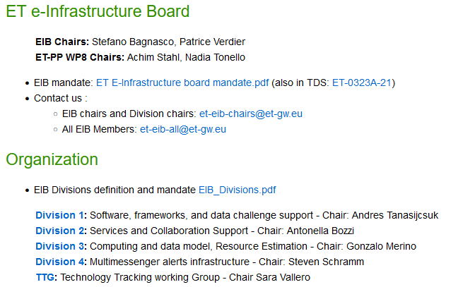
E-Infrastructure Board
ET E-Infrastructure
● Data transfer and storage
● Software packaging and distribution
● Computing power
● Data distribution
● High-availability service management
● Data cataloguing and bookkeeping
● Job lifecycle management
● High-level workload management
● Monitoring and accounting
● Authentication, Authorisation and Identity management

Slide 22
How to join the Collaboration:
Joining a Research Unit
Talk to a RU leader.
It is up to the RU leader to admit new members into the RU. The RU leader will tell you how to get in touch with the relevant Working groups or divisions of the Collaboration and which formal steps to take to declare your activities in the ET Member Database.
Forming a new Research Unit
To initiate the formal application process to join the ET collaboration, contact Michele Punturo, Harald Lück or Eugenio Coccia
and outline the focus of your proposed research group’s contribution towards ET. They will send you relevant information and files, and put you in contact with the appropriate committees and working groups, in preparation for the process.

Slide 23
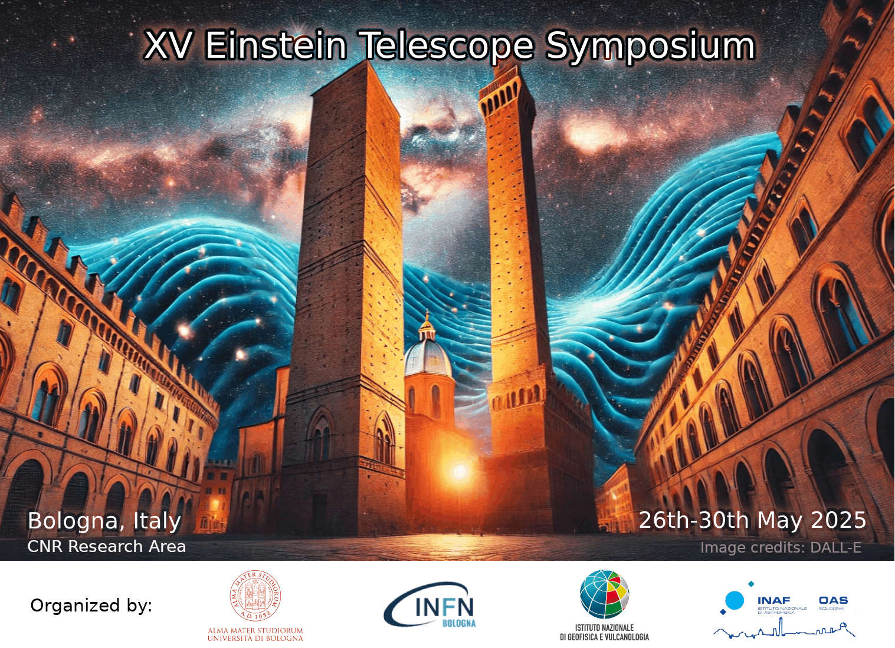
Deadline for submitting abstracts 31.3.2025
https://indico.ego-gw.it/event/819/

