Slide 1








Pixel TPC particle identification performance update
Yevgen Bilevych, Klaus Desch, Sander van Doesburg, Harry van der Graaf, Fred Hartjes, Jochen Kaminski, Peter Kluit, Naomi van der Kolk,
Cornelis Ligtenberg,
Gerhard Raven, and
Jan Timmermans
LCTPC Bonn meeting January 2025

Slide 2
DESY testbeam Module Analysis
PID performance truncation method
Electron resolution
3.6%
1 m track 60% and coverage
Linearity MIP-e = 1.03
z drift=5-15 mm (flat)
Preliminary
MIP in plot was corrected … thanks Ulli

Slide 3
DESY testbeam Module Analysis
PID performance template fit method
Electron resolution
2.9%
1 m track 60% and coverage
Linearity MIP-e = 1.07
so syst uncertainty on resolution +7%
Preliminary

Slide 4
DESY testbeam Module Analysis
PID performance of a Pixel TPC
The dEdx resolution for electrons from data by combining tracks to form a 1 m long track with realistic coverage ~60% coverage.
Preliminary
Method | B=0 Resolution (%) | B= 1 T Resolution (%)
Truncation | 6.0 | 3.6
Template fit | 5.4 | 2.9
The truncation method has a slightly worse performance – as it is more sensitive to the hits than the template fit method – that is more sensitive to the number of clusters.

Slide 5
DESY testbeam Module Analysis
PID Performance extrapolated to the ILD detector
ILD detector
rInner = 329 rOuter = 1770 mm
electron resolution = 2.4 (3.0) %
at θ=π/2
Assume Pixel TPC performance at B = 1 T at p = 5,6 GeV/c
Test beam B = 1 T
p=5,6 GeV/c
Template fit (Truncation)
electron resolution
2.9 (3.6)%
1 m track 60% and coverage

Slide 6
DESY testbeam Module Analysis
ILD dEdx performance
From dEdx studies in ILD (Ullrich Einhaus)
Extracted the ILC soft parametrisations for energy loss based on G4 and full simulation of the ILC TPC with T2K gas
Link generated in 2020 with ILC soft v02-02 and v02-02-01

Slide 7
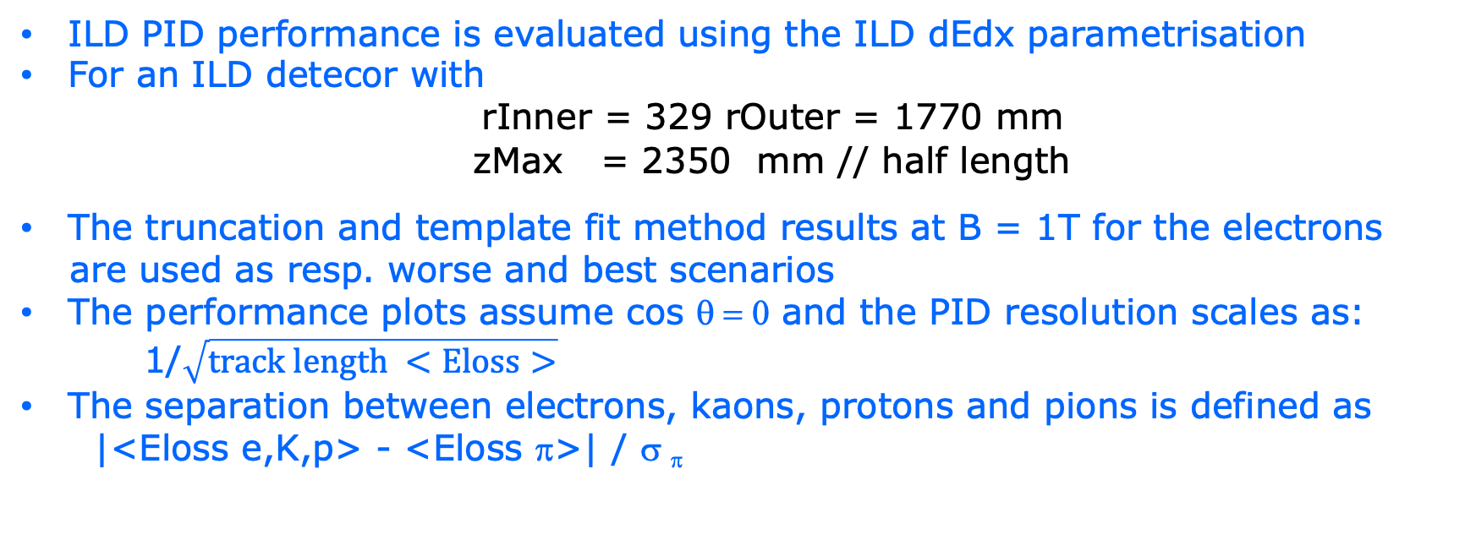
DESY testbeam Module Analysis
ILD Pixel TPC PID performance
ILD PID performance is evaluated using the ILD dEdx parametrisation
For an ILD detecor with
rInner = 329 rOuter = 1770 mm
zMax = 2350 mm // half length
The truncation and template fit method results at B = 1T for the electrons
are used as resp. worse and best scenarios
The performance plots assume cos θ = 0 and the PID resolution scales as:
1/$\sqrt{track length <Eloss>}$
The separation between electrons, kaons, protons and pions is defined as
|<Eloss e,K,p> - <Eloss π>| / σ _{π}

Slide 8
DESY testbeam Module Analysis
ILD pixel TPC PID performance
ILD PID Performance for the two methods: template fit (solid), truncation (dashed)
The expected pion-kaon PID separation for momenta in the range of 2.5-45 GeV/c at cos θ = 0 is more than 5.5(4.5)σ
At a momentum of 100 GeV/c the separation is still 3.0(2.0)σ
The expected pion-proton PID separation for momenta in the range of 2.5-100 GeV/c at cos θ = 0 is more than 6.0(4.8)σ
ILD Pixel TPC
Preliminary

Slide 9
DESY testbeam Module Analysis
ILD pixel TPC PID performance as a function of the drift distance
Question from Ron Settles (and also Ulrich Einhaus);
Can one quantify what the impact of the longer drift is on the PID performance for the two mehods?
One can analyse and quantify this by looking at the extremes
  Ideal cluster counting that is possible if no diffusion is present
  Truncation method that gives the performance for long drift distances
First, concerning the ideal cluster counting
  In the extrapolation a 60% Pixel TPC coverage is assumed
  Note that per cm (100% in the senstive volume) we will have 26 primary clusters out of in total 100 single electrons
PDG clusters/cm primary total
T2K 26 100

Slide 10
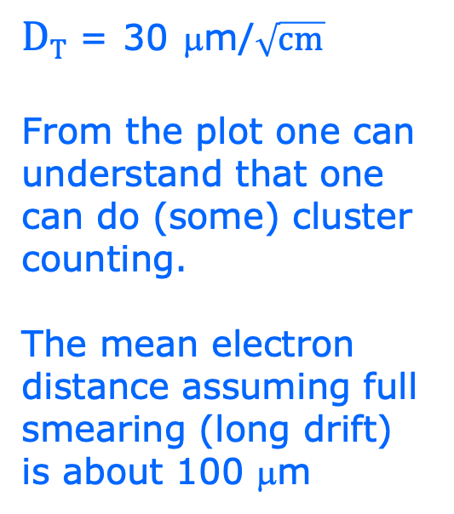
DESY testbeam Module Analysis
ILD pixel TPC PID performance as a function of the drift distance
$DT$ = 30 μm/$\sqrt{cm}$
From the plot one can understand that one can do (some) cluster counting.
The mean electron distance assuming full smearing (long drift) is about 100 μm

Slide 11

DESY testbeam Module Analysis
ILD pixel TPC PID performance as a function of the drift distance
$DT$ = 30 μm/$\sqrt{cm}$
Ideal cluster counting with 60% pixel coverage gives a PID resolution 2.2%.
The truncation method gives is the other extreme of 3.1%
The red curve is an interpolation based on the template fit method
The red point is corresponds to the testbeam single electron resolution 130 μm and a PID resolution of 2.5%

Slide 12
Running a Pixel TPC with Ne
For example Z run @ CEPC or FCCee
The idea is use in the TPC not the T2K gas. But another gas mixture that gives less hits. And a gas that is less sensitive to the beam background and more performant for dEdx (cluster counting)
One could think of a Ne based gas.
The advantage would be: the number of electrons /cm is lower by a factor of about 2.5 w.r.t. the T2K gas. The probability that the photons (from the beam-beam background) interact with Neon is also a factor of 5 lower.
I am not absolutely sure but this could bring a factor 12.5 beam background reduction.

Slide 13
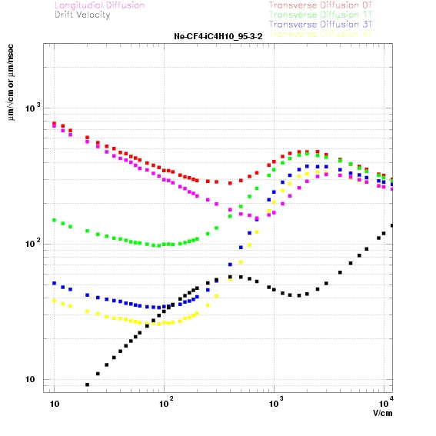
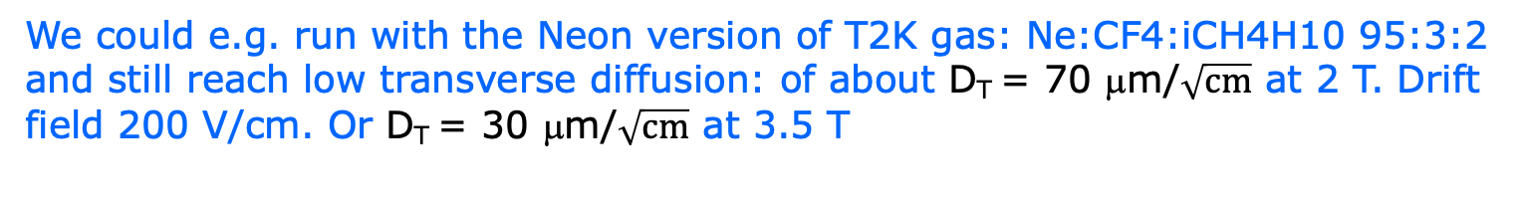
Running a Pixel TPC with Ne
For example Z run @ CEPC or FCCee
We could e.g. run with the Neon version of T2K gas: Ne:CF4:iCH4H10 95:3:2 and still reach low transverse diffusion: of about D_{T} = 70 μm/$\sqrt{cm}$ at 2 T. Drift field 200 V/cm. Or D_{T} = 30 μm/$\sqrt{cm}$ at 3.5 T
PDG clusters/cm primary total
Ne:CF4:iCH4 16.04 46
T2K 26 100
The disadvantage would be a TPC tracking resolution that is a factor 1.47 worse (than running with T2K).

Slide 14
Running a Pixel TPC with Ne
For example Z run @ CEPC or FCCee
A clear advantage of Neon is the larger mean cluster distance and the lower number of electrons/cluster.
That makes it more suited for cluster counting in a Pixel TPC

Slide 15
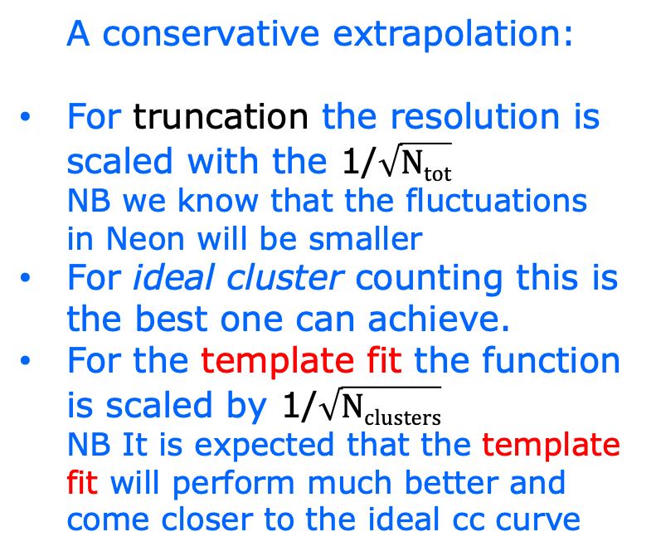
Running a Pixel TPC with Ne
PID performance
A conservative extrapolation:
For truncation the resolution is scaled with the 1/$\sqrt{Ntot}$
NB we know that the fluctuations in Neon will be smaller
For ideal cluster counting this is the best one can achieve.
For the template fit the function is scaled by 1/$\sqrt{Nclusters}$
NB It is expected that the template fit will perform much better and come closer to the ideal cc curve
Coverage 60%

Slide 16
Running a Pixel TPC with Ne or Ar
For example Z run @ CEPC or FCCee
:
The beam backgrounds for a Pixel TPC running Ne:CF4:iCH4 95:3:2
are likely a factor 12.5 lower than running with the default T2K gas
  It would be nice to have this confirmed/studied by D. Jeans
  It is important for the Z running in view of limiting occupancies and distortions (due to the ion back flow)
The price is a worse TPC tracking resolution at high momenta with a factor of about 1.5. For low momenta the track is less scattered in the Ne than in the Ar based gas. Note that in the ILD experiment the overall momentum resolution will be almost unaffected due to contribution of the Inner and Outer silicon trackers.
A conservative extrapolation gives a PID resolution of 2.8-4% for Ne based gas in a Pixel TPC inside ILD at cos θ=0 assuming 60% coverage. This can compared to the ILD PID resolution result of 2.5-3% for the T2K gas.
It would be nice to take some test beam data with B field and this gas

