Slide 1
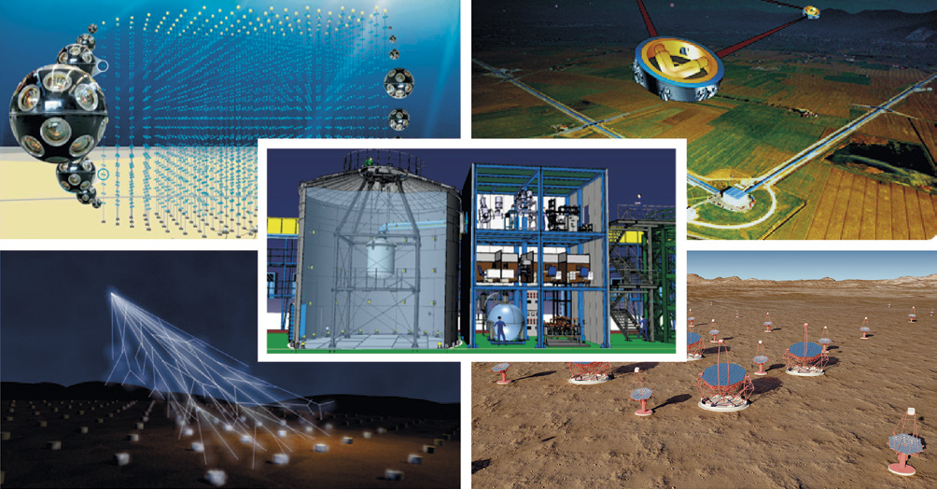
CAN PhD Thesis prize
2025

Slide 2
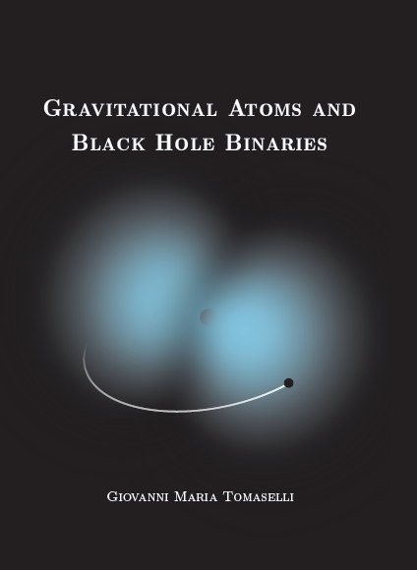
This theoretical study excels in its overarching nature, in line with the theme of the CAN, connecting astrophysics (black hole binary dynamics), particle physics (particles outside the Standard Model), atomic physics (the gravitational atom) and general relativity (creation of GWs) in a beautifully imaginative manner accessible to the non-expert. The impact of this thesis work is large, considering the more than 275 citations for the 5 papers that make up the core of the thesis, of which 3 as first-author, for refereed journals in his thesis.

Slide 3
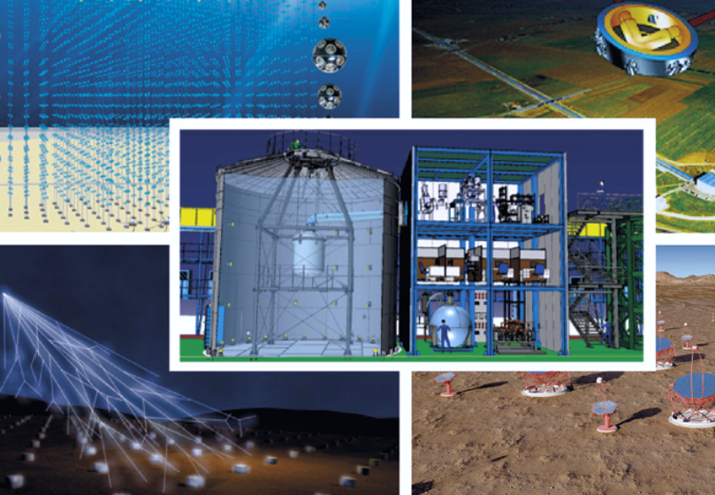
CAN
Thesis
Prize
2025
1000€
Giovanni M. Tomaselli
“Gravitational Atoms
and Black Hole Binaries”

Slide 4
CAN PhD Thesis prize
2024

Slide 5
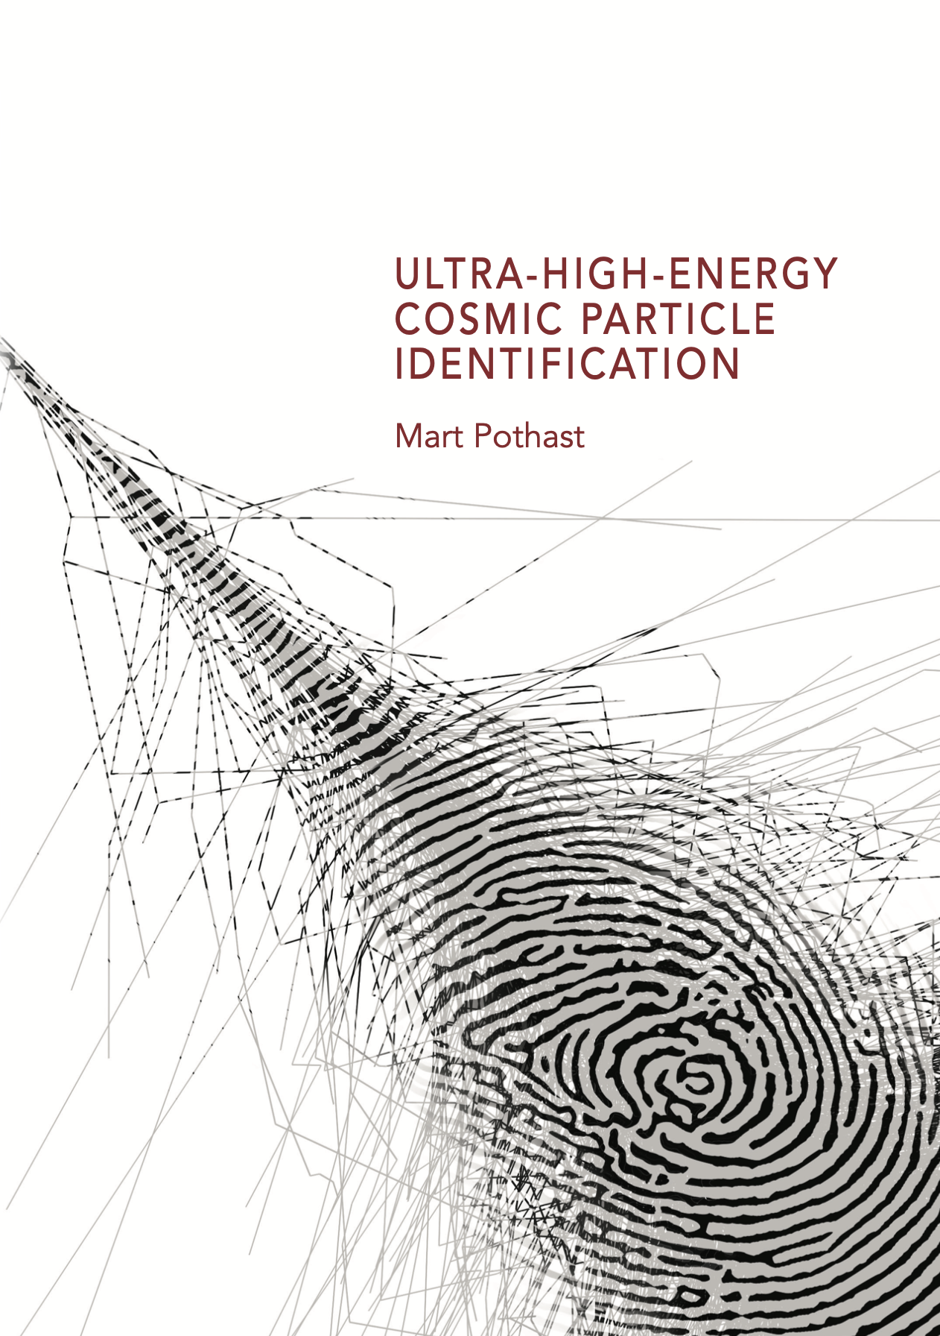
Mart’s work provides an in-depth knowledge of the signal shape and amplitude that is measured by the water-Cherenkov detectors of Auger, and the newly installed scintillator detectors.
The method Mart developed goes beyond previous results by using the complete time traces rather than an approximate parameter.
The use of the complete time traces of the particle detectors will be crucial for the future analyses using the upgrade of the Pierre Auger observatory.

Slide 6
CAN
Thesis
Prize
2024
500€
Mart Pothast
“Ultra-high-energy cosmic particle identification”

