Slide 1
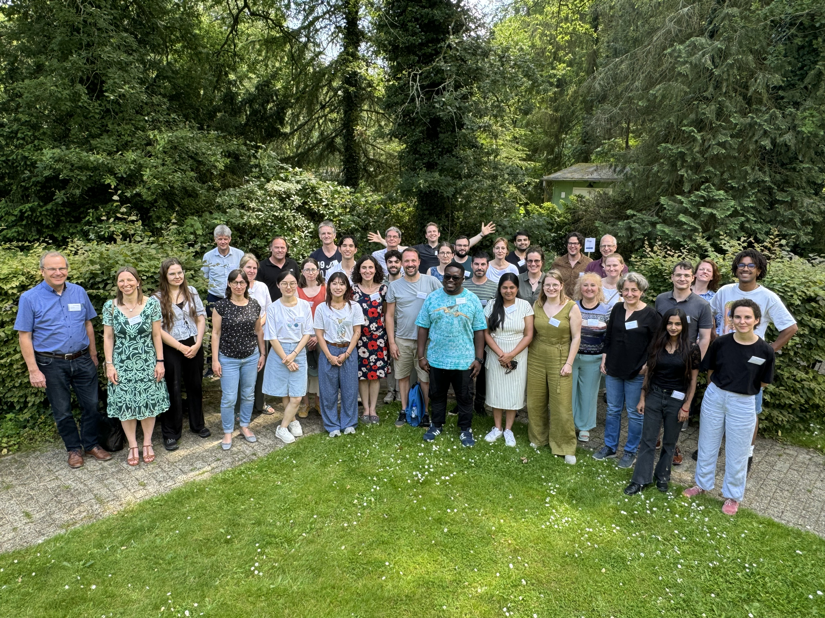
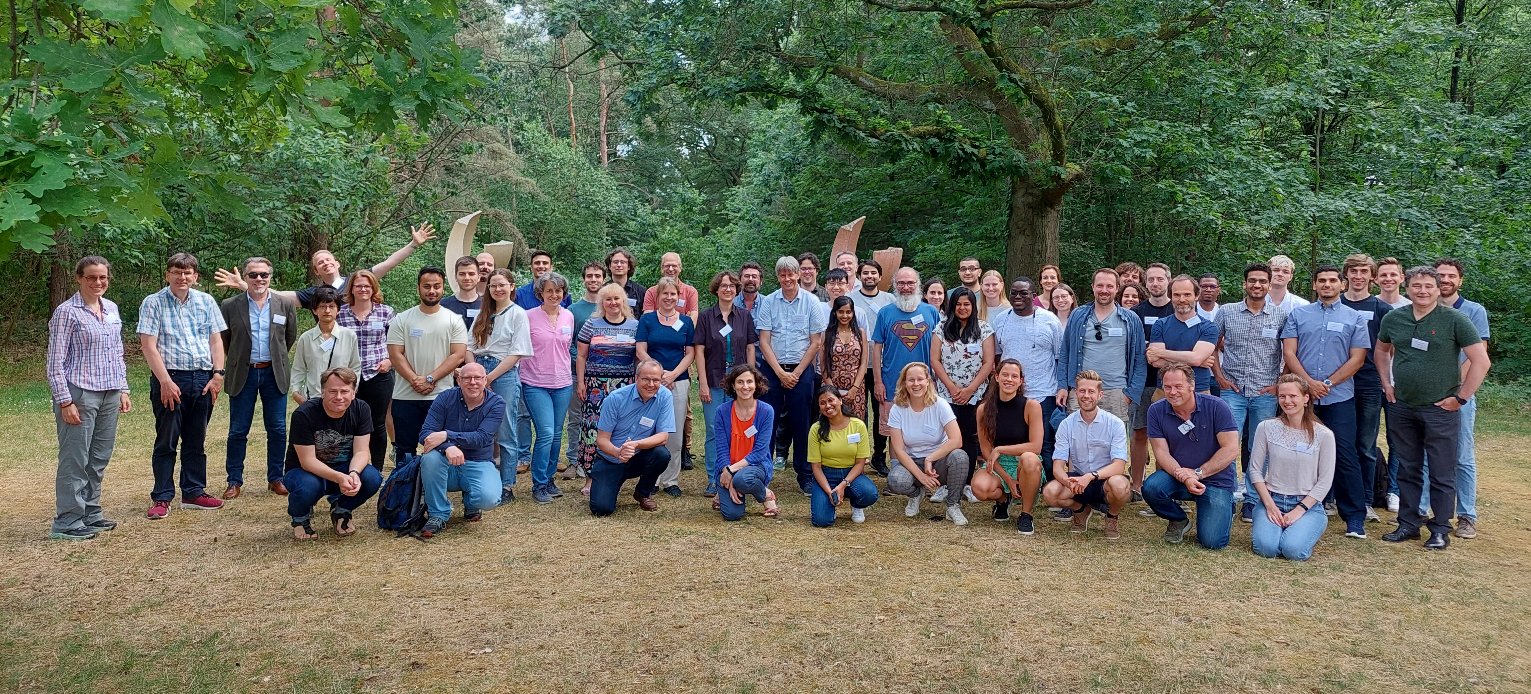
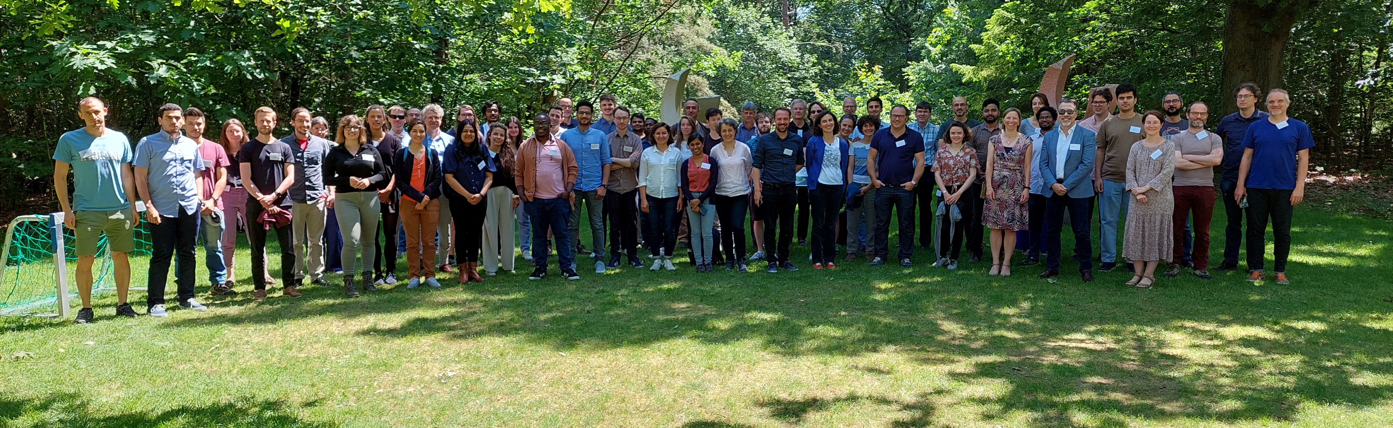



28th Symposium 2024
27th Symposium 2023
Welc
Welcome to the 29th Symposium for Astroparticle Physics in the Netherlands
26th Symposium 2022
Dutch
Astronomy

Slide 2
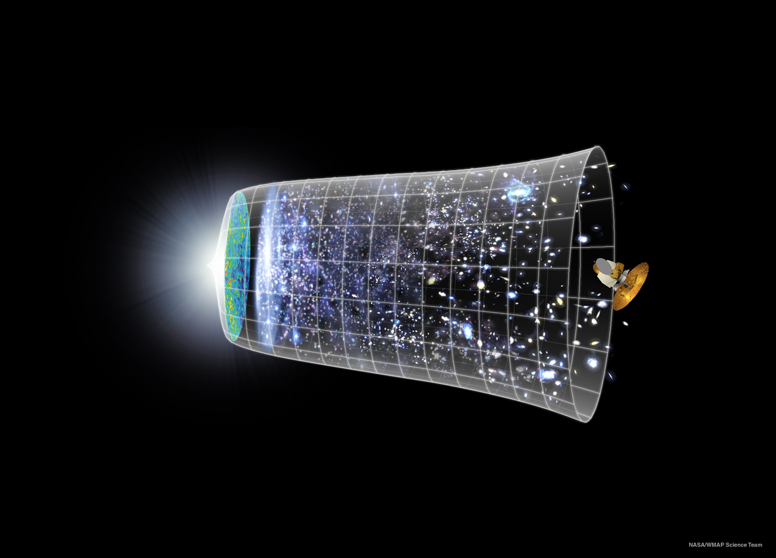
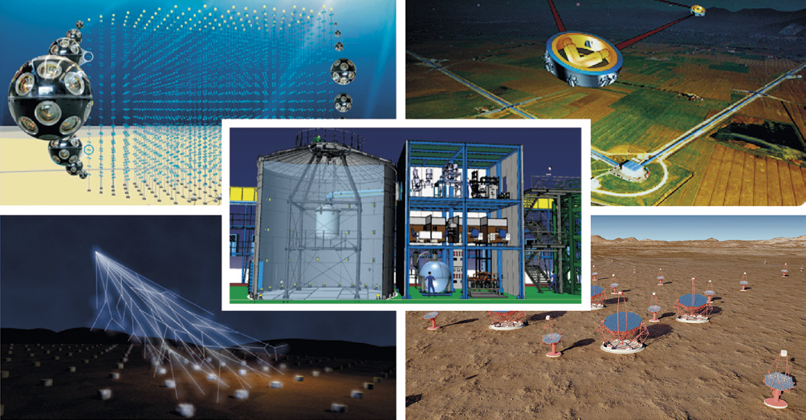
Astroparticle Physics in the Netherlands
What is the nature of Dark Matter?
What is the origin of the highest
energy particles in the Universe?
What is the dynamics of spacetime?
What is the structure of Physics beyond the Standard Model?

Slide 3
APP in the Netherlands – the CAN
(Committee for Astroparticle physics in the Netherlands)
  Established in 2004, the CAN represents the Dutch scientific community interested in astroparticle physics. It comprises members, representing the different sub-fields and the institutions involved in astroparticle physics in the Netherlands.
  Objective of the committee is to strengthen and further develop the field of astroparticle physics in the Netherlands in research and teaching.
  Members:
    Chris Van Den Broeck (U Utrecht) Dorothea Samtleben (Nikhef & U Leiden)
    Andreas Freise (VU Amsterdam) Charles Timmermans (RU Nijmegen)
    Jason Hessels (ASTRON) Jean in ’t Zand (SRON)
    Stefan Hild (U Maastricht) Manuela Vecchi (RU Groningen)
    Jörg Hörandel (RU Nijmegen) Jacco Vink (UvA Amsterdam)
    Elena Rossi (U Leiden) Christoph Weniger (UvA Amsterdam)

Slide 4
APP in the Netherlands - Organisation
The organisation was formalised in 2020 by creation of the AppSC
(Astroparticle physics Strategic Committee)
  Members: Nikhef Director, CAN Chair, RvdA Chair, NWO secretary
  Task: Align particle physics and astronomy strategies with CAN strategy
AppSC appoints CAN members and chair and mandates its mission
  Members: one for each APP group at Dutch University or Institute
  Tasks:
  - Promote APP in the Netherlands
    - Provide strategy input to AppSC
    - Monitor implementation of strategy as agreed with AppSC

Slide 5
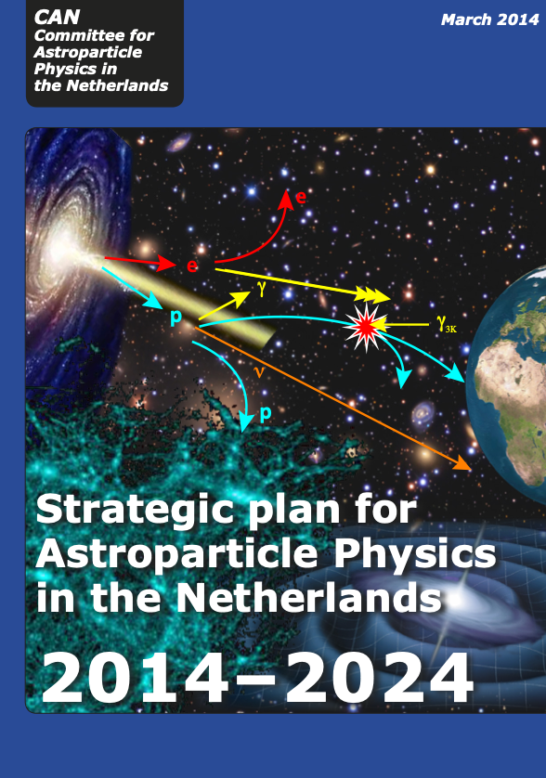
APP in the Netherlands - Strategy
APP through 5 different pillars:
  Cosmic Rays
  Neutrinos
  Gamma Rays
  Gravitational Waves
  Dark Matter
Next version of this document in the works

Slide 6
APP in the Netherlands – Participate!
http://astroparticlephysics.nl/ -> Subscribe to mailinglist
Participate in the events
Provide Input

Slide 7
28th Symposium 2024
27th Symposium 2023
Welc
Enjoy the symposium!
26th Symposium 2022
Organizers:
Harm Schoorlemmer, Dorothea Samtleben
Dutch
Astronomy

