Slide 1
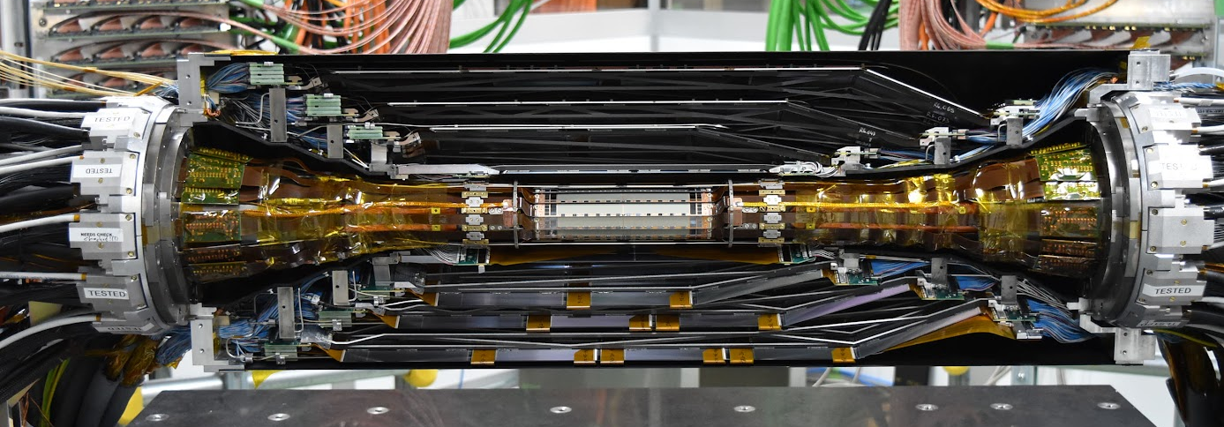
Belle-II
Vertex Detector
Image src: https://www.desy.de/news/news_search/index_eng.html?openDirectAnchor=2876

Slide 2
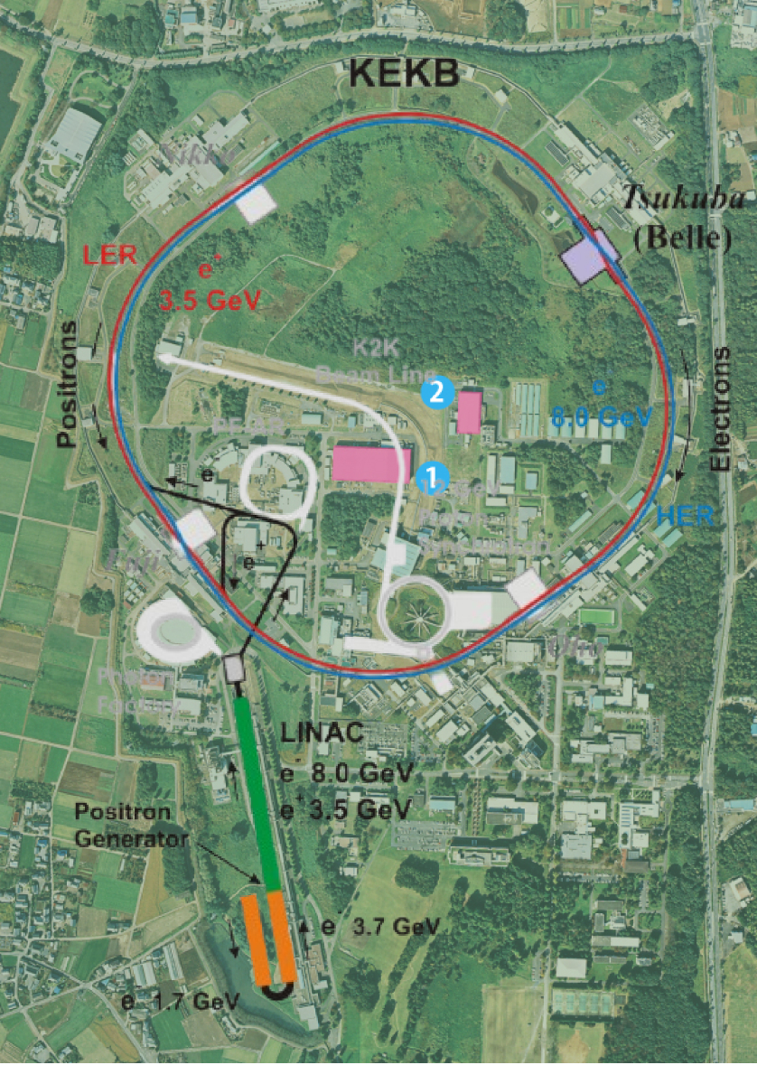
Where and What?
The Belle II experiment is situated at the SuperKEKB collider (circumference ~3km) in Tsukuba, Japan.
SuperKEKB operates at a center-of-mass energy of 10.58 GeV, achieved through asymmetric electron-positron collisions (7 GeV e⁻, 4 GeV e⁺).
Designed to produce large numbers of B mesons, SuperKEKB aims for an instantaneous luminosity of 8 × 10³⁵ cm⁻²s⁻¹, surpass the LHC’s peak luminosity of ~2.1 × 10³⁴ cm⁻²s⁻¹, making it the most intense collider for precision flavor physics.
A key objective is the precise measurement of time-dependent CP asymmetries in the B-meson system, probing physics beyond the Standard Model.
Image src: https://en.wikipedia.org/wiki/KEKB_%28accelerator%29
https://www2.kek.jp/accl/legacy/acclmap_atfstf.html

Slide 3
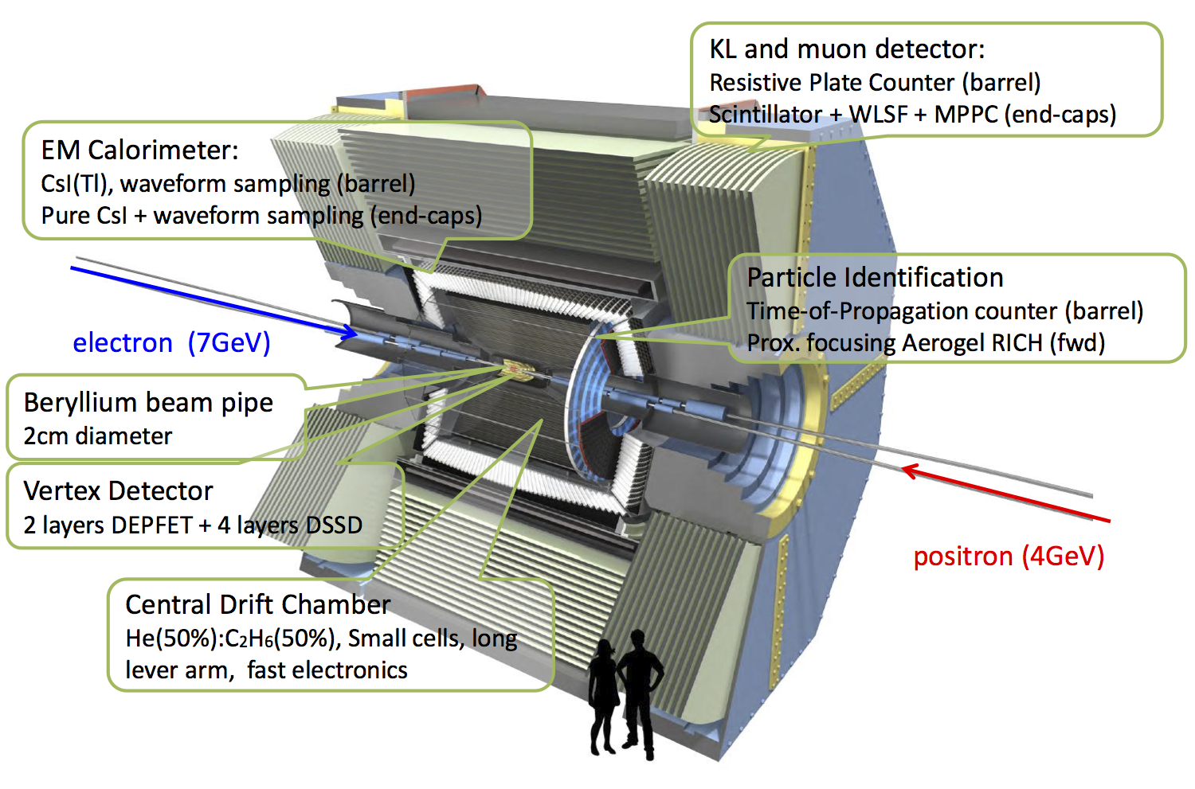
Belle II Vertex Detector (VXD)
Image src: https://www.uvic.ca/science/physics/vispa/research/projects/bphysics/index.php

Slide 4
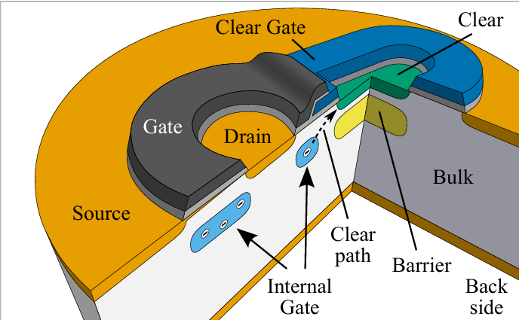
Belle II VXD: PXD
Two layers of DEPFET-based (DEpleted P-channel Field Effect Transistor) Silicon Pixel Detectors (PXD):
Pixel size: 50x(55-85) μm².
250 x 768 pixels per sensor and 40 sensors in total.
Image src: https://link.springer.com/referenceworkentry/10.1007/978-981-19-6960-7_20
Notes:
Explain DEPFET
A DEPFET pixel cell consists of a MOSFET structure on a fully depleted high-resistivity n-type substrate bulk. At a distance of 1 um below the transistor channel an additional n-implant causes a potential minimum for traversing electrons. Stored electrons in this so-called internal gate induce mirror charges in the gate, which in turn modulates the p-channel current. The change in this current is measured over the drain contact.
The DEPFET consists of a p-channel MOSFET built on a fully depleted, high-resistivity n-doped silicon bulk13.
A deep n-implant below the transistor channel creates a potential minimum called the "internal gate"13.
When ionizing radiation enters the depleted silicon bulk, it generates electron-hole pairs1.
The electric field in the bulk separates these charge carriers:
Holes drift towards the p+ contact on the back surface
Electrons are collected in the internal gate1
The collected electrons in the internal gate modulate the transistor's channel conductivity, which can be measured as a change in current or voltage

Slide 5
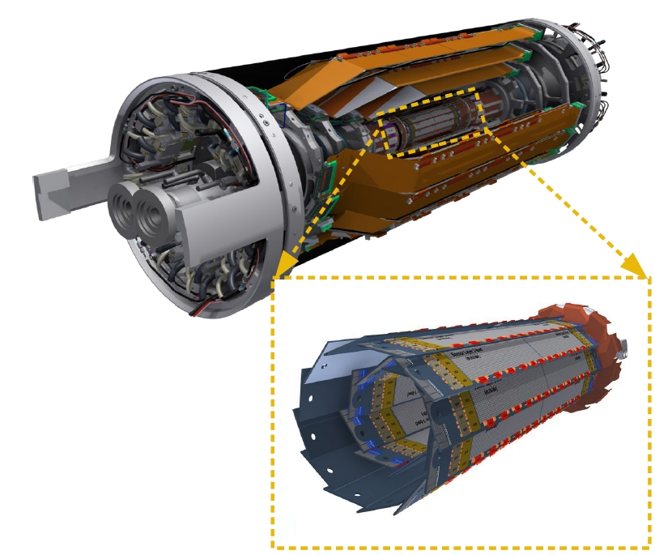
Belle II VXD: PXD
2 layers of DEPFET-based (DEpleted P-channel Field Effect Transistor) silicon pixel detectors (PXD):
Pixel size: 50x(55-85) μm².
250 x 768 pixels per sensor and 40 sensors in total.
Layer 1: 14mm (8 ladders), Layer 2: 22mm (12 ladders)
PXD1 2019-2022 incomplete
PXD2 from 2023 full 2-layer
Data readout via Data Acquisition System (DAQ):
Read 4-rows of pixels at a time (~100ns), total 20 μs
DCDs (Drain Current Digitizers) and DHPs (Data Handling Processors)
Significant larger unfiltered raw data rate
CO₂ (-20ºC) cooling for DCDs and DHPs and N₂ (+/-2ºC) gas for sensor and switchers.
Image src: https://indico.cern.ch/event/1184921/contributions/5576921/attachments/2766920/4819786/72-schmitz-belle_II-pxd.pdf
Notes:
All clear and gate lines of each row and all drain lines of one column are connected, 4 at a time, uses DCPs and DHPs
The (DCD) digitize the incoming drain current in 256 channels
For further signal processing each DCD has a DHP to perform pedestal subtraction, zero suppression and data transmission

Slide 6
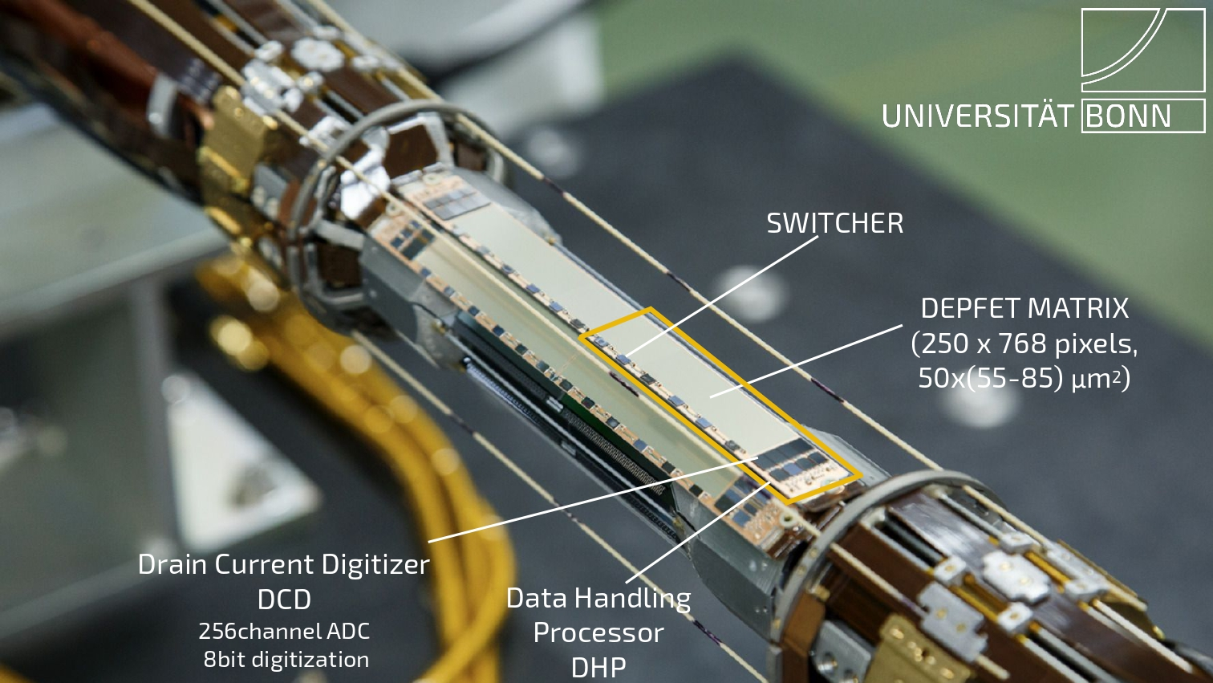
Belle II VXD: PXD
Image src: https://indico.cern.ch/event/1184921/contributions/5576921/attachments/2766920/4819786/72-schmitz-belle_II-pxd.pdf
Notes:
The Switchers are responsible for driving the gate and clear lines.
The (DCD) digitize the incoming drain current in 256 channels
For further signal processing each DCD has a corresponding (DHP) to perform pedestal subtraction, zero suppression and data transmission

Slide 7
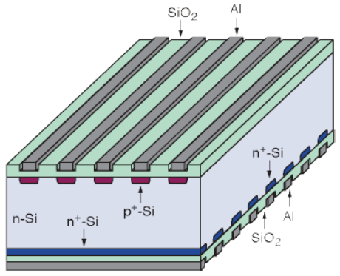
Belle II VXD: SVD
4 Layers of DSSDs (Double Sided Silicon Detectors).
p-side: 𝑢 = 𝑟𝜙 position
n-side: 𝑣 = 𝑧 coordinate
Image src: https://www.researchgate.net/figure/Schematics-showing-a-double-sided-silicon-strip-detector-After-42_fig6_296683651
Notes:
These DSSDs consist of an N-type silicon substrate ∼300 μm thick with P-type strips implanted on one side, and orthogonal N-type strips implanted on the other side, providing two-dimensional spatial information. The strips on u/P side are orientated in parallel to the beam axis, measuring the 𝑢 = 𝑟𝜙 position, while the ones on v/N side are transverse to the beam axis and provide the 𝑣 = 𝑧 coordinate.

Slide 8
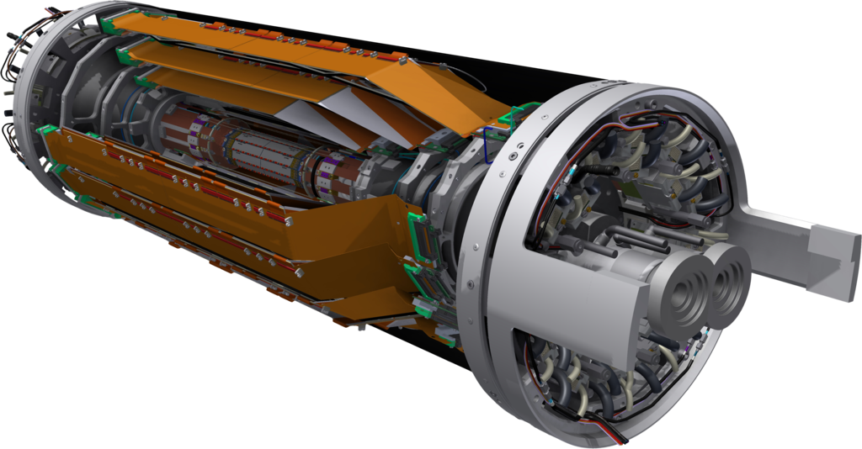
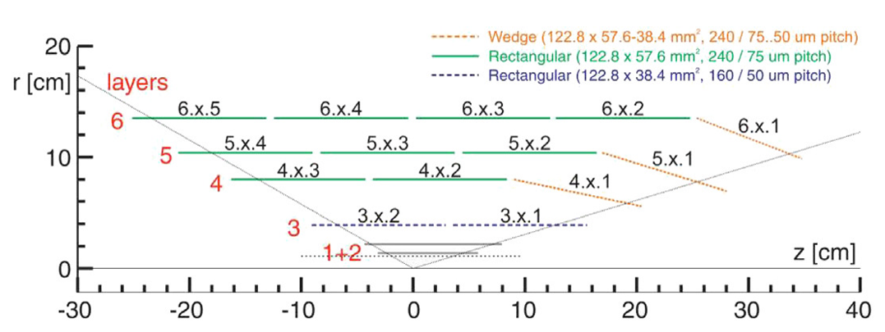
Belle II VXD: SVD
4 Layers of DSSDs; p-side: 𝑢 = 𝑟𝜙 position n-side: 𝑣 = 𝑧 coordinate
Radii(ladders) 39(7), 80(10), 104(12), and 135(16) mm.
Total 172 DSSDs.
Two shapes: Rectangles and Trapezium
Covers the polar angle interval of 17◦ < 𝜃 < 150◦ and the full azimuthal range with respect to the direction of 𝑒− beam.
The APV25 chip is used as readout ASIC, shaping time of 50ns and radiation tolerance of more than 60kGy, PXD: 200kGy.
Image src: https://belle2.jp/ja/inner-and-tracking-detectors/
https://indico.cern.ch/event/775317/contributions/3227530/attachments/1773865/2883570/talk_SVD_Manish.pdf

Slide 9
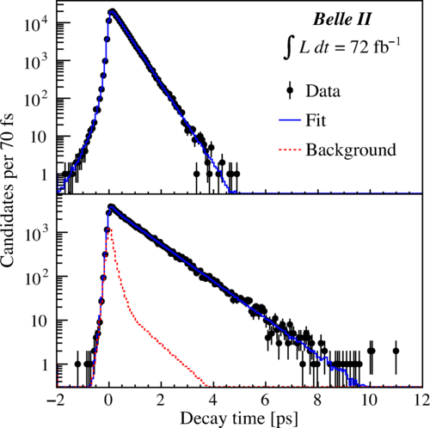
Belle II VXD: Performance
PXD:
Homogeneous signal and noise response.
SNR ~30-50.
Spatial resolution: 10-22 μm
98% hit efficiency.
SVD:
SNR are between 15 and 25 on the 𝑝-side and between 18 and 30 on the 𝑛-side.
99% hit efficiency.
Time resolution <3ns
Belle II proper time resolution ~2x better than Belle:
Decay-time distributions of (top) 𝐷0 →𝐾−⁢𝜋+ and (bottom) 𝐷+ →𝐾−⁢𝜋+⁢𝜋+ candidates in their respective signal regions with fit projections overlaid
Image src: https://journals.aps.org/prl/abstract/10.1103/PhysRevLett.127.211801
Notes:
The hit efficiency is calculated as the fraction of times a cluster is found within ±0.5 mm from the extrapolated position of tracks on the sensor.
Influenced by tracking quality and alignment.
Take only tracks with good tracking and pT > 1 GeV/c
Strip Pitch and Geometry:
P-side strips are parallel to the beam axis and have a finer pitch (50-75 μm), which generally results in higher signal collection efficiency but also potentially more noise due to increased inter-strip capacitance.
N-side strips are perpendicular to the beam axis and have a coarser pitch (160-240 μm), leading to lower noise due to reduced inter-strip capacitance but also lower signal collection efficiency.
Charge Collection:
The P-side typically collects more charge because of its orientation and finer pitch, which can lead to a higher signal amplitude. However, this also means more noise due to increased capacitance.
The N-side collects less charge due to its coarser pitch and orientation, resulting in lower signal amplitude but also less noise

Slide 10
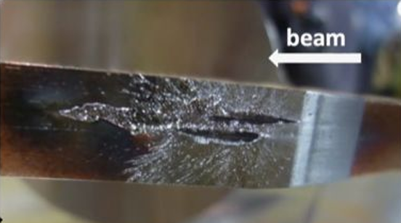
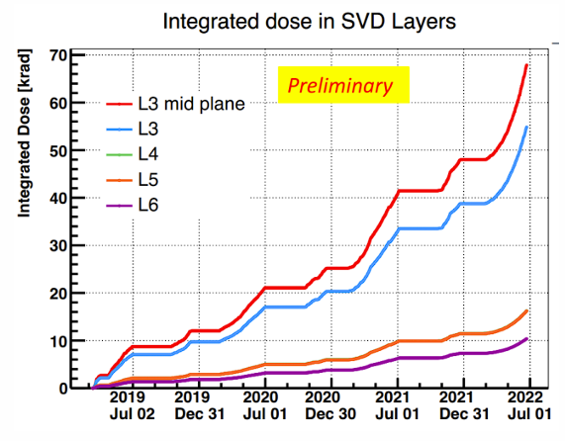
Challenges
High beam-induced backgrounds
Radiation bursts to PXD up to 3Gy in 40μs
Permanent Switcher damage → ~3% drop in efficiency.
The occupancy in layer 3 about 0.3% (limit ~4%), reached >8%
leakage currents and strip noises increased in all SVD sensors; < 20%(30%) for n(p) side
Bulk damage can change effective doping and depletion voltage.
Image src: https://indico.cern.ch/event/1184921/contributions/5576921/attachments/2766920/4819786/72-schmitz-belle_II-pxd.pdf
Graph: https://indico.cern.ch/event/1140707/contributions/4988213/attachments/2533474/4359608/Vertex2022_khkang_v3.pdf
Notes:
In PXD: Radiation bursts to PXD up to 3Gy in 40μs
Permanent Switcher damage after beam incidents → Inefficient/dead readout rows → ~3% drop in efficiency
Leakage current refers to the unwanted current flowing through the silicon detector when it is biased. This current increases with radiation exposure due to the creation of defects in the silicon material. the leakage current's contribution to noise remains negligible due to the short shaping time (50 ns) of the APV25 readout chips1.
Strip noise refers to the random fluctuations in the signal measured by the detector strips. It is primarily dominated by inter-strip capacitance in the SVD.

Slide 11
Future Upgrades
PXD2 has been installed.
Advanced tracking algorithms for dense environments: hit-time selection, SVD grouping, : reduce the fake rate by 16%
Machine learning for track reconstruction: rejecting the off-time tracks additional 1.5% fake rate reduced.
SVD occupancy limit for layer 3 can be increased from 4.7% to around 6%
New materials for radiation resistance
Notes:
Hit time selection: One way to reduce the off-time tracks is to apply a hit-time selection that takes advantage of the excellent hit-time resolution of SVD (<3 ns). With the current selection, which requires that the time difference between the P-side and N-side clusters, |𝑡𝑝 − 𝑡𝑛| <20 ns, and a requirement on the absolute value of the cluster time, |𝑡𝑝;𝑛| <50 ns, about 50% of the background hits are rejected while keeping the signal efficiency above 99%.
Another suppression method called ‘‘SVD grouping’’ has been de veloped to further increase the occupancy limit. The method consists of classifying the clusters event-by-event by their time: in this way, clusters belonging to tracks from the same collisions are collected in the same group, while clusters from different collisions or beam background are placed in the other groups.
occupancy refers to the fraction of detector cells (or strips) that are hit by particles during an event. It is a measure of how often a particular detector element is activated by a passing particle, which can be a signal or background event.

Slide 12
Summary
Belle 2 in SuperKEKB (e⁺ e⁻) Japan.
VXD = PXD + SVD
PXD = 2 layers DEPFET detector; crucial for impact parameter
SVD = 4 layers DSSD detector; extrapolate PXD output and track particles
Key role in precision tracking & CP violation studies
Performance:
High efficiency (98% for PXD 99% SVD)
spatial resolution (10-22 μm for PXD, 20-40 μm for SVD), &
radiation tolerance (200kGy for PXD 60kGy for SVD)
SuperKEKB aims at high luminosity therefore more background thus more efficient materials and methods needed

Slide 13
Resources
Belle 2: https://belle2.jp/
The Belle II Pixel Detector for the SuperKEKB Flavour Factory: https://doi.org/10.1016/j.nima.2010.12.116
Performance of the Belle II Silicon Vertex Detector: https://doi.org/10.1016/j.nima.2020.164129
The silicon vertex detector of the Belle II experiment: https://doi.org/10.1016/j.nima.2022.166688
DEPFET Active Pixel Sensors: https://arxiv.org/pdf/2204.13099
Alignment for the first precision measurements at Belle II: https://www.researchgate.net/publication/346904397_Alignment_for_the_first_precision_measurements_at_Belle_II#pf4
Image src: https://www.uvic.ca/science/physics/vispa/research/projects/bphysics/index.php

