Slide 1
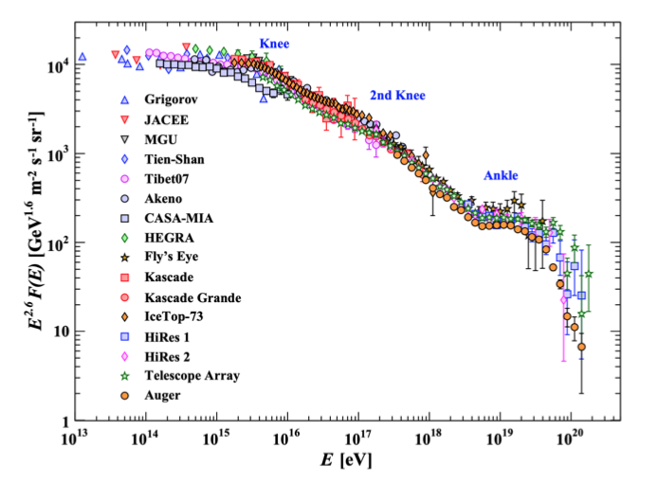
Objectives (1)
High energy (>10e17 eV) cosmic ray detection
Measure primary particle type, energy and direction
Scientific results (2)
Suppression of the cosmic ray flux at energies above 4×10e19 eV
Photon and neutrino limits rule out “top-down” source processes
Unexpected evolution of the mass composition of cosmic rays in the energy range from 10e18 to 10e19.5 eV
(1) The Pierre Auger Cosmic Ray Observatory arXiv:1502.01323
(2) The Pierre Auger Observatory Upgrade - Preliminary Design Report arXiv:1604.03637
High-energy CR spectrum
Particle Data Group collaboration, Review of Particle Physics, Phys. Rev. D98 (2018) 030001.
Notes:
https://www.researchgate.net/figure/The-layout-of-the-Pierre-Auger-Observatory_fig1_50285669

Slide 2
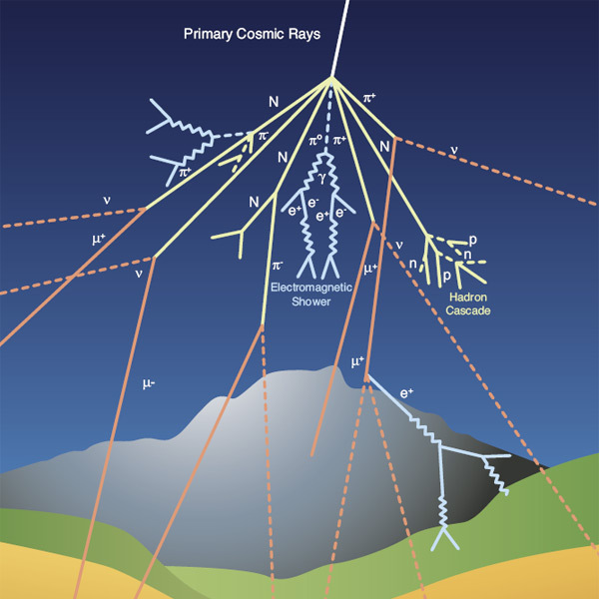
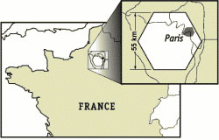
High-energy CR particles create air showers in the atmosphere
Observables
shower axis, longitudinal profile, lateral extend, composition and arrival time of particles on the ground
Very low particle flux at high energies
1 particle/km2/yr at 10e19 eV
1 particle/km2/century at >10e20 eV
Large surface detector (∼3000km2)
Pierre Auger Observatory

Slide 3
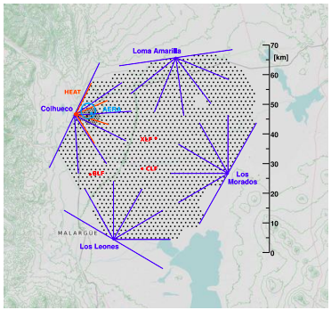
Auger uses complementary techniques to measure air showers
Auger Hybrid Detector
Surface detector (SD): 1660 water cherenkov detectors
Fluorescence detector (FD): 27 fluorescence telescopes placed at 4 sites
AERA (Auger Engineering Radio Array)
Radio emission from the shower
AMIGA (Auger Muons and Infill for the Ground Array)
Muon counters buried 2.5m underground
<10e17 eV
HEAT (High Elevation Auger Telescopes)
Similar to FDs but pointed upwards
∼ 10e17 eV
Pierre Auger Observatory

Slide 4
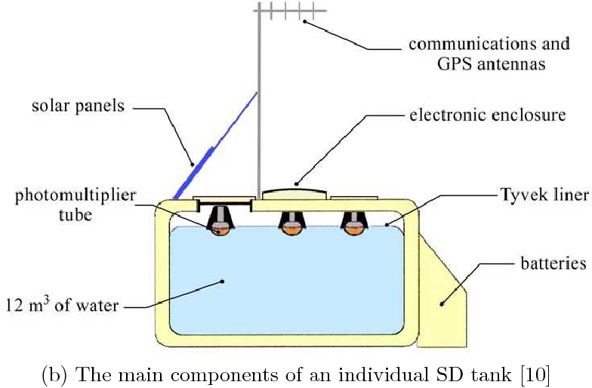
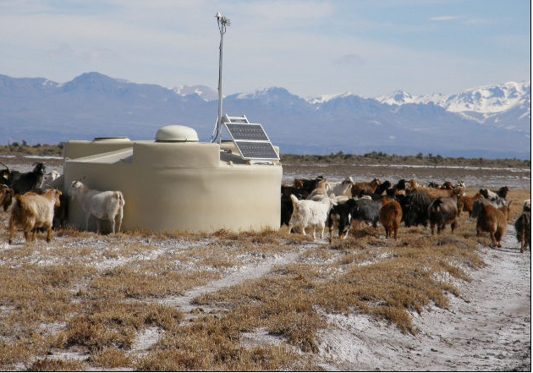
Surface Detector
Cherenkov light
Generated by charged CR particles or photons that convert to electron-positron pairs in the water volume
The SD consists of 1660 water tank stations
Dimensions: 1.2 m × 10 m2
Tanks made of polyethylene + enhancers for UV-protection + 1% carbon on the inner wall for light tightness
3 photomultiplier tubes, windows of clear polyethylene
Self-contained
https://www.semanticscholar.org/paper/Exploration-of-cosmic-ray-propagation-and-models-to-Gibson/48b4f18931e060bf8f54fe6ff357232a23437c9b Fig. 1.3
Pierre Auger Observatory / Miguel Salvadores

Slide 5
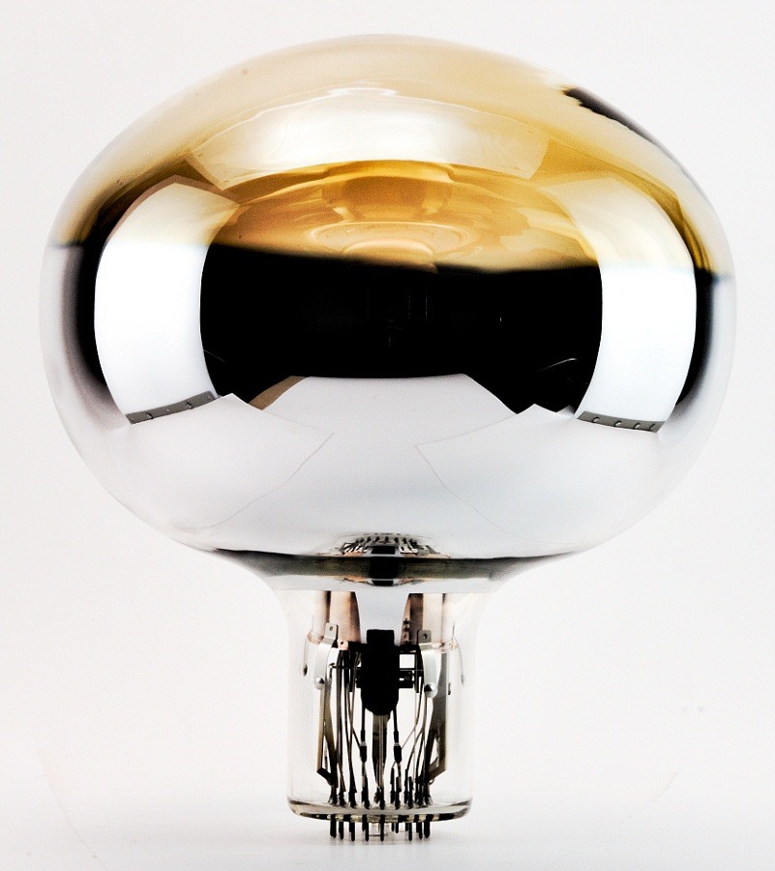
Surface Detector electronics
PMT (photomultiplier tube)
9 in. diameter photocathode (converts light into electrons) and eight dynodes (electron multiplier).
Two outputs: AC anode signal and amplified signal from the last dynode
Filtering
5-pole Bessel filter with a 3 dB cutoff at 20 MHz.
The choice of filter cutoff results in 5% aliasing noise while preserving the time structure of the signals.
GPS receiver
Event timing and synchronization of ADC data to GPS time
CDAS (Central Data Acquisition center)
https://lampes-et-tubes.info/pm/pm168.php?l=

Slide 6
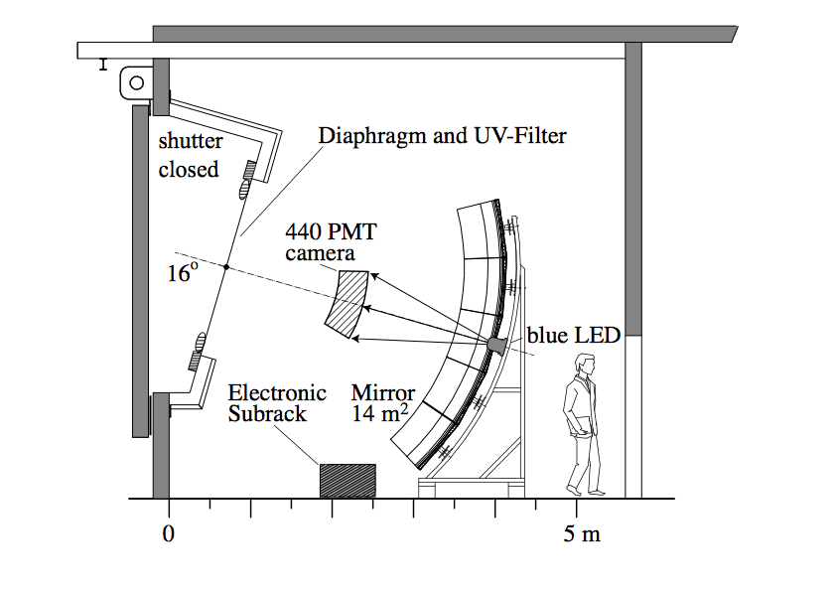
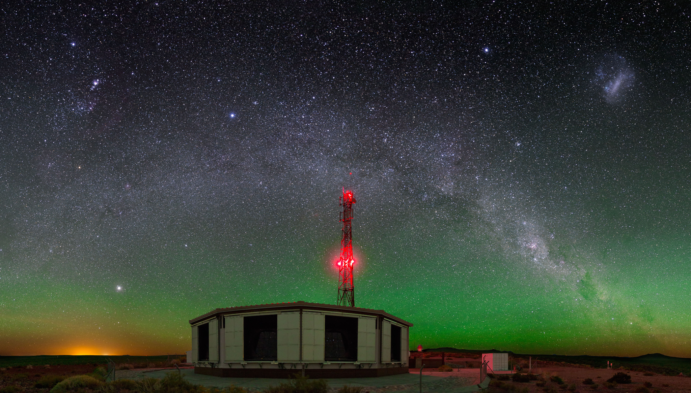
Fluorescence Detector
Nitrogen fluorescence light
Emitted isotropically by the air shower in the UV spectrum
Produced mainly by the EM component of the air shower
FD only operates at night
Low sky brightness: on average 17 nights per month
Test beams to measure performance, FD-SD clock calibration and aerosol optical depth
The FD consists of 27 telescopes
Diaphragm of 1.1 m radius
Filter glass window: filters background light flux
Hexagonal photomultiplier tubes arranged in a (20x22) matrix
https://www.researchgate.net/publication/4039873_Fast_gain_calibration_of_photomultiplier_and_electronics Fig.1
ESA/ S. Saffi

Slide 7
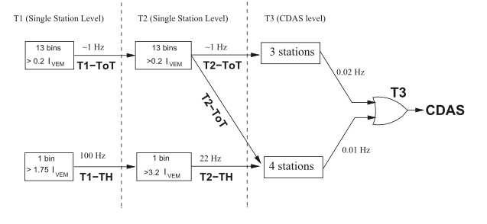
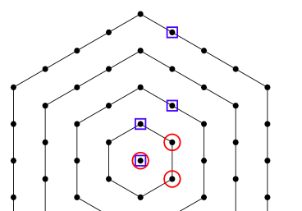
CDAS Central Data Acquisition System
SD Triggers
T1 : threshold trigger (TH) + time-over-threshold trigger (ToT)
T2: Decrease the global rate of the T1 trigger.
FD Triggers
T1: threshold trigger to keep trigger rate of each pixel around 100 Hz
T2: searches for track segments at least five pixels in length
T3: cleans data from noise events such as lightning, CR muons or randomly triggered pixels
After each night of operation, data for T3 FD event triggers are transferred to the CDAS.
CDAS
T3 or Central Trigger initiates SD data acquisition based on three conditions:
Main trigger, based on clusters in space and time of SD events
Random trigger, promotes a random T2 to a T3 every 30 minutes.
2-fold coincidence within 1 μs
(1) The Pierre Auger Cosmic Ray Observatory Fig. 15,16 arXiv:1502.01323

Slide 8
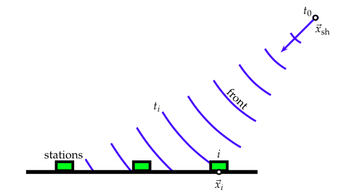
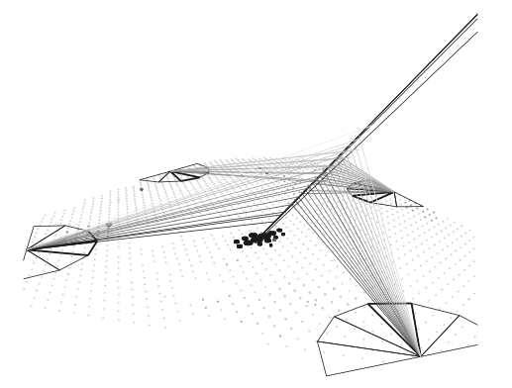
Hybrid event reconstruction
Shower detector plane
Plane that contains the shower axis and the triggered FD stations
Light flux
Intensity is linearly proportional to the energy deposit
“Missing energy” corrections necessary to estimate the energy of the air shower
Lateral distribution function
Impact points are found by fitting SD station signals
Shower size S(1000)
Optimum distance is 1000 m for SD array with 1.5 km spacing
(1) The Pierre Auger Cosmic Ray Observatory Fig. 33,35 arXiv:1502.01323

Slide 9
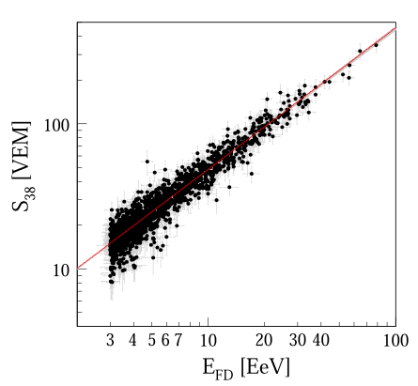
Hybrid energy reconstruction
Shower size from SD and energy from FD are related by a power law
S38 may be regarded as the signal a particular shower with size S(1000) would have produced had it arrived at θ = 38°
SD and FD have different systematic uncertainties
Improved angular resolution with hybrid method
Total uncertainties are dominated by FD
Key performance parameter is the 15% on-time
(1) The Pierre Auger Cosmic Ray Observatory Fig 41 arXiv:1502.01323

Slide 10
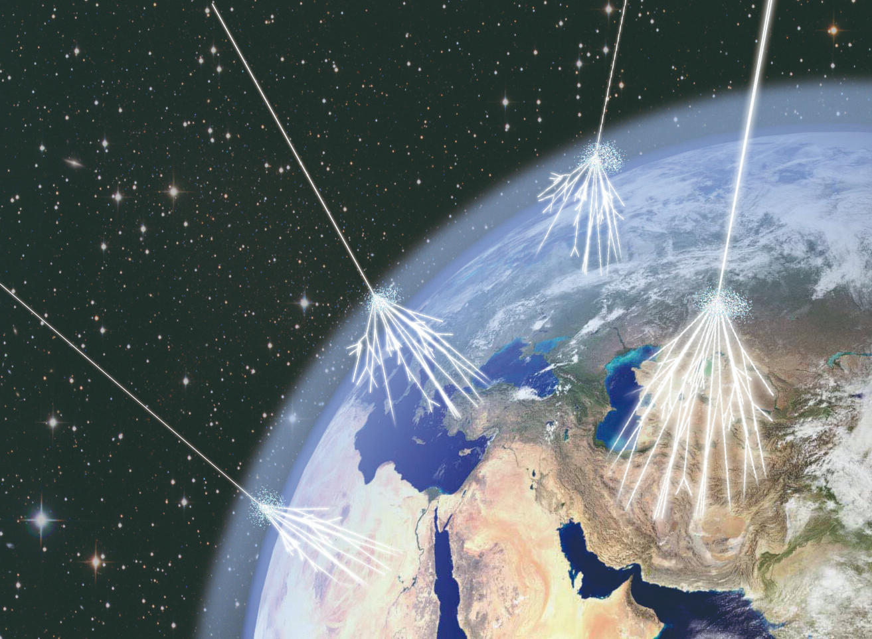
Any Questions?

