Slide 1
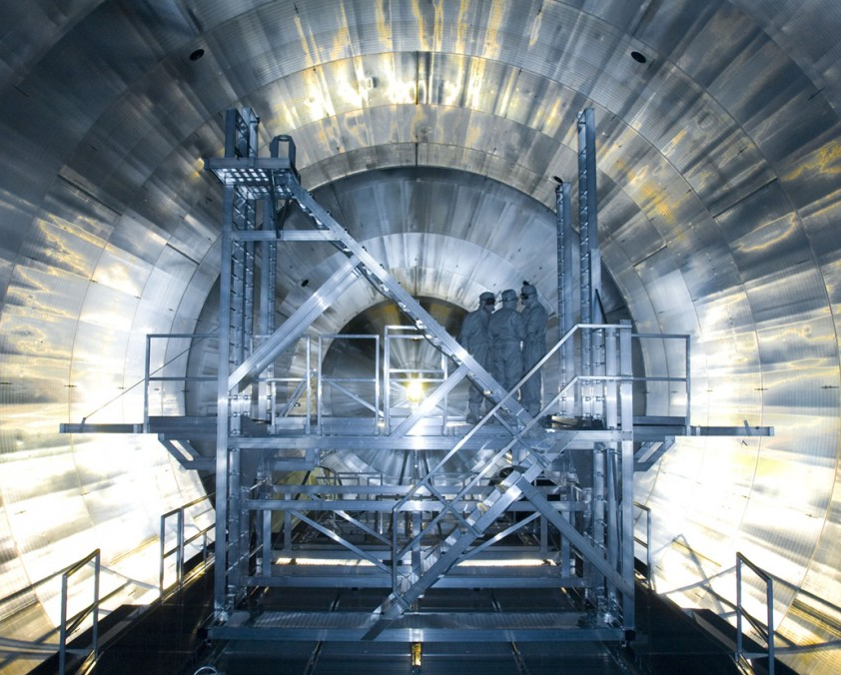
KATRIN
Karlsruhe
Tritium
Neutrino Experiment
Mathilda Lopuszanski
1

Slide 2
KATRIN Experiment
What are the masses of neutrinos?
Are neutrinos Dirac of Majorana particles?
New Physics? Sterile Neutrinos?
β-decay of molecular Tritium:
[1]
2

Slide 3
Tritium Source
95% purity of T₂
Continuous injection of T₂
[2]
3

Slide 4
Spectrometer
Electrons only pass with sufficient kinetic energy
Energy resolution of 2.7 eV
[2]
4

Slide 5
[4]
[3]
5

Slide 6
Focal Plane Detector
Detection of electrons in 10 - 100 keV range after the spectrometer
6
[5]

Slide 7
FPD Wafer
Monolithic 148 p-i-n diode array
Single silicon wafer
Thickness: 503 µm
Diameter: 125 mm
Pixel area: 44 mm²
Bias voltage: 120 V
7
[5]

Slide 8
Focal Plane Detector System
Ultra High (10⁻⁹ mbar) and High Vacuum (10⁻⁶ mbar)
Cooling system
Veto to detect incoming muons using scintillators
Shielding of lead and copper to reduce 𝛾-background
[5]
8

Slide 9
Data Processing
Pixel connected to preamplifier with a pogo pin
24 preamplifier modules in radial pattern connected to 6 or 7 pixels
Optical fibers transport the signal to DAQ system
DAQ system is at 2.5 m distance from the front end electronic and consists of triggers system and ADC
[5]
9

Slide 10
Perfomance of the FPD
Dead layer thickness
155.4 ± 0.5 (stat.) ± 0.2 (sys) nm
46% charge collection
Detection efficiency
95.0 ± 1.8 (stat.) ± 2.2 (syst.) %
mainly due to dead layer losses
Energy resolution
Global 1.86 ± 0.13 keV
Timing resolution
between 96 ns and 246 ns for 18 keV electrons
Charge splitting over pixels
[6]
10

Slide 11
References
[1] M. Steidl, KIT Katrin. KIT Available at: https://www.katrin.kit.edu/1033.php.
[2] M. Aker et al 2022 J. Phys. G: Nucl. Part. Phys. 49 100501
[3] Katrin Experiment investigates Neutrino Mass Available at: https://phys.org/news/2018-06-katrin-neutrino-mass.html.
[4] Katrin. Wikipedia (2025). Available at: https://de.wikipedia.org/wiki/KATRIN.
[5] J. F. Amsbaugh et al 2015 Nucl. Inst. Meth. A 778 arXiv:1404.2925v3
[6] The KATRIN collaboration et al 2021 JINST 16 T08015 DOI 10.1088/1748-0221/16/08/T08015
11

Slide 12
12

