Slide 1
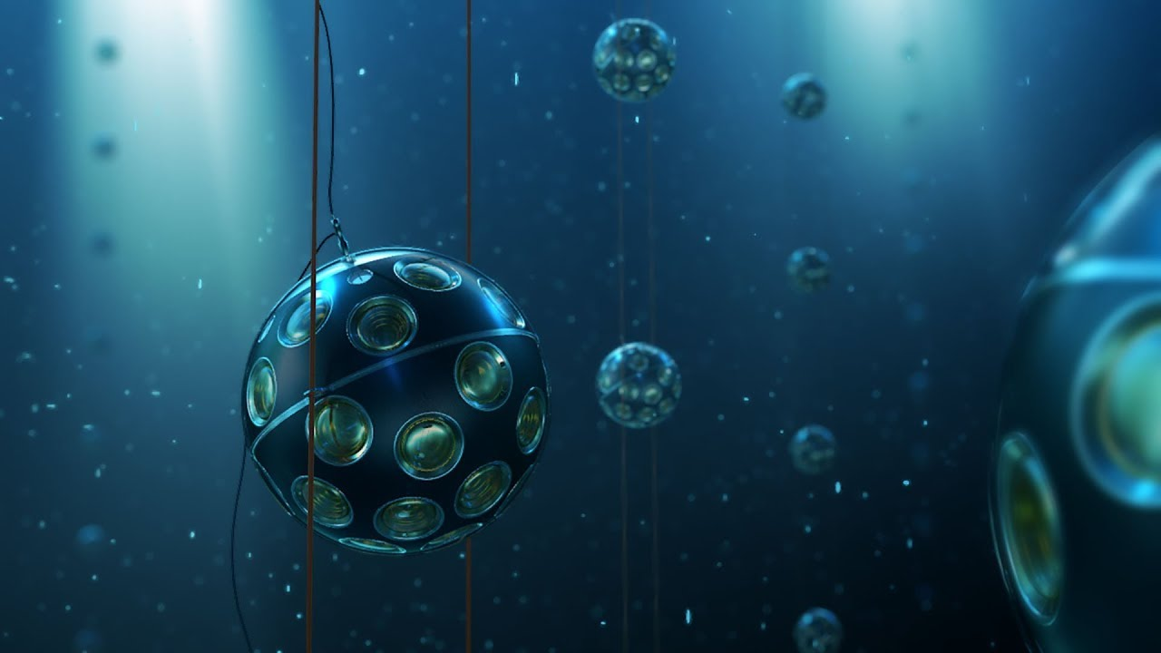
The KM3NeT ARCA Detector
The deep-sea cubic kilometer neutrino telescope
By Nathan Slingerland

Slide 2
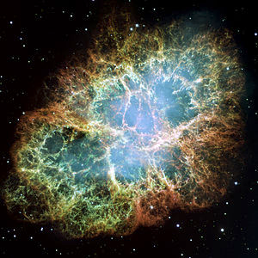
The Goal – Why Build a Neutrino Detector?
The goals of the KM3NeT collaboration:
Observation of high-energy neutrino sources in the Universe
Determination of neutrino mass hierarchy
To contribute to multi-messenger astronomy
Why neutrinos?
Neutrinos travel in straight lines through outer space
Unanswered questions
ARCA

Slide 3
The ARCA Detector
Astroparticle Research with Cosmics in the Abyss
Detects Cherenkov radiation from particles produced by neutrino interactions
Measure arrival time and intensity of photons using PMTs
Material: seawater:
Transparent
Slows speed of light
Optimised for high-energy cosmic neutrinos
3.5km depth
Studies upward-moving muons: only neutrinos can pass through the earth

Slide 4
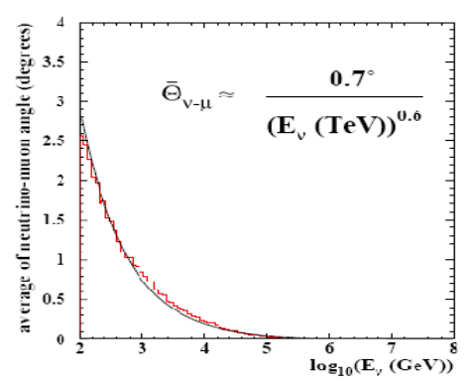
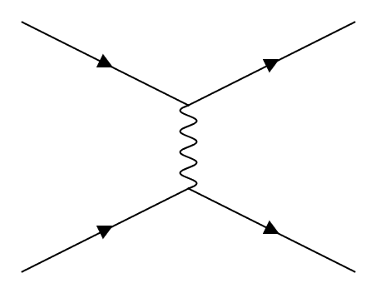
Neutrino Interactions: Single Track Muon Events
$$ν_{μ}$$
$$μ$$
What is detected
$$W^{+}$$
Neutron or proton in nucleus
Hadrons
Can happen far from detector: 10 GeV muon flies ~ 60 km before decay
0.3° directional correlation of $μ$ and $ν_{μ}$ trajectories if $E_{ν}$ > 10 TeV

Slide 5
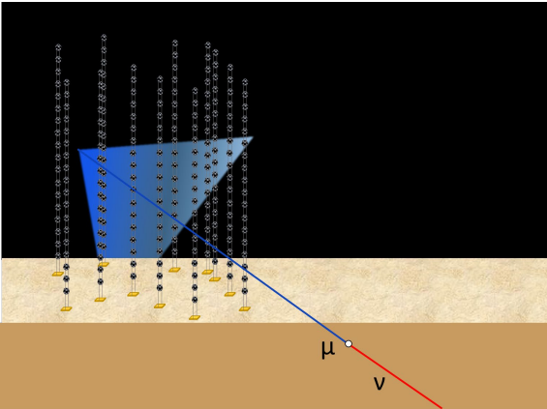
Cherenkov cone
Muon produced by neutrino interaction

Slide 6
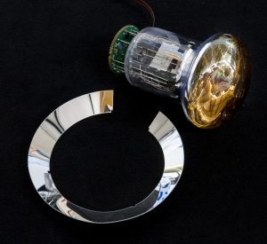
Photomultiplier Tubes (PMTs)
Many (64170) small (3”) PMTs
Measure arrival time and TOT
Use ADC
Threshold: 0.3 of an average single photon
PMTs small:
Earth’s magnetic field on electrons in PMT negligible
Don’t have to shield
Reflection ring increases photon acceptance by 20-30%
Negative high voltage (HV) on the photocathode:
Amplification of $3×{10}^{6}$
Base (ADC and HV)
PMT
Reflection ring

Slide 7
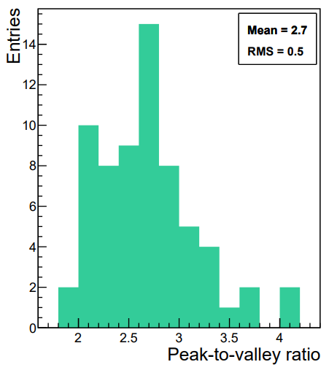
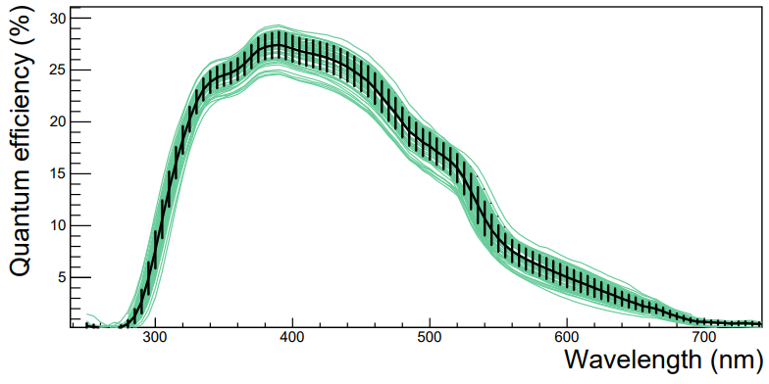
PMT Characteristics
High quantum efficiency
Low dark count rate
Peak to valley ratio of 2.7
Wavelength of interest

Slide 8
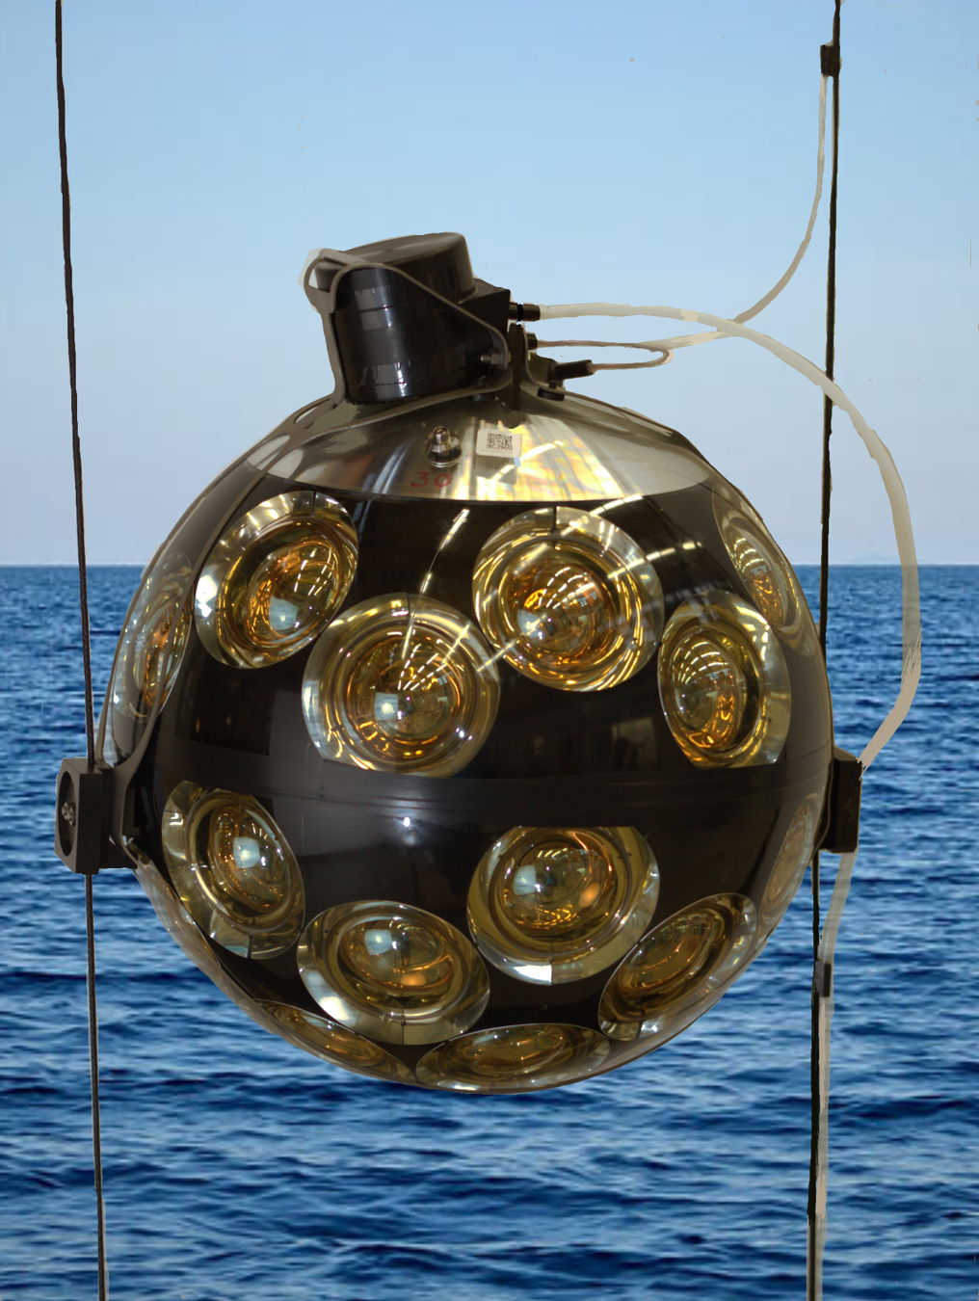
The Digital Optical Module (DOM)
44 cm diameter sphere, 31 PMTs
Many small PMTs means:
Good angular coverage
Good directional information
Good background filtering
Optical gel between glass and PMT: no refraction
DOM also contains:
Data electronics
Acoustic sensor
Compass
LED nano-beacon
Consumes 7 W of power

Slide 9
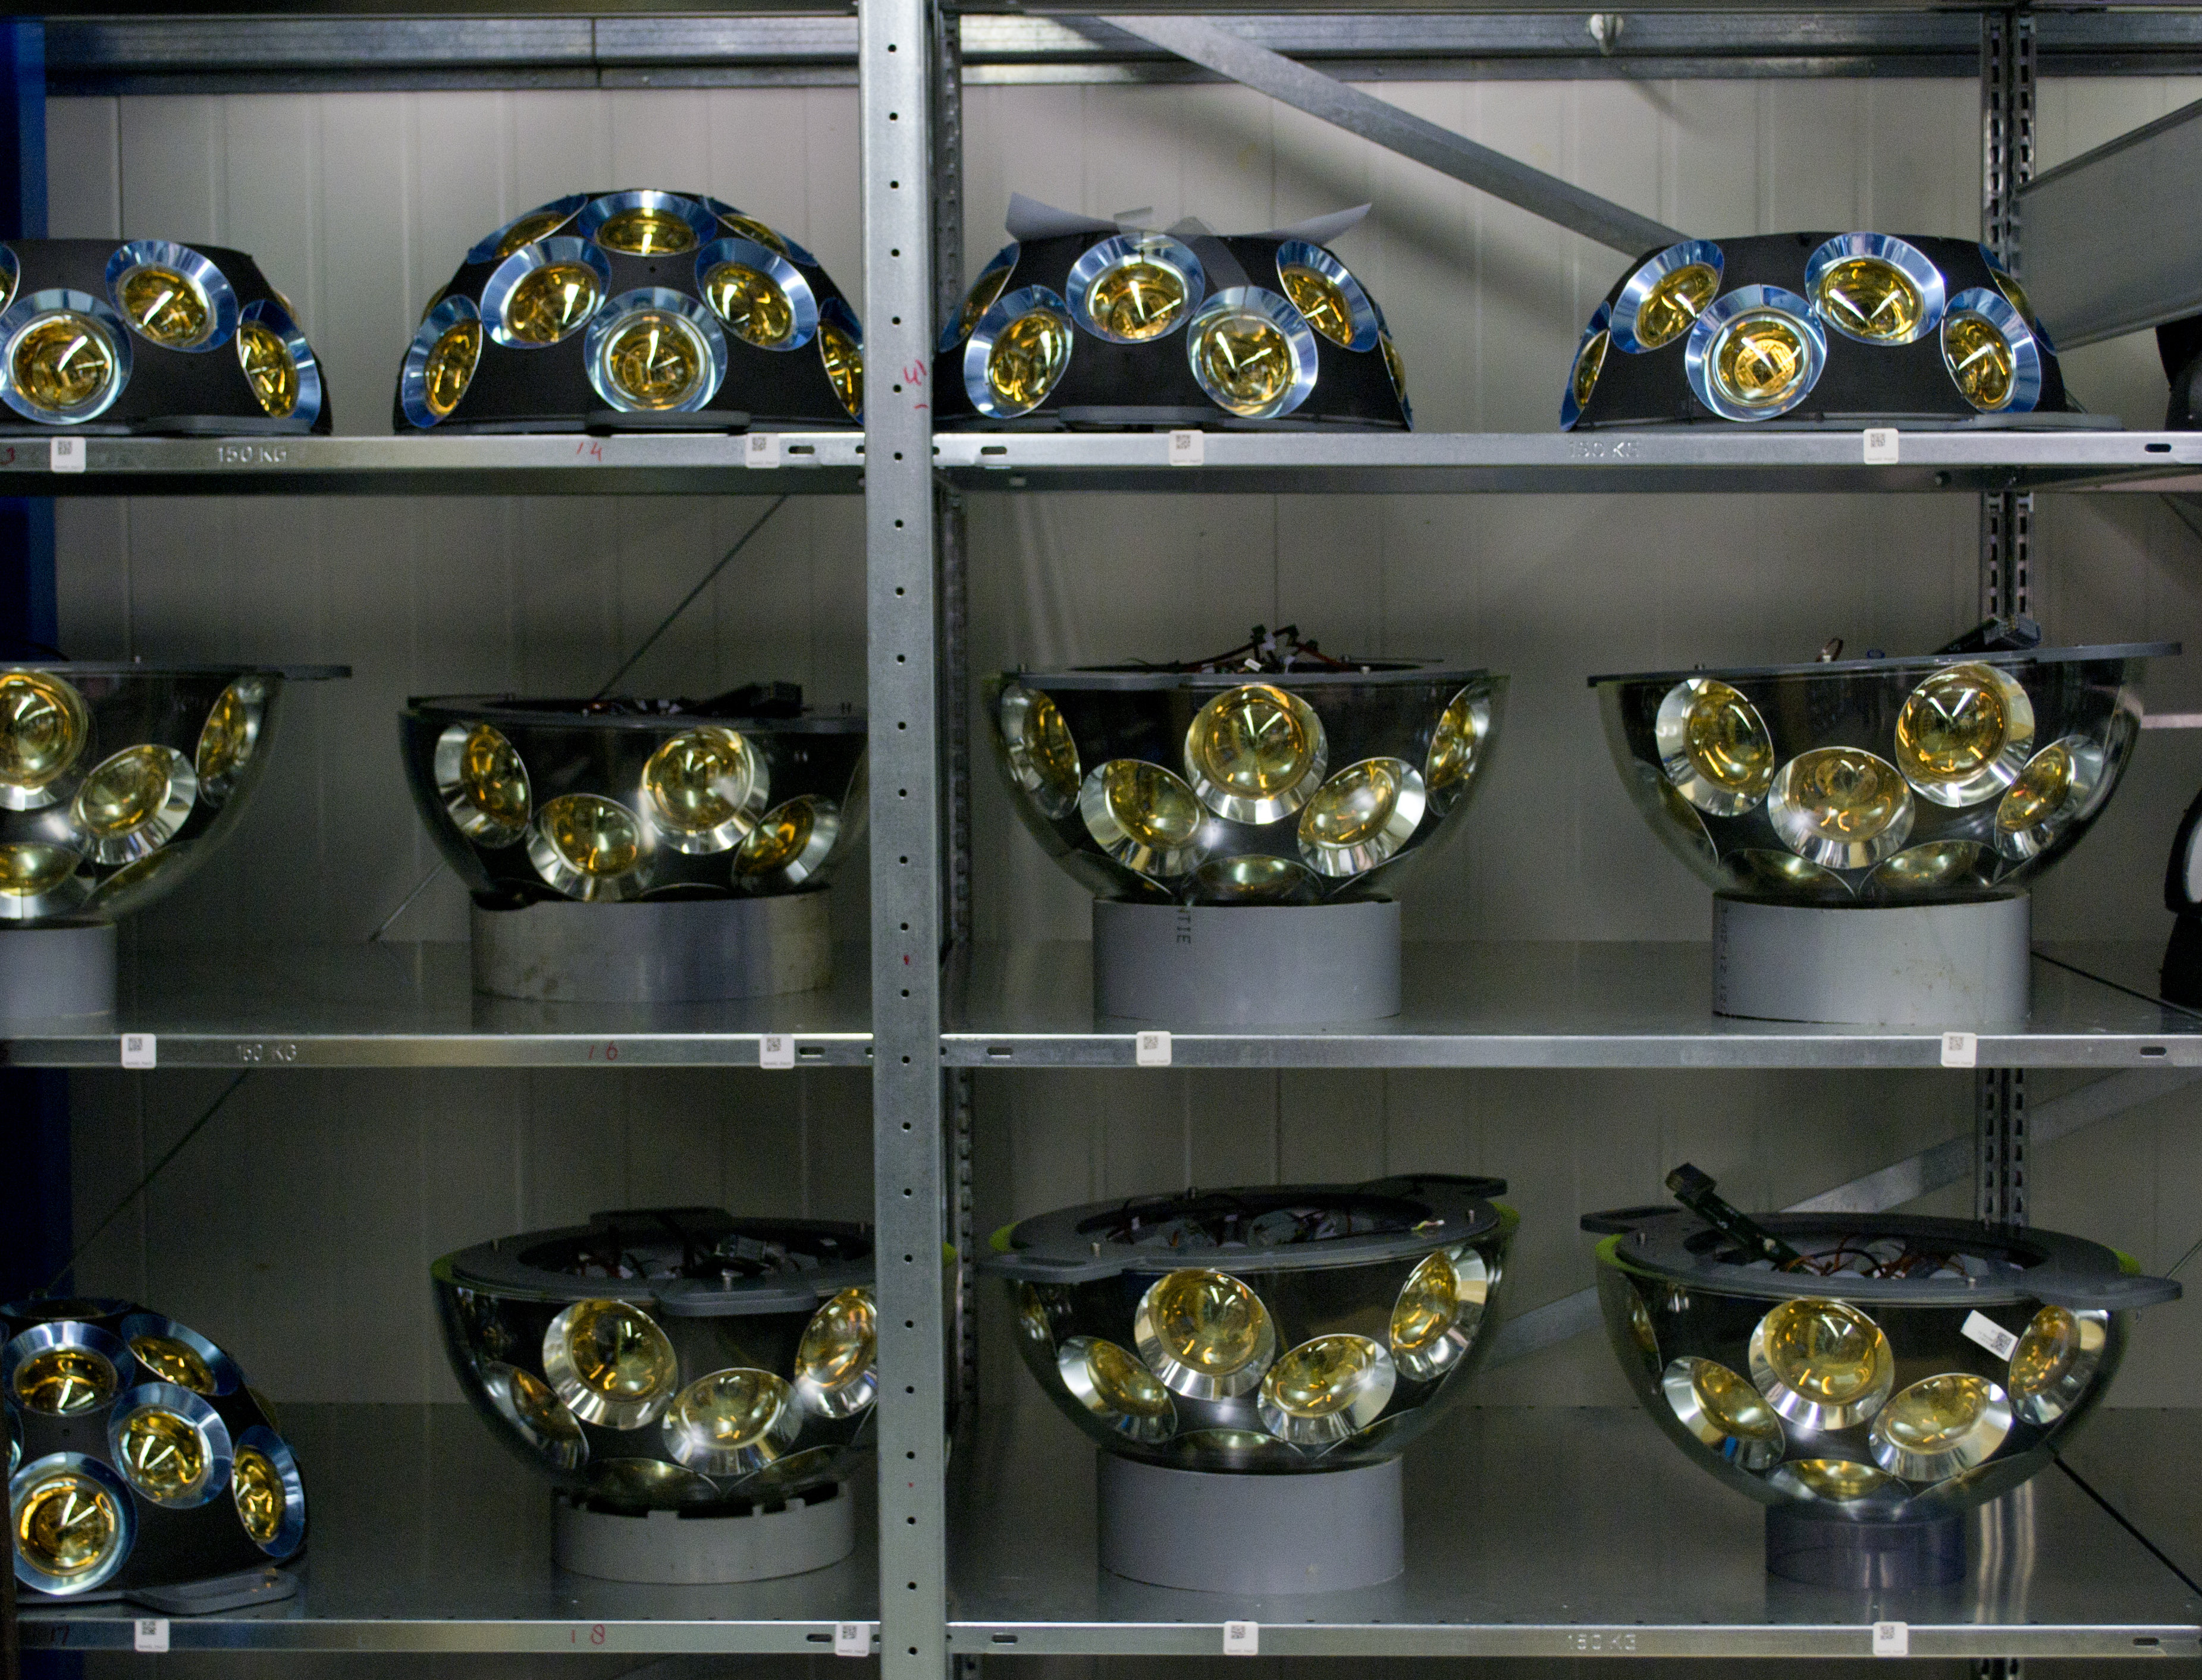
The DOM
DOM assembled in hemispheres
5 rings of 6 PMTs
One PMT pointing straight down
Rings of PMTs

Slide 10
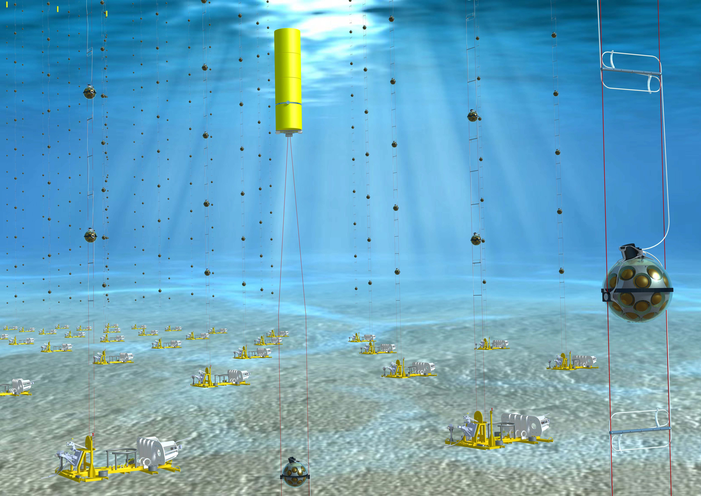
Detector Units (DUs)
Buoy on top of DU
String of 18 DOMS
Anchored to sea floor
Held close to vertical by submerged buoy
Each DU has one optical fibre:
Each DOM has dedicated wavelength
All data to shore:
Background filtering
Muon reconstruction
Electro-optical Cable
Oil filled
Pressure balanced
Anchor
Data to shore station
Clock signal and power to DOMs
Image Copyright Edward Berbee/Nikhef

Slide 11
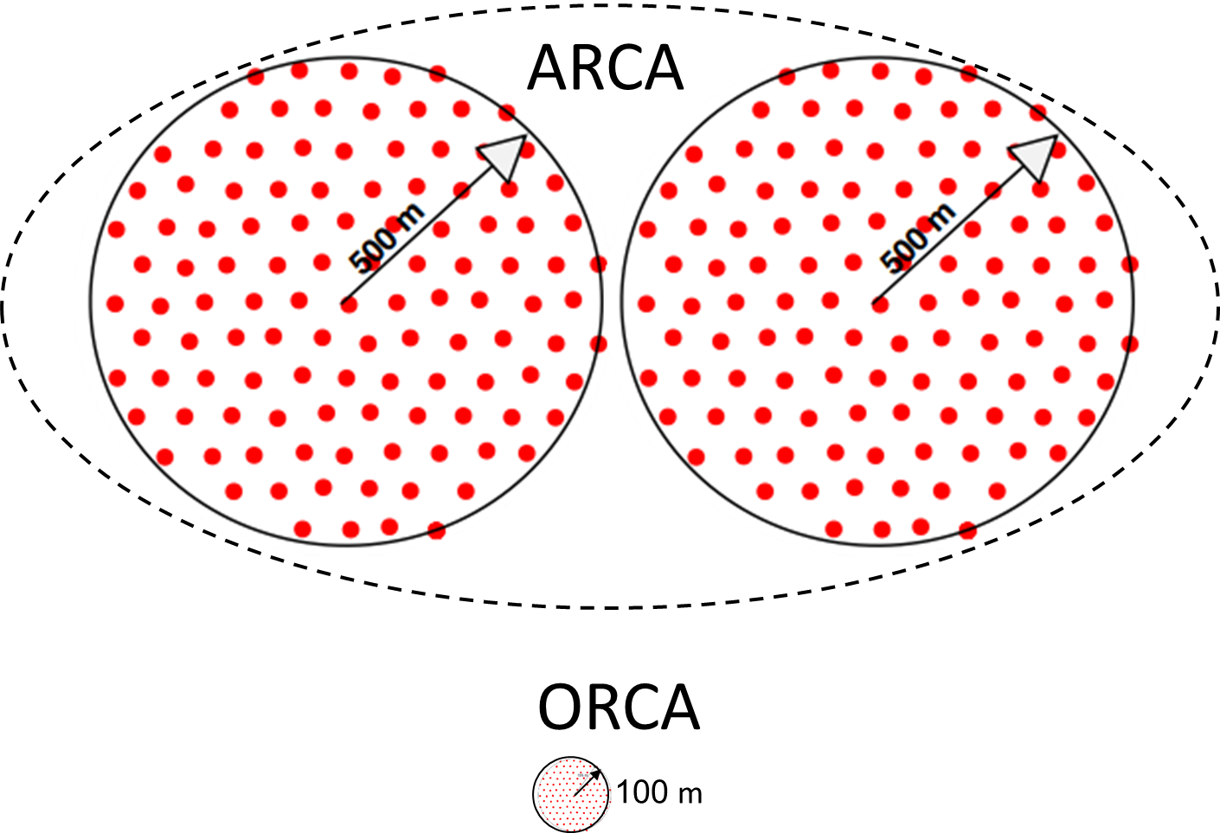
Detector Blocks
ARCA made up of 2 detector blocks
500m radius
Detector block contains 115 DUs
Spacing between DOMs:
40m vertical
100m horizontal

Slide 12
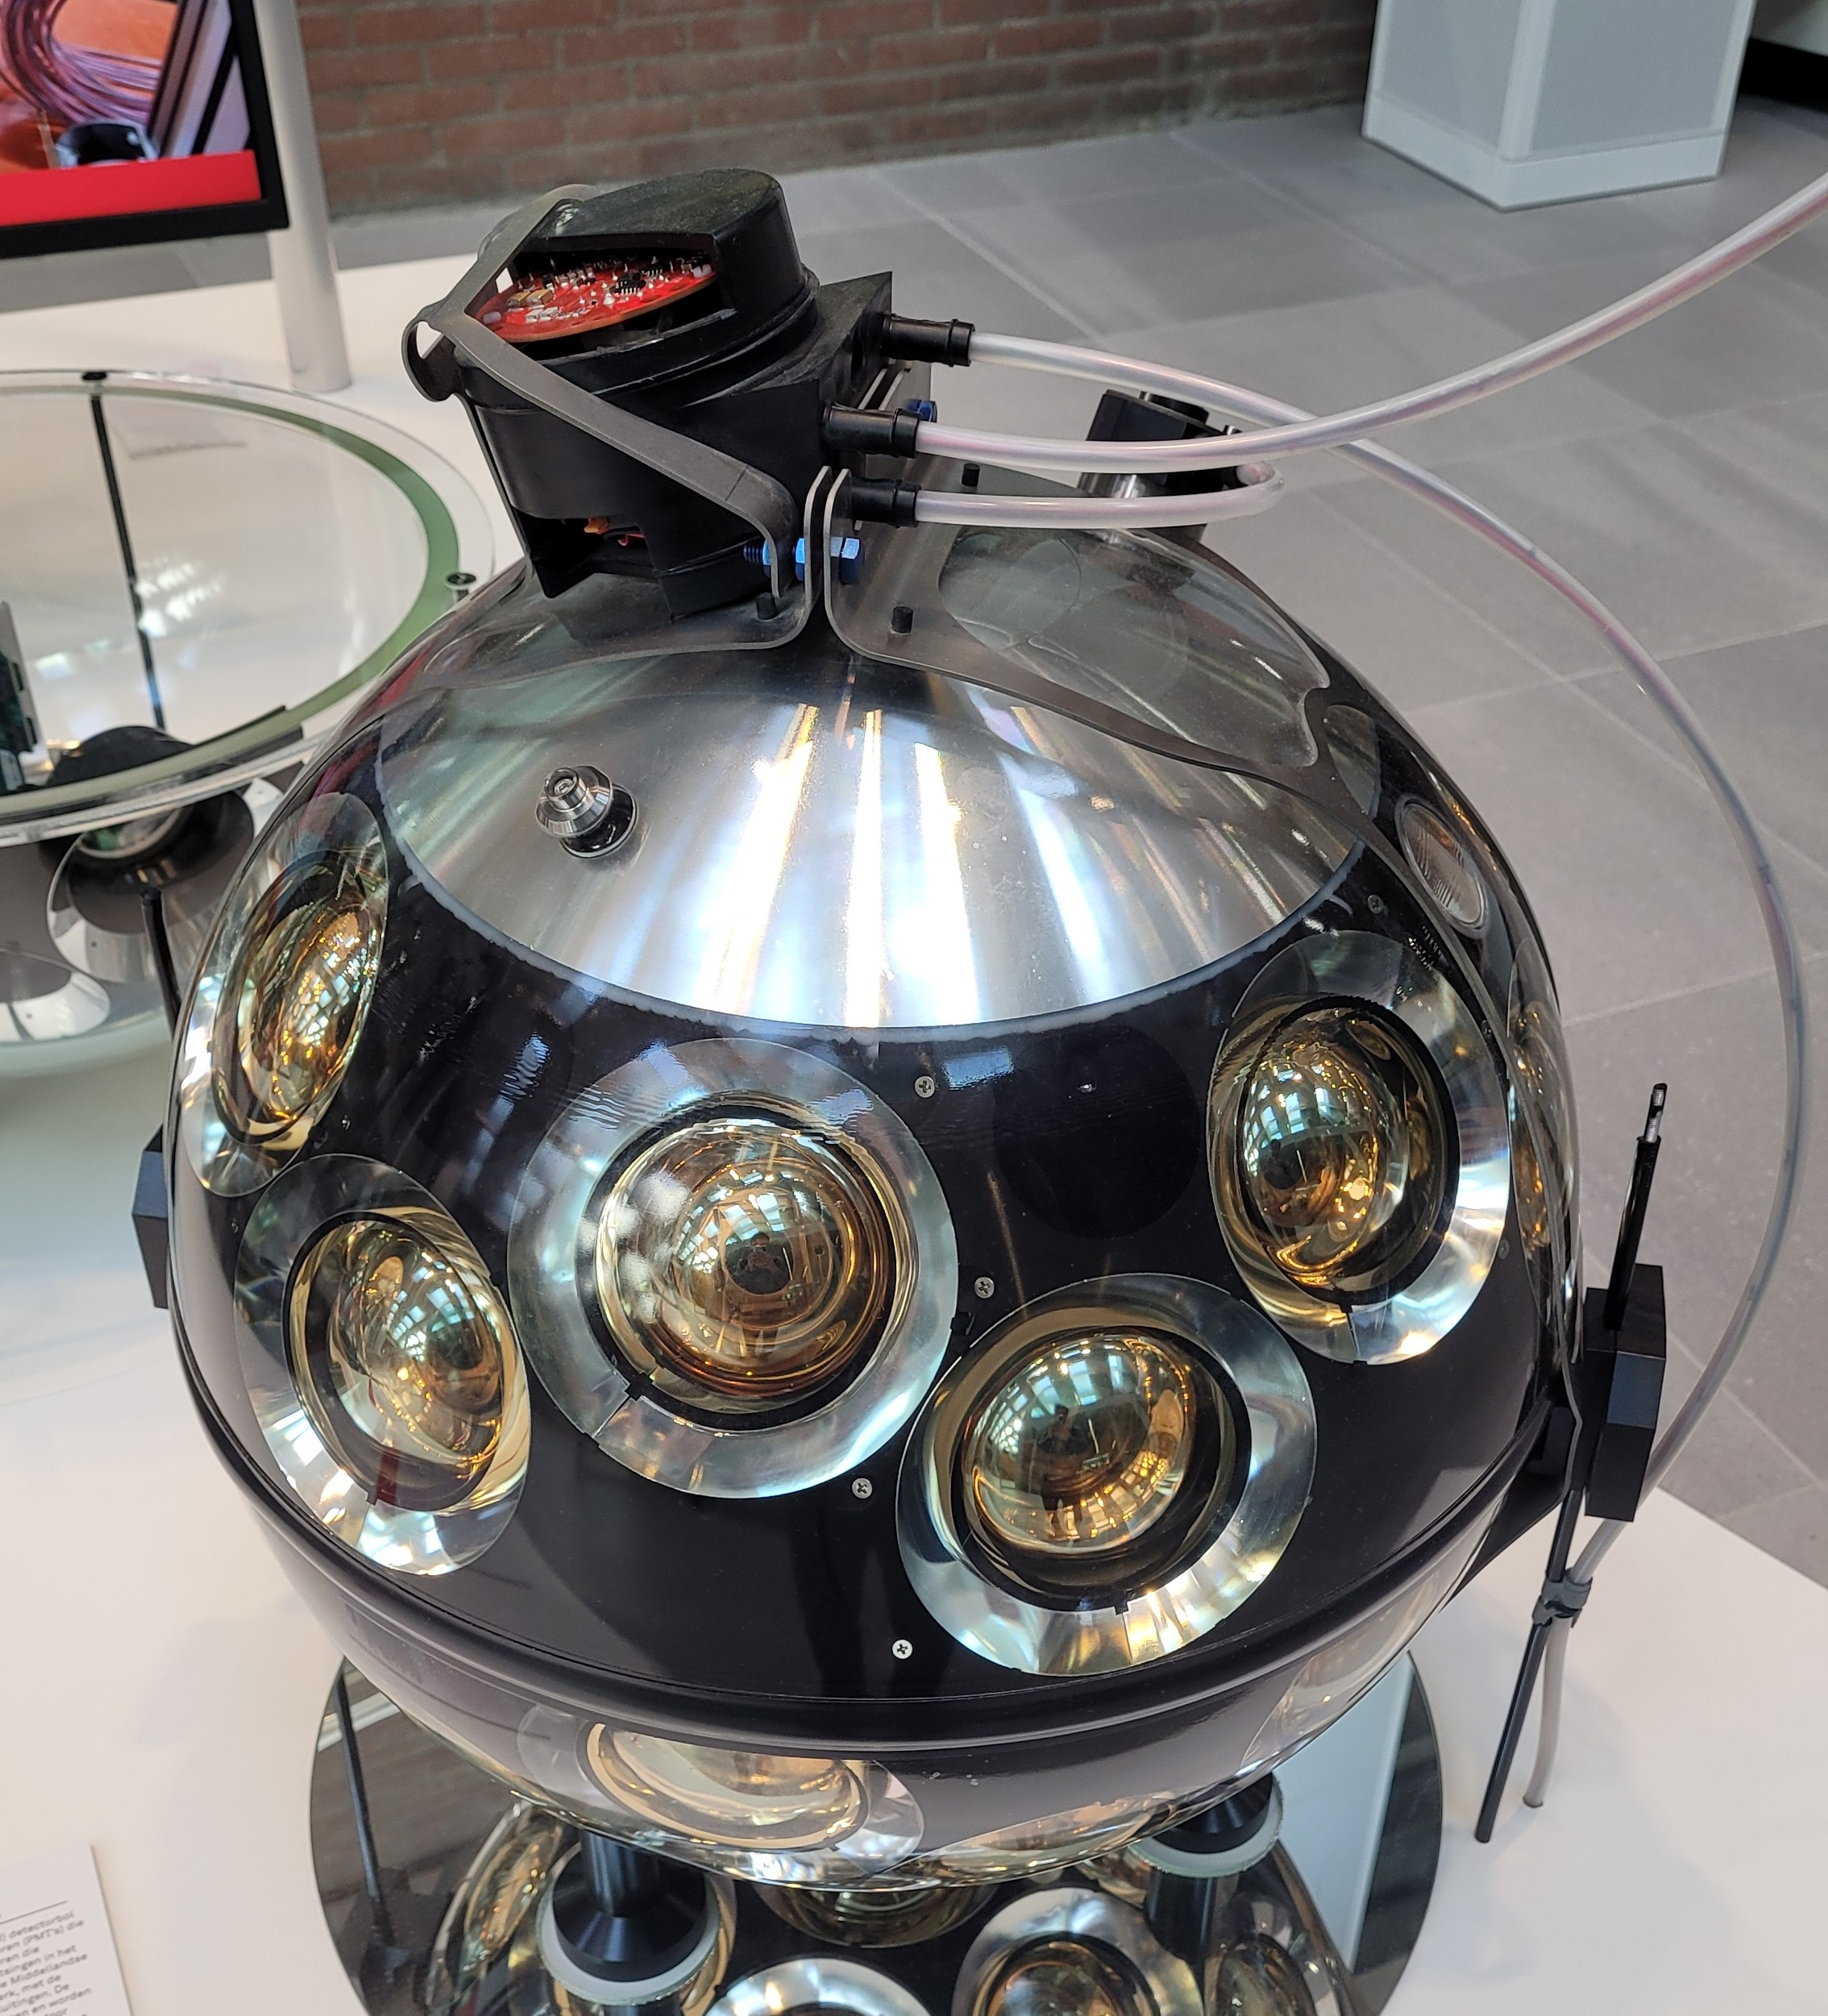
Cooling
Cooling is a major concern
Withstand corrosion = bad heat conductor
Top of DOM has aluminium just under the glass
Connected to all internal components
Passive cooling
Restrict temperature rises to 12°C above sea water ambient
Aluminium
Picture credit Nathan Slingerland

Slide 13
Background
Atmospheric muons and neutrinos
Bioluminescence
Radioactive decays in seawater:
⁴⁰K beta decay product $e^{−}$:
Cherenkov light
Electromagnetic shower
Daylight does not penetrate below 1km
Background

Slide 14
Calibration
Strings stretch over time and sway in sea current
Required Information | Calibration System
Timing | DOM LED beacon
DOM position | Acoustic system
DOM orientation | DOM Compass
Absolute detector orientation | Sun and moon cosmic ray shadow
Acoustic system: emitters on seabed, receivers in DOMs
Measure time delay
Compass: magnetometer and accelerometer in each DOM
Position and orientation continually updated

Slide 15
Tilt amplitude for each detection unit
Square of the measured sea current velocity
Position and orientation measurements match sea current well

Slide 16
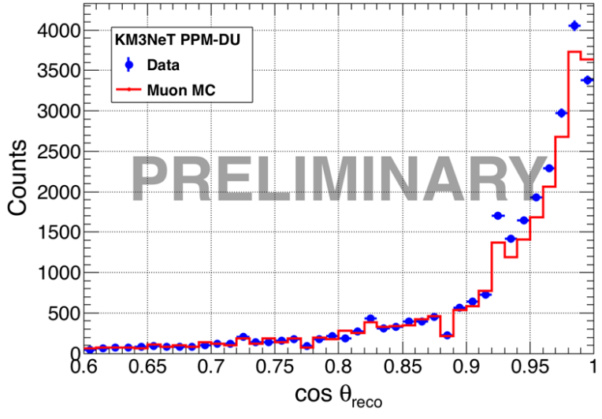
Performance
Performance depends on:
Muon reconstruction precision and accuracy:
Direction and energy
Data acquisition and processing rates

Slide 17
Summary and Outlook
ARCA currently under construction
33/230 detection units installed
Measures high-energy neutrinos via Cherenkov radiation
Using PMTs in DOMs
ARCA

Slide 18
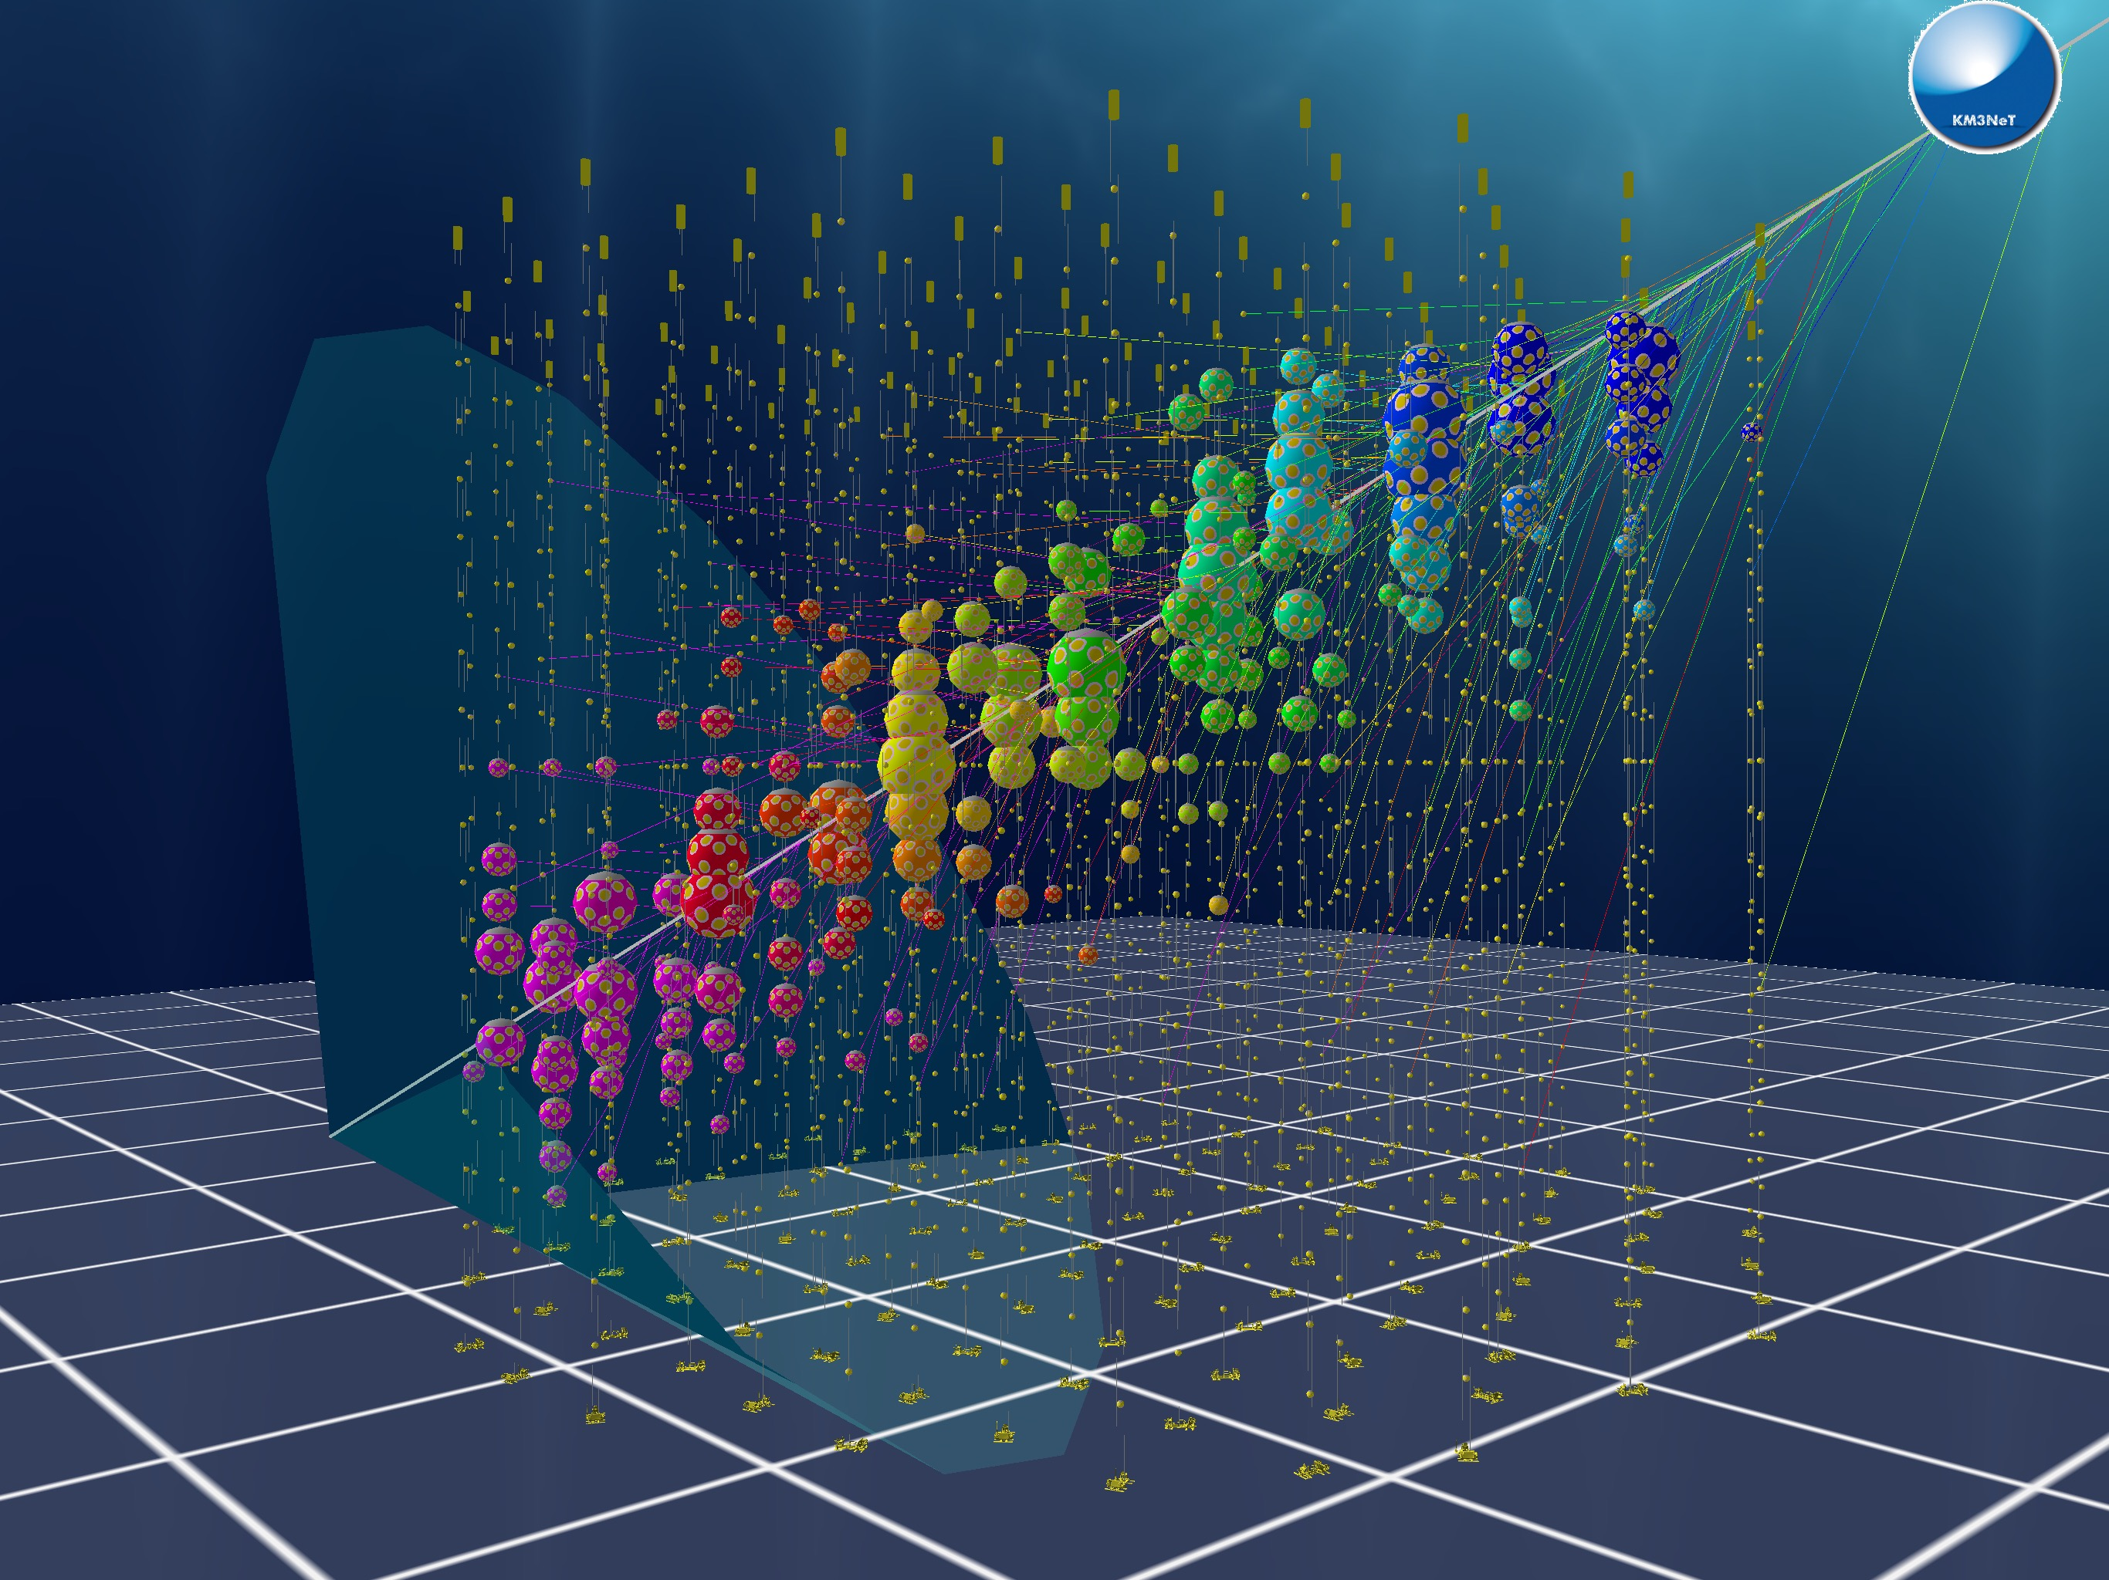
DOM
Cherenkov cone
An image of a simulated event
Time

Slide 19
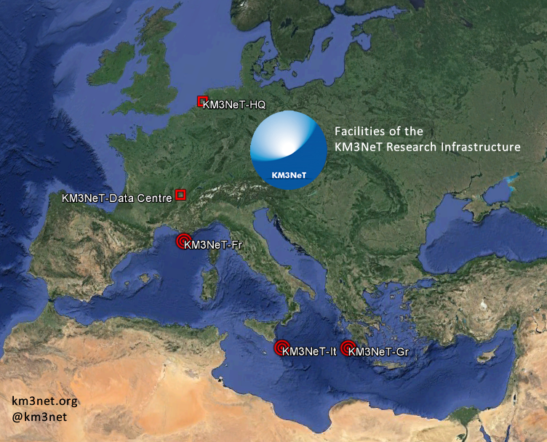
ORCA
KM3NeT-Gr used for validation and qualification. Site for possible future expansion
ARCA

Slide 20
References
S. Adrián-Martínez et al. (KM3NeT Collaboration), Letter of intent for KM3NeT 2.0. Journal of Physics G: Nuclear and Particle Physics, 43(8), 2016. https://arxiv.org/pdf/1601.07459
KM3NeT Consortium. Conceptual design for a deep-sea research infrastructure incorporating a very large volume neutrino telescope in the Mediterranean Sea. 2008. https://www.km3net.org/wp-content/uploads/2015/07/CDR-KM3NeT.pdf
S. Aiello, et al. (KM3NeT Collaboration), Characterisation of the Hamamatsu photomultipliers for the KM3NeT Neutrino Telescope, Journal of Instrumentation 13 (2018) 05035 https://iopscience.iop.org/article/10.1088/1748-0221/13/05/P05035/pdf
KM3NeT Collaboration. KM3NeT Website (2025) ww.km3net.org
S. Aiello et al. (KM3NeT Collaboration), Astronomy potential of KM3NeT/ARCA. The European Physical Journal C 84(9), 2024. https://arxiv.org/pdf/2402.08363v2
S. Aiello et al. (KM3NeT Collaboration), The KM3NeT multi-PMT digital optical module. J. Inst., 17, 2022 https://arxiv.org/pdf/2203.10048
F. Bretaudeau, C.G. Oliver, M. de Jong and L. Martin, Dynamical position and orientation calibration of the KM3NeT telescope. 38th International Cosmic Ray Conference. 202.3 https://pos.sissa.it/444/1033/pdf
S. Aiello et al. (KM3NeT Collaboration), Determining the Neutrino Mass Ordering and Oscillation Parameters with KM3NeT/ORCA. The European Physical Journal C, 82(1), 2022. https://arxiv.org/pdf/2103.09885
KM3NeT Collaboration. KM3NeT Strategy Report 2015-05-06. 2015 https://www.km3net.org/wp-content/uploads/2015/07/KM3NeT-Strategy-Report-2015-05-06.pdf
Biagi, Simone. "Performances and main results of the KM3NeT prototypes." PoS (ICRC2015) 1164 (2015). https://s3.cern.ch/inspire-prod-files-4/4f7e5a27997afde95919f4d60fee02bf
Particle detection course material (canvas page) https://canvas.uva.nl/courses/49795
Maarten de Jong
Images courtesy of KM3Net unless otherwise stated

Slide 21
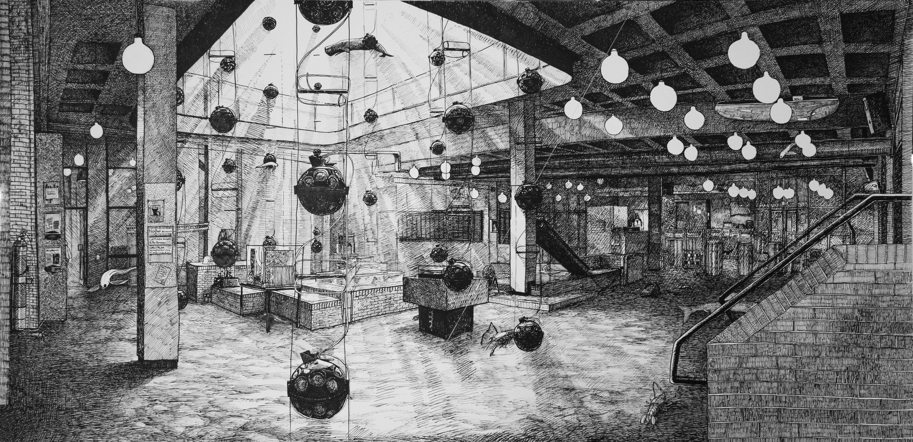
Questions?
Art by Floris Tilanus

Slide 22
Backup Slides
All the cool stuff I couldn’t squeeze in

Slide 23
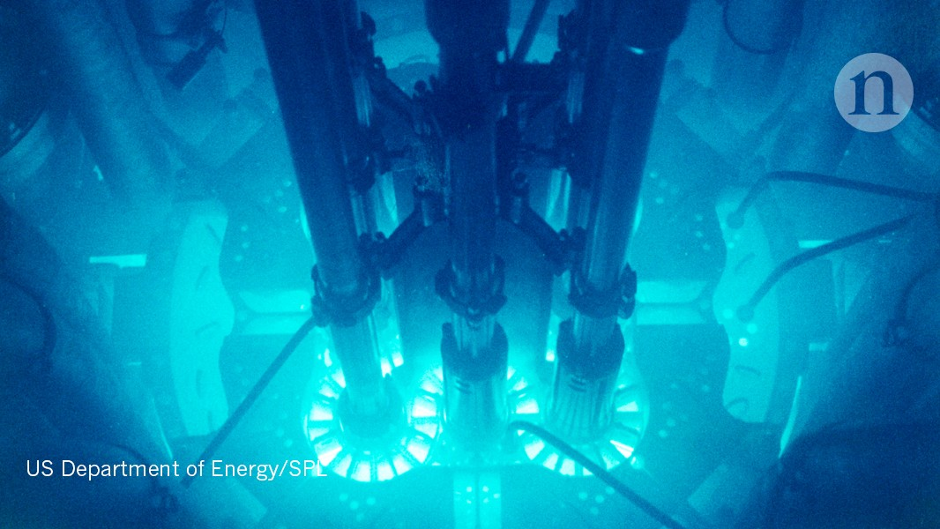
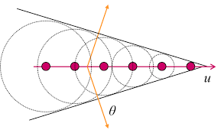
Cherenkov Radiation Recap
Sonic boom but for light
The angle is known: $cosθ=\frac{1}{nβ}$, where $n$ is index of refraction of seawater and depends on temperature and salt content
Produces photons with a wavelength around 440nm, they have an absorption length of 70m in the sea.
The energy of a muon as it passes through the detector can be estimated from the measured intensity of the Cherenkov light
Background from US Department of Energy/SPL
Diagram from Standford University

Slide 24
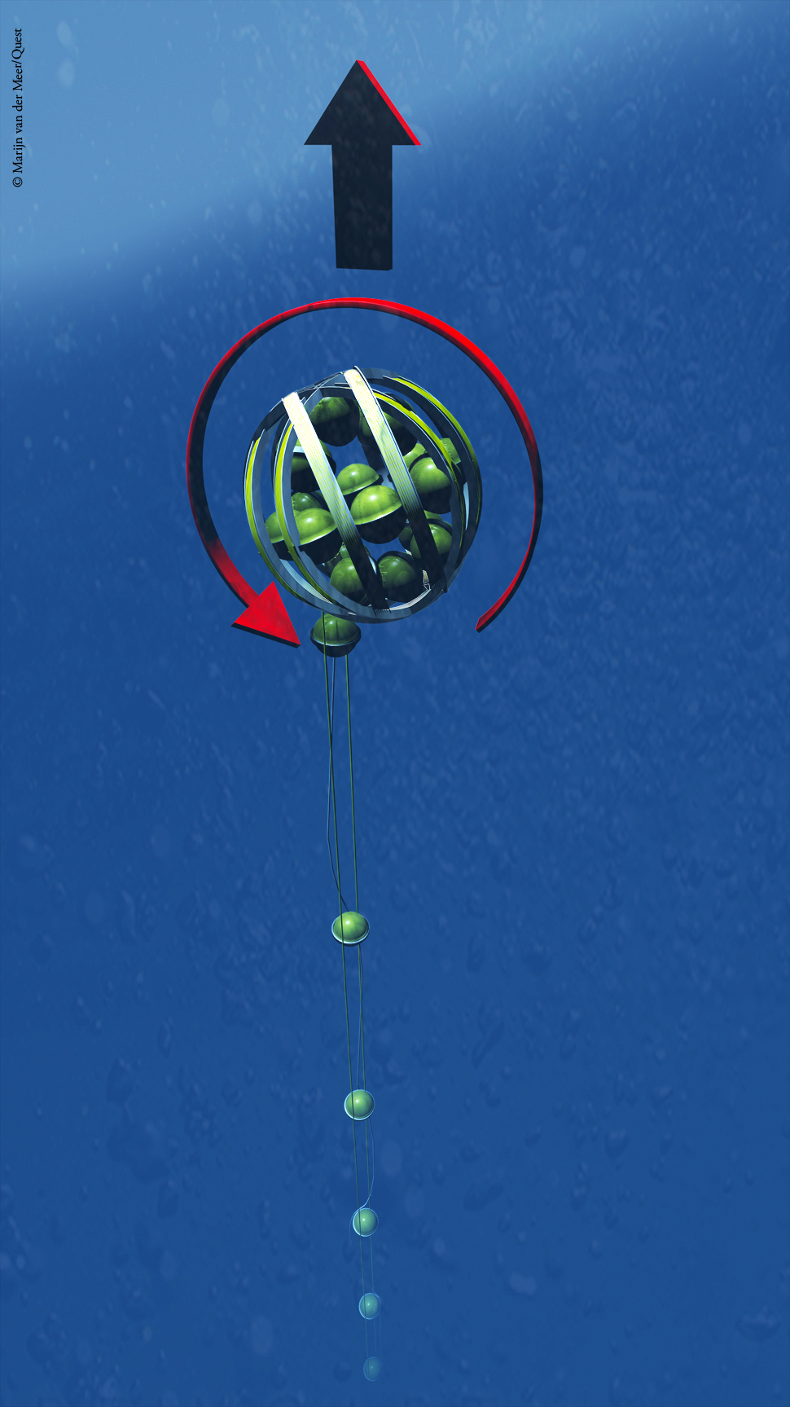
Installation
Each DU is coiled up in the “launcher vehicle” and brought to the sea floor
Once anchored, the system is released and the ball floats upwards uncoiling the string as it goes
A remotely operated vehicle is used to deploy and connect the interlink cables from the base of the DU to the junction box
Undersea cables connect the junction box to the shore station for power and data communication
Image copyright Marijn van der Meer/Quest

Slide 25
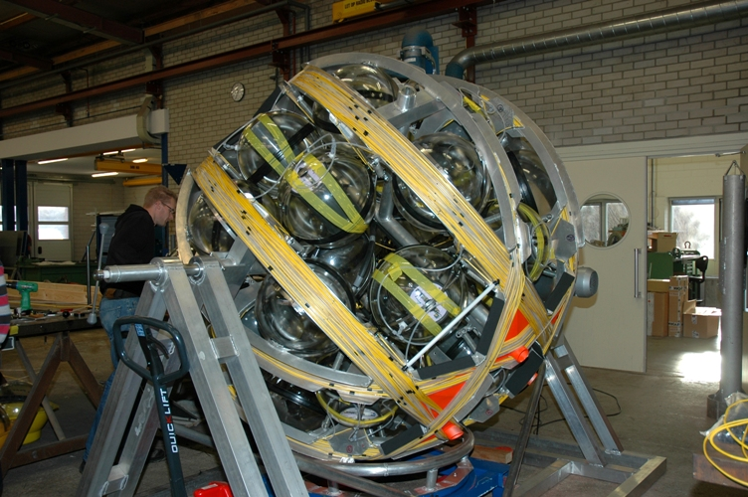
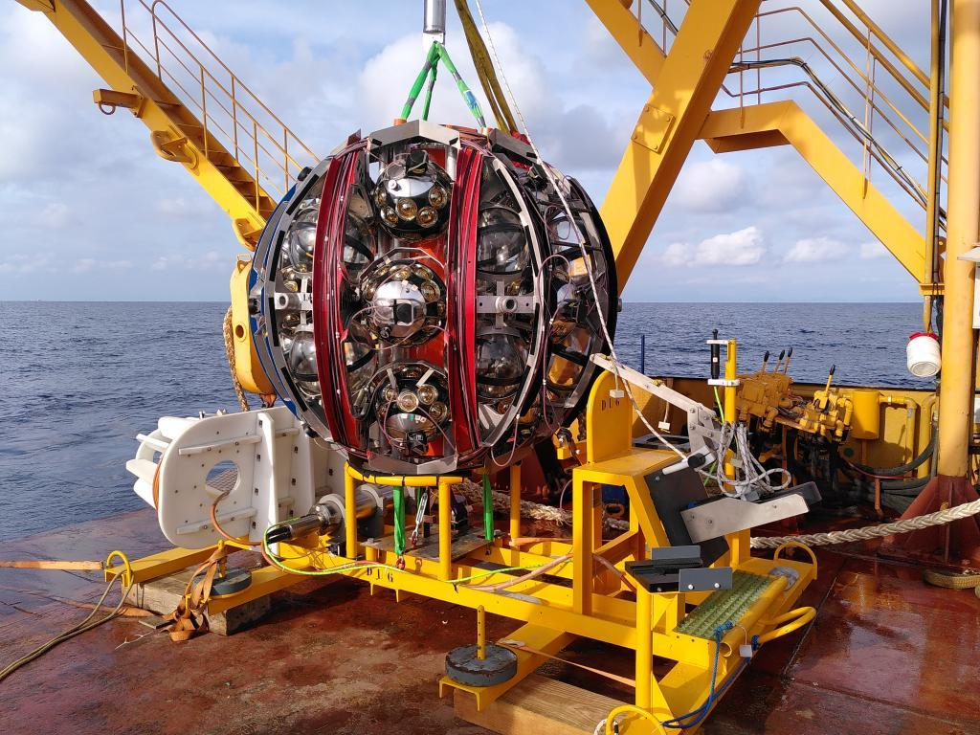

Slide 26
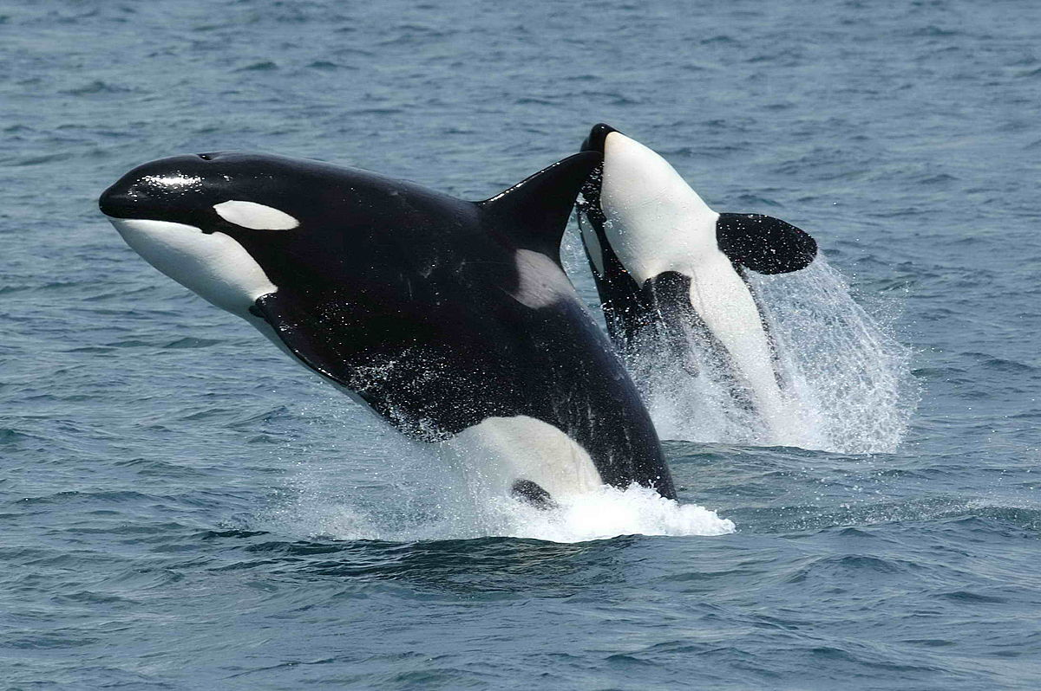
The ORCA Detector
Oscillation Research with Cosmics in the Abyss - dedicated to low energy atmospheric neutrinos
Detector array dense – 9m vertical and 20m horizontal spacing
2500m depth
Investigates neutrino oscillations through the flux of different neutrino flavours
Image from Wikipedia

Slide 27
Detector Blocks
A collection of 115 detector units forms a single KM3NeT building block

Slide 28
Neutrino Interactions – Shower Events
$ν_{x}+N→x+X$ ($W^{±}$ and $Z^{0}$ interactions)
Produces hadronic shower (and electromagnetic if $x=e$)
Reaction must occur inside detector array
Signature is a very dense localised hit pattern
Important for neutrino flavour studies

Slide 29
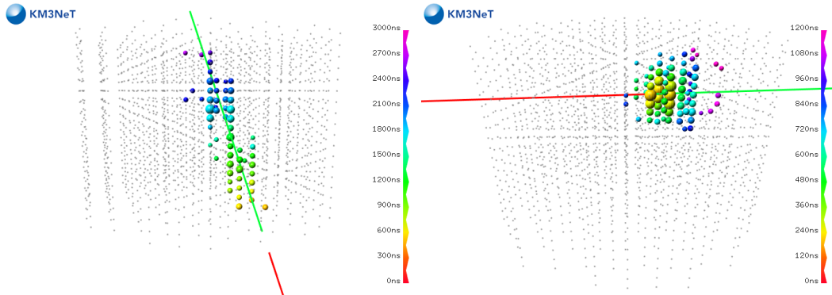
Track-like event:
Accurate direction
Cascade-like event: Accurate energy

Slide 30
Operational Conditions
The electro-optical cable:
Pressure balanced
Sends power and clock signal
Receives data
Each DOM consumes 7 W of power
Negative high voltage for PMT amplification
Insulating coating prevents electrical discharge between PMT and surroundings
Everything pressure and corrosion resistant

Slide 31
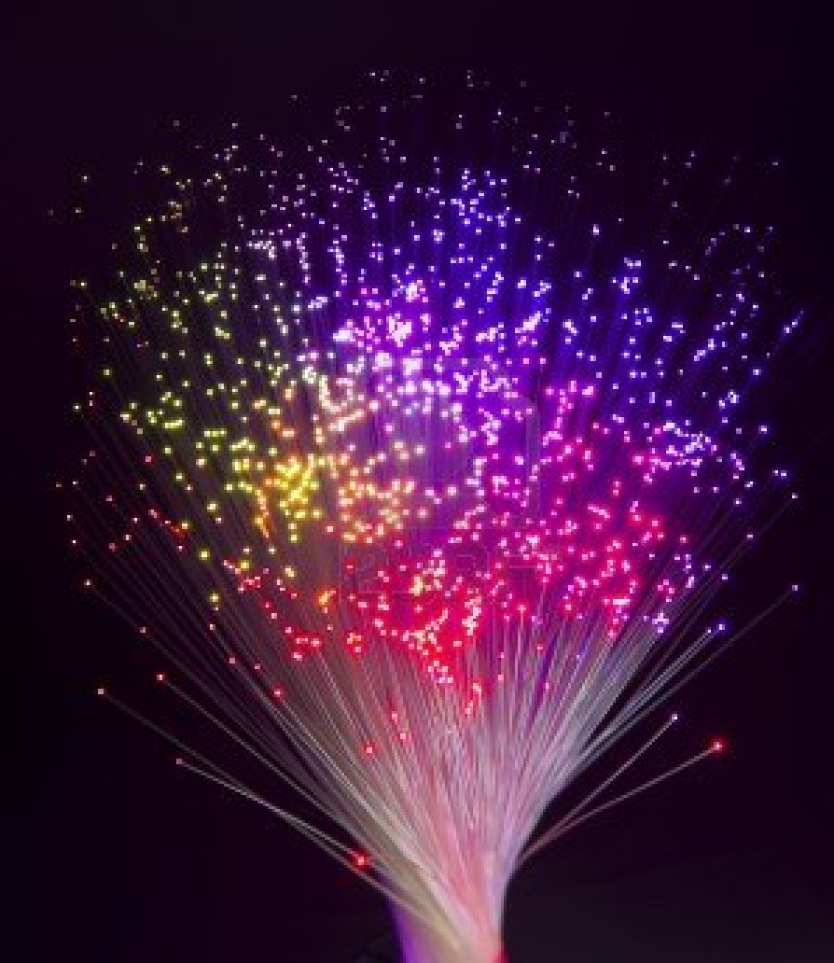
Readout and Data Processing
ADC at each PMT converts photon detection to a hit time and TOT
Each DOM in a DU has a dedicated wavelength for transfer via a single optical fibre for the whole DU
All data to shore
An event only considers limited PMTs due to:
Causality
Absorption length of photons
Improves signal to noise ratio

Slide 32
Background Filtering
Random backgrounds reduced by coincidence methods, causality, and absorption distance of photons in seawater (70m)
Software and algorithms filter out the background and perform muon reconstruction

Slide 33
Potential Problems
Large pressure difference:
1 bar inside DOM
250-300 bar outside
Corrosion
Recovering failed DUs is possible but expensive
Making Adjustments
Fibre-optic data transmission system: individual control for each DOM and PMT:
Set the HV of a PMT
Turn off/on a single PMT
Update software and firmware

Slide 34
Video
Representation of reconstructed downgoing muons in KM3NeT/ARCA6, from the KM3NeT YouTube:
https://youtu.be/ichBoVs3TZU?si=kAP4ec4UUXp_4aKC

