Slide 1
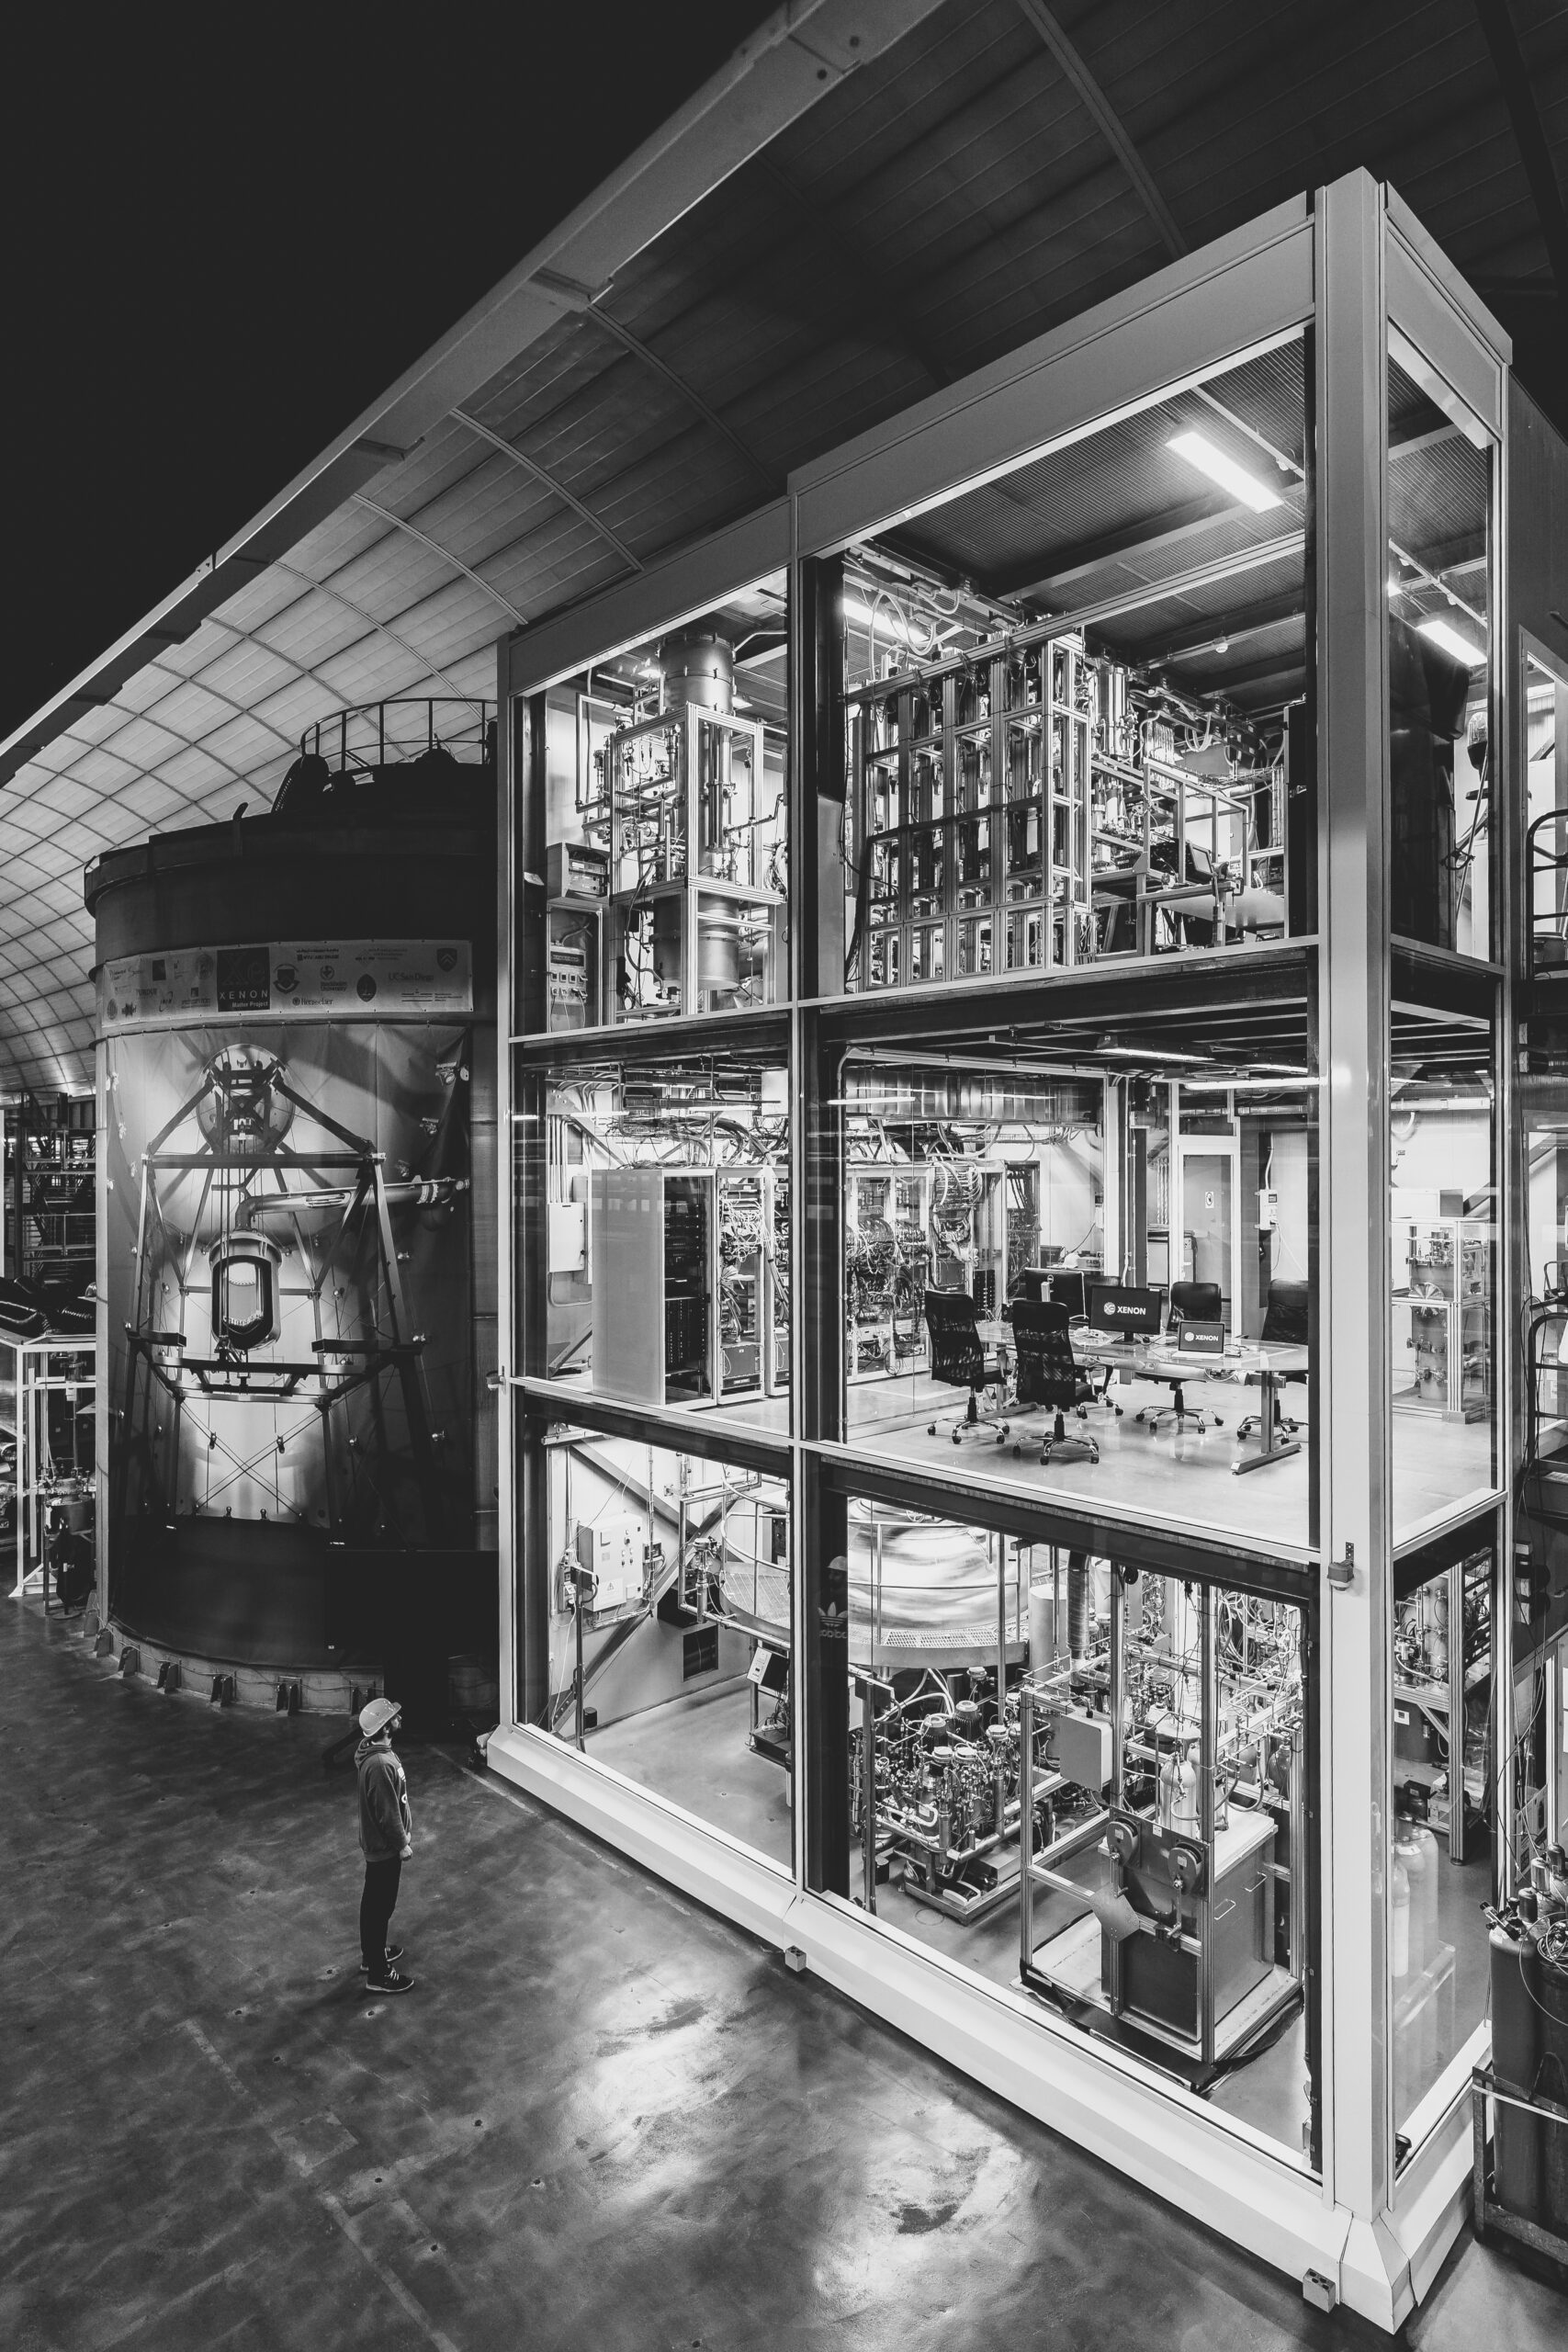
Particle Detection using the XENONnT Detector
Bart Sarlemijn March 2025
The XENON Experiment. Photo gallery. Available at:
https://xenonexperiment.org/photos/ (Accessed: 13 March 2025)

Slide 2
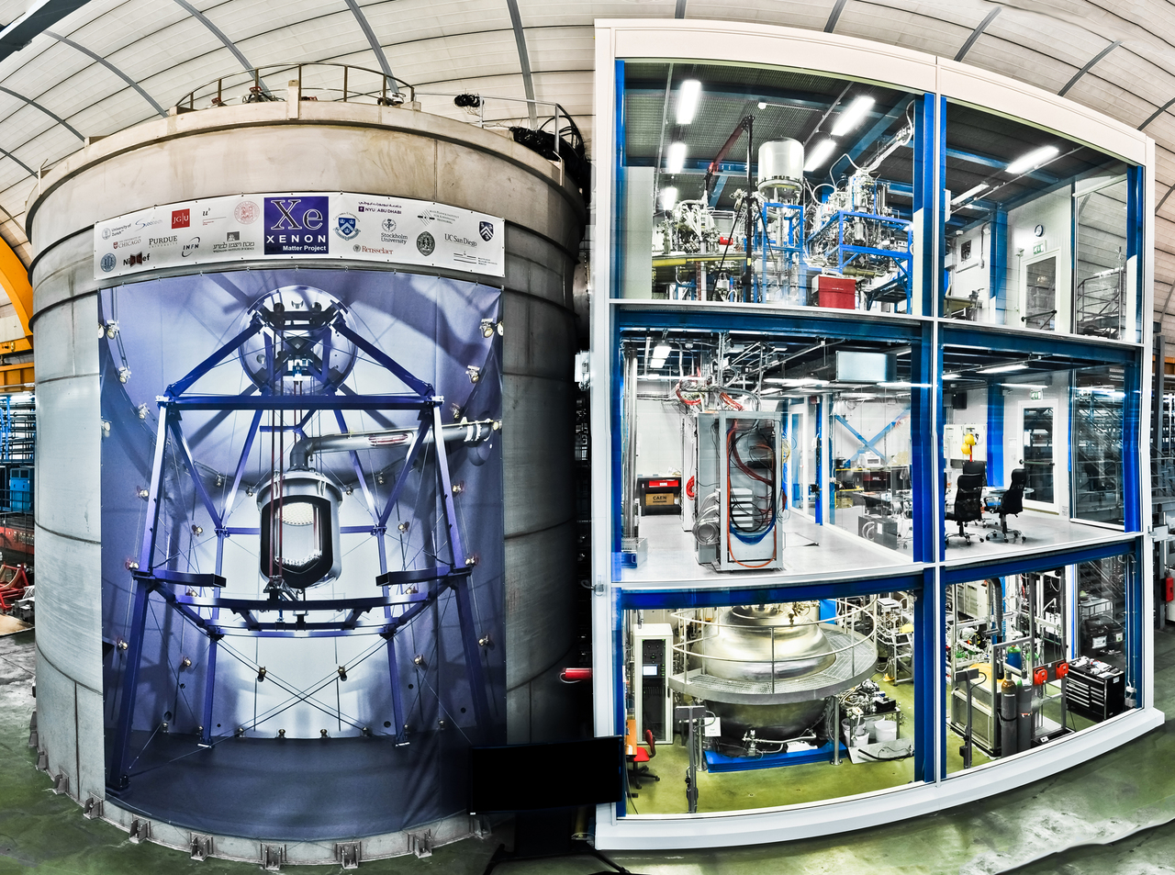
XENONnT
XENON Collaboration
LNGS in Gran Sasso Italy
1400m underground
29 institutes, 200 scientists
Detecting dark matter
Weakly interacting massive particles (WIMPs)
History
XENON10 15kg Xe (2006)
XENON100 160 kg Xe (2008)
XENON1T 3200 kg Xe (2015)
XENONnT 8600 kg Xe (2020)
The XENON Experiment. The XENONnT experiment underground at LNGS. Available at:
https://xenonexperiment.org/photos/ (Accessed: 13 March 2025)

Slide 3
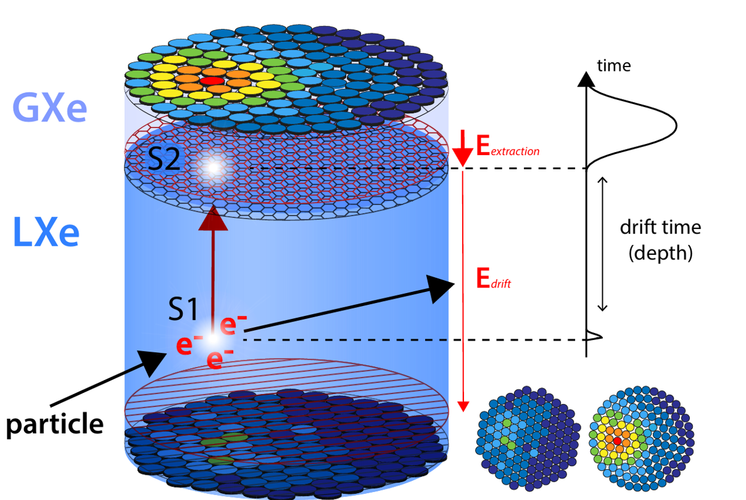
Dual-PhaseTime Projection Chamber
Liquid xenon (LXe) & gaseous xenon (Gxe)
Incoming particle
Excites LXe → emits light (S1)
Ionizes LXe → frees electrons
Electrons
Drift upwards
By electric drift field
To liquid gas interface
Accelerated in GXe
Stronger electric extraction field
Excites GXe → emits light (S2)
Althüser, L. (2017). Light collection efficiency simulations of the xenon1t experiment and comparison to data.

Slide 4
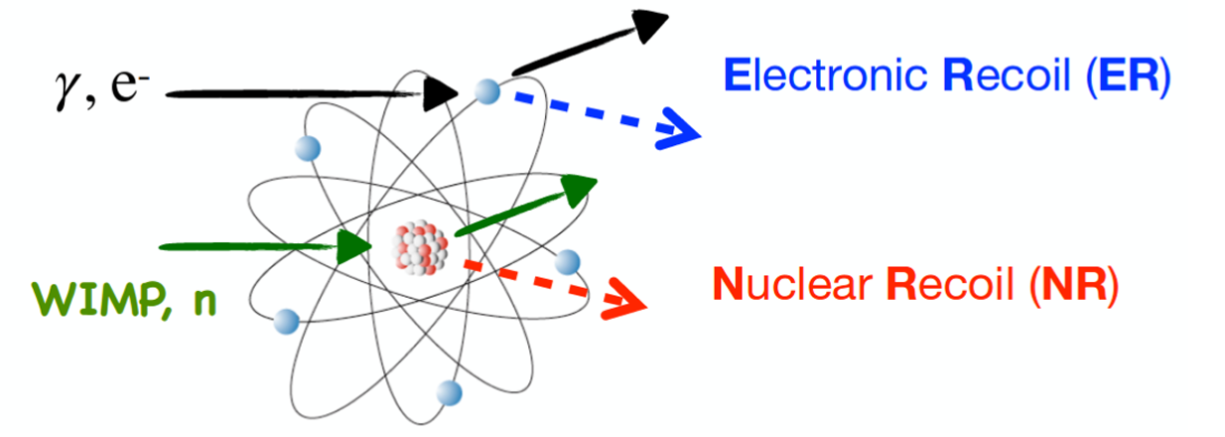
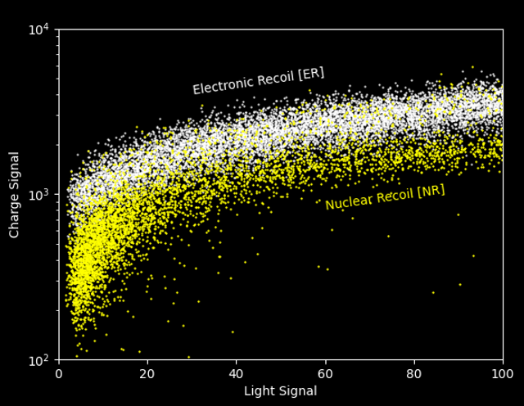
Particle Identification
Electronic recoil (ER)
Scatter of Xe electronic shell
Background
Gamma & Beta
Nuclear recoil (NR)
Scatter of Xe nucleus
Heavier particles
WIMPs
Muons & Neutrons
Baudis, L., et al. Dark Matter Detection with XENON [Conference poster]. University of Zurich.
The XENON Experiment. Time projection chamber. Available at:
https://xenonexperiment.org/time-projection-chamber/ (Accessed: 13 March 2025)

Slide 5
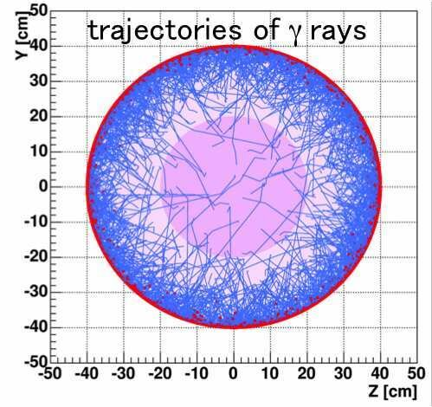
Xenon
Properties:
Excellent scintillator:
Emits UV light($\text{λ}$ = 175nm)
Transparent to its own scintillation
High atomic number (A=131) → enhances WIMP detection ($σ∝A^{2}$)
High charge (Z=54) → stops low-energy gamma rays → Self-shielding
Dense (3 g/cm³ ), low boiling point (178K at 2 bar), which allows for the construction of a compact detector
Moriyama, S. (2016) ‘Direct dark matter searches with XMASS’, Proceedings of the 11th International Workshop Dark Side of the Universe 2015.

Slide 6
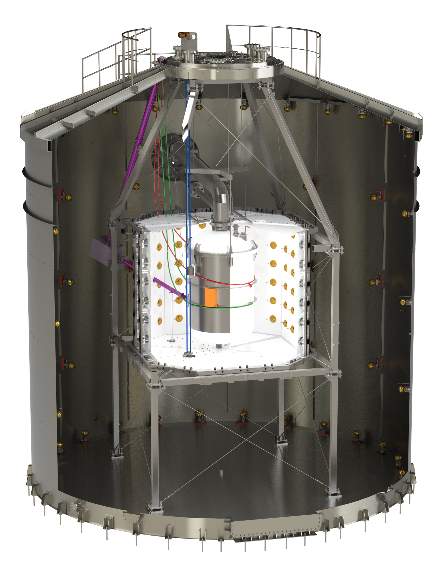
The detector
Outer layers
Muon Veto
Pure water
Tags cosmic-ray muons
Water Cherenkov Detectors
Why? NRs
Neutron Veto
Gadolinium-doped water
Capture neutrons → reduce material neutrons
Time projection chamber
Diameter 1.34m (d) x 1.48m (h)
494 photomultiplier tubes (PMTs)
Hamamatsu R11410-22 3-inch
The XENON Experiment. XENONnT infrastructure. Available at:
https://xenonexperiment.org/infrastructure/ (Accessed: 13 March 2025)

Slide 7
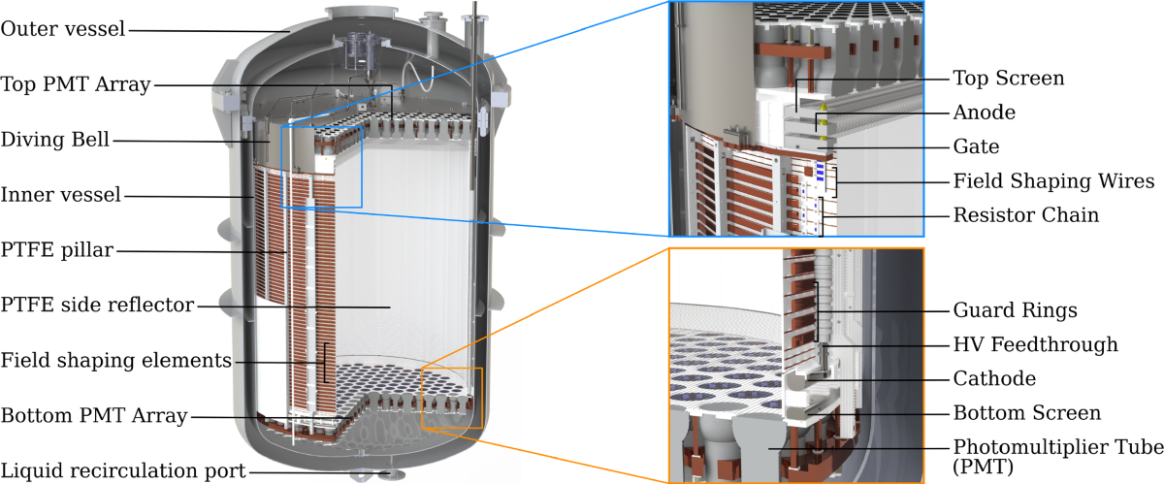
The detector
Aprile, E. et al. (2024). ‘The XENONnT dark matter experiment’, The European Physical Journal C, 84(8), p.784.

Slide 8
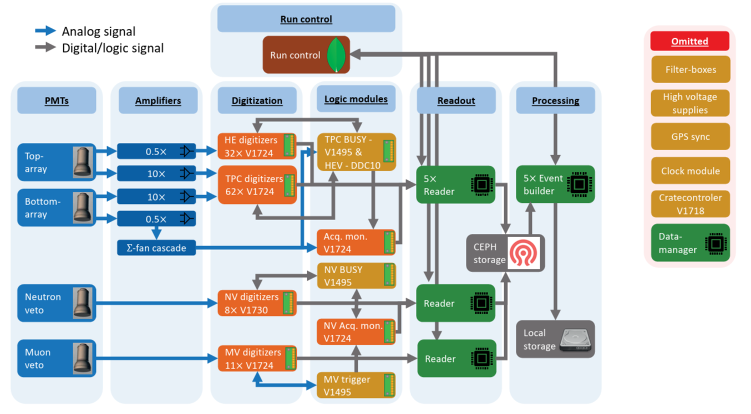
Data acquisition
Gaemers, P.W. (2024) Electronic recoils in XENONnT. PhD Thesis, University of Amsterdam.

Slide 9
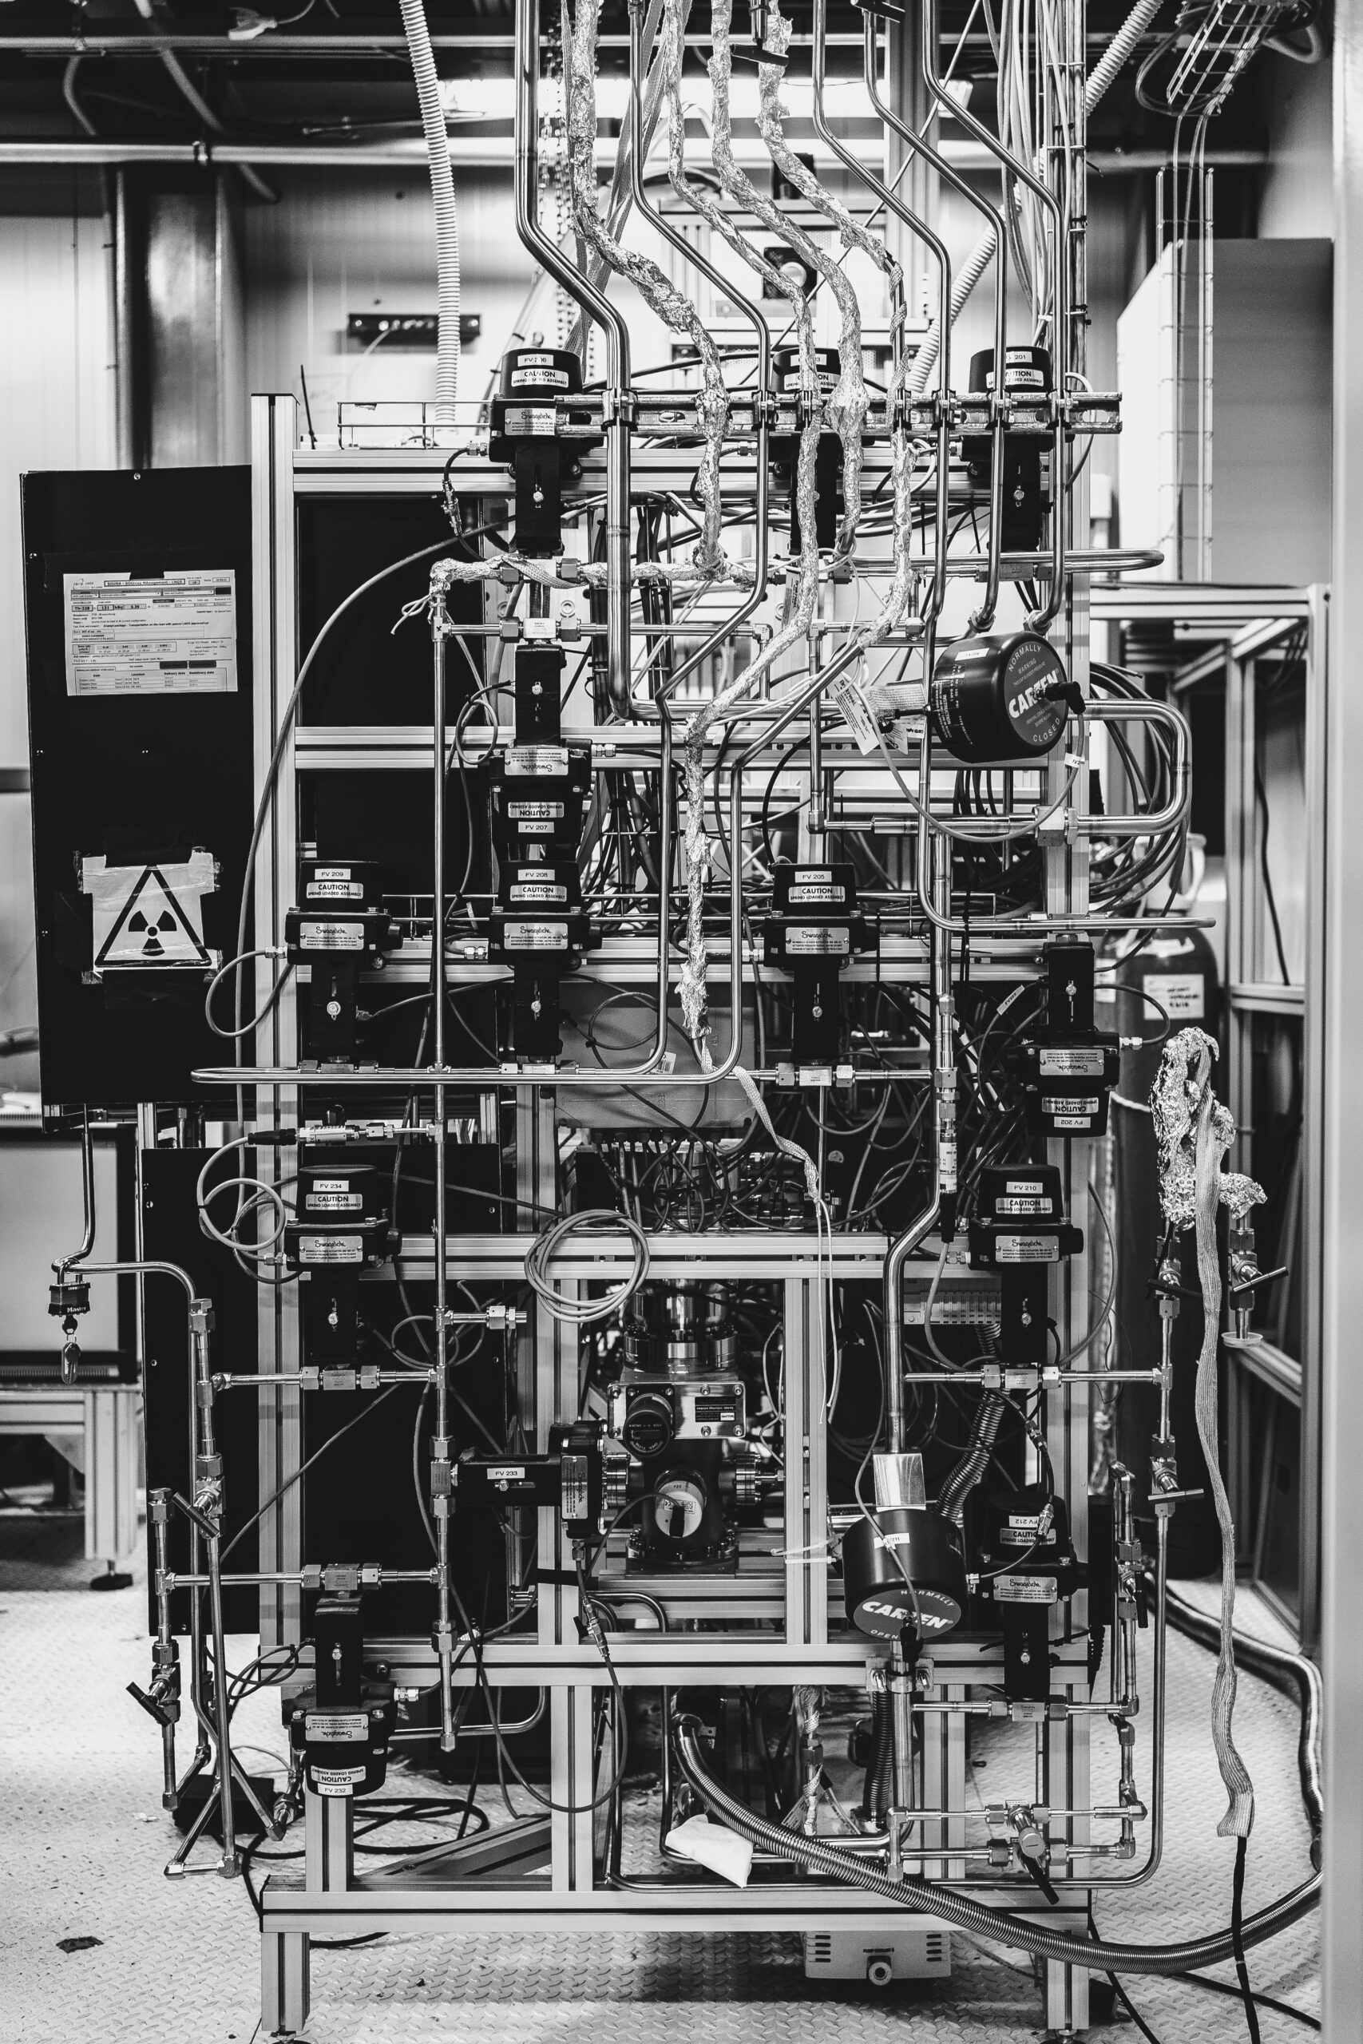
Challenges
Noise reduction
Deep underground
Detector housed in water
Nonradioactive detector materials
Cooling Xe
Essentially a bomb when cooling stops
Emergency cooling systems
LN₂ (Liquid Nitrogen)
Cleaning Xe
Remove impurities
Steady liquid gas interface
The XENON Experiment. Gaseous Purification System. Available at:
https://xenonexperiment.org/photos/ (Accessed: 13 March 2025)

Slide 10
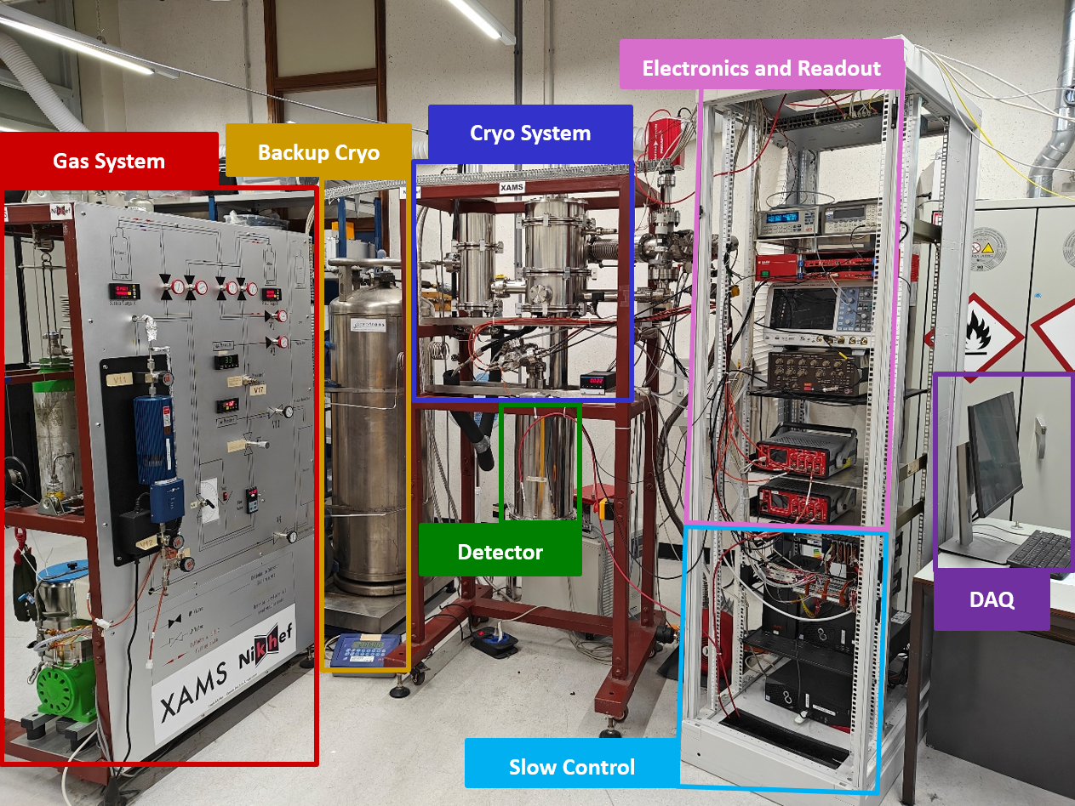
XAMS (Xenon Amsterdam)
At Nikhef
First lab left of the entrance
Dark matter group
R&D for future generation xenon detectors

Slide 12
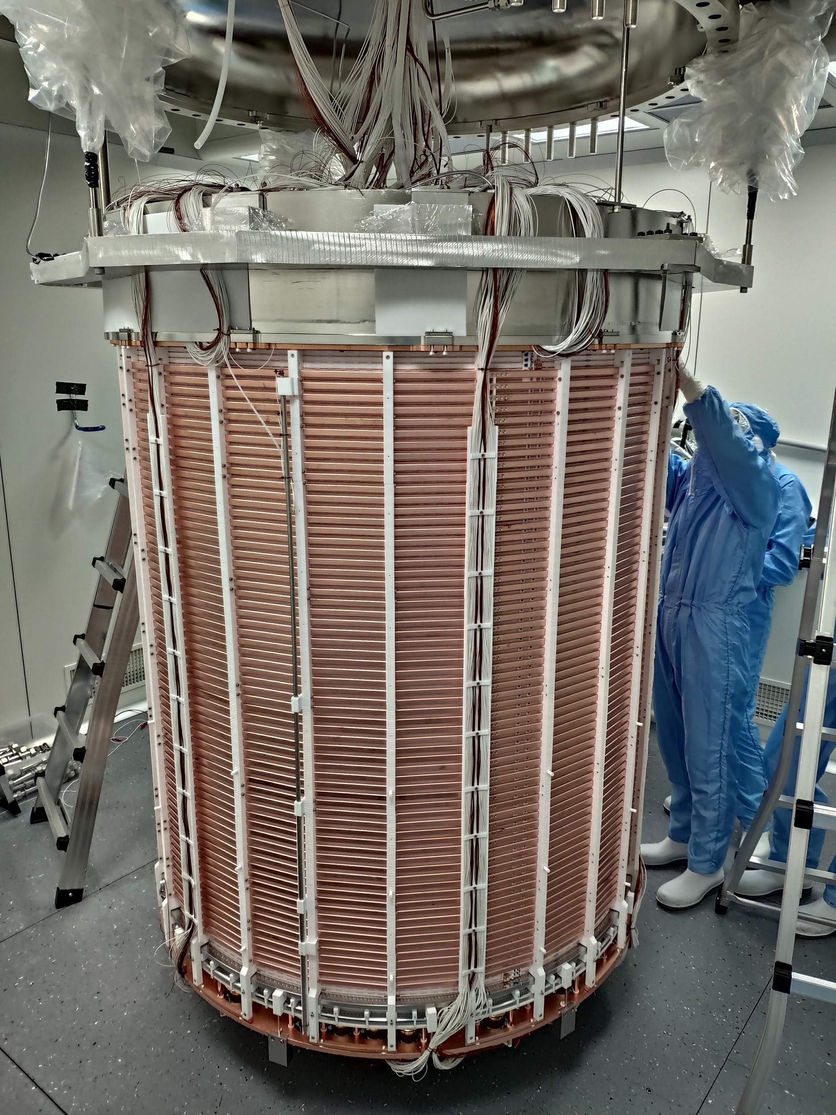
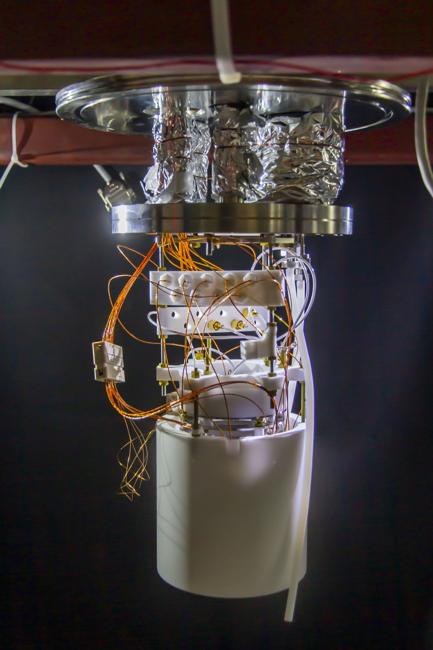
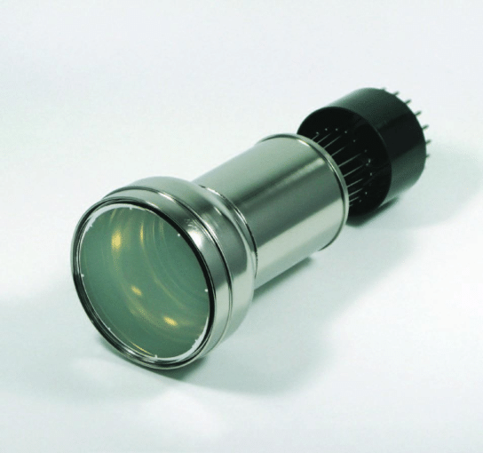
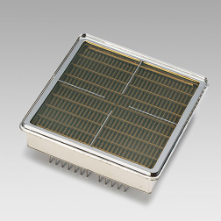
TPCs

Slide 13
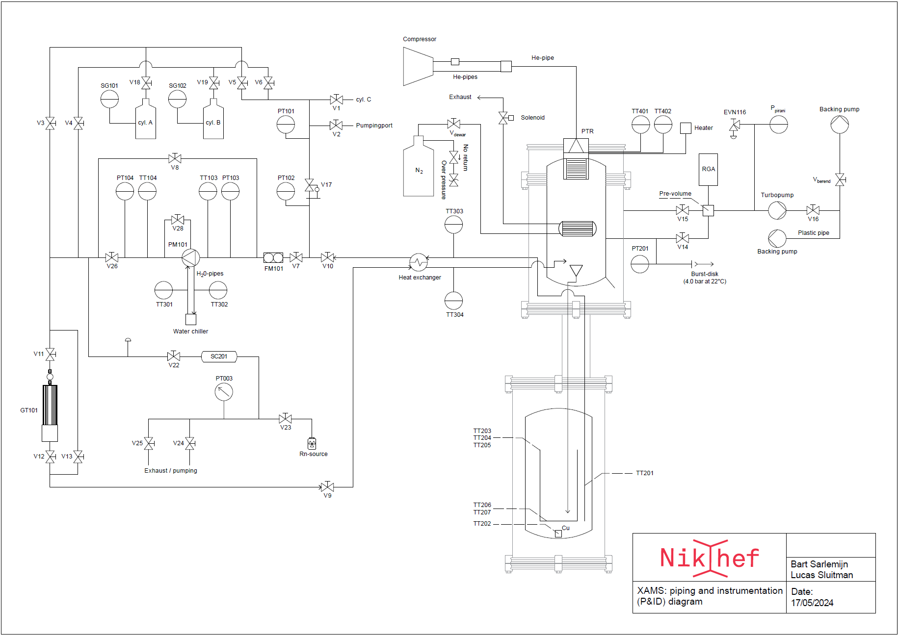
P&ID XAMS

