Slide 1
Looking for new physics at LHC: ForwArd Search ExpeRiement
Intro F.Xiao 1
Presented by: Feifei Xiao

Slide 2
Location & Goal F.Xiao 2
Location: 480m from the ATLAS Interaction point (IP)
Location of the FASER experiment [1]
Goal of the FASER:
Search for new light weakly-interacting long-lived particles (LLPs)
Study high-energy neutrino interactions (with sub-detector FASERν）

Slide 3
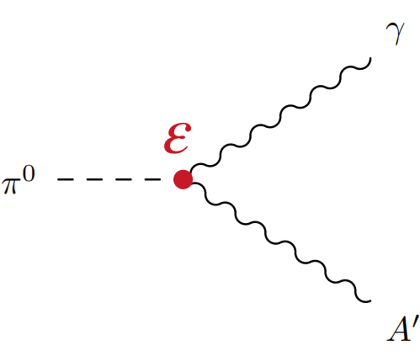
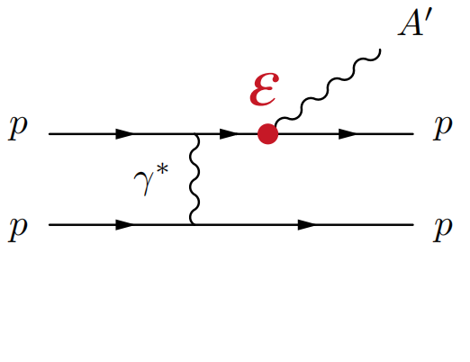
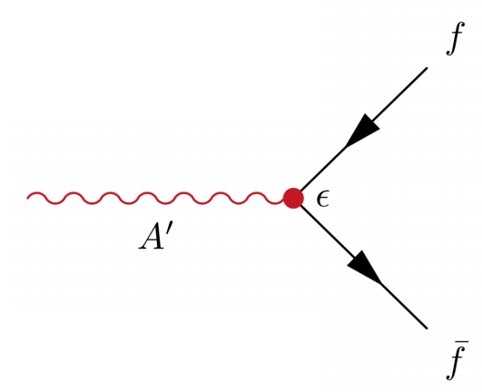
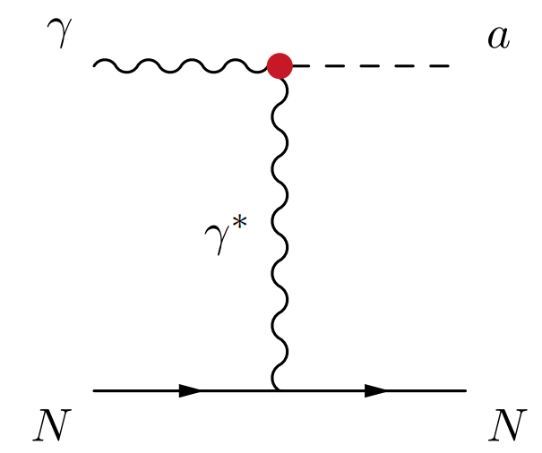
Theory (What to measure?) F.Xiao 3
What can LLPs be?
Dark Photons
Axion-like Particles (ALPs)
Dark higgs [2]
Heavy Neutral Leptons [2]

Slide 4
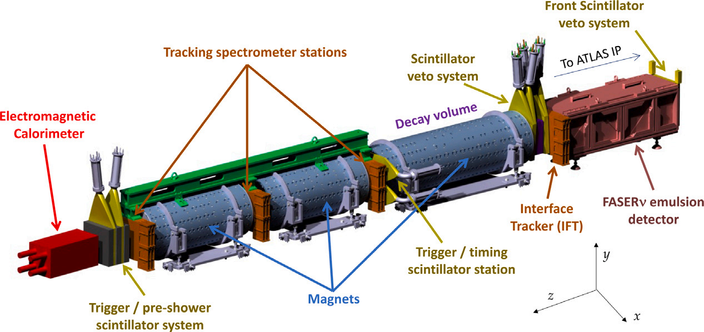
Detector Components & Advantages F.Xiao 4
Detector Components:
A Schematic view of the FASER detector [3]
Advantages:
Small: 7m · 1.1m (aperture: 20cm) [4] & Inexpensive
Low Background noise (1event cm⁻¹s⁻¹) & Minimal Radiation (4×10⁶ 1MeV ν cm⁻² yr⁻¹)

Slide 5
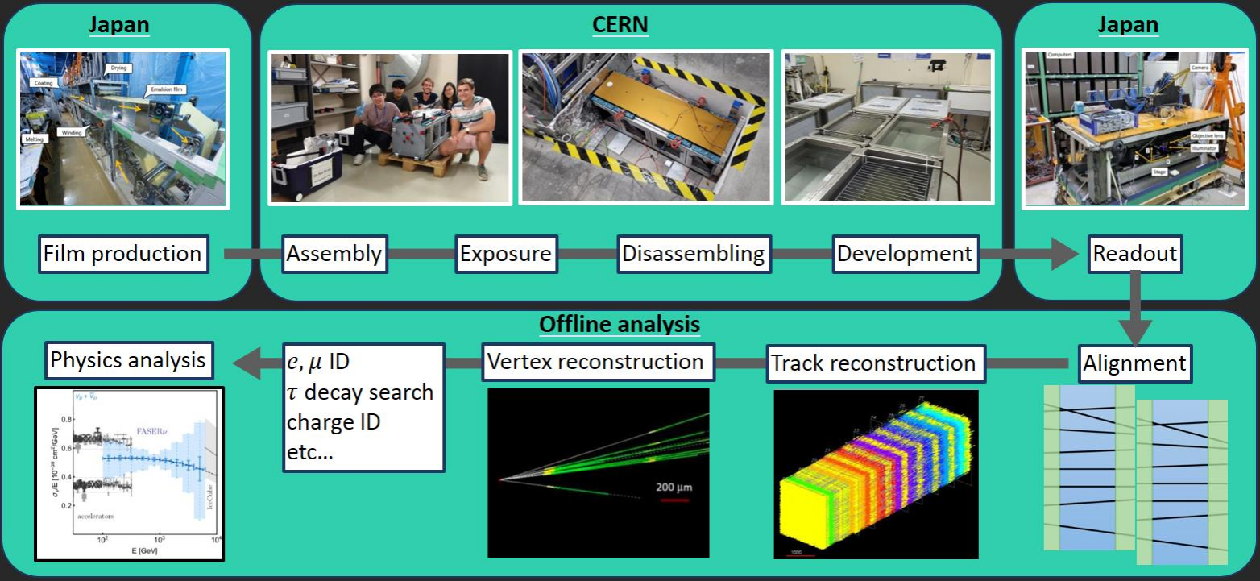
FASERν Emulsion Detector F.Xiao 5
FASERν Emulsion Detector:
730 layers (emulsion + tungsten)
1m long, 1.1 ton heavy
Exchange emulsions every 3 mo-
nths (keep track density < 30 fb⁻¹)
emulsion film tungsten plate (1.1m) [5]
What to Measure? Technology?
Analyze the trajectory inside the emulsion films
ν flavour tagging with topological information
Latent image formation (similar to film exposure)
Submicron spatial resolution (~0.4μm)
No timing resolution
Get event number of different neutrinos.
110fb⁻¹ data collected, compare data with
prediction.
FASERν processing and analysis chain [6]

Slide 6
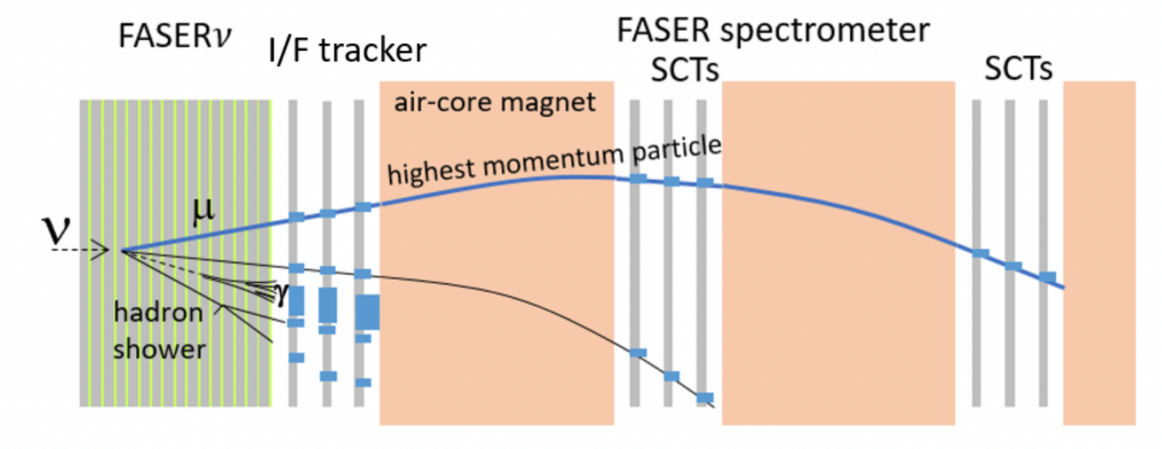
FASERν Detector F.Xiao 6
First direct observation of neutrino interaction at a particle collider experiment:
Schematic side view of the FASER detector with a muon neutrino undergoing a CC interaction in the emulsion-tungsten target [7]
Interface Silicon Tracker (IFT) [8]:
3-layer siliconstrip tracker
Match tracks between FASERν and spectrometer
ATLAS SCT barrel module (more details later)
Spectrometer & decay volume:
Magnetic field of 0.55T
Charge identification determine ν or anti-ν
More details later

Slide 7
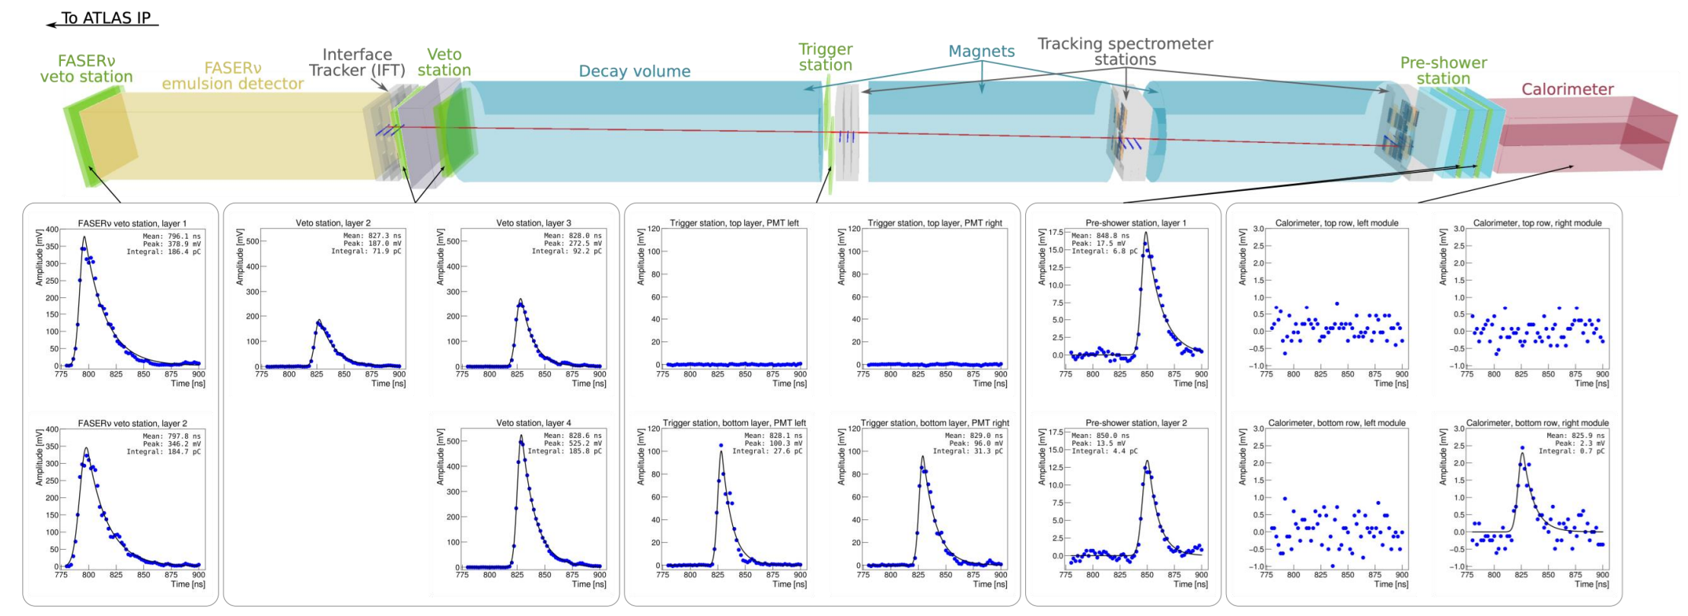
FASER Scintillators F.Xiao 7
Scintillators: charged particles scintillator photomultiplier tubes DAQ
A schematic view of scintillators [1]
CAEN digitiser [1]
μ event:
(background)
Example event: a muon background [9]

Slide 8
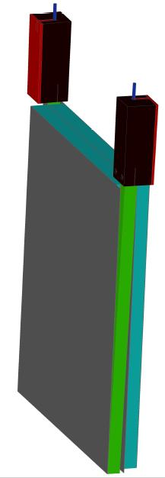
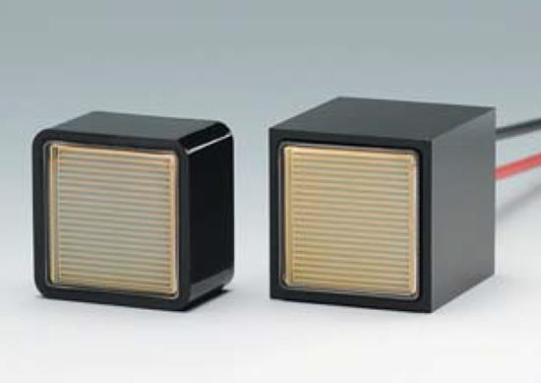
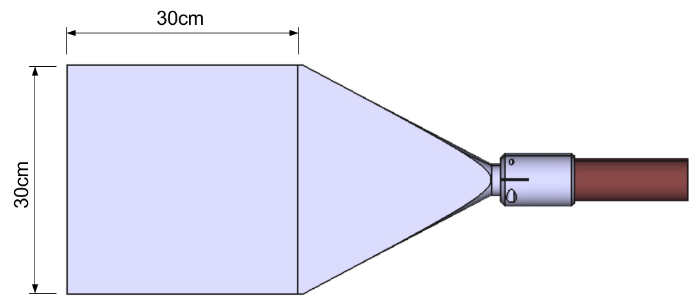
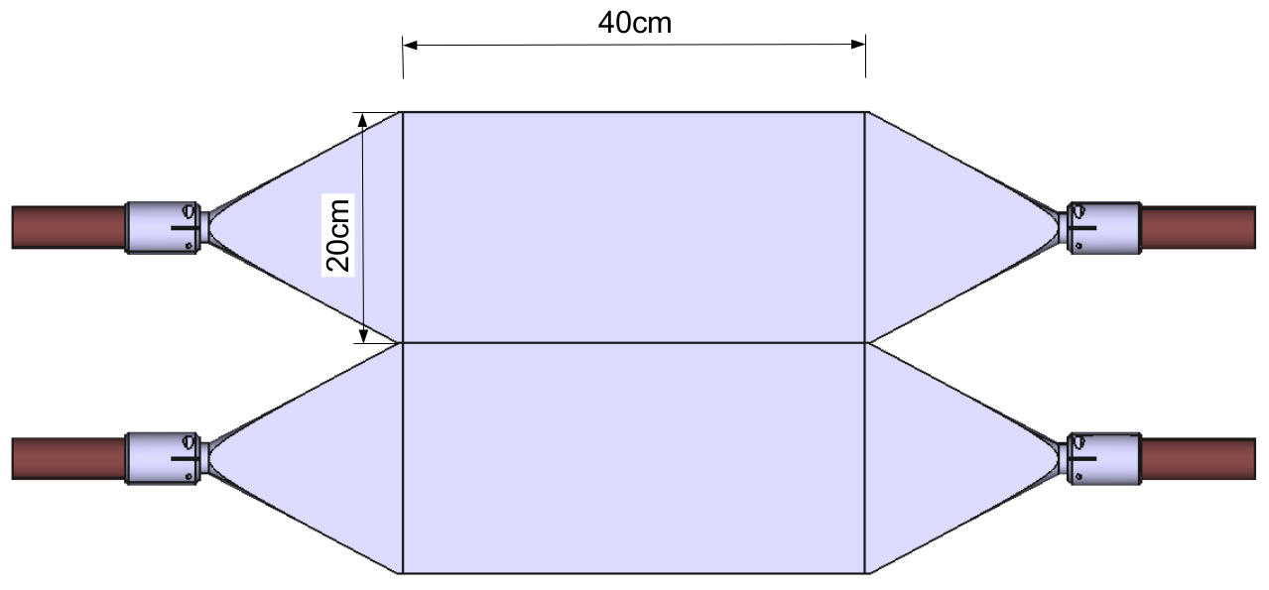
FASER Scientillators F.Xiao 8
Scintillators: charged particles scintillator photomultiplier tubes DAQ
PMT (H11934-300)
A schematic view of scintillators [1]
CAEN digitiser [1]
Veto Station component[10]
Veto station:
2 cm-thick, 30 cm × 30 cm plastic scintillators connected through light guides to PMTs
Detect charged particles and veto these events, target efficiency per layer > 99%
Veto & Preshower Station [11]
Timing station:
A single scintillator layer made from two 20 cm × 40 cm scintillator blocks with a thickness of 1cm.
Detect the presence of a charged particle pair from the decay of an LLP in the decay volume of the first dipole magnet
Timing resolusion < 1ns
Preshower station:
A thin layer of radiator (about 1 radiation length of tungsten and graphite)
Used in a coincidence with the first trigger station to reduce the rate of non-physics triggers
Timing Station [11]

Slide 9
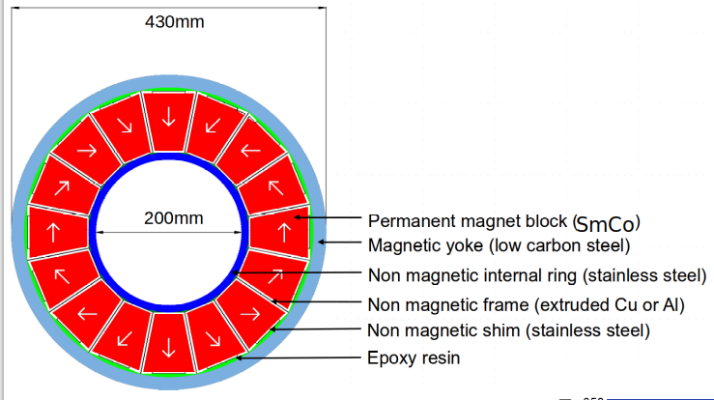
LLP trajectory & Decay Volume F.Xiao 9
If a dark photon comes through:
A schematic view of a dark photon coming through [12]
Magnets:
0.55 T permanent dipole magnets based on the Halbach array design with SmCo magnetic material
1 magnet of 1.5m (decay volume)
2 magnets of 1m (spectrometer)
Separate closely spaced charged particles
No need for power supply, cooling system
Additional μ-metal shielding is used, to minimize the potential impact of the stray field on PMTs
Sketch of the FASER magnet design [13]

Slide 10
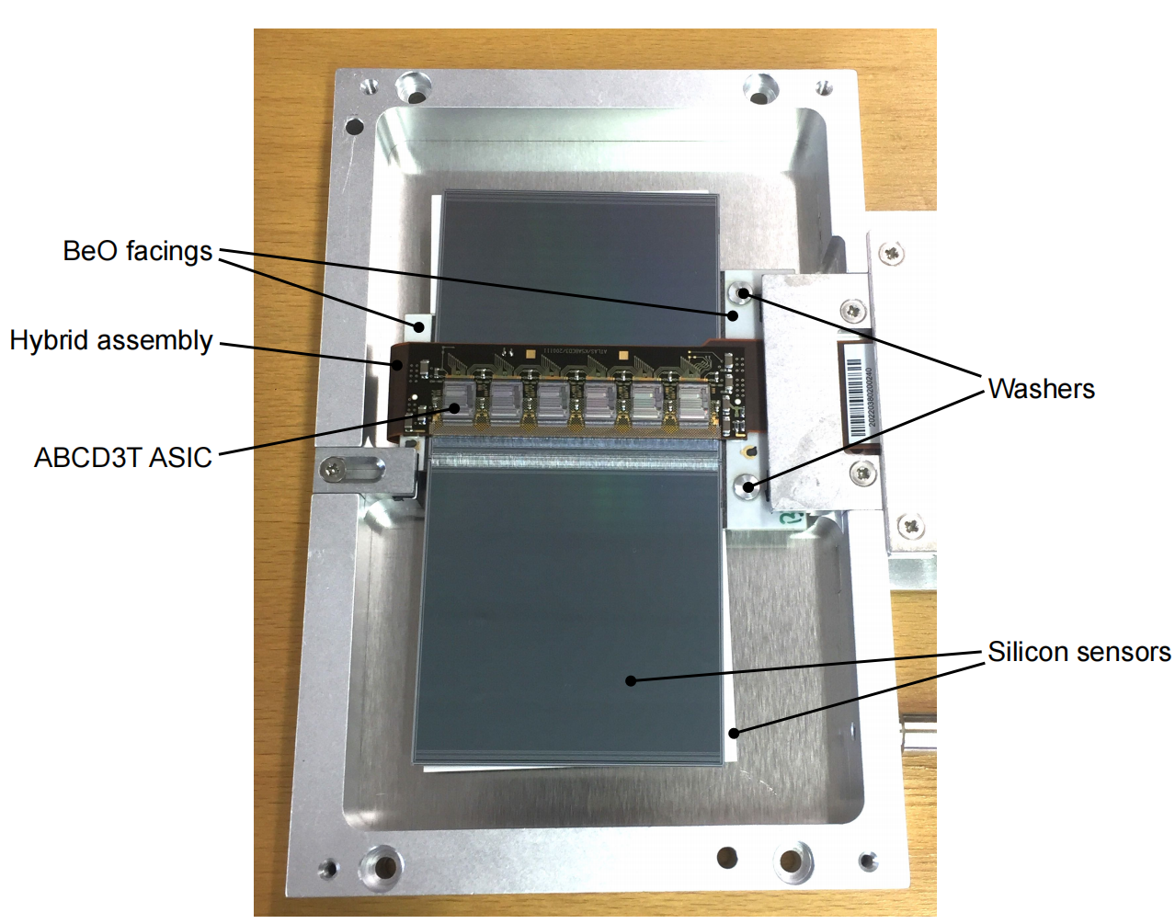
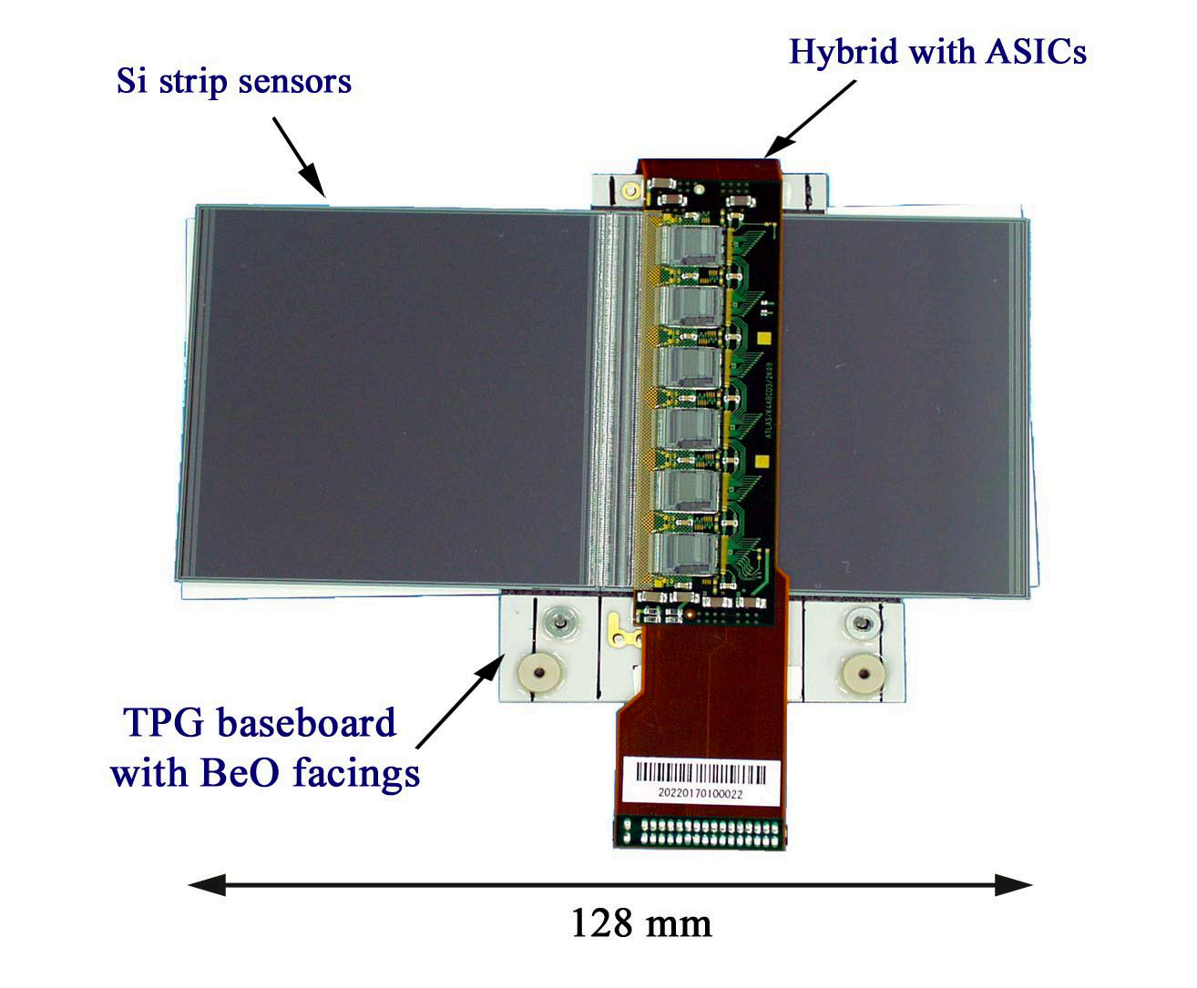
FASER Tracker F.Xiao 10
Tracker Overview:
3 stations × 3 layers × 8 spare ATLAS semiconductor tracker barrel modules
4 silicon microstrip detectors in pairs on two sides of a central based borad
p in n silicon sensor (based on electron hole pair production) n-type substrate of 285μm thickness & 768 (p⁺ implant) strips with at a constant pitch of 80 μm
spatial resolution of ~17μm perpendicular to the strips, ~580μm parallel
Exploded CAD view of a tracker station [14]
Photograph of a SCT barrel strip module [14]
Electronics:
ABCD3TA chip contains 128 readout channels that consist of a
preamplifier, shaper and discriminator
Double-pulse resolution < 50ns
Trim Scan: correcting for the threshold dispersion inside the chip
Tracker Readout Boards (TRB) get data, in short: measuring
information of position, timing and charge
ATLAS SCT barrel module [1]

Slide 11
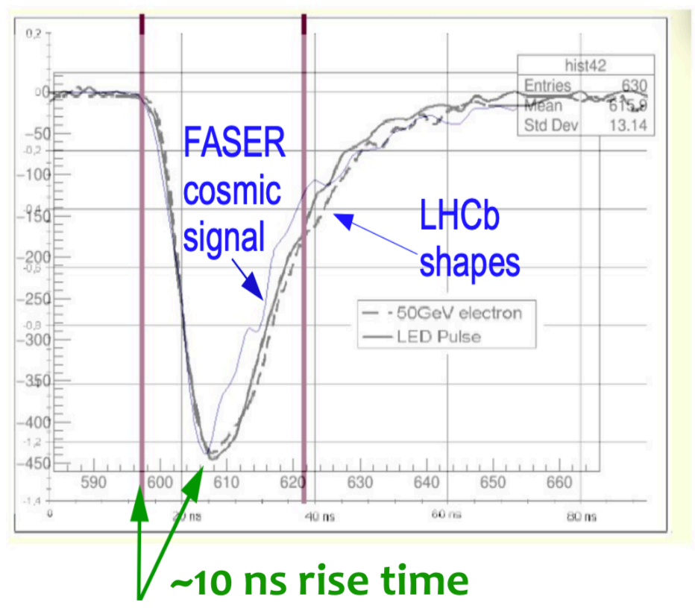
FASER Calorimeter F.Xiao 11
Calorimeter module:
Design of a FASER calorimeter module [15]
LHCb outer ECAL modules, 66 layers of interleaved 2mm lead plates and 4mm scintillator, 64
wavelength shifting fibers delivering the scintillation light to a single PMT
Measure the electromagnetic energy, electron and photon identification
~1% energy resolution
Calibration using ¹³⁷Cs source and cosmic-ray test stand
Resolution degrades at energies above 1 TeV due to leakage out of the
back of the calorimeter
FASER cosmic signal comparison [1]

Slide 12
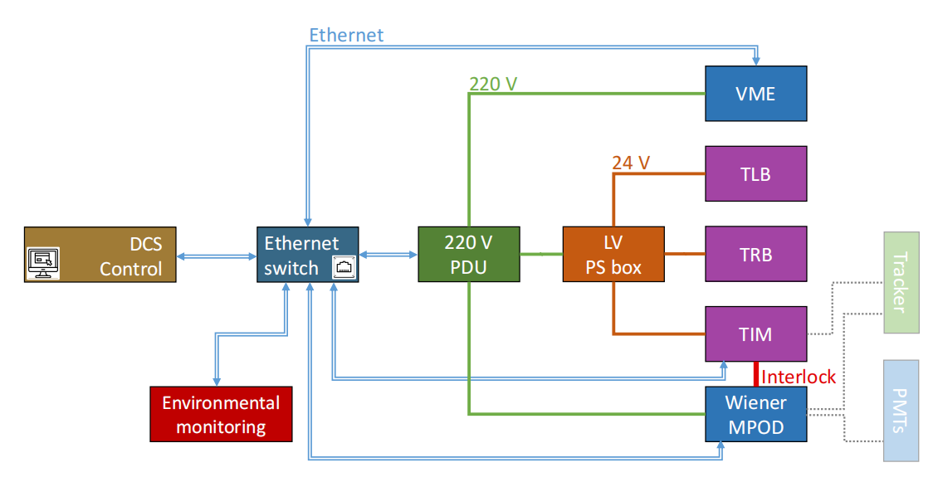
FASER DCS System F.Xiao 12
Detector Control and Safety System:
The DCS control hierarchy [15]
Cooling system:
simple water chiller ~15 ℃ to cool ASICs
dry air system to avoid condensation on the electronics due to the cooling [14]
Safety Interlock:
monitor temperture and humidity data
control and monitor power supplies
software system: turn off individual detector components
hardware system: shut down power supplies

Slide 13
Summary F.Xiao 13
FASER has two sub-detectors: the main FASER detector and the FASERν detector
high-energy ν
LLPs
The FASER detetor makes use of emulsion detectors, scintillators, photomultiplier tubes, silicon strip trackers, etc. Thanks to the donation of ATLAS and LHCb Collaboration, it has mature SCT and ECAL modules. More than 105 fb⁻¹ data collected so far, and new generation of FASER has been proposed.

Slide 14
References F.Xiao 14
[1] https://indico.uu.se/event/766/attachments/1122/1560/Uppsala_FASER_MQueitschMaitland_011020.pdf
[2] https://indico.cern.ch/event/783977/contributions/3455126/attachments/1894349/3124893/faser_poster_dm_at_ lhc_2019.pdf
[3] Inada T, FASER Collaboration. Early performance of the tracking detector for the FASER experiment[J]. Nuclear Instruments and Methods in Physics Research Section A: Accelerators, Spectrometers, Detectors and Associated Equipment, 2024: 169547
[4] Ariga A, Ariga T, Boyd J, et al. Letter of intent for FASER: ForwArd Search ExpeRiment at the LHC[J]. arXiv preprint arXiv:1811.10243,2018.
[5] https://indico.global/event/7282/contributions/67857/attachments/32781/61683/FASERnu_ISVECRI2024_Sato_v2. pdf
[6] https://indico.cern.ch/event/1291157/contributions/5904124/attachments/2899129/5083552/20240718_Dmitrievsky _FASERnu.pdf
[7] Abreu H, Anders J, Antel C, et al. First direct observation of collider neutrinos with FASER at the LHC[J]. Physical review letters, 2023, 131(3): 031801.
[8] https://indico.global/event/470/contributions/13319/attachments/3676/5726/LakeLouise2022_DaikiHayakawa.pdf
[9] https://indico.cern.ch/event/1216905/contributions/5448276/attachments/2702823/4691466/JAtkinson_NuFACT2023_ObservationAnd ResultsOfTheFASERnuDetector.pdf
[10] https://indico.global/event/774/contributions/21311/attachments/9159/13901/20210526_tariga_FASERnu_Pheno_v2.pdf
[11] https://faser.web.cern.ch/about-the-experiment/detector-design/scintillators
[12] https://indico.cern.ch/event/1460367/contributions/6240690/attachments/3002176/5290909/FASER_Ariga_NeutrinosAtCERN2025.pdf
[13] https://faser.web.cern.ch/index.php/about-the-experiment/detector-design/magnets
[14] Abreu H, Antel C, Ariga A, et al. The tracking detector of the FASER experiment[J]. Nuclear Instruments and Methods in Physics Research Section A: Accelerators, Spectrometers, Detectors and Associated Equipment, 2022, 1034: 166825.
[15] Abreu H, Mansour E A, Antel C, et al. The FASER detector[J]. Journal of Instrumentation, 2024, 19(05): P05066.

Slide 15
Back UP F.Xiao 15
BACK UP

Slide 16
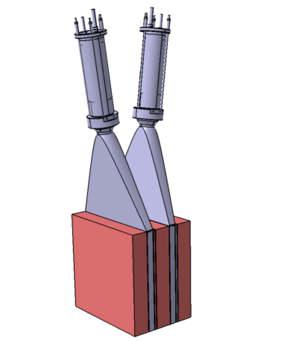
Back UP F.Xiao 16
What about a ALP comes through:
A schematic view of an axion-like particle coming through [16]
Current detector has irreducible background from neutrino interactions in preshower
Preceded with 3 mm-thick layer of radiators (tungsten) to create a simple preshower detector to distinguish two close-by energetic photons & deep inelastic scattering of high-energy neutrinos
A 5 cm-thick low-Z absorber material (graphite) is placed in front of each layer of tungsten and between the final scintillator module and the calorimeter reduce backsplash from the calorimeter and preshower radiator into the last tracking station
Preshower station [15]

Slide 17
Back UP F.Xiao 17
Different BSM Particles:
Feynman Diagram of BSM [16]
References:
[16] https://indico.cern.ch/event/1451530/contributions/6186586/attachments/3009676/5306062/FASER-LHCbWorkshop-6.2.25.pdf

