Slide 1
LHCb SciFi
By Aidan Molloy
https://lhcb.web.cern.ch/speakersbureau/material/

Slide 2
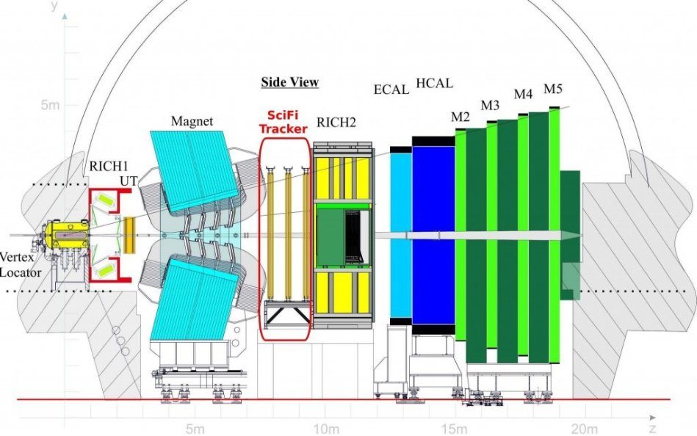
Background
The LHC or Large Hadron Collider is the world's largest circular collider, situated on the border of Switzerland and France.
LHCb is the name of one of the detector experiments that uses the collider.
The b stands for the beauty or bottom quark, the heaviest of the known quarks.
The experiment aims to study the small differences between matter and antimatter.
As opposed to other detectors at the LHC (ATLAS, CMS), LHCb's detectors are in forward geometry.
LHCb SciFi: From performance requirements to operational detector [3]
Notes:
Quarks decay quickly – moveable detector is used to catch b quarks
Other detectors – ATLAS, CMS, ALICE use detectors that surround the collision point
20 meters long along the particle track – 1 direction

Slide 3
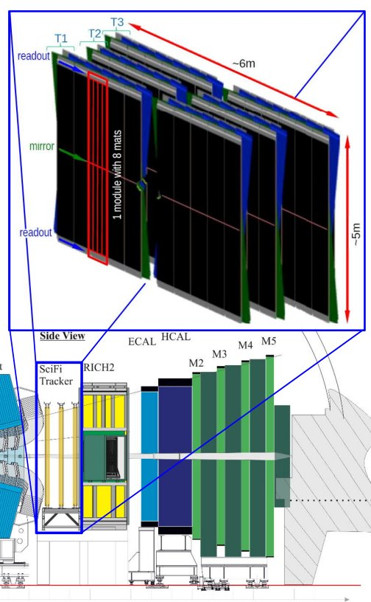
SciFi Upgrade
The upgrade was planned during down-time between 2019 and 2020, a new sub-detector was added.
Due to the pandemic, installation was delayed, being completed late 2021.
This large area tracking detector replaced previous trackers. The outer straw tube tracker and the inner silicon micro strip tracker.
The detector is made up of more than 10000 km of scintillating fibres.
LHCb SciFi: From performance requirements to operational detector [3]
Notes:
12000km total – 10000km in the detector

Slide 4
Goals
The upgrade aimed to increase the luminosity by 5x, to 2.e33 /cm² s, have a readout rate of 40 MHz (or 25 ns) that is triggerless and collect 50 events per femtobarn of cross-section of the detector in 10 years.
The tracker itself requires a hit detection efficiency of 99% and a spatial resolution better than 100 μm.
The aim was for the detector to have less than 10% of the signal be noise in all regions and keep the material budget at 1% radiation length per detector layer (12 total).

Slide 5
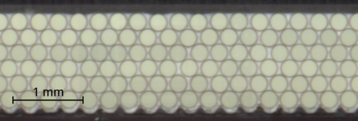
Scintillators
Tubes of diameter 250μm with a polystyrene core (n=1.59), polymethylmethacrylate inner cladding (n=1.49) and fluorinated polymer outer cladding (n=1.42).
The tube cores are doped with an activator and wavelength shifter dye and are made into a mat of 6 layers of tubes with epoxy glue mixed with TiO₂ in between.
Light emission peak ~450 nm with an attenuation length ~3.5 m, which degrades by about 1.4% per year. 5.35% of the light is captured in the tube, 35% of the signal is lost at the expected dose, with a light yield of 8000 photons per MeV and a light decay time of 2.8 ns.
Expecting fibres to receive an ionising dose of 35 kGy over lifetime and to reduce from 16-20 photoelectrons per detector plane to 10-12.
LHCb SciFi: From performance requirements to operational detector [3]
https://arxiv.org/pdf/1710.08325
Notes:
(PS has poor scintillation light yield in UV to visible)
Light travels up to 2.4 meters from creation to detection
Signal amplitude at inner detector parts reduced up to 40%
N – refractive indices
Epoxy – reduce optical cross-talk between fibres

Slide 6
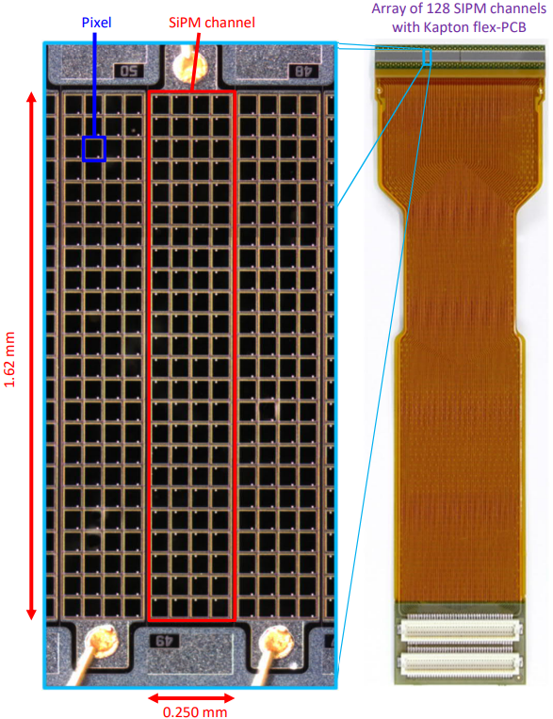
Photomultipliers
4096 linear SiPM arrays each with 128-channels consisting of 104 pixels which are each Avalanche Photodiodes in Geiger-Mode.
They are optimised to have high photon deletion efficiency with a peak of 45% and a total correlated noise probability of 7% at ΔV = 3.5 V.
They feature a quenching resistor of 520 kΩ, giving a large operating range and a recovery time of 85 ns (~10% variation).
Main damage due to neutron irradiation which massively increases dark count rate. DCR can be reduced by a factor 2 every 10 K the temperature is reduced, so the detector is kept at -40 °C.
Neutron radiation expected: 6 · 10¹¹ n_{eq}/cm² . No irradiation : 0.04 MHz. Room temp: 550 MHz. -40°C: 14 MHz.
LHCb SciFi: From performance requirements to operational detector [3]
Notes:
Each channel 2 chips of 64 SiPMs
each channel is 0.25 × 1.62 mm², Pixels - (57.5 × 62.5 μm²)
low after-pulse (below 0.1%) and cross-talk and have a thin entrance window

Slide 7
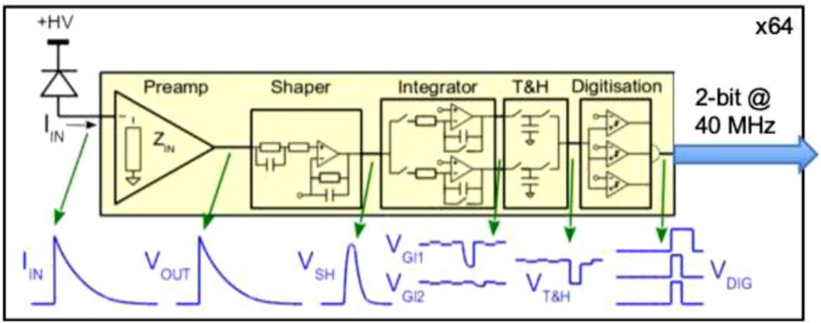
Front-end Electronics
Aimed to have a short integration time and clustering allows them to efficiently reject noise.
The SiPM signal is read by a custom 64-channel ASIC (called PACIFIC) that uses 10 mW of power and consists of a preamplifier, a fast shaper (90% of charge in 10 ns), a double gated integrator (25 ns) to avoid dead time, a track and hold stage and three comparators to apply signal thresholds for digitisation.
Several channels combined (3-bit output to 2-bit values), then individual channels combined into clusters (expected 3 MHz cluster rate per array), reducing noise from 14 MHz/channel to 2 MHz/array.
Front-end electronics cooled by 17 °C water (30 kW heat load).
LHCb SciFi – Upgrading LHCb with a scintillating fibre tracker [2]
Notes:
The three thresholds allow to identify signal clusters and accurately determine their location while efficiently suppressing noise.
Array – Kapton flex-PCB – PACIFIC – Cluster – Master
Radiation tolerant (neutrons + 100 Gy ionizing dose)

Slide 8
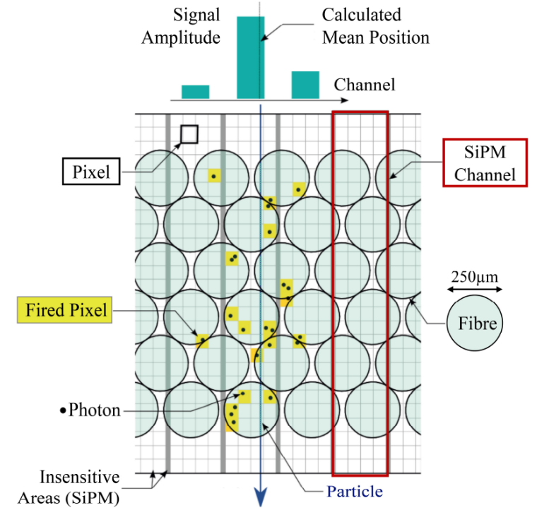
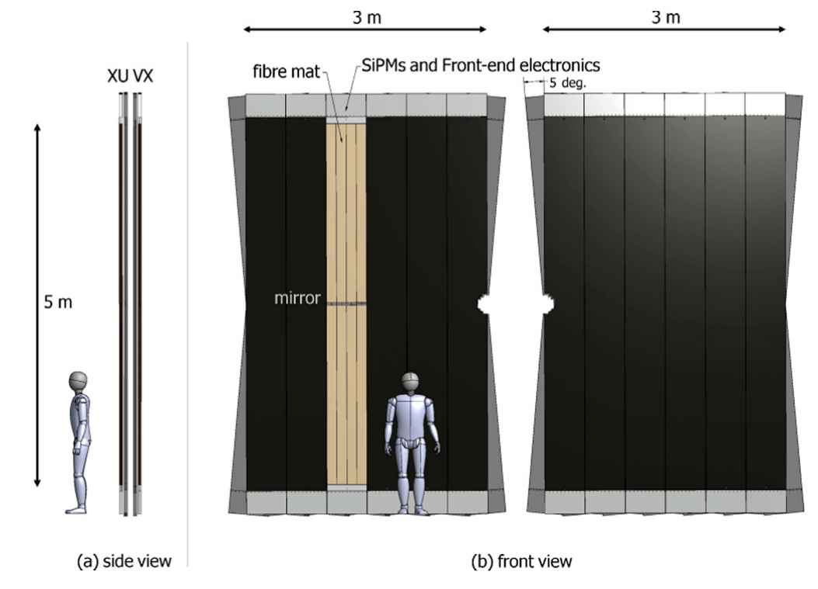
Installation
The tubes are made into mats with one end of each tube having a mirror and 8 of these mats are put together into a module.
The SiPM’s are placed at the top and bottom, in gas- and light-tight cold-boxes and are glued to titanium cold-bars circulating monophase 3M Novec 649 which is at -50 °C.
Boxes are flushed with dry air with a dew point of -70 °C to avoid ice buildup.
The modules are held by C-frames with alternating tilted modules (±5°) that can be moved in and out from the beam for repair.
LHCb SciFi: From performance requirements to operational detector [3]
LHCb SciFi – Upgrading LHCb with a scintillating fibre tracker [2]
Notes:
144 modules created, 128 used

Slide 9
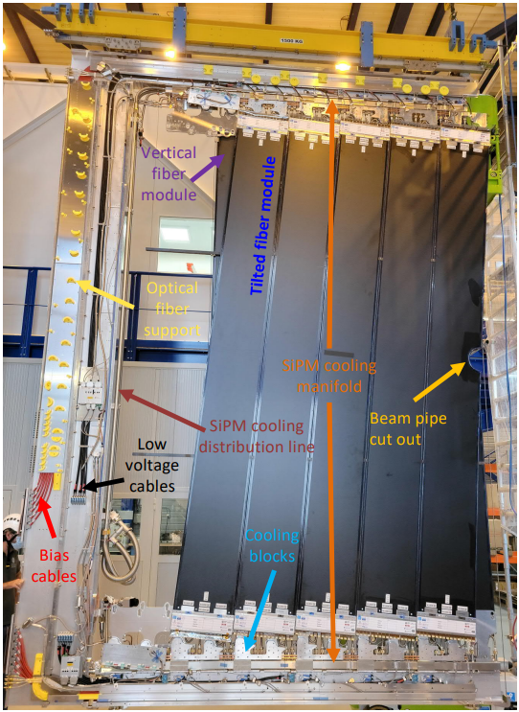
Results
The detector achieved almost all its goals since the restarting of the LHC.
It has achieved an efficiency of 99.4%, a spatial resolution of 70 μm and a readout of 20 Tbits/s.
The material budget ended up being 1.1% as it allowed for the detector to be longer lived at a higher performance level.
The detector also seems to be on track to hit the 50 fb⁻¹ integrated luminosity over its lifetime.
All parts of the detector have been commissioned and after a few tweaks, like the water-cooling clogging, it is running as expected.
LHCb SciFi: From performance requirements to operational detector [3]

Slide 10
References
LHCb CERN information page - https://home.cern/science/experiments/lhcb
LHCb SciFi – Upgrading LHCb with a scintillating fibre tracker - https://www.sciencedirect.com/science/article/pii/S016890021930422X?fr=RR-2&ref=pdf_download&rr=91bac02c0a45224e
LHCb SciFi: From performance requirements to operational detector - https://cds.cern.ch/record/2814025/files/LHCb%20SciFi%20From%20performance%20requirements%20to%20operational%20detector%20final.pdf
Refining and testing 12,000 km of scintillating plastic fibre for the LHCb SciFi tracker - https://iopscience.iop.org/article/10.1088/1748-0221/13/10/P10025/pdf
SciFi: A large Scintillating Fibre Tracker for LHCb - https://arxiv.org/pdf/1710.08325

Slide 11
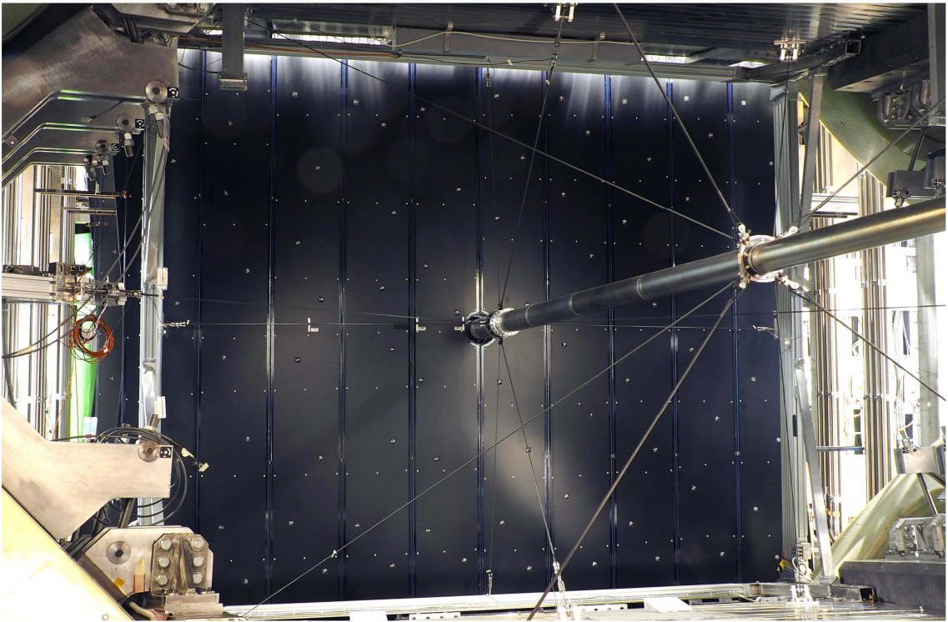
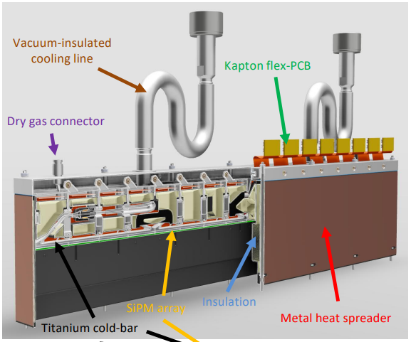
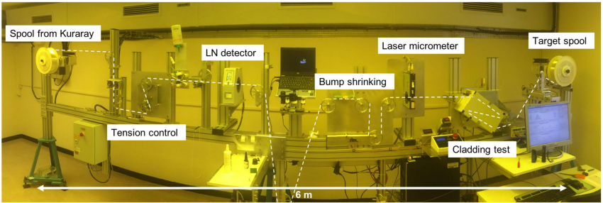
LHCb SciFi: From performance requirements to operational detector [3]
LHCb SciFi: From performance requirements to operational detector [3]
LHCb SciFi: From performance requirements to operational detector [3]
LHCb SciFi: From performance requirements to operational detector [3]
Notes:
C-frames hold the modules so they Loe level UNICOS and high level LHCb Detector Control System for control and monitoring, Finite State Machine for all service
-20 mm clearance around beam pipe
deficits in the light transport (light leaks) of a fibre, affecting hit efficiency and position resolution
Bumps exceeding a diameter of 350μm were shrunk by drawing the fibre through a hot conical tool

