Slide 1
ATLAS Pixel Detector
Alejandro Guerrero Ramos
Particle Detection, Nikhef, March 14 2025

Slide 2
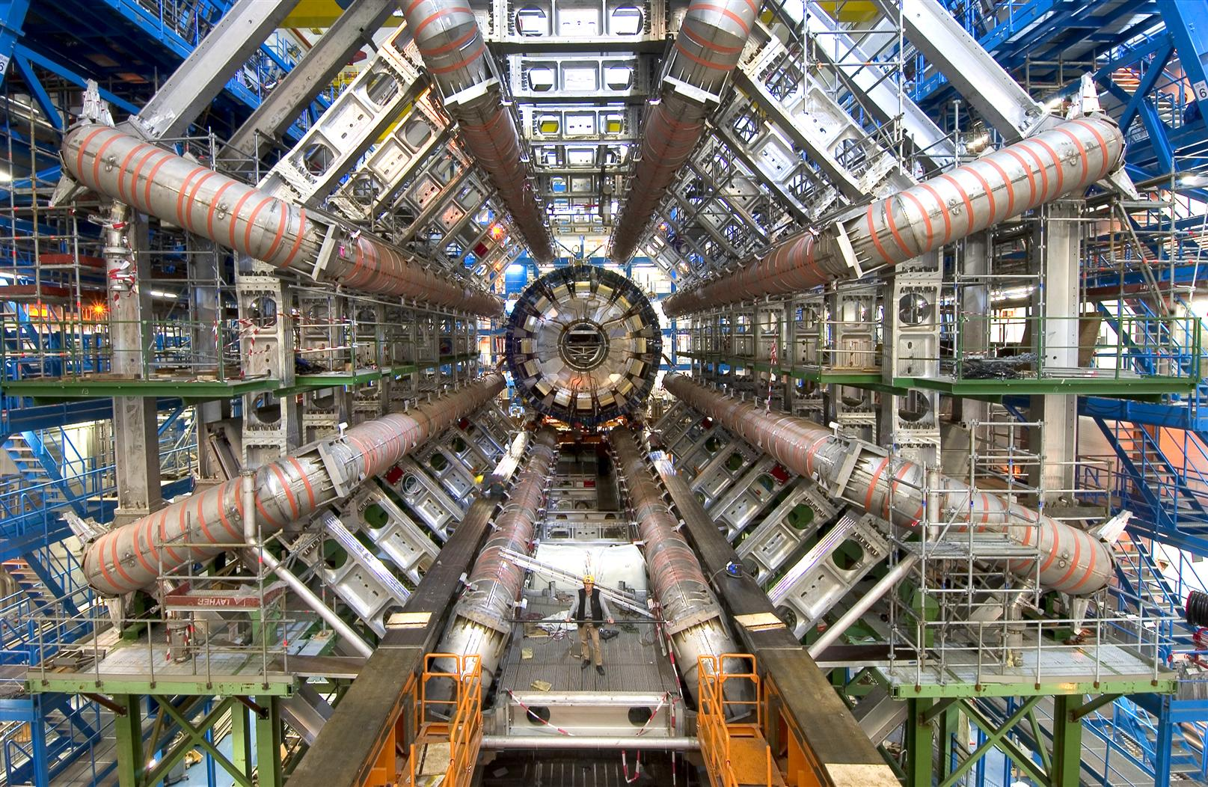
ATLAS
ATLAS is the largest collider experiment at the LHC at CERN.
Its studies mainly consist of:
Higgs boson
Super symmetry
New particles
Dark matter
https://www.nikhef.nl/en/programs/atlas/
https://flickr.com/photos/atlasexperiment/42850523502/

Slide 3
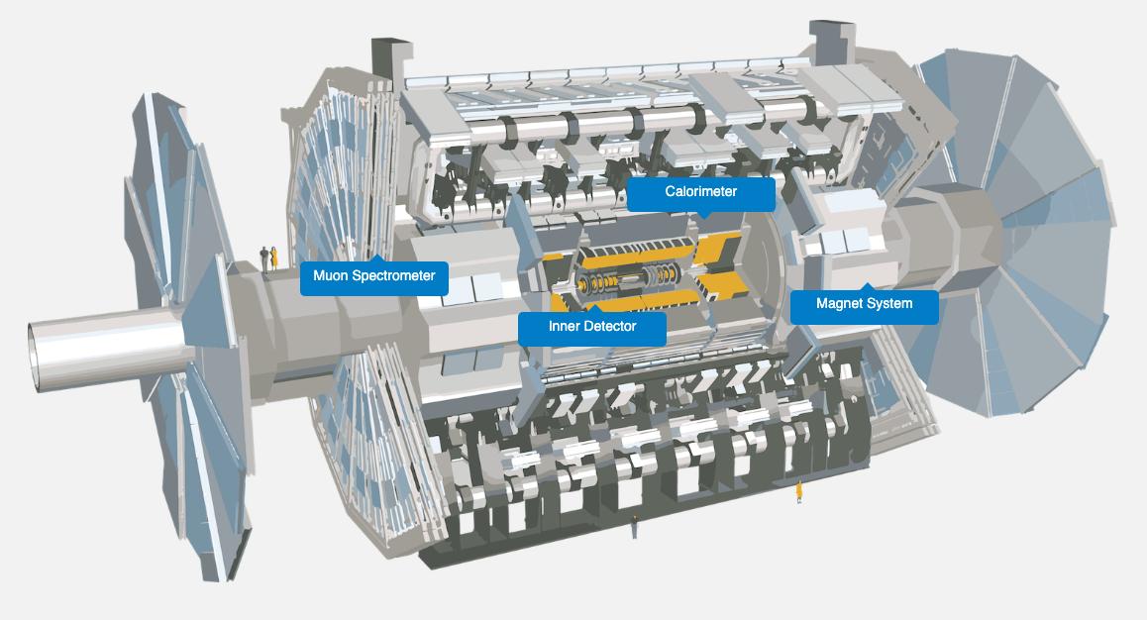
The Detector
46 meters long & 25 m of diameter
100 meters below underground
7000 tonnes
1000000000 collisions per second
Consists of four different main detecting subsystems wrapped concentrically around the collision point
https://atlas.cern/Discover/Detector

Slide 4
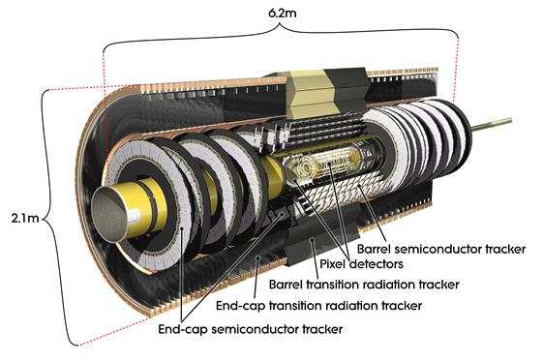
Inner Detector
First part of ATLAS to see the decay products of the collisions. Designed for precision tracking of charged particles.
Consists of three different systems of sensors immersed in a magnetic field parallel to the beam axis.
Measures direction, momentum, and charge of charged particles produced in p-p collisions.
Main components are:
Pixel detector
Semiconductor Tracker (SCT)
Transition Radiation Tracker (TRT)
https://atlas.cern/Discover/Detector/Inner-Detector
https://arxiv.org/pdf/physics/0412138

Slide 5
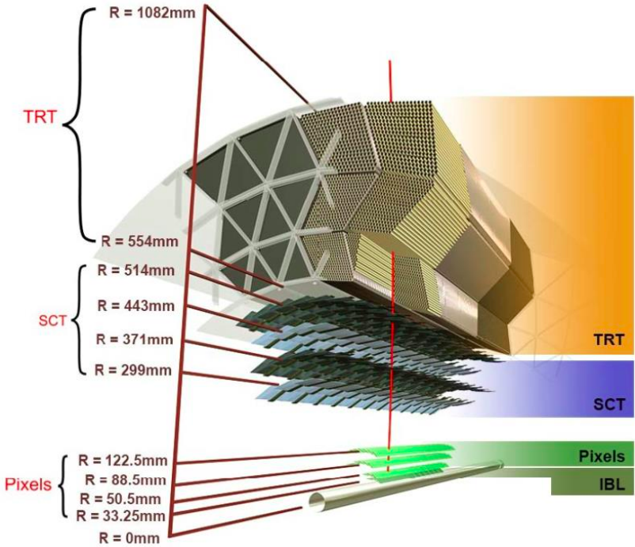
Pixel Detector
First point of detection in ATLAS.
Four layers from radii 3.35 cm to 12.25 cm of 250 μm thick silicon pixels + three endcap disks on either side.
A total of 1,744 modules, each measuring 2x6 cm, each containing 16 readout chips.
The smallest unit is a pixel of 50x400 μm for the external layers and 50x250 μm for the innermost layer (IBL).
Each module has roughly 47,000 pixels, adding to a total of over 92 million pixels.
Signals are measured with a precision of ~10 μm to determine the origin and momentum of the particle
https://atlas.cern/Discover/Detector/Inner-Detector
https://www.sciencedirect.com/science/article/pii/S0168900224002389?via%3Dihub#b5
https://arxiv.org/abs/physics/0412138
https://cds.cern.ch/record/2898792/files/ATL-INDET-SLIDE-2024-109.pdf

Slide 6
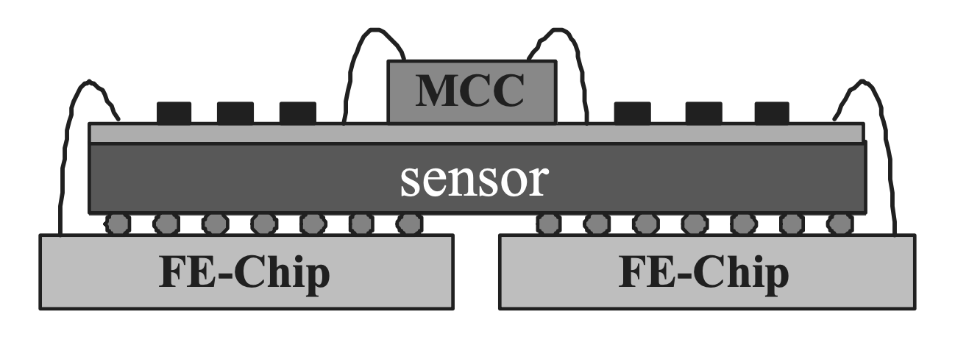
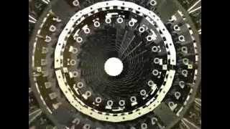
Pixel Detector
A pixel module consists of an oxygenated single n-on-n silicon sensor subdivided into over 47,000 pixels connected individually to 16 front-end (FE) chips using fine pitch “bump bonding”.
The detection of particles consists on the ionization by charged particles of molecules in the silicon pixels, which produce an electric current that is read by one or more solderballs. The ones that detect a signal produce a binary string that is stored and analysed later on. Seeing which bumps had a signal tells the original particle’s position and where it went.
https://arxiv.org/pdf/physics/0412138

Slide 7
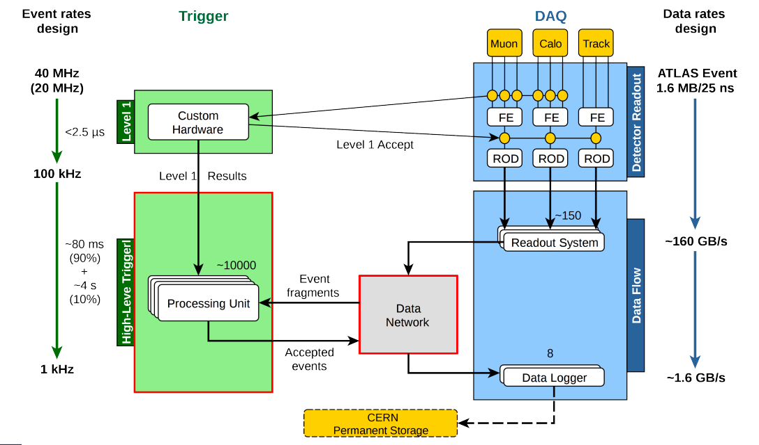
Data Processing
The LHC delivers events at up to 40 MHz (1 bunch crossing every 25 ns). Only 1 kHz can be written up, so 1 in 40,000 events can be kept. Events are selected using triggers that decide which events to keep.
The readout from the pixel detectors is fed into these triggers and the readout system, after which the data is ultimately processed and stored.
https://indico.cern.ch/event/472469/contributions/1982677/attachments/1220934/1785823/intro_slides.pdf

Slide 8
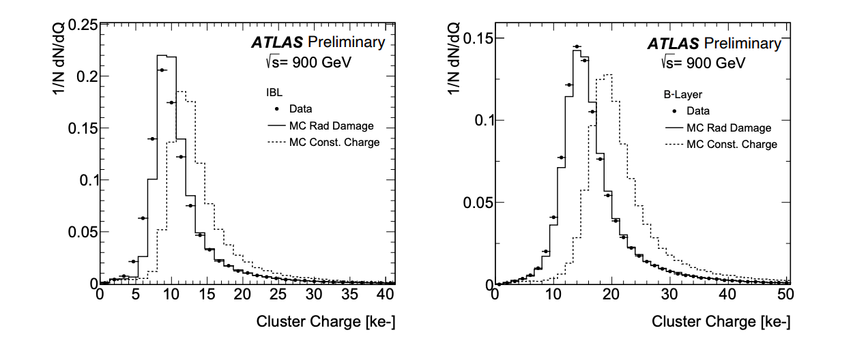
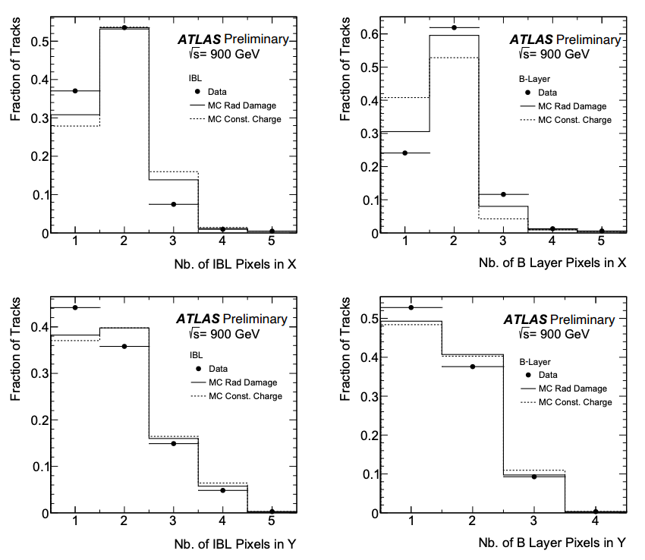
Performance: Pixel Detector Response
The performance of the pixel detector is mainly characterised by the pixel response and the hit-on-track rates and spatial resolution:
The pixel response is characterised in terms of charge collected, in clusters associated to reconstructed particle tracks.
The second measure is the distribution of the number of pixels in clusters associated to tracks. This distribution depends on the particle’s incidence angle and the position of impact, and on charge diffusion.
Data is compared with MC simulations to evaluate the response. The figures shown here include sensitivity to radiation damage.
https://cds.cern.ch/record/2814766/files/ATL-PHYS-PUB-2022-033.pdf

Slide 9
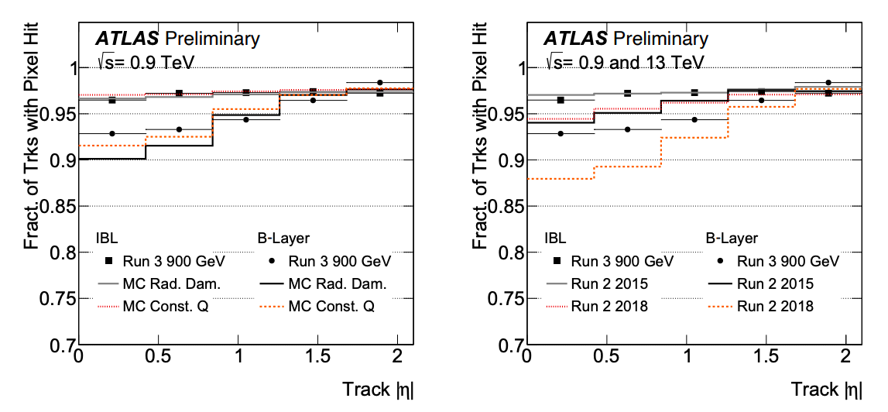
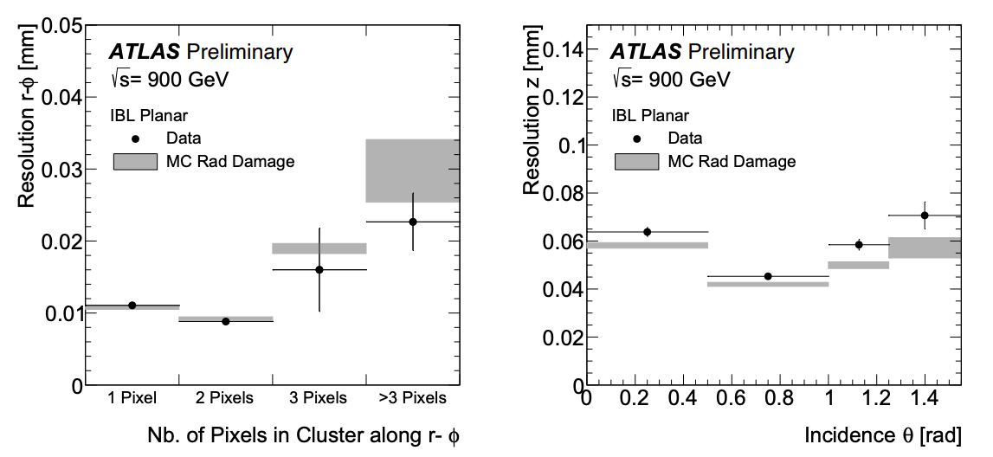
Performance: Pixel Hit-on-Track rates and spatial resolution
The performance of the pixel detector is mainly characterised by the pixel response and the hit-on-track rates and spatial resolution:
The efficiency of pixel clusters associated to tracks and the pixel hit spatial resolution are the two performance figures most important for track reconstruction.
The fraction of particle tracks reconstructed with associated pixel detector hits in a layer gives an indication of the detector efficiency for tracking purposes.
The second performance figure shown here is the IBL spatial resolution, owing to its position closest to the interaction region
https://cds.cern.ch/record/2814766/files/ATL-PHYS-PUB-2022-033.pdf

Slide 10
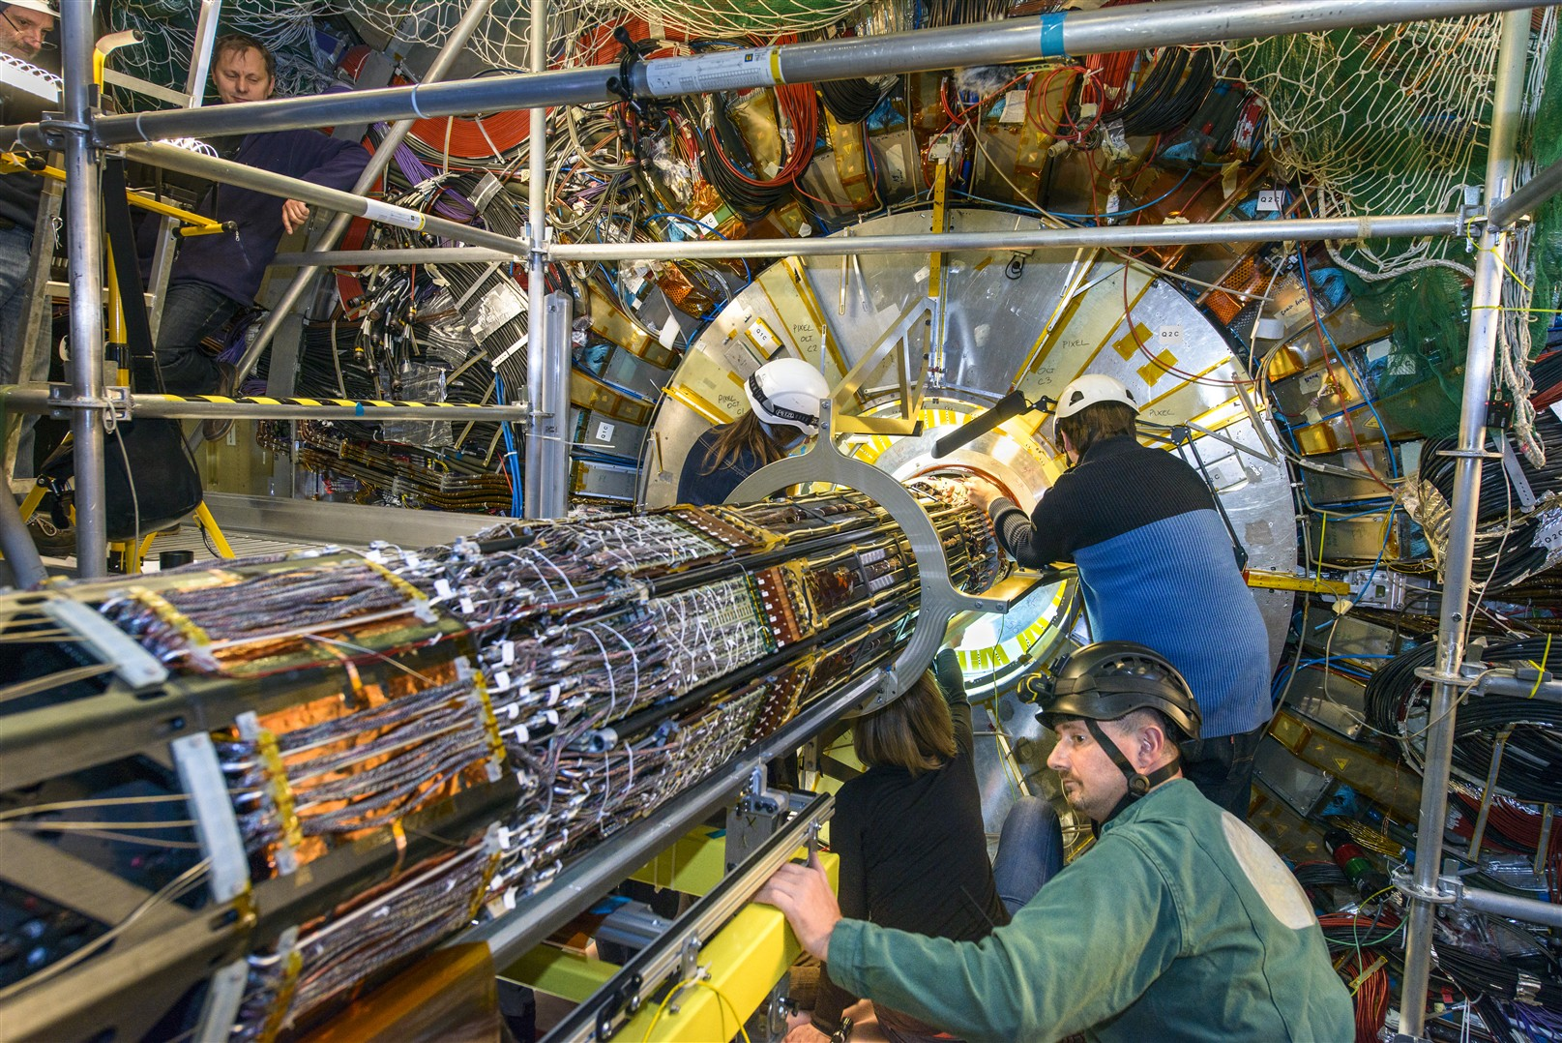
Summary and future outlook
Pixel is running well, and is foreseen to continue to do so until the end of Run 3
Pixel will be replaced with ITk for the High-Luminosity LHC upgrade
https://www.nikhef.nl/en/programs/atlas/
https://flickr.com/photos/atlasexperiment/42850523502/

Slide 11
References
[1] “Atlas.” Nikhef, 10 Jan. 2023, www.nikhef.nl/en/programs/atlas/.
[2] “Detector & Technology.” ATLAS Experiment at CERN, atlas.cern/Discover/Detector.
[3] Hügging, Fabian. The Atlas Pixel Detector - Arxiv, arxiv.org/pdf/physics/0412138.
[4] “Performance of Atlas Pixel Detector and Track Reconstruction at the Start of Run~3 in LHC Collisions at $\sqrt{s}=900~\Gev$.” CERN Document Server, 4 July 2022, cds.cern.ch/record/2814766?ln=en.
[5] Philip Iddon, et al. “Operational Experience and Performance with the Atlas Pixel Detector at the Large Hadron Collider at CERN.” Nuclear Instruments and Methods in Physics Research Section A: Accelerators, Spectrometers, Detectors and Associated Equipment, North-Holland, 2 Apr. 2024, www.sciencedirect.com/science/article/pii/S0168900224002389?via%3Dihub#b5.
[6] The Atlas Data Processing Chain: From Collisions to Papers, indico.cern.ch/event/472469/contributions/1982677/attachments/1220934/1785823/intro_slides.pdf.

Slide 12
Thank you!
Questions?

