Slide 1
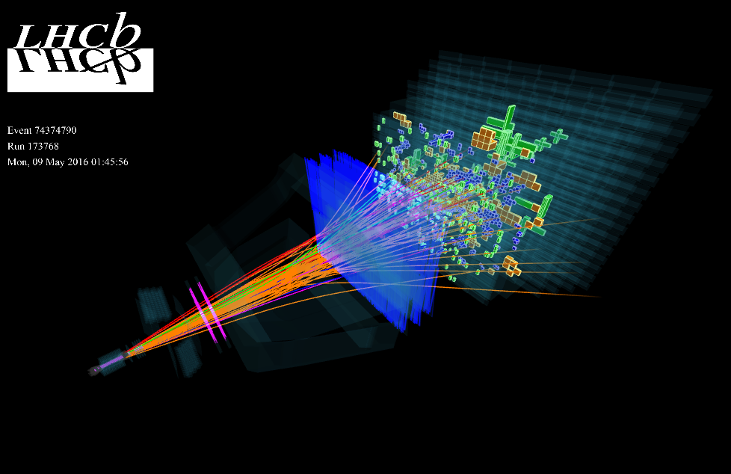
The LHCb VELO Detector
Introduction & Purpose of the LHCB
The VELO detector, introducing subcomponents: ASICs, Pixels
ASIC properties of the VELO detector
Calibration of pixels and ASIC
ASIC data collection architecture
Operational conditions of the VELO
References

Slide 2
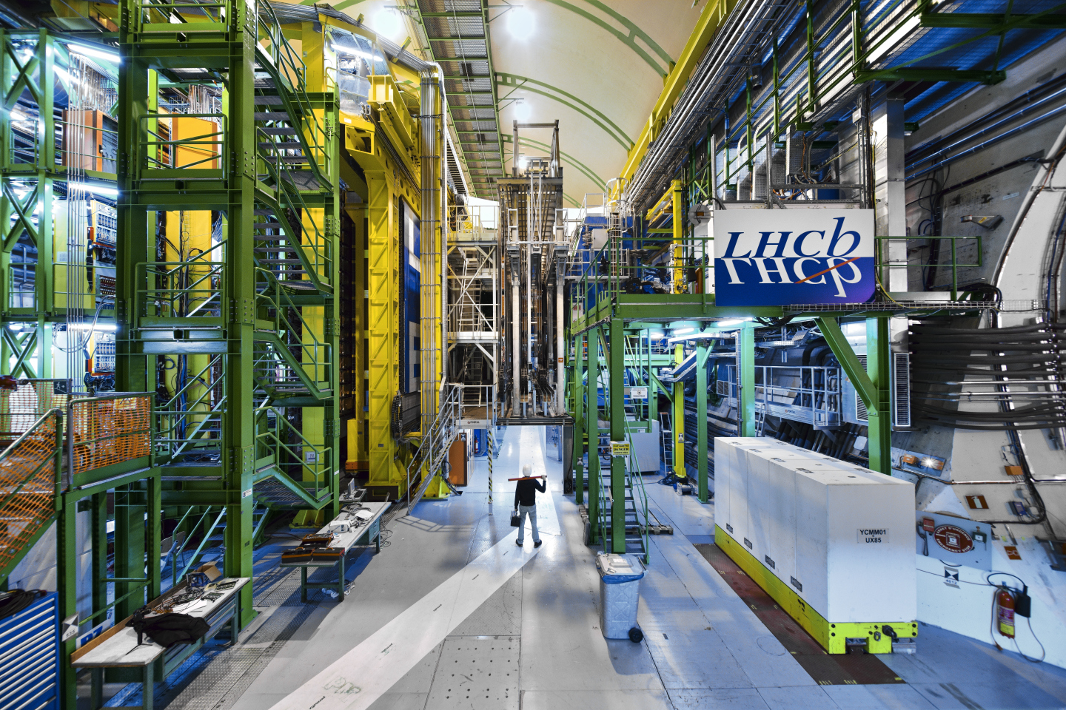
Understanding the Universe’s Asymmetry
“Why do we live in a matter dominated universe?”
Investigate CP violation
Study rare decays
Probe new physics

Slide 3
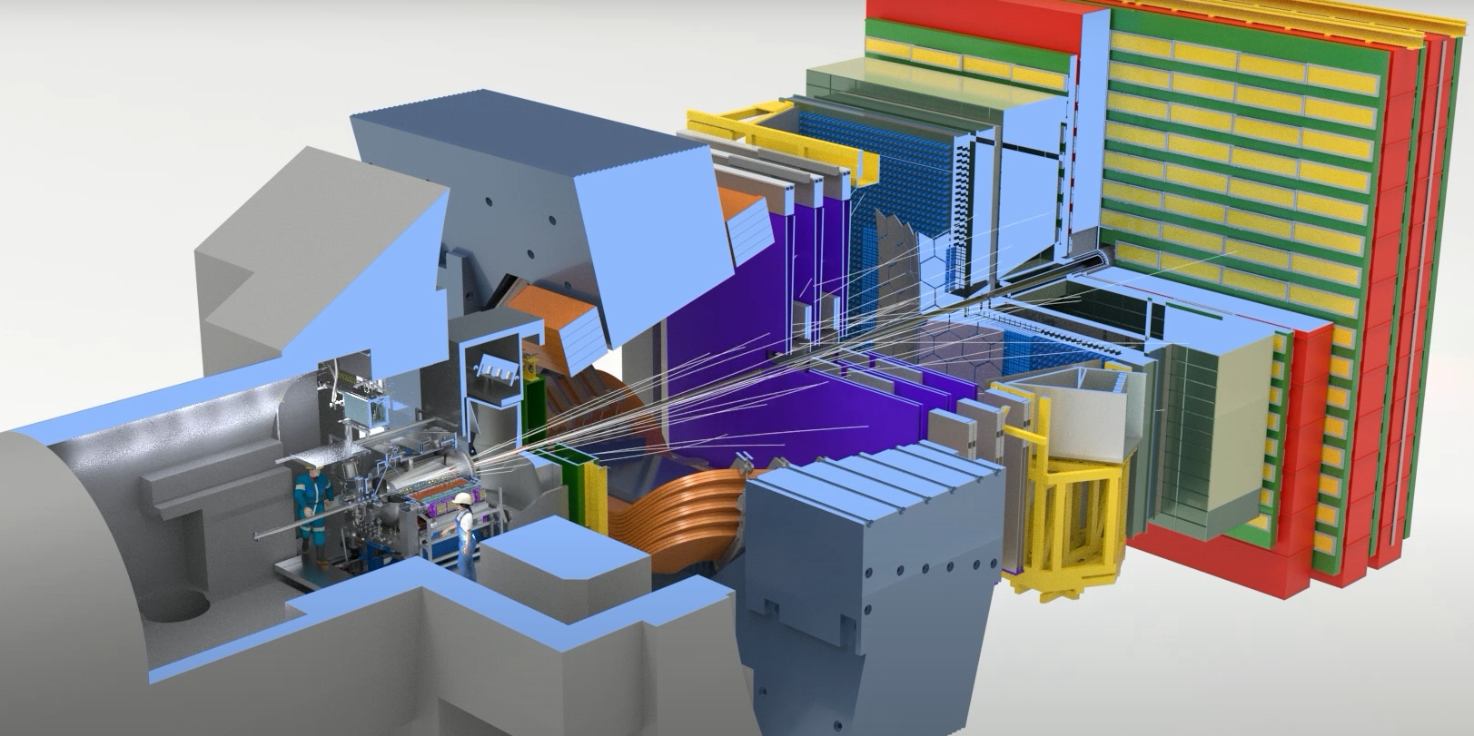
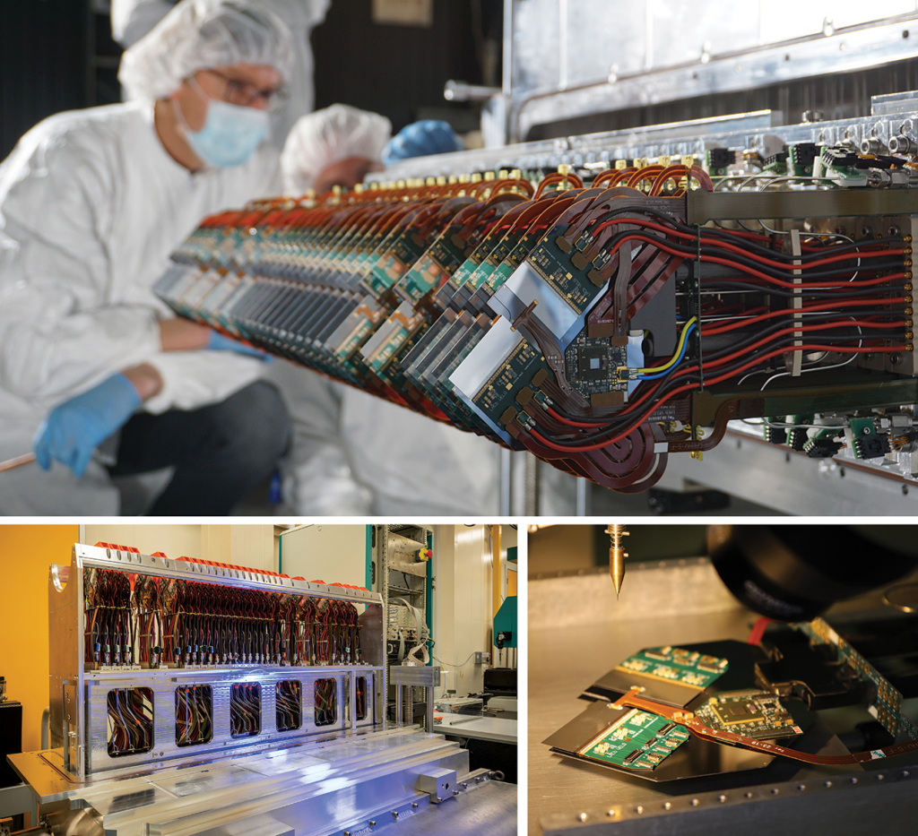
Vertex LOcator
The primary vertex is the point where protons collide (and where particles containing b quarks are created)
The secondary vertex is the point where these particles decay, spraying out other particles which the LHCB detects
proton-proton interaction point
The VELO’s purpose is to extremely accurately measure the position of these vertices to allow indirect measurements of B hadrons to within 10 microns

Slide 4
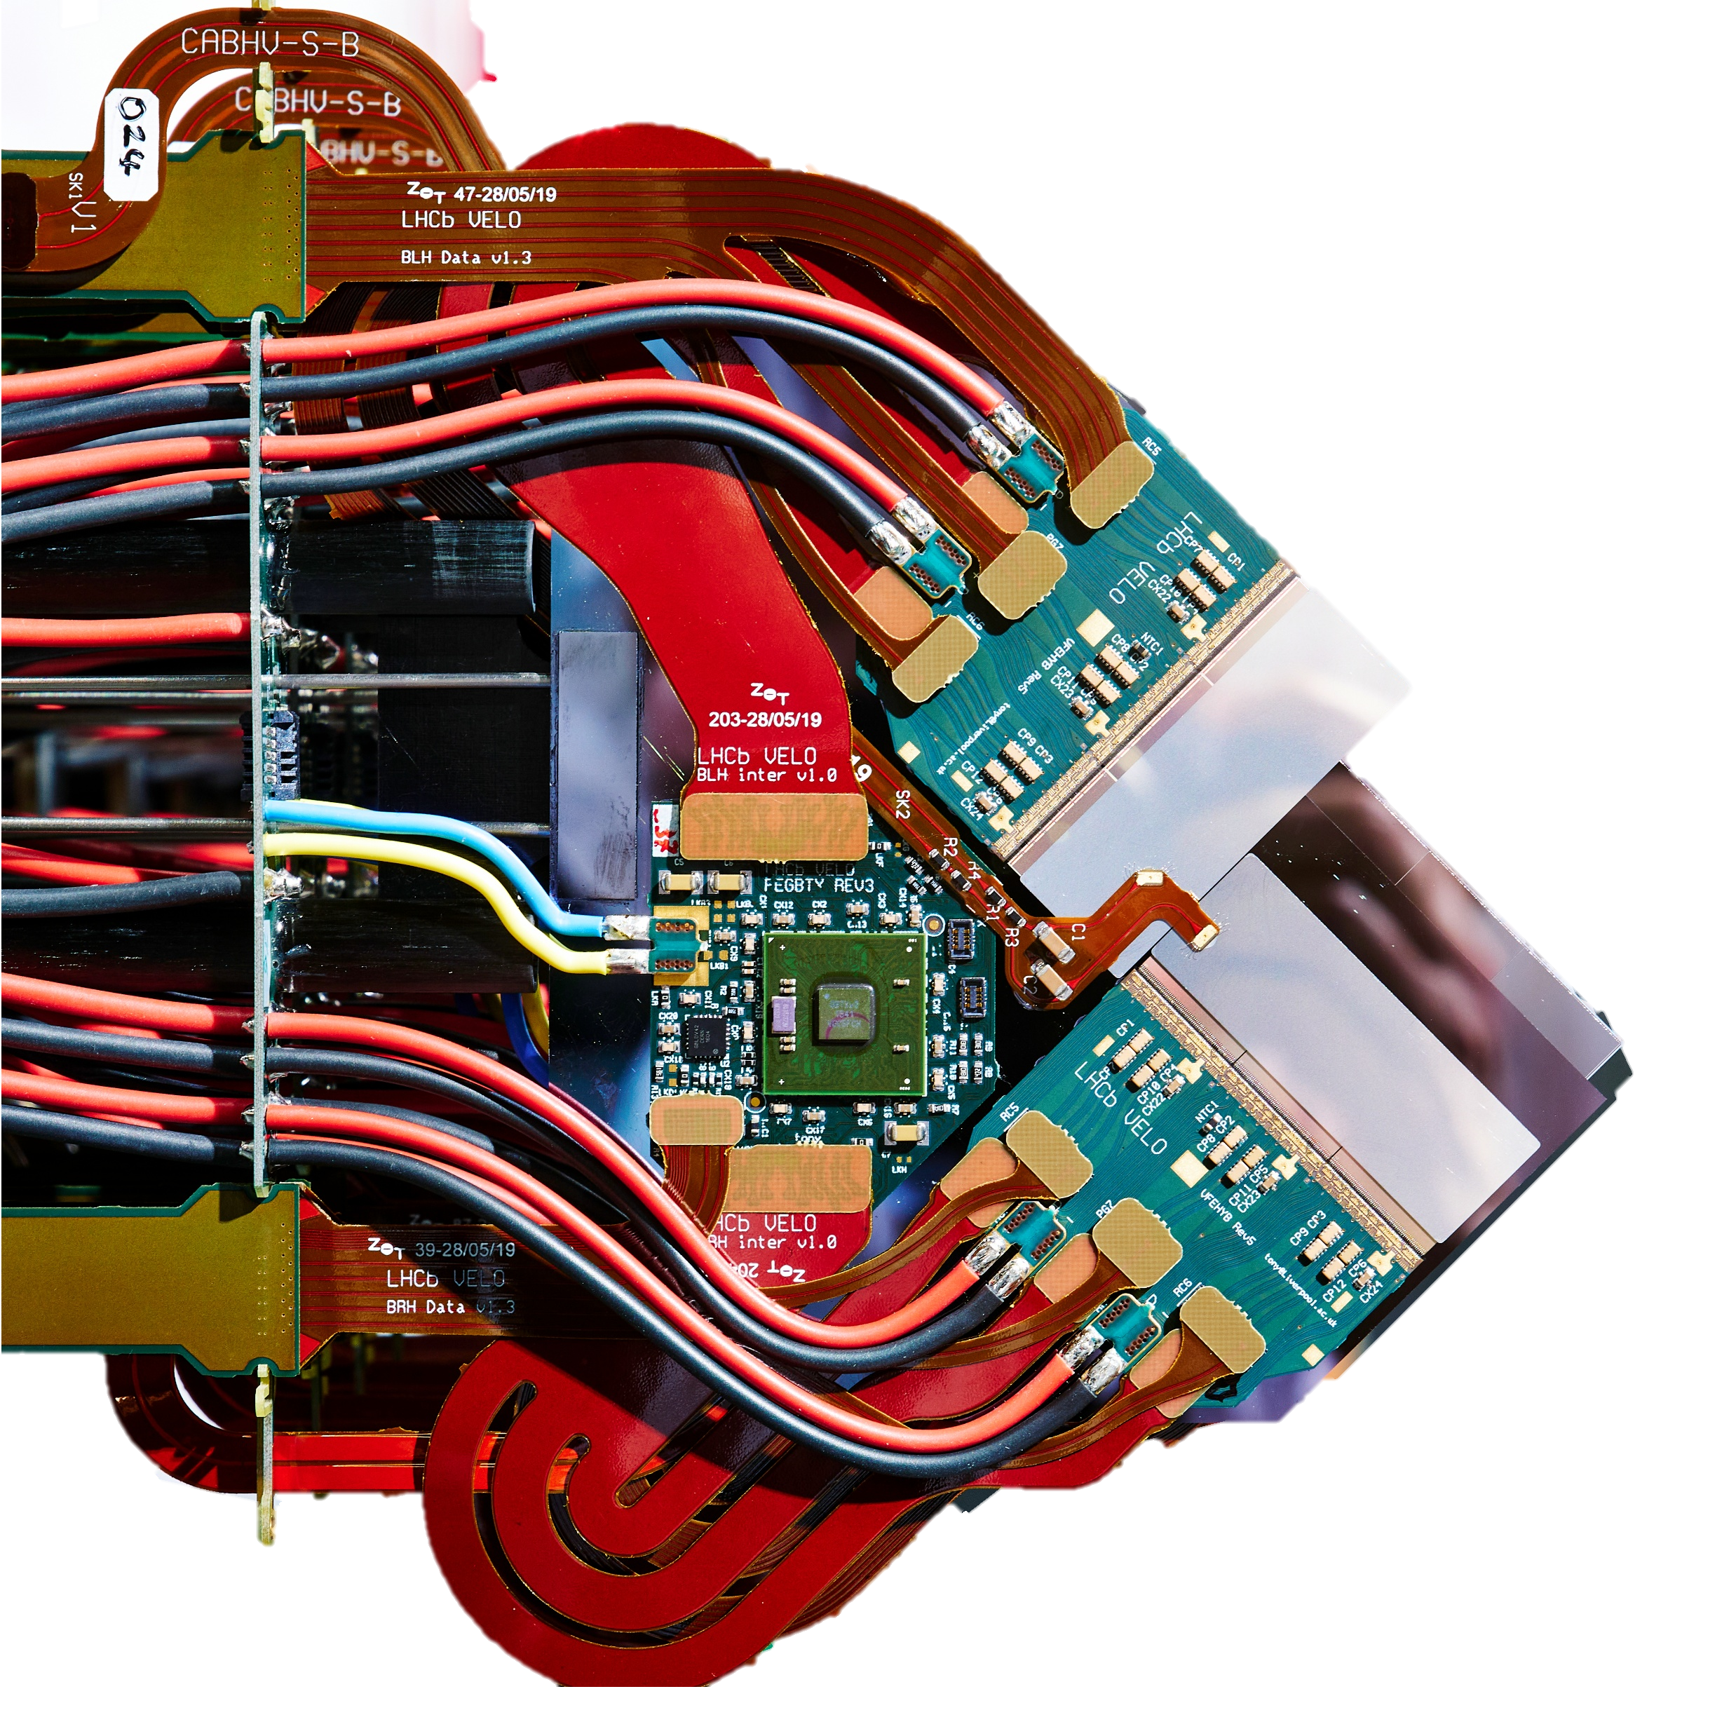
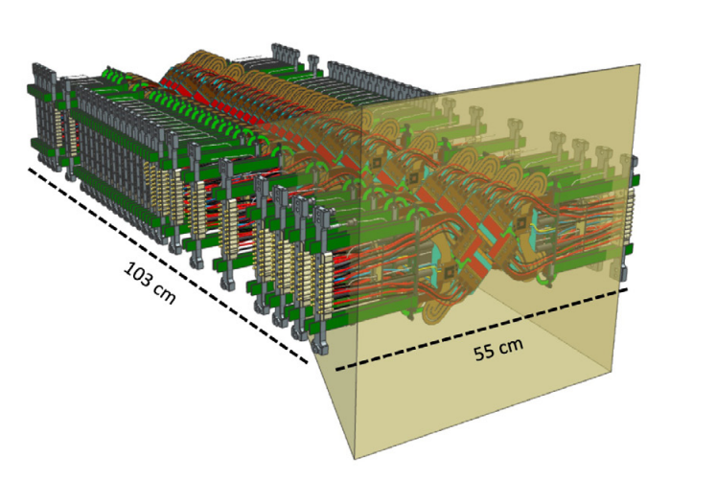
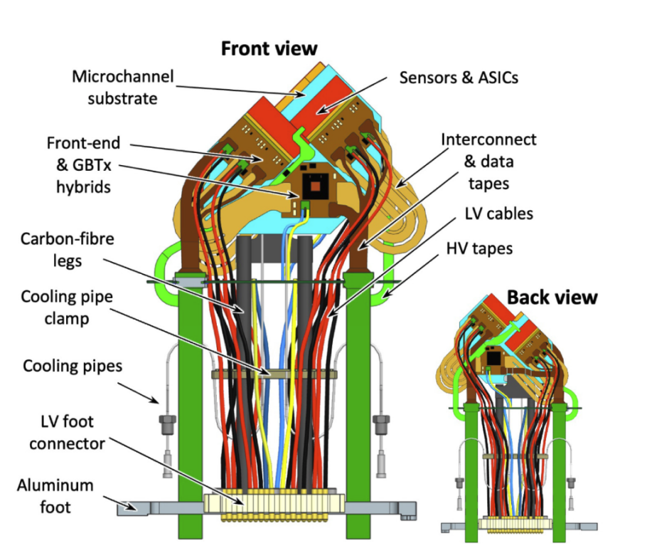
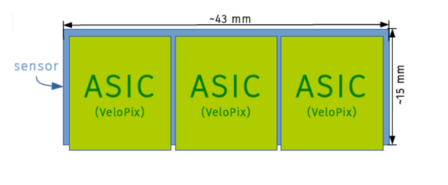
VELO Pixel Detector
During injection the VELO is kept open to ~25 mm between the center dot, and the detector.
Once the beam is stable the VELO is slowly closed to be as close as possible to the beam, leaving a gap of ~5.1 mm between the center dot, and the detector.
52 modules consisting of 200 μm thick n-on-p silicon detectors
1 module = 12 Velopix ASICS
1ASIC = 256x256 pixels
1 Pixel = 55 x 55 μm
Total ~41 million pixels
Both with an accuracy of 10 μm

Slide 5
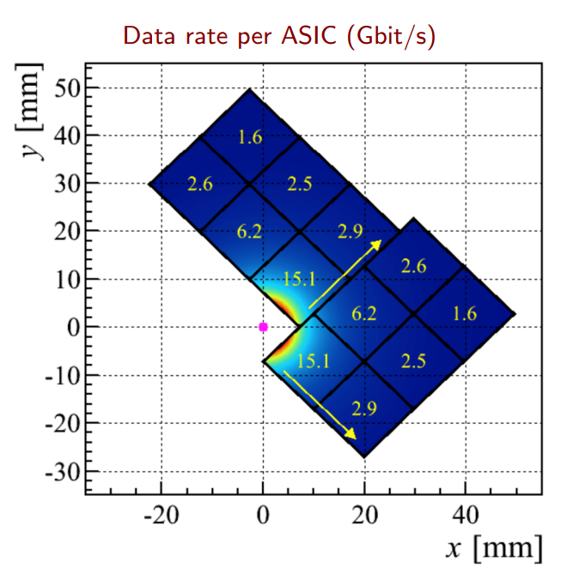
Closest active element is 5.1 mm from interaction region
Expected total ionizing dose 400Mrad
Operate with leakage current of 7nA/pixel at end of life
Average (Peak) rate of 600 (900) Mhits/s
Hottest ASIC has rate of 15.1 Gbits/s
Timing resolution: 25ns
Hit efficiency > 99%
Qualified up to 1000 Volt bias current

Slide 6
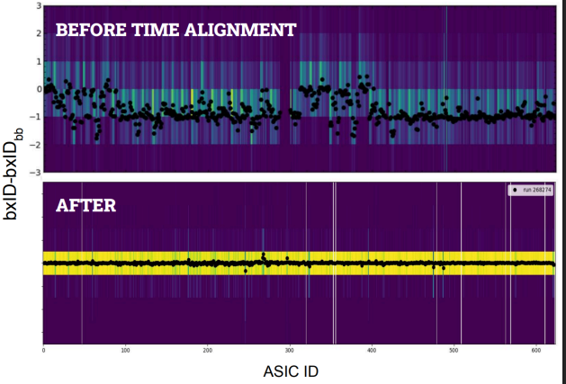
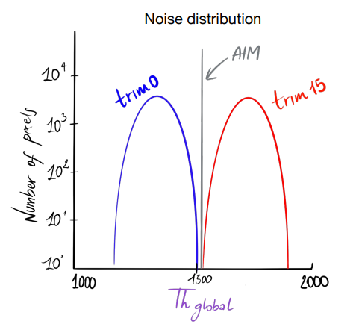
2 important calibrations for proper measurement
Time alignment
Equalization
$$Th_{local}=Th_{global}+trim$$
Due to different amplitudes hits have different ToT durations shifting the registration times of the hits. By synchronizing this with the LHC isolated bunch crossing ID (bxID), hits can be calibrated to the correct timing
Calibrated each pixel to ensure consisten response to noise across the detector

Slide 7
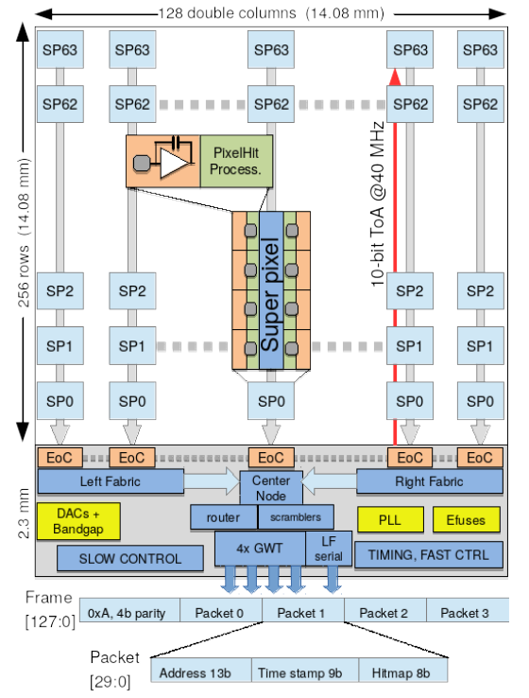
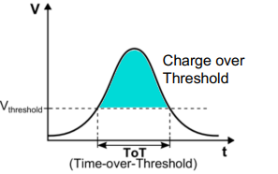
Down the rabbit hole of VeloPix architecture
Velopix transmits binary data generated from ToT measurement in each pixel
Combining information in “Super Pixels”, grouping 8 pixels in 2x4 grid sharing addres and time stamp info saving 30% data volume
Data is vertically transmitted with clock rate of 160MHz until it reached End of Column block (Eoc)
Data sent to Central node which assembles data in 128 bit frames and feed into the scrambler
Scrambles uses Linear Feedback Shift Registers (LFSR) to avoid potential DC offsets, reducing electromagnetic interference and proper clock recovery
Gigabit Wireline Transmitter (GWT) serializes the data feeding to ensure radiation hardening
Data collection

Slide 8
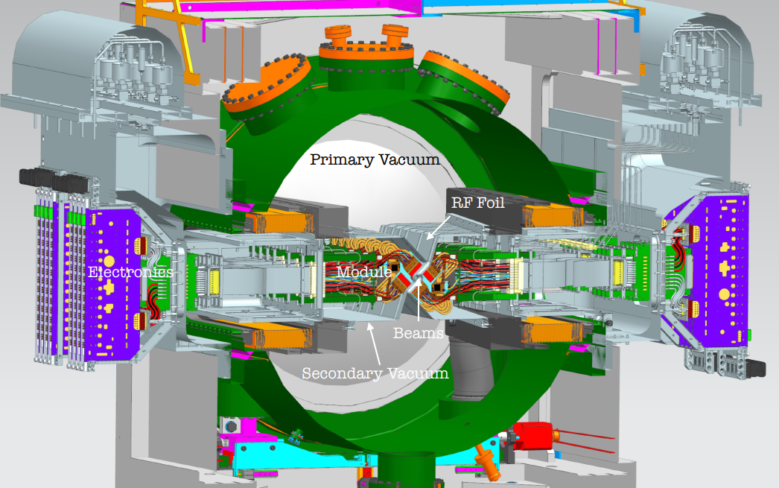
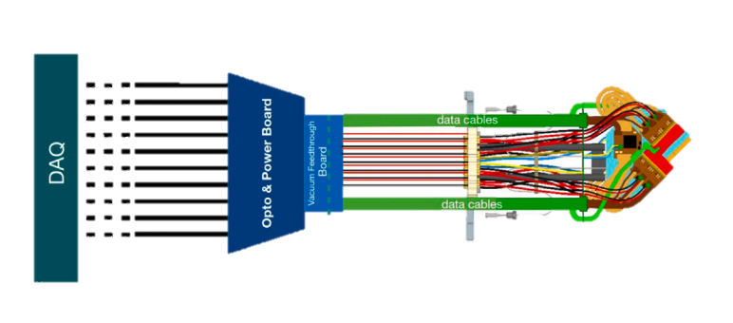
Zooming out.
What are further operational conditions?
RF Box/Foil of ~150 μm separates the LHC vacuum from the detector.
Evaporative CO2 cooling up to
-30 ºC in silicon micro-channel subtrates of ~ 0.5 mm thick withstanding pressures well above 65bar
Secondary vacuum
Air

Slide 9
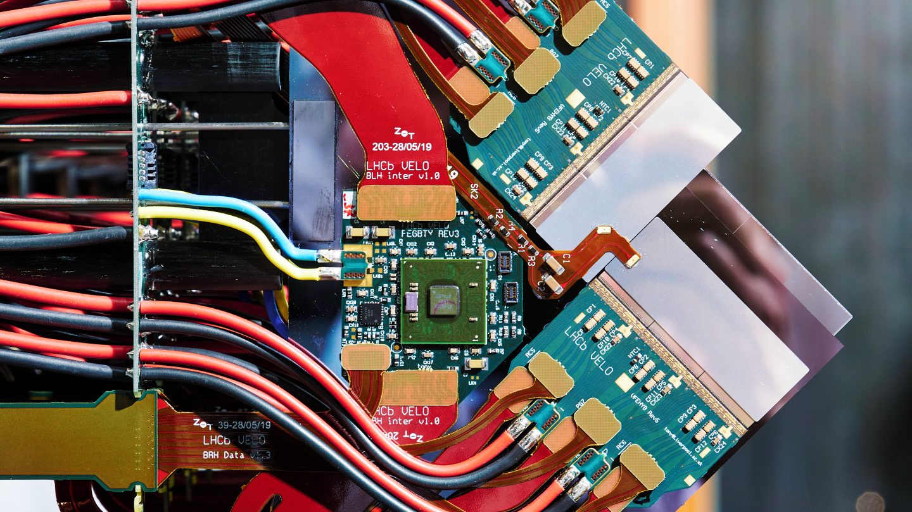
References:
https://indico.cern.ch/event/1291157/contributions/5876968/attachments/2899104/5083506/2024-07-18%20ICHEP.pdf
https://cds.cern.ch/record/2802195
https://cds.cern.ch/record/2655464/files/VeloPix_Pixel2018_KDeBruyn.pdf
https://indico.cern.ch/event/1291157/contributions/5876968/attachments/2899104/5083506/2024-07-18%20ICHEP.pdf
https://cds.cern.ch/record/2900026/files/Publication.pdf
https://www.nikhef.nl/news/bloedstollend-lhcb-detector-sluit-zich-voor-het-eerst-behoedzaam-om-lhc-bundel/
https://www.researchgate.net/publication/338926330_Phase_I_Upgrade_of_the_Readout_System_of_the_Vertex_Detector_at_the_Experiment
https://ep-news.web.cern.ch/content/upgrading-vertex-detector-lhcb-experiment
https://lhcb-outreach.web.cern.ch/detector/vertex-locator-velo/
https://cds.cern.ch/record/2846414/files/LHCb-PROC-2023-001.pdf
https://fse.studenttheses.ub.rug.nl/27620/1/bPHYS_2021_ClandfieldL.pdf
https://indico.cern.ch/event/1233430/attachments/2591386/4471987/decapua_VeloUpgrade.pdf

