Slide 1
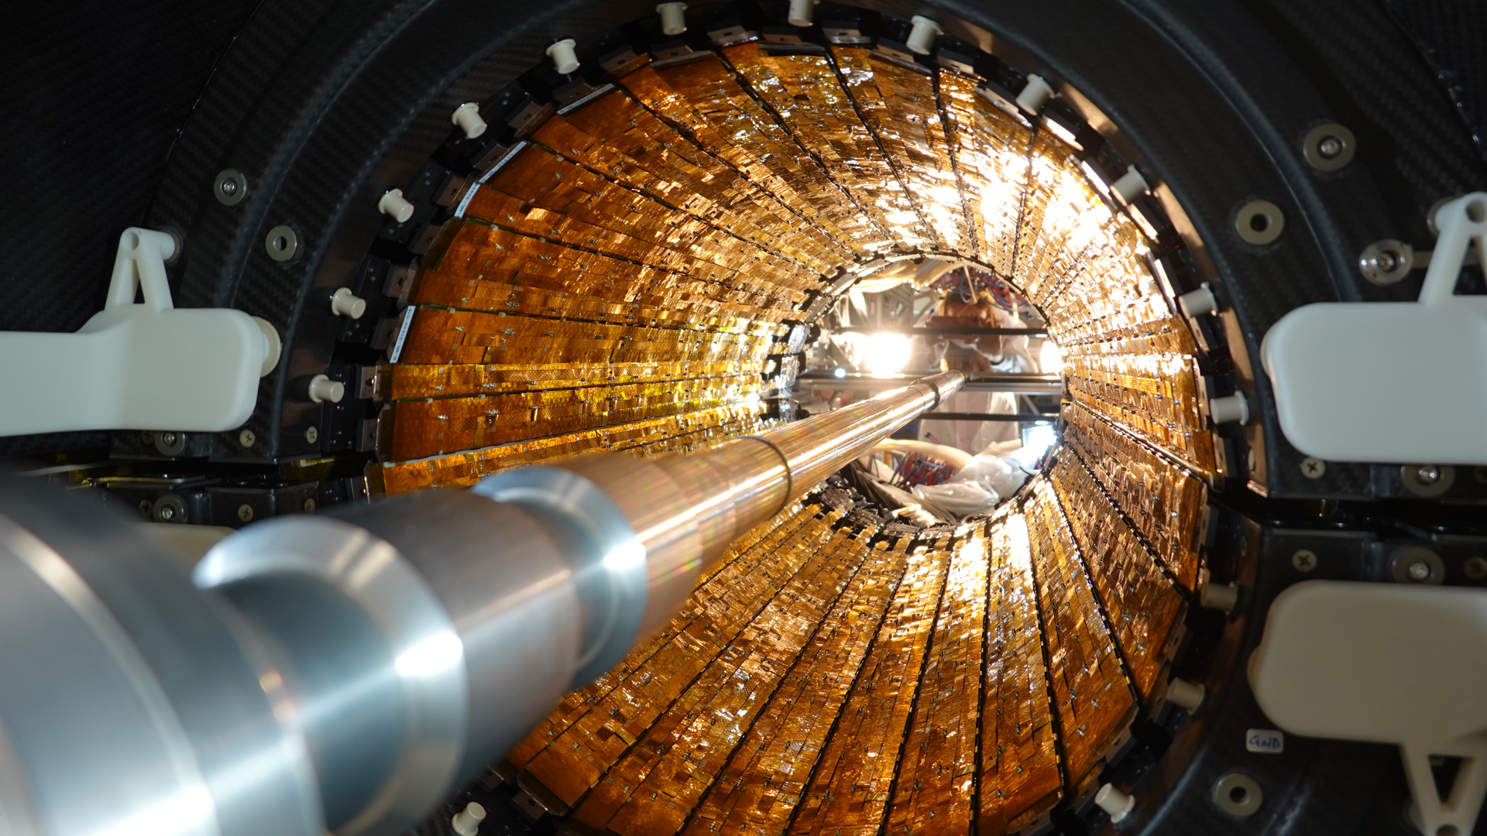
ALICE ITS2
By Wopke Telman
Alice ITS2 [1]

Slide 2
ALICE
A Large Ion Collider Experiment
LHC at CERN
1993
Quark Gluon Plasma (QGP)
Pb-Pb collisions
pp collisions
ALICE Logo [2]

Slide 3
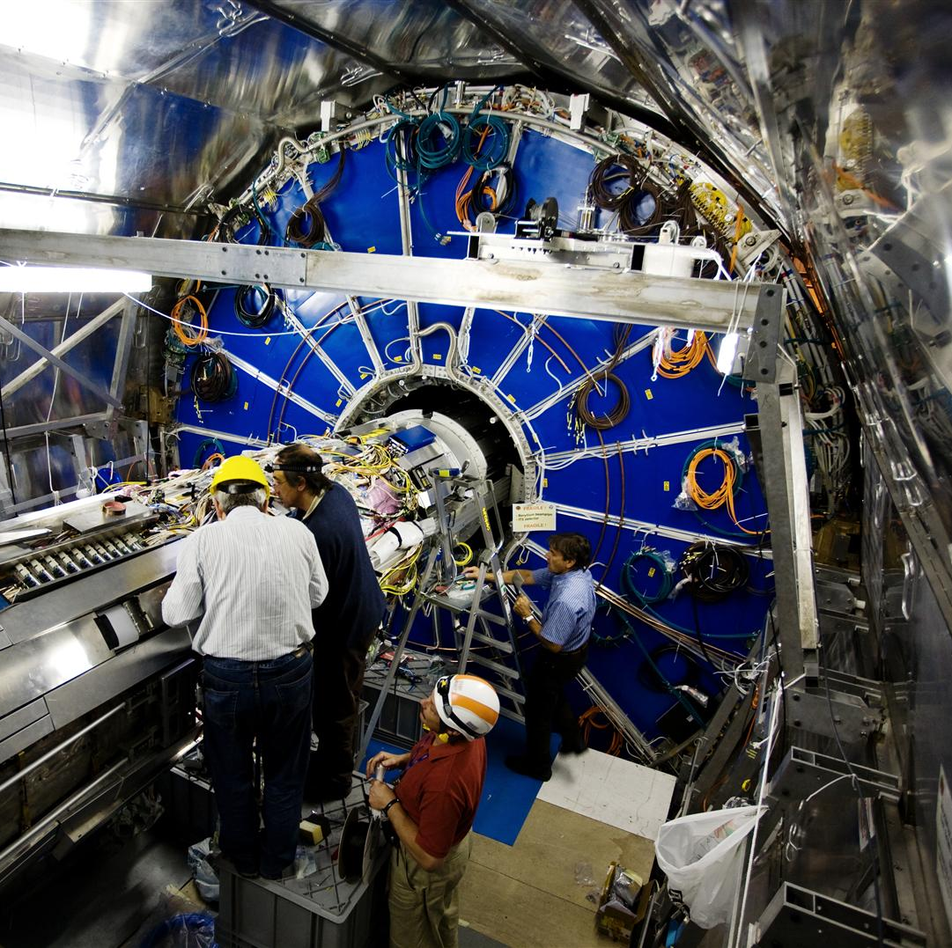
ALICE ITS1
Inner Tracking System
2013-2018
Sillicon detectors
Runs 1 and 2
ALICE ITS1 [3]

Slide 4
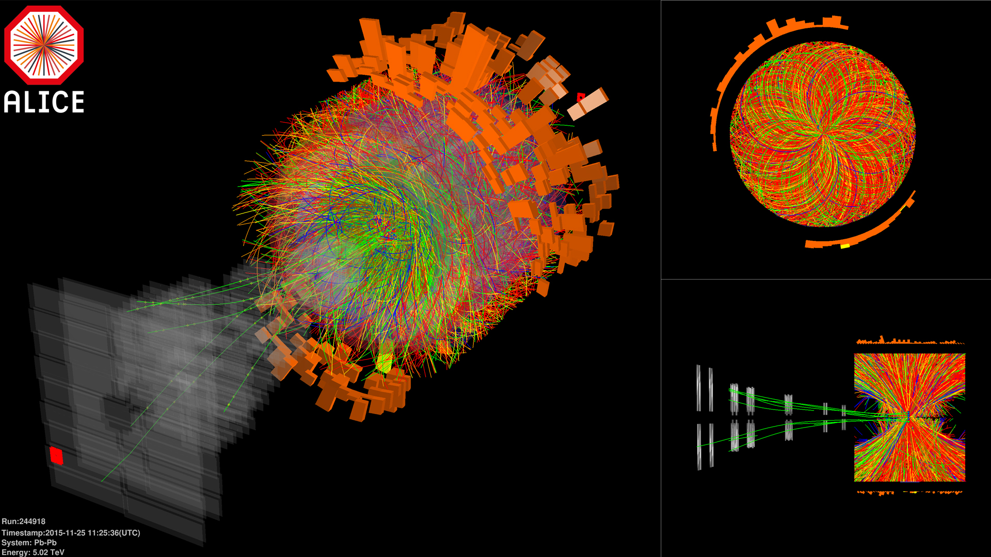
ITS2 Upgrade
LHC Long Shutdown 2
2022-now
Run 3
7 layer monolithic active pixel sensor-based detector
Particle tracks Pb collision [5]

Slide 5
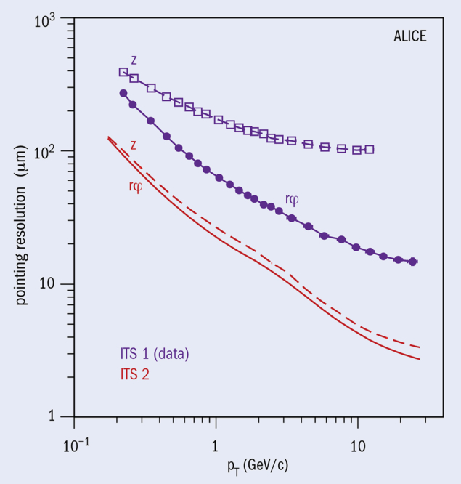
ITS2 Upgrade
Increase in Pb-Pb collision rate
Improved precision of the reconstruction of the primary vertex
Pixels with the same granularity
Low material budget (~0.36% X₀ per layer)
Impact parameter resolution as a function of the transverse momentum[6]

Slide 6
Comparison ITS1 – ITS2 [7]
Layers: 6 – 7
Pb-Pb read out: ~1kHz – 50 kHz
Innermost layer to interaction point: 39mm – 23mm
Pixel size: 50×425 µm² – 30×30 µm²
Material budget ~1.14% X₀ – ~0.36% X₀

Slide 7
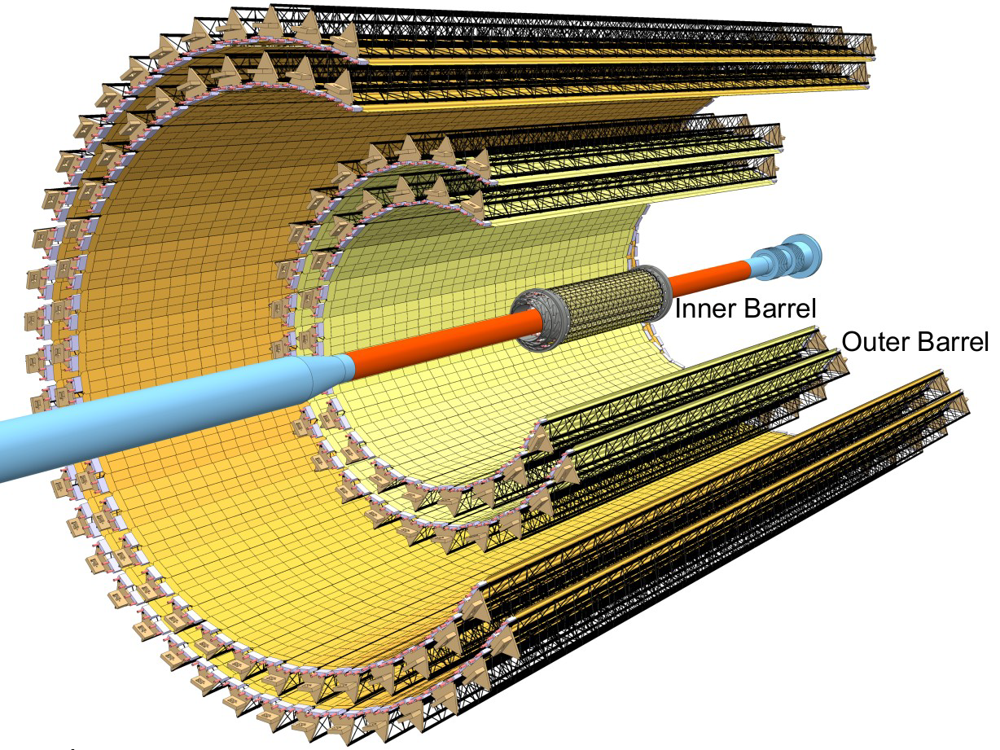
ITS2 Layout and Design Features
7 layers (3/2/2)
192 staves (48/54/90)
IB: 9 ALPIDE chips
OB: HICS, 2 rows by 7 chips
50-100 µm layers
10m² of active sillicon area
ALICE ITS2 Layout [7]

Slide 8
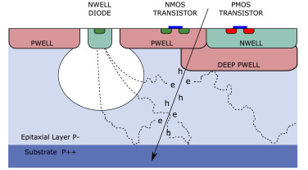
ALPIDE and Readout System
ALICE PIXEL DETECTOR:
MAPS (Monolithic Active Pixel Sensor)
Low power and noise (Fake-hit rate < 10⁻⁶ per pixel per event)
Radiation tolerant
Readout:
Continuous
Synchronization with LHC orbit frame
Two-phase CO₂ cooling system
Cross-section pixel sensor [8]

Slide 9
Tracking and Data Rate
Improvements in Tracking and Resolution
Low noise and stability (~0.15‰ of pixels had to be masked for noise out of 12.5 billion)
High-rate data taking: Continuous 50 kHz Pb–Pb readout achieved (TS1: <1kHz)
Calibration and alignment (~5 µm accuracy)
First fully MAPS-based tracker
HIC [1]

Slide 10
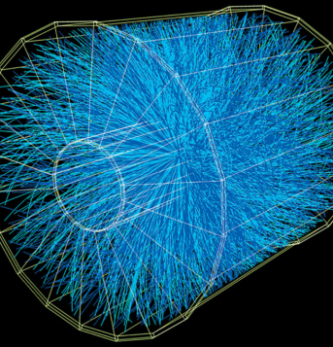
Heavy-Ion Physics Enabled by ITS2
ITS2 enables measuring more charmed and beauty hadrons, including baryons, to determine heavy-flavour transport coefficients [9]
Low-p_{T} reach: track charged particles down to zero momentum with efficiency [10]
High statistics
Rare probes: exotic states and rare signals
Forward and future synergy: better forward-rapidity vertexing for muonic decays with MFT
Pb-Pb collision [11]

Slide 11
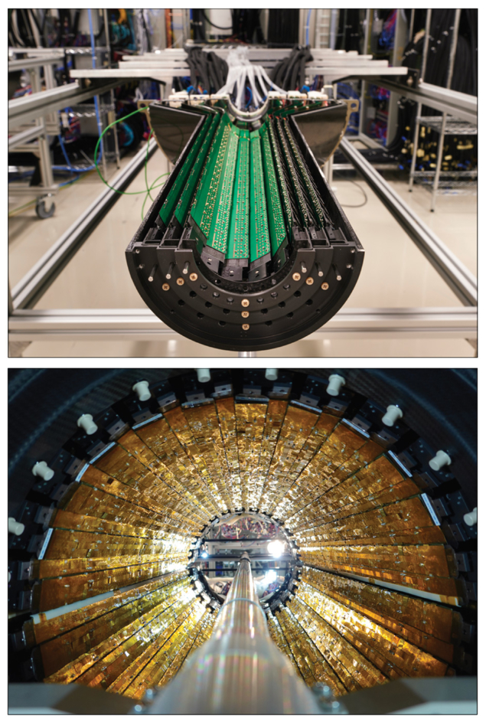
First Results from Run 3 (pp and Pb–Pb)
Data collected: 80 pb⁻¹ of pp collisions, 2 nb⁻¹ of Pb-Pb collisions
Heavy-ion performance; clear signals of heavy-flavor hadrons
New analysis avenues:
Non-prompt heavy flavor in Pb–Pb
First look at doubly charmed baryons and heavy exotica
Inner and outer barrel ITS2 [6]

Slide 12
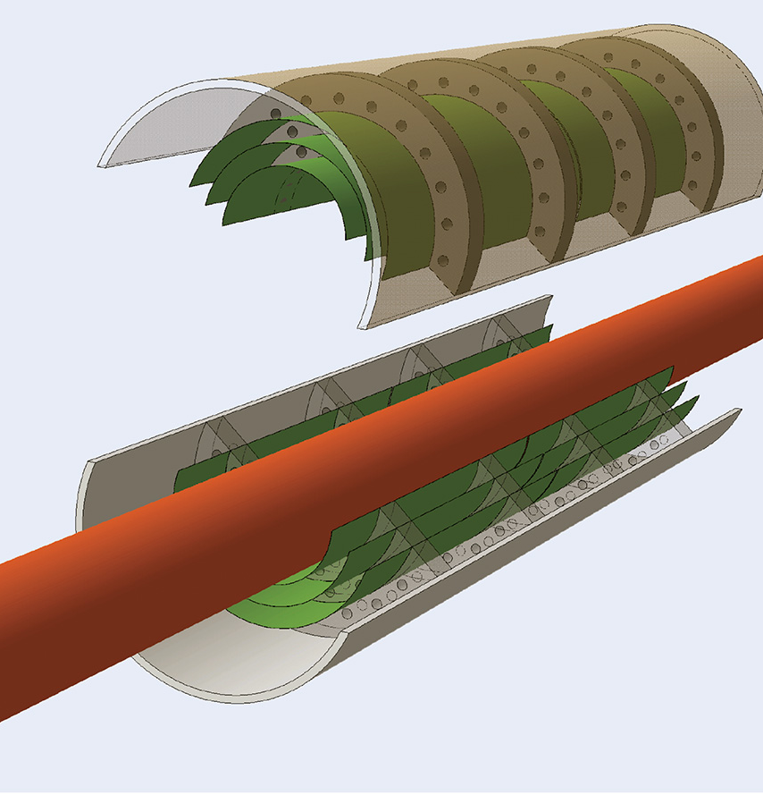
Summary and Future Outlook (ITS3 and Beyond)
Summary of ITS2: met its design goals
ITS3 (Long Shutdown 3, 2027), material budget to ~0.05% X₀ [12]
Future experiments
Concluding remark
Conceptual design ITS3 [12]

Slide 13
References
[1] https://www.technology.stfc.ac.uk/Pages/Project-Showcase/Inner-Tracking-System-2-%28ITS2%29---ALICE-upgrade%E2%80%AF%E2%80%AF-.aspx
[2] https://ep-dep.web.cern.ch/organisation/alice
[3] https://en.wikipedia.org/wiki/ALICE_experiment
[5] https://www.innovationnewsnetwork.com/inside-the-upgraded-alice-nuclear-physics-experiment-at-cern/20346/
[6] https://cerncourier.com/a/alice-tracks-new-territory/
[7] Isakov, A. (2025). ALICE ITS2: overview and performance. arXiv preprint arXiv:2502.04781.
[8] Mager, M., & ALICE collaboration. (2016). ALPIDE, the Monolithic Active Pixel Sensor for the ALICE ITS upgrade. Nuclear Instruments and Methods in Physics Research Section A: Accelerators, Spectrometers, Detectors and Associated Equipment, 824, 434-438.
[9] https://cerncourier.com/a/alice-tracks-new-territory/#:~:text=of%20new%20phenomena,understanding%20the%20interplay%20between%20the
[10] https://ep-news.web.cern.ch/content/alice-its-upgrade-pixels-quarks#:~:text=The%20brand,all%20collisions%2C%20translates%20to%20an
[11] https://cerncourier.com/a/heavy-ion-physics-past-present-and-future/
[12]Liu, J., & ALICE collaboration. (2024). ALICE ITS3: A truly cylindrical vertex detector based on bent, wafer-scale stitched CMOS sensors. Nuclear Instruments and Methods in Physics Research Section A: Accelerators, Spectrometers, Detectors and Associated Equipment, 169355.

