Slide 1
Aart
Heijboer
neutrino
physics
KM3NeT 2.0
Mediterranean Sea

Slide 2
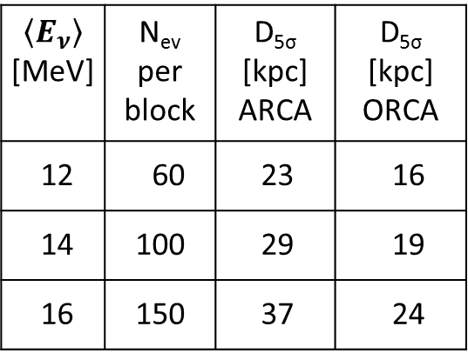
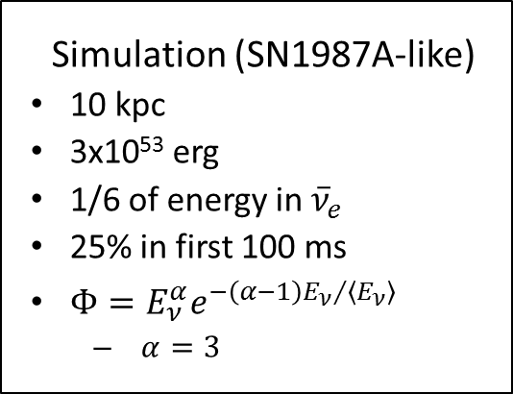
Supernova neutrinos
10³
10²
10¹
1
10⁻¹
10⁻²
10⁻³
10⁻⁴
⁴⁰K
<E_{ν}>=12 MeV
<E_{ν}>=14 MeV
<E_{ν}>=16 MeV
Simulation (SN1987A-like)
10 kpc
3x10⁵³ erg
1/6 of energy in ${\overline{ν}}_{e}$
25% in first 100 ms
$Φ=E_{ν}^{α}e^{−\left(α−1\right){E_{ν}}/{\left\langle E_{ν}\right\rangle }}$
  $α=3$
Supernova
neutrinos
rate [Hz]
atmospheric
muons
$$\left\langle E_{ν}\right\rangle$$ [MeV] | N_{ev} per block | D_{5σ} [kpc] ARCA | D_{5σ} [kpc] ORCA
12 | 60 | 23 | 16
14 | 100 | 29 | 19
16 | 150 | 37 | 24
2
4
6
8
10
12
14
16
18
20
multiplicity
≥80% of all Galactic Supernovae
detected with 5σ / detector block!

Slide 3
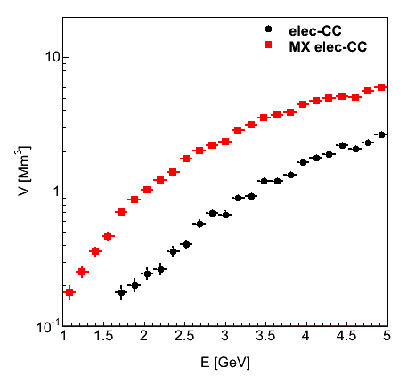
ORCA effective volume ν_{e}

