Slide 1


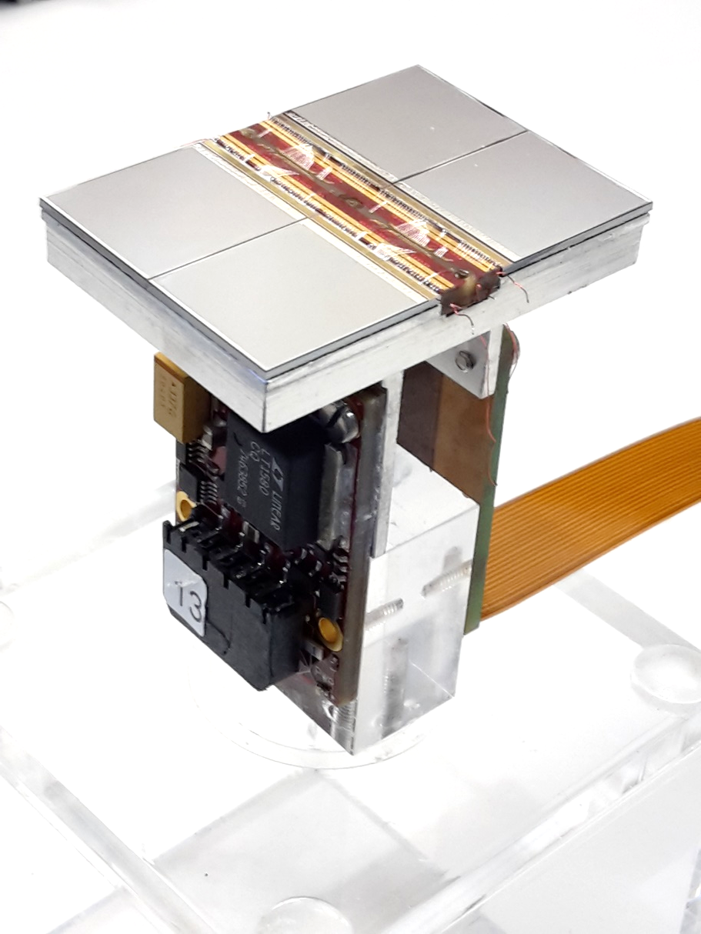





Pixel TPC particle identificaction performance
Yevgen Bilevych, Klaus Desch, Sander van Doesburg, Harry van der Graaf, Fred Hartjes, Jochen Kaminski, Peter Kluit, Naomi van der Kolk,
Cornelis Ligtenberg,
Gerhard Raven, and
Jan Timmermans
LCTPC Bonn meeting January 2025

Slide 2
Discuss of two NIM papers
on module performance
First paper with emphasis on module construction and tracking performance (this talk)
Second paper with emphasis particle identification (second talk) and other analysis results (this talk)

Slide 3
DESY testbeam Module Analysis
Number of hits per chip
B=0 T
B=1 T
Preliminary
B=0 T has a large Landau tail
B=1 T smaller Landau tail and a more gaussian distribution
An electron crossing 8 chips in the module has about 1000 TX3 hits

Slide 4
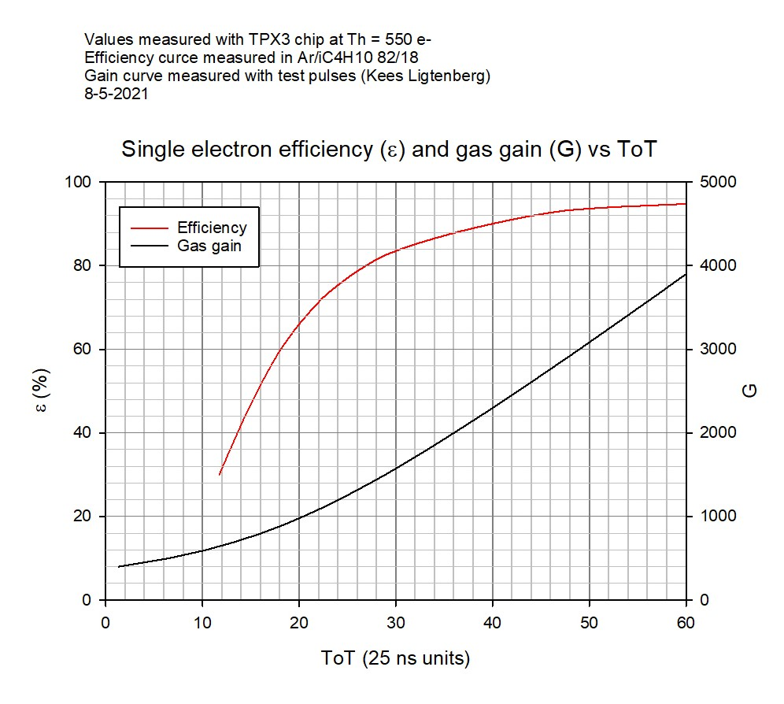
DESY testbeam Module Analysis
Single-electron efficiency of the module
The single electron efficiency for the quad detector as a function of the grid voltage and the measured ToT
For the module <ToT> = 0.68(0.86) µs at B= 0(1) T
The following results were obtained
 | <hits> (MOP) B=0 | <hits> (MOP) B= 1
Measured | 124 (87) | 89 (64)
MagBoltz | 106 | -
This is consistent with a detector running at 85% single-electron efficiency

Slide 5
DESY testbeam Module Analysis
Particle Identification (PID) performance
The number of hits per unit of track length can be used to identify particles by hit or cluster counting
Here not only the number of hits or clusters are important but also the fluctuations
Comparing the number of hits for B=1 T to 0 T one can observe a reduction of the fluctuation
For a GridPix we know that there is a contribution from UV photons that contribute to the Landau
The HV scan shows extra hits that are produced
Note the smaller the fluctuations* the better the PID
* So if one can reduce the UV photons, using e.g. a double grid it will improve further the PID performance
Thesis Kees Ligtenberg

Slide 6
DESY testbeam Module Analysis
Analysis of PID performance
Combine chips to form 1 m long track with 60 % coverage for electrons
Truncation method: reject large clusters and then run dEdx @ 90% with slices of 20 pixels along track (xy) (gives nr of selected hits). A large cluster has more than 6 hits in 5 consecutive pixels.
Template fit method: fit the slope of the N_{scaled} minimum distance in xy (d) distribution with an exponential function (N_{scale}(d)=defines the inverse weights):
N(d)_{scaled} = N_{scale}(d) N_{observed}(d)
N(d)_{scaled} is then fitted for each track with N₀ exp(-slope d)
Calculate the “PID” variable for electrons and MIP (==70% of hits)
  Truncation method = nr of selected hits
  Template fit method = slope
  Resolution is σ = σ(PID)/PID (for σ we use the rms)

Slide 7
DESY testbeam Module Analysis
Distance distribution
Calculate minimum distance in xy between the hits.
The slope of the distribution is related to the number of primary clusters/cm.
The diffused peak at d<10 pixels comes from clusters with > 1 hit.
Single chip
Quad module
B=0 T
Preliminary
Thesis Kees Ligtenberg

Slide 8
DESY testbeam Module Analysis
Performance of dEdx
Template fit of slope of the distance distribution
From 10 clusters onwards an exponential distribution is followed.
Below 10 the distribution will be down-weighted (N_{scale}(d) = 1/weight). The weights are:
Weights B=0 = { 35.0467 , 12.1497 , 4.52914 , 2.76311 , 1.99386 , 1.59795 , 1.3656 , 1.21409 , 1.11898 , 1.04385 };
Weights B=1 = { 22.5617 , 7.39573 , 2.43318 , 1.54528 , 1.23428 , 1.09727 , 1.04368 , 1.01625 , 1.00182 , 0.998178 };
Note the difference in weights in the B=0 and 1 T data sets. This is related to the large Landau fluctuations
B=0 T
Preliminary

Slide 9
DESY testbeam Module Analysis
PID performance truncation method
Electron resolution
3.6%
1 m track 60% and coverage
Linearity MIP-e = 1.03
z drift=5-15 mm (flat)
Preliminary
MIP in plot was corrected … thanks Ulli

Slide 10
DESY testbeam Module Analysis
PID performance template fit method
Electron resolution
2.9%
1 m track 60% and coverage
Linearity MIP-e = 1.07
so syst uncertainty on resolution +7%
Preliminary

Slide 11
DESY testbeam Module Analysis
PID performance of a Pixel TPC
The dEdx resolution for electrons from data by combining tracks to form a 1 m long track with realistic coverage ~60% coverage.
Preliminary
Method | B=0 Resolution (%) | B= 1 T Resolution (%)
Truncation | 6.0 | 3.6
Template fit | 5.4 | 2.9
The truncation method has a slightly worse performance – as it is more sensitive to the hits than the template fit method – that is more sensitive to the number of clusters.

Slide 12
DESY testbeam Module Analysis
PID Performance extrapolated to the ILD detector
ILD detector
rInner = 329 rOuter = 1770 mm
electron resolution = 2.4 (3.0) %
at θ=π/2
Assume Pixel TPC performance at B = 1 T at p = 5,6 GeV/c
Test beam B = 1 T
p=5,6 GeV/c
Template fit (Truncation)
electron resolution
2.9 (3.6)%
1 m track 60% and coverage

Slide 13
DESY testbeam Module Analysis
ILD dEdx performance
From dEdx studies in ILD (Ullrich Einhaus)
Extracted the ILC soft parametrisations for energy loss based on G4 and full simulation of the ILC TPC with T2K gas
Link generated in 2020 with ILC soft v02-02 and v02-02-01

Slide 14
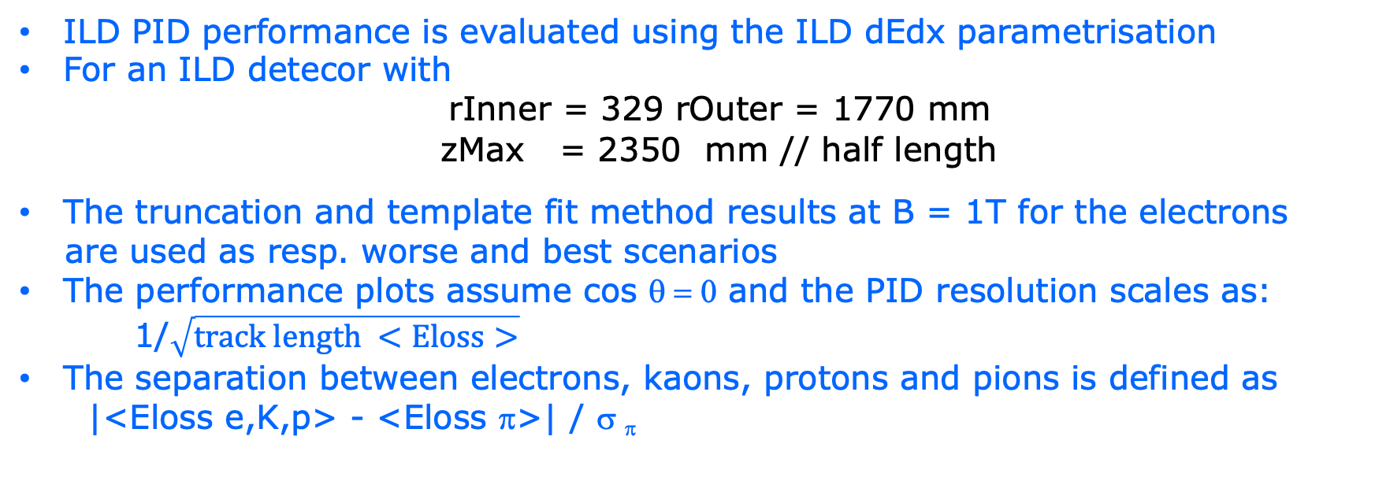
DESY testbeam Module Analysis
ILD Pixel TPC PID performance
ILD PID performance is evaluated using the ILD dEdx parametrisation
For an ILD detecor with
rInner = 329 rOuter = 1770 mm
zMax = 2350 mm // half length
The truncation and template fit method results at B = 1T for the electrons
are used as resp. worse and best scenarios
The performance plots assume cos θ = 0 and the PID resolution scales as:
1/$\sqrt{track length <Eloss>}$
The separation between electrons, kaons, protons and pions is defined as
|<Eloss e,K,p> - <Eloss π>| / σ _{π}

Slide 15
DESY testbeam Module Analysis
ILD pixel TPC PID performance
ILD PID Performance for the two methods: template fit (solid), truncation (dashed)
The expected pion-kaon PID separation for momenta in the range of 2.5-45 GeV/c at cos θ = 0 is more than 5.5(4.5)σ
At a momentum of 100 GeV/c the separation is still 3.0(2.0)σ
The expected pion-proton PID separation for momenta in the range of 2.5-100 GeV/c at cos θ = 0 is more than 6.0(4.8)σ
ILD Pixel TPC
Preliminary

Slide 16
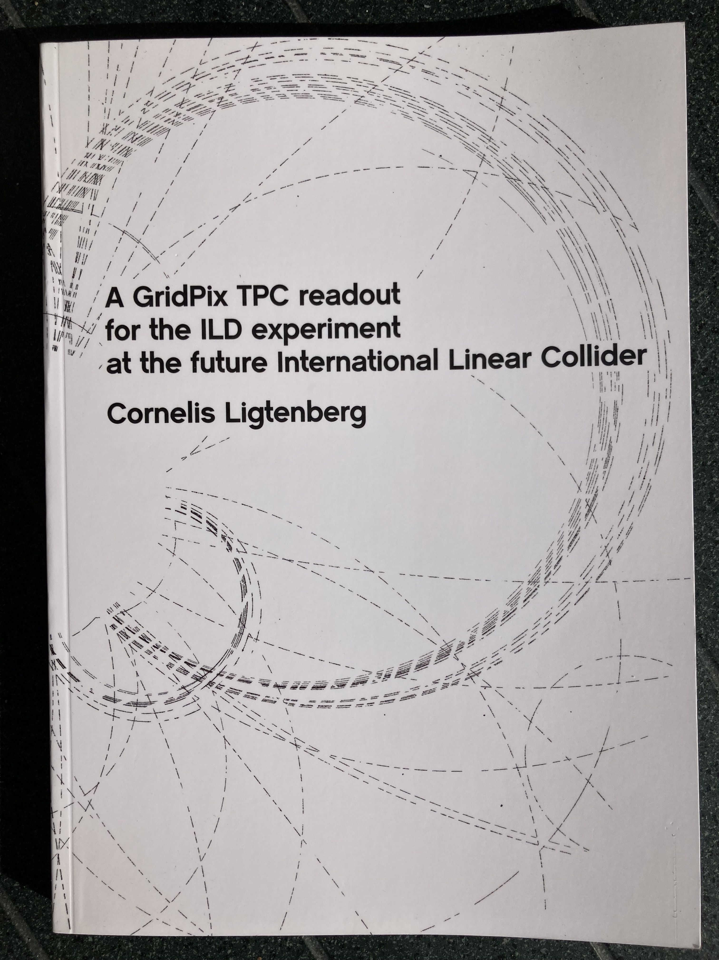
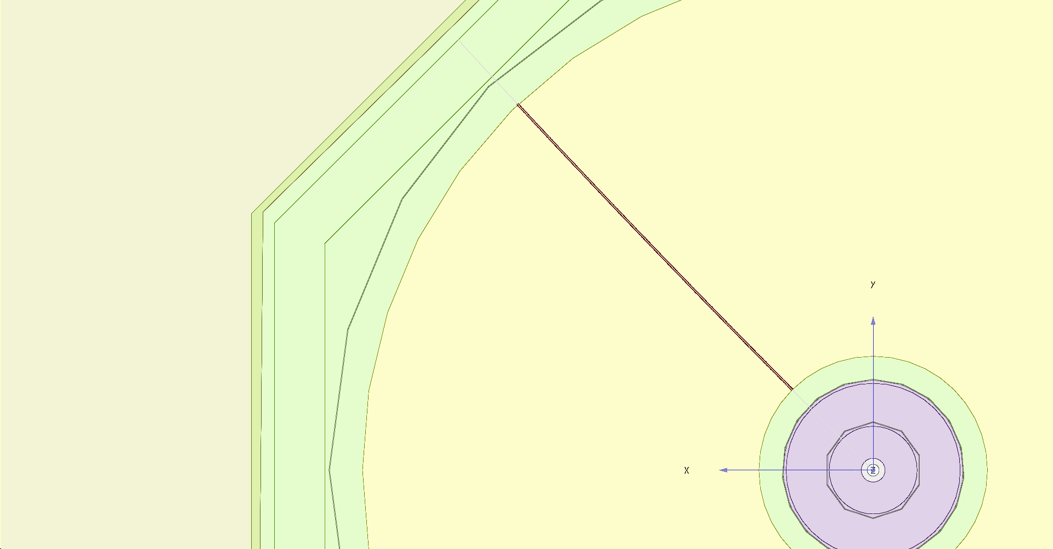
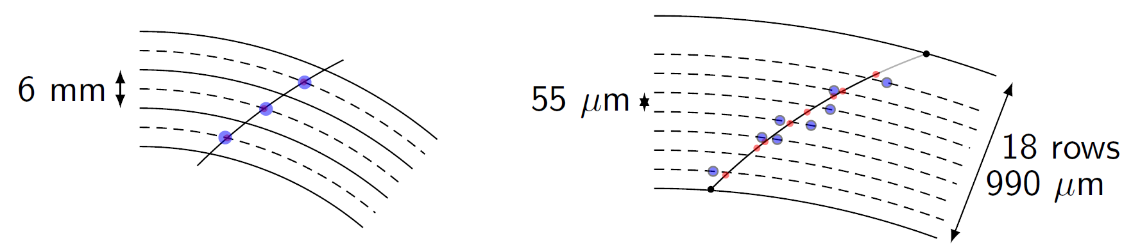
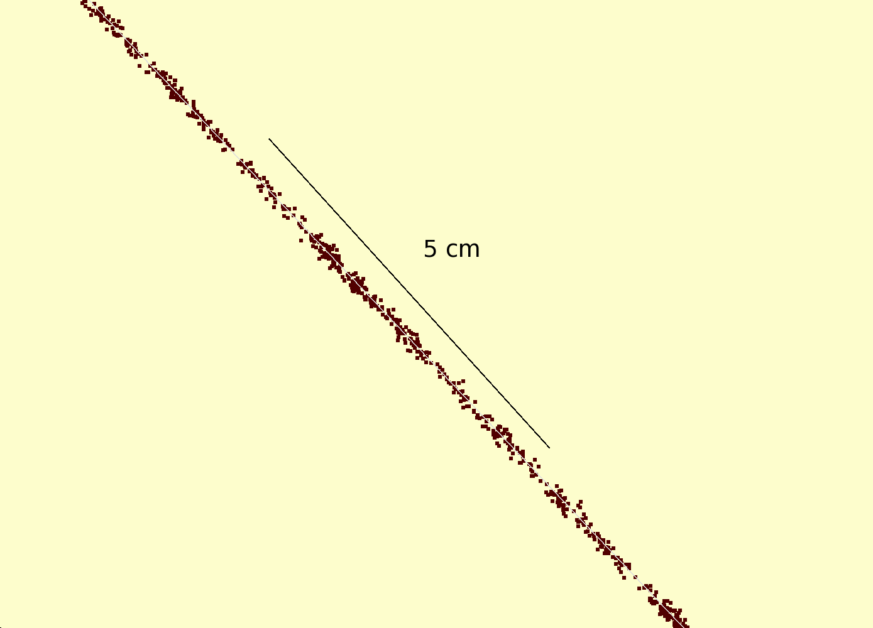
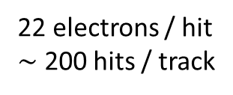
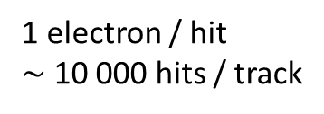
Simulation of ILD TPC with pixel readout
To study the performance of a large pixelized TPC, the pixel readout was implemented in the full ILD DD4HEP (Geant4) simulation
Changed the existing TPC pad readout to a pixel readout
Adapted Kalman filter track reconstruction to pixels
details: PhD thesis Kees Ligtenberg
pixels
pads
50 GeV muon track with
pixel readout

Slide 17
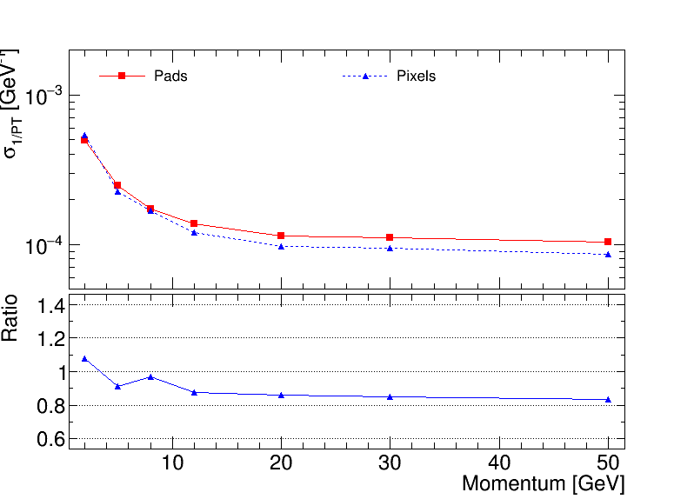
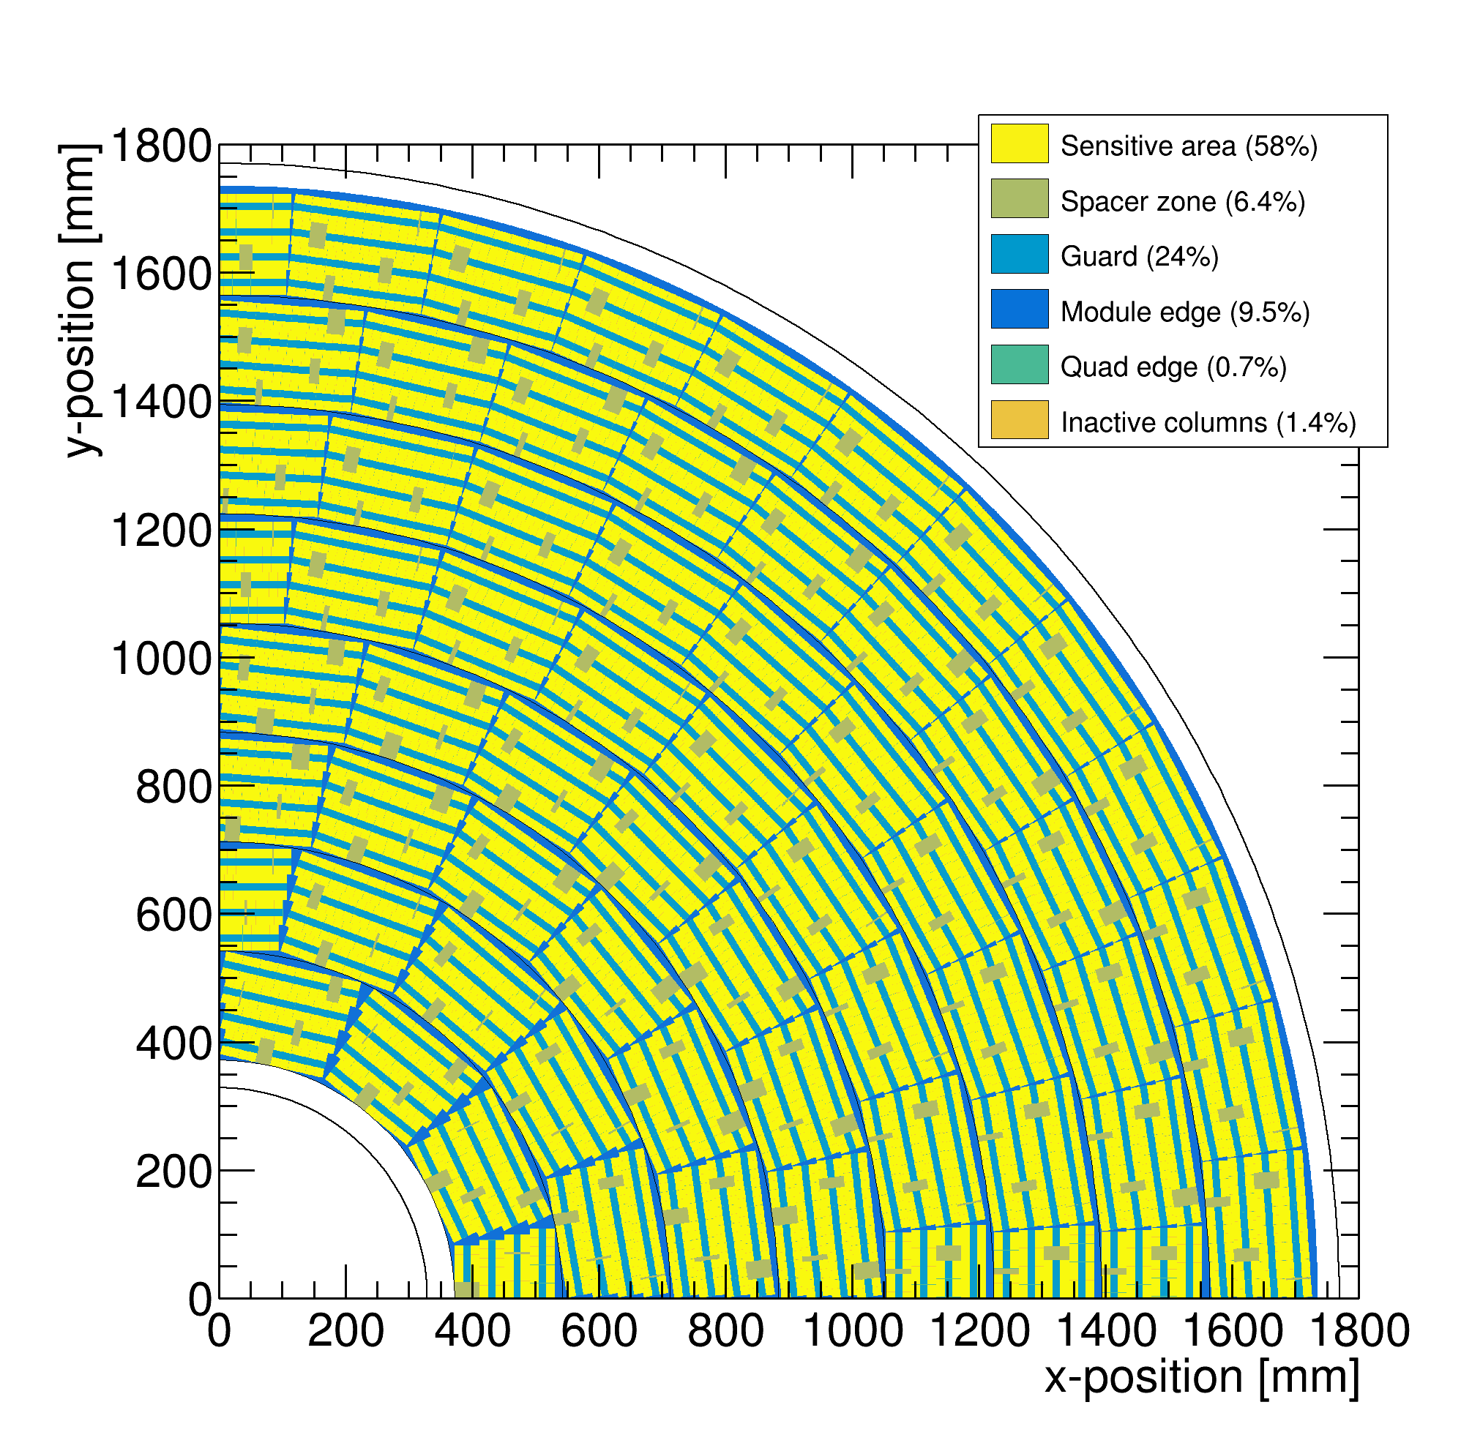
Performance of a GridPix TPC at ILC
From full simulation the momentum resolution can be determined
Momentum resolution is about 15% better for the pixels with realistic coverage (with the quads arranged in modules coverage 59%) and deltas.

Slide 18
Pixel TPC tracking studies
ILD tracking Performance for a Pixel TPC based on test beam
10 cm track resolution
Single electron resolution 6 mm track(“pad”) resolution
Each 10 cm we have a point with a resolution of < 18 (31) μm on the track
Comparable to performance of a silicon detector (but TPC gas material).

Slide 19
Performance of a GridPix TPC
Further integration of the Pixel TPC in the ILD software
A thought by Frank Gaede about combining pixels into pads:
one could easily project the pixels into pads - of similar/same size as in the current ILD simulation
but rather than simply adding up the charge, you can compute the true center-of-gravity based position and charge of the virtual pad
in a second step you combine neighbouring pads to a cluster and compute the position (in r-phi, z) of the cluster and create a SimHit from this
both operations should be linear in time (i.e. one loop over pixels/pads)
This procedure should preserve all the point resolution information of the pixels but allow you to run standard Clupatra as for the pad based TPC reconstruction.

Slide 20
Pixel TPC: Track fitting at the edge
In case of the a realistic geometry with detector edges, Kees Ligtenberg observed a worsened momentum resolution and momentum biases. This was traced down to be caused by biases in the residuals at the edge of the detector
The conclusion was that the track fit should be updated to take into account the (small) biases in the residuals at the detector edge(s)
Recently, a master student (computational physics) at the UvA, Peter Voerman, has written a track fit that corrects the biases in one pass: “Track fitting at the edge”.
The technique can also be applied to fit hits from other gaseous or non-gaseous detectors:
  a centre of gravity technique is used (with measured charges over multiple strips near the edge)
  in case of silicon detector hits near the boundaries of the sensitive volume

Slide 21
Pixel TPC PID performance
The relative PID resolution for an electron with p=5,6 GeV/c and 1 m track length with 60% coverage is measured to be:
  2.9 (3.6)% using the template fit (truncation) methods at B = 1 T
This is world-best resolution per meter of track length of constructed TPCs running at atmospheric pressure
The extrapolated PID resolution for the ILD detector is 2.4 (3.0)%
This allows for particle identification and separation of kaons from pions for momenta 2.5-45 GeV/c at cos θ = 0 with more than 5.5 (4.5)σ.
A pixel TPC has become a realistic viable option for experiments
  High precision tracking like ILD@ILC in the transverse and longitudinal planes, dE/dx by electron and cluster counting, excellent two track resolution, digital readout that can deal with high rates

Slide 22
DESY testbeam Module Analysis
ILD Pixel TPC PID performance
Backup
ILD Pixel TPC
Separation pion-kaon for different cos(theta) values due to the track length dependence
For cos(theta)=0 till 0.95 the separation lies between the black and red curves. Only above 0.95-0.975 the separation drops till the blue curve.
Excellent performance over very large polar angle range
Preliminary

Slide 23
Pixel TPC: Track fitting at the edge
Backup
Peter Voerman

Slide 24
Pixel TPC: Track fitting at the edge
Backup
Peter Voerman

Slide 25
Operation of a Pixel TPC at CEPC or FCC-ee

Slide 26
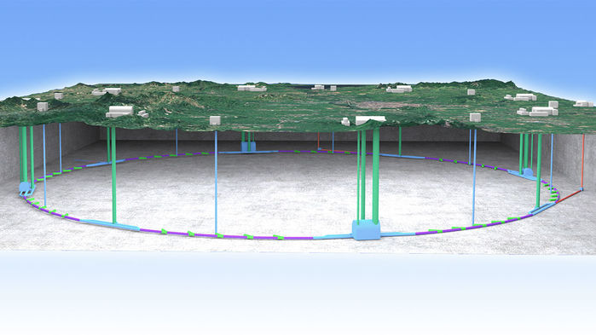
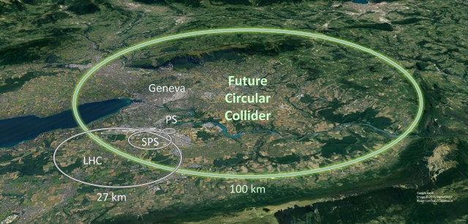
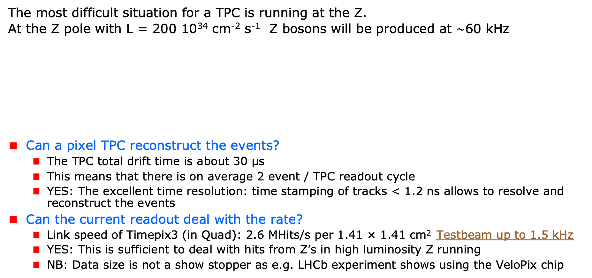
A Pixel TPC at CEPC or FCC-ee
The most difficult situation for a TPC is running at the Z.
At the Z pole with L = 200 10³⁴ cm⁻² s⁻¹ Z bosons will be produced at $\sim$60 kHz
Can a pixel TPC reconstruct the events?
  The TPC total drift time is about 30 μs
  This means that there is on average 2 event / TPC readout cycle
  YES: The excellent time resolution: time stamping of tracks < 1.2 ns allows to resolve and reconstruct the events
Can the current readout deal with the rate?
  Link speed of Timepix3 (in Quad): 2.6 MHits/s per 1.41 × 1.41 cm² Testbeam up to 1.5 kHz
  YES: This is sufficient to deal with hits from Z’s in high luminosity Z running
  NB: Data size is not a show stopper as e.g. LHCb experiment shows using the VeloPix chip
Picture IHEP

Slide 27
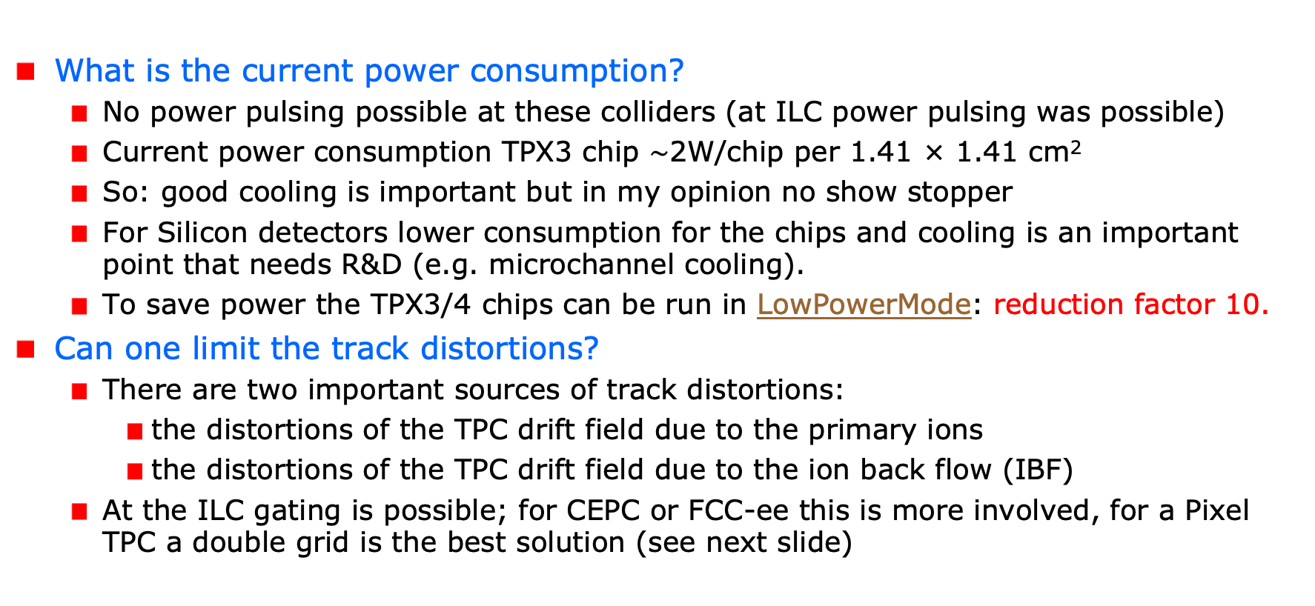
A Pixel TPC at CEPC or FCC-ee
What is the current power consumption?
  No power pulsing possible at these colliders (at ILC power pulsing was possible)
  Current power consumption TPX3 chip $\sim$2W/chip per 1.41 × 1.41 cm²
  So: good cooling is important but in my opinion no show stopper
  For Silicon detectors lower consumption for the chips and cooling is an important point that needs R&D (e.g. microchannel cooling).
  To save power the TPX3/4 chips can be run in LowPowerMode: reduction factor 10.
Can one limit the track distortions?
  There are two important sources of track distortions:
    the distortions of the TPC drift field due to the primary ions
    the distortions of the TPC drift field due to the ion back flow (IBF)
  At the ILC gating is possible; for CEPC or FCC-ee this is more involved, for a Pixel TPC a double grid is the best solution (see next slide)

Slide 28
A Pixel TPC at CEPC or FCC-ee
Is it possible to reduce the IBF for a pixel TPC?
  IDEA: by making chip with a double grid structure (see back up slide)
  This idea was already realized as a TWINGRID NIMA 610 (2009) 644-648
  For GEMs for the ALICE TPC this was also the way – several GEMs on top of each other to reduce IBF
  For the Pixel the IBF can be easily modelled and with a hole size of 25 μm an IBF of 3 10⁻⁴ can be achieved and the value for IBF*Gain (2000) would be 0.6.
  YES: the IBF can be reduced to 0.6 but this needs R&D
  In the new detector lab in Bonn it is possible to make and study this device
What would be the size of the TPC distortions?
  Tera-Z studies by Daniel Jeans and Keisuke Fuji show that for FCC-ee or CEPC this means: distortions from Z decays up to < O(100) μm
  Beam strahlung gives (now) a factor 200 more hits in the TPC. See Daniel Jeans studies in ECFA2024. Detector optimization and shielding is important for TPC and Silicon detectors to reduce pair background. A recemt study shows the potential.
  It was argued that in an ILD like detector the distortions can be mapped or fitted out using the VTX-SIT/SET detectors (see next slide).

Slide 29
Fitting out TPC distortions in ILD/CEPC
It is possible to map out distortions using e.g. muons from Z decays
  E.g. by fitting the 3D spatial distribution as a function of time as was done by ALEPH and more recently by ALICE. Using this distribution the hits positions are corrected and the TPC track refitted.
However, with silicon trackers around the TPC, more elaborate methods can be used. One can use the track predictions based of the silicon trackers SIT and SET to correct on a track-by-track level the TPC track.
  One can use as a constraint that the extrapolated positions and angles agree with the measured in the SIT and SET.
  Practically, one can e.g. correct the TPC track parameters
The ultimate way is a fitting technique similar to ATLAS. In the ATLAS track fit the common systematics is fitted out for sets of Muon hits. For ILD/CEPC the fit would fit free parameters in the distortion model, while using as a constraint the SIT and SET position and direction measurements.
  The simplest case is a model where the strength (amplitude) and radial dependence would be scaled and a model is used for the 3D extrapolations.

Slide 30
Conclusions: Pixel TPC at CEPC or FCCee
YES: a pixel TPC can reconstruct the Z events in one readout cycle
YES: the current readout of the Timepix3 chip can deal with the Z hit rate running
  The beam–beam background currently dominates the hit rate
The current power consumption is 1W/cm². By running the TPX chips in low power mode this can be reduced by a factor of 10. Still good cooling is important no show stopper.
Track distortions in the TPC drift volume are a concern at high lumi Z running:
  Track distortions from Z decays in TPC are O(100) μm
  The current MDI design FCCee/CEPC gives a lot of beam-beam background more that a factor 100 more hits from the beam than from the Z. An improved MDI is needed. Also a high B field (say 3 T) would help (now an option at FCCee).
  It is possible to reduce the IBF for a pixel TPC by making a device with a double grid
  A double grid needs dedicated R&D that can be performed in the new lab in Bonn
The Z physics program at FCC-ee or CEPC with an ILD-like detector with a Pixel TPC (with double grid structures) sliced between two silicon trackers (VTX-SIT and SET) can be fully exploited. The reduction of beamstrahlung by an improved MDI – and the fitting out of distortions - needs more study.
A pixel TPC can perfectly run at WW, ZH or tt energies where track distortions are several orders of magnitude smaller

Slide 31
Reducing the Ion back flow in a Pixel TPC
The Ion back flow can be reduced by adding a second grid to the device.
It is important that the holes of the grids are aligned. The Ion back flow is a function of the geometry and electric fields. Detailed simulations – validated by data - have been presented in LCTPC WP #326.
With a hole size of 25 μm an IBF of 3 10⁻⁴ can be achieved and the value for IBF*Gain (2000) would be 0.6.
Ion backflow | Hole 30 μm | Hole 25 μm | Hole 20 μm
Top grid | 2.2% | 1.2% | 0.7%
GridPix | 5.5% | 2.8% | 1.7%
Total | 12 10⁻⁴ | 3 10⁻⁴ | 1 10⁻⁴
transparancy | 100% | 99.4% | 91.7%

