Slide 1


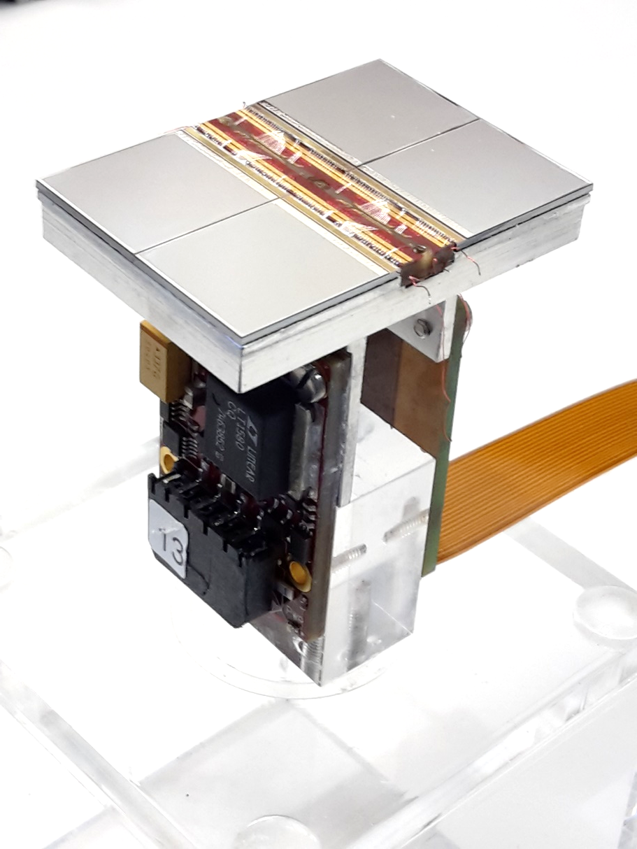





Pixel TPC resolution and deformation results
Yevgen Bilevych, Klaus Desch, Sander van Doesburg, Harry van der Graaf, Fred Hartjes, Jochen Kaminski, Peter Kluit, Naomi van der Kolk,
Cornelis Ligtenberg,
Gerhard Raven, and
Jan Timmermans
LCTPC Bonn meeting January 2025

Slide 2
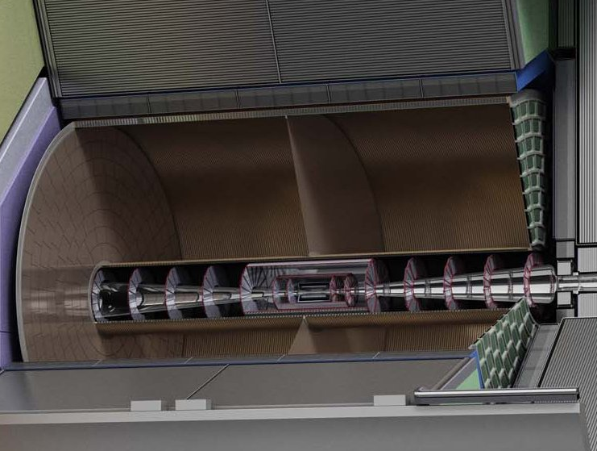
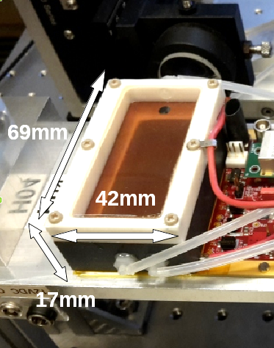
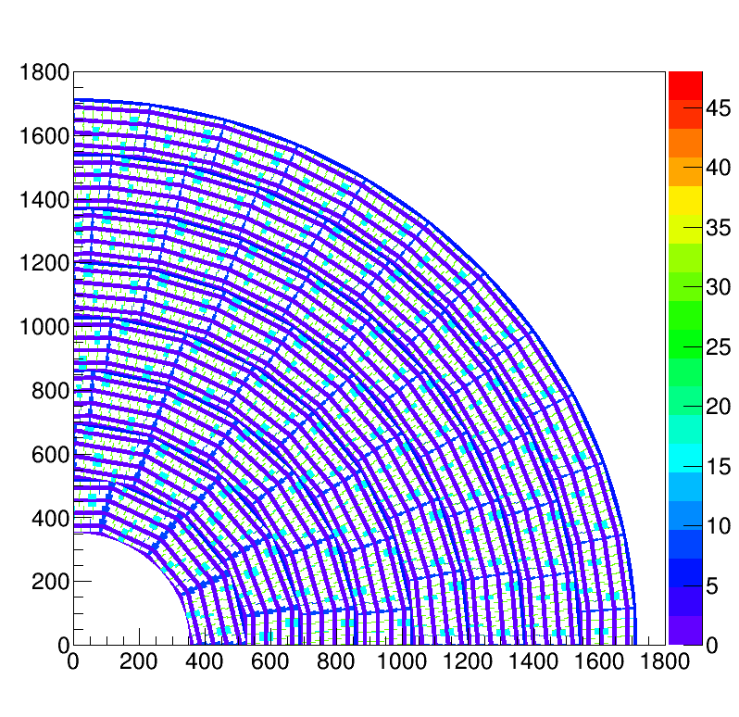
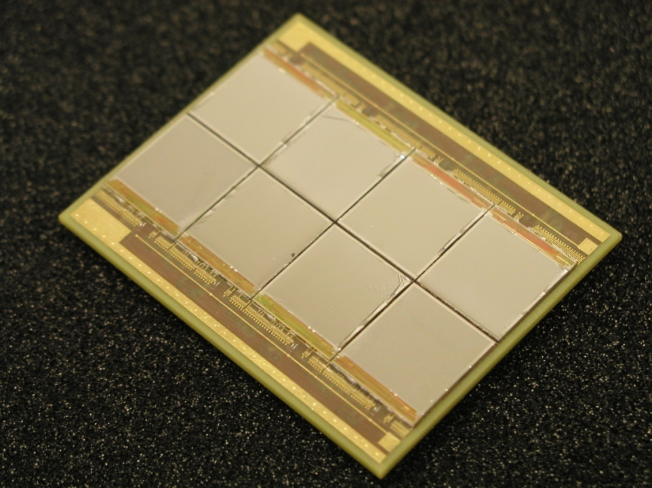
Pixel TPC
(Octopuce)
(TimePix1) TPX3 chip Quad Module TPC plane
(2007-14) 2017 2018 2019

Slide 3
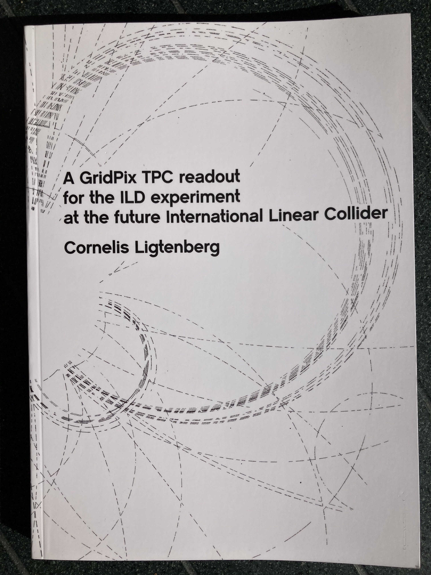
Pixel TPC
Material budget is
  0.01 X₀ TPC gas
  0.01 X₀ inner cylinder
  0.03 X₀ outer cylinder
  < 0.25 X₀ endplates (incl readout)
Note the very low budget in the barrel region. Material budget can be respected by different technologies like GEM, MicroMegas and Pixels
TPC is sliced between silicon detectors VTX, SIT and SET
pixel readout is a serious option for the TPC readout plane @ ILC/FFC-ee/CLIC/CEPC colliders
https://www.nikhef.nl/pub/services/biblio/theses_pdf/thesis_C_Ligtenberg.pdf

Slide 4
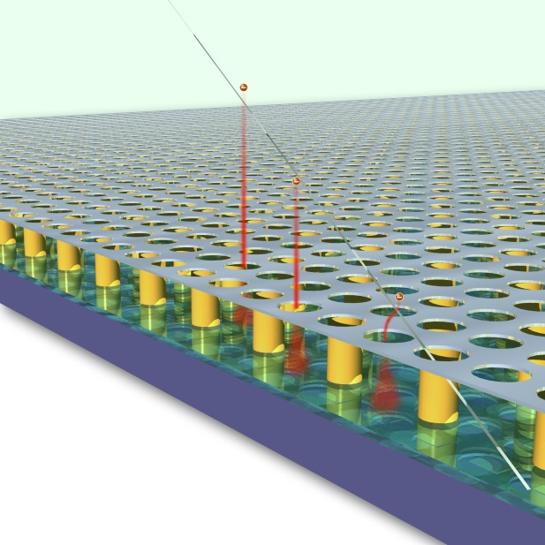
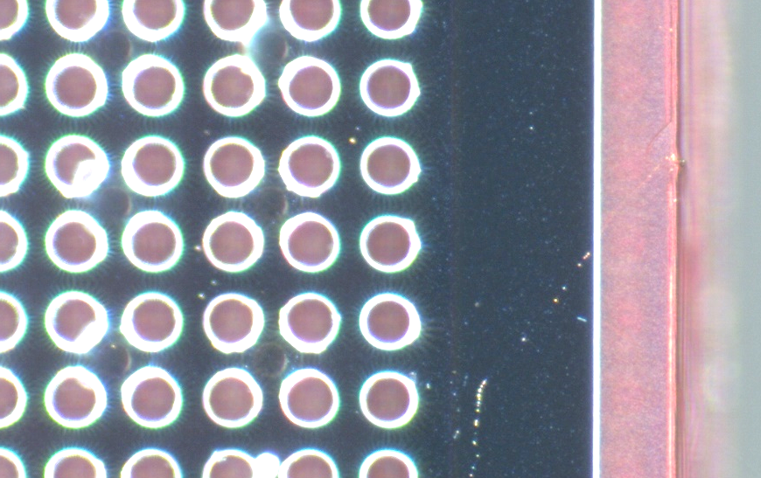
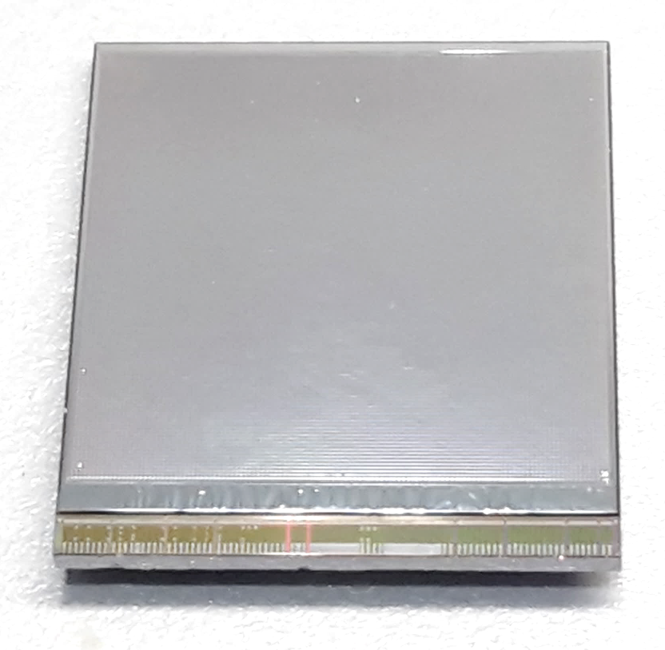
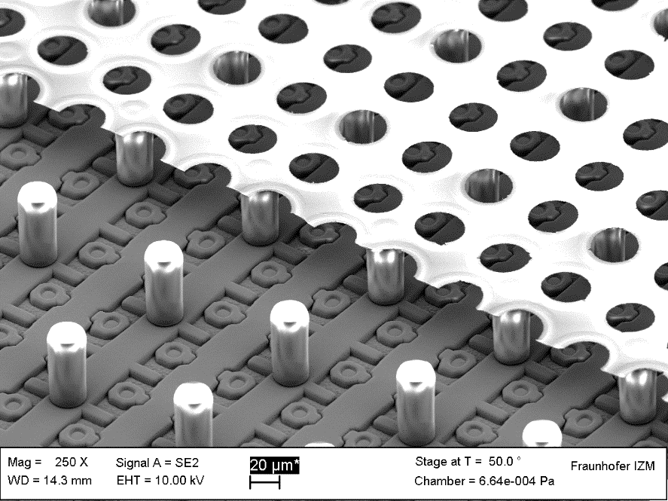
GridPix technology
Pixel chip with integrated Grid (Micromegas-like)
InGrid post-processed @ IZM
Grid set at negative voltage (300 – 600 V) to provide gas amplification
Very small pixel size (55 µm)
detecting individual electrons
dyke
55 µm
Aluminium grid (1 µm thick)
35 µm wide holes, 55 µm pitch
Supported by SU8 pillars 50 µm high
Grid surrounded by SU8 dyke (150 µm wide solid strip) for mechanical and HV stability
50 µm

Slide 5
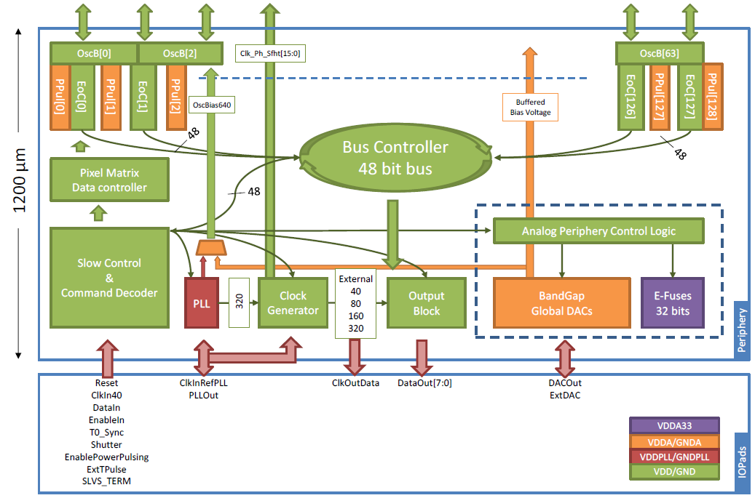
Pixel chip: TimePix3
256 x 256 pixels
55 x 55 µm pitch
14.1 x 14.1 mm sensitive area
TDC with 640 MHz clock (1.56 ns)
Used in the data driven mode
  Each hit consists of the pixel address and time stamp of arrival time (ToA)
  Time over threshold (ToT) is added to register the signal amplitude
  compensation for time walk
  Trigger (for t₀) added to the data stream as an additional time stamp
Power consumption
  ~1 A @ 2 V (2W) depending on hit rate
  good cooling is important
Sensitive area
14.1 mm
2+3 mm

Slide 6
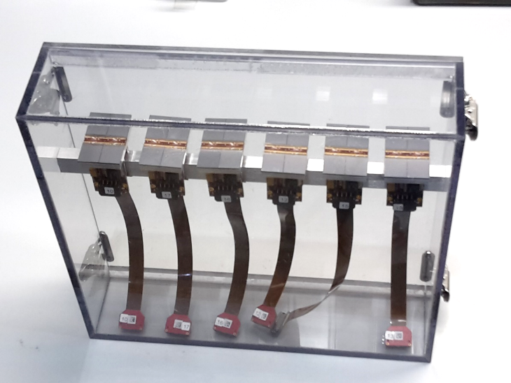
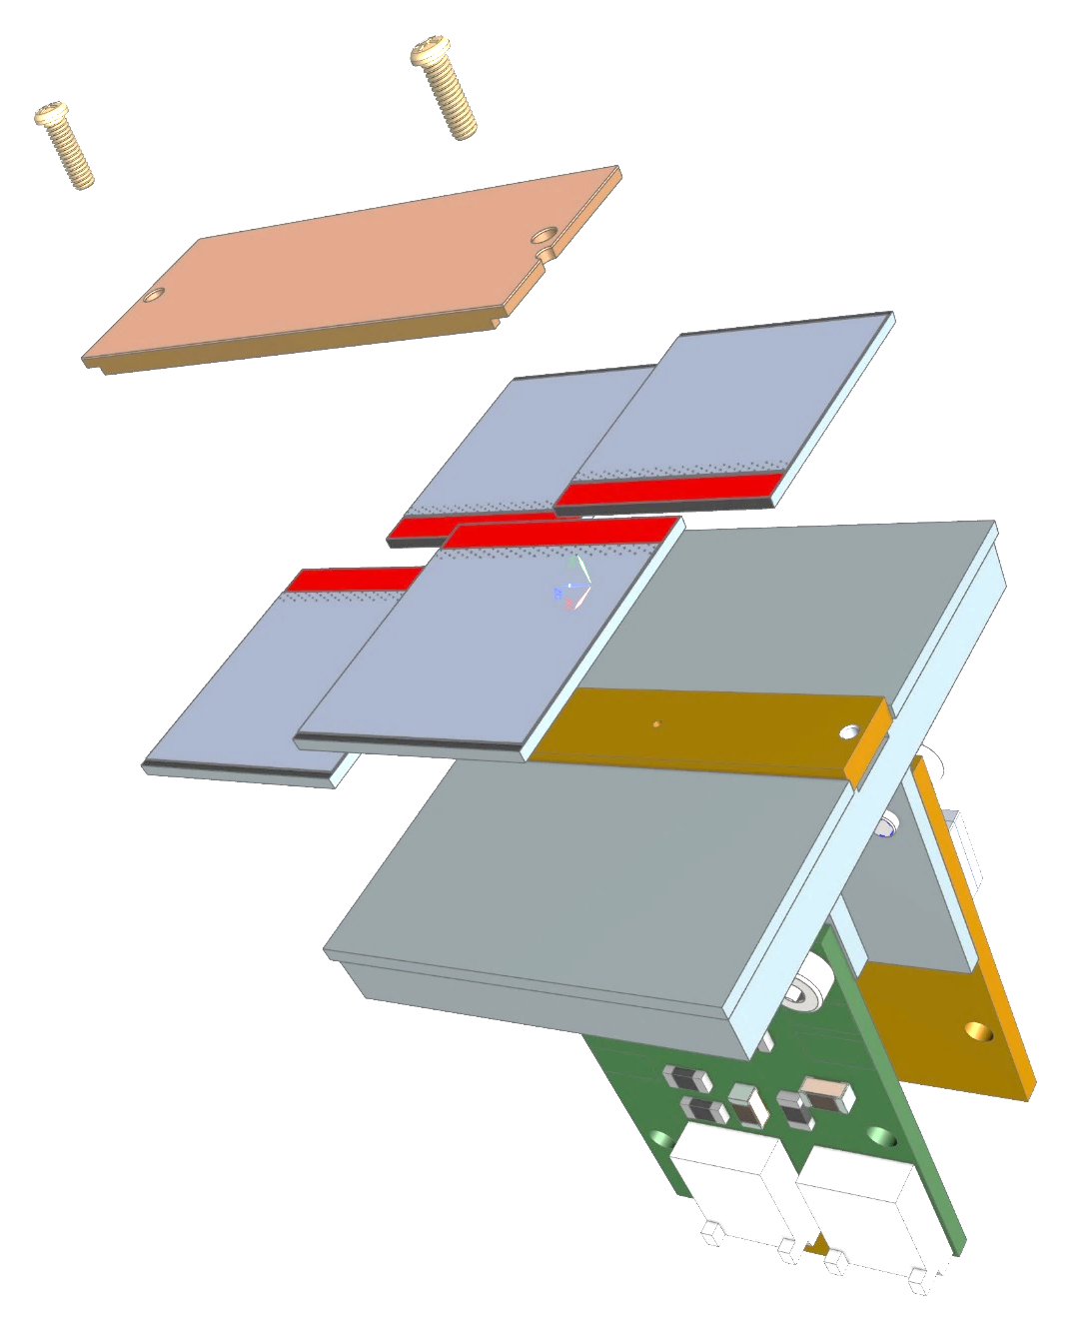
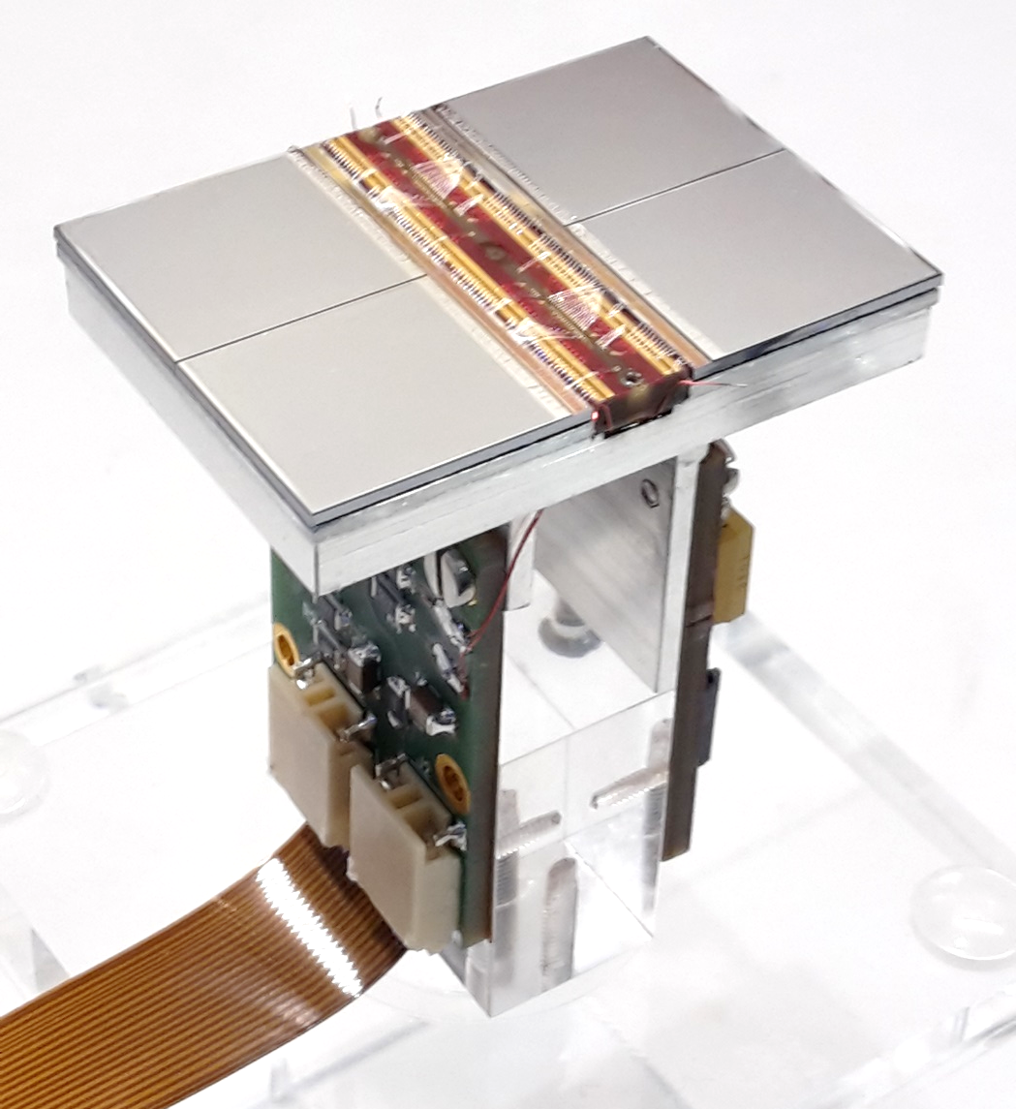
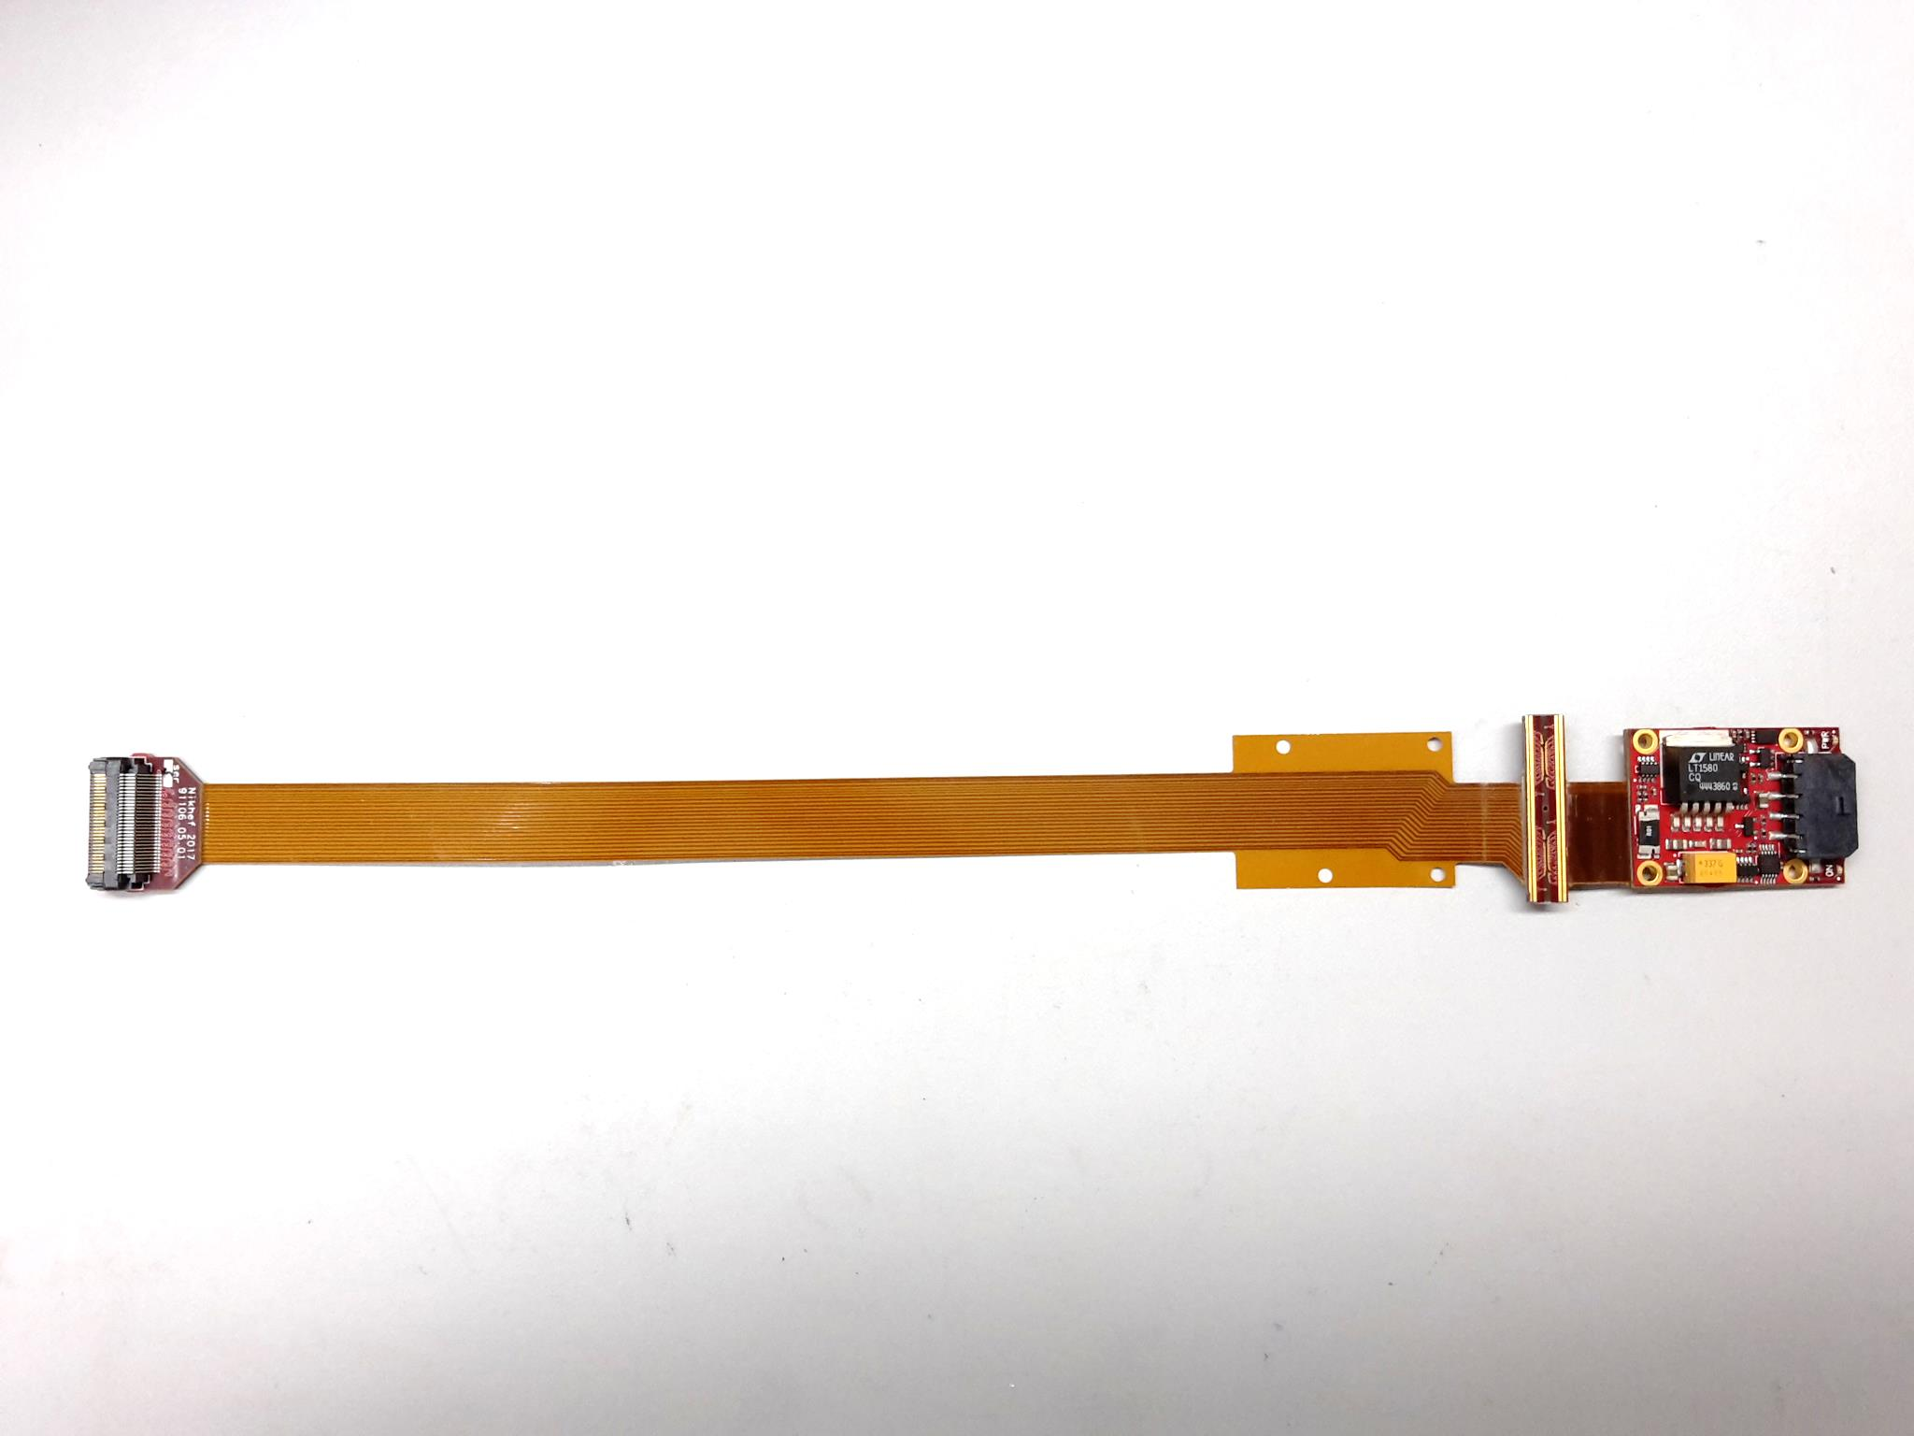
QUAD design and realization
Four-TimePix3 chips
All services (signal IO, LV power) are located under the detection surface
The area for connections was squeezed to the minimum
Very high precision 10 μm mounting of the chips and guard
QUAD has a sensitive area of 68.9%
DAQ by SPIDR
39.6 x 28.38 mm
series of QUADs
Guard
TPX3
TPX3
TPX3
TPX3
COld
CArrier

Slide 7
QUAD as a building block
8-QUAD module (2x4 quads) with field cage
in red guard wires

Slide 8
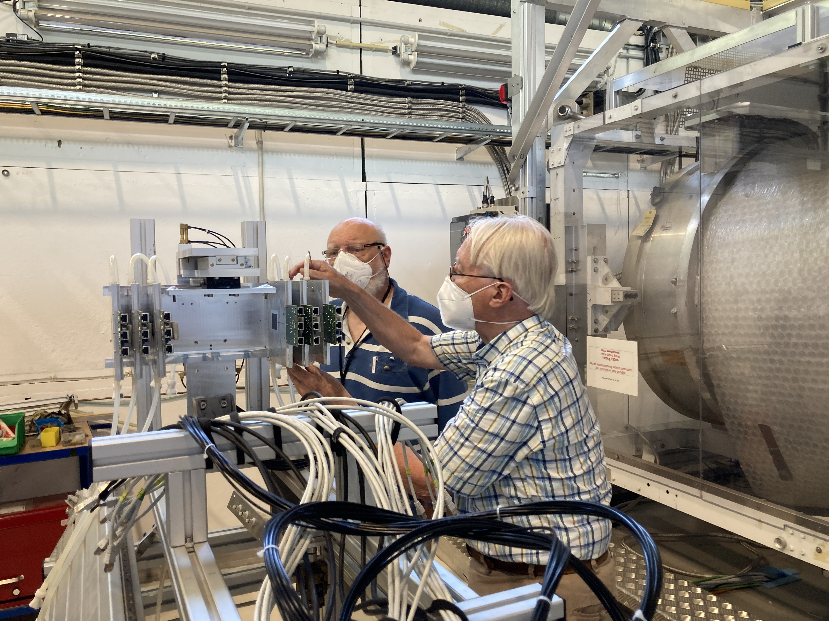
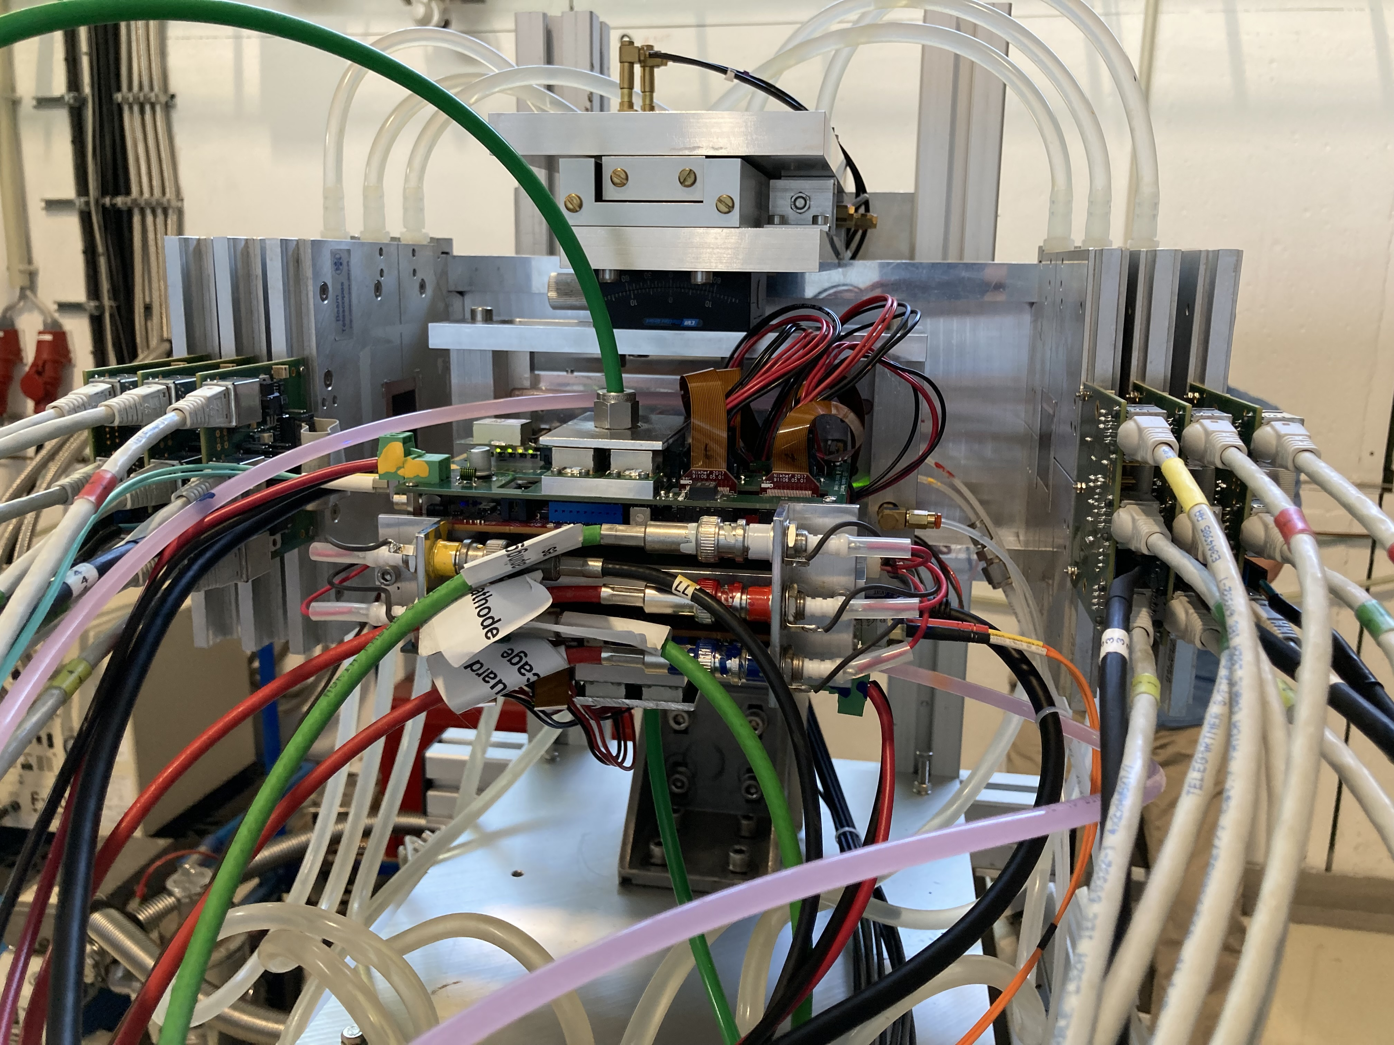
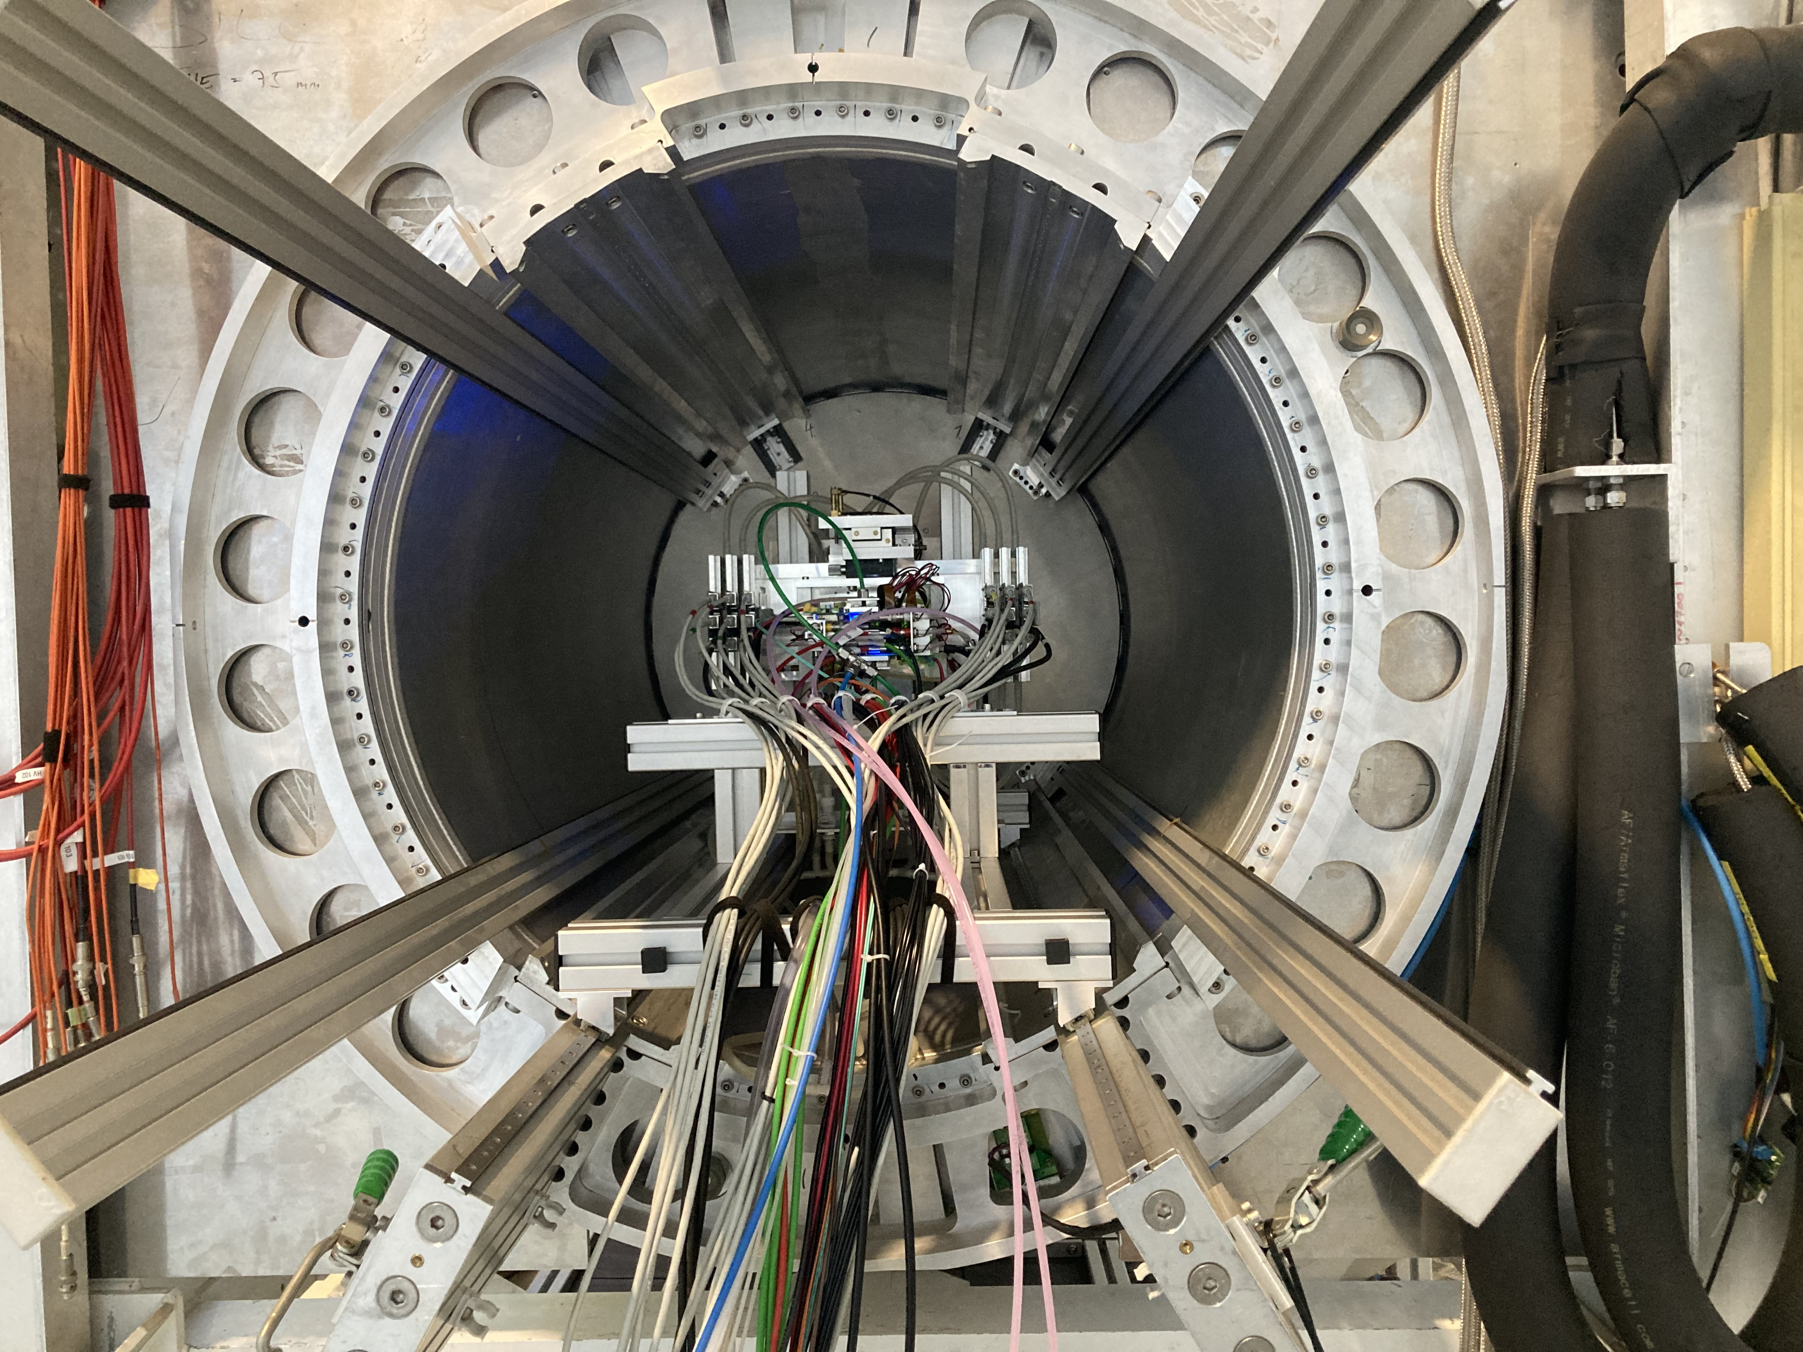
DESY testbeam June 2021
Mounting the 8 quad module between the silicon planes
sliding it into the 1 T PCMAG solenoid

Slide 9
Discuss of two NIM papers
on module performance
First paper with emphasis on module construction and tracking performance (this talk)
Second paper with emphasis particle identification (second talk) and other analysis results (this talk)

Slide 10
DESY testbeam June 2021

Slide 11
DESY testbeam Module Analysis
Event display with module and telescope
TPX3 track 1130 hits
χ²_{xy} = 677.5/1128
χ²_{z} = 775.9/1069
Asymmetric tail outlier removal applied 1071 hits in z kept.
TPX3 track hits
Telescope track hits (off track green)
Preliminary
x global
x local
z global
y local
z global
y global
z local drift
y local

Slide 12
DESY testbeam Module Analysis
B=0 T and p =6 GeV
Preliminary
8-quad module Tracking precision:
position 9 μm (xy) 13 μm (z)
angle 0.19 mrad (dx/dy) 0.25 mrad (dz/dy)
module tracklength = 157.96 mm
Note that in a B field because of the reduced diffusion the tracking precision will improve substantially
964 selected tracks
Impressive 1009 hits / track

Slide 13
DESY testbeam Module Analysis
Run 6916-6918 B=0 T p=6 GeV
Three runs at different drift distances
Preliminary

Slide 14
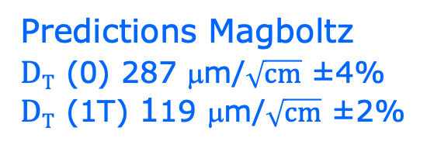


DESY testbeam Module Analysis
B=0, 1 T p=5, 6 GeV
Fitted resolution
$$σxy2=σ2xy0+D2T \left(z−z0\right)$$
$DT$ 287 ±0.5 μm/$\sqrt{cm}$
$DT$ 120 ±0.5 μm/$\sqrt{cm}$
σ² _{xy0}= σ²_{pixel} + σ²_{xy tele} σ²_{pixel}= 55²/12 μm²
σ_{xy tele}=35 μm
Preliminary
Predictions Magboltz
$DT$ (0) 287 μm/$\sqrt{cm}$ ±4%
$DT$ (1T) 119 μm/$\sqrt{cm}$ ±2%
T2K*
E_{d}=280 V/cm
T2K* = T2K gas with O₂ and H₂O
Ar/iC4H10/CO2 gas mixture 93.6/5.0/1.4

Slide 15
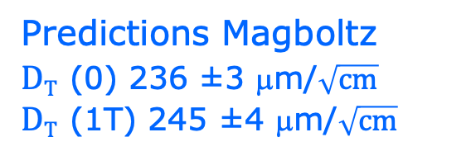
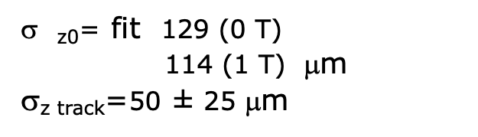


DESY testbeam Module Analysis
B=0, 1 T p=5, 6 GeV
Fitted resolution
$$σz2=σ2z0+\text{s}\text{2}\text{z} \text{track} +D2L \left(z−z0\right)$$
_{z0}= fit 129 (0 T)
114 (1 T) μm
σ_{z track}=50 $\text{±} \text{25}$μm
$D$_{L} 251 ± 14 μm/$\sqrt{cm}$
$$D\text{L} \text{2}\text{24} \text{±}\text{ 14 }\text{m}\text{m}\text{/}\sqrt{cm}$$
Rather large experimental uncertainty coming from syst uncertainty on σ_{z track}
Preliminary
ToT > 50 μs
Predictions Magboltz
$DT$ (0) 236 ±3 μm/$\sqrt{cm}$
$DT$ (1T) 245 ±4 μm/$\sqrt{cm}$
T2K*
E_{d}=280 V/cm
T2K* = T2K gas with O₂ and H₂O
Ar/iC4H10/CO2 gas mixture 93.6/5.0/1.4

Slide 16
DESY testbeam Module Analysis
B=0 T situation
Mean residuals in the module plane with acceptance cuts
There are clear deformations in xy for the chips in the 4 corners.
The field around chip 11 (no grid HV) is affected.
The Efield defined by the field cage is in these areas not homogenous enough
Preliminary
xy
Vertical white bands guards
z

Slide 17
DESY testbeam Module Analysis
B=1 T situation
Mean residuals in the module plane with acceptance cuts
There are clear deformations in xy for the chips in the 4 corners.
The field around chip 11 (no grid HV) is affected.
The Efield defined by the field cage is in these areas not homogenous enough
Preliminary
xy
Vertical white bands guards
z

Slide 18
DESY testbeam Module Analysis
Regrouping the module plane to increase stats
Mean residuals (module) ‘row’ regrouping
B=0 T B=1 T
xy
xy
column 256 pixels
Preliminary
z
z
row 4x256 pixels

Slide 19
DESY testbeam Module Analysis
B=0 T
Distribution of mean residuals in the plane
Method row
B=0 T situation
xy
z
method | rms (stat) xy | bins xy | rms (stat) z | bins z
row | 11 (4) μm | 896 | 15 (5) μm | 891
column | 13 (4) μm | 895 | 13 (5) μm | 892
Preliminary
Method column
We did not include the 4 corner chips and (11), 14, 8, 13 and 19.
These are affected by the field cage and the short in chip 11.

Slide 20
DESY testbeam Module Analysis
B=1 T
Distribution of mean residuals in the plane
Method row
B=1 T situation
xy
z
method | rms (stat) xy | bins xy | rms (stat) z | bins z
row | 13 (2) μm | 896 | 19 (3) μm | 896
column | 11 (2) μm | 880 | 20 (3) μm | 880
Preliminary
Method column

Slide 21
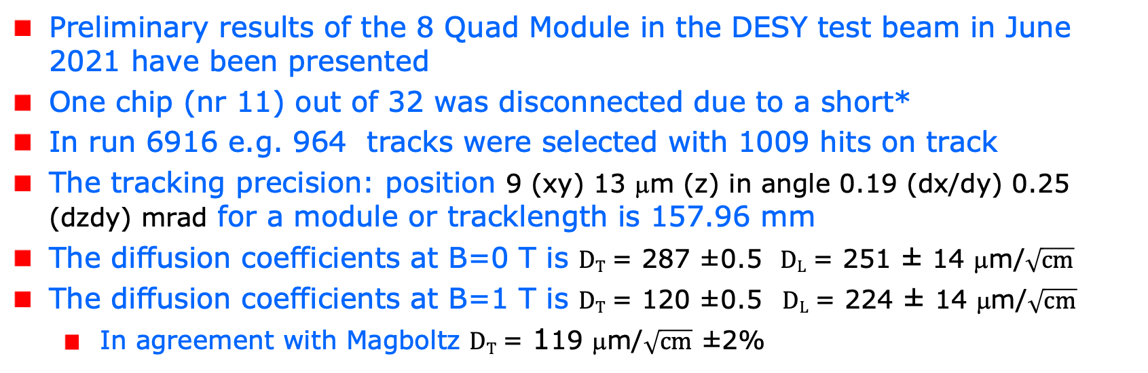
Conclusions on module performance
resolution and precision
Preliminary results of the 8 Quad Module in the DESY test beam in June 2021 have been presented
One chip (nr 11) out of 32 was disconnected due to a short*
In run 6916 e.g. 964 tracks were selected with 1009 hits on track
The tracking precision: position 9 (xy) 13 μm (z) in angle 0.19 (dx/dy) 0.25 (dzdy) mrad for a module or tracklength is 157.96 mm
The diffusion coefficients at B=0 T is $DT$ = 287 ±0.5 $DL$ = 251 ± 14 μm/$\sqrt{cm}$
The diffusion coefficients at B=1 T is $DT$ = 120 ±0.5 $DL$ = $\text{2}\text{24} \text{±}\text{ 14 }\text{m}\text{m}\text{/}\sqrt{cm}$
  In agreement with Magboltz $DT$ = 119 μm/$\sqrt{cm}$ ±2%
*the chip was successfully repaired in 2023 Bonn see backup slide

Slide 22
Conclusions on module performance
resolution and systematics
Results for the module showed that:
  the HV of the guard wires was well tuned
  B=0 T rms residuals in the module plane xy 13 μm and z 15 μm
  The results are compatible with (very) high stats quad measurement
  B= 1 T rms residuals in the plane xy 13 μm and z 20 μm;
High tracking precision is demonstrated with small systematics in the bending plane:
  deformations in xy stay below 13 μm

Slide 23
DESY testbeam Module Analysis
Analysis topics part of the second paper
  Measured efficiency at high hit rates
  Study and characterization of bursts i.e. large numbers of hits due to highly energizing particles (e.g. delta’s)
  Extraction of the resolution as a function of the incident angle using circles (helixes)

Slide 24
DESY testbeam Module Analysis
Efficiency at high hit rates
The efficiency of the device to detect a hit in a high (low) rate environment is measured comparing the mean time over threshold for low and high rate runs at B fields of 0 and 1T.
A succesfull approach is based on hits associated to TPX3 tracks using the two central rows of six chips. The mean ToT was calculated for ToT values between 0.15 and 1.4 μs to remove the tail.
The change in ToT in low and high rate runs is then related to a (maximum) the efficiency change.

Slide 25
DESY testbeam Module Analysis
Efficiency at high hit rates
Tot 1 (2) = mean ToT for upper/lower part (each 6 chips) stat errors are neglible
Hits 1 (2) are raw hits with ToT> 0.15 μs
Trigger rate is not corrected for efficiency off scintillators and duty cycle of machine
The raw hit rates are not affected by the trigger efficiency

Slide 26
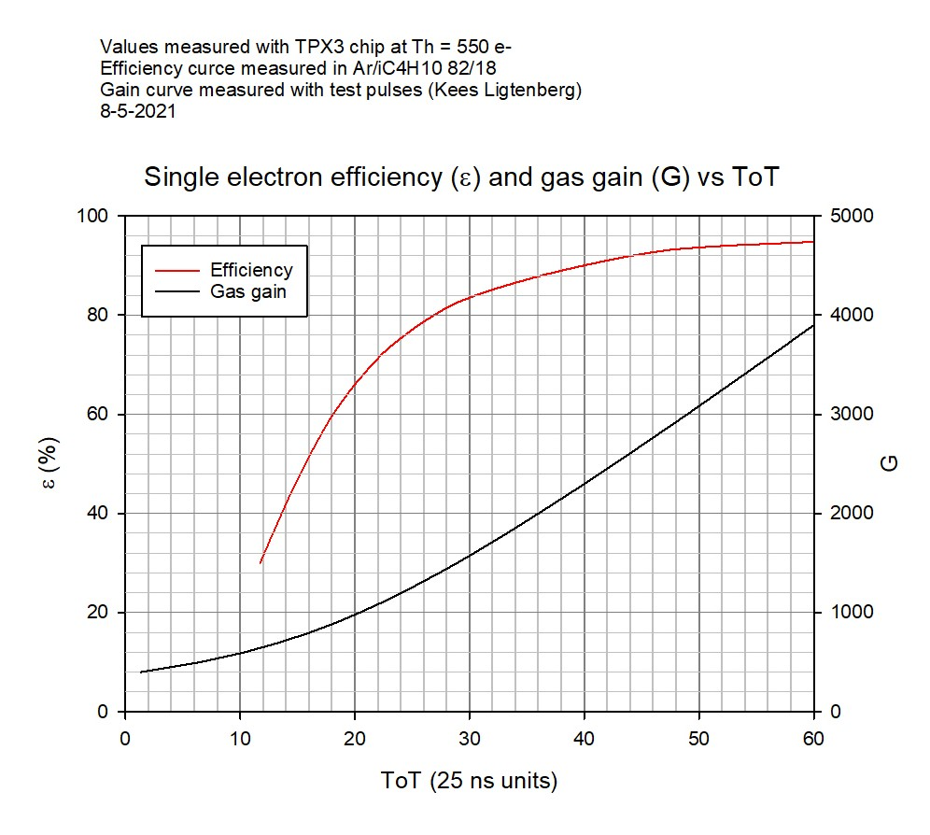
DESY testbeam Module Analysis
Efficiency at a high hit rates
The relative change in mean ToT is related to the relative change in the efficiency ε - at the working point around 0.6 μs - as:
δε/ε ~ 0.5 δToT/ToT
This means that the efficiency δε/ε is stable at the level of +0.9% (B=1T) and -0.6% (B=0T) for hit rates up to 3.3 (5.7) kHz per chip.
Conclusion
It is demonstrated that running at hit rates up 5.7 kHz per chip or 2.9 kHz/cm² (a quite high rate) gives at most a reduction of 0.6% in the relative efficiency.

Slide 27
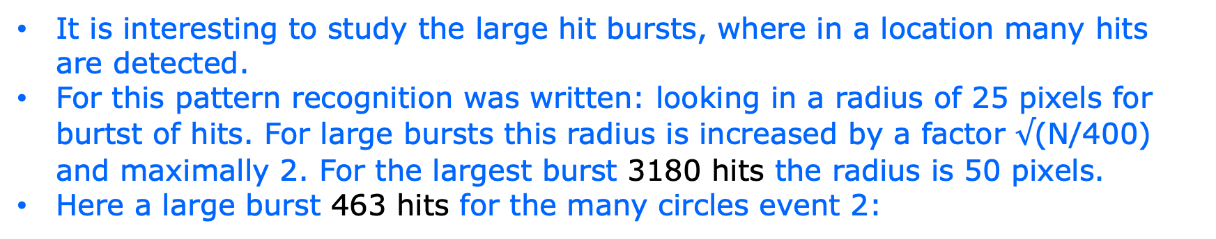
DESY testbeam Module Analysis
Characterisation of large hit bursts
It is interesting to study the large hit bursts, where in a location many hits are detected.
For this pattern recognition was written: looking in a radius of 25 pixels for burtst of hits. For large bursts this radius is increased by a factor $√$(N/400) and maximally 2. For the largest burst 3180 hits the radius is 50 pixels.
Here a large burst 463 hits for the many circles event 2:

Slide 28
DESY testbeam Module Analysis
Large hit bursts
Event 42 with a burst of 1066 hits
Note that the TPX3 deadtime of a pixel is 475 ns and therefore not all the hits in the core of the burst will be detected

Slide 29
DESY testbeam Module Analysis
Characterisation of large hit bursts B = 0
Radius90 (time90) is radius (time) where 90% of the hits are contained
For the B=0 radius90 and time90 distributions are pretty similar for large hit bursts.

Slide 30
DESY testbeam Module Analysis
Characterisation of large hit bursts B = 1 T
Radius90 and time90 are pretty different for large bursts!
B=1 T
The largest burst has 3180 hits
100 or 50 ns
data B=1 T p= 6 GeV run 6969 ~ 8000 triggers (events)

Slide 31
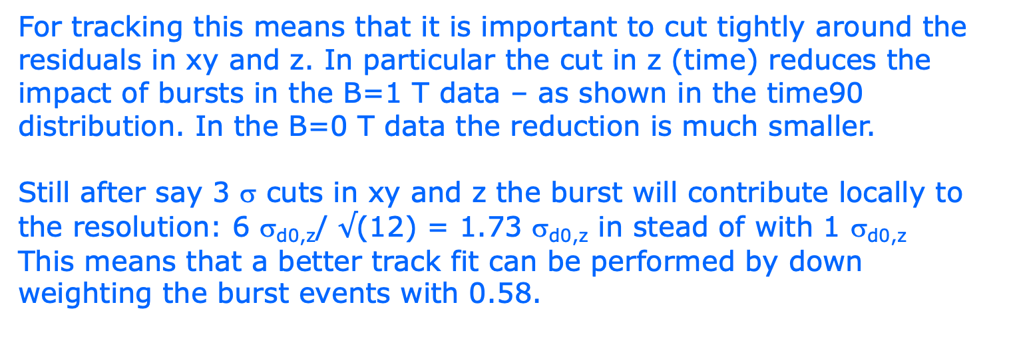
DESY testbeam Module Analysis
Track fitting and large hit bursts
For tracking this means that it is important to cut tightly around the residuals in xy and z. In particular the cut in z (time) reduces the impact of bursts in the B=1 T data – as shown in the time90 distribution. In the B=0 T data the reduction is much smaller.
Still after say 3 σ cuts in xy and z the burst will contribute locally to the resolution: 6 σ_{d0,z}/ $√$(12) = 1.73 σ_{d0,z} in stead of with 1 σ_{d0,z}
This means that a better track fit can be performed by down weighting the burst events with 0.58.

Slide 32
DESY testbeam Module Analysis
Does a Pixel TPC have a hit resolution independent of the local track angle?
In a pixel TPC one expects that the resolution is independent of the local track angle φ. For pads one expects and has measured a rather strong dependence.
In order to study this topic we use circular tracks (curlers)*. Each hit on the circle will have a different local track angle φ
To get a part of a circle and a large φ phi range, we analysed the B=1 data for run 6969 p = 6 GeV beam.
a Hough transform for a circle was coded; also a straight line hough transform was used to reject high momentum tracks.
We took data with small incident beam angles plus min 10 degrees; in a circle one will have 360 degrees incident angles.

Slide 33
DESY testbeam Module Analysis
Circle finding
The center should lie in the plane
Pattern finding can get disturbed by large hit bursts and “straight” line beam particles
The solutions in red are selected
Events 14 and 41
R = 1024 pixels
p = 16.9 MeV/c
R = 121 pixels
p = 1 MeV/c
R = 25 pixels
p = 412 keV/c

Slide 34
DESY testbeam Module Analysis
Circle finding
For the events 14 and 41. Calculate phi around the circle (phi = 0 is pointing opposite the local y axis = right to left in the event display).The drift time (z) can be fitted vs phi. It has a linear dependence (for a helix). The residuals in z are calculated after the fit.
phi hit on circle

Slide 35
DESY testbeam Module Analysis
Event selection for circles
Radius > 50 pixels with at least 20 selected hits
Reject circles with a better SL line fit by applying cuts on the χ² and number of hits for the circle and line hypothesis.
Resolution σ _{xy} = 4 pixels and σ _{z} = 1 mm
Track χ²_{xy}/dof < 5 χ²_{z}/dof < 5
Phi range (phi max – phi min) > 1 rad
phi> 8 π/32 and phi < 2 π − 8 π/32
Remove hits near edge of chip (15 pixels columns and rows)
Residual cuts at 2.5 σ (xy and z)
Down weighting of large clusters (counting hits N in bins Rφ 1 pixels)
where w = 1/ (N(bin-1)+N(bin)+N(bin+1))

Slide 36
DESY testbeam Module Analysis
Selected circles plots

Slide 37

DESY testbeam Module Analysis
Fitted resolution in xy
More details in backup
Fit result resolution flat in phi
0.241 $±$ 0.016 mm
fit: a + b cos φ
Conclusion
the Pixel TPC single electron resolution is – as expected - independent of the local track angle within an uncertainty of 16 μm.
Local track angle

Slide 38
DESY testbeam Module Analysis
Conclusions Pixel TPC analysis topics
  Measured efficiency at high hit rates
  It is demonstrated that running at hit rates up 5.7 kHz per chip or 2.9 kHz/cm² at most a reduction of 0.6% in the relative efficiency.
  Characterization of bursts
  The time distribution in the B=1 T data is most sensitive to reject burts. In the track fit an improvement can be obtained by identifying and downweighting burst.
  The Pixel TPC single electron resolution is – as expected - independent of the local track angle within an uncertainty of 16 μm.

Slide 39
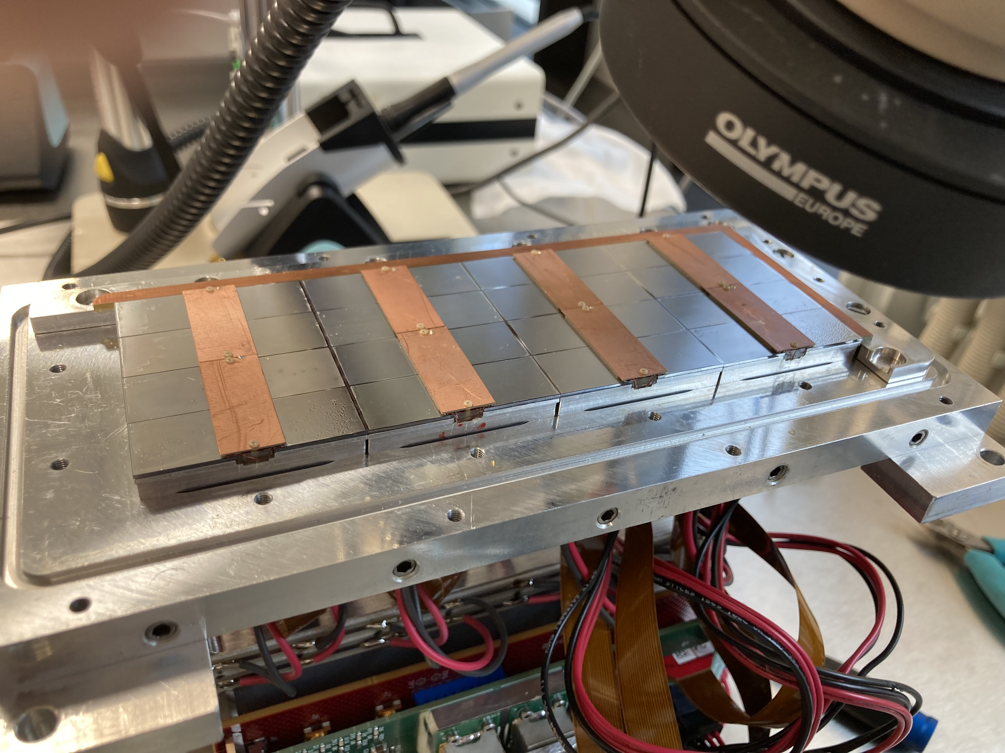
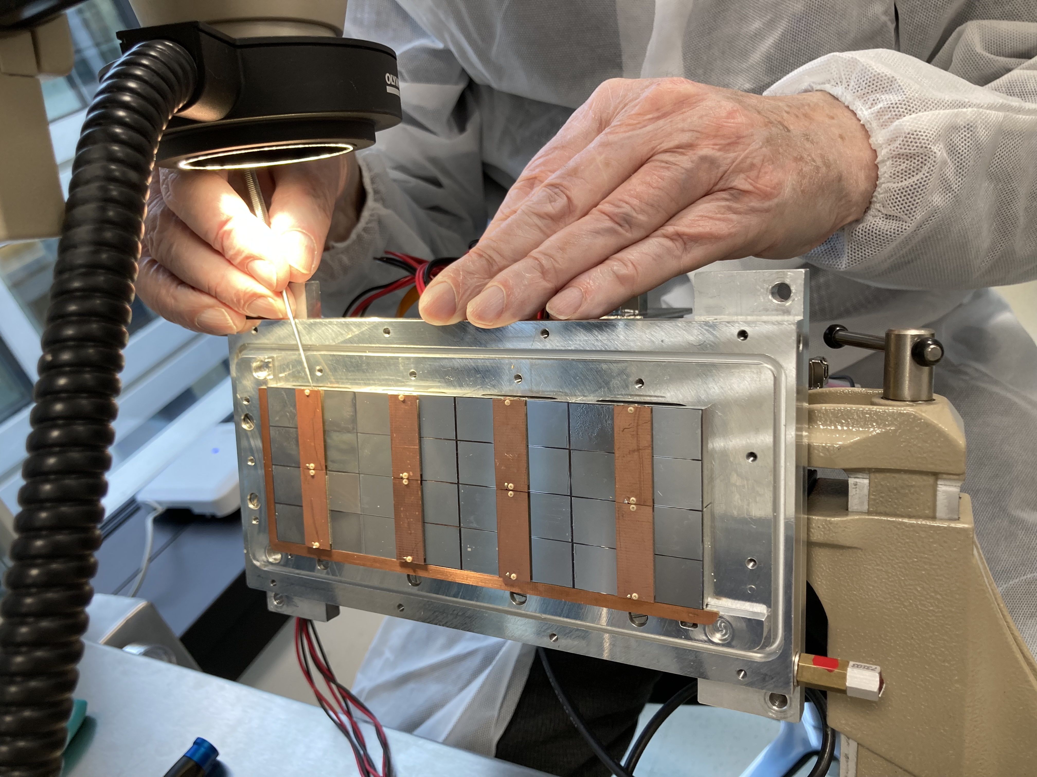
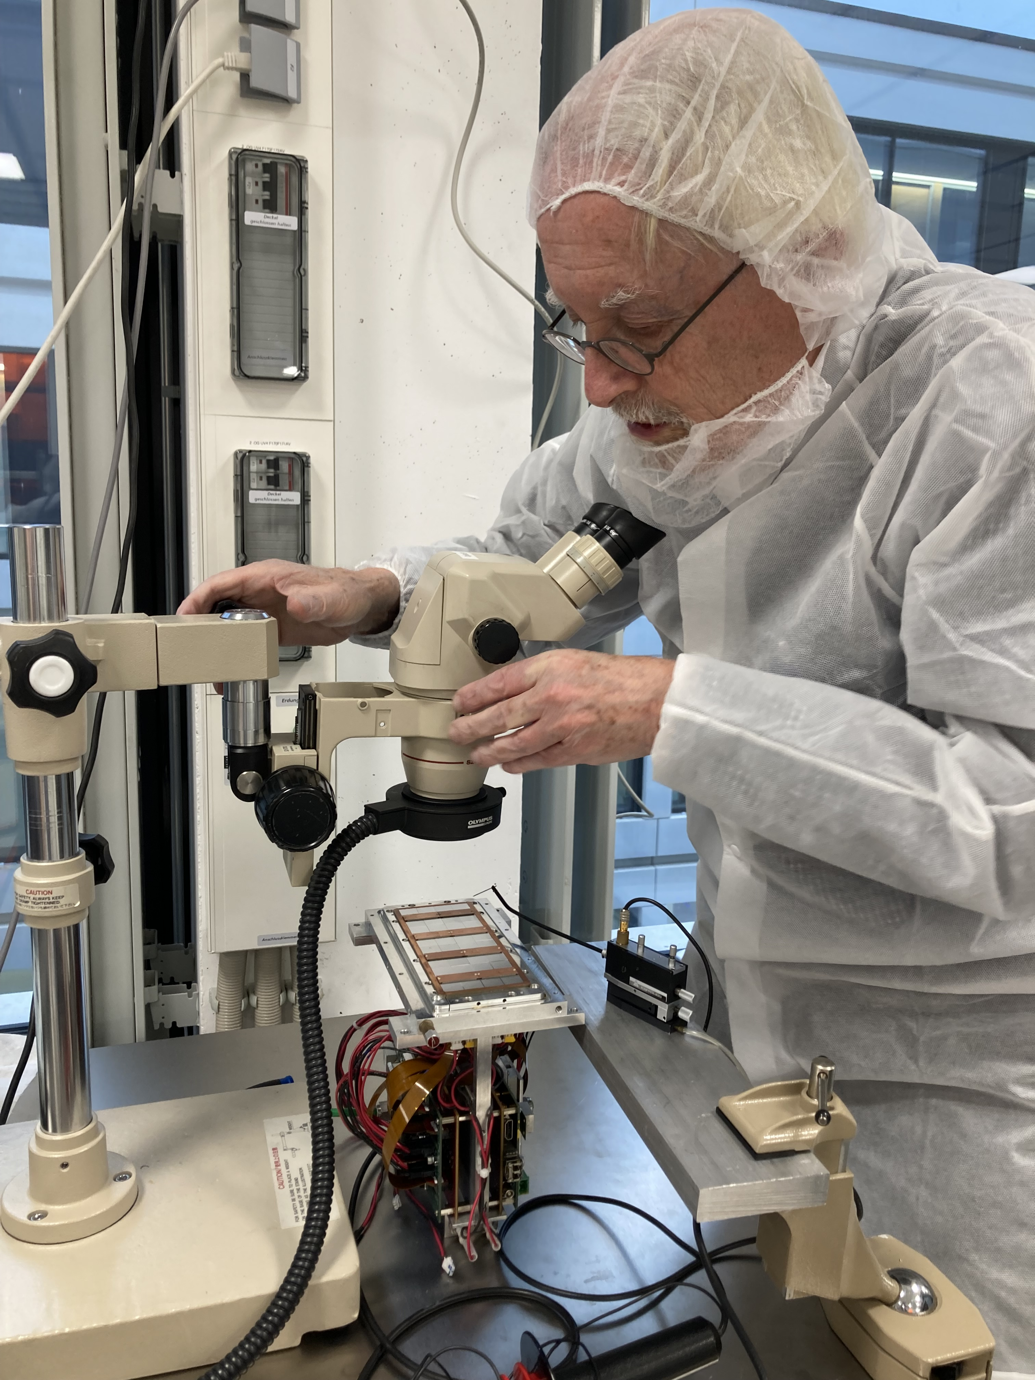
Pictures of repair work in Bonn
Backup
The short in chip 11 was succesully repaired by Fred Hartjes

Slide 40
DESY testbeam Module Analysis
Backup
Selected circles plots weighted
local phi angle
There is a dependency of the resolution of phi and the radius
Small radii correlated to large phi range

