Slide 1
LEPCol readout scheme proposal
TPX3 @ 160Mb readout speed ≈ 2Mhit/s
8x4x4=128 TPX3 chips per readout syste
KU040 devkit = 1K€
Link concentrator uses cheap (25€) Microsemi FPGA
Option for magnetic field tolerant DC/DC converter
Quad
TPX3 Module
Quad
TPX3 Module
8x
3.125Gb 8b10b
1x
10Gb Ethernet
2x
Link
Concentrator
(rad hard+ magnetic field tolerant)
SPIDR
(KU040 FPGA Development Kit)
8x
SFP
Quad
TPX3 Module
DAQ PC
Quad
TPX3 Module

Slide 2
Planning first half of 2017
TODO PCB
Finish layout WireBond board
Schematic + layout of simple SPIDR adapter
Schematic + layout of Data Concentrator
Schematic + layout of SFP board
TODO FPGA Firmware
Firmware for Data Concentrator
SPIDR modification

Slide 3
Planning first half of 2017
 | Jan | Feb | Mar | Apr | May | Jun
PCB
Layout WB Board
Schematic adapter board
Layout adapter board
Schematic DC board
Layout DC board
Schematic SFP board
Layout SFP board
Firmware
DC firmware
SPIDR modification
Start assembly testing
Bas
Hans
Charles
Intern
Production

Slide 4
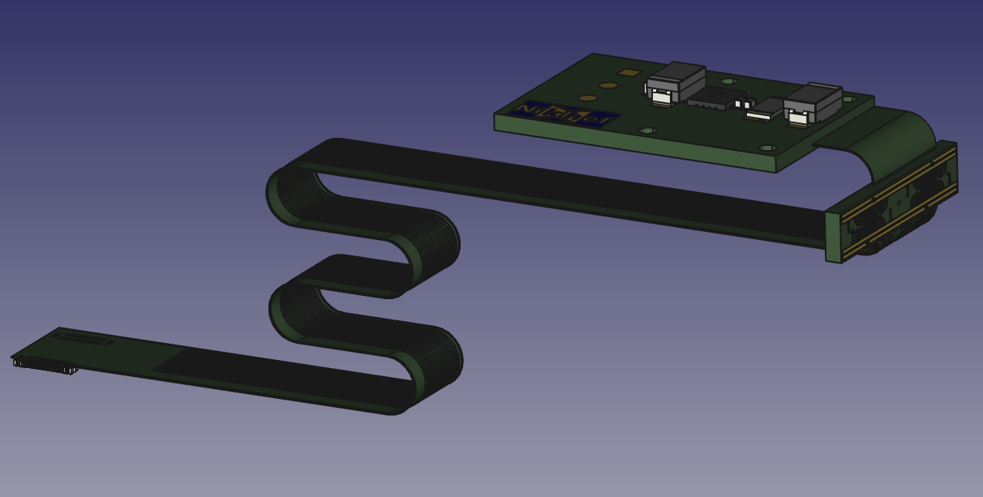
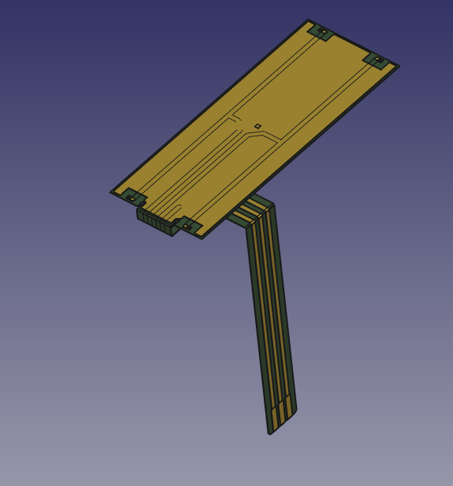
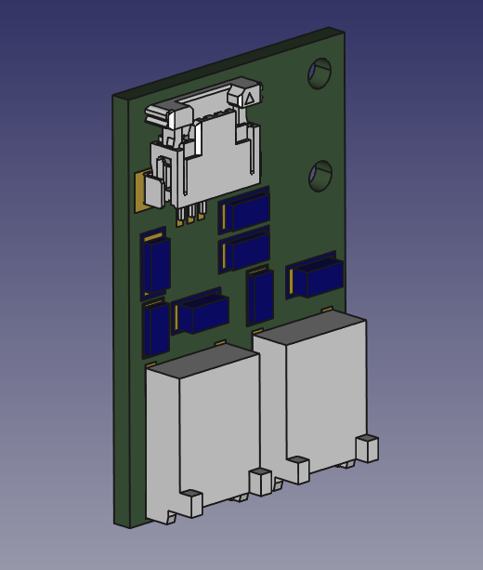
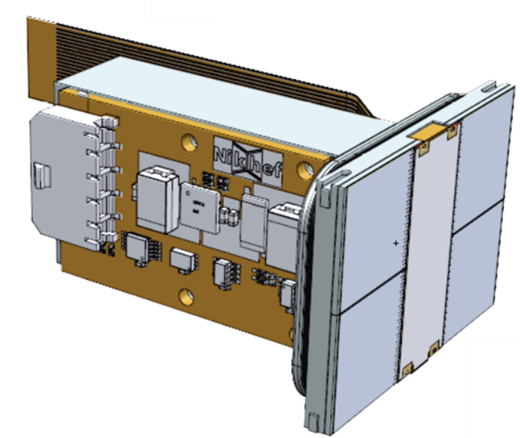
WireBond board
HV guard
HV power
Quad assembly

Slide 5
Data concentrator
Q1 data
Q1 power
Power mezzanine
FPGA
SFP cage
Q2 data
Q2 power
Q3 data
Q3 power
Q4 data
Q4 power
Power mezzanine

Slide 6
DC/DC converter for data concentrator
Magnetic field tolerant
50W power
12V input?
Mezzanine board

