Slide 1
Dutch National Technology Strategy
ESPP-NL Technology Day
David Groep
January 2025

Slide 2
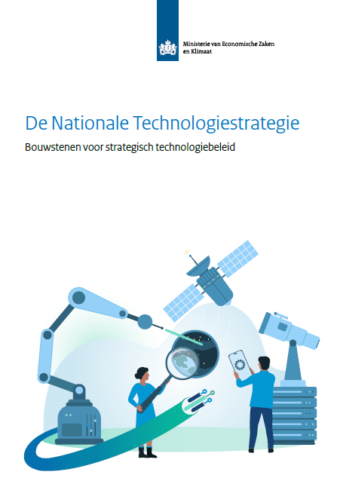
Dutch National Technology Strategy
In view of international competition and strategic emphasis abroad on key technologies, the Dutch government developed the “NTS” (Nationale Technologie Strategie) with technologies
that increase significantly national earning power
are crucial for societal developments
are important for national (economic) security
enable (continued) Dutch technological leadership
There are actually two versions: one (Jan 19th, 2024) missing Cybersecurity, and one (June 6th) with CyberSec and some formatting changes! So beware which one you pick – I chose the latest one
https://www.rijksoverheid.nl/documenten/rapporten/2024/06/07/nationale-technologiestrategie

Slide 3
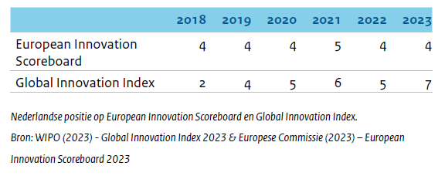
The political context of the NTS
The Netherlands are good in developing technologies “and want to stay that way”
a strategy the ministry of Economic Affairs, so not OCW
with input from (tech) industry, knowledge institutions, and societal organisations
with urgency provided by the geo-political and economic context
both in Europe and globally
national security, mostly for non-kinetic conflicts, considered in all roadmaps and actions
“partner, competitor, system rival” reducing risks of negative impact in the technology competition for national security by prioritising strategic technologies
aligned with EU strategy plans, but with specific Dutch emphasis (as there are competitors within the EU as well)

Slide 4
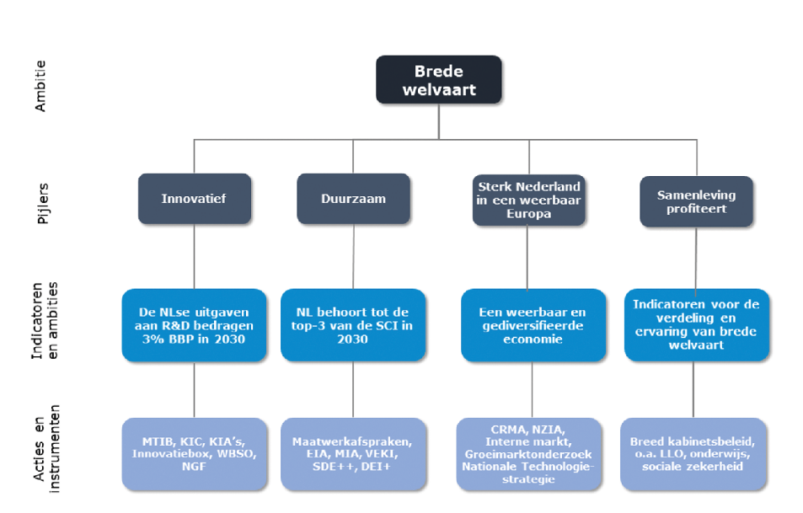
Part of a larger picture
https://zoek.officielebekendmakingen.nl/kst-33009-131, published 27-07-2023

Slide 5
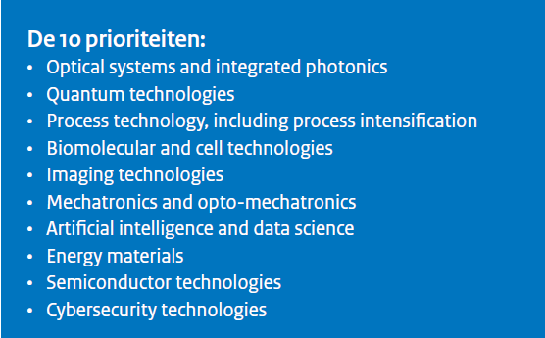
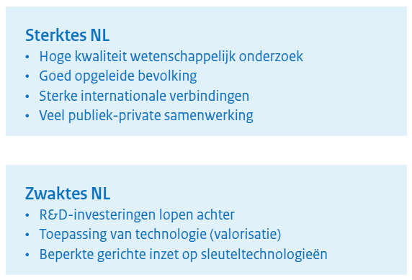
Having a look at the technologies that will see investment

Slide 6
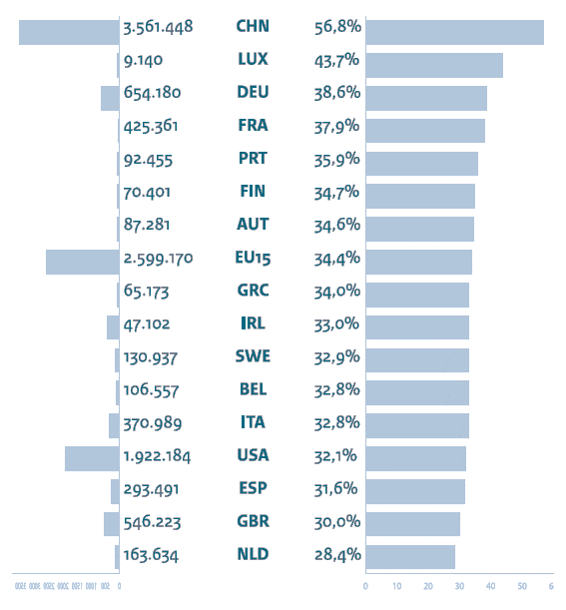
Closing the priorities gap
#key technology papers
% key tech papers/all
from the NTS agenda, pg. 11

Slide 7
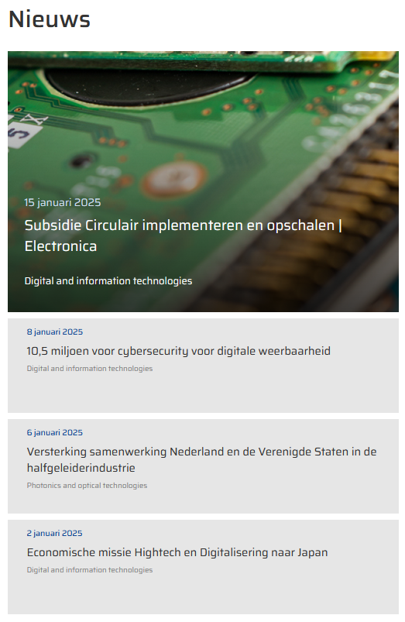
Implementation mechanisms
Top-sector futures missions (Energietransitie, Circulaire Economie, Landbouw-Water-Voedsel, Gezondheid & Zorg, Veiligheid) play an important role, but here
Key Technologies 2024-2027 is an underpinning Knowledge and Innovation Agenda (KIA) alongside Digitalisation and Societal Earning Power
High Tech Systems and Materials: “Key Technologies as an urgent transition”
https://www.topsectoren.nl/missiesvoordetoekomst; https://www.kia-st.nl/; https://hollandhightech.nl/innovatie/urgente-transities/sleuteltechnologieen

Slide 8
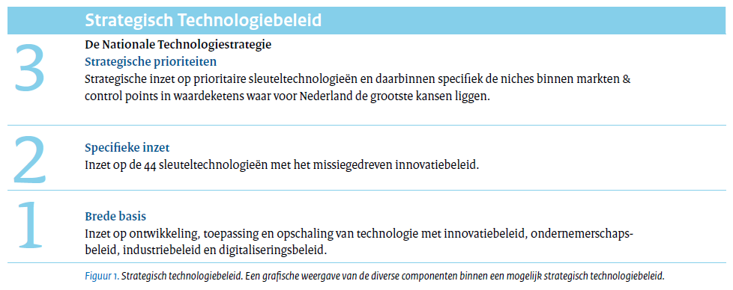
Not all technologies are created equal
‘Each of the 44 key technologies are important for mission-driven innovation policy’
‘Broad basis: target development, application and scale-up of technology by means of innovation, entrepreneurial, and industry policy’
but when you have a closer look, of course …
NL also holds ‘control points’, i.e. crucial tech in the international value chain, and wants to acquire more of these it is noted that also others (US, UK) prioritise controls points within their strategic technologies portfolio

Slide 9
Control-point technologies
Next to existing controlpoints in e.g. Optical Systems (semicon) the strategy identifies
Quantum “Nederland is een gidsland met control points in internationale waardeketens voor alle drie de beschreven technologiegebieden, met spelers die concurreren op internationaal niveau.” – targeting specific niches for the control points “rekening gehouden met de lokale economische omstandigheden, niet enkel de wetenschappelijke kwaliteit.”
Imaging “the combination of semicon and quantum (optics, optomechatronics, acoustics) is unique for quality assurance. This can become a controlpoint for the semicon industry”
Energy materials the existing NGF programme targets specific elements of the battery value chain; next gen cells, stationary load-balancing batteries, HGV batteries

Slide 10
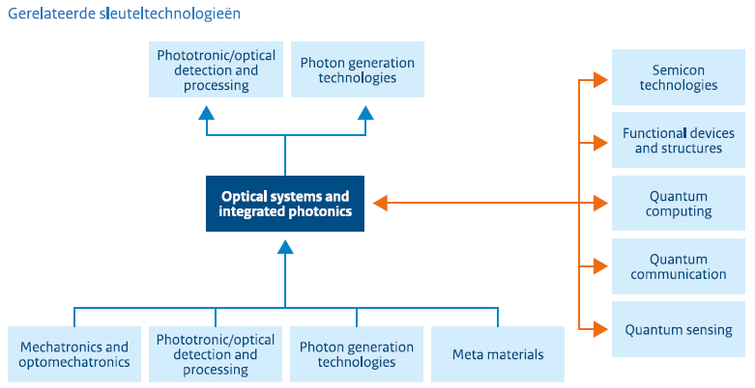
Optical systems and photonics “in 2035 NL is the world leader and we outcompete the rest”
Optical systems
industrial scale achieved, but there are some low-TRL developments
widely applicable, but emphasis here on complex systems
Integrated photonics
mostly niche applications (apart from Datacom)
sensing in datacom (strategic!) and in agro/bio sectors
low TRL for things like wafer-scale
Existing partners dominate (PhotonicsNL, Optics Netherlands and PhotonDelta, plus HTSM)

Slide 11
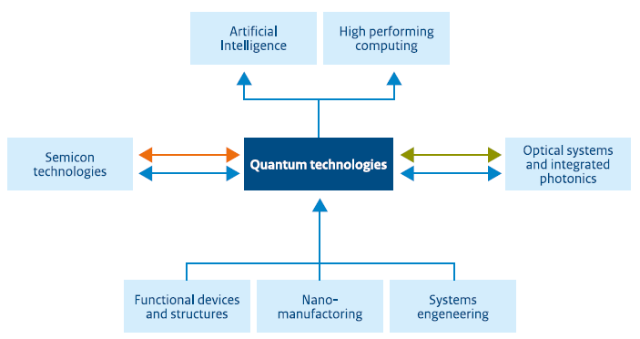
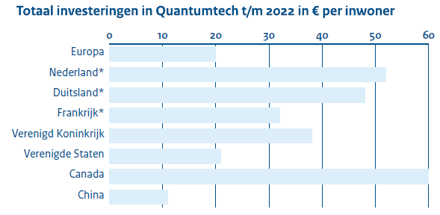
Quantum “In 2035 the Dutch Quantum ecosystem is world-class with the Dutch leading with controlpoints for all three areas”
Quantum Computing
Quantum Communications
Quantum Sensing
Clear focus on ‘Dutch’ quantum tech: “Quantumtoepassingen zullen in toenemende mate kennis uit semicon technologies gebruiken voor het ontwerp van chips en systemen.”
Recognition this will be European as there’s lack of large tech and venture capital - should align well for NL linking to a European strategy (with the EU QT Flagship)

Slide 12
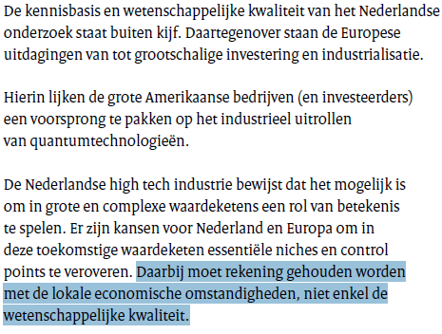
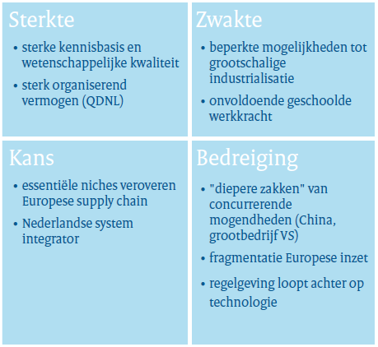
Research and test facility emphasis strengthens existing hubs (QuTech, NanoLabNL, QuSoft)
Quantum SWOT for NL

Slide 13
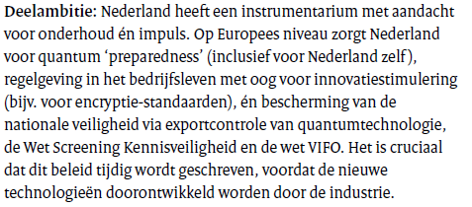
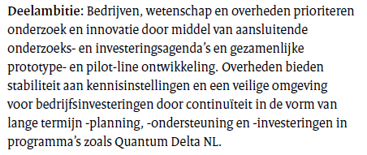
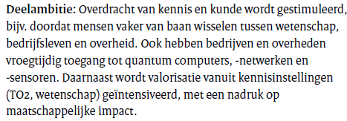
Quantum Quotes

Slide 14
Here may be less overlap (but who knows)
Process technology including process intensification (bio-mass and waste energy conversion, pyrolyse plants, syngas, ethanol fermentation)
Biomolecular and cell technologies (precision health, sustainable agro and non-food bioproduction)
Energy materials (batteries, electrolysers, heat storage

Slide 15
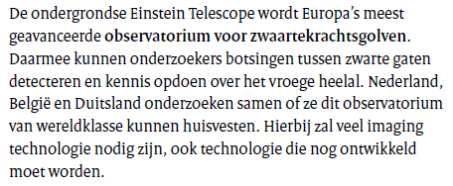
But … Imaging?
“Imaging is the generation, duplication, analysis and visualisation of images” … with “applications in medicine, semicon, security, agriculture, industry, traffic and aerospace.”
And it’s very nice of course, but why here?
True that analytics equipment and research instrumentation is needed, but also here ‘just ET’ is mentioned ☺
listed alongside medical, defence, semicon, agro, industry and traffic imaging on pg. 56 as significant application area for new imaging techniques

Slide 16
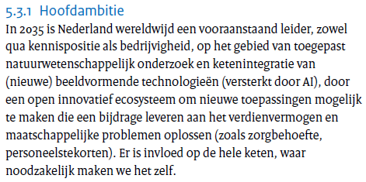
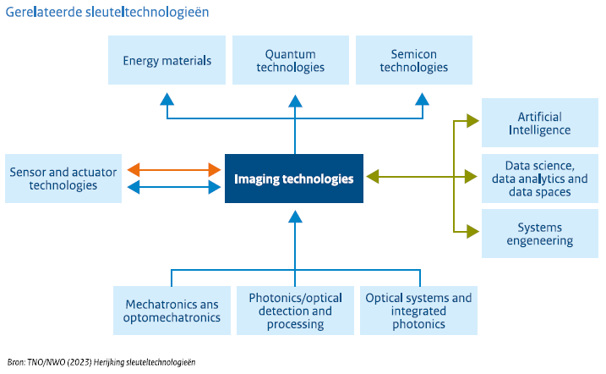
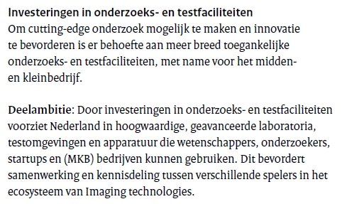
Some imaging considerations as a counterbalance

Slide 17
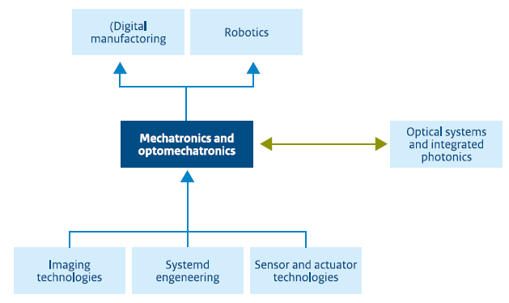
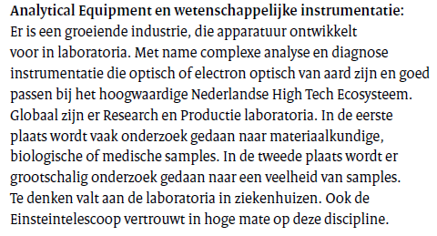
Mechatronics en Optomechatronics “the Netherlands has further strengthened its leadership position” “delivering open strategic autonomy”
Here ET is mentioned, and makes perfect sense

Slide 18
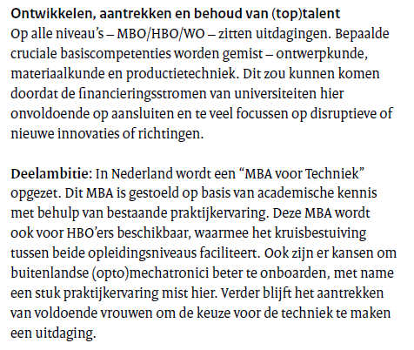
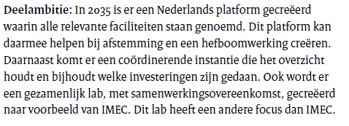
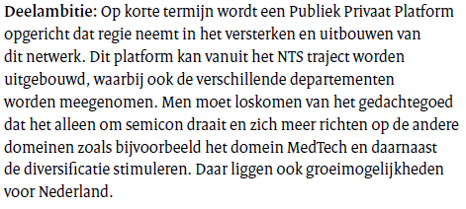
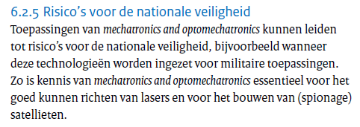
Mechatronics en Optomechatronics

Slide 19
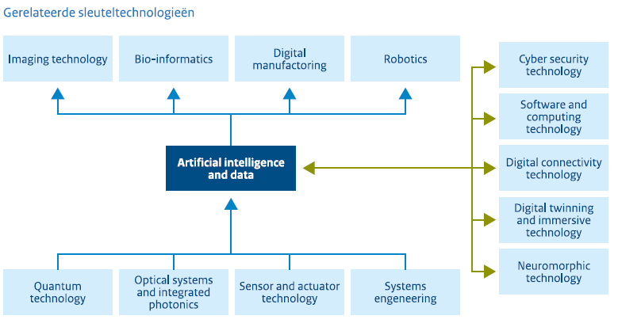
Artificial Intelligence and data “the Netherlands has the capacity to work with AI and data, leading to innovation and accelerating societal transitions”
note this was not designated as a control-point technology
entire focus of this topic is on decentralised learning, federated models, and sharing in data spaces
it is recognised that NL has prominent scientific position, but failed (fails) in large-scale AI and data analytics … just like the rest of Europe!

Slide 20
AI and data – identified barriers
Challenges
lack of sufficient compute capacity and dependence on foreign infrastructure (and is likely to remain so)
lack of access to data: and that is not always lack of will: also regulatory barriers
lack of access to capital, both public and private
limited uptake by companies of AI innovations, apart from a select few
climate for attracting talent is deteriorating (fiscal, immigration)
Within Europe, NL is actually quite OK (as on the Digital Economy and Society Index)
above average on human capital, connectivity, integration of digital technologies, and digital public services
broad presence of AI research in universities and HBO, and good collaboration between AI (data) research groups and SSH groups
strong public-private partnerships (Commit, Commit2Data, AI Coalition)

Slide 21
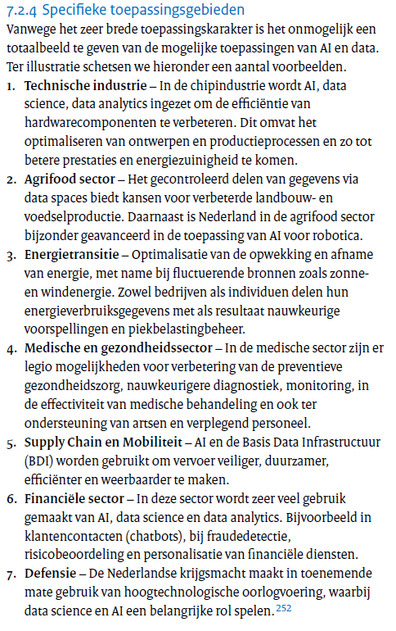
Identified application areas don’t help us
But some other elements might – in the longer future
the other aspects are not directly helpful to us, although some aspects may indirectly harm us. The limitations the EU AI Act imposes may push talent away from the EU, and the ‘federated learning’ does not provide much advantages for HEP
The ‘data’ aspect here is not on volume, but on access

Slide 22
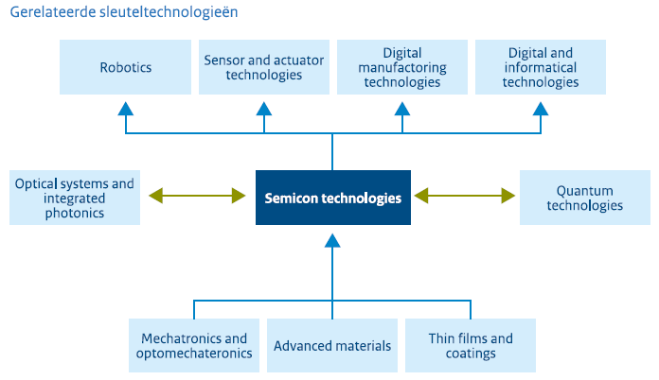
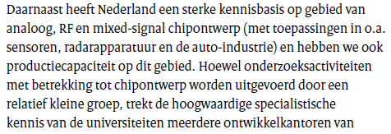
Semiconductor technologies “in 2035, the Netherlands holds signature sustainable positions in chip design, production equipment, materials, and packaging. With pride.”
We know that, so the let’s look inside:

Slide 23
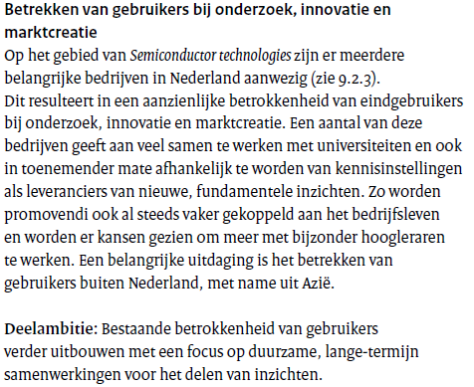
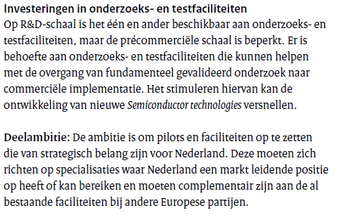
Ambitions

Slide 24
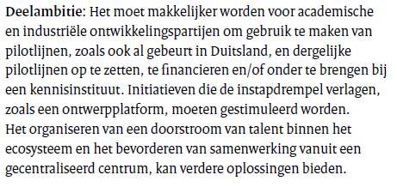
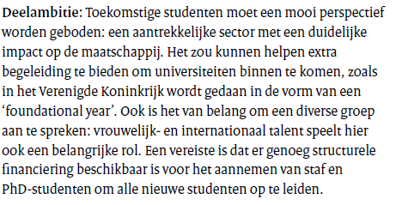
Ambitions

Slide 25
Ambitions

Slide 26
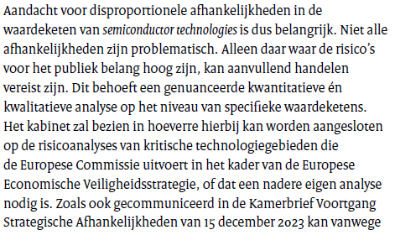
And there’s the caveat

Slide 27
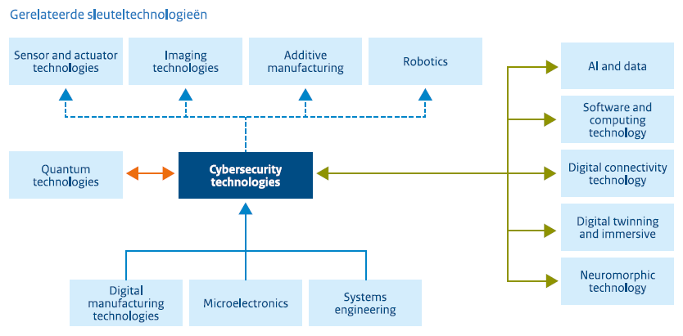
Cybersecurity Technologies
“by 2035 a competitive cybersecurity market with enough talent, through a multi-disciplinary approach … protecting infrastructure, IT, OT, and post-quantum and automation and defence using AI”
Remember this was a late addition … it shows a bit in the text …

Slide 28
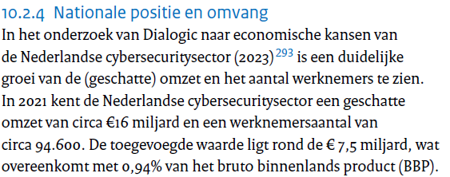
The strategy is a bit creative here with the data
Drivers:
NIS2
Cyber Resilience Act
Cyber Security Act
ongoing growth of threats
??

Slide 29
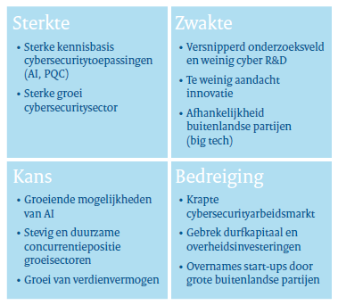
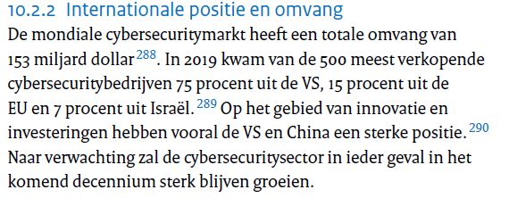
But its (again) not a controlpoint technology

Slide 30
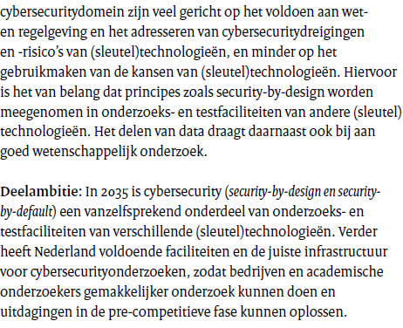
But the strategy will have broad impact

Slide 31
So where are out best chances? What should the strategy say?
Summarizing the potentially relevant areas:
optical/photonics, quantum, (opto)mechatronics, AI & datascience, and semicon.
… and we may leverage cybersecurity in some way plus have a look at imaging
The strategy should increase the focus on and strengthen
semiconductor development
quantum technologies (quantum sensing as well as quantum computing)
build on the (opto)mechatronics basis
fiber sensing through integrated photonics (?)

