Slide 1
Cosmic Rays
Scientific diversity:
Charles Timmermans

Slide 2
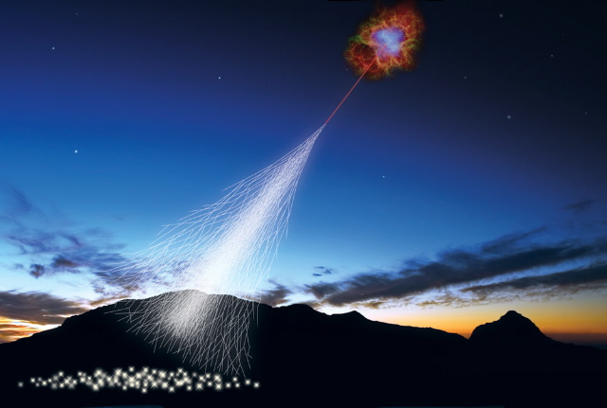
50x60 km = Dutch province
Introduction
We measure the results of the interactions of the highest energy particles known to man with the atmosphere.
Main goals:
Identifying and understanding the sources of these particles
Understanding the physics governing the interactions in the atmosphere
Our workhorse: The upgraded Pierre Auger Observatory (AugerPrime) in Malargüe Argentina. This is the largest cosmic ray detector in the world.
27 telescopes measuring fluorescence light induced by particles moving through the atmosphere
Over 1600 Surface Detector stations measuring particles at Earth as well as Electromagnetic radiation in the atmosphere
The Netherlands is the main player in the upgrade with a new detection technique “Radio” and major contributions to the design and construction of the scintillator detector
Notes:
We should keep developing methods to make (more) accurate observation of air showers, as they provide a unique alternative path for studying interactions at extreme energies and geometries.
Observations of air showers and transport through space of ultra-high-energetic particles provides alternative ways to look for deviations from relativity, where better knowledge on the particle types and sources is essential.
We support the development of next-generation detectors to enhance the current precision and statistics, and enable searches for neutral particles at ultra-high energies.

Slide 3
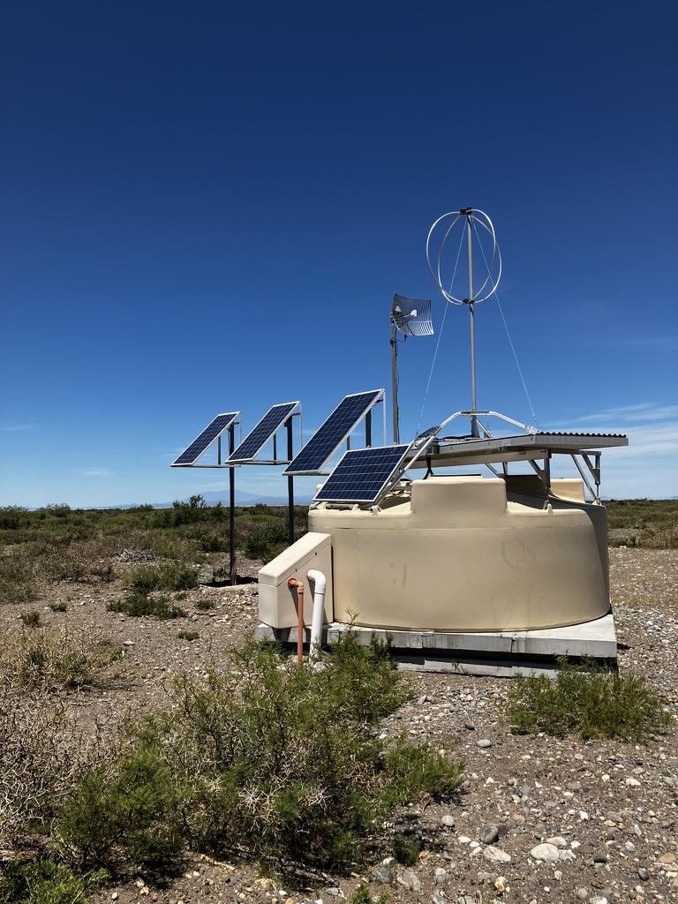
Augerprime: the principle

Slide 4
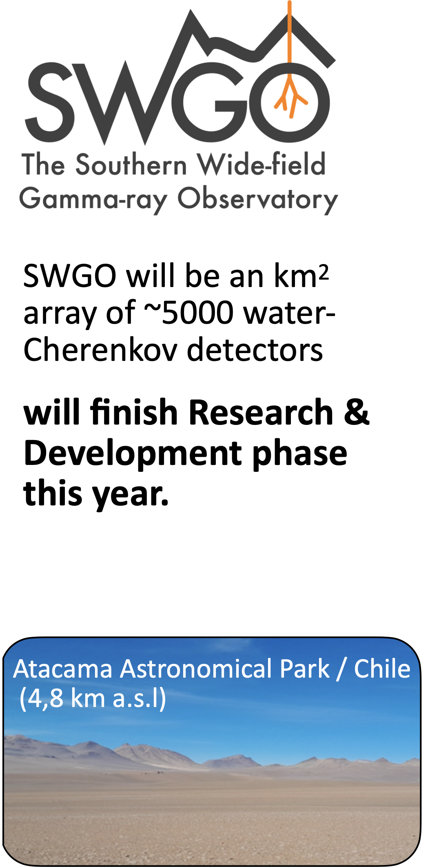


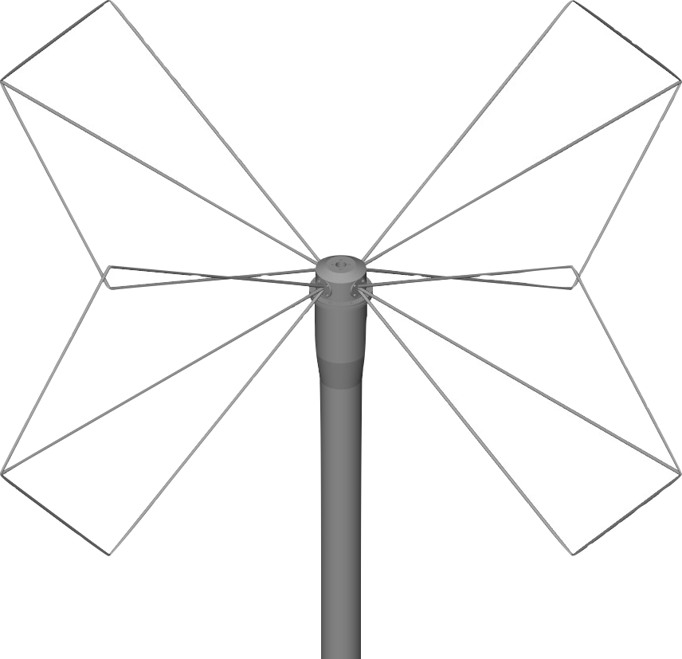

Southern Wide field gamma ray observatory
Radio antennas segmented water Cherenkov detectors
+
Electromagnetic interactions in the air shower
Hadronic interactions in the air shower
Part of the ERC of Harm Schoorlemmer is to add high-density radio detection to SWGO, allowing to study air shower physics in detail

Slide 5
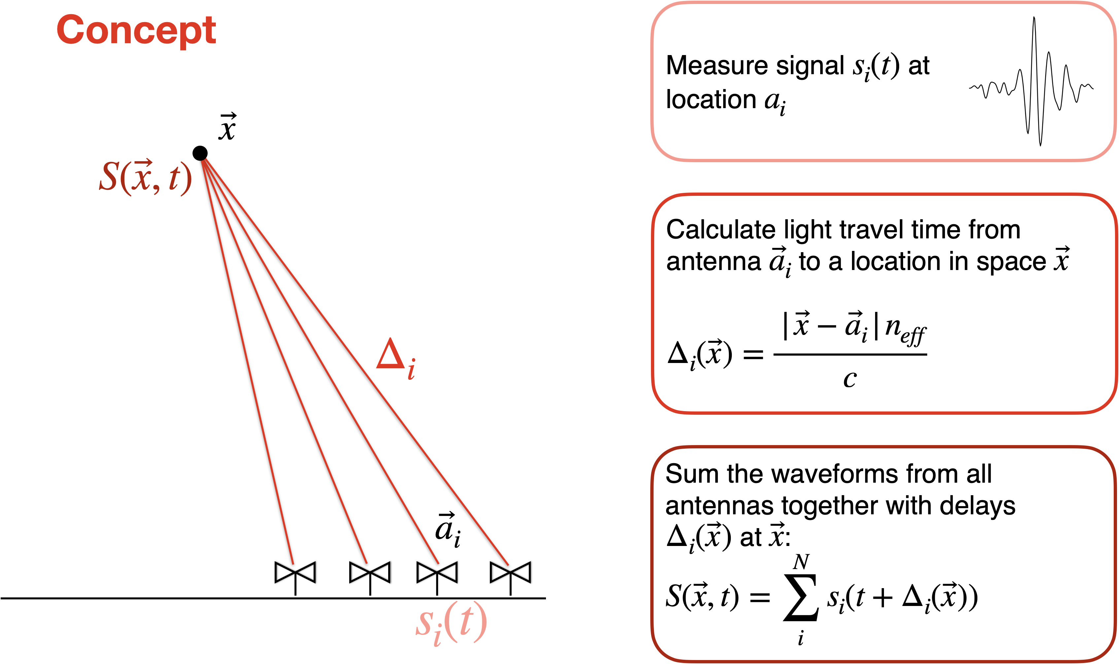
Using radio to measure shower features
interferometry

Slide 6
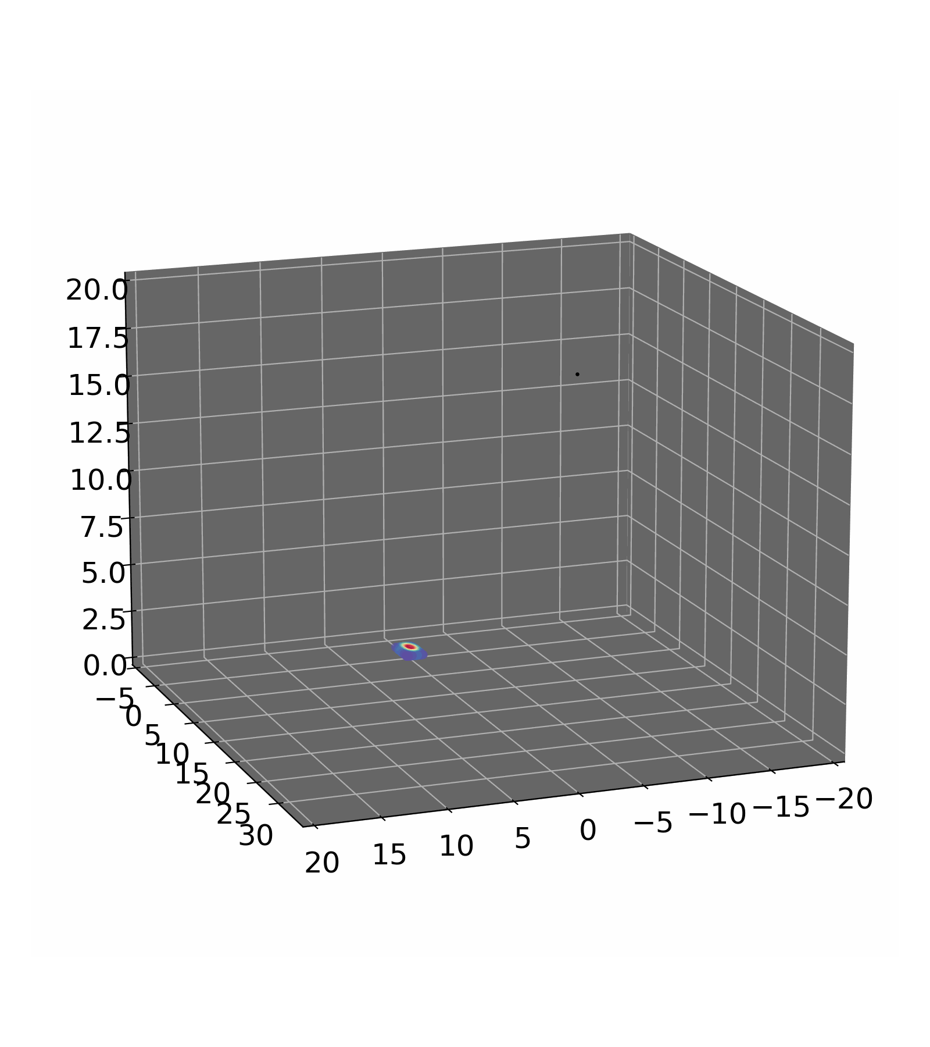
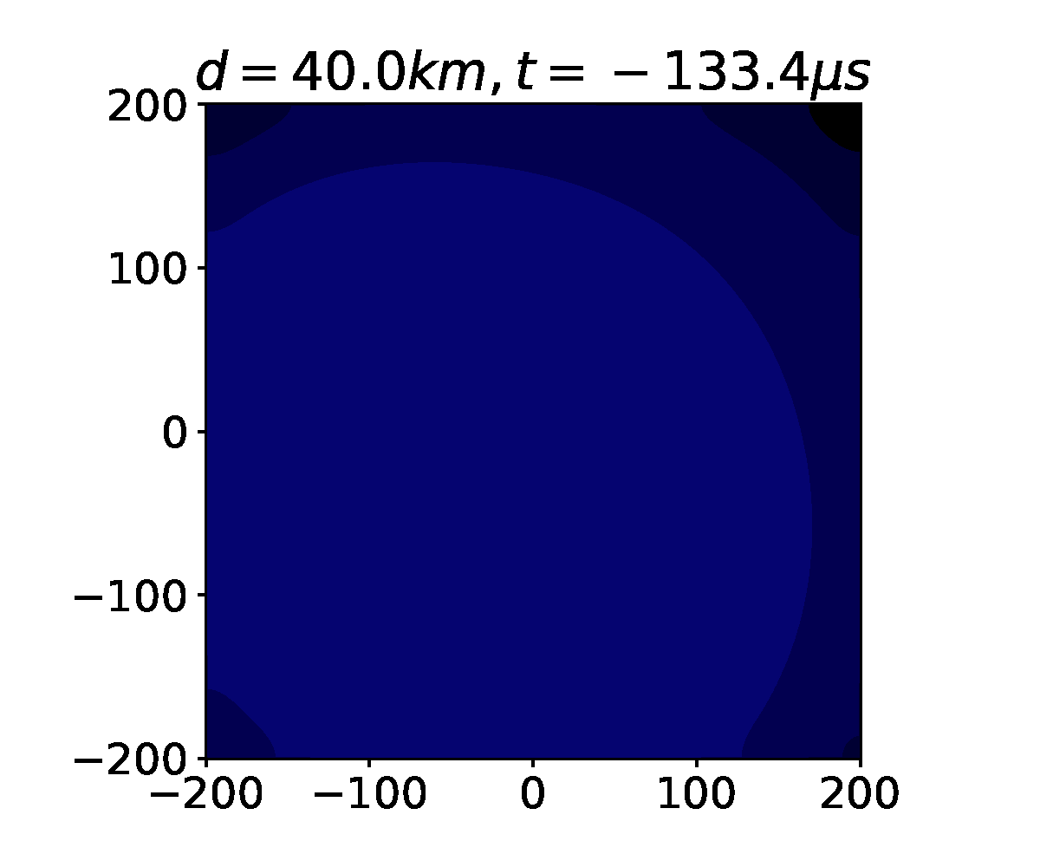
Using radio to measure shower features

Slide 7
Physics avenues (jamboree2024)

Slide 8
Physics avenues (jamboree2024)

Slide 9
Physics avenues
Examining the muon content of air showers
Using Xmax to set the mass-scale for primary cosmic rays

Slide 10
The next generation….

Slide 11
The next generation….
2 prototypes currently operational:
GRAND@Auger (10 antennas)
GP300 in western China (DunHuang)
(80 antennas)
About 20 sites of 10,000 km2 !

Slide 12
timeline
AugerPrime:
will run until 2035
SWGO:
construction phase 1 to start in 2026
Radio production ready by 2027
Installation and commissioning 2028
Next generation observatory:
decision on what to do within the next 3-5 years

Slide 13
Why including UHECR in the ESPP document
UHE particles provide alternative ways to look for deviations from standard theories
Europe (the Netherlands) has a strong history and bright future in this field, provided funding is available
AugerPrime needs to collect data for another 10 years, and these data need to be analyzed
SWGO will provide an opportunity to confirm detector concepts and study air shower physics in much more detail
A next generation experiment should be ready at the end of AugerPrime

Slide 14
How to include UHECR in the ESPP document
I assume only a few sentences will be available:
“Detailed observations from air showers may provide insight into physics not reachable by man-made accelerators. Furthermore, with better knowledge of the sources of UHE particles, the transport of these particles through space provides an alternative way to look at deviations from GR. These studies require more statistics and better detail than what is currently available”

Slide 15
Statements
We should keep developing methods to make (more) accurate observation of air showers, as they provide a unique alternative path for studying interactions at extreme energies and geometries.
Observations of air showers and transport through space of ultra-high-energetic particles provides alternative ways to look for deviations from relativity, for which better knowledge on the particle types and sources is essential.
We support the development of next-generation detectors to enhance the current precision and statistics and enable searches for neutral particles at ultra-high energies.

