Slide 1
Variational Quantum Algorithms
November Meeting of Nikhef ML/AI group Xenofon Chiotopoulos 22/11/2024

Slide 2
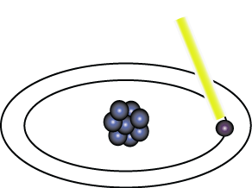
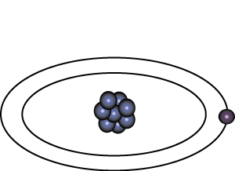
What is Quantum Computation
Light pulse of frequency λ for time interval t
Excited State
Nucleus
Ground State
Electron
State |0>
State |1>

Slide 3
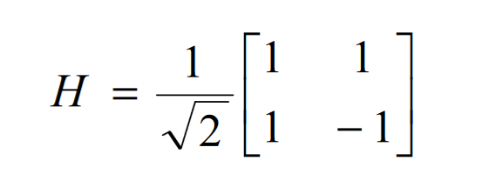
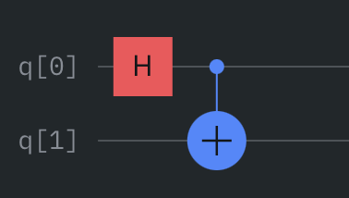
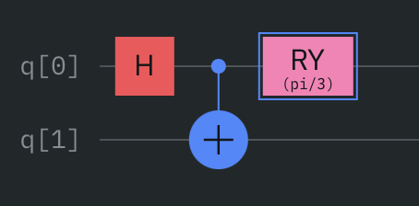
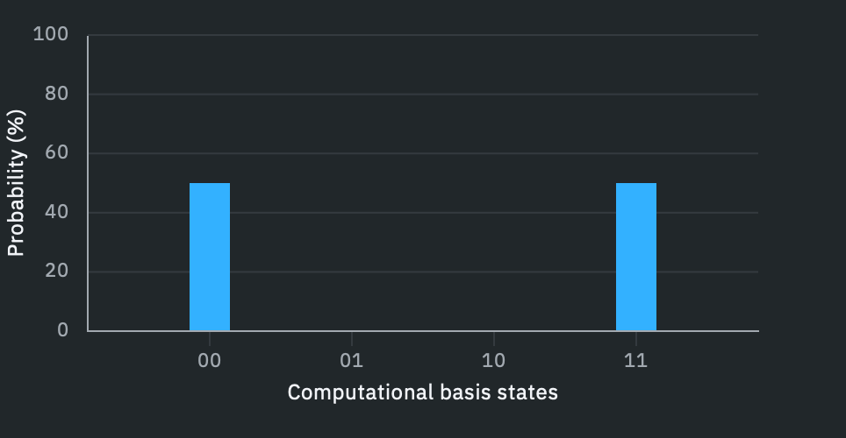
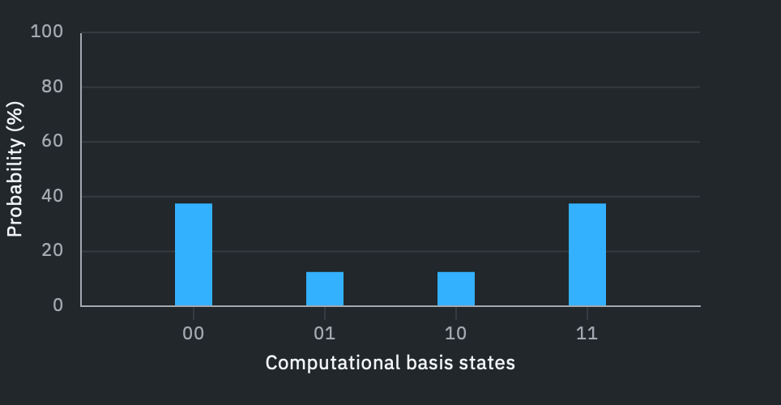
Circuit-based Quantum Computing
Add Gate $R_{y}\left(\frac{π}{3}\right)$

Slide 4
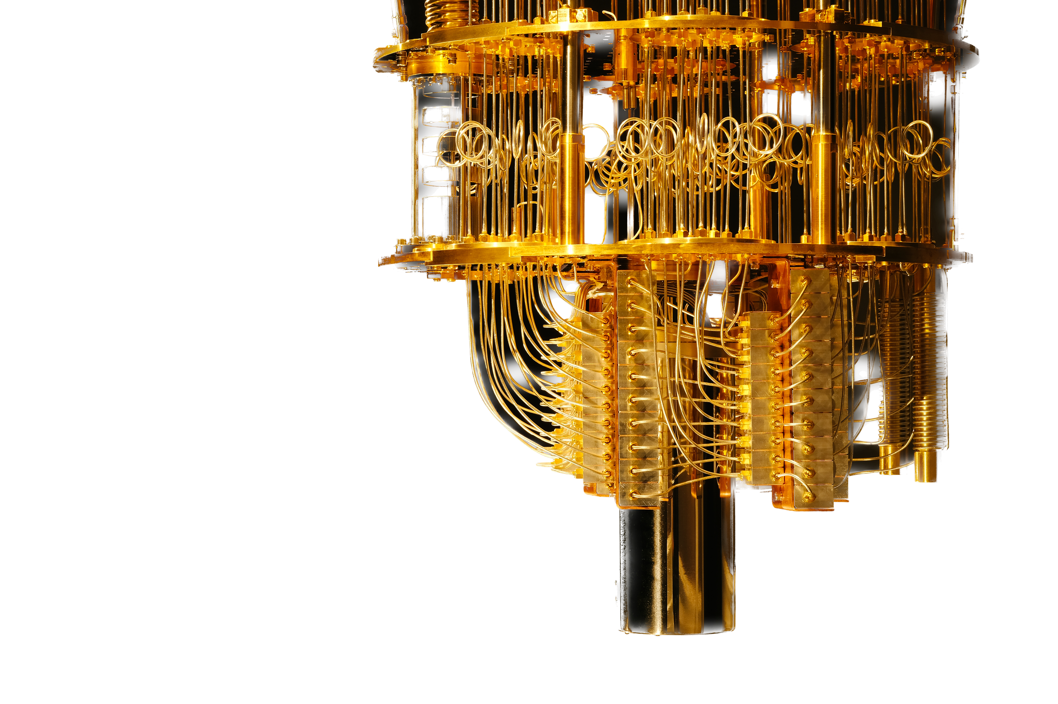
Current Quantum Computers dispose of limited resources
Limited number of qubits
Limited connectivity between qubits
Quantum noise
What can we achieve with currently available quantum computers?
Variational Quantum Algorithms

Slide 5
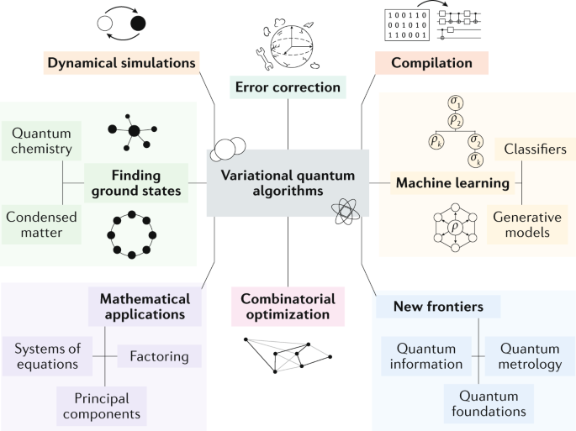
https://www.nature.com/articles/s42254-021-00348-9

Slide 6
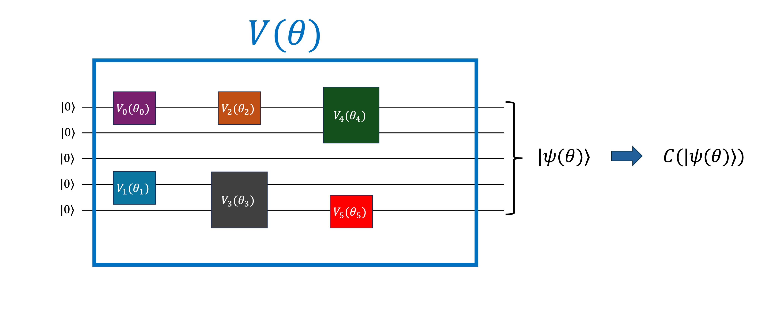
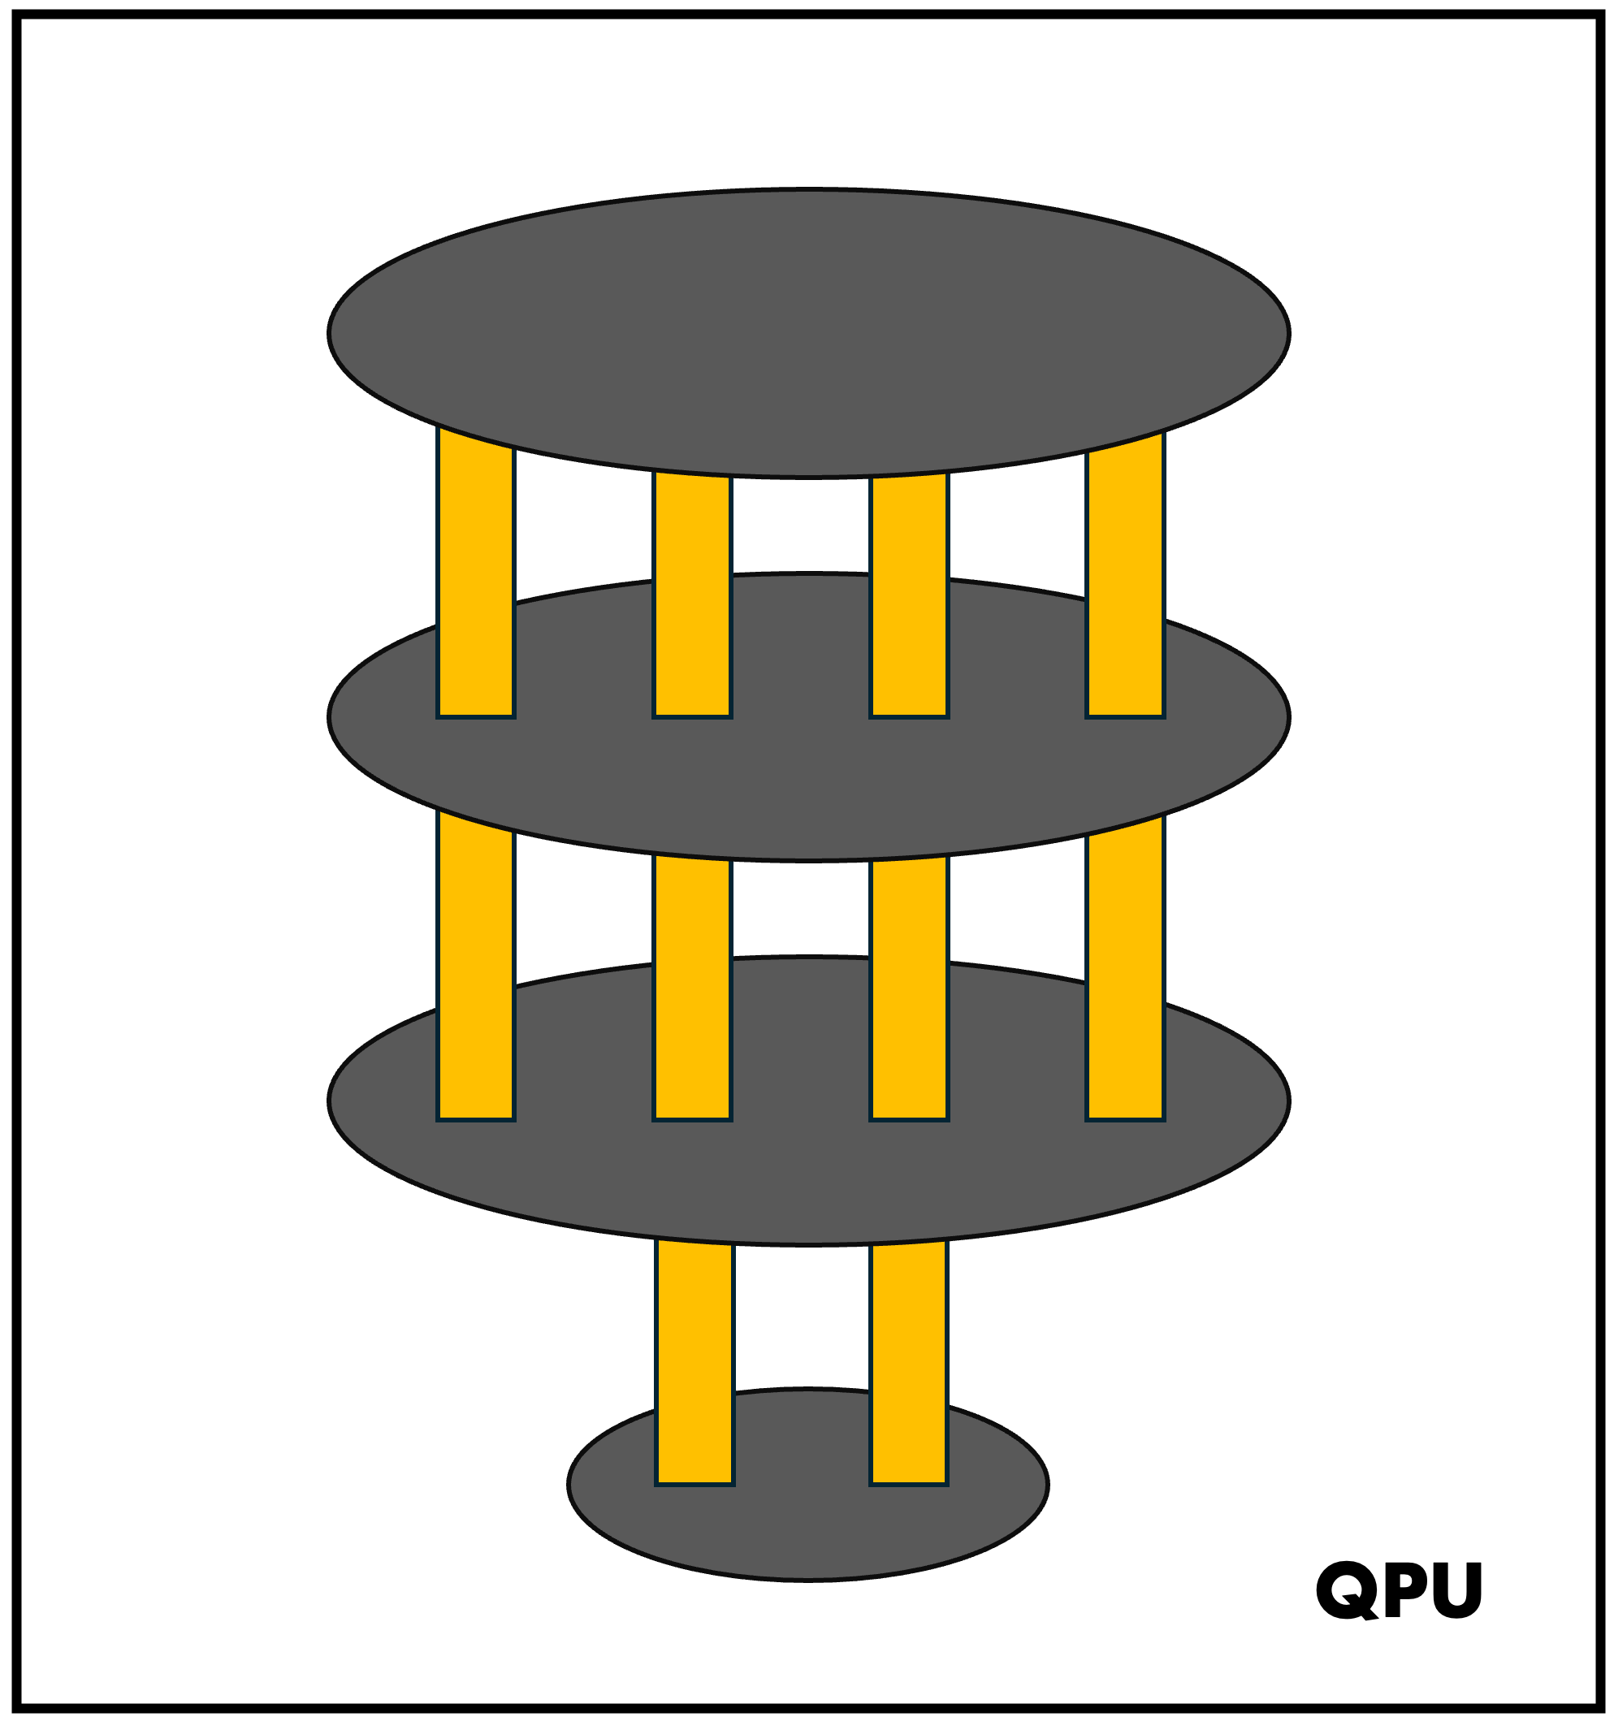
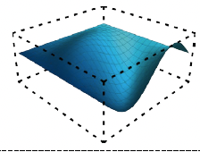
Variational Quantum Algorithms: a hybrid quantum-classical approach
Classical Optimizer
$$\arg{\min_{θ}{C(|ψ(θ⟩)}}$$

Slide 7
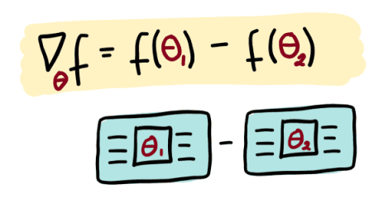
Computing Gradients
Parameter-shift Rule
$$f^{′}\left(x\right)=\frac{1}{2}\sin\left(x+\frac{π}{2}\right)−\frac{1}{2}\sin\left(x−\frac{π}{2}\right)$$
$$f\left(x\right)=\sin{x}$$
$$C\left(θ_{i}\right)=\left\langle ψ\left(θ_{i}\right) | \hat{O} | ψ\left(θ_{i}\right)\right\rangle$$
$$\frac{∂C\left(θ_{i}\right)}{∂θ_{i}}=\frac{1}{2}\left[C\left(θ_{i}+\frac{π}{2}\right)−C\left(θ_{i}−\frac{π}{2}\right)\right]$$
If you want to learn more

Slide 8
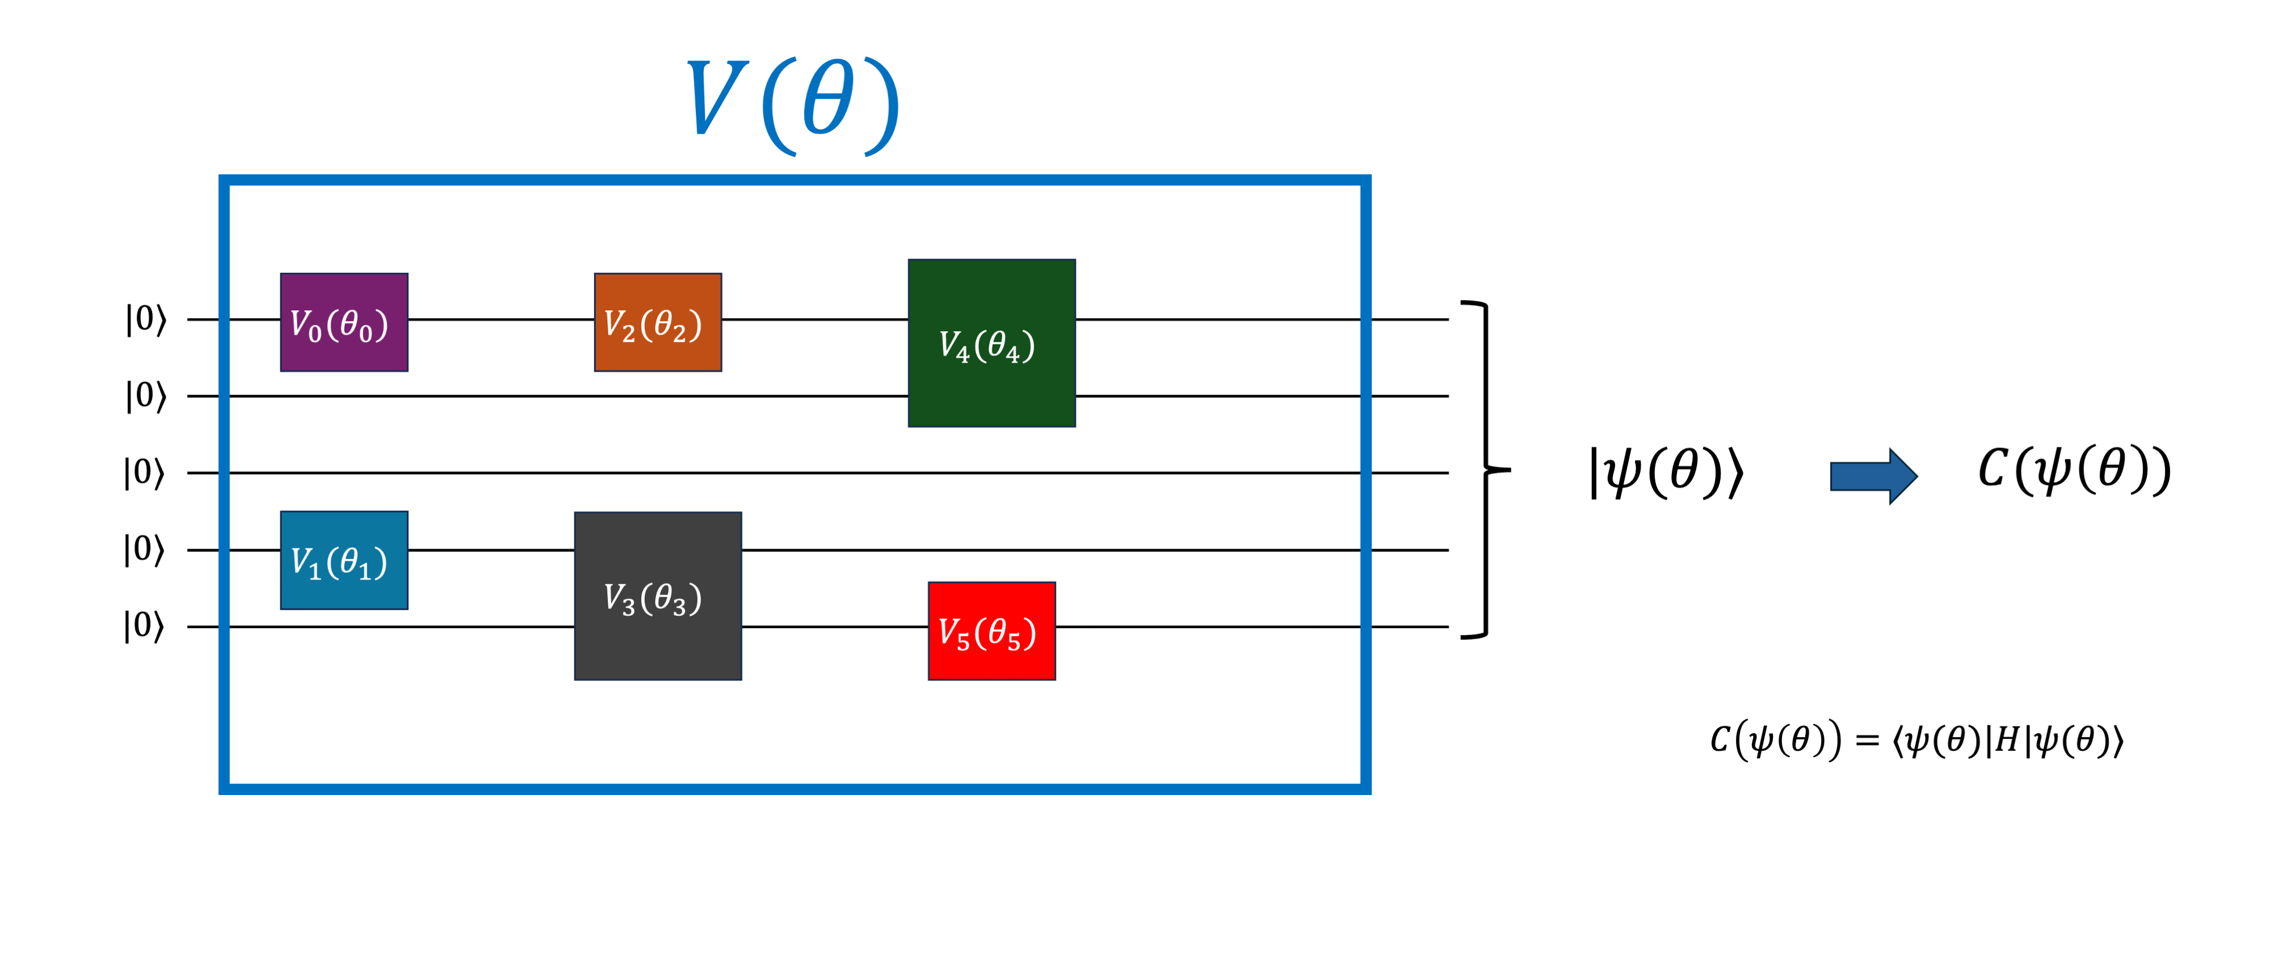
Encode the Problem in a Parameterized Quantum Circuit
Cost Function
How do we determine the structure of the circuit to optimize on?

Slide 9
Quantum Ansatz Search
Parameter Space
Solution Space

Slide 10
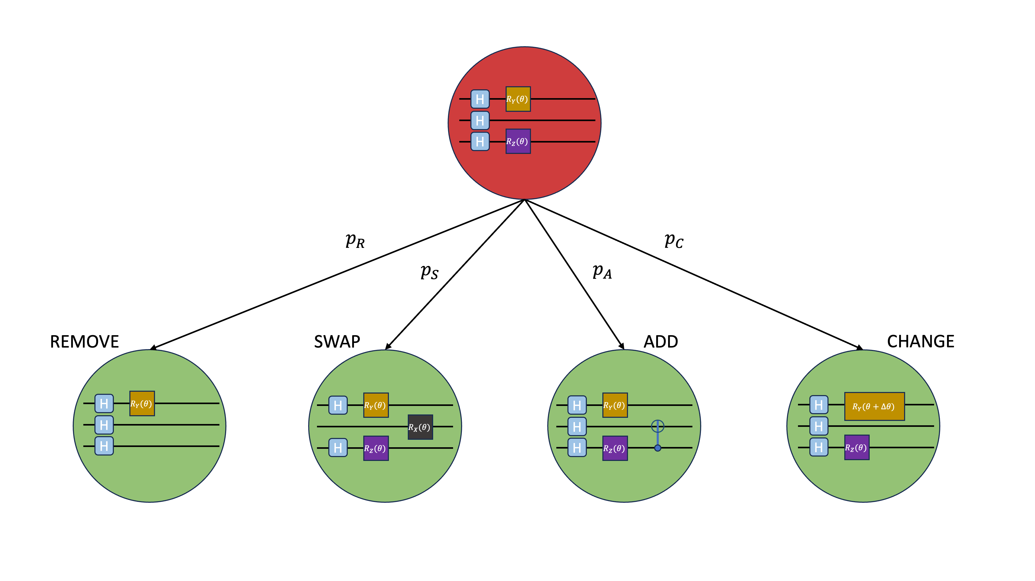
Quantum Ansatz Search

Slide 11
Quantum Ansatz Search
Monte Carlo Tree Search
Reinforcement Learning
Parameter Space
Solution Space
Genetic Algorithms
Bayesian Optimization

Slide 12
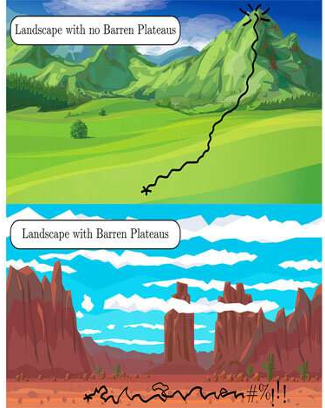
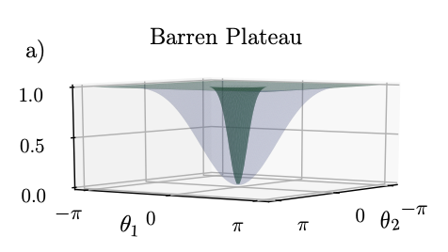
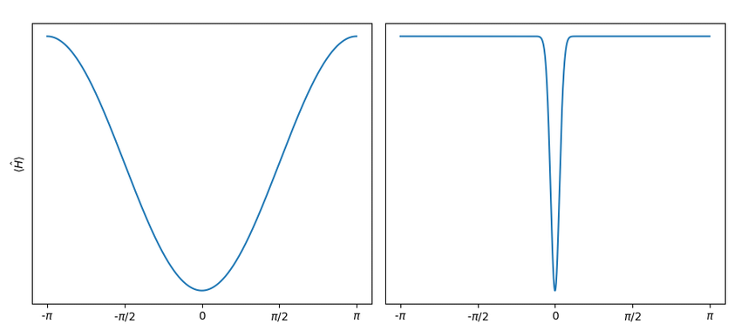
Barren Plateaus
https://www.nature.com/articles/s41467-021-21728-w

Slide 13
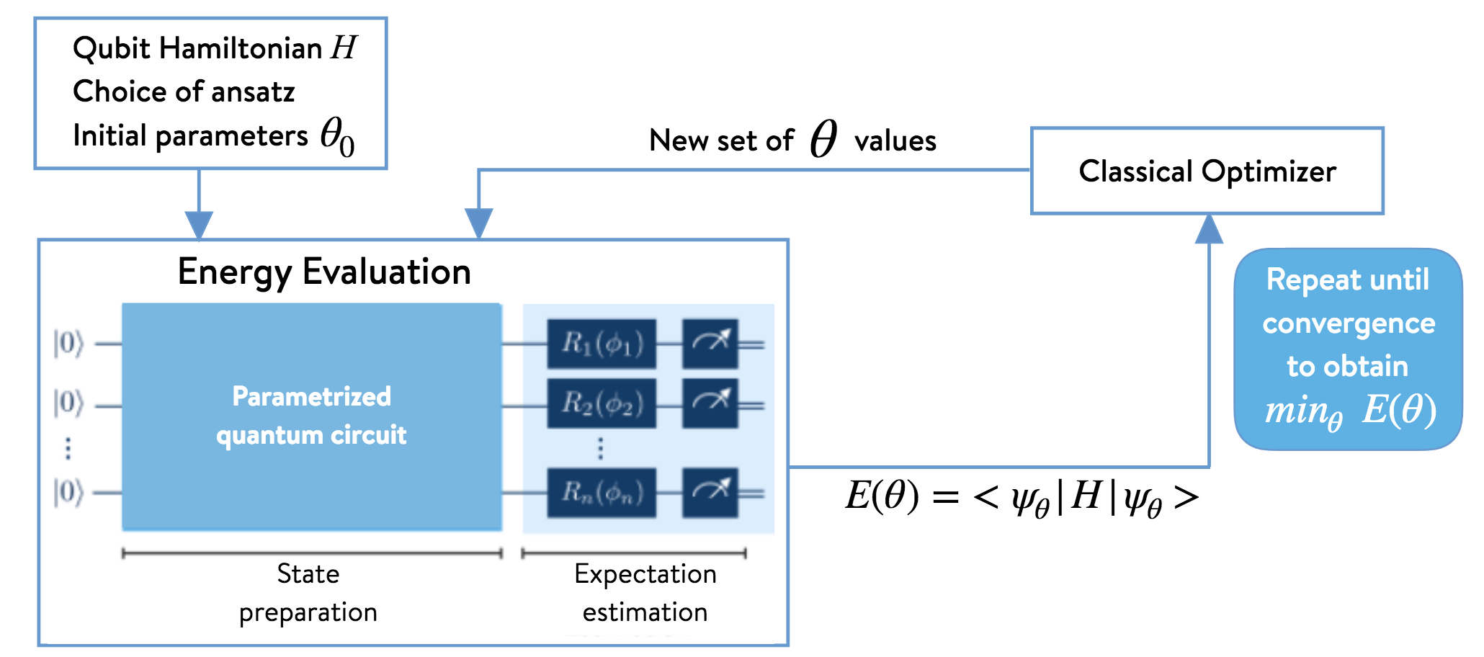
Variational Quantum Eigensolver

Slide 14
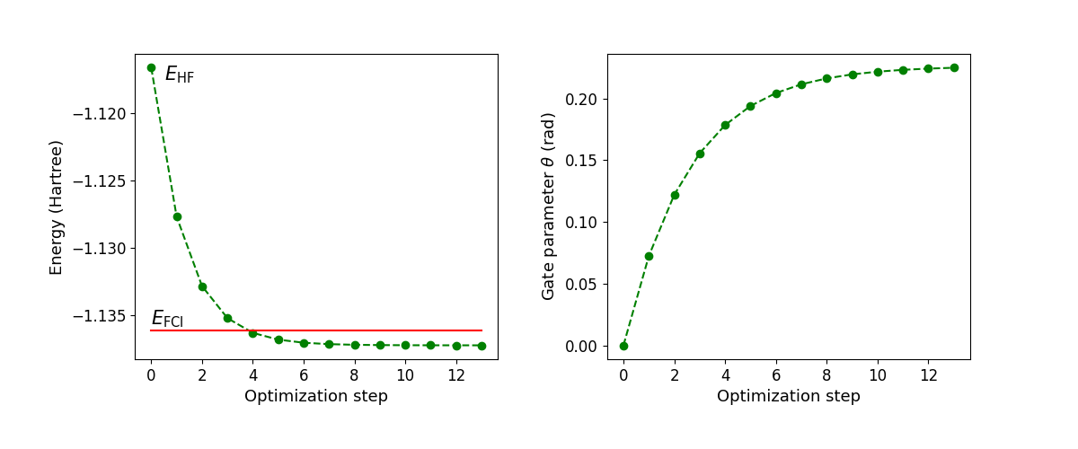
Variational Quantum Eigensolver

Slide 15
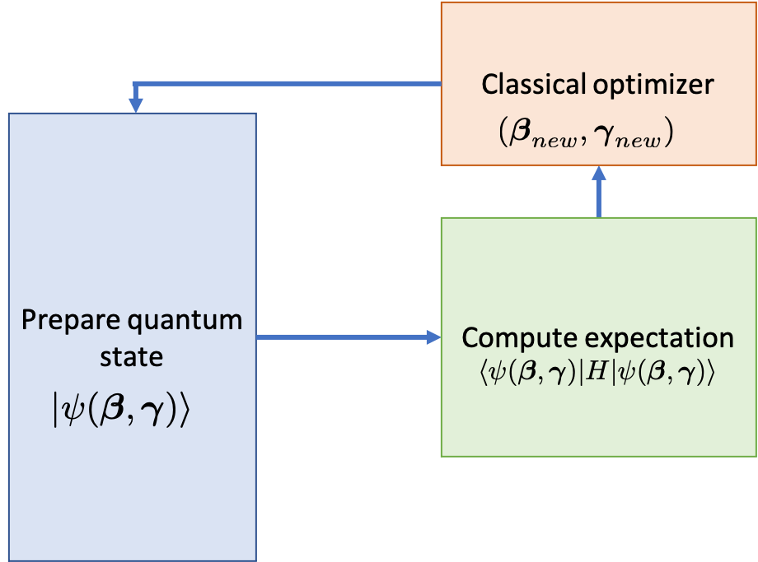
Quantum Approximate Optimization Algorithm
H_{B}: mixing Hamiltonian, H_{P}: problem Hamiltonian
Goal: find optimal parameters (ꞵ_{opt},γ_{opt}) such that the quantum state encodes the solution to the problem

Slide 16
Applications of Quantum Computing in HEP
https://journals.aps.org/prxquantum/abstract/10.1103/PRXQuantum.5.037001

Slide 17
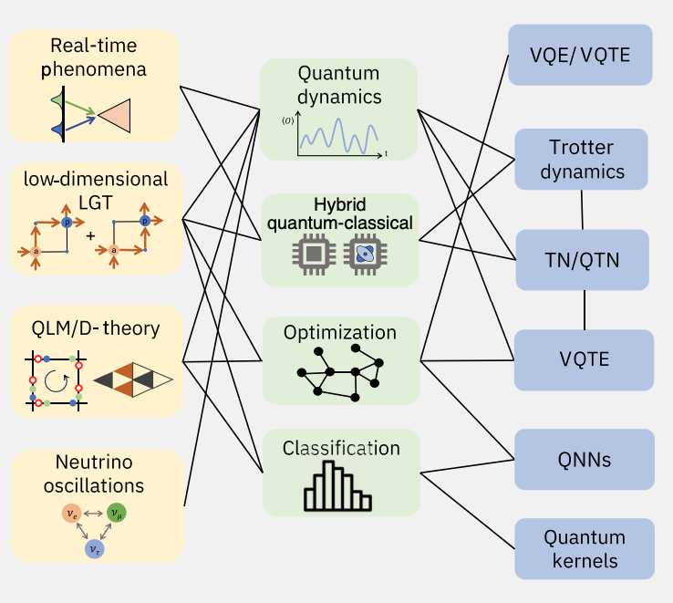
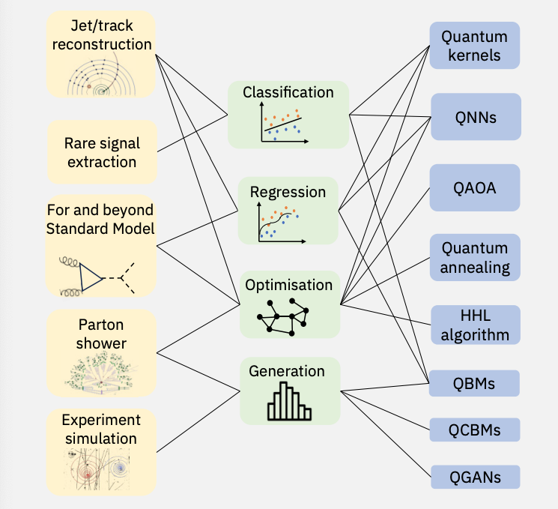
Application Areas

Slide 18
NEXT
Quantum Neural Networks

