Slide 1









Pixel TPC tracking and dE/dx performance
Yevgen Bilevych, Klaus Desch, Sander van Doesburg, Harry van der Graaf, Fred Hartjes, Jochen Kaminski, Peter Kluit,
Naomi van der Kolk,
Cornelis Ligtenberg,
Gerhard Raven, and
Jan Timmermans

Slide 2
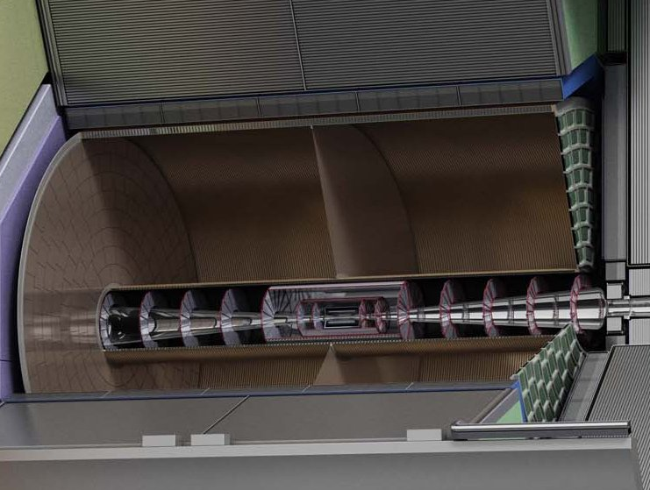



Pixel TPC
(Octopuce)
(TimePix1) TPX3 chip Quad Module TPC plane
(2007-14) 2017 2018 2019

Slide 3
Pixel TPC
Material budget is
  0.01 X₀ TPC gas
  0.01 X₀ inner cylinder
  0.03 X₀ outer cylinder
  < 0.25 X₀ endplates (incl readout)
Note the very low budget in the barrel region. Material budget can be respected by different technologies like GEM, MicroMegas and Pixels
TPC is sliced between silicon detectors VTX, SIT and SET
pixel readout is a serious option for the TPC readout plane @ ILC/FFC-ee/CLIC/CEPC colliders

Slide 4
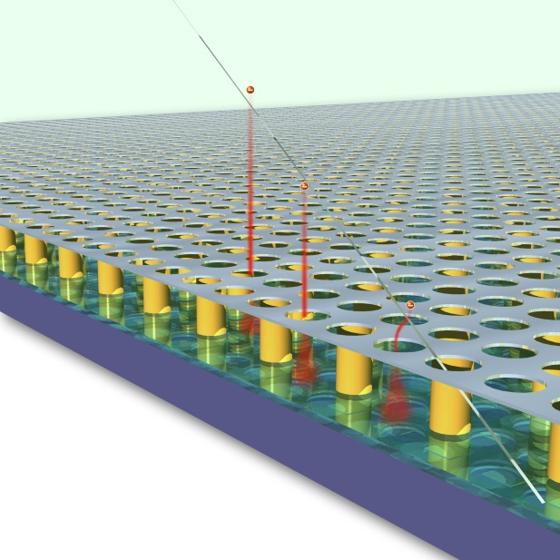
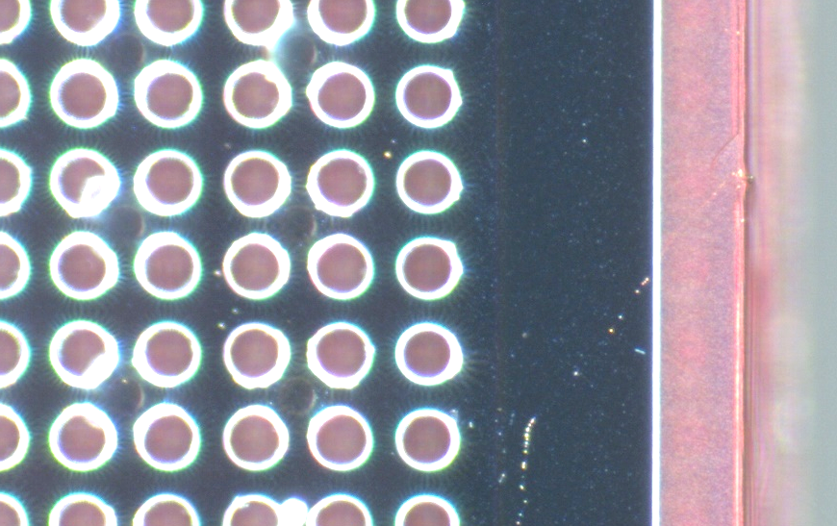
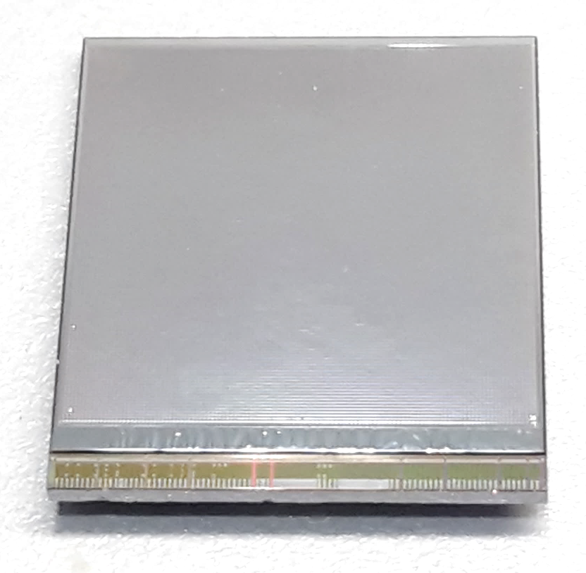
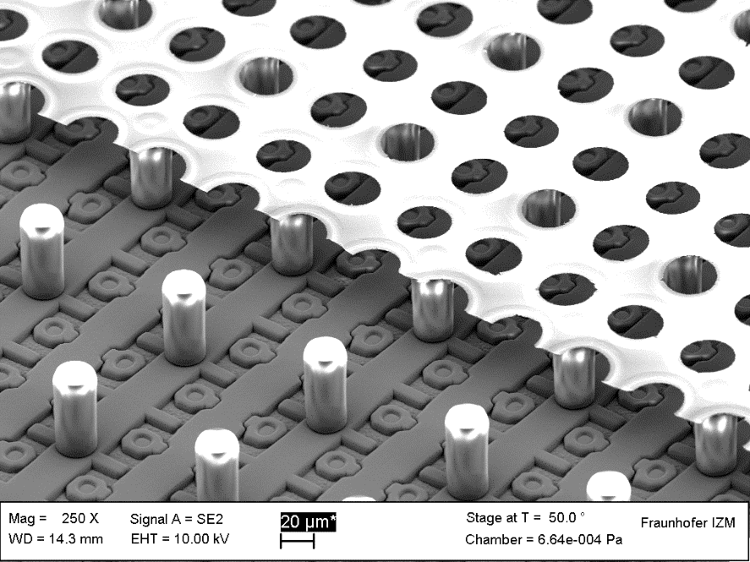
GridPix technology
Pixel chip with integrated Grid (Micromegas-like)
InGrid post-processed @ IZM
Grid set at negative voltage (300 – 600 V) to provide gas amplification
Very small pixel size (55 µm)
detecting individual electrons
dyke
55 µm
Aluminium grid (1 µm thick)
35 µm wide holes, 55 µm pitch
Supported by SU8 pillars 50 µm high
Grid surrounded by SU8 dyke (150 µm wide solid strip) for mechanical and HV stability
50 µm

Slide 5
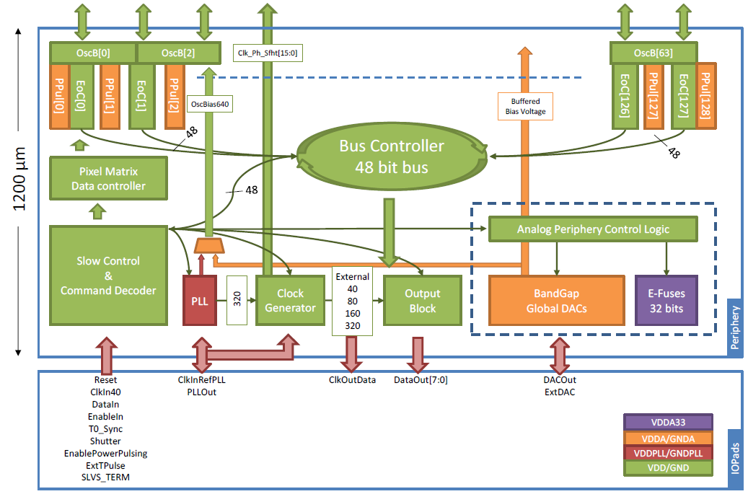
Pixel chip: TimePix3
256 x 256 pixels
55 x 55 µm pitch
14.1 x 14.1 mm sensitive area
TDC with 640 MHz clock (1.56 ns)
Used in the data driven mode
  Each hit consists of the pixel address and time stamp of arrival time (ToA)
  Time over threshold (ToT) is added to register the signal amplitude
  compensation for time walk
  Trigger (for t₀) added to the data stream as an additional time stamp
Power consumption
  ~1 A @ 2 V (2W) depending on hit rate
  good cooling is important
Sensitive area
14.1 mm
2+3 mm

Slide 6
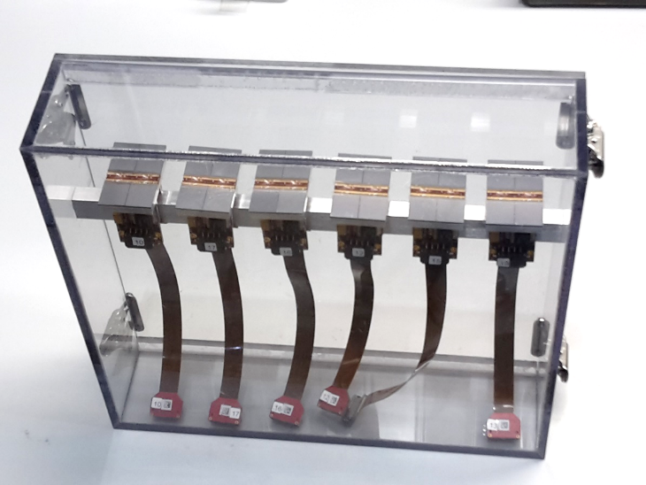
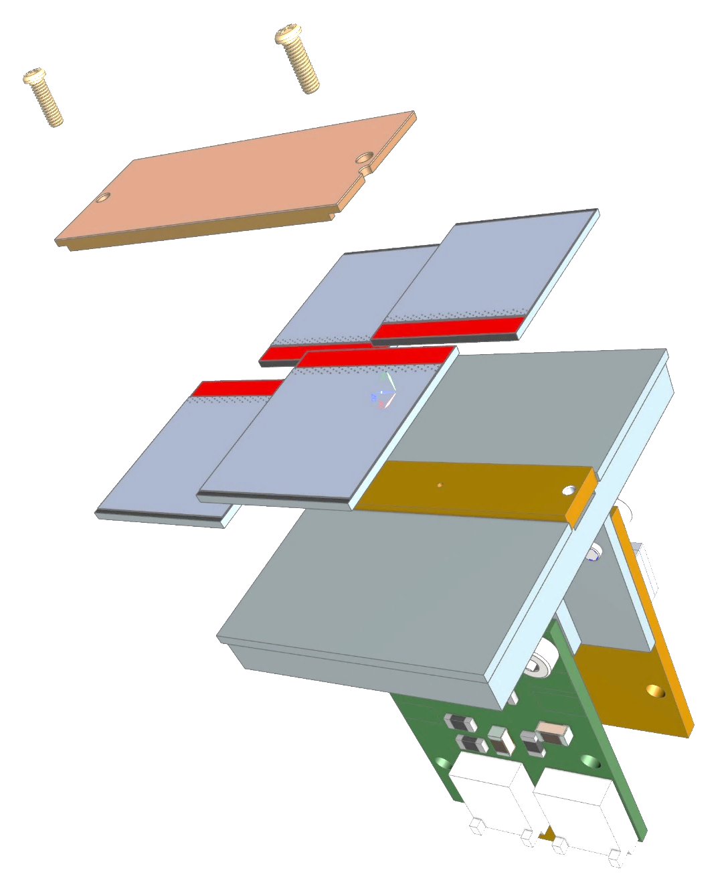
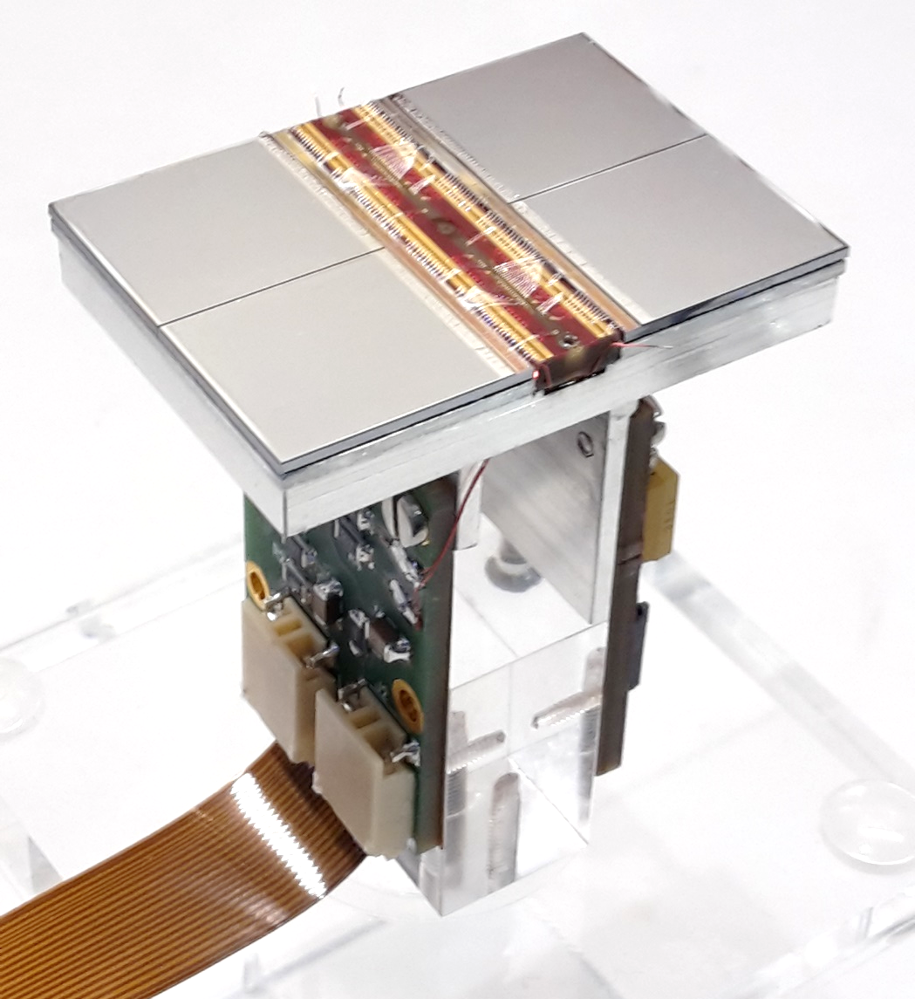
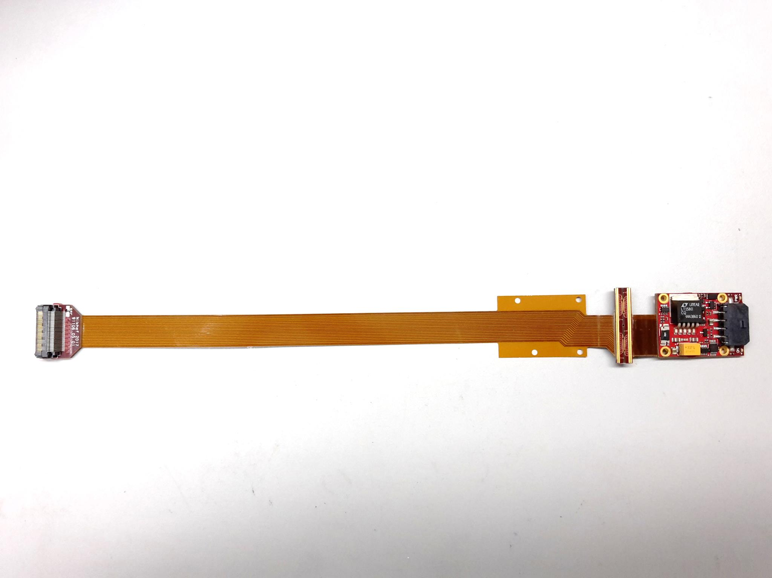
QUAD design and realization
Four-TimePix3 chips
All services (signal IO, LV power) are located under the detection surface
The area for connections was squeezed to the minimum
Very high precision 10 μm mounting of the chips and guard
QUAD has a sensitive area of 68.9%
DAQ by SPIDR
39.6 x 28.38 mm
series of QUADs
Guard
TPX3
TPX3
TPX3
TPX3
COld
CArrier

Slide 7
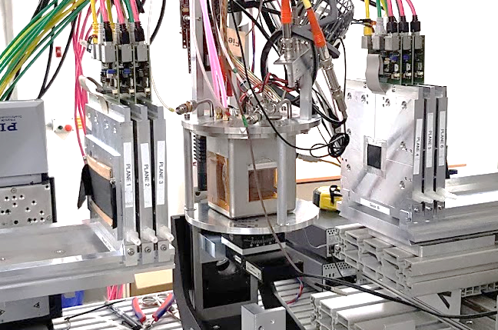
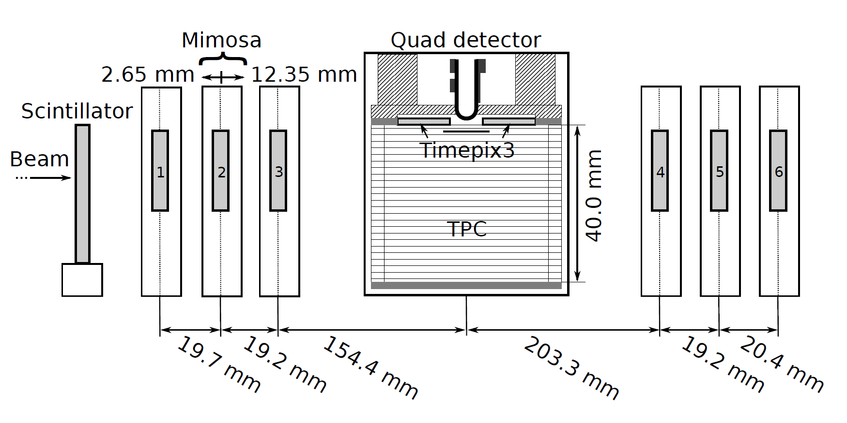

QUAD test beam in Bonn (October 2018)
ELSA: 2.5 GeV electrons
Tracks referenced by Mimosa telescope
QUAD sandwiched between Mimosa planes
  Largely improved track definition
  6 planes with 18.4 μm × 18.4 μm sized pixels
Gas: Ar/CF₄/iC₄H₁₀ 95/3/2 (T2K)
E_{d} = 400 V/cm, V_{grid} = -330 V
Typical beam height above the chip: ~1 cm
Published NIMA https://doi.org/10.1016/j.nima.2019.163331
@Bonn
Field cage

Slide 8
QUAD as a building block
8-QUAD module (2x4 quads) with field cage
in red guard wires

Slide 9
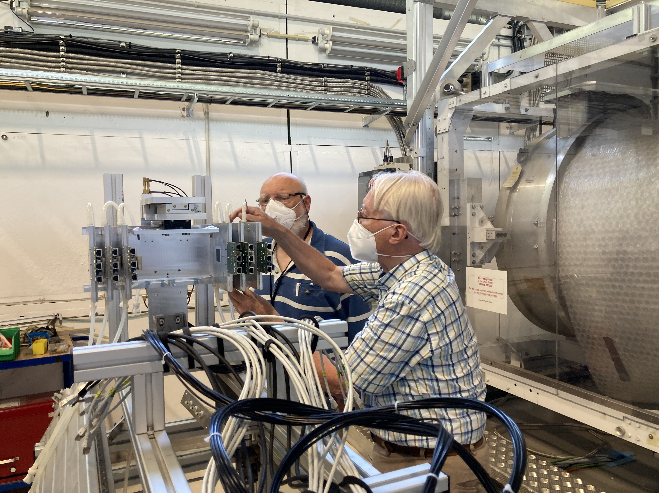
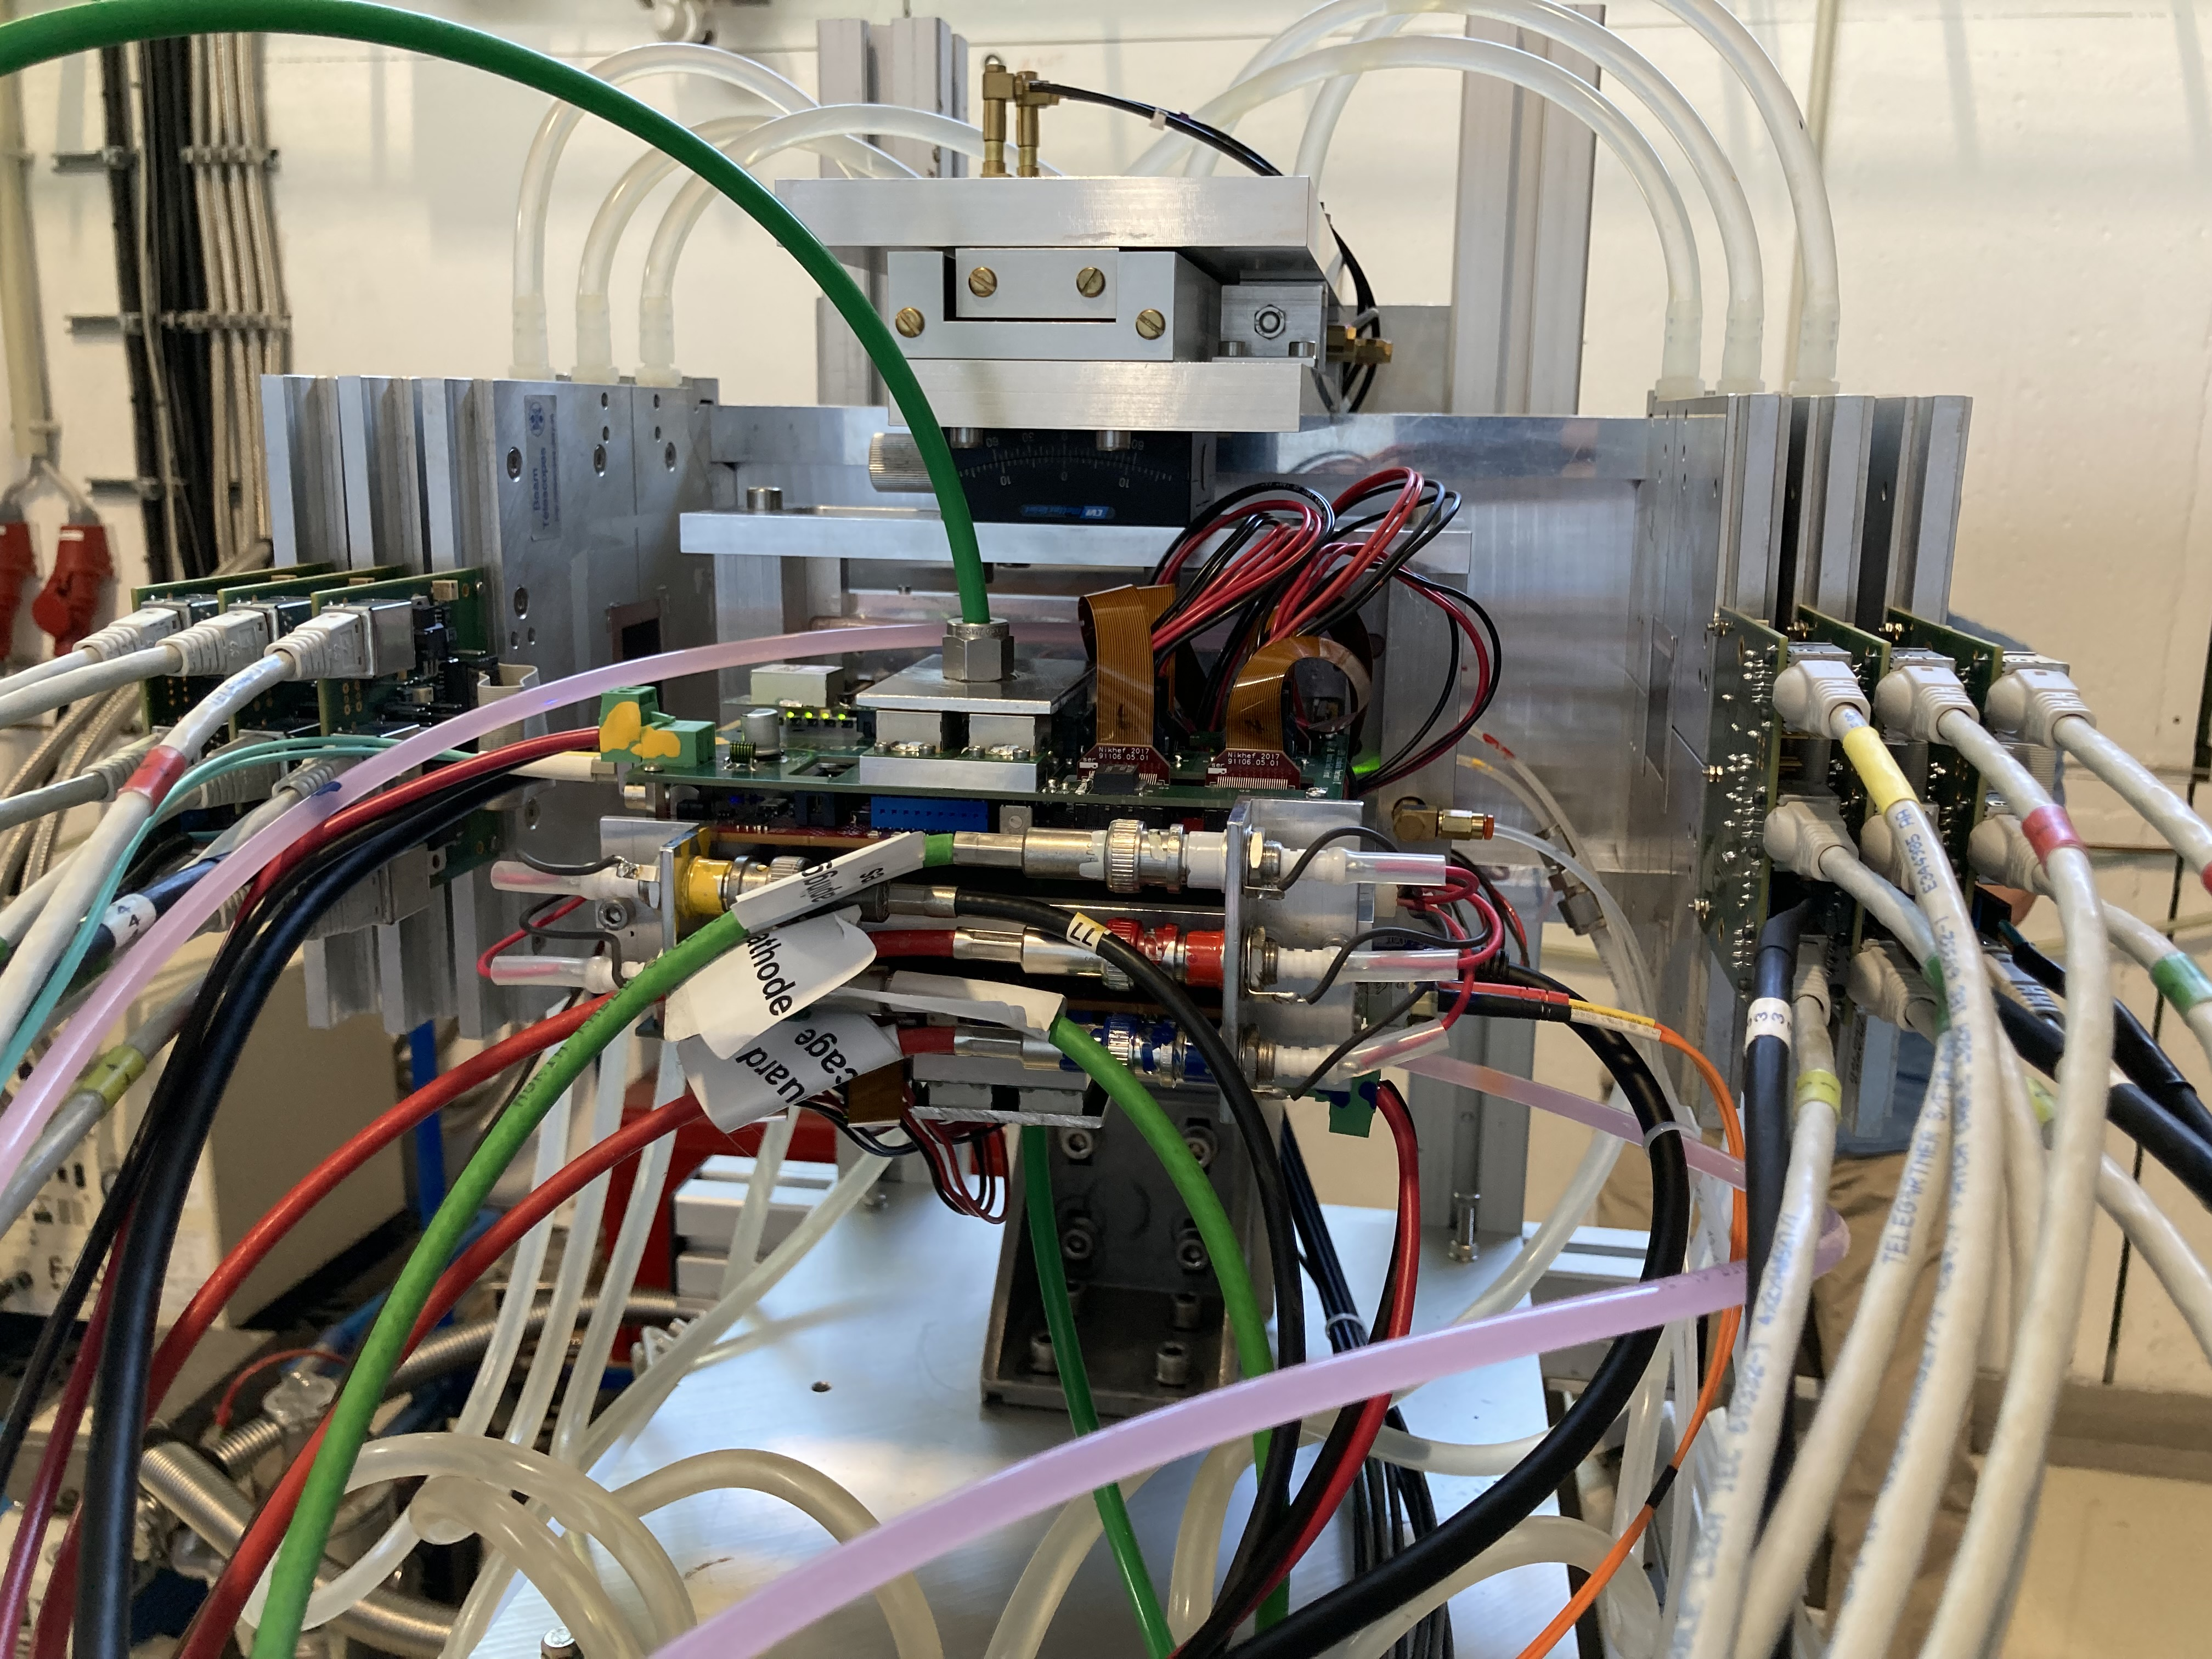
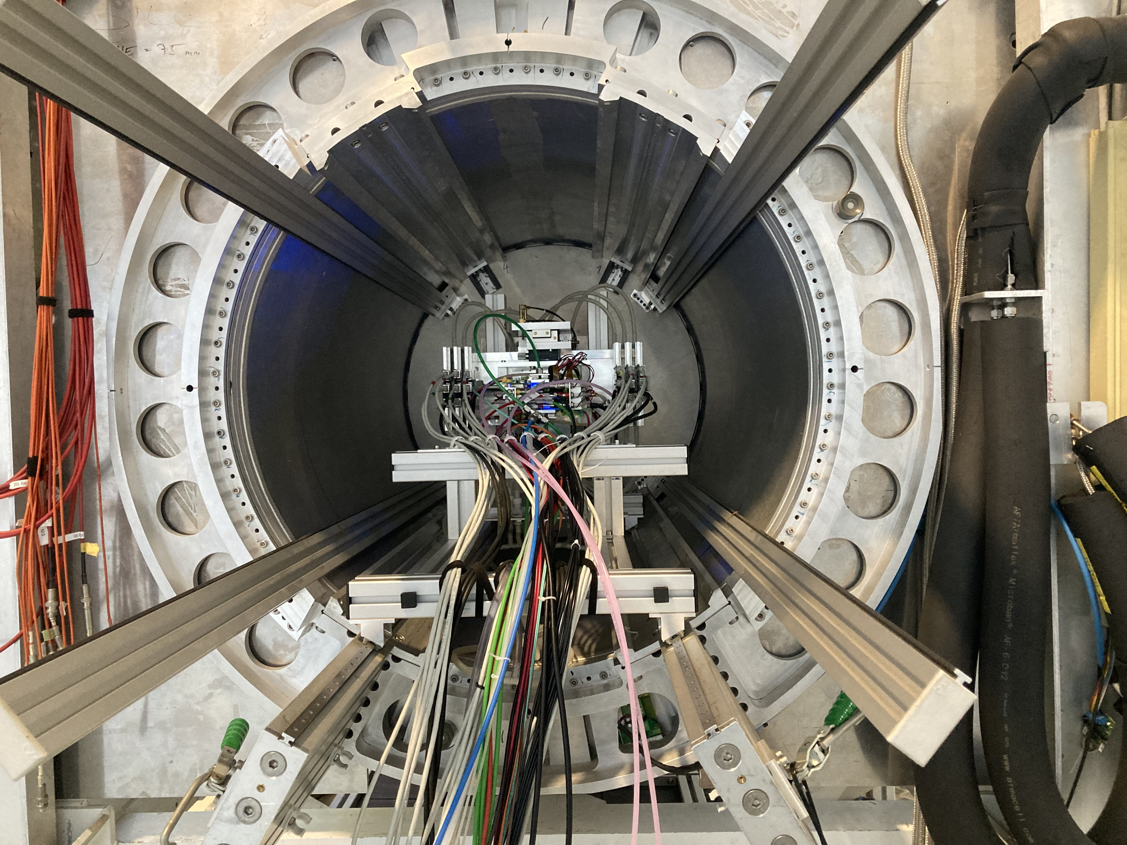
DESY testbeam June 2021
Mounting the 8 quad module between the silicon planes
sliding it into the 1 T PCMAG solenoid

Slide 10
DESY testbeam June 2021

Slide 11
DESY testbeam Module Analysis
Event display with module and telescope
TPX3 track 1130 hits
χ²_{xy} = 677.5/1128
χ²_{z} = 775.9/1069
Asymmetric tail outlier removal applied 1071 hits in z kept.
TPX3 track hits
Telescope track hits (off track green)
Preliminary
x global
x local
z global
y local
z global
y global
z local drift
y local

Slide 12
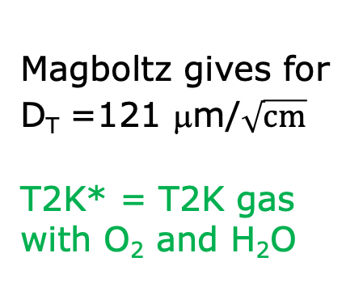
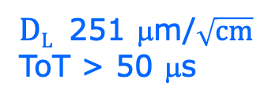

DESY testbeam Module Analysis
Run 6983-6990 B=1 T p=5 and 6 GeV
Fitted resolution
$$σxy,z2=σ2xy0,z0+D2xy,z \left(z−z0\right)$$
σ² _{xy0}= σ²_{pixel} + σ²_{xy tele} σ²_{pixel}= 55²/12 μm²
σ_{xy tele}=42 μm
$DT$ 120 μm/$\sqrt{cm}$
$DL$ 251 μm/$\sqrt{cm}$
ToT > 50 μs
Preliminary
Magboltz gives for D_{T} =121 μm/$\sqrt{cm}$
T2K* = T2K gas with O₂ and H₂O
B=1 T
T2K*
E_{d}=280 V/cm

Slide 13
DESY testbeam Module Analysis
Runs 6983-6988 B=1T p=5 GeV
Distribution of mean residuals in the plane
Method row
B=1 T situation
xy
z
method | rms (stat) xy | bins xy | rms (stat) z | bins z
row | 13 (2) μm | 896 | 19 (5) μm | 896
column | 11 (2) μm | 880 | 20 (5) μm | 880
Preliminary
Method column
* We did not include the 4 corner chips and (11), 14, 8, 13 and 19.
These are affected by the field cage and the short in chip 11.

Slide 14
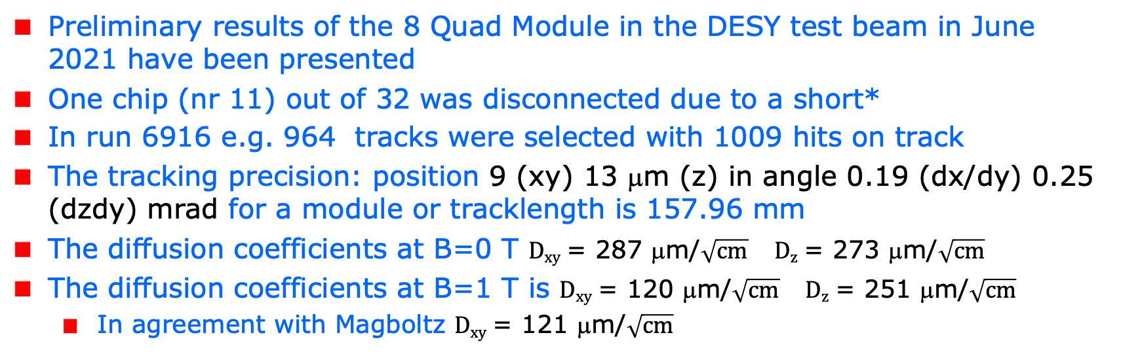
Tracking resolution and precision
Preliminary results of the 8 Quad Module in the DESY test beam in June 2021 have been presented
One chip (nr 11) out of 32 was disconnected due to a short*
In run 6916 e.g. 964 tracks were selected with 1009 hits on track
The tracking precision: position 9 (xy) 13 μm (z) in angle 0.19 (dx/dy) 0.25 (dzdy) mrad for a module or tracklength is 157.96 mm
The diffusion coefficients at B=0 T $Dxy$ = 287 μm/$\sqrt{cm}$ $Dz$ = 273 μm/$\sqrt{cm}$
The diffusion coefficients at B=1 T is $Dxy$ = 120 μm/$\sqrt{cm}$ $Dz$ = 251 μm/$\sqrt{cm}$
  In agreement with Magboltz $Dxy$ = 121 μm/$\sqrt{cm}$
*the chip was successfully repaired in 2023 Bonn

Slide 15
Tracking resolution and precision
Results for the module showed that:
  the HV of the guard wires was well tuned
  B=0 T rms residuals in the module plane xy 13 μm and z 15 μm
  The results are compatible with (very) high stats quad measurement
  B= 1 T rms residuals in the plane xy 13 μm and z 20 μm;
High tracking precision is demonstrated with small systematics
  deformations xy stay below 13 μm
A NIM paper has been submitted and is reviewed

Slide 16
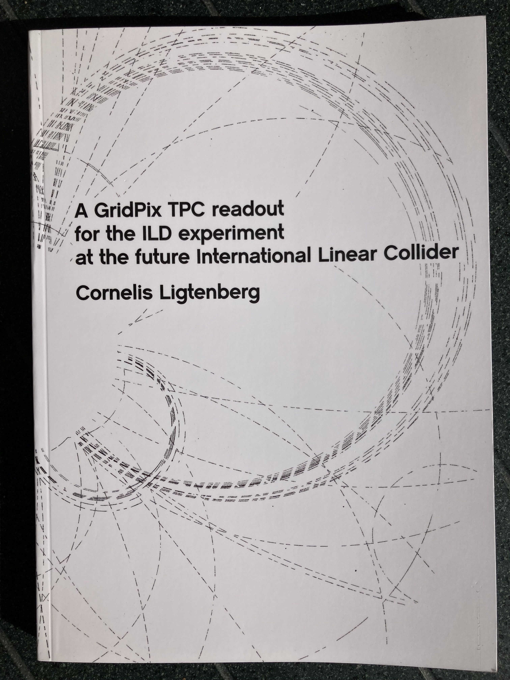
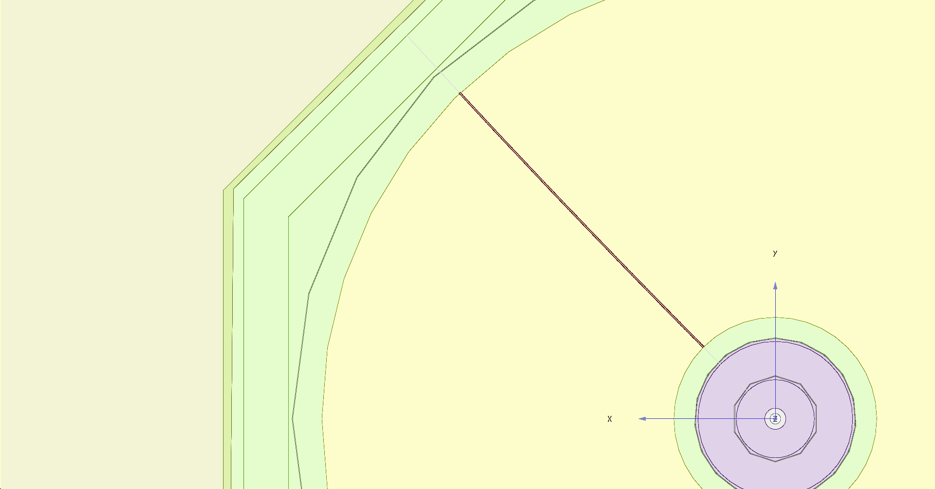
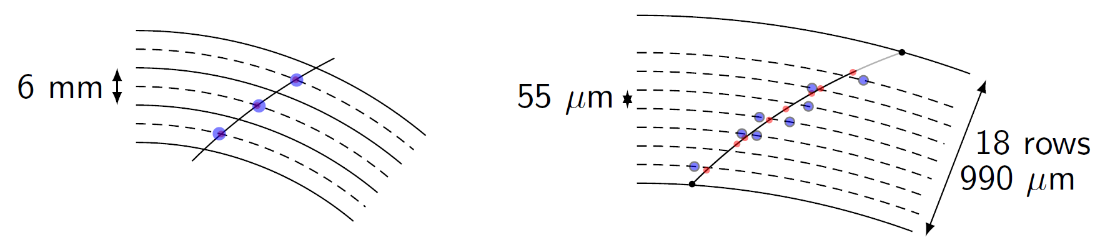
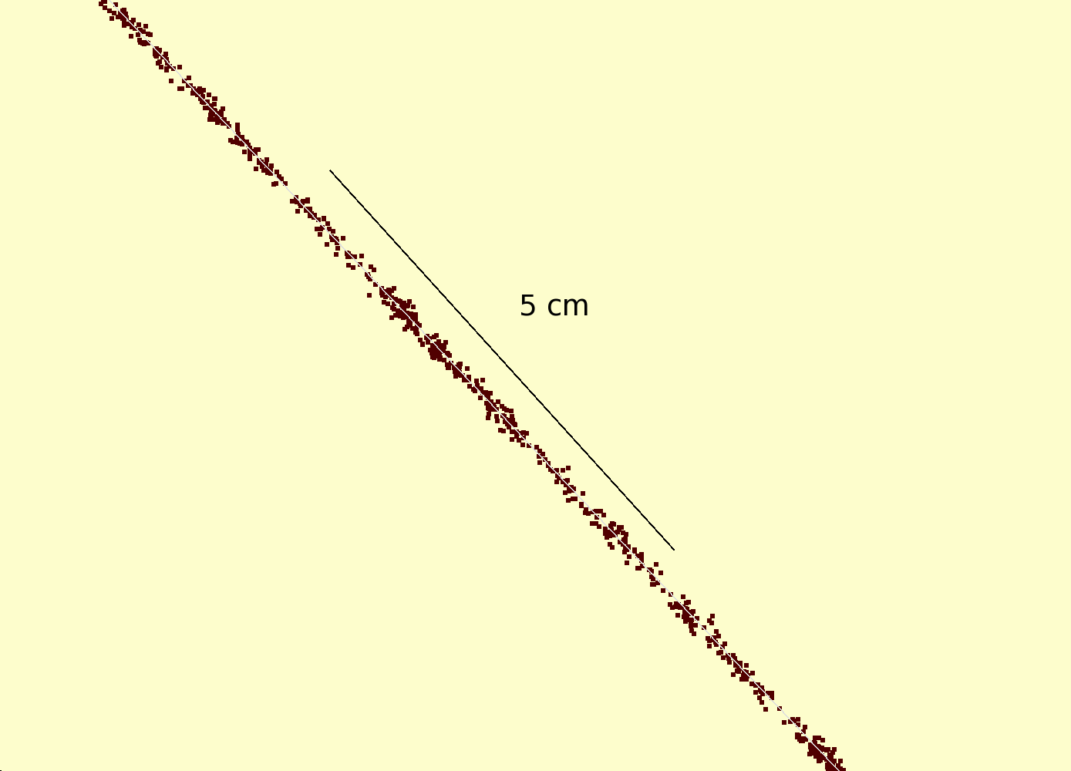
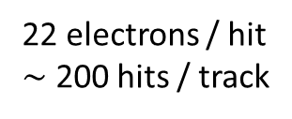
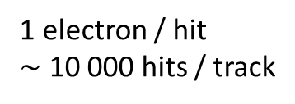
Simulation of ILD TPC with pixel readout
To study the performance of a large pixelized TPC, the pixel readout was implemented in the full ILD DD4HEP (Geant4) simulation
Changed the existing TPC pad readout to a pixel readout
Adapted Kalman filter track reconstruction to pixels
details: PhD thesis Kees Ligtenberg 2022
pixels
pads
50 GeV muon track with
pixel readout

Slide 17
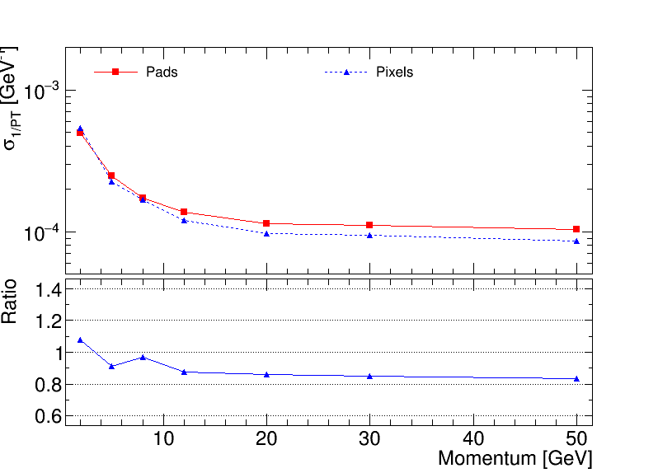
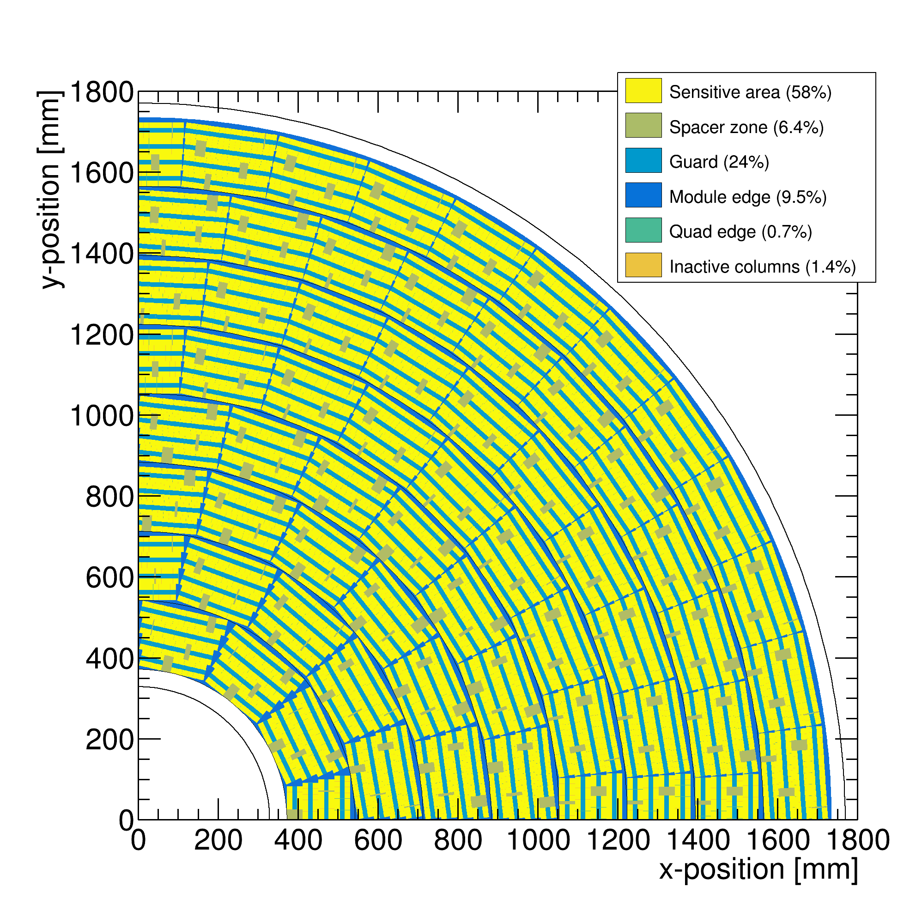
Performance of a GridPix TPC at ILC
From full simulation the momentum resolution can be determined
Momentum resolution is about 15% better for the pixels with realistic coverage (with the quads arranged in modules coverage 59%) and deltas.

Slide 18
Pixel TPC tracking studies
ILD tracking Performance for a Pixel TPC based on test beam
10 cm track resolution
Single electron resolution 6 mm track(“pad”) resolution
Each 10 cm we have a point with a resolution of < 18 (31) μm on the track
Comparable to performance of a silicon detector (but TPC gas material).

Slide 19
DESY testbeam Module Analysis
Performance of dEdx
It is possible to study in data the energy loss of electrons
The Pixel TPC has measurements with 55 μm pixel size
This allows to measure the number of hits as a function of the distance along the track dN/dx (dE/dx) with high granularity
It is possible to use also the ToT (time over threshold as a measure of the deposited charge) but this is not explored
The advantage of hit counting in a Pixel TPC is that one is NOT getting the fluctuations from the multiplication process. The ToT will include these avalanche fluctuations.
Using e.g. a pad readout the charge is used as a measure of dEdx
  This readout has a worse granularity and includes avalanche fluctuations

Slide 20
DESY testbeam Module Analysis
Testbeam performance of dEdx
B=0 T
B=1 T
Preliminary
B=0 T has a large Landau tail
B=1 T smaller Landau tail and a more gaussian distribution
An electron crossing 8 chips in the module has about 1000 TX3 hits

Slide 21
DESY testbeam Module Analysis
Analysis of dEdx performance
Combine chips to form a 1 m long track with 60 % coverage for electrons
Method 1 ”dEdx truncation”: reject large clusters and then run dEdx @ 90% using slices of 20 pixels along track (xy) (gives nr of selected hits). A large cluster has more than 6 hits in 5 consecutive pixels.
Method 2 “Template fit”: fit the slope of the N_{scaled} minimum distance (d) in xy distribution with an exponential function (N_{scale}(d)=defines the inverse weights):
N(d)_{scaled} = N_{scale}(d) N_{observed}(d)
N(d)_{scaled} is then fitted for each track with N₀ exp(-slope d)
Calculate the “dEdx” observable for electrons and MIP (==70% of hits)
  method 1 = nr of selected hits, method 2 = fitted slope
  Resolution is σ = σ(dEdx)/dEdx (for σ we use the rms)

Slide 22
DESY testbeam Module Analysis
dEdx performance method 1
Electron resolution
3.6%
1 m track 60% and coverage
Linearity MIP-e = 1.03
z drift=5-15 mm (flat)
MIP distribution is obtained by dropping 30% of the hits
Preliminary

Slide 23
DESY testbeam Module Analysis
dEdx performance method 2
Electron resolution
2.9%
1 m track 60% and coverage
Linearity MIP-e = 1.07
Ideally this is 1. A number larger than 1 means that the resolution is +7% larger
Preliminary

Slide 24
DESY testbeam Module Analysis
Summary of performance of dEdx
The dEdx resolution for electrons from data by combining tracks to form a 1 m long track with realistic coverage ~60% coverage.
Preliminary
Method | B=0 Resolution (%) | B= 1 T Resolution (%)
(1) dEdx truncation | 6.0 | 3.6
(2) Template fit | 5.4 | 2.9
The resolution for B=0 is worse than of the B=1 T data because of the larger fluctuations, that were already observed at the chip level.

Slide 25
DESY testbeam Module Analysis
dEdx Performance extrapolated to the ILD detector
ILD detector
rInner = 329 rOuter = 1770 mm
electron resolution = 2.5(3.0)%
at θ=π/2 for method 2 (1)
Assume Pixel TPC performance at B = 1 T at p = 5,6 GeV/c
Test beam B = 1 T
p=5,6 GeV/c
electron resolution 2.9(3.6)% for method 2 (1)
1 m track 60% and coverage

Slide 26
DESY testbeam Module Analysis
ILD dEdx performance for T2K gas
Ullrich Einhaus performed dEdx studies in ILD and extracted the ILC soft parametrisations for energy loss based on G4 and full simulation of the ILC TPC with T2K gas
Link to the software. Samples were generated in 2020 with ILC soft v02-02 and v02-02-01

Slide 27
DESY testbeam Module Analysis
Pixel TPC dEdx performance
ILD Performance with specified detector dimensions for particles at cos θ = 0
Pixel TPC resolution from electron p = 5 (6) GeV test beam (for B = 1 T) of 2.5% and 3% (dashed = method 1) at cos θ = 0
Separation electron pion defined as:
|<Eloss e> - <Eloss π>| / σ _{π}
Separation pion kaon as:
|<Eloss π > - <Eloss Κ>| / σ _{π}

Slide 28
DESY testbeam Module Analysis
Pixel TPC dEdx performance
The expected pion-kaon separation for momenta in the range of 2.5-45 GeV/c at cos θ = 0 is more than 5.5(4.5)σ for the two resolution scenarios.
At a momentum of 100 GeV/c the separation is still 3.0(2.0)σ.
Protons can be separated from pions for momenta in the range of 2.5-100 GeV/c with more than 6.0(4.8)σ.

Slide 29
Pixel TPC performance
dE/dx resolution for an electron with p=5,6 GeV/c of 1 m track length with 60% coverage is measured to be 2.9(3.6)% at B = 1 Tesla.
The dE/dx resolution an ILD detector is 2.4% (3 %)
This allows for particle identification and separation of kaons from pions up to momenta of 45 GeV with more than 5.5 σ (4.5 σ ) for cos θ = 0. The separation increases up to cos θ = 0.85 (see back up slide).
A test beam @ FermiLab with a quad in a TPC is planned (2024, US Grant EIC)
  an EIC R&D program for CO2 cooling is funded (2023) (Yale, Stony Brook, Purdue, Bonn, Nikhef)
  Focus is particle identification and tracking at the Electron-Ion-Collider
A pixel TPC has become a realistic viable option for experiments
  High precision tracking like ILD@ILC in the transverse and longitudinal planes, dE/dx by electron and cluster counting, excellent two track resolution, digital readout that can deal with high rates

Slide 30
backup
Operation of a Pixel TPC at a circular collider

Slide 31
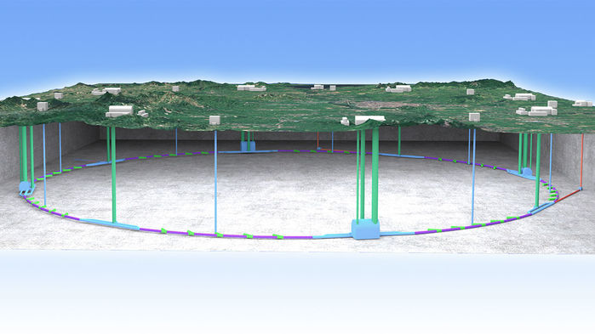
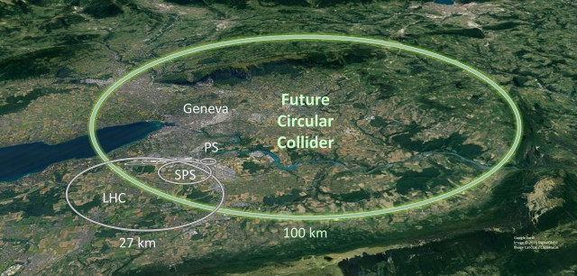
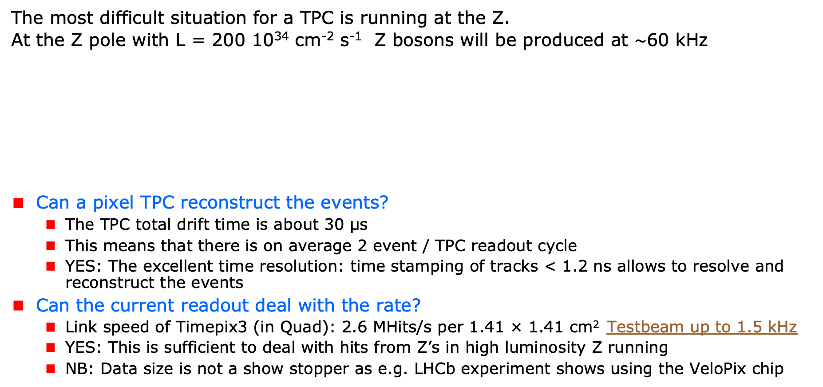
A Pixel TPC at a circular collider
The most difficult situation for a TPC is running at the Z.
At the Z pole with L = 200 10³⁴ cm⁻² s⁻¹ Z bosons will be produced at $\sim$60 kHz
Can a pixel TPC reconstruct the events?
  The TPC total drift time is about 30 μs
  This means that there is on average 2 event / TPC readout cycle
  YES: The excellent time resolution: time stamping of tracks < 1.2 ns allows to resolve and reconstruct the events
Can the current readout deal with the rate?
  Link speed of Timepix3 (in Quad): 2.6 MHits/s per 1.41 × 1.41 cm² Testbeam up to 1.5 kHz
  YES: This is sufficient to deal with hits from Z’s in high luminosity Z running
  NB: Data size is not a show stopper as e.g. LHCb experiment shows using the VeloPix chip
Picture IHEP

Slide 32
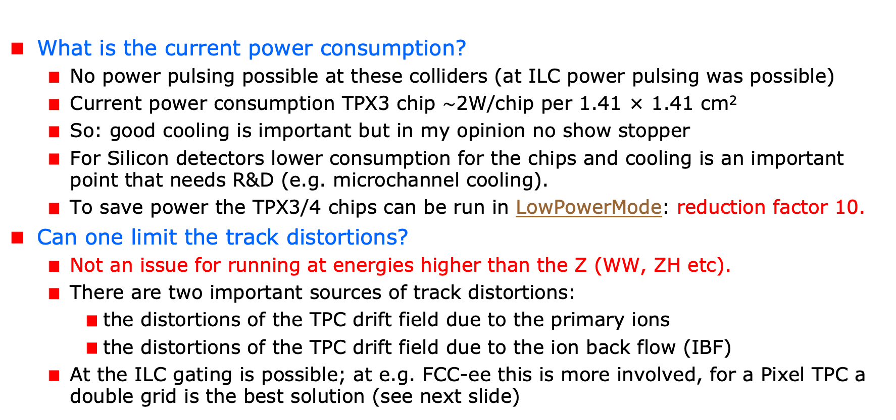
A Pixel TPC at a circular collider
What is the current power consumption?
  No power pulsing possible at these colliders (at ILC power pulsing was possible)
  Current power consumption TPX3 chip $\sim$2W/chip per 1.41 × 1.41 cm²
  So: good cooling is important but in my opinion no show stopper
  For Silicon detectors lower consumption for the chips and cooling is an important point that needs R&D (e.g. microchannel cooling).
  To save power the TPX3/4 chips can be run in LowPowerMode: reduction factor 10.
Can one limit the track distortions?
  Not an issue for running at energies higher than the Z (WW, ZH etc).
  There are two important sources of track distortions:
    the distortions of the TPC drift field due to the primary ions
    the distortions of the TPC drift field due to the ion back flow (IBF)
  At the ILC gating is possible; at e.g. FCC-ee this is more involved, for a Pixel TPC a double grid is the best solution (see next slide)

Slide 33
A Pixel TPC at CEPC or FCC-ee
Is it possible to reduce the IBF for a pixel TPC?
  IDEA: by making chip with a double grid structure (see back up slide)
  This idea was already realized as a TWINGRID NIMA 610 (2009) 644-648
  For GEMs for the ALICE TPC this was also the way – several GEMs on top of each other to reduce IBF
  For the Pixel the IBF can be easily modelled and with a hole size of 25 μm an IBF of 3 10⁻⁴ can be achieved and the value for IBF*Gain (2000) would be 0.6.
  YES: the IBF can be reduced to 0.6 but this needs R&D
  In the new detector lab in Bonn it is possible to make and study this device
What would be the size of the TPC distortions?
  Tera-Z studies by Daniel Jeans and Keisuke Fuji show that for FCC-ee or CEPC this means: distortions from Z decays up to < O(100) μm
  Beam strahlung gives (now) a factor 200 more background. Detector optimization and shielding is important for TPC and Silicon detectors to reduce pair background.
  It was argued that in an ILD like detector the distortions can be mapped out using the VTX-SIT/SET detectors.

Slide 34
Fitting out TPC distortions in ILD/CEPC
It is possible to map out distortions using e.g. muons from Z decays
  E.g. by fitting the 3D spatial distribution as a function of time as was done by ALEPH and more recently by ALICE. Using this distribution the hits positions are corrected and the TPC track refitted.
However, with silicon trackers around the TPC, more elaborate methods can be used. One can use the track predictions based of the silicon trackers SIT and SET to correct on a track-by-track level the TPC track.
  One can use as a constraint that the extrapolated positions and angles agree with the measured in the SIT and SET.
  Practically, one can e.g. correct the TPC track parameters
The ultimate way is a fitting technique similar to ATLAS. In the ATLAS track fit the common systematics is fitted out for sets of Muon hits. For ILD/CEPC the fit would fit free parameters in the distortion model, while using as a constraint the SIT and SET position and direction measurements.
  The simplest case is a model where the strength (amplitude) and radial dependence would be scaled and a model is used for the 3D extrapolations.

Slide 35
Conclusions: Pixel TPC at a circular collider
YES: a pixel TPC can reconstruct the Z events in one readout cycle
YES: the current readout of the Timepix3 chip can deal with the Z hit rate running
  The current MDI design FCCee/CEPC gives a lot of beam-beam background more that a factor 100 more hits from the beam than from the Z. This far from optimal. An improved MDI is needed.
The current power consumption is 1W/cm². By running the TPX chips in low power mode this can be reduced by a factor of 10. Still good cooling is important no show stopper; but needs extensive R&D.
Track distortions in the TPC drift volume are a concern at high lumi Z running:
  Track distortions from Z decays in TPC are O(100) μm
  It is possible to reduce the IBF for a pixel TPC by making a device with a double grid
  A double grid needs dedicated R&D that can be performed in the new lab in Bonn
The Z physics program at FCC-ee or CEPC with an ILD-like detector with a Pixel TPC (with double grid structures) sliced between two silicon trackers (VTX-SIT and SET) can be fully exploited. The reduction of beamstrahlung by an improved MDI – and the fitting out of distortions - needs more study.
A pixel TPC can perfectly run at WW, ZH or tt energies where track distortions are several orders of magnitude smaller

Slide 36
Backup plots

Slide 37
Pixel TPC tracking studies
ILD tracking Performance for a Pixel TPC based on test beam
The last 10 cm track provides very high resolution ‘point’ in the endcap (cos θ>0.8). This is due to the short drift distance and the high resolution pixel readout.
Question can we use the endcap ‘point’ and calibrate out the TPC distortions?

Slide 38
DESY testbeam Module Analysis
Distance distribution
Single chip
Quad module
Calculate minimum distance between the hits.
The slope of the distribution is related to the number of primary clusters /cm
The diffused peak at d<10 comes from clusters with more than 1 hit.
B=0 T
Preliminary
Thesis Kees Ligtenberg

Slide 39
DESY testbeam Module Analysis
Performance of dEdx
Method 2: Fit slope of the distance distribution
From 10 clusters onwards an exponential distribution is followed.
Below 10 the distribution will be down-weighted (N_{scale}(d) = 1/weight). The weights are:
Weights B=0 = { 35.0467 , 12.1497 , 4.52914 , 2.76311 , 1.99386 , 1.59795 , 1.3656 , 1.21409 , 1.11898 , 1.04385 };
Weights B=1 = { 22.5617 , 7.39573 , 2.43318 , 1.54528 , 1.23428 , 1.09727 , 1.04368 , 1.01625 , 1.00182 , 0.998178 };
Note the difference in weights in the B=0 and 1 T data sets. This is related to the fluctutations
B=0 T
Preliminary

Slide 40
DESY testbeam Module Analysis
Pixel TPC dEdx performance
Separation pion kaon
|<Eloss π > - <Eloss Κ>| / σ _{π}
Separation pion kaon for different cos(theta) values due to the track length dependence
For cos(theta)=0 till 0.95 the separation lies between the black and red curves. Only above 0.95-0.975 the separation drops till the blue curve.
Excellent performance over very large polar angle range
ILD Pixel TPC

Slide 41
Reducing the Ion back flow in a Pixel TPC
The Ion back flow can be reduced by adding a second grid to the device.
It is important that the holes of the grids are aligned. The Ion back flow is a function of the geometry and electric fields. Detailed simulations – validated by data - have been presented in LCTPC WP #326.
With a hole size of 25 μm an IBF of 3 10⁻⁴ can be achieved and the value for IBF*Gain (2000) would be 0.6.
Ion backflow | Hole 30 μm | Hole 25 μm | Hole 20 μm
Top grid | 2.2% | 1.2% | 0.7%
GridPix | 5.5% | 2.8% | 1.7%
Total | 12 10⁻⁴ | 3 10⁻⁴ | 1 10⁻⁴
transparancy | 100% | 99.4% | 91.7%

