Slide 1
When your data becomes part of something bigger
Identifiers, repositories, licenses, and DMPs
David Groep
Nikhef
Computing Course 2024

Slide 2
Objectives for this ‘data and software’ session
Know common persistent identifier schemes; such as DOI, hndl.net and ORCID
Possess an ORCID identifier and
know how to update basic information in their ORCID record
Know the importance of applying licenses to data and software for re-usability
Know the basic licenses for data and software, and
know where to find guidance on license application,
and the main differences between licenses
Know the basic outline of a data management plan
Know how to fill in a mock data management plan using the on-line tools

Slide 3
I’m not a number!
Persistent identifiers
for publications, data … and for researchers

Slide 4
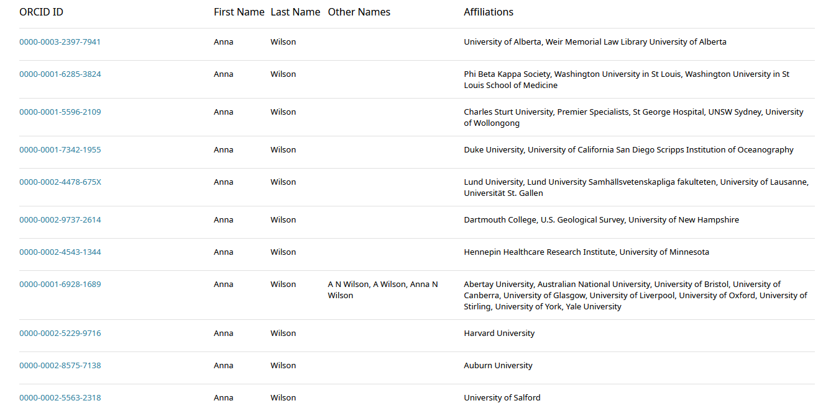
Getting a unique identifier is hard … which Anna Wilson?
Data from ORCID – search for “Anna Wilson”

Slide 5
Assigning a globally unique non-reassigned one helps:
Data from ORCID – search for “Anna Wilson”

Slide 6
What should an identifier scheme do?
unique
persistent
non-reassigned
findable: identifier should be good enough to take you to the object
for ‘evolving’ objects: be able to identify a collection (and ‘latest version’)
come from an authoritative source

Slide 7
Not all identifiers are created equal
Technical qualities, but also ‘impact perception’
ObjectIDs (OID)
Universal Resource Names (URN)
Digital Object Identifiers (DOI)
Handles (hndl.net)
And then there are plenty of non-persistent identifiers, like URLs

Slide 8
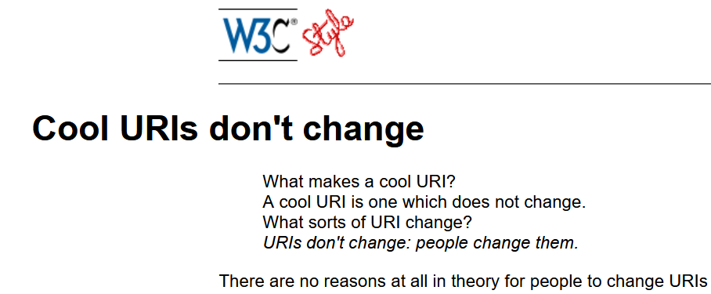
Uniform Resource Indicators == URLs + URNs
But URLs do change for no good reason (or simply because “functions follows form”)
URNs (and OIDs) are unique + persistent but hard to resolve – just try find the path to
urn:geant:nikhef.nl:idm:md:entity:spproxy:201606
Tim Berners-Lee, https://www.w3.org/Provider/Style/URI, 1998; for the URN namespace, see RFC 4926, then http://www.dante.net/urn-geant/urn-geant.html, then see #12

Slide 9
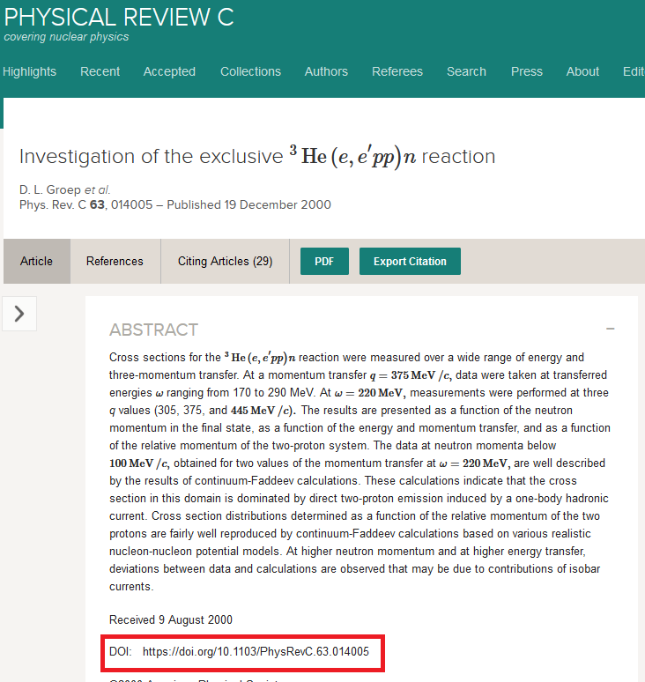
DOI and Hndl.net
DOIs – a persistent link (opaque) to publications & more …
originally come from the publishing industry (CrossRef)
perception is still very much ‘high quality paper’ like
libraries and evaluation reports really love DOIs
but are a bit expensive for repositories with lots of objects
but there are now many large-scale repositories for data,
whitepapers, drafts, presentations, &c that assign DOIs
Zenodo (hosted at CERN)
HADRON Nikhef institutional repository (https://doi.org/10.60953/uuid)
4TU.RD (hosted at TU Delft)
and commercial services like Figshare
and now the movie industry even assigns DOIs to films and broadcasts

Slide 10
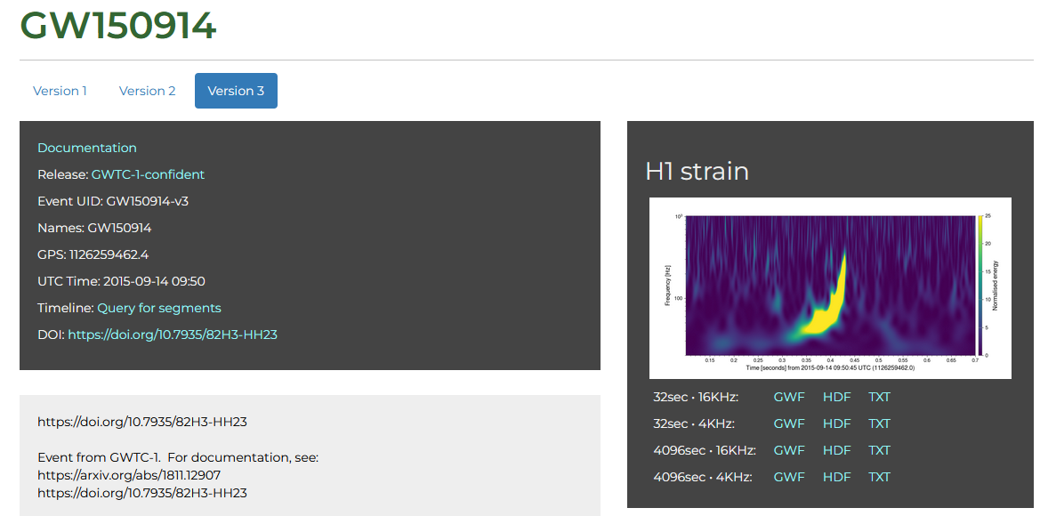
One well-cited dataset
https://doi.org/10.7935/K5MW2F23
but an updated version (in this case a phase correction) results in a new DOI
https://doi.org/10.7935/82H3-HH23
This is the data set corresponding to GW150914
data reference https://www.gw-openscience.org/eventapi/html/GWTC-1-confident/GW150914/v3 - also adhered to common data formats (here: HDF5) – see later!

Slide 11
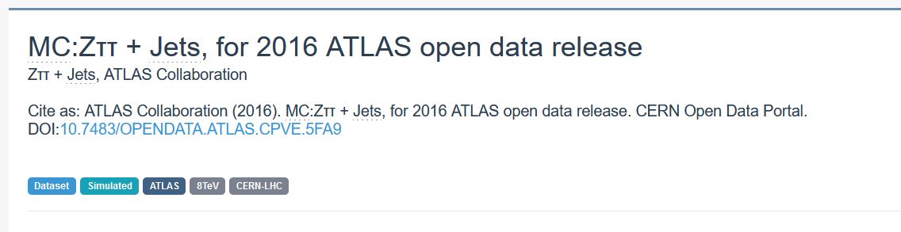
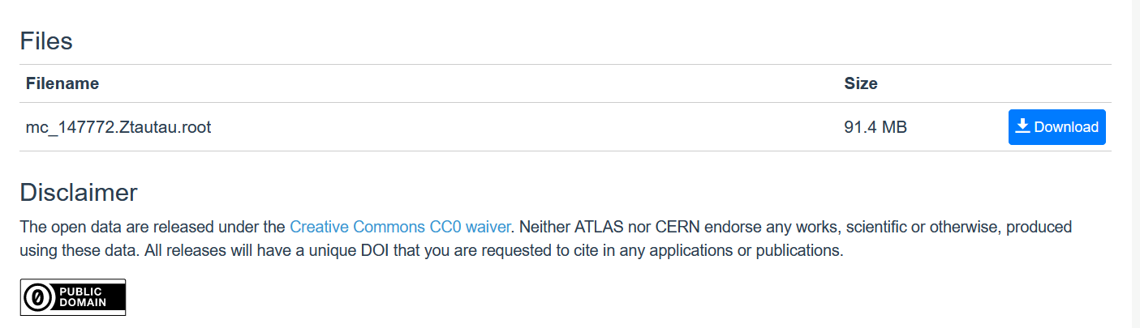
DOI:10.7483/OPENDATA.ATLAS.CPVE.5FA9
http://opendata.cern.ch/record/3822, resolved from the DOI http://doi.org/10.7483/OPENDATA.ATLAS.CPVE.5FA9

Slide 12
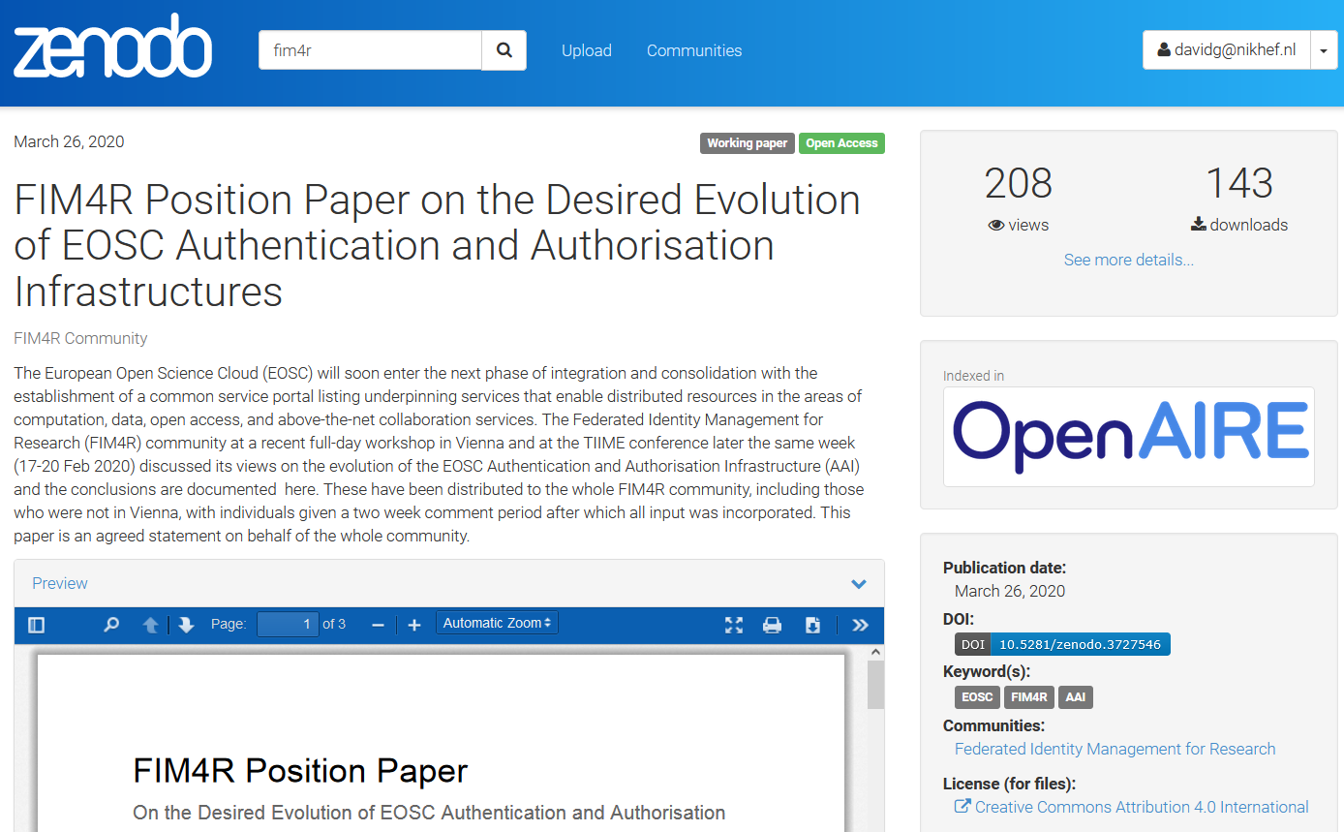
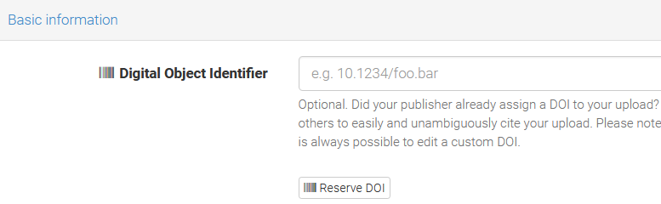
DOIs can be assigned to almost any object
https://zenodo.org/ and for your own experimentation, use https://sandbox.zenodo.org/

Slide 13
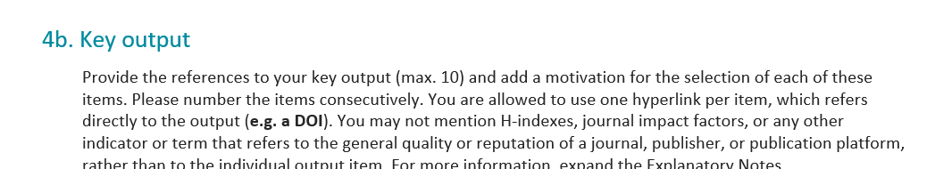
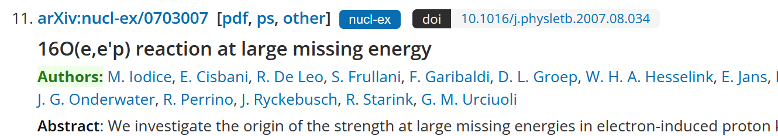
Make sure you have identifiers for everything
Also for data sets, software, standards specifications, &c
– they come in handy for grant applications, like for a Veni:
for papers, journal will assign one
arXiv links are persistent as well and link to later DOIs
From the Veni 2022 grant template, see https://www.nwo.nl/en/calls/nwo-talent-programme-veni-science-domein-2022

Slide 14
Identifying you …

Slide 15

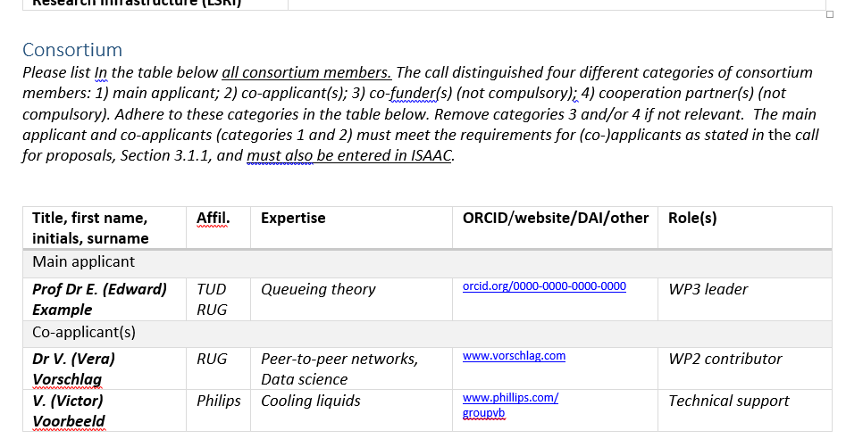
ORCID – the Open Reseacher and Contributor ID
helps to uniquely identify your papers
makes sure recognition goes to the right author
helps you build your list of publications
can act as an academic resume
use it to login to R&E services
needed for grant applications
Go to https://orcid.org/
Example from NWO Roadmap 2021 Application Form, from https://www.nwo.nl/en/calls/large-scale-research-infrastructure-lsri-national-roadmap-consortia-2021

Slide 16
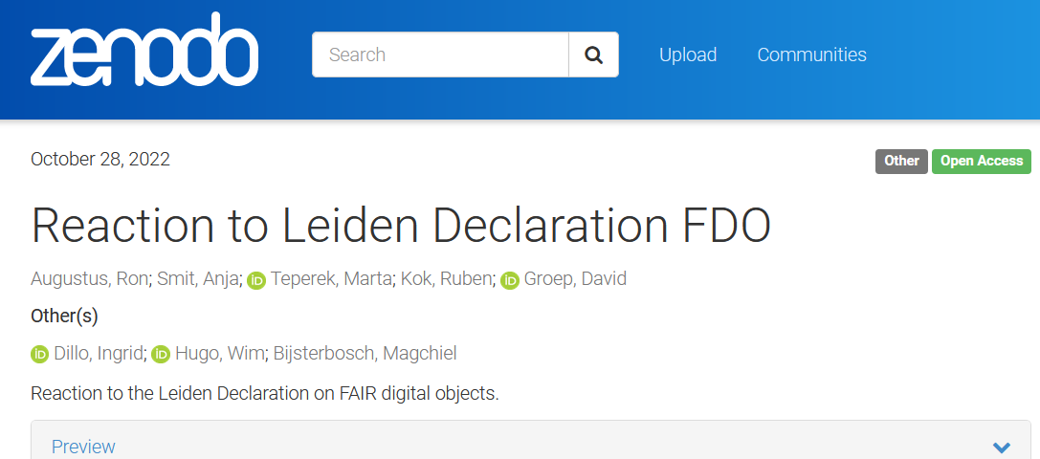
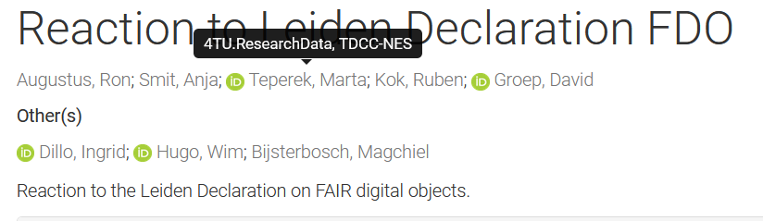
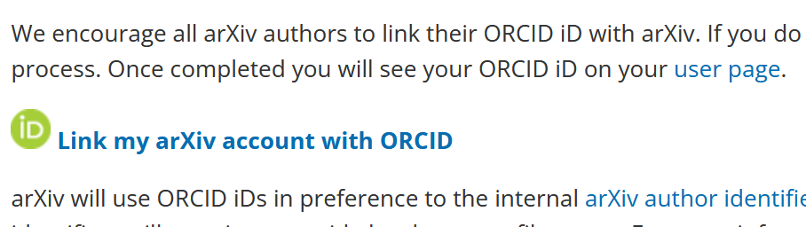
Recognising and using ORCID with linking
based on the ISNI format
orcid.org/0000-0003-1026-6606
can be linked automatically
in journals and repositories
https://arxiv.org/help/orcid; https://doi.org/10.5281/zenodo.7260200

Slide 17
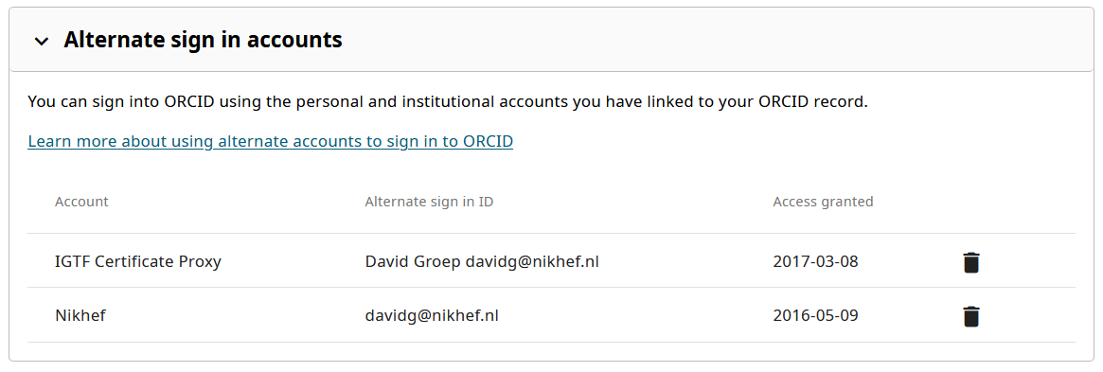
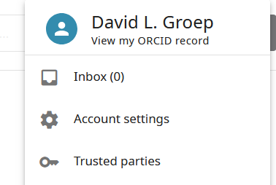
Authenticating to your ORCID
Your ORCID ID is for life – not only when you’re at Nikhef
you can link multiple authentication sources to your ORCID
one is a username-password specific to the service
you can link one (or more) institutional IDs (also most universities should work)
you should add multiple email addresses to your ORCID (also a personal one)
– these are not public by default!
as well as multiple login methods! At some point, you may leave your home org!

Slide 18
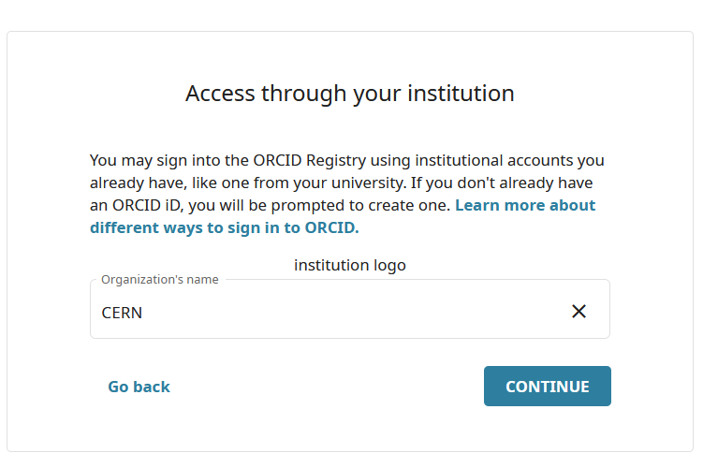
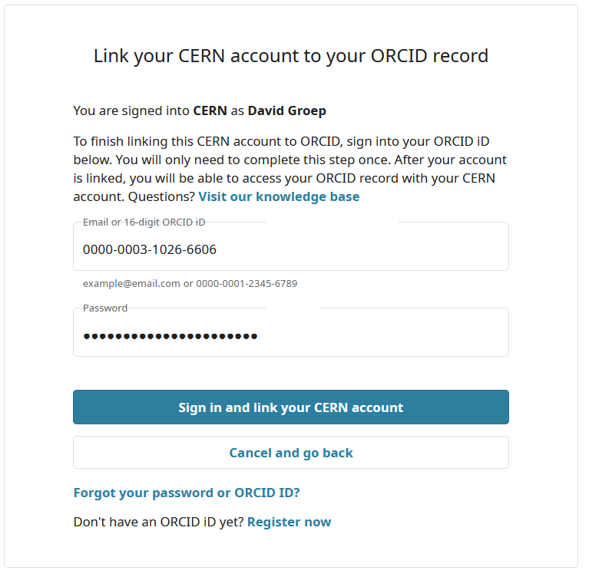
Multiple ways into your ORCID is good

Slide 19
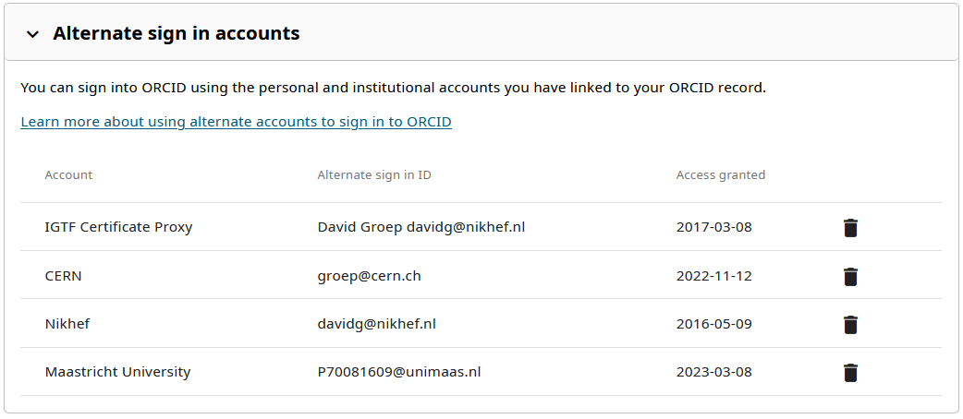
https://orcid.org/account

Slide 20
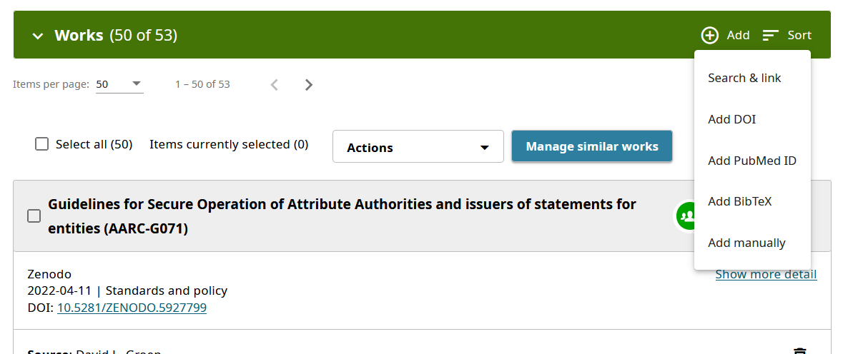
Linking your publications to ORCID
Import from Scopus and commercial publishers
logging in to Zenodo with your ORCID

Slide 21
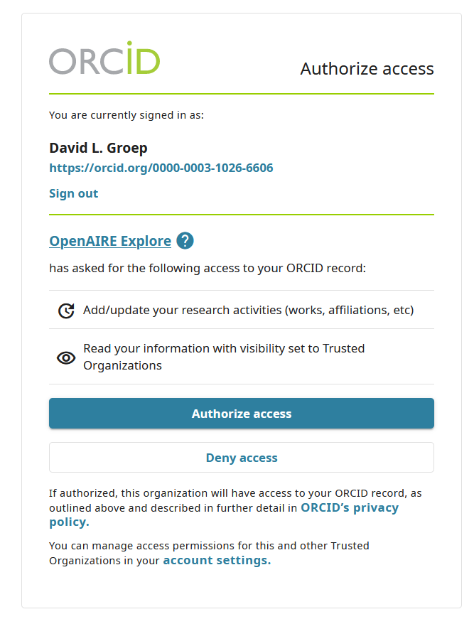
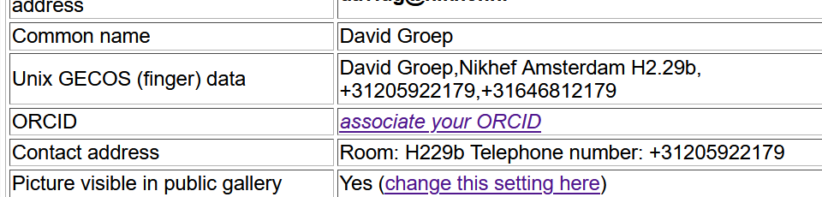
Some agencies can update your record for you
You do get a notice, like this:
and you can associate your ORCID with your Nikhef account (can be shared with services, but not much used yet)
https://sso.nikhef.nl/myorcid/

Slide 22
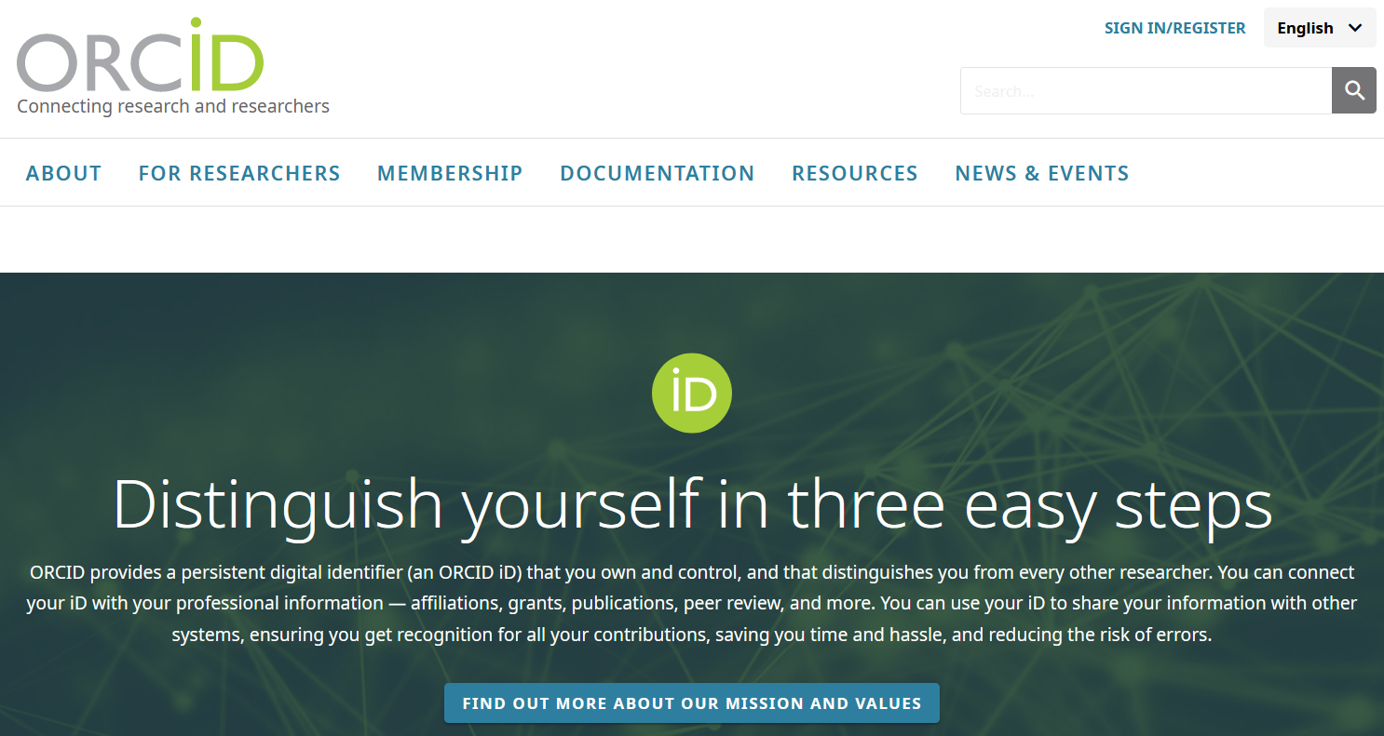
Now go over to orcid.org, and …

Slide 23
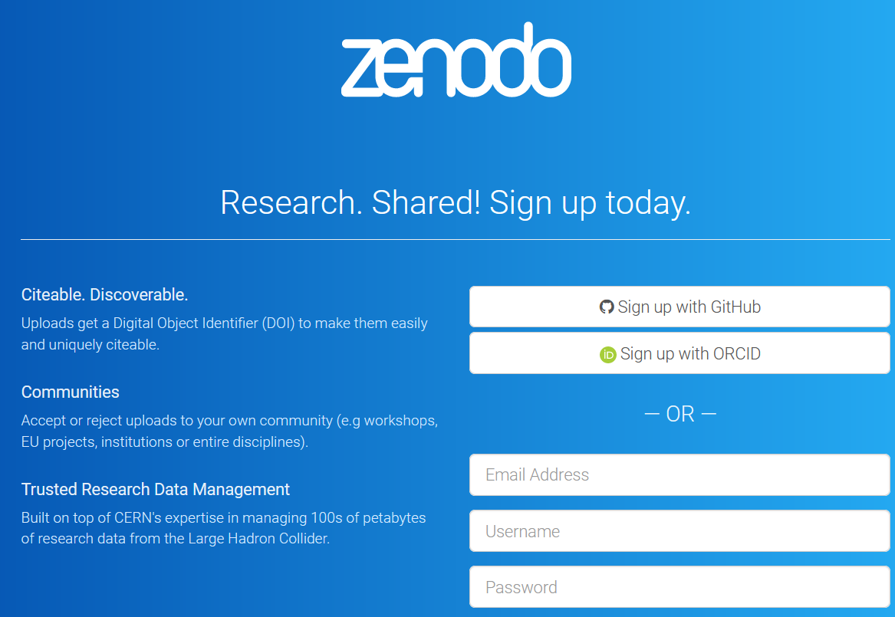
And sign up for Zenodo with ORCID or github (or password)

Slide 24
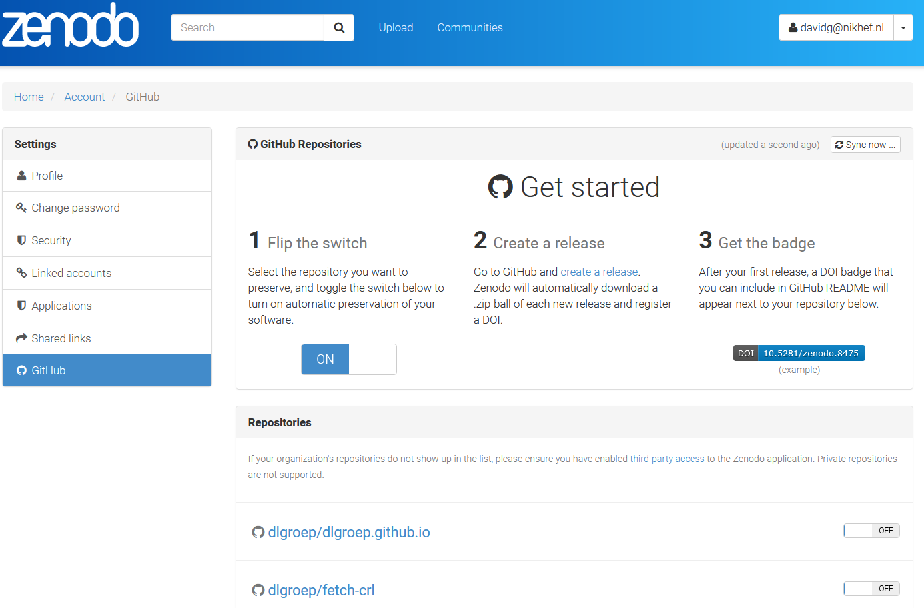
But what about PID and software?
A personal github repository is not a persistent identifier either
it is good for FOSS and collaboration,
but it is not a publication … yet
from Zenodo, link your github account
in Zedono select your repository
in Github, make a release
this will be automatically uploaded into
Zenodo – and you have persistent DOIs for all versions
specifically useful for research software and your reproduction package
https://zenodo.org/account/settings/github/ and https://docs.github.com/en/repositories/archiving-a-github-repository/referencing-and-citing-content

Slide 25
Zenodo test uploads
“We provide a sandbox environment where you can test your API integration during development. The sandbox environment is available at
http://sandbox.zenodo.org
Please note that the sandbox environment can be cleaned at anytime. Also, the sandbox environment will issue test DOIs using the 10.5072 prefix instead of Zenodo’s normal prefix (10.5281).”
https://developers.zenodo.org/#quickstart-upload

Slide 26
Enabling Software Re-use
Licensing and open source

Slide 27
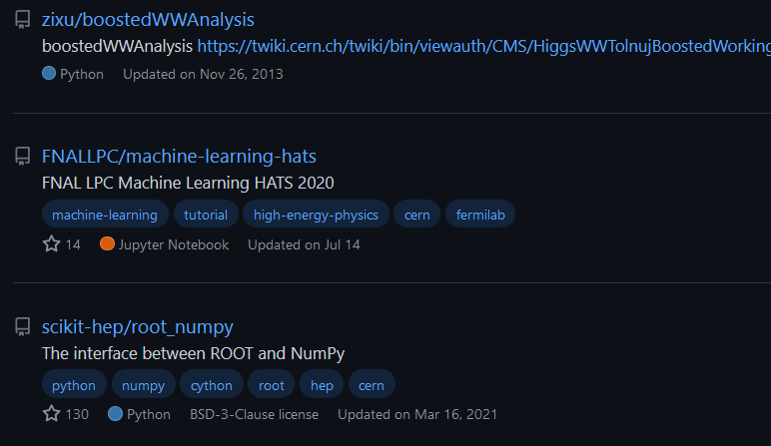
“IANAL” + “IANYL” DISCLAIMER – I Am Not A Lawyer (and certainly not your lawyer ☺)
however: code and source files without a license means ‘all rights reserved’ ☹

Slide 28
What do we actually want to achieve with our software?
meet open science needs
re-use & replication
collaborative development
not encourage ‘patent hostages’
make generally available the results of its experimental and theoretical work*
be understandable
E.g. Article II.1 CERN convention, see https://council.web.cern.ch/en/content/convention-establishment-european-organization-nuclear-research

Slide 29
A range of Open Source licenses to choose from
pre-Apache family
(GEANT4, EDG)
Apache family
(Apache 2.0)
copyleft family
(GPL)
BSD family
compact licenses (BSD 3-clause, BSD 2-clause, MIT)
no patent protection
re-use friendly
re-use friendly
patent protection
re-use unfriendly
3.0+patent protection
contributions auto-imported
contributions auto-imported
contributions auto-imported: N/A
re-use friendly
no patent protection
Service transparent (AGPL)
Mozilla family
(MPL, Perl Artistic)
lesser copyleft (LGPL)
contributions unspecified
re-use unfriendly
3.0+patent protection
re-use friendly
patent protection
re-use unfriendly
no patent protection
contributions auto-imported: N/A
contributions unspecified
contributions auto-imported: N/A
https://opensource.org/licenses

Slide 30
Licenses cannot be mixed at random …
For example, Apache 2.0 and GPL 2.0 are ‘incompatible’ (because Apache protects against software patents, which is a restriction beyond GPLv2), but Apache 2.0 can be linked in GPL v3 software.
But not the other way round: GPL software is infectious / viral in nature
“Apache 2 software can therefore be included in GPLv3 projects […].
However, GPLv3 software cannot be included in Apache projects. The licenses
are incompatible in one direction only, and it is a result of […] the GPLv3 authors' interpretation of copyright law.”
https://www.apache.org/licenses/GPL-compatibility.html

Slide 31
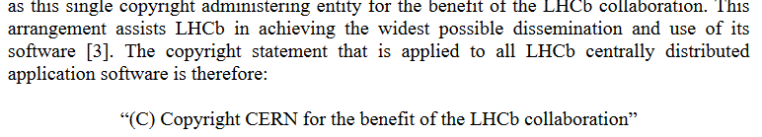
Many LHC experiments have standard license & IP clause
although some LHC experiments are completely silent on this
(and the CERN Convention, in II.1, does not help in case of IP from contributors)
https://twiki.cern.ch/twiki/pub/LHCb/LHCbNationalComputingBoard/20210215_LHCbSoftwareCopyrightAndLicense.pdf

Slide 32
But LHCb early on got infected with GPL code …
“The LHCb software depends on packages licensed under the “GNU General Public License (GPL)”. The terms of GPL require that derivative works be licensed under the same license that governs the original software when distributed.
Accordingly, the LHCb software stack also needs to be licensed under the
“GNU General Public License v3”
[…] the LHCb collaboration – acting through CERN as the copyright holder – can
re-license or distribute the software under a dual license scheme, always taking into account dependencies and license compatibility

Slide 33

Yet ATLAS is all Apache 2.0, so …
So one common piece of software (Gaudi), which has
no dependencies on GPL or other LHCb core,
is Apache 2.0 licensed
And some independent code, like Allen, is also Apache 2.0,
with those bits of general code from LHCb used therein
being dual licensed.
https://twiki.cern.ch/twiki/pub/LHCb/LHCbNationalComputingBoard/20210215_LHCbSoftwareCopyrightAndLicense.pdf

Slide 34
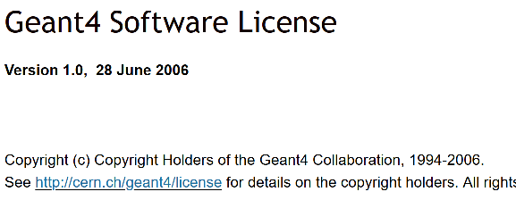
Listing contributors
‘a successful community has many contributors!’
‘… but listing them all will then be a challenge!’
co-shipped ‘contributors’ file, or a web page listing contributors
“members of the XXX collaboration”
+ a web page is commonly used
some projects list main contributors
and have just given up
probably worst thing to do is
to also accept changes
in the copyright license statement itself
(the “SymPy” case)
‘right to be identified as an author’ is a ‘moral’ right you cannot get rid of, but can be (partially) waived, e.g. as part of employment …
Source: from the GEANT4 web pages at
https://geant4.web.cern.ch/license/LICENSE.html

Slide 35
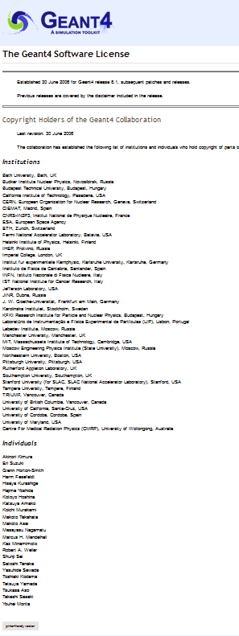
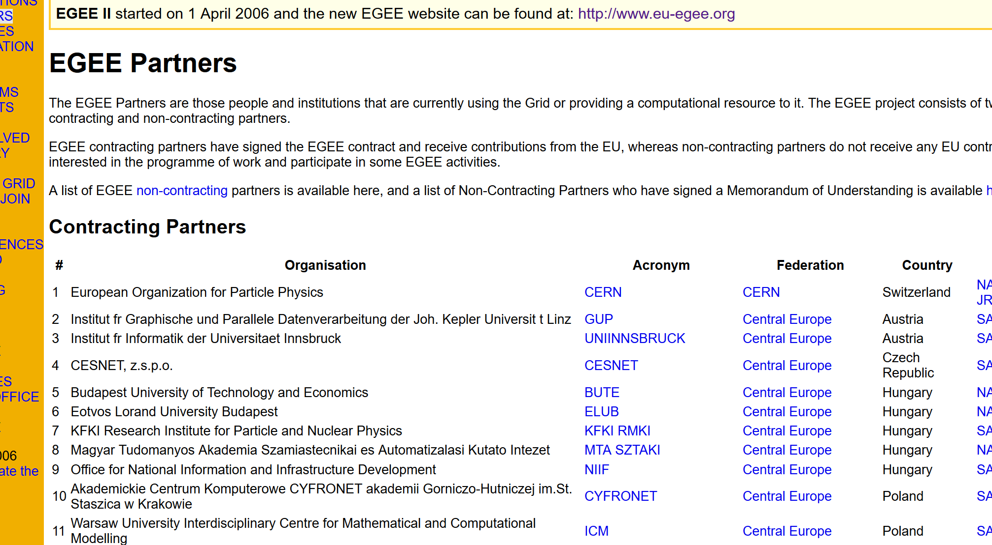
… and the long list of contributors
either you get lists like on the left
(and then GEANT4 is a ‘small’ project)
or you become creative, like
use github’s contributor log (e.g. for SimpleSAMLphp)
or link to your project or collaboration page
Sources:
from the GEANT4 web pages at
https://geant4.web.cern.ch/license
and
http://eu-egee.org/partners

Slide 36
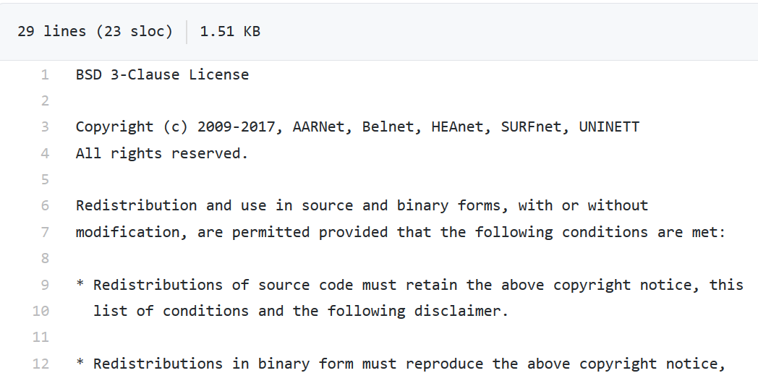
The most simple open source license: 3-clause BSD
listing all contributors in the copyright line
all rights assigned to the organisations (not individual employee)
but:
no patent protections
e.g. https://github.com/filesender/filesender/

Slide 37
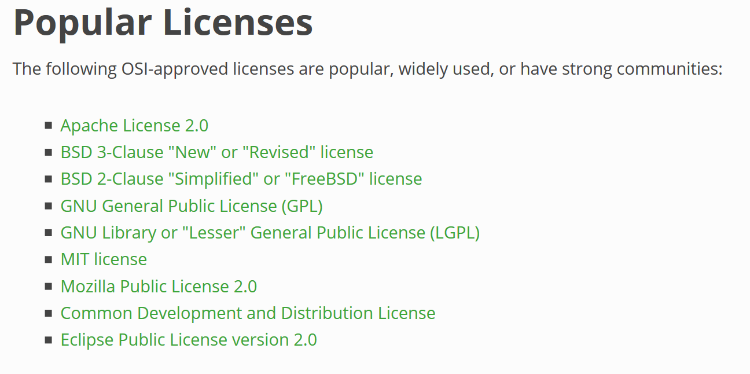

Reinder’s NWO-I LDCC License Tool:
https://www.nikhef.nl/pdp/rdm/license-tool
Have your pick …
Nikhef RDM and Licensing guidelines:
https://www.nikhef.nl/pdp/rdm/policies
from: https://opensource.org/licenses

Slide 38
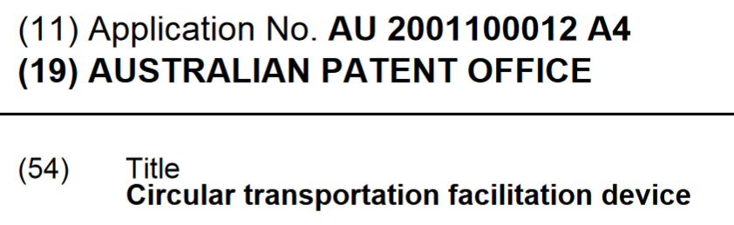
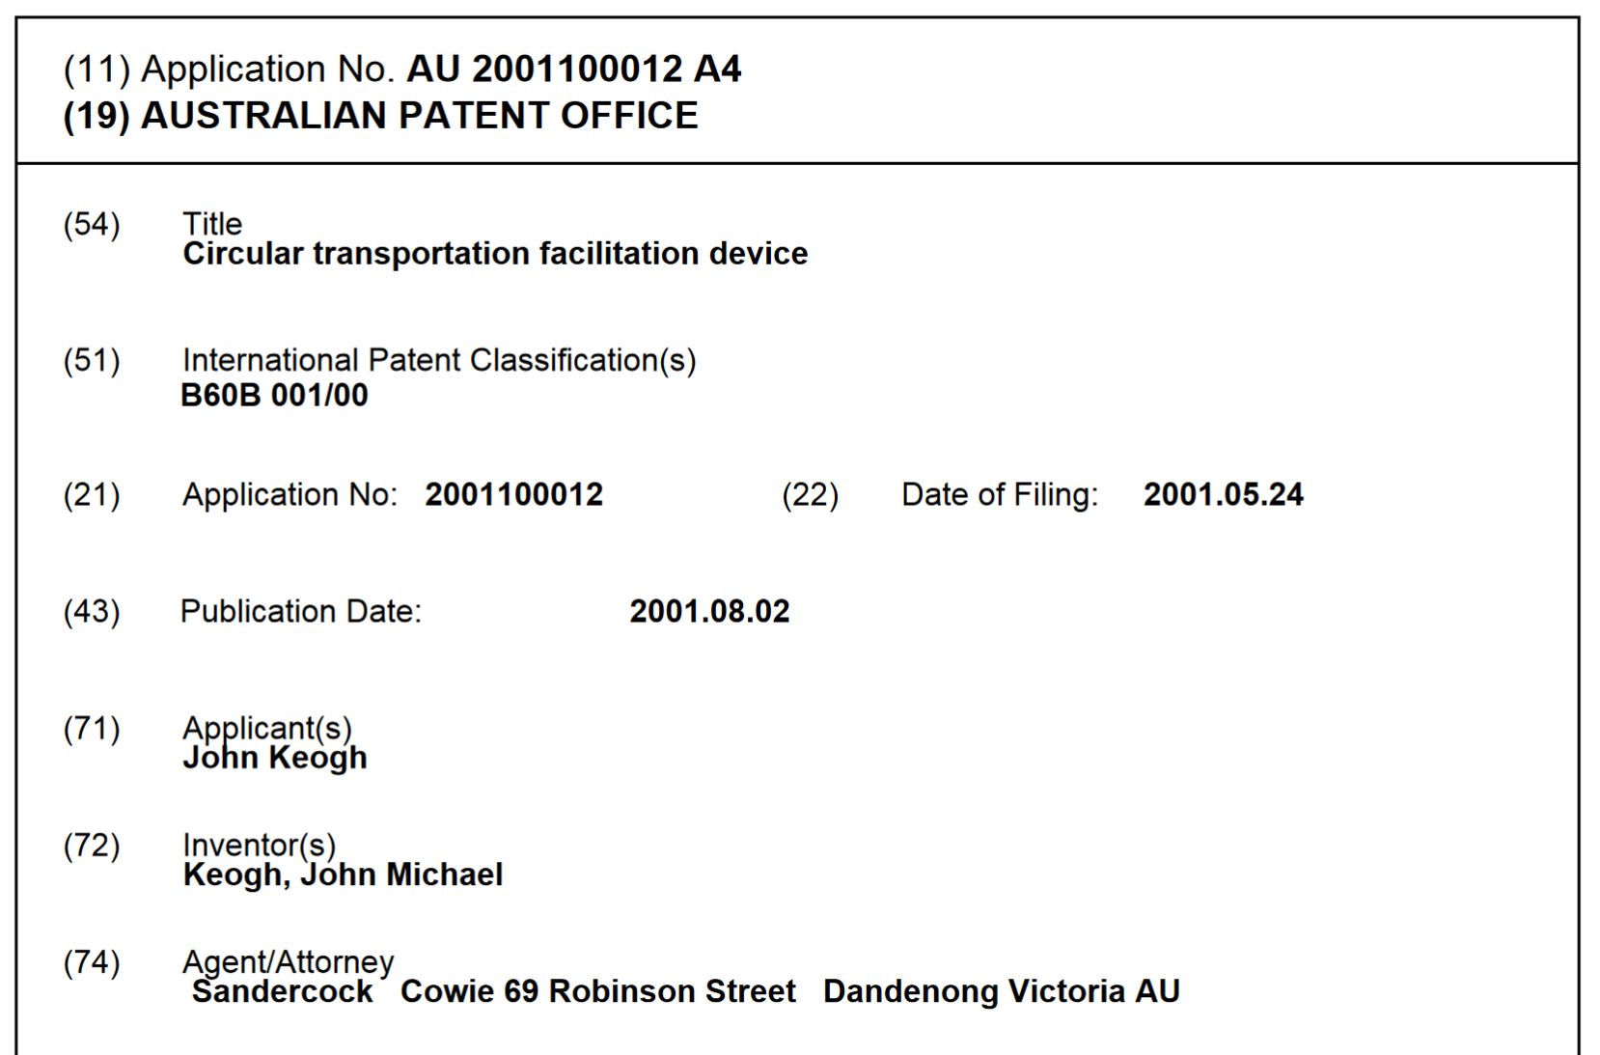
A last word about patents …
… usually for mutual litigation,
but have been used against
open source (although rejected)
Some licenses try to address that
by voiding themselves if the licensee
institutes patent litigation involving
(parts of) the work against anyone else:
Apache 2.0, GPL 3.0, Perl Artistic
Australian (light-weight) Innovation Patent #2001100012,
from 2001, since voided after international upheaval ☺
http://pericles.ipaustralia.gov.au/ols/auspat/applicationDetails.do
plus the 2001 Ignobel prize, of course!

Slide 39
You have data, you have software, you have a PID: charge!
Data Management Plans

Slide 40
A data management plan is there to help you*
where did I put that data file?
where was the source data for this plot from?
is the place where I write the results a safe one?
do I understand what the columns in this file mean? Also next year?
where did my predecessor put that data?
What the $*&^$$%^& does the data in this directory mean?
The Data Management Plan “DMP” helps you structure your data,
consider proper formats, ways to annotate your data (so you know what it means),
… and how to make your results outlive your laptop.
* and your successor, your advisors, and colleagues!

Slide 41
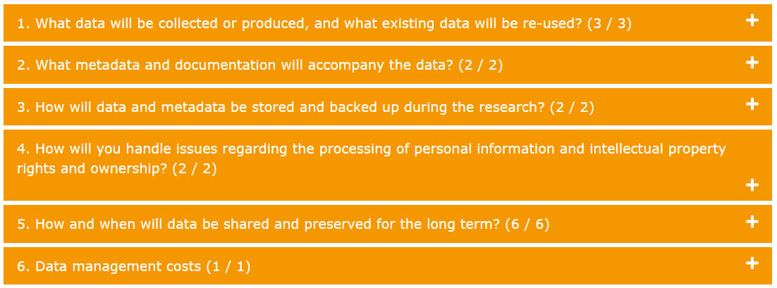
Data Management Plan structure – just 6 questions
NWO DMP format at https://dmponline.dcc.ac.uk/

Slide 42
Data Management Plan elements
What data will be collected or produced, and what existing data will be re-used?
  Will you re-use existing data for this research?
  If new data will be produced: describe the data you expect your research will generate and the format and volumes to be collected or produced.
  How much data storage will your project require in total?

Slide 43
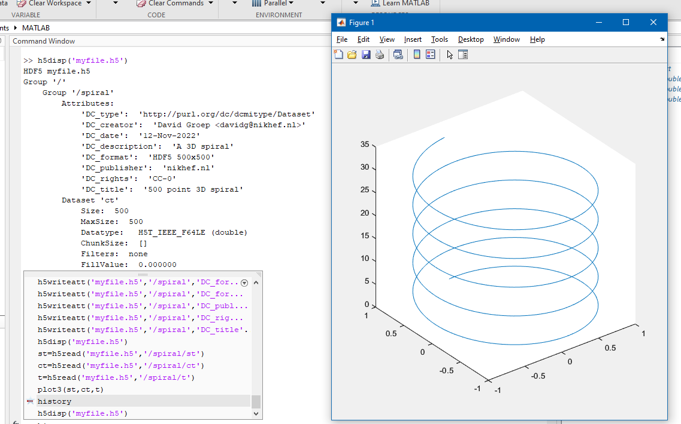
Useful data formats
Are commonly used, and
should be self-describing
allow metadata embedding
be use re-use friendly, with a long (decades-long) comprehensibility
OS, architecture & tool agnostic
Good examples
root files
CSV (HEPData compliant)
HDF5 (and thus NetCDF)
JSON – with a vocabulary
but for specific purposes, other formats are sometimes better

Slide 44
Organising data and meta-data
What metadata and documentation will accompany the data?
  Indicate what documentation will accompany the data
  Indicate which metadata will be provided to help others identify and discover the data.
Consider
using a ‘cookie cutter’ to organize sources, references, results,
https://cookiecutter.readthedocs.io/ (see Roel’s session as well)
and your repository/git convention, so add
README, LICENSE, NOTICE, CHANGES, CONTRIBUTING
and then on to meta-data …
As a cookie cutter example, see e.g. https://github.com/drivendata/cookiecutter-data-science

Slide 45

Dublin Core and more
Already encountered the basic “Dublin Core” meta-data elements this morning
But you may need more meta-data for interoperability
your experiment framework may provide that (alongside DC where useful)
most of HEP is bespoke, given its long tradition and life span, but has meta-data
… we just never bothered to register, given the coherency of the discipline
do ask which other standards are relevant
for example for GW, we also look at the IVOA standards
https://www.ivoa.net/documents/RM/20070302/index.html
and review the RDA meta-data standards catalogue https://rdamsc.bath.ac.uk/
most file formats support embedding: e.g. for Root objects, there’s TTree::fUserInfo
https://root-forum.cern.ch/t/meta-data-in-root-files/16490/2 - see also the Research Data Alliance outputs at https://rd-alliance.org/

Slide 46
When you still want to work with the data
How will data and metadata be
stored and backed up during the research?
  Describe where the data and metadata will be stored and backed up during the project.
  How will data security and protection of sensitive data be taken care of during the research?

Slide 47
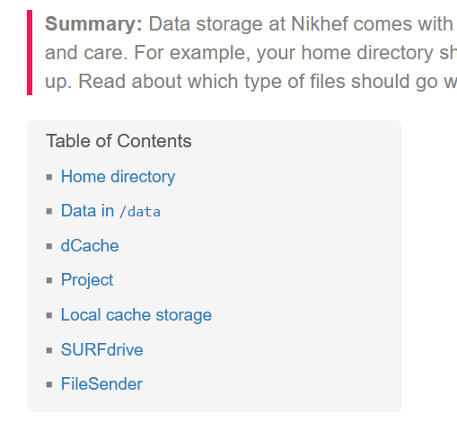
Put your data in the right place
During your work, use managed systems
  avoid using only your local laptop for storage,
  so use surfdrive for syncing non-reproducible plots and docs
  external disks/USB thumbdrives are for transfer only
  publishable results, code, scripts, meta-data?
  these should be in /project/<groupname>
  bulk data, events, large data that can be generated
  should be in /data (small volumes) or /dcache
  data suitable for re-use: in your experiment DDM system, in Zenodo, arXiv, or SURFDataRepository
See https://kb.nikhef.nl/ct/Storage_overview.html

Slide 48
Some data needs more care than others
How will you handle issues regarding the processing of
personal information and intellectual property rights and ownership?
  Will you process and/or store personal data during your project?
  How will ownership of the data and intellectual property rights to the data be managed?
Consider
  Do you collaborate with industry? What does the consortium agreement say?
  Do you use information ‘under NDA’ as an input? Review how it affects the results!

Slide 49
When you are done with your data ... but the world isn’t
How and when will data be shared and preserved for the long term?
  How will data be selected for long-term preservation?
  Are there any (legal, IP, privacy related, security related)
  reasons to restrict access to the data once made publicly available, to
  limit which data will be made publicly available, or to not make part of the data publicly available?
  What data will be made available for re-use?
  When will the data be available for re-use, and for how long will the data be available?
  In which repository will data be archived and made available for re-use, under which license?
  Your strategy for publishing the analysis software that will be generated in this project?

Slide 50
Long-term preservation – once you (think) you’re done
‘Curation may be the art of throwing away’ – but what to keep?
keep things ‘relevant for re-use’
obviously: all data that is used directly in publications
data that can be needed to reproduce the analysis (also for research integrity)
for a few specific things: there can be regulatory requirements to keep it
See e.g. https://www.dcc.ac.uk/guidance/how-guides/appraise-select-data

Slide 51
Not all data is, or should, be public
Quite obvious for personal data (“GDPR”) – but we don’t have much of that
But
It may be ‘dual-use’, and then subject to grant conditions or regulatory constraints
It could disclose data we got originally as ‘commercial in confidence’ (under NDA)
Even if not dual-use, also non-published results it may still be sensitive
think of potential abuse-cases!
any irking about what your data or project could cause? Talk about it!
there is the ‘loket Kennisveiligheid’, and we have access to more sources
Is your result patentable? Then you should file a patent before publishing
For knowledge safety, ethical, and espionage concerns, contact me, ronalds@nikhef.nl, or avr@nikhef.nl

Slide 52
Is Open Data always open right now ?
Data in publications, data points in plots, should be open alongside it,
For the rest
data can be embargoed (be in a ‘proprietary period’)
for most LHC experiments 5 years after run ends, for LIGO 18 months, …
for bulk data does not make sense: e.g. raw LHC data (‘level 4’) are not released
think of ‘non-intuitive’ cases, e.g. some raw data for machine learning research, or how other domains can re-use data
‘open by default, closed only when necessary’ – and include the needed software
and in the data management plan, describe what data is made available when
‘‘where’ we already discussed: your collaboration open data system, or Zenodo, or …
See e.g. http://opendata.cern.ch/docs/cern-open-data-policy-for-lhc-experiments , https://www.gw-openscience.org/, and https://dcc.ligo.org/LIGO-M1000066/public

Slide 53
The million-euro question … literally ☺
Data management costs
  What resources (for example financial and time) will be dedicated to data management and ensuring that data will be FAIR (Findable, Accessible, Interoperable, Re-usable
  Keep in mind
    Open Access publication costs money, and
    then you store a lot of data, the repository must charge for it as well
    Storing data is quite costly:
    if data is actually used, it is ~80 Eur/TB/year, and even for ‘archival’ data it is ~15 Eur/TB/year!
    The Repository - meta-data & anything beyond transfer accessibility – needs both storage but also effort

Slide 54
Filling your Data Management Plan
a DMP is there to make your results ‘FAIR’, so be kind to your peers and do things reasonable for our work. So for GW, use formats that are discipline relevant (like IVOA meta-data), for LHC things use Root files.
For other kinds of arrays (like geo data, detector measurements), use a structured self-describing format like HFD5 or a well-documented CSV.
don’t re-invent the wheel, there are Nikhef-specific examples!
anyway, there is a Nikhef Data Management Policy … www.nikhef.nl/pdp/rdm/
use an on-line DMP tool to guide you through the process
Try it now as a mock DMP on https://dmponline.dcc.ac.uk/
https://www.nikhef.nl/pdp/rdm/

Slide 55
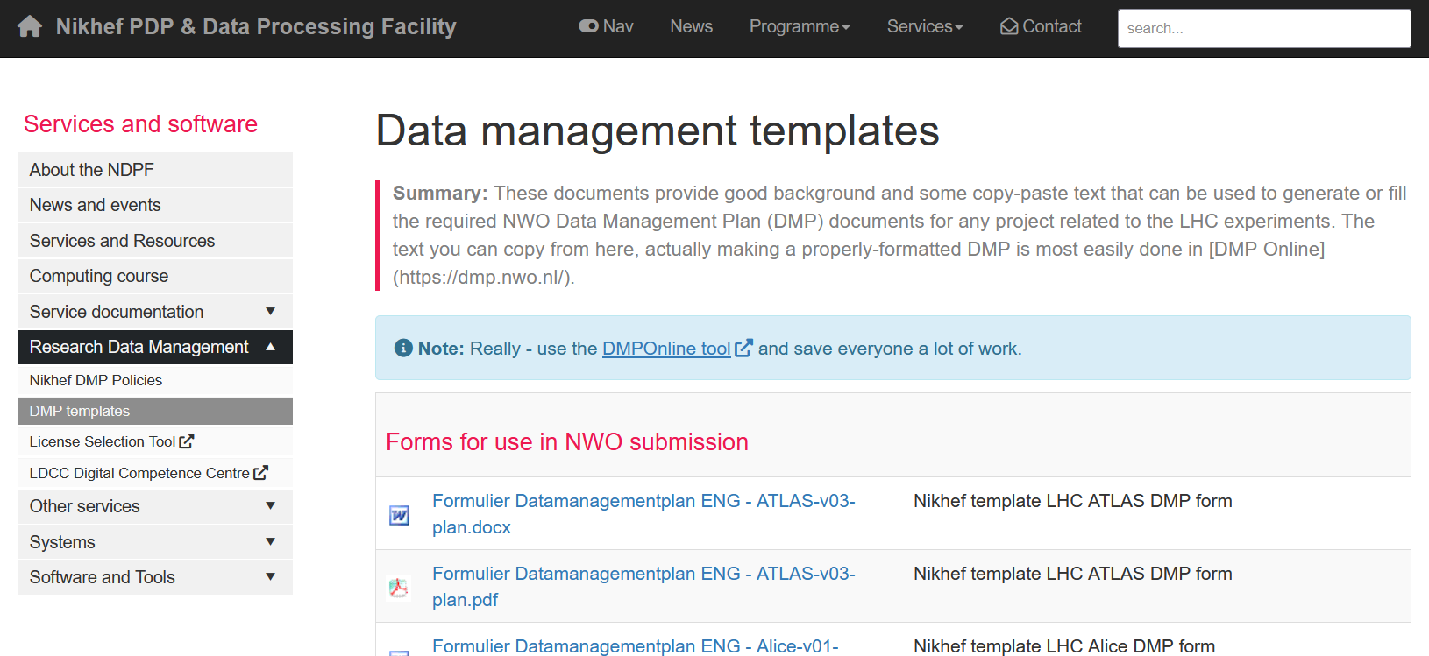
Examples for pure-LHC centred projects
https://www.nikhef.nl/pdp/doc/dmp-templates

Slide 56
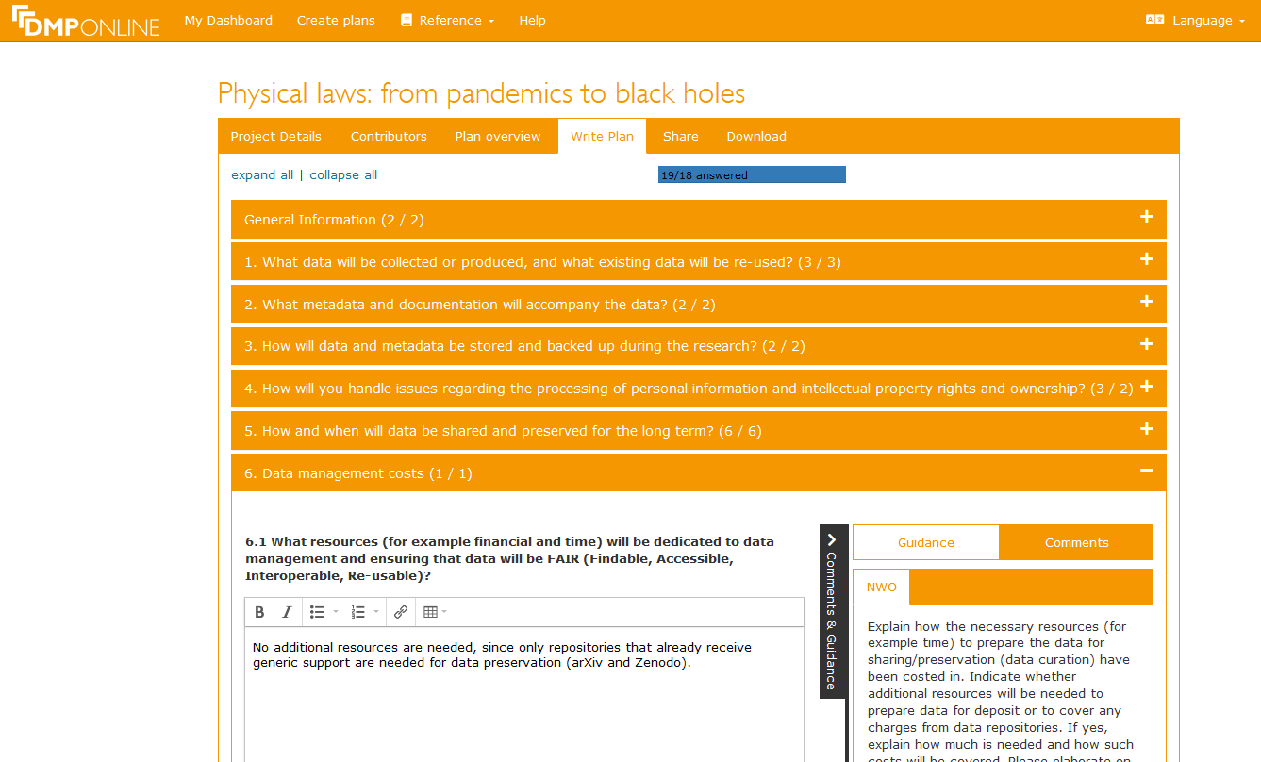
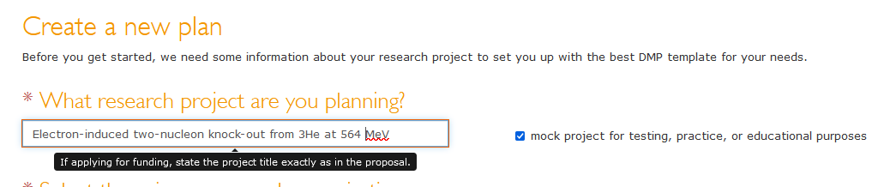
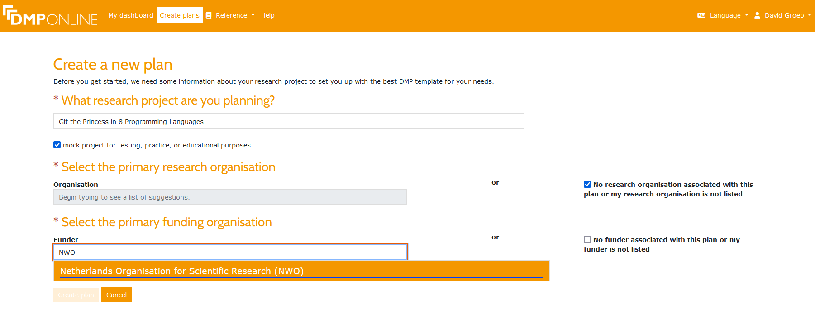
DMP Online Tool – a global tool
https://dmponline.dcc.ac.uk/plans/new -
you can login with your Nikhef or university credentials

Slide 57
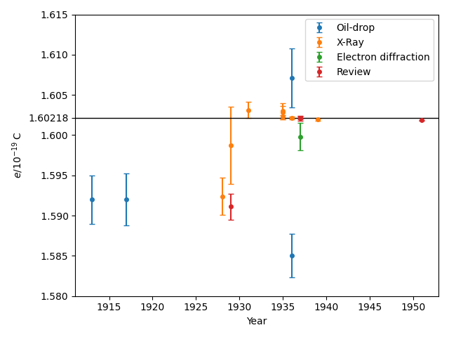
Data reproducibility
since data management is ‘just good science’
besides obvious issues you already know:
  results altered or omitted to make it ‘look good’
  use open data to identify selection bias (or
  just ‘interesting’ use of statistics …)
less obvious:
confirmation bias – keep analysing until it fits
  we mostly use blinding, but that’s because we learnt …
  and why we plots results as a function of time!
and some things only become apparent decades later …
Image from Christian Hill, https://scipython.com/blog/measurements-of-the-electron-charge-over-time/ (CC-BY-SA). See also Feynman, 1986
see also https://www.nwo-i.nl/en/employees/work-and-behaviour/scientific-integrity/

