Slide 1

Use of the TPX3CAM at M4i
Ian G. M. Anthony
The Maastricht Multimodal Molecular Imaging Institute (M4i)
Division of Imaging Mass Spectrometry
Maastricht University, The Netherlands

Slide 2
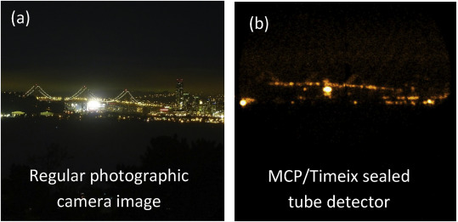
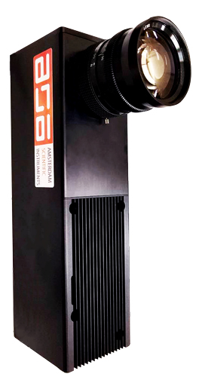
Timepix3 chip and TPX3CAM
256 pixels
256 pixels
MCP/Timepix sealed
tube detector
60 fps = 16.67 ms
1.56 ns
TPX3CAM
Tremsin, A.S.; Vallerga, J. V. Radiation Meas. 2020, 16228
Amsterdam Scientific Instruments, amscins.com/tpx3cam/tpx3cam-with-lens/, Retrieved April 30th, 2022
2

Slide 3
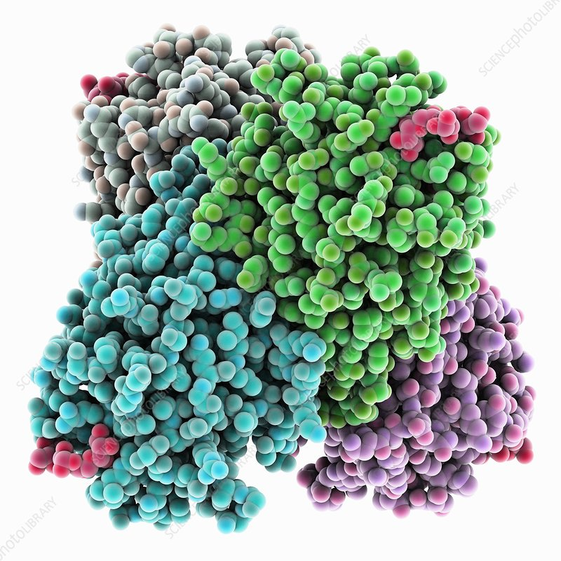
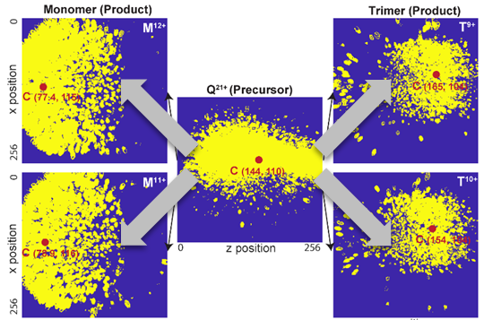
Molecular structure of protein complexes
Concanavalin A
Mathew, A., et al. JASMS 34.7 (2023): 1359-1371.
3

Slide 4
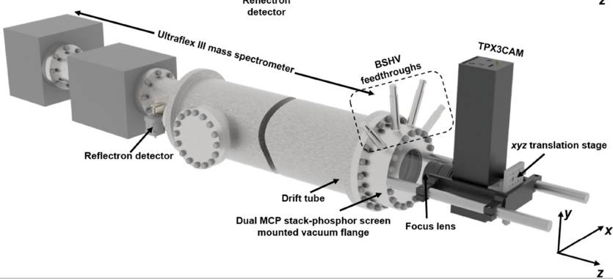
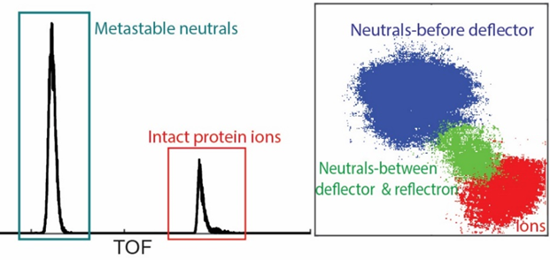
Study of Ion trajectories and metastable fragments
Insulin chain B
Mathew, A., et al. Journal of the American Society for Mass Spectrometry 32.2 (2021): 569-580.
Mathew, A., et al. Analytical Chemistry 95.2 (2023): 1470-1479.
4

Slide 5
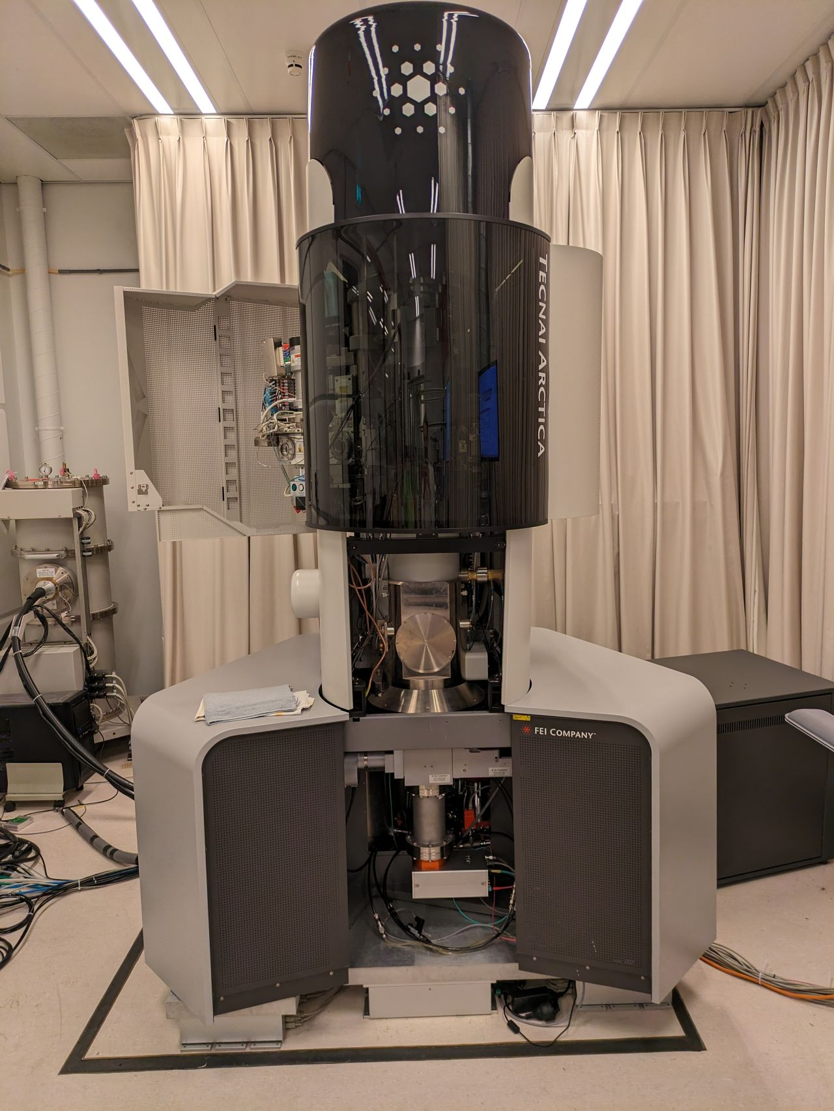
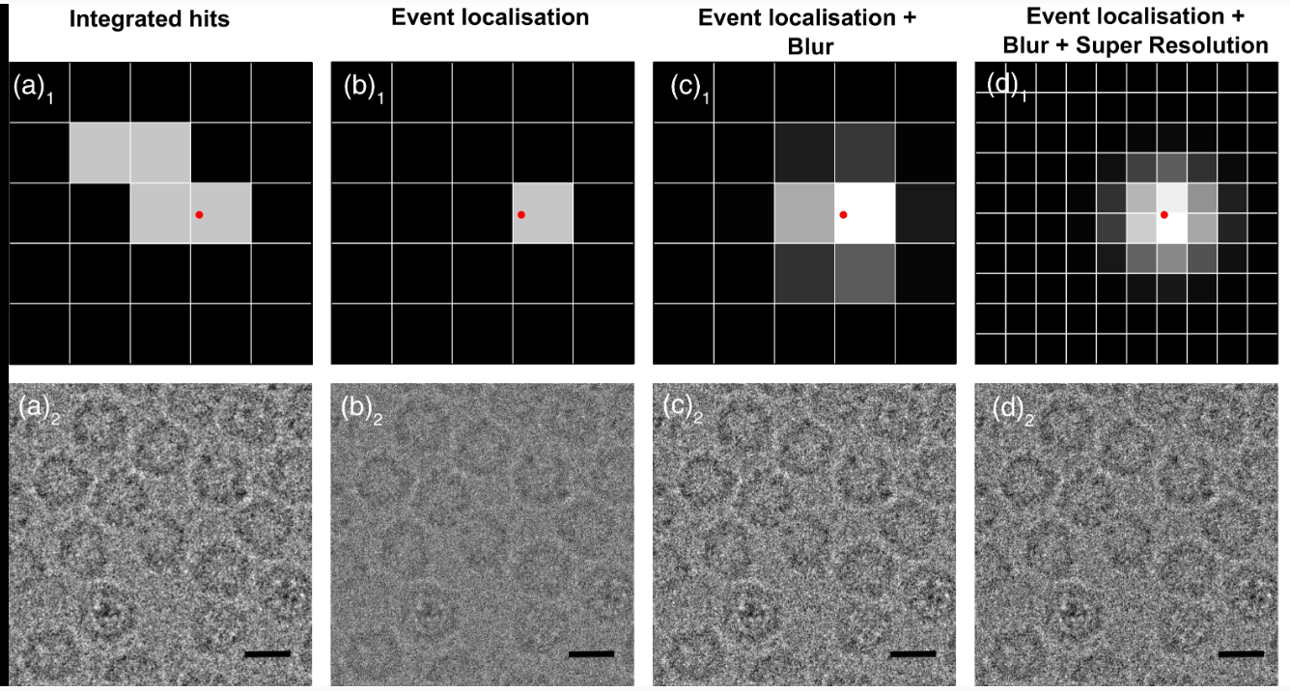
Cryo-EM Imaging of graphene-coated samples
200 kV TEM with Timepix3
Timepix4
van Schayck, J. P., et al. Microscopy and Microanalysis 2023, 29, 1, 352-363
Zhang, Y., et al. ACS nano 2023, 17, 16, 15836-15846
5

Slide 6
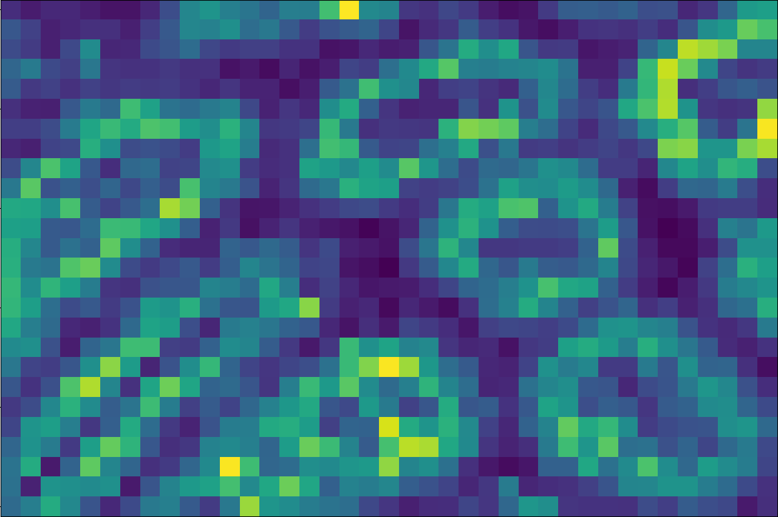
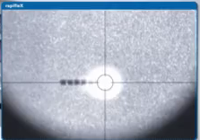
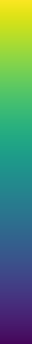
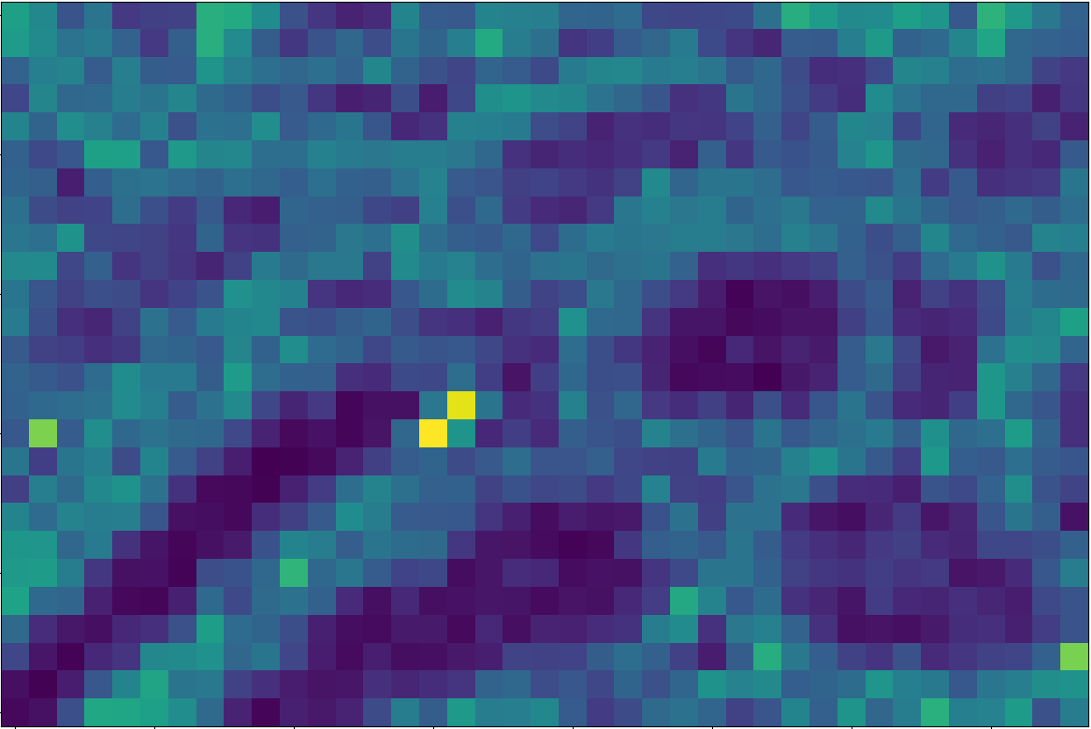
Microprobe-mode mass spectrometry imaging (MSI)
40 pixels per s
647.50 m/z
High
Low
820.52 m/z
High
Low
Bruker rapifleX™ MALDI Tissuetyper™, YouTube Video, youtube.com/watch?v=EJGyc1BBb7U, Accessed 02/10/2021
6

Slide 7
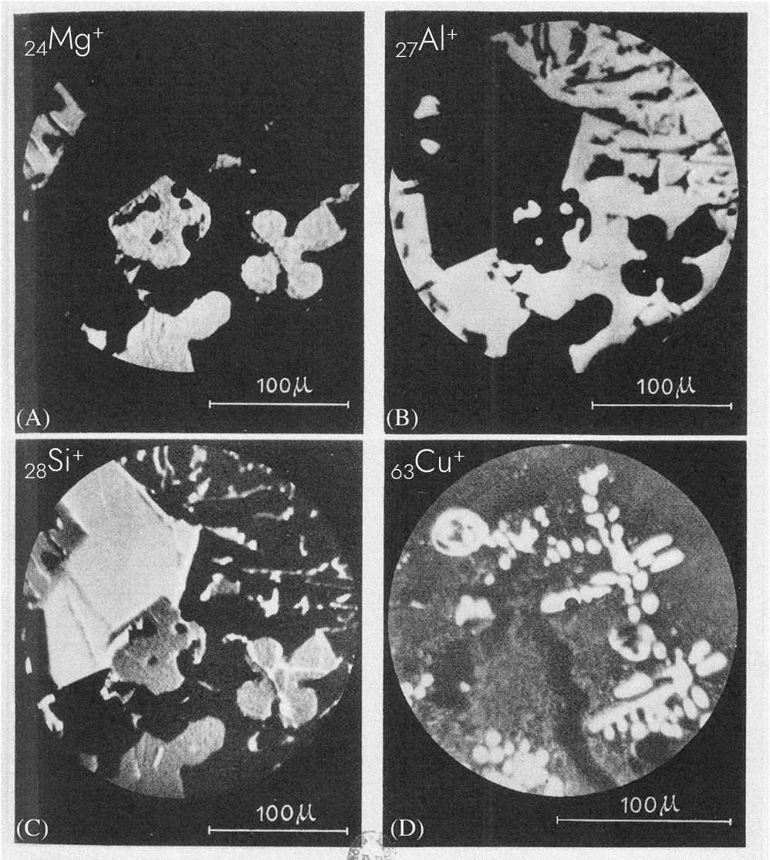
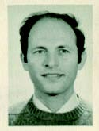
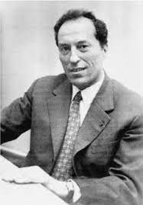
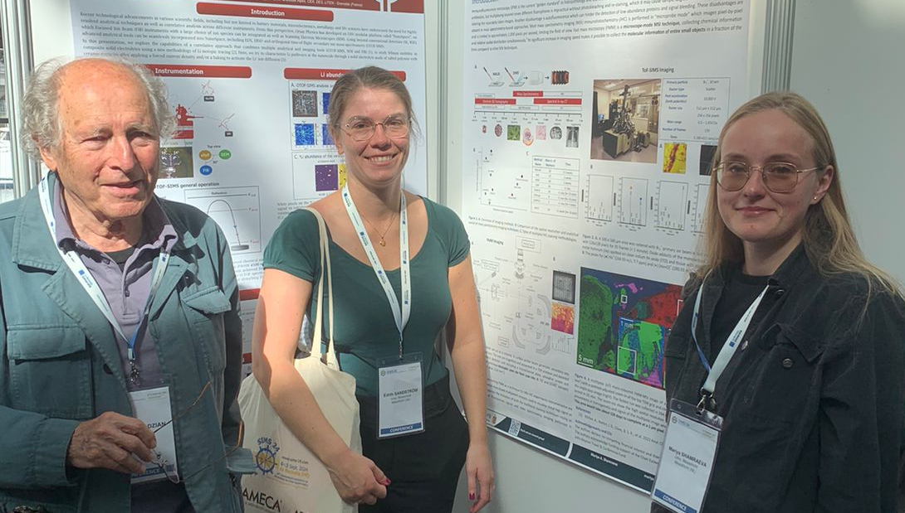
Mass microscopy: an alternative to microprobe-mode MSI
Georges Slodzian
*Raimond Castaing
MSI in 1962
Castaing R, Slodzian G. J. Mass Spectrom. 2021; 56 (12): e4800. doi:10.1002/jms.4800
*Advances in Imaging and Electron Physics, Volume 167, ISSN 1076-5670, DOI: 10.1016/B978-0-12-385985-3.00001-8.
7

Slide 8
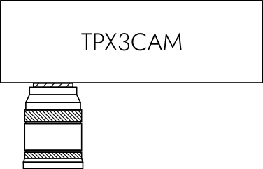
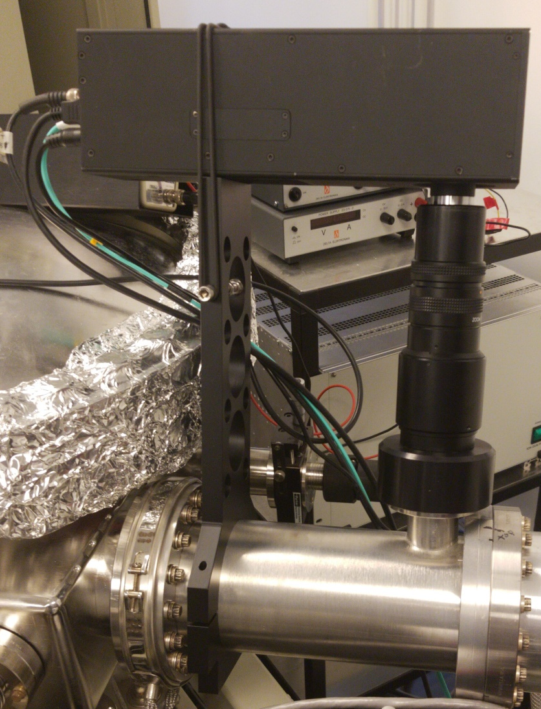
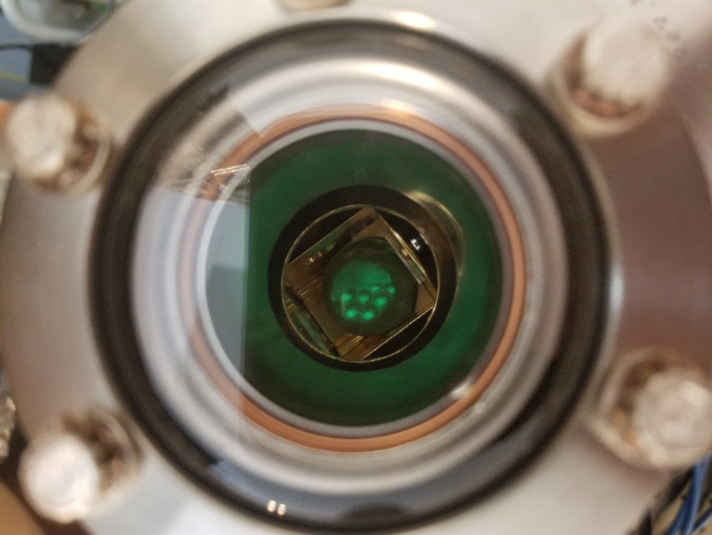

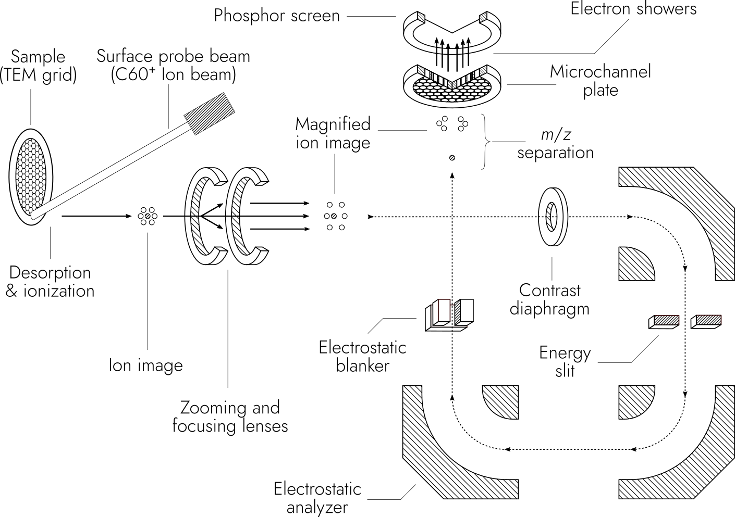
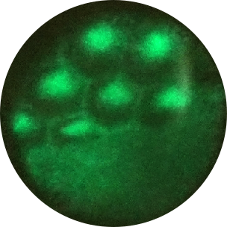
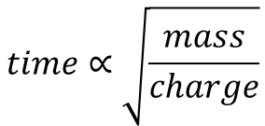
Mass microscopy
$$time∝\sqrt{\frac{mass}{charge}}$$
~320 µm
8

Slide 9
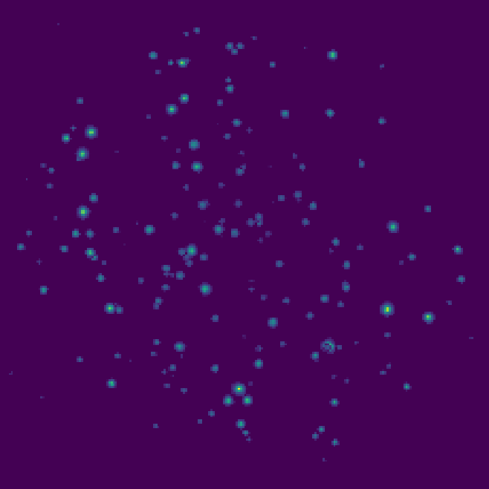
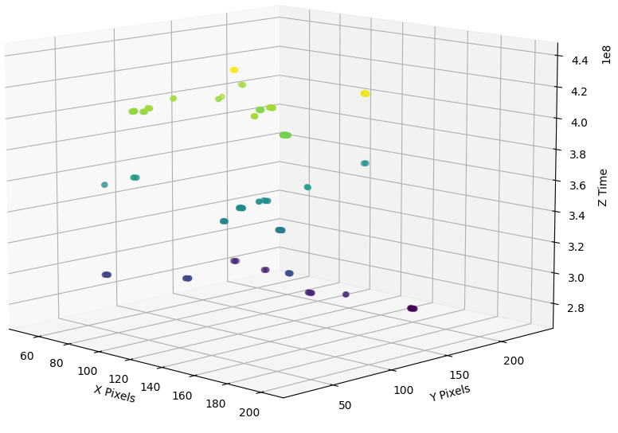
Timepix3 can resolve single ion hits
100 ms
100 μs
1.56 ns
~1000 TOF pulses
1 TOF pulse
1 TOF pulse
9

Slide 10
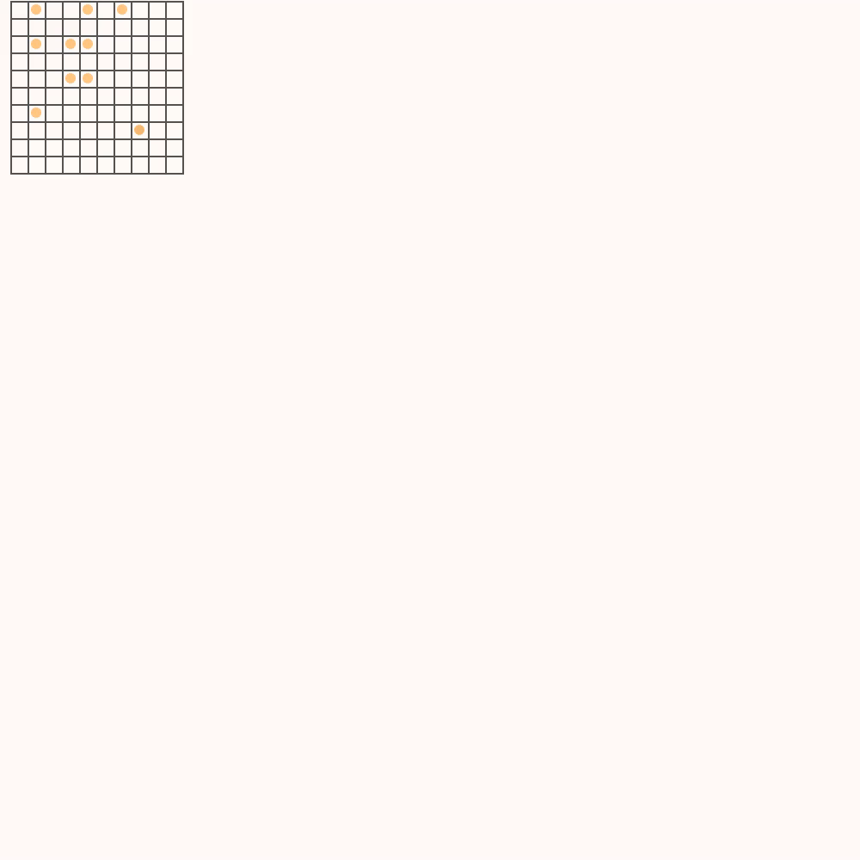
Fast mass microscopy
Fast mass microscopy
Microprobe-mode MSI
10

Slide 11
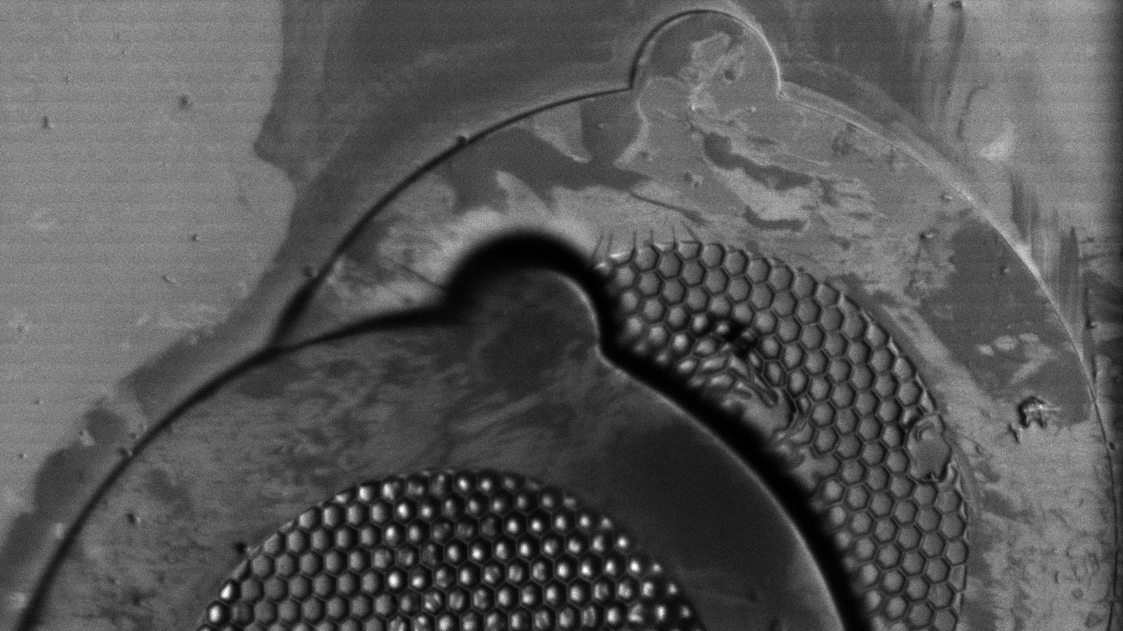
500 μm
TIC
11

Slide 12
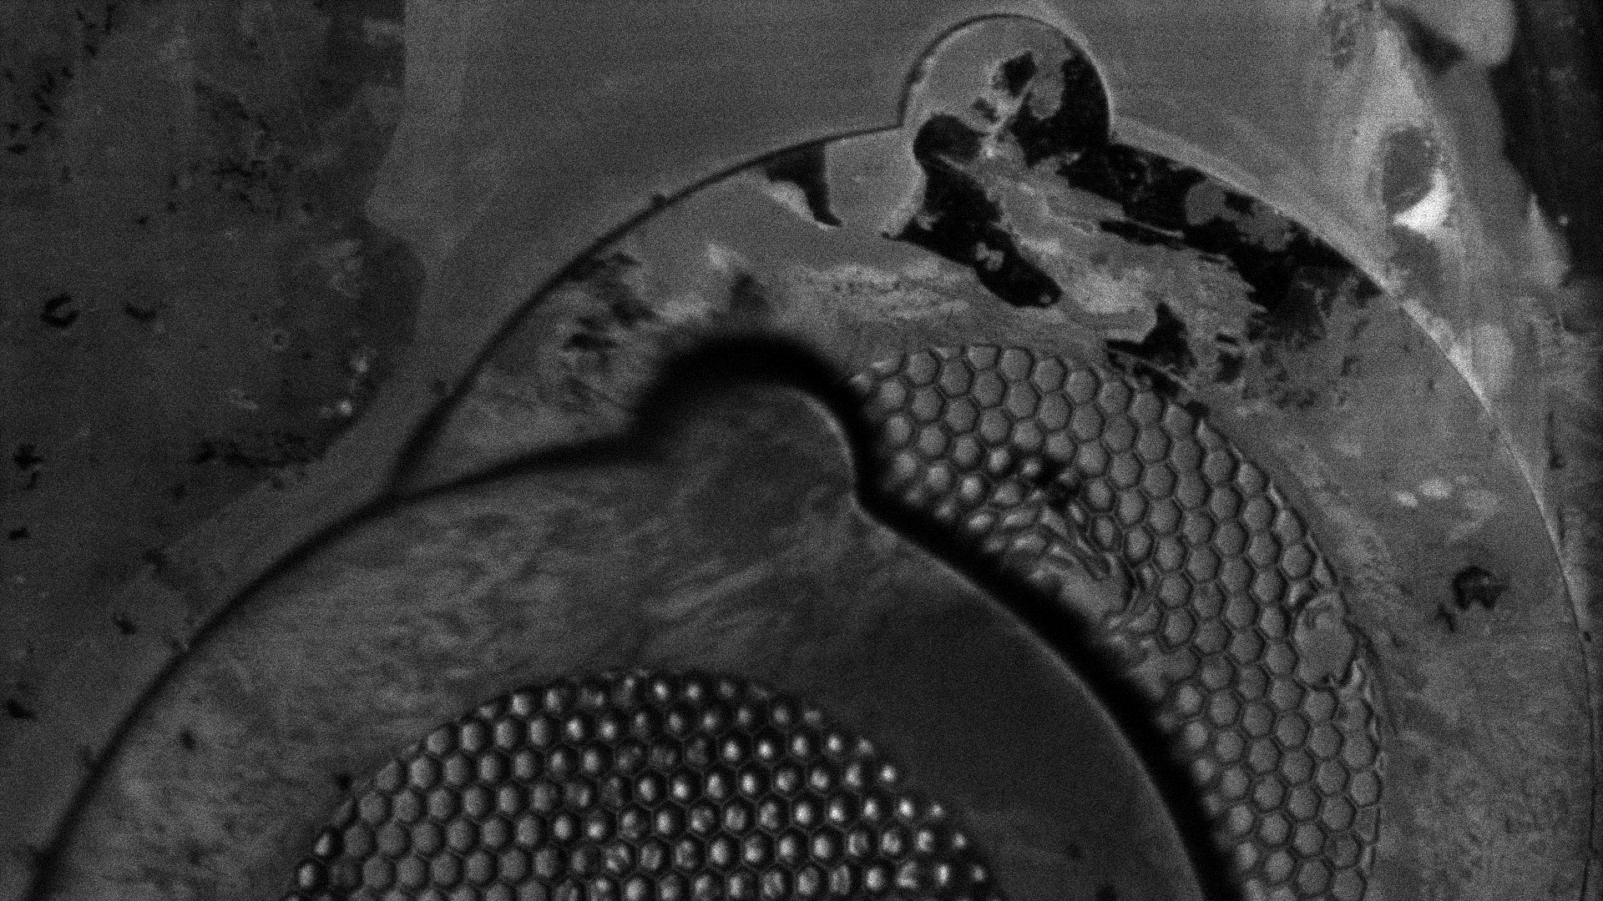
500 μm
Sodium – 23 m/z
12

Slide 13
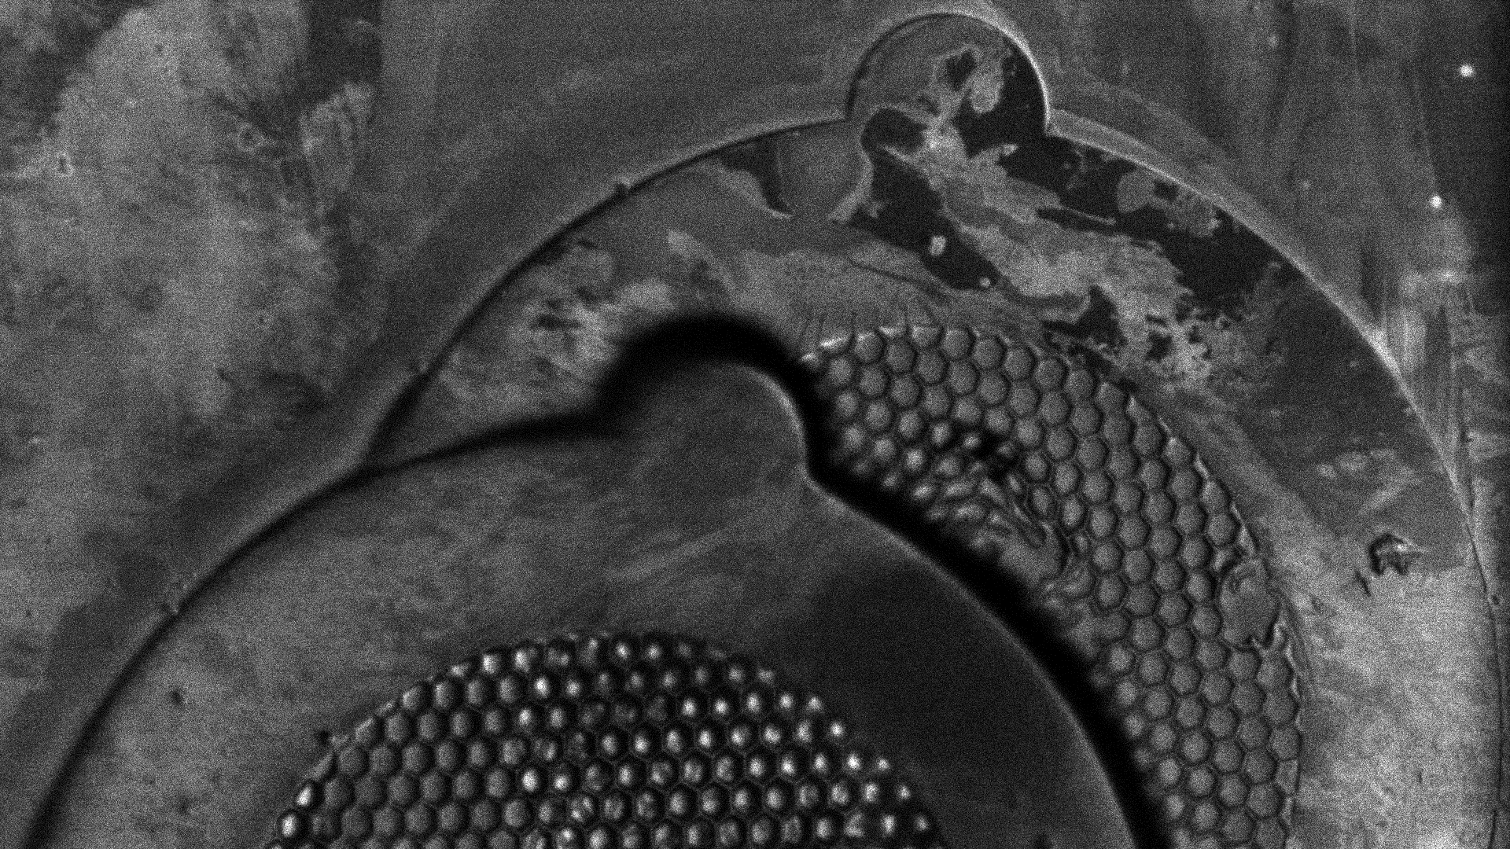
500 μm
Potassium – 39 m/z
13

Slide 14
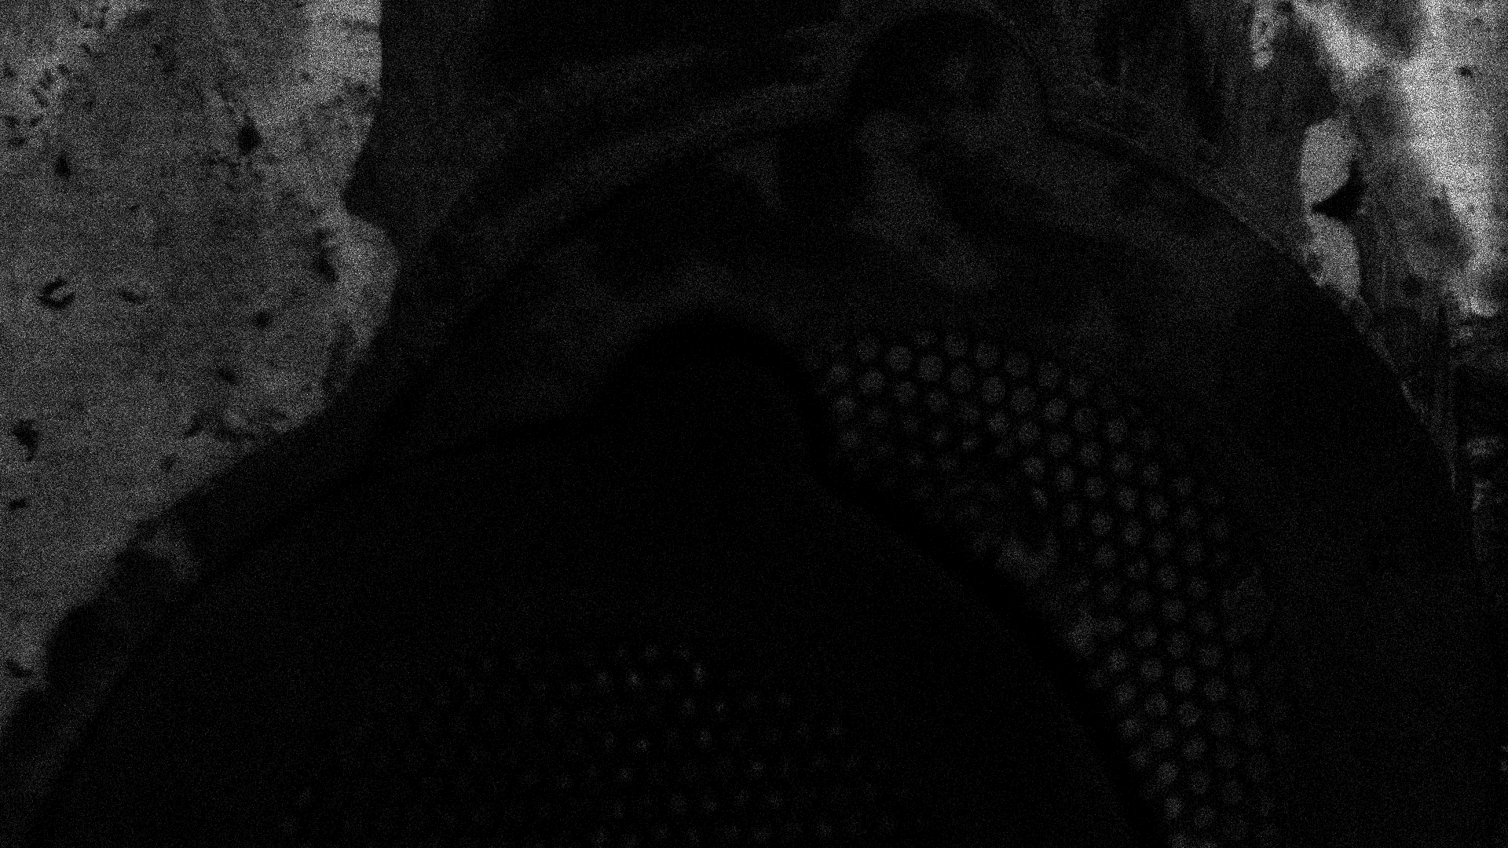
500 μm
Indium – 115 m/z
14

Slide 15
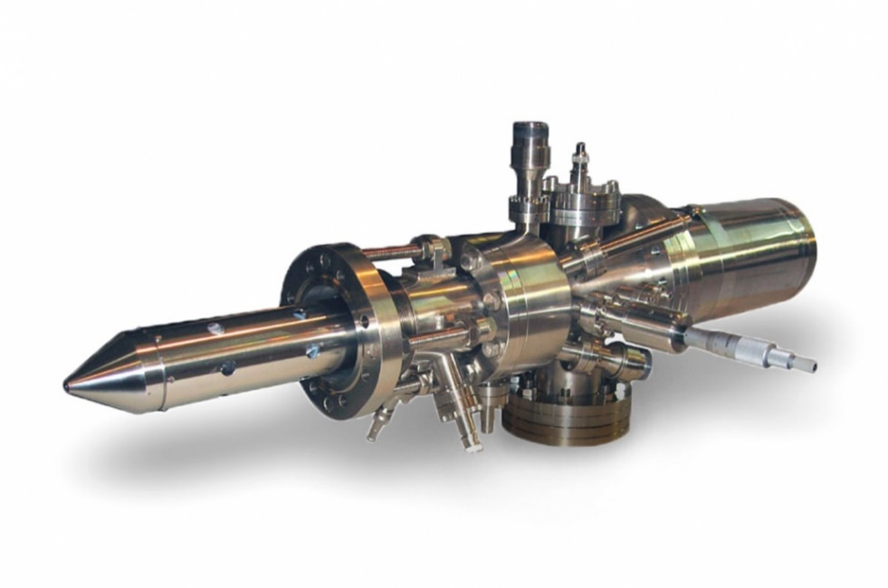
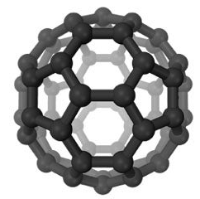
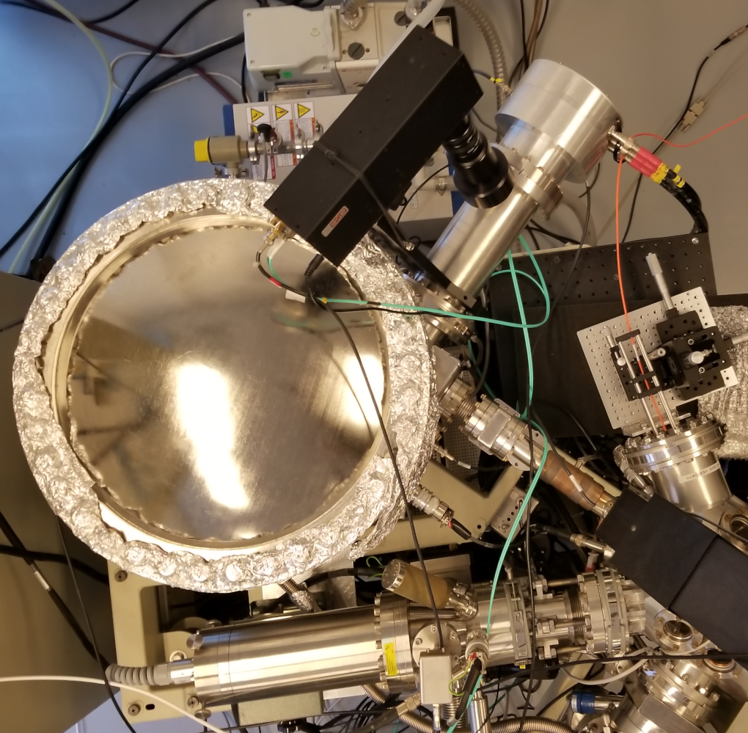
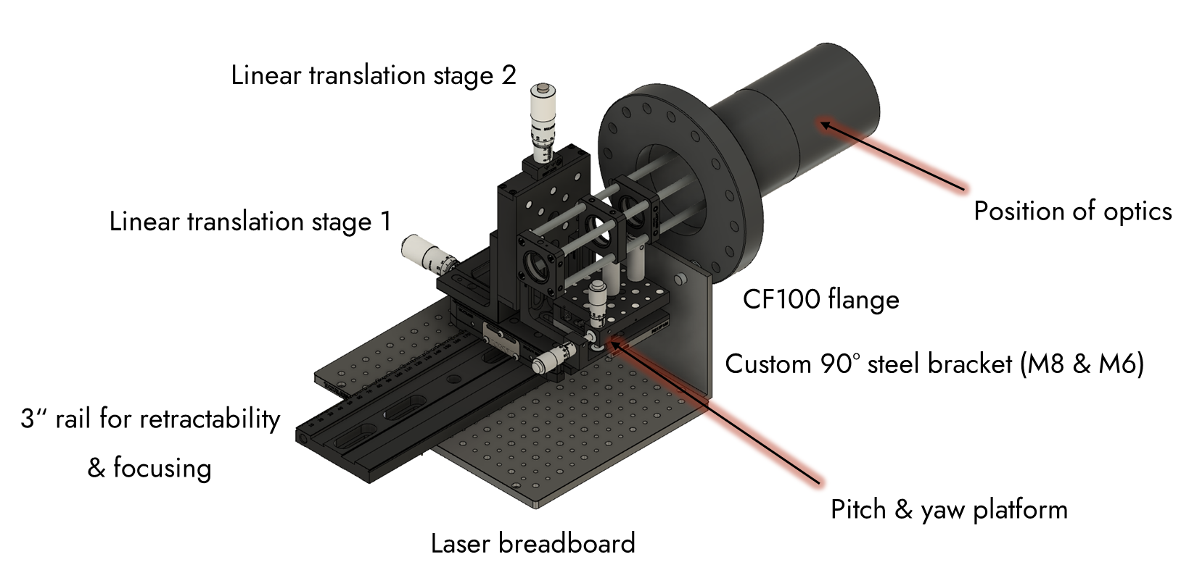
Laser interface
C₆₀ Ion gun
Optical
fiber
TPX3CAM
Laser Interface
Laser interface
TRIFT
Sample chamber
C₆₀⁺ Ion gun
15

Slide 16
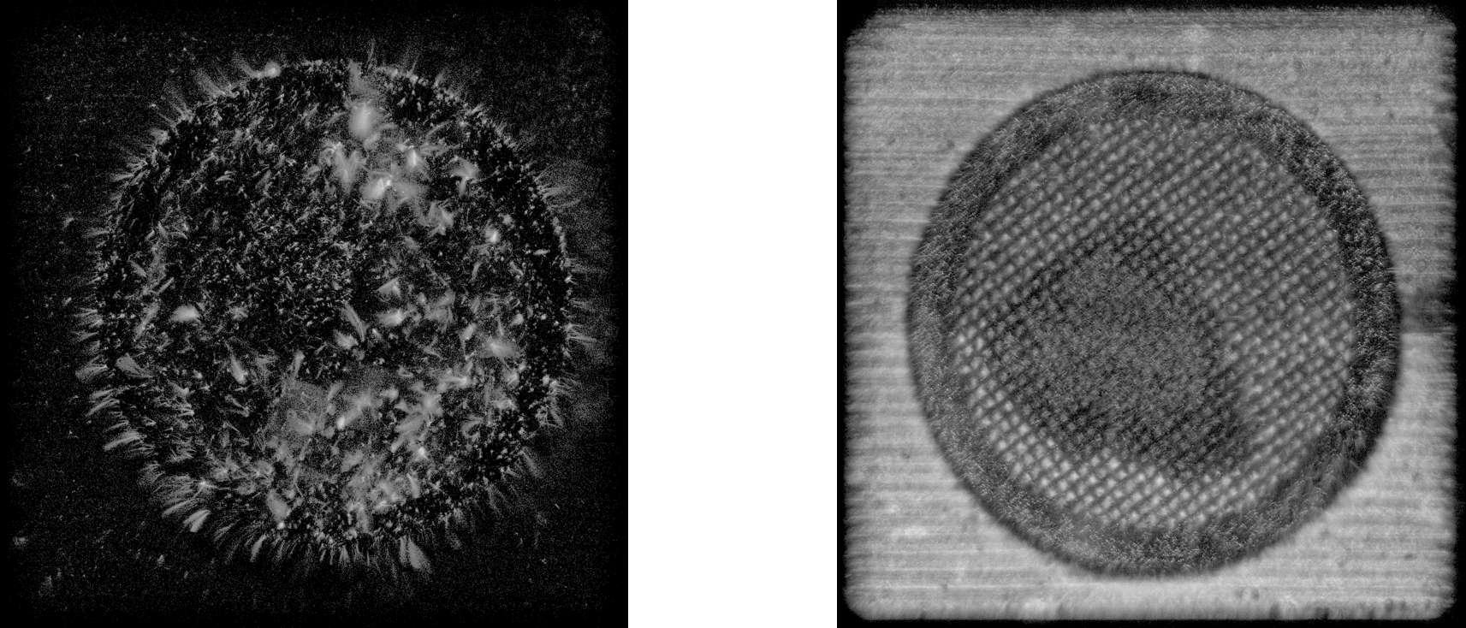
Surface charging effects when using a laser (MALDI)
500 µm
500 µm
No gold coating (insulating)
With gold coating (conductive)
Publication in Preparation
16

Slide 17
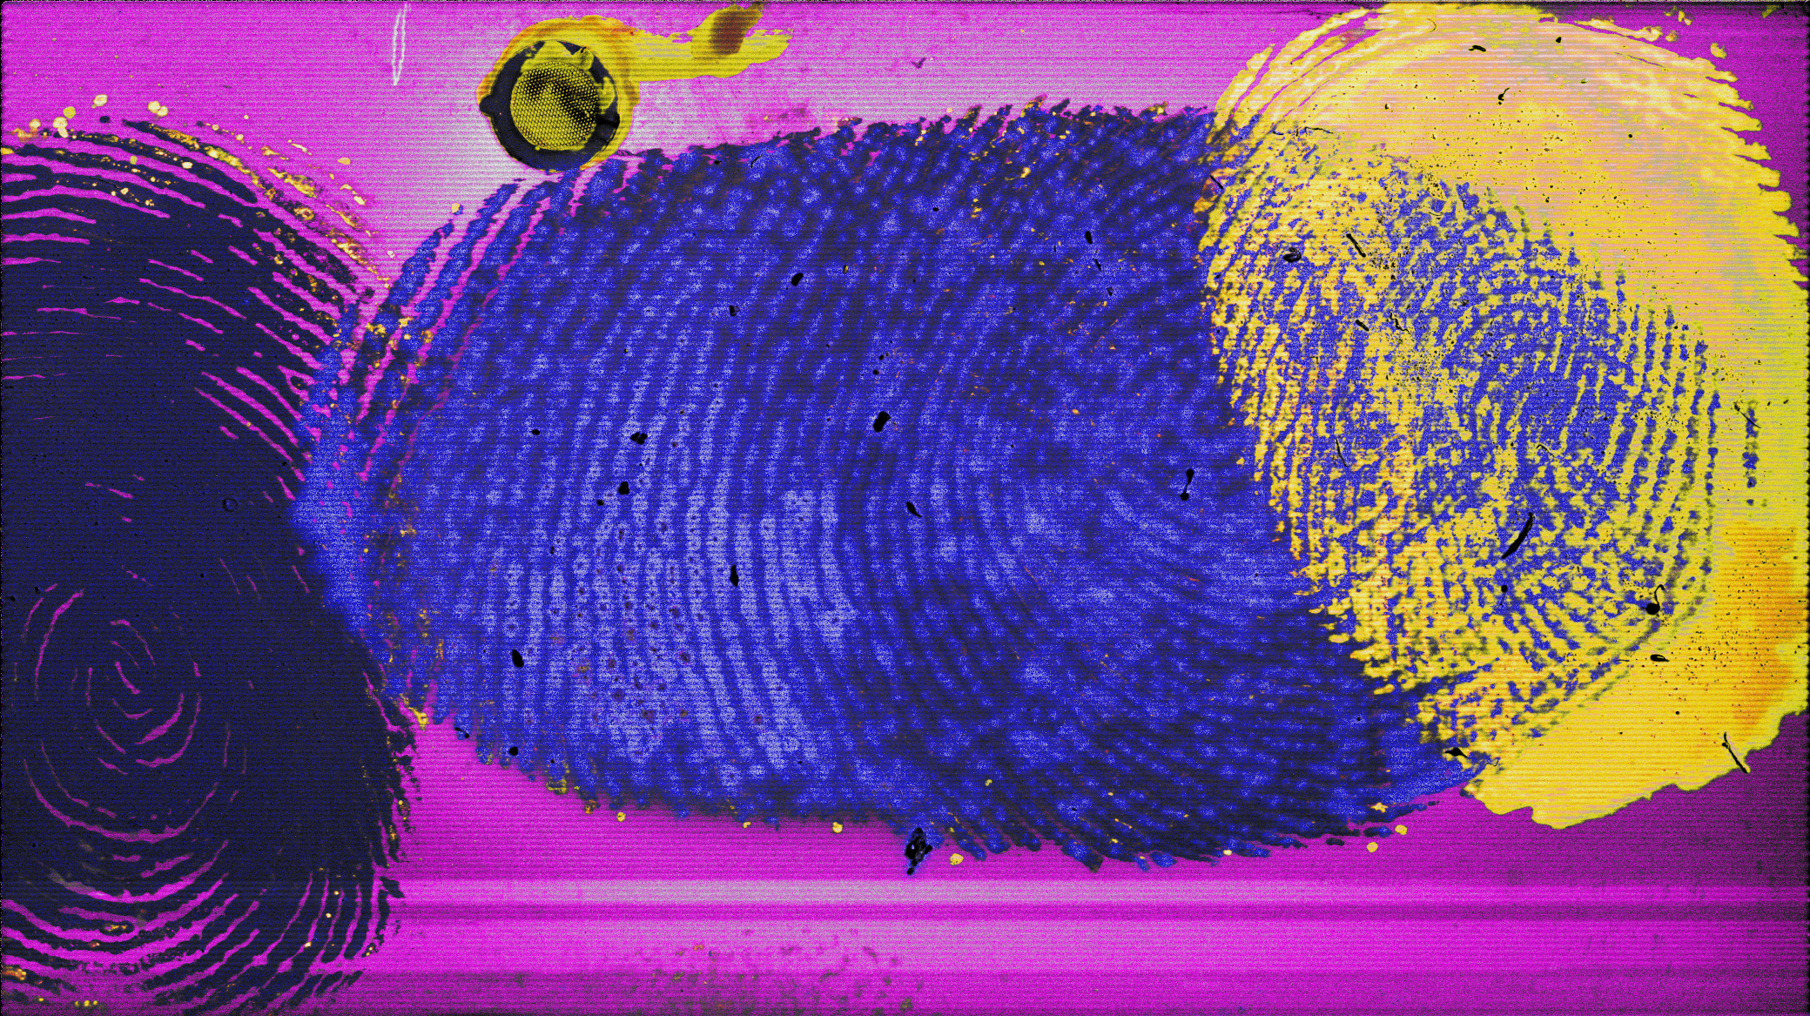
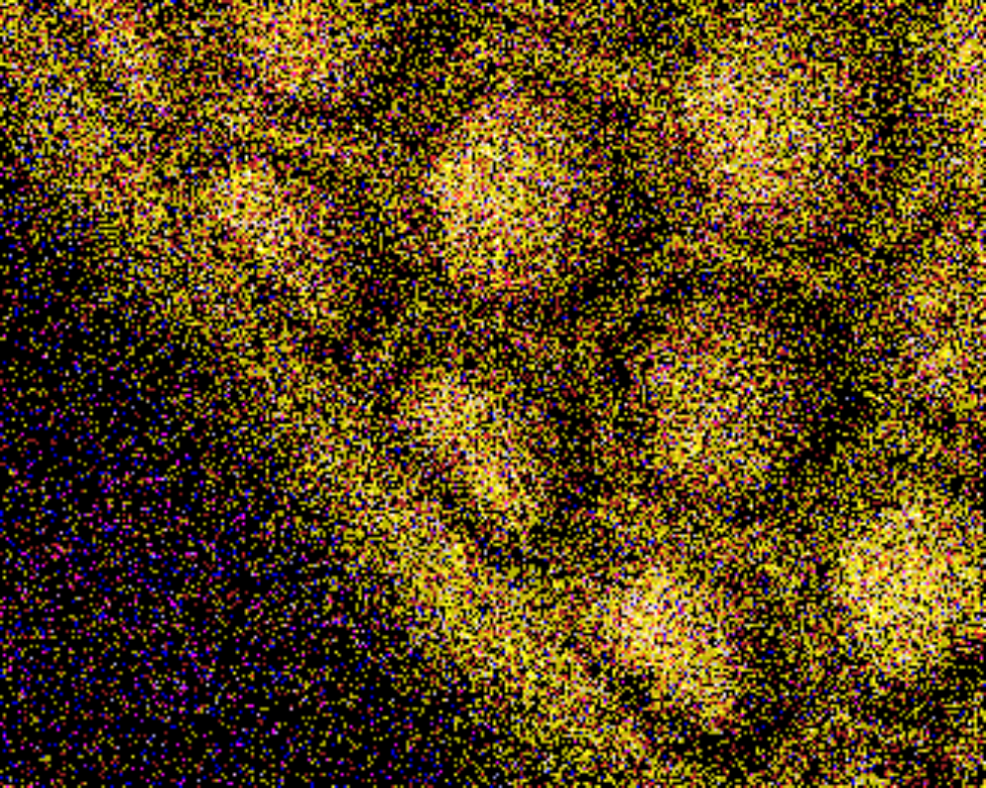
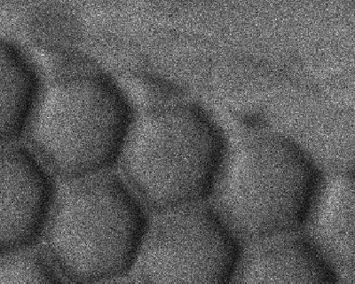
100 μm
100 μm
33.3 minutes
42 × 23.5 mm
0.9 μm pixels
1.2 gigapixels
609,564 pix s⁻¹
@ 600 pix s⁻¹
42 × 23.5 mm
~23 days
33.3 minutes
42 × 23.5 mm
0.9 μm pixels
1.2 gigapixels
>600,000 pix s⁻¹
5 mm
Körber, A.; et al. Anal. Chem. 2022, 94, 42, 14652–8

Slide 18
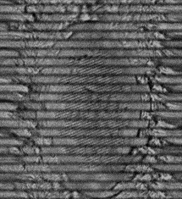
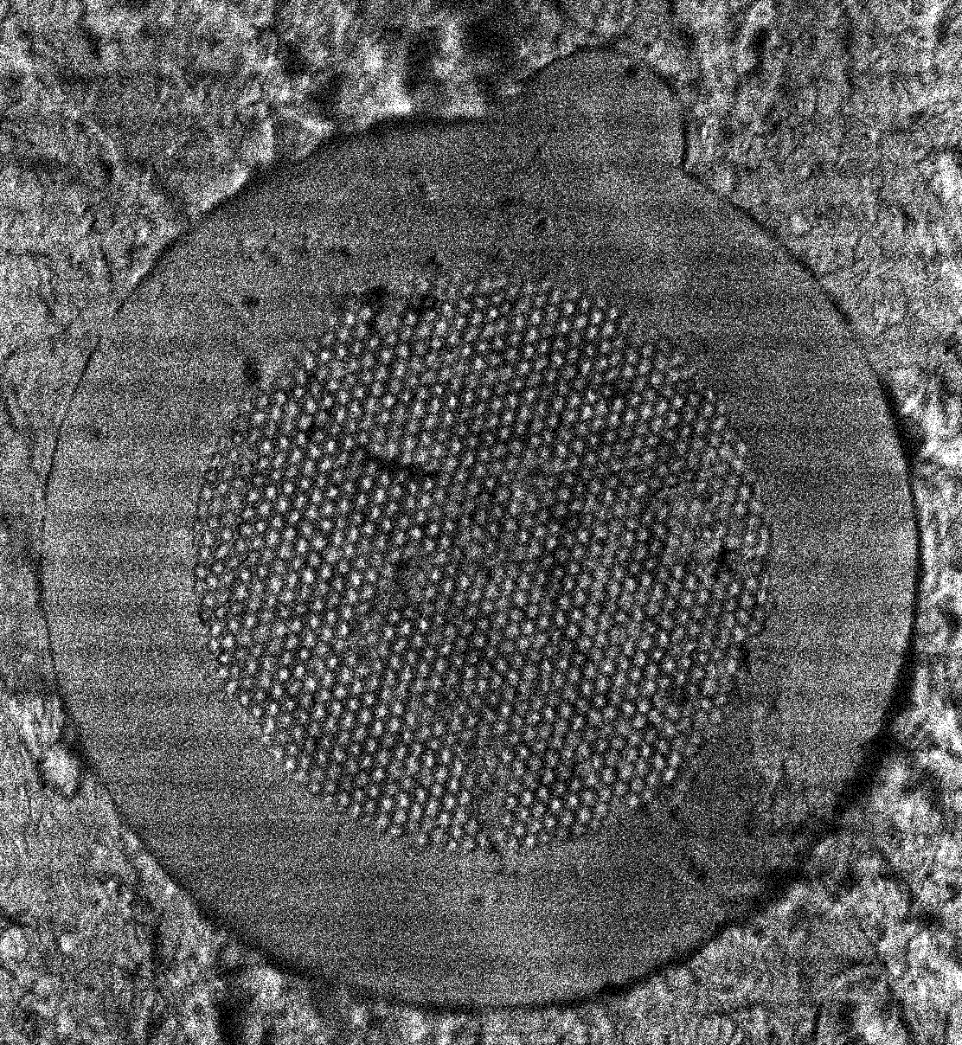
Addition of encoders
500 µm
500 µm
With linear interpolation (guessing)
With encoders (not guessing)
Publication in Preparation
18

Slide 19
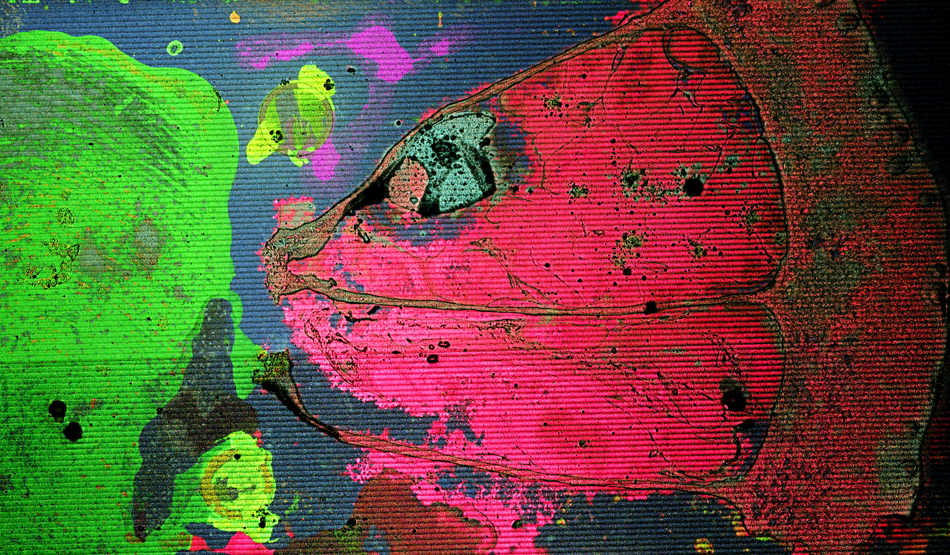
< 4.5 minutes
42 × 26 mm
> 5 million pix s⁻¹
4.18 mm² s⁻¹
~8.5× faster
5 mm
Publication in preparation

Slide 20
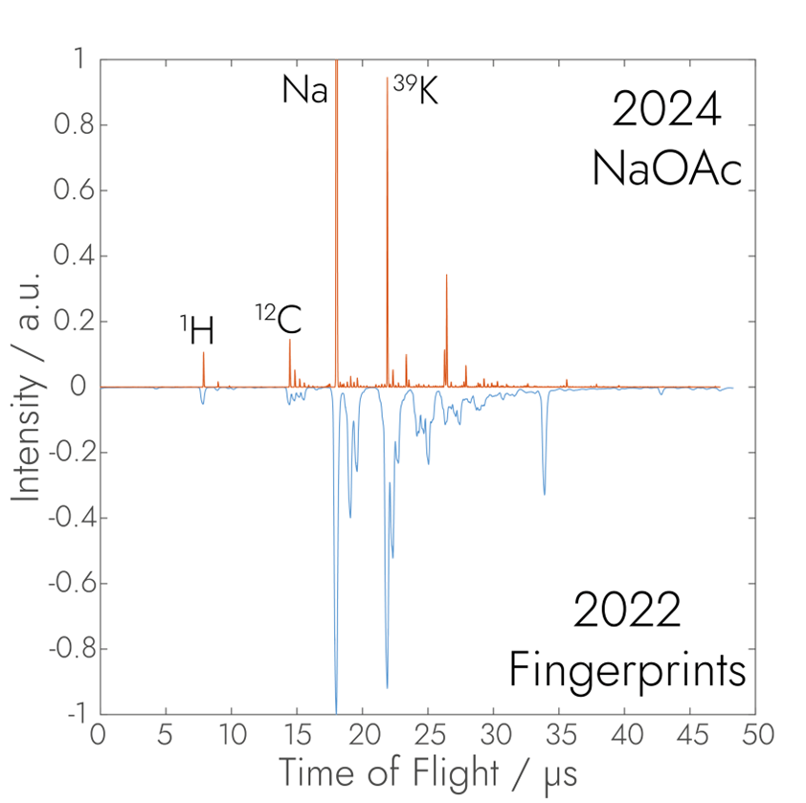
Exciting opportunities for improvement!
~7x improvement
(>600 m/Δm_{50%} at m/z 400)
Signal processing
Primary pulse width optimizations
There is need for a TPX4CAM detector
Goal is 2,000 m/Δm_{50%} at m/z 400
Körber, A.; et al. ASMS Poster TP 204, 2024
20

Slide 21
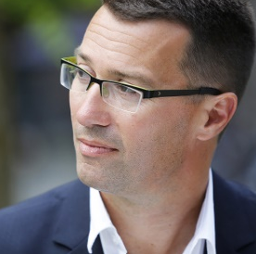

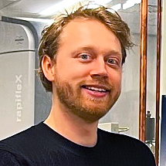
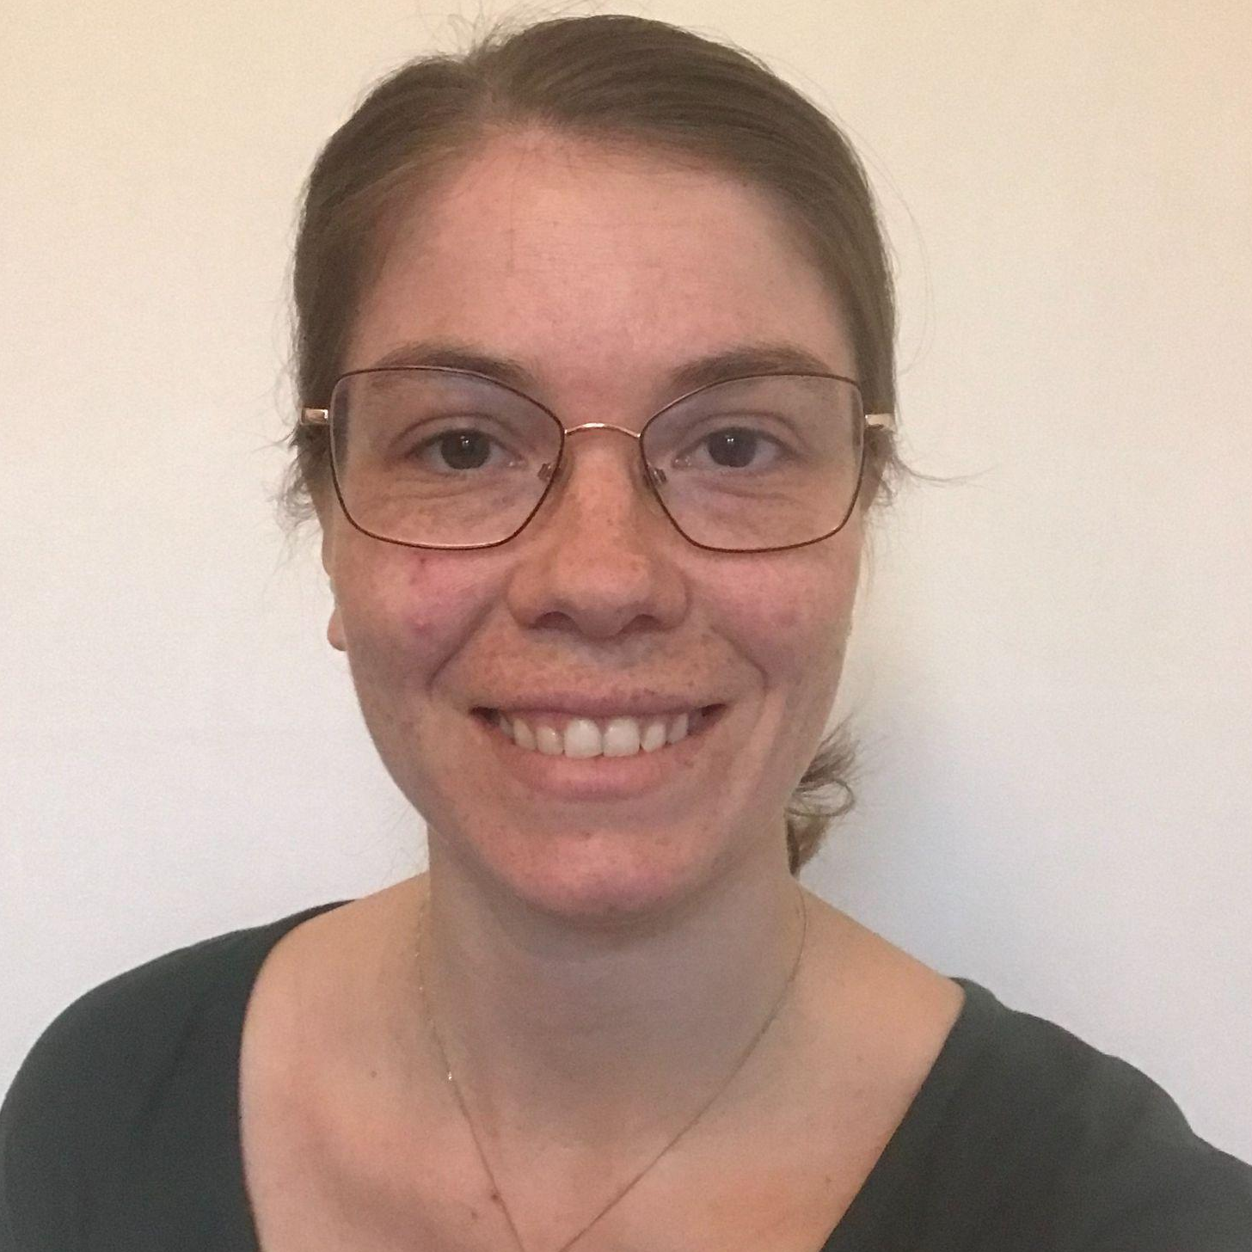

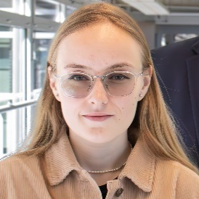
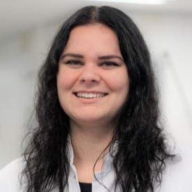
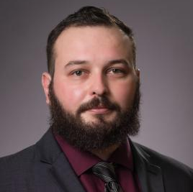
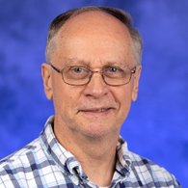

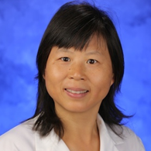
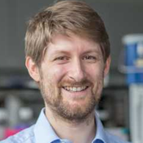








Acknowledgements
Prof. Dr. Ron M.A. Heeren
Aljoscha Körber
Kasper
Krijnen
Dr. Edith Sandström
Dr. Anjusha
Mathew
Dr. Mariya
Shamraeva
Britt S. R. Claes
Dr. Sebastiaan Van Nuffel
Prof. Dr. Neil Christensen
Prof. Dr. Yusheng Zhu
Dr. Jiafen Hu
Prof. Dr. Bernd Bodenmiller
Frans Giskes
Paul Laeven
Pascal Huysmans
21

Slide 22

I am hiring a PhD student to build a new fast mass microscope! i.anthony@maastrichtuniversity.nl

