Slide 1
Clustering methods for high-luminosity
ANDREJ Sarnatskiy
FASTER meeting

Slide 2
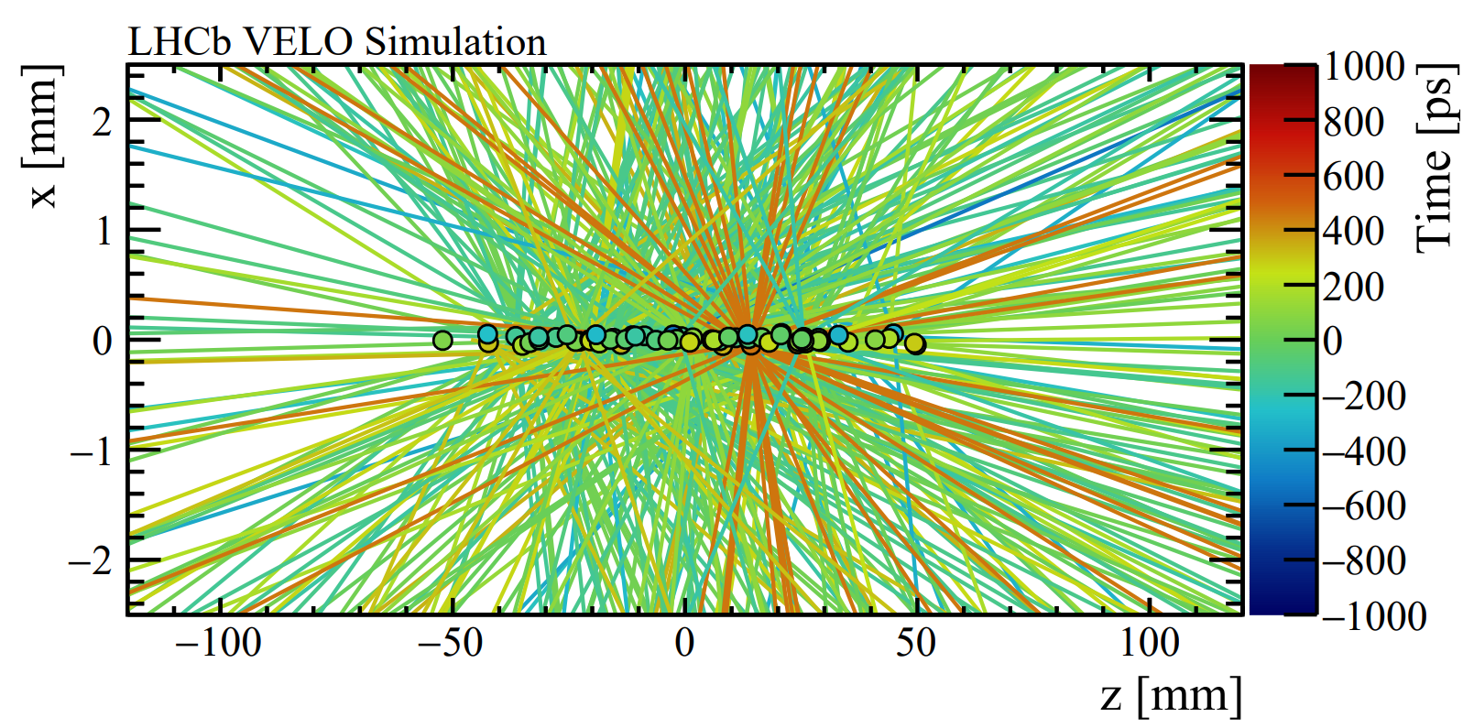
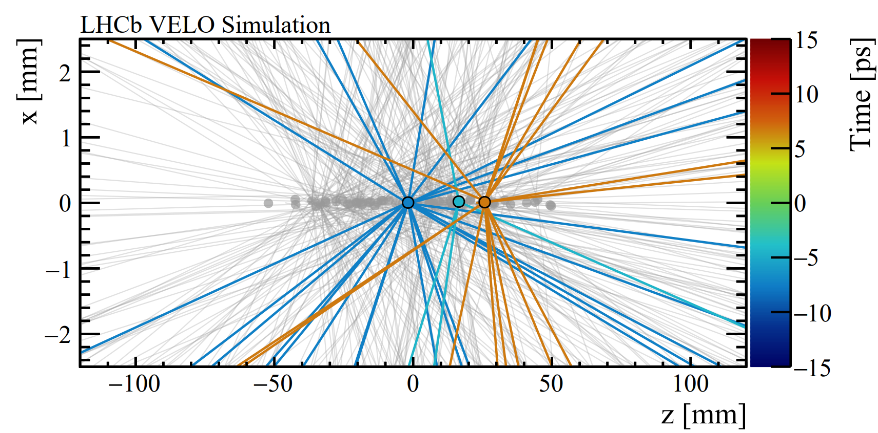
Motivation
Challenges to get data from chips to trigger farm
Decrease data rate (compression)
Distinguish PV events during high pile-up (timing)
Apply corrections as soon as possible for improved reconstruction
What corrections can be applied and where ? e.g. timewalk correction or hit interpolation
Being part of both R&D and LHCb, analysis is done both on LHCb simulation of run5 and the current hardware.
~ 1.6 Tbps
~ 5 – 40 collisions
Courtesy: R. E. Geertsema

Slide 3
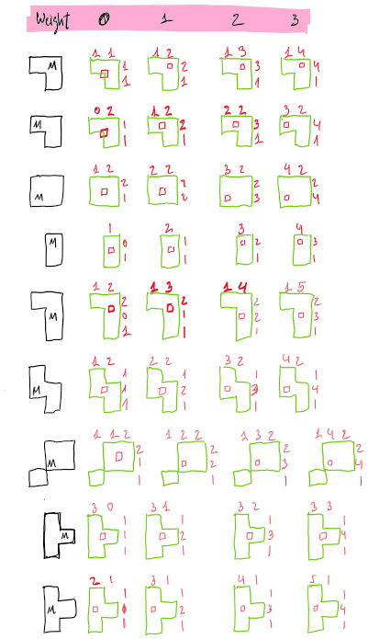
Data processing
Attempt to reduce data rate by rejection in the ASICs
Uncertainty of hits, e.g. multiple particles mimicking a cluster
No possibility of correcting data afterwards
Is the system reliable for the lifetime of U2?
Current bit structure of TimePix4 still available
The alternative is to apply corrections down the road @ FPGA
Possibility of combining and correcting pixel hit to clusters
Firmware is adjustable
Reference to Xavi Llopart’s presentation: https://indico.cern.ch/event/1381444/
Interesting methodology exists already: https://doi.org/10.1016/j.nima.2016.05.077

Slide 4
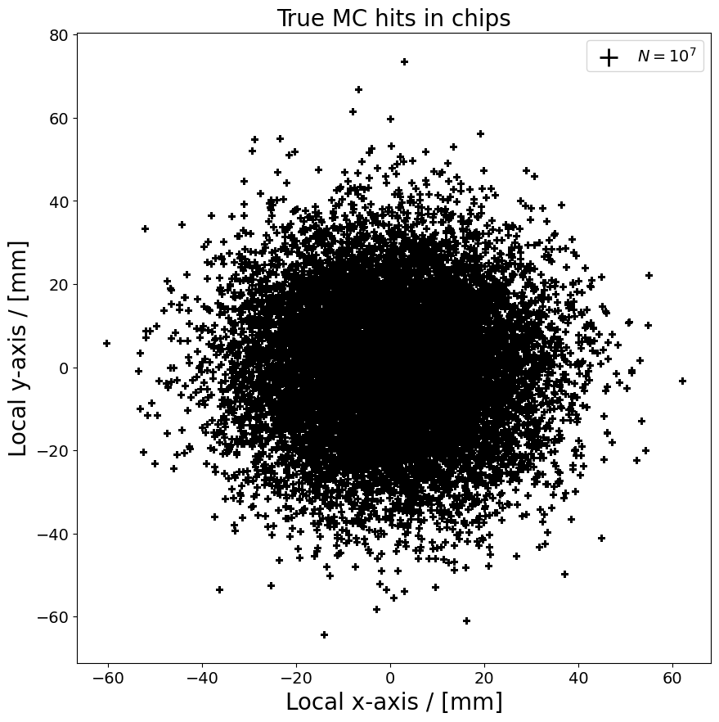
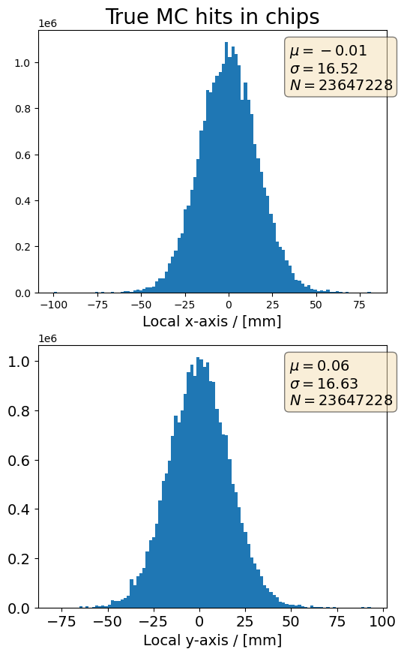
LHCb Upgrade 2 simulation
Using LHCb simulation to analyse impact of algorithms
Local (chip) coordinates needed
Failed to use existing functions within LHCb software
No geometry information found

Slide 5
Struggle of duality
Either run the LHCb simulation ones, then do analysis/transformations later
Or implement additional code in the simulation
Online C++
algorithm
in Gaudi
Offline Python
analysis code
in Jupyter

Slide 6
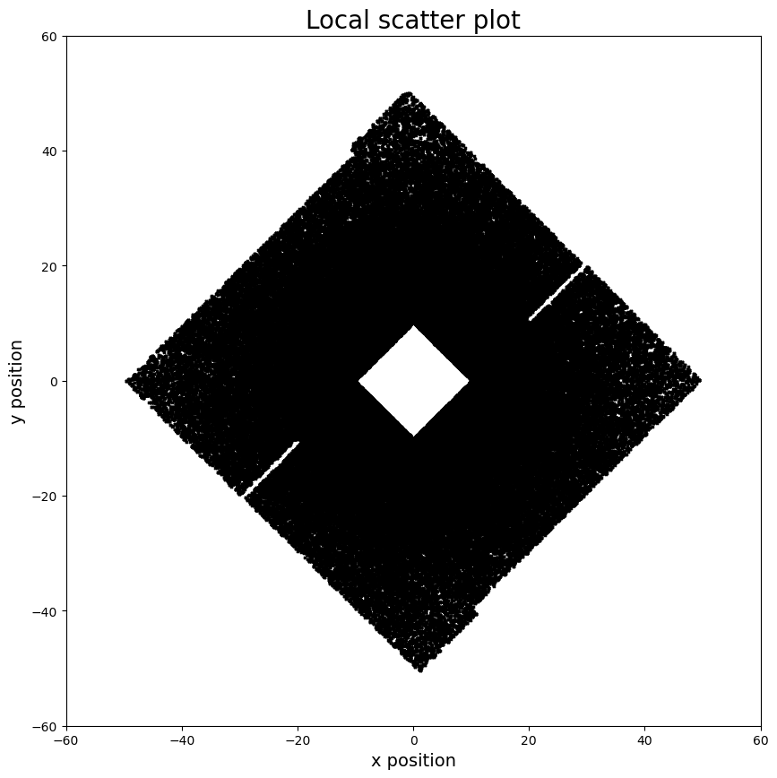
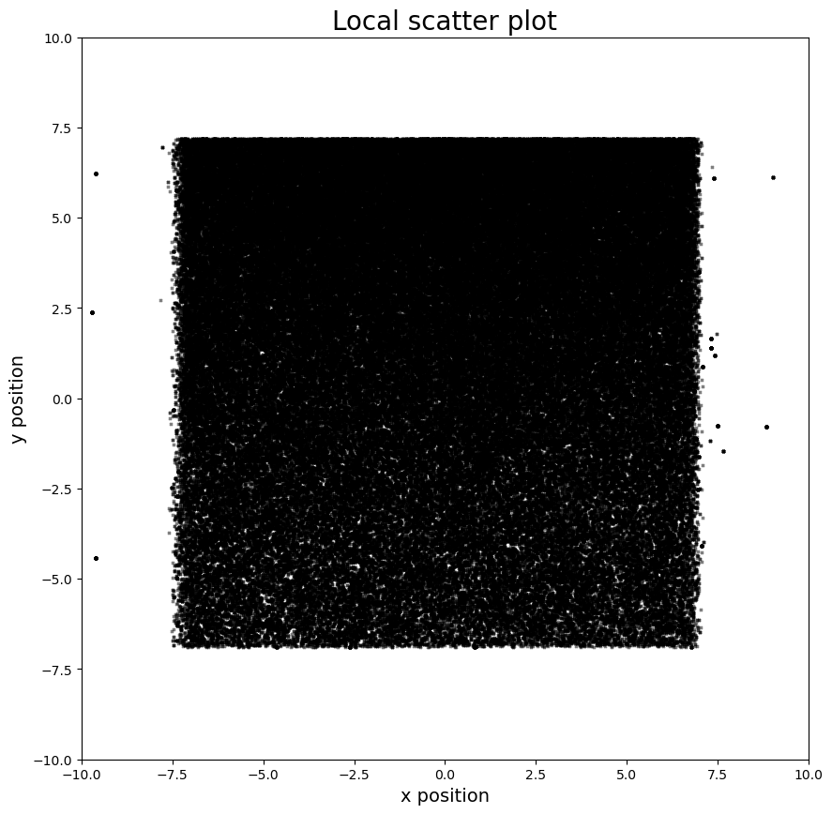
OFFLine analysis
Global to local mapping
Columns and rows aligned, reflected if needed
Additional micro alignment applied
Source for systematic uncertainty

Slide 7
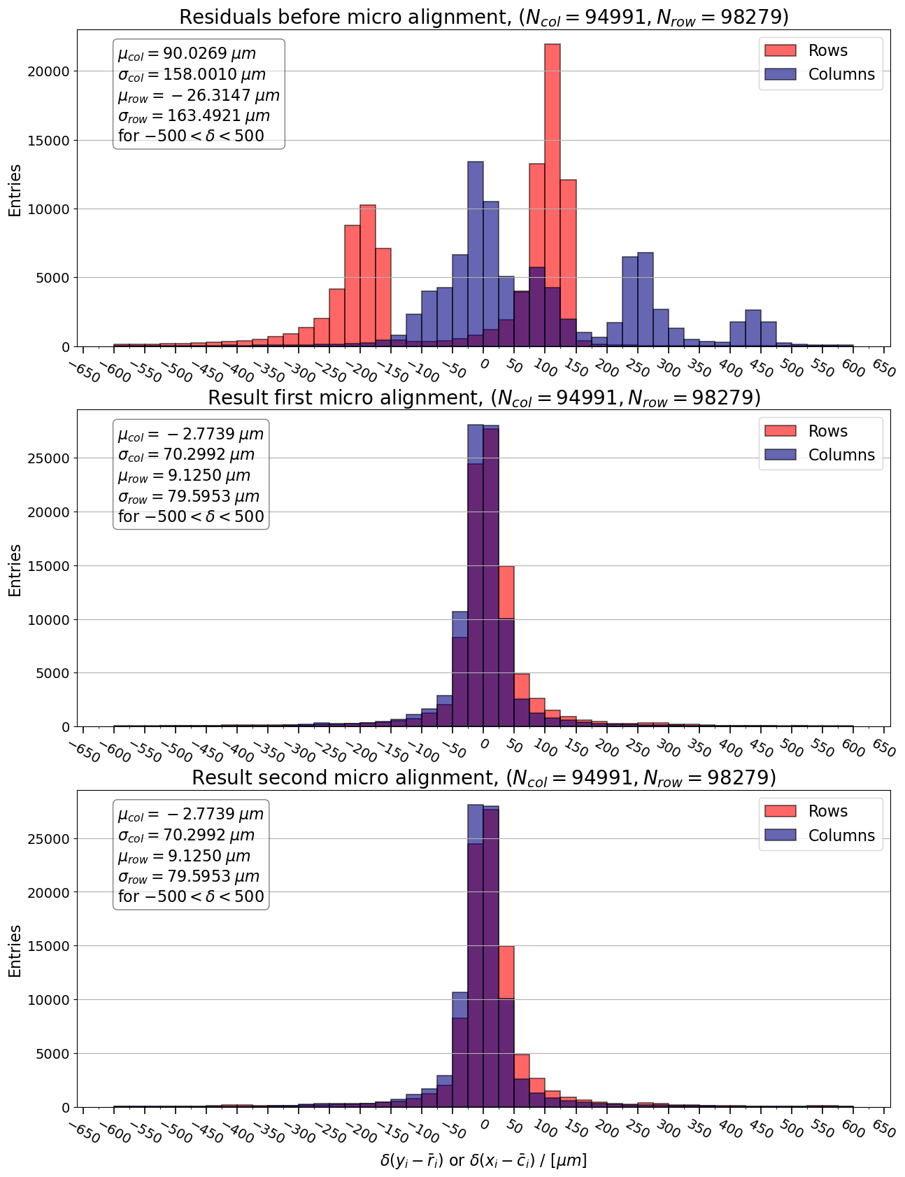
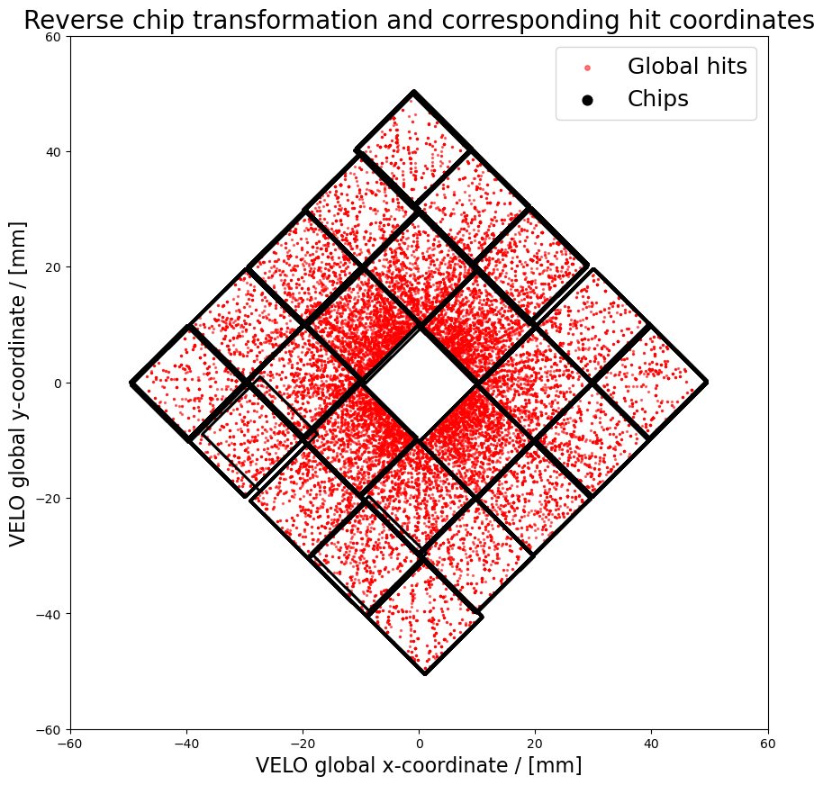
Microalignment
The error is plotted between the centre of the column/row $x_{i}$, $y_{i}$ and the average of hits in that column/row $\overline{c_{i}}$, $\overline{r_{i}}$

Slide 8
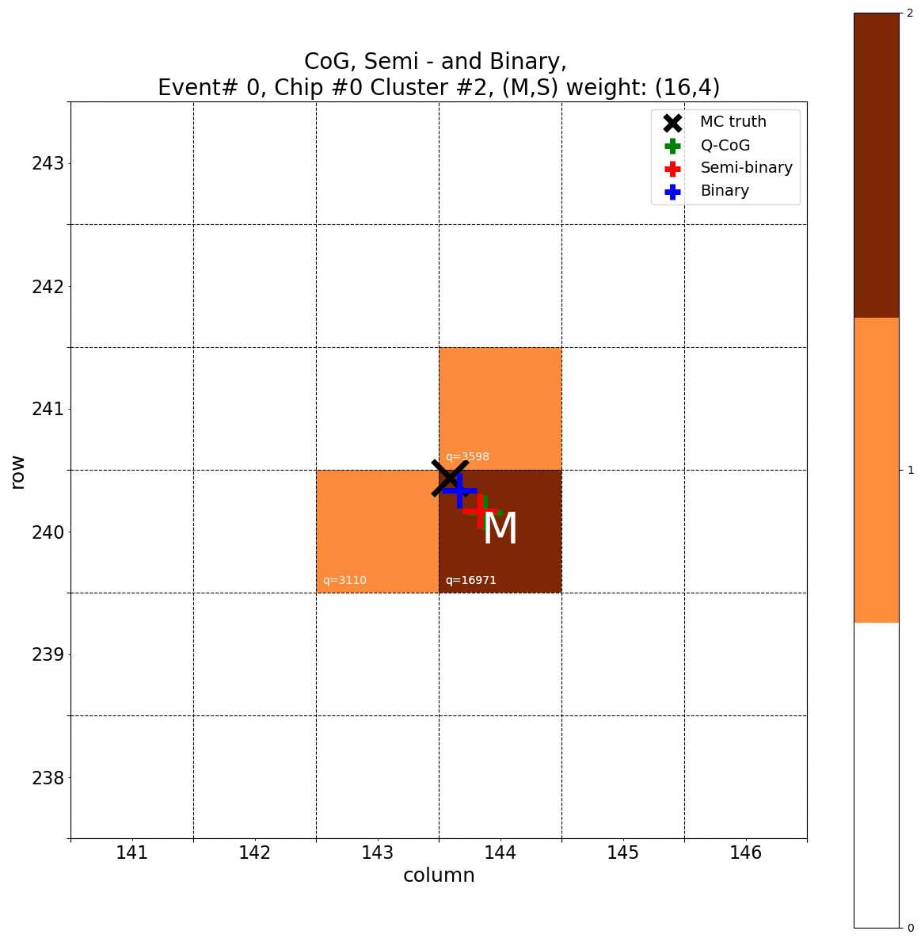
Clustering interpolation
Three methods tested:
Charge weighted center of gravity (CoG)
Binary Every pixel in cluster has equal weight
Semi-binary Pixel with highest collected charge is Main pixel (M), others are Spectators (S). Different ratio’s (M/S) tested.

Slide 9
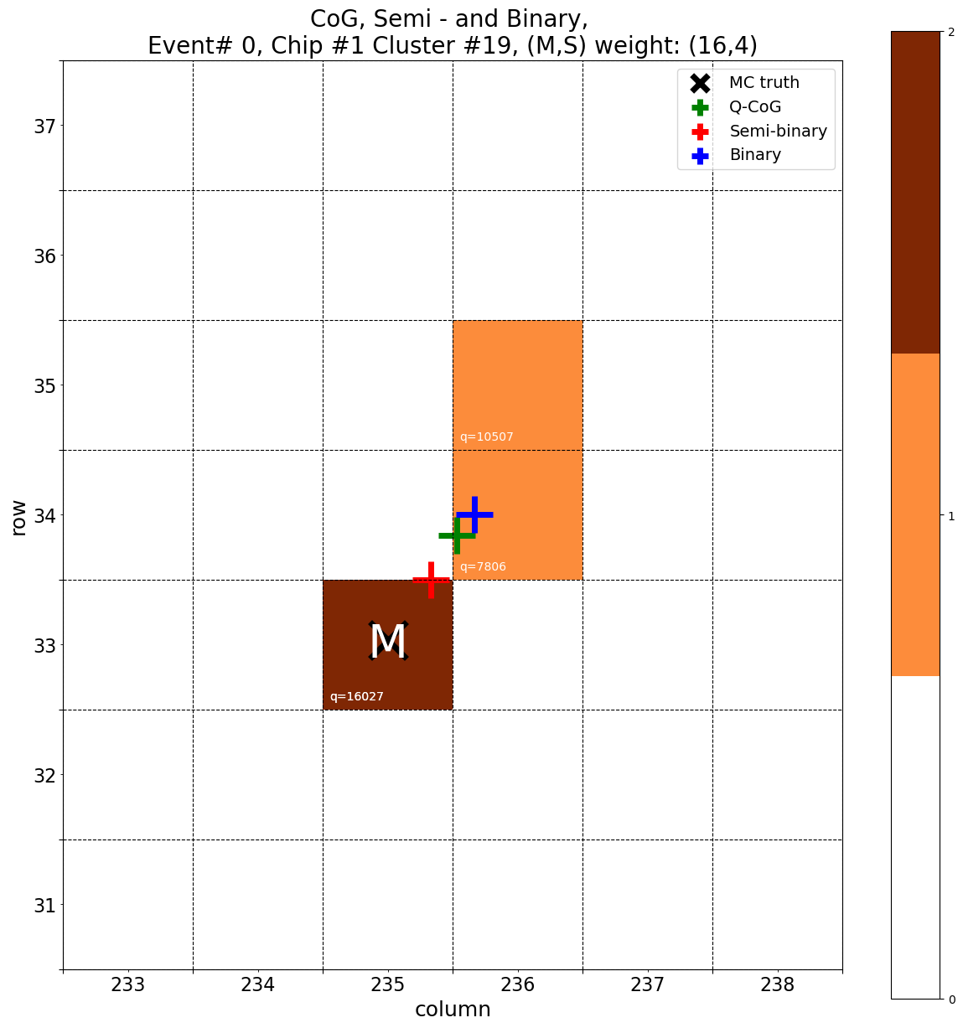
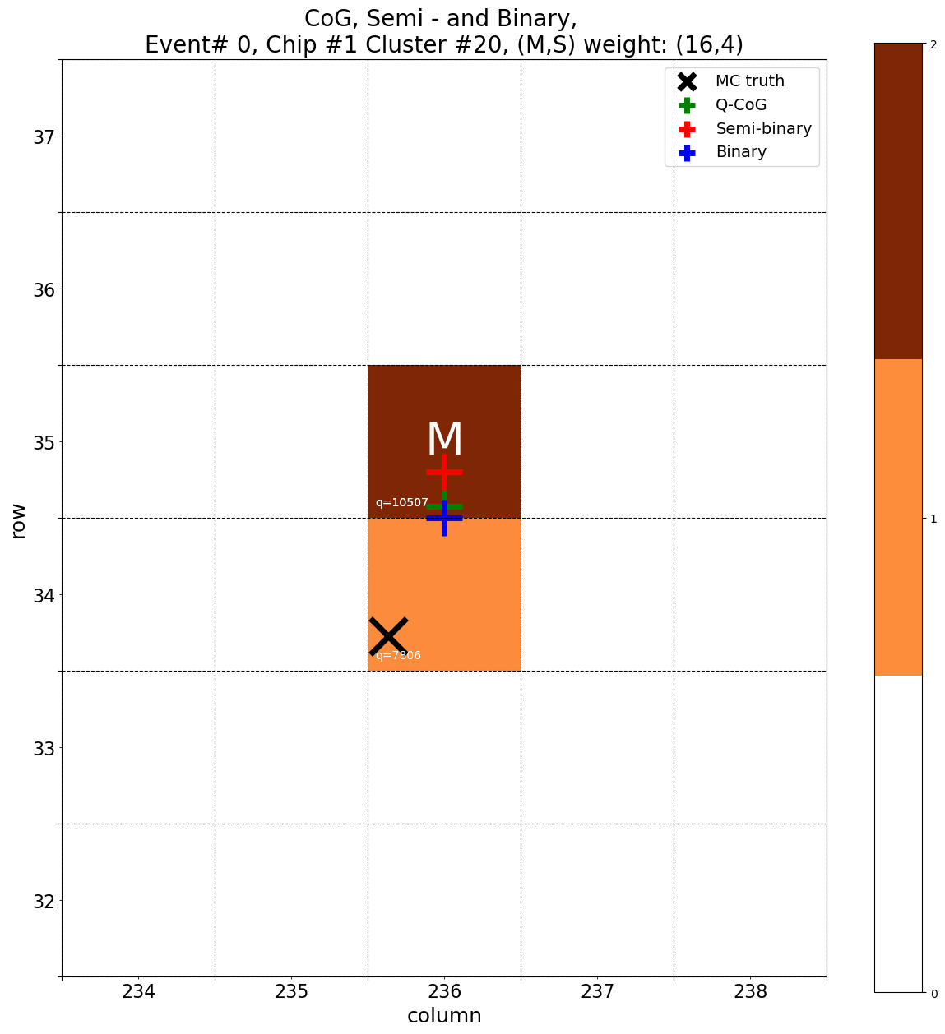
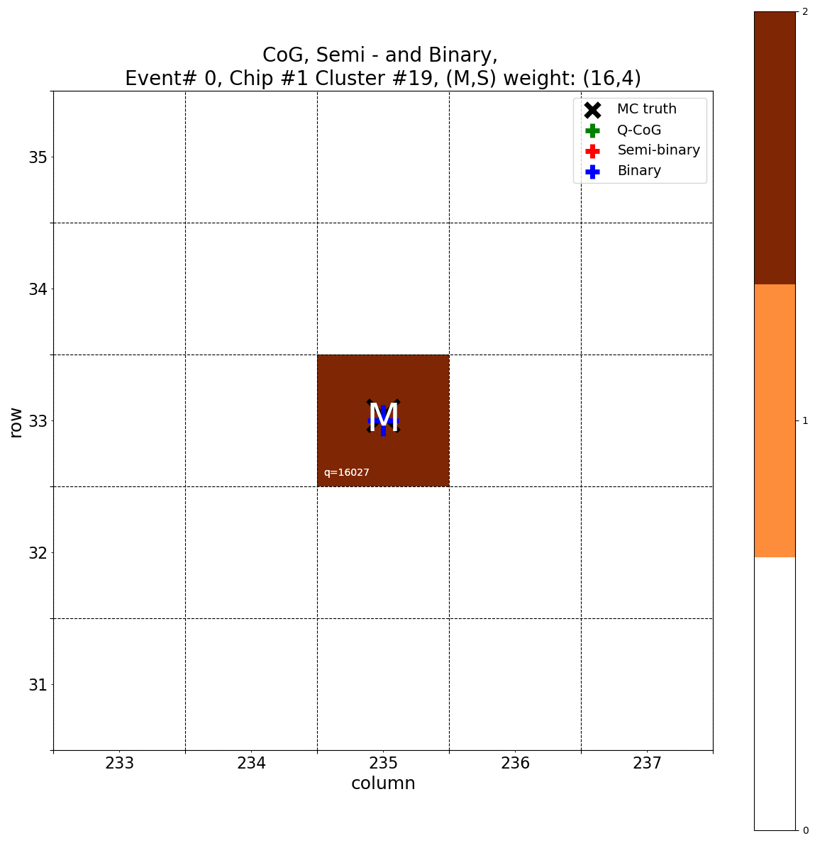
Clustering interpolation
Low statistic: 10 PV events, $𝒪$(200,000) hits
First pixels are clustered by neighbourhood approximation
Later simulation truth information used

Slide 10
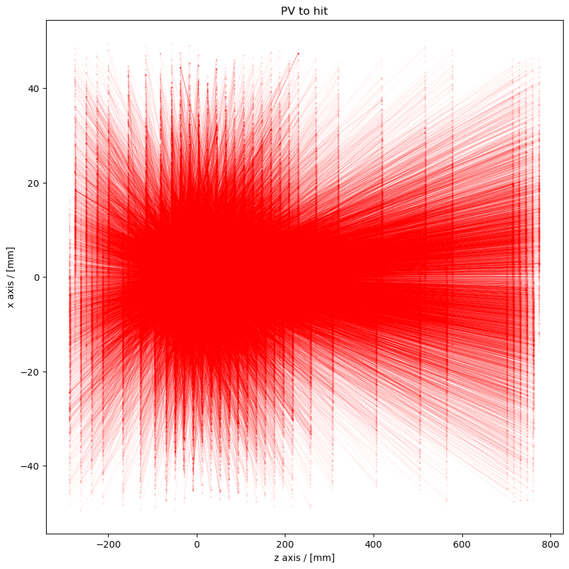
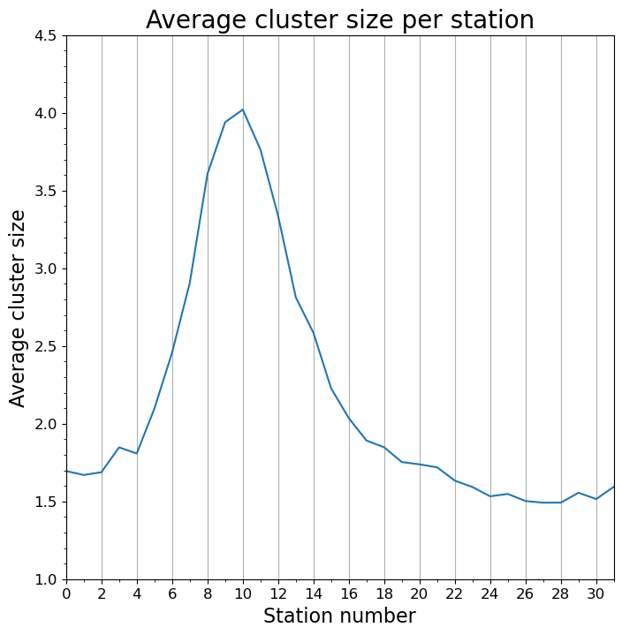
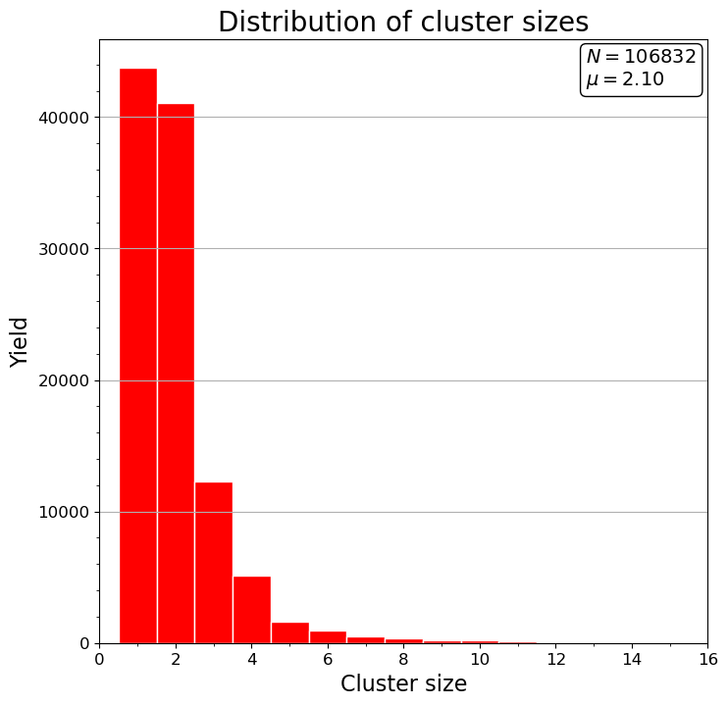
Results
All results are work in progress. Additional checks are still being made.

Slide 11
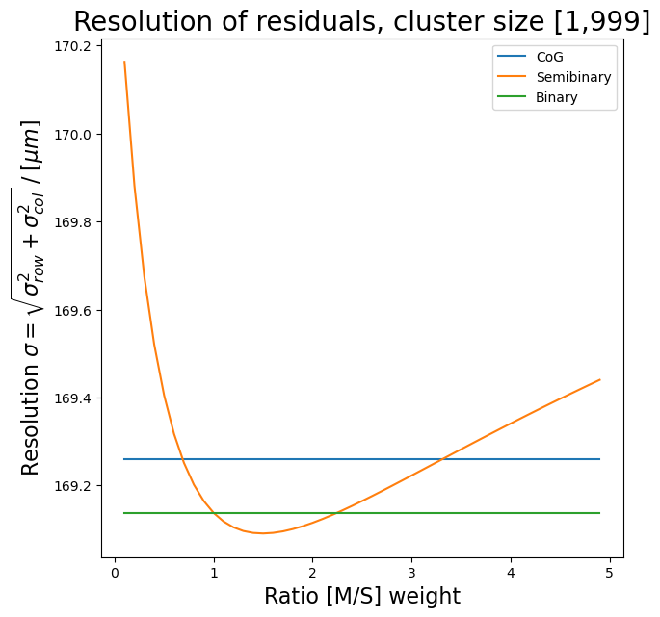
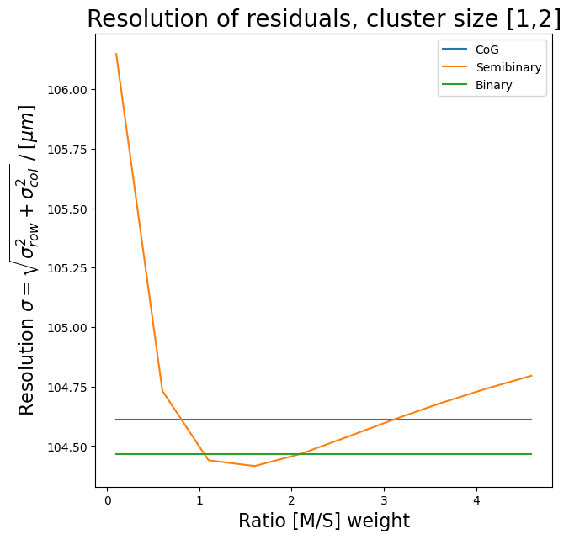
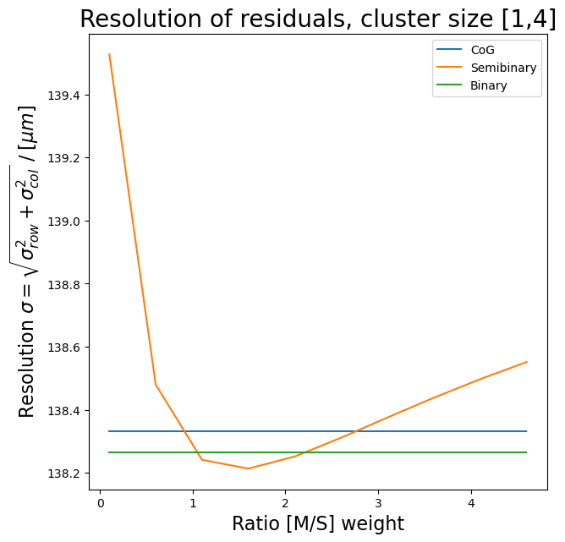
Results
Some residuals are of order ~ 2000um
Caused either by the alignment or huge clusters
Different (M/S) ratio’s tested:
For different cluster size’s

Slide 12
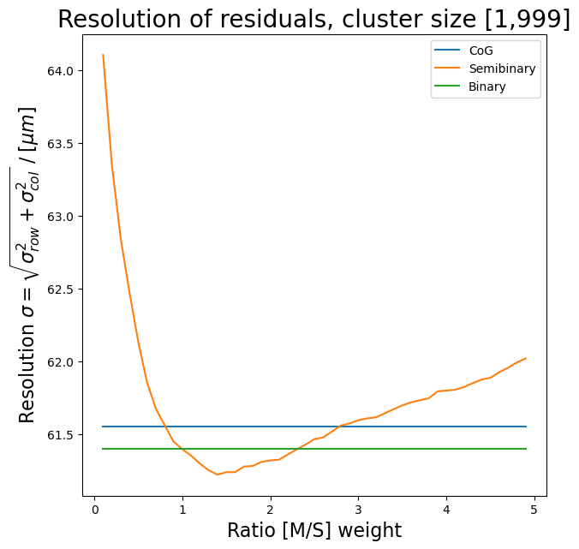
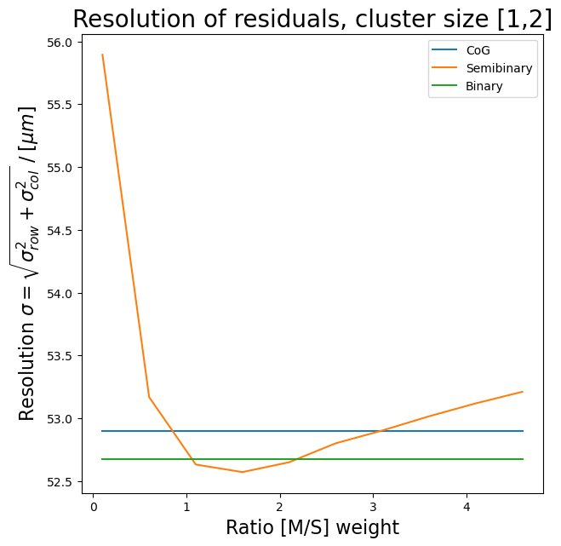
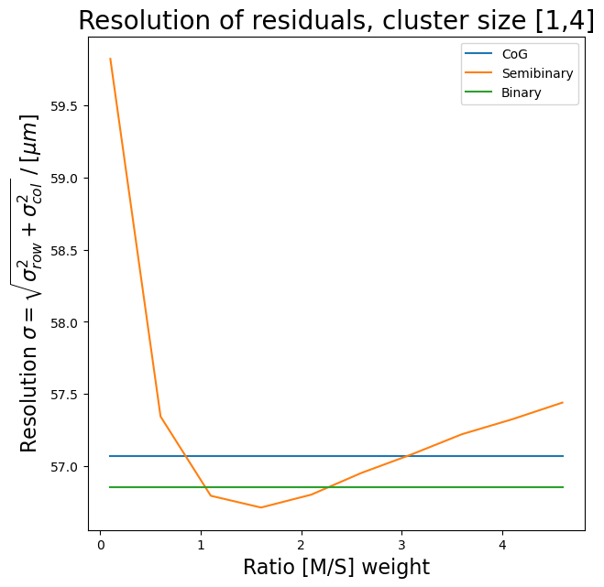
Results
If |residuals| > 300 um filtered out:
Filtering out unphysical results shows better resolution

Slide 13
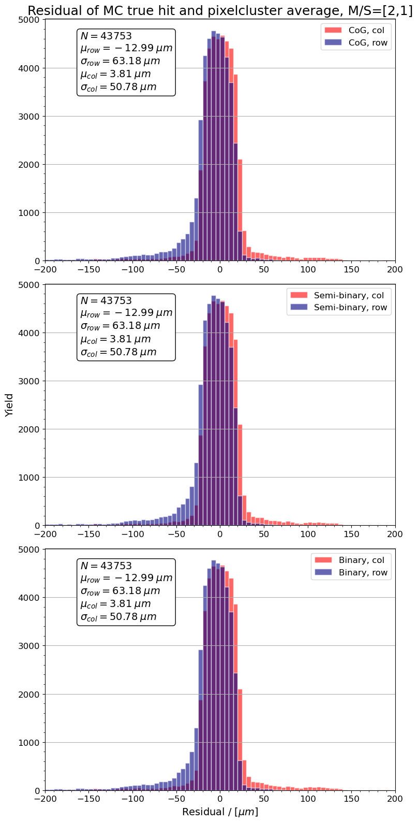
Results
|res|>200um filtered
Sanity check
Local residuals, single pixel clusters unfiltered

Slide 14
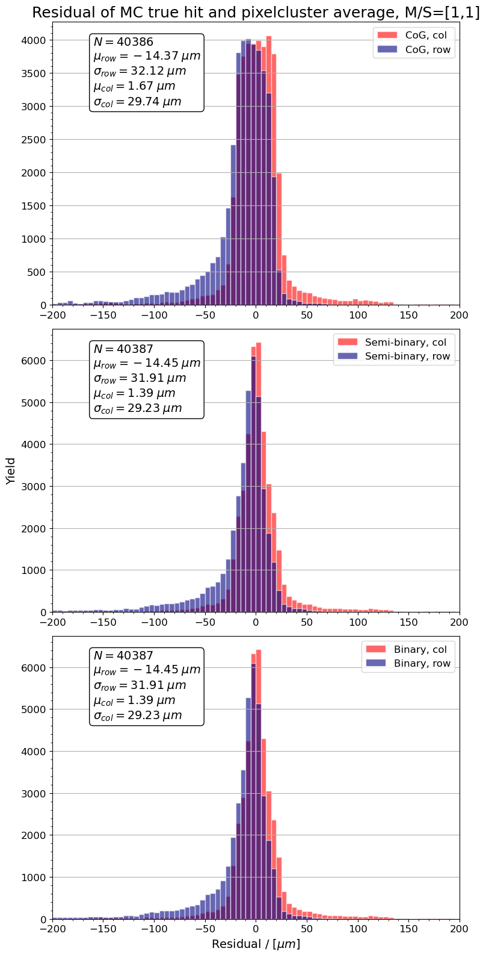
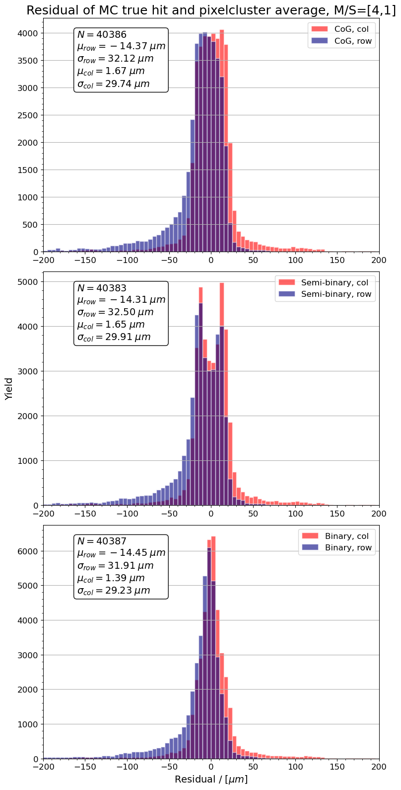
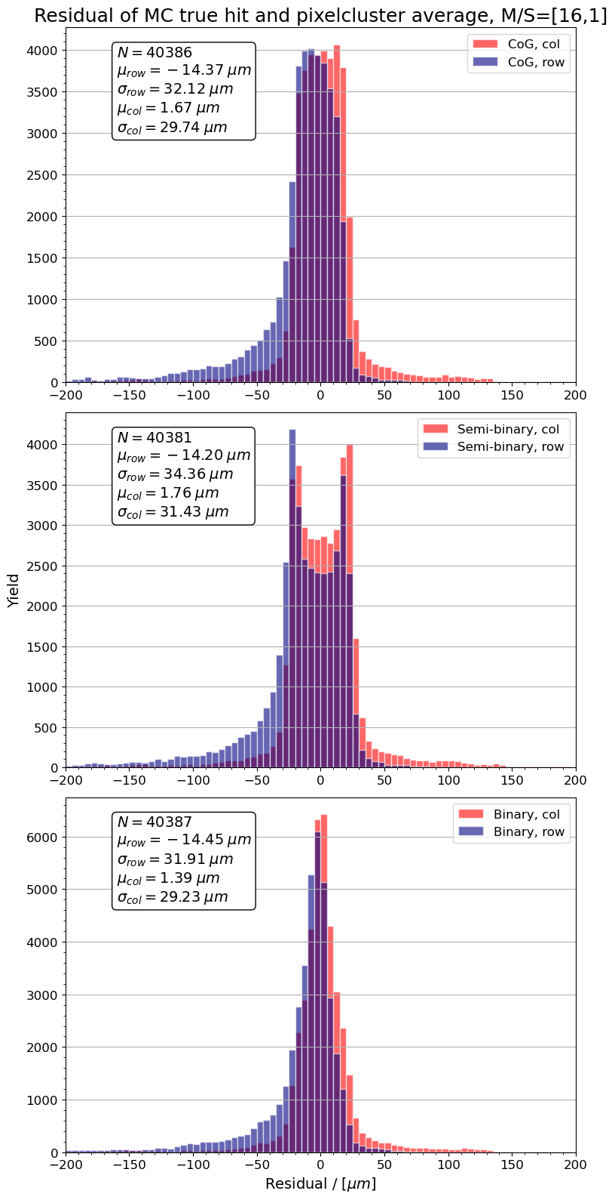
Results
Local residuals, double pixel clusters |res|>200um filtered

Slide 15
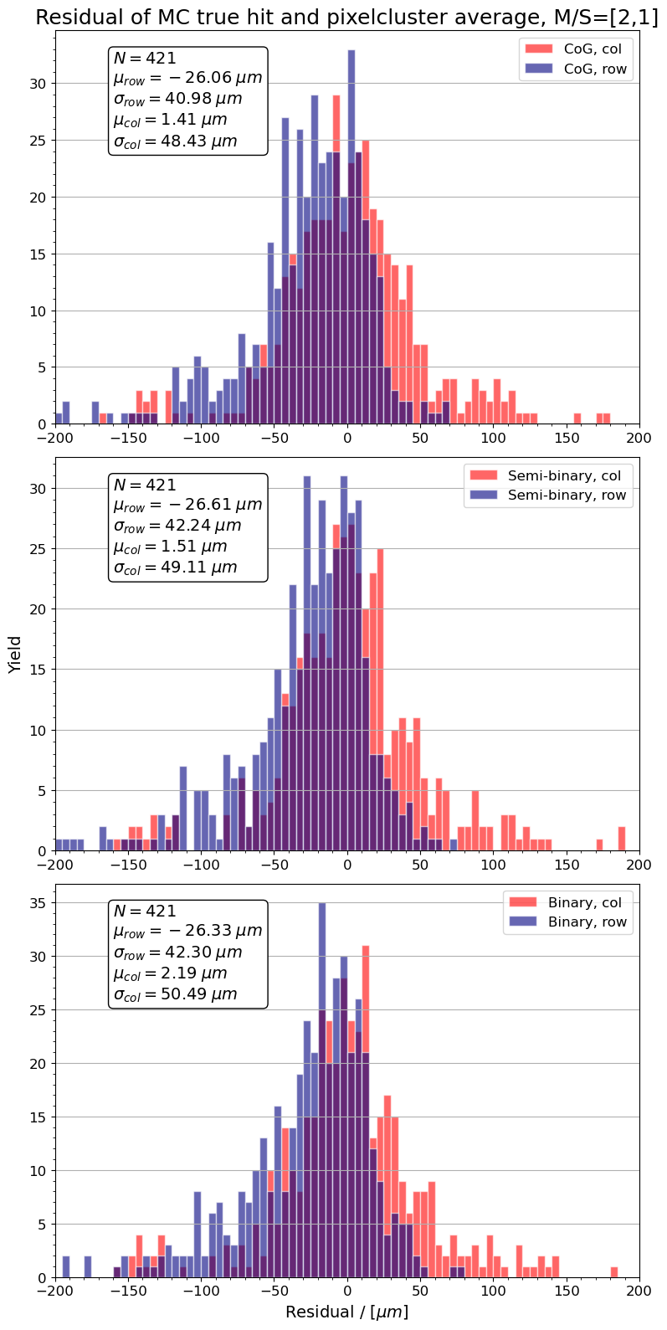
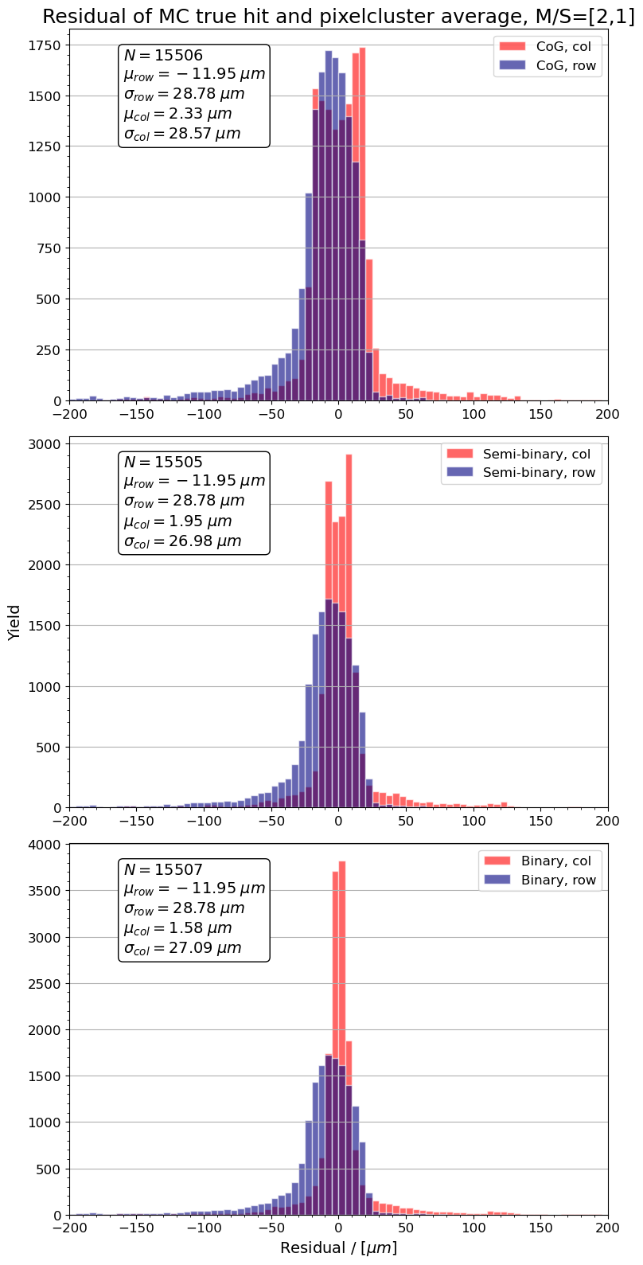
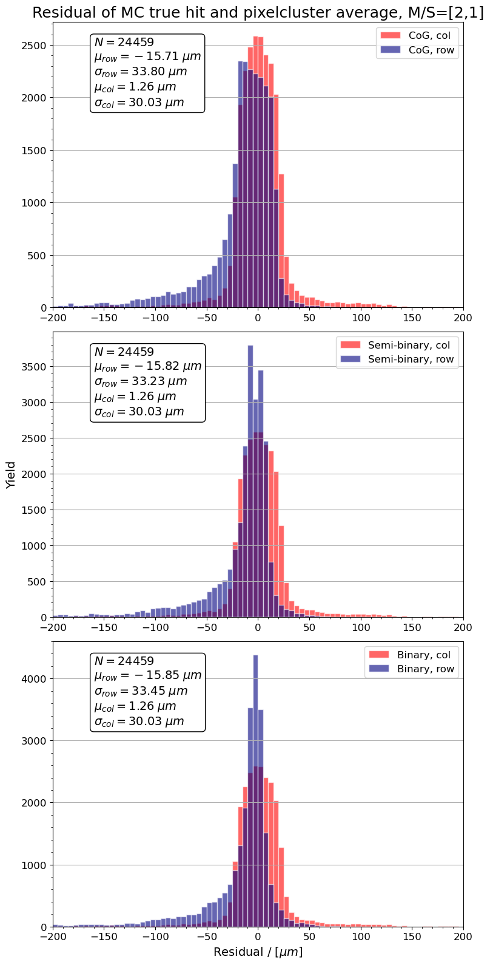
Results
Local residuals, two pixel clusters

Slide 16
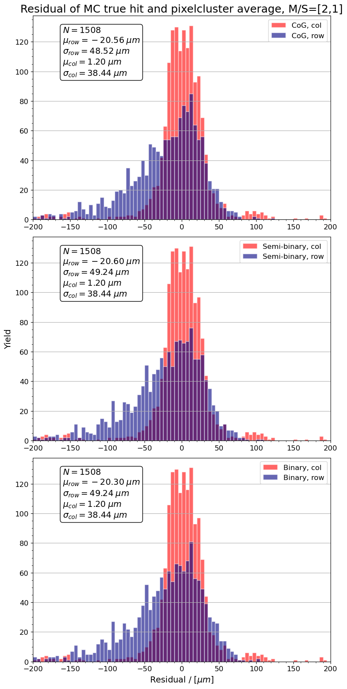
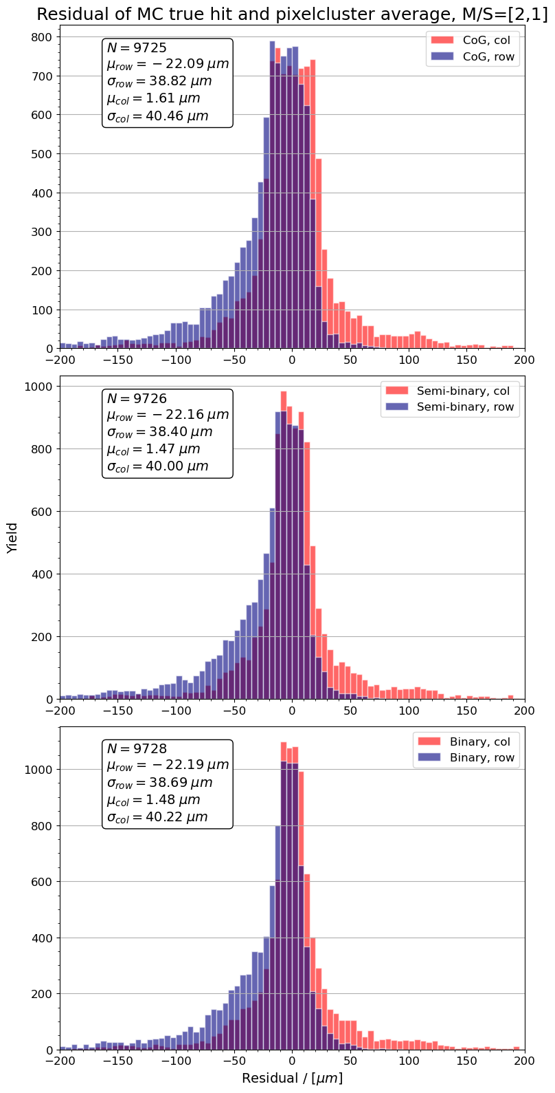
Results
3 pixel hits, within 1x3
Local residuals, 3 pixel hits, within 2x2

Slide 17
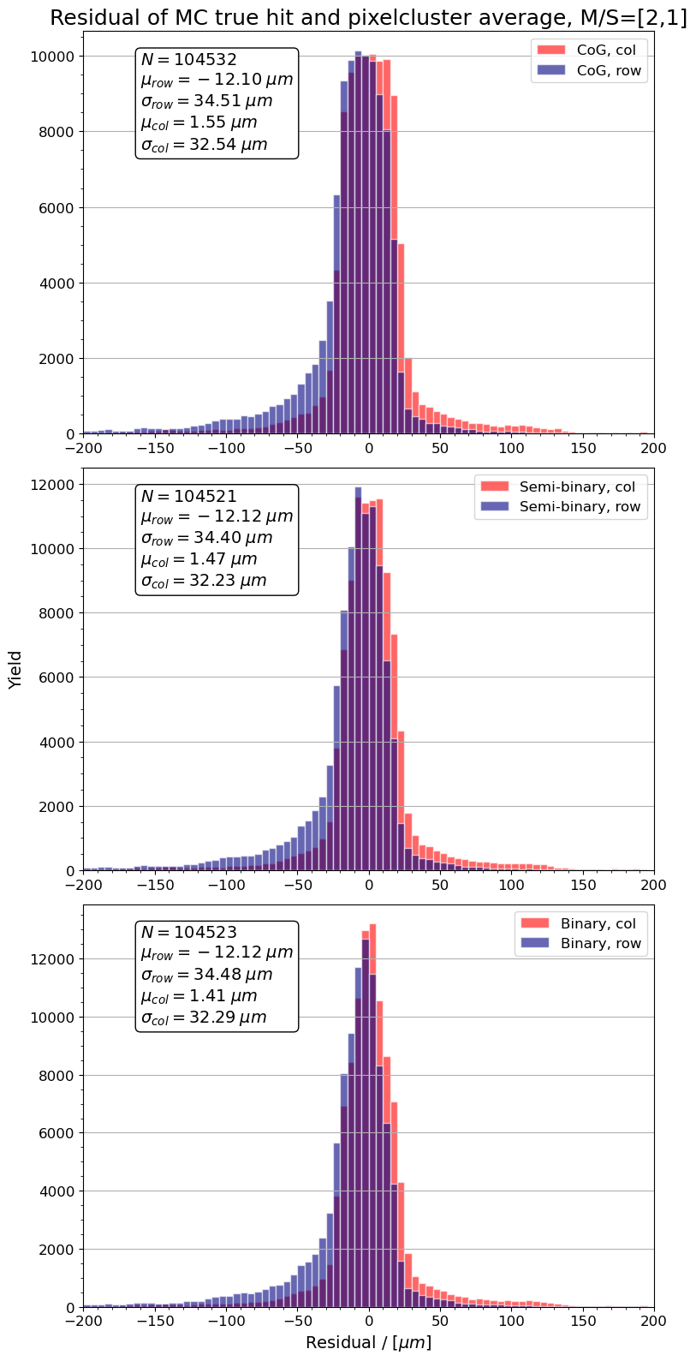
Results
Local residuals, all clusters
|residual| > 200 um filtered out

Slide 18
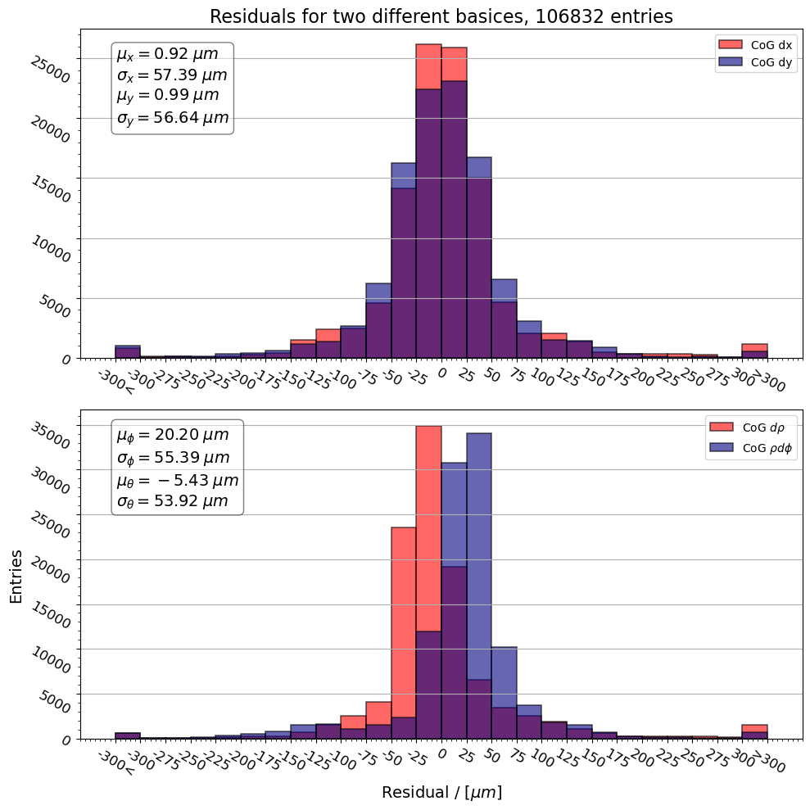
Results
Also angular residuals are considered: $(rdθ,rdφ)$
Residuals calculated as projections on the chip:
$rdθ$ is approximated as $dρ$
$rdφ$ is approximated as $ρdφ$
where $r$ is the global radius and $ρ$ is the radius in XY-plane
However the global coordinates are used for these residuals, see slide 9.

Slide 19
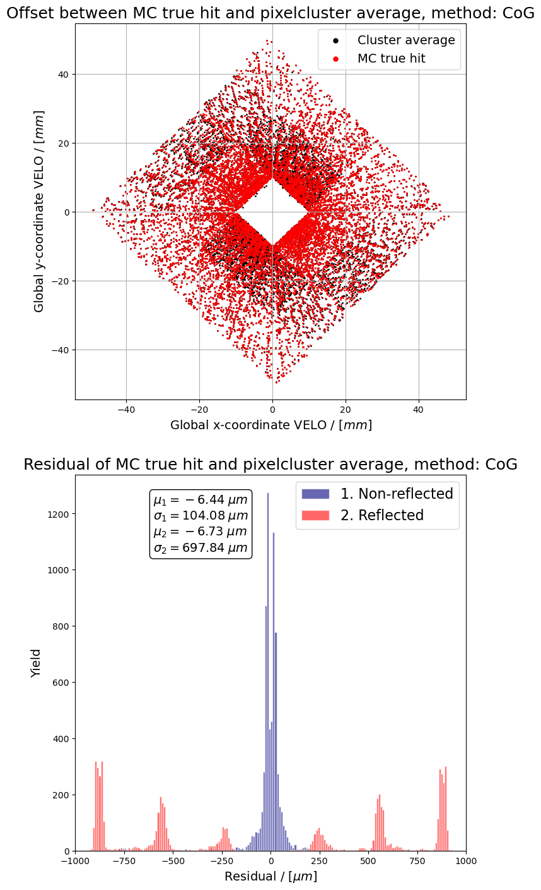
Caveats
Apart from the micro alignment, additional systematic deviation found in simulation. Cause unknown.
Chip 0 (mod24): [dx,dy] = [+0.1, 0]
Chip 1 (mod24): [dx,dy] = [+0.25, 0]
Chip 2 (mod24): [dx,dy] = [+0.40, 0]
Chip 11 (mod24): [dx,dy] = [0, -0.27]
Chip 12 (mod24): [dx,dy] = [-0.1, 0]
Chip 13 (mod24): [dx,dy] = [-0.25, 0]
Chip 14 (mod24): [dx,dy] = [-0.40, 0]
Chip 23 (mod24): [dx,dy] = [0, +0.27]

Slide 20
Caveats
Apart from the micro alignment, additional systematic deviation found in simulation. Cause unknown.
These results depend on the way pixel hits are and charge sharing is simulated.

Slide 21
Caveats
Apart from the micro alignment, additional systematic deviation found in simulation. Cause unknown.
These results depend on the way pixel hits and charge sharing are/is simulated.
Clear indication that some code needs to run online
Online C++
algorithm
in Gaudi
Offline Python
analysis code
in Jupyter

Slide 22
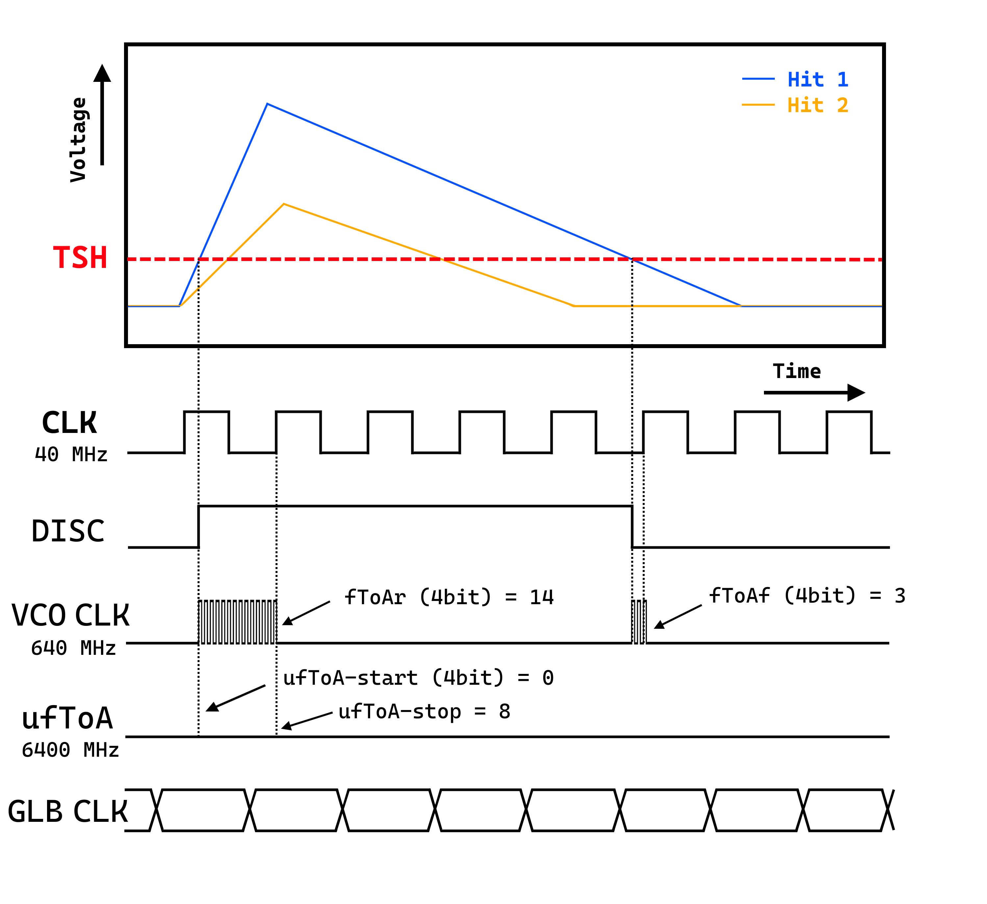
Outlook
Implement detailed timing in simulation → time-weighted clustering
Investigating impact of digitization (bit allocation), e.g. in LHCb simulation and/or Allpix2
Can timing information improve spatial resolution, or vice versa?

Slide 23
Outlook
Hit
Cluster
Track
Track reconstruction information can be fed back to cluster calculation to improve resolution
Develop firmware to test algorithms during test beam

Slide 24
Thank you for your time and attention

Slide 25
BACK UP

Slide 26
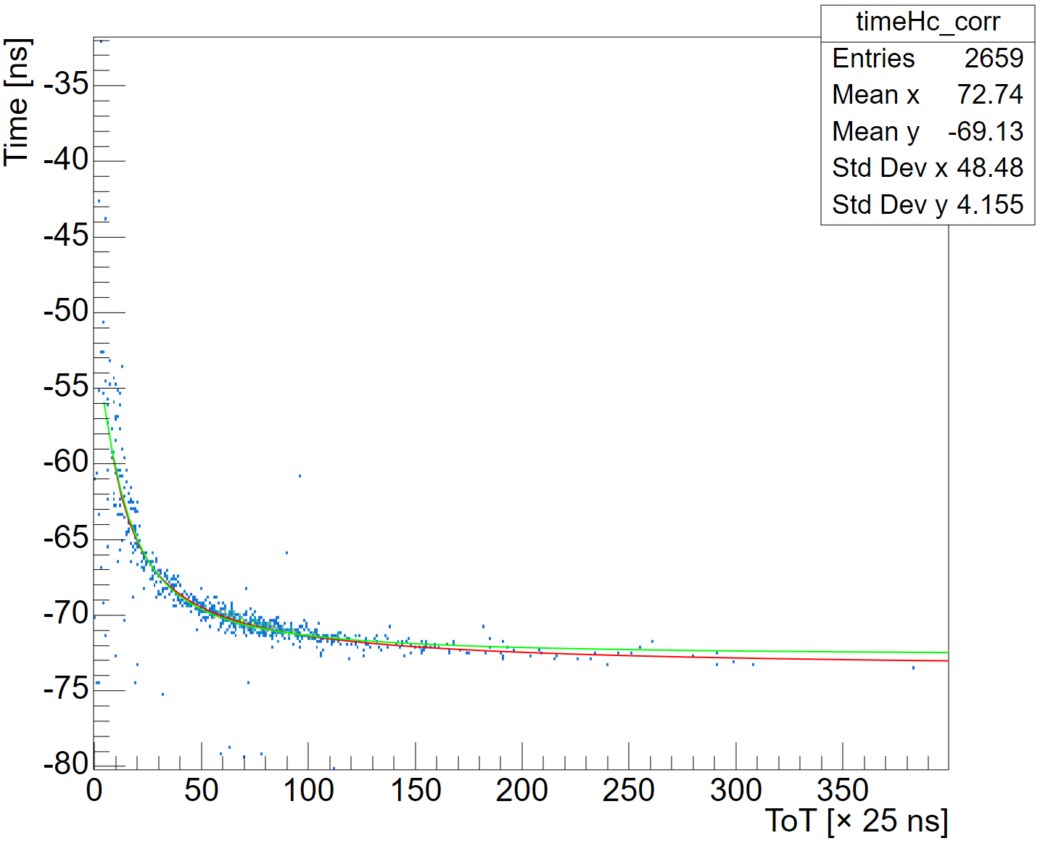
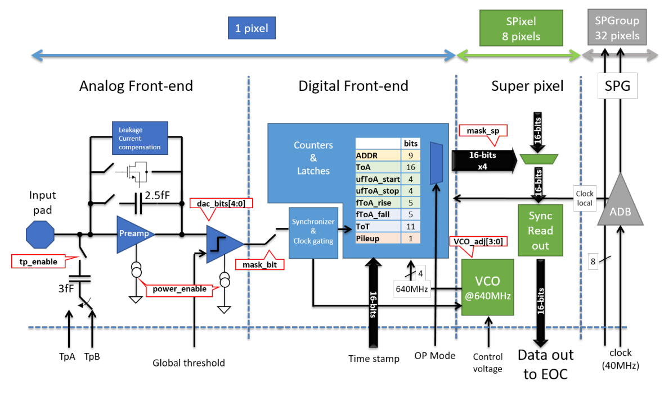
Timing and Timepix
$${∆t}_{tw}=\frac{b}{{({∆T}_{ToT}+c)}^{d}}+a$$
Courtesy: E. Rodríguez²

Slide 27
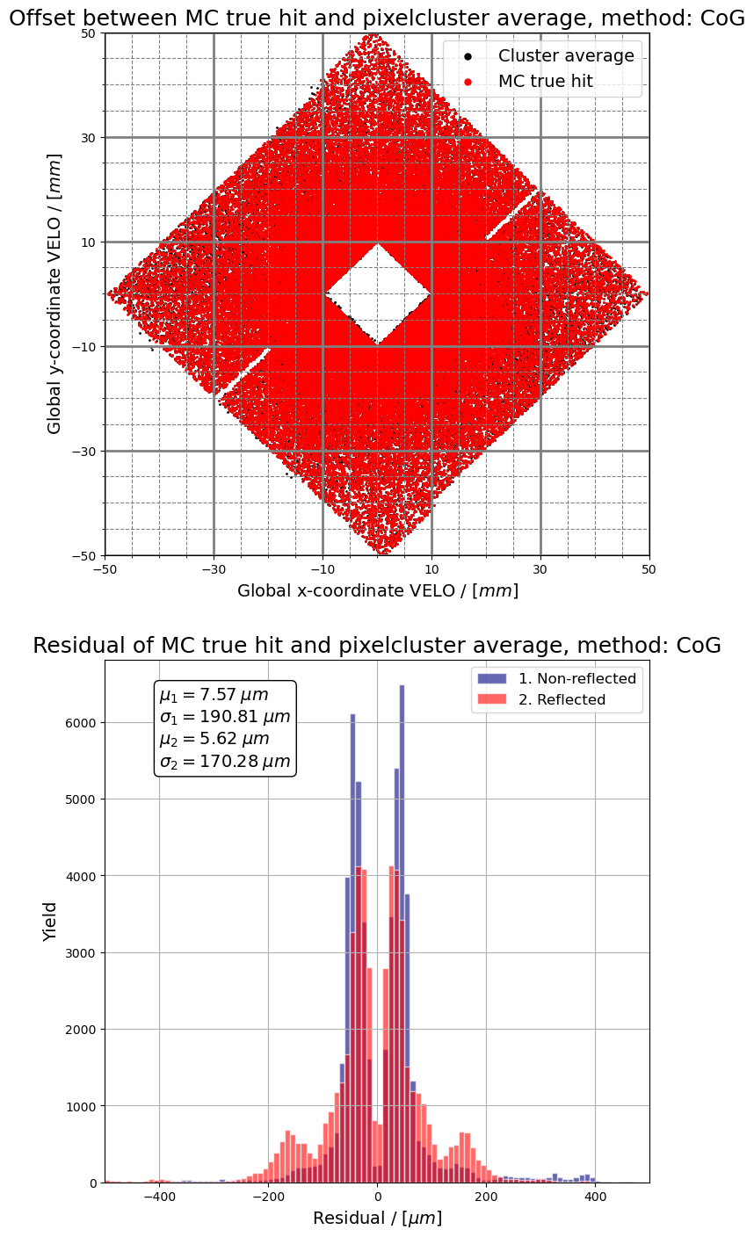
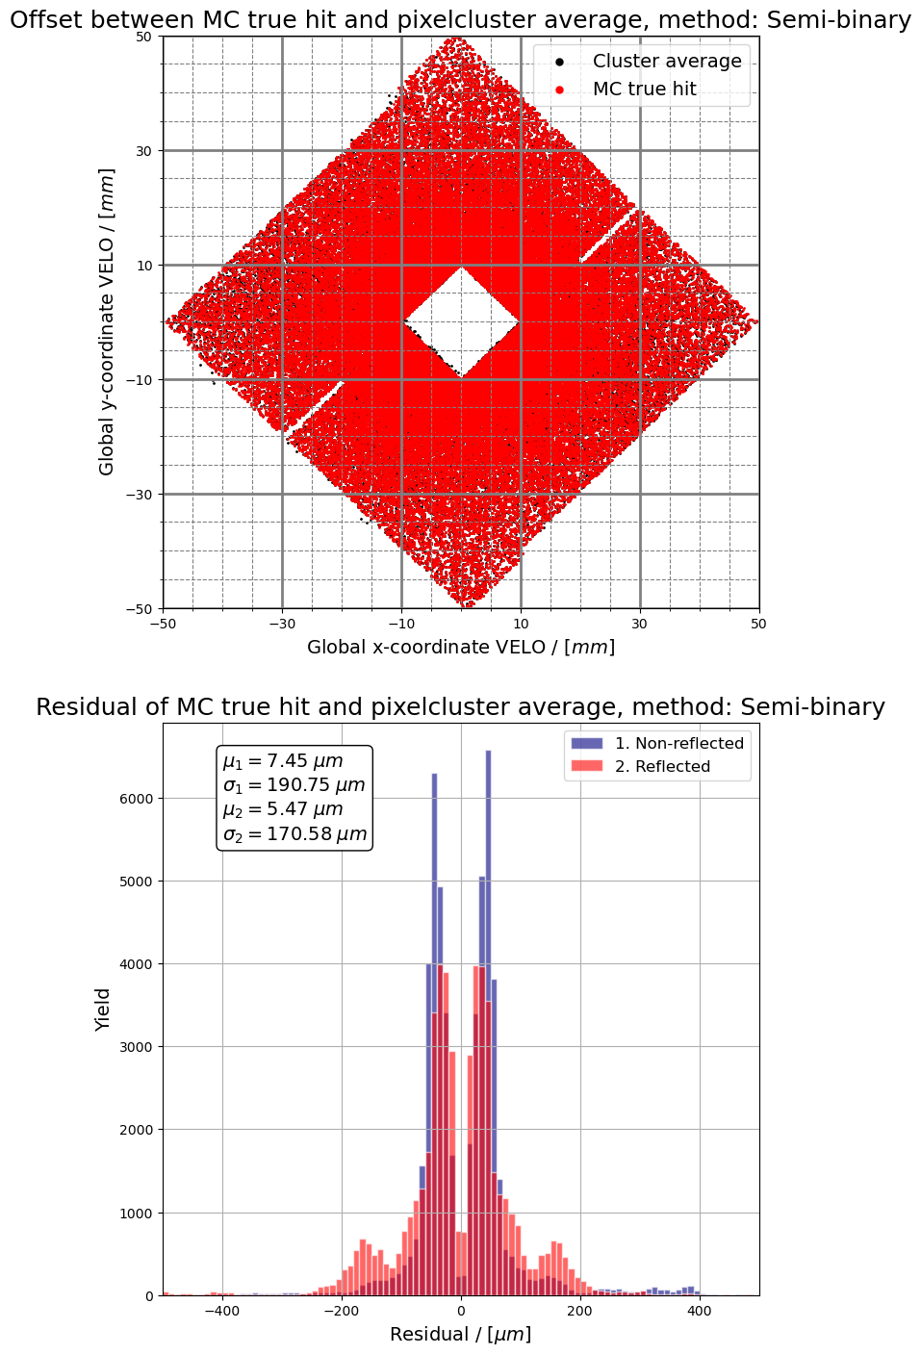
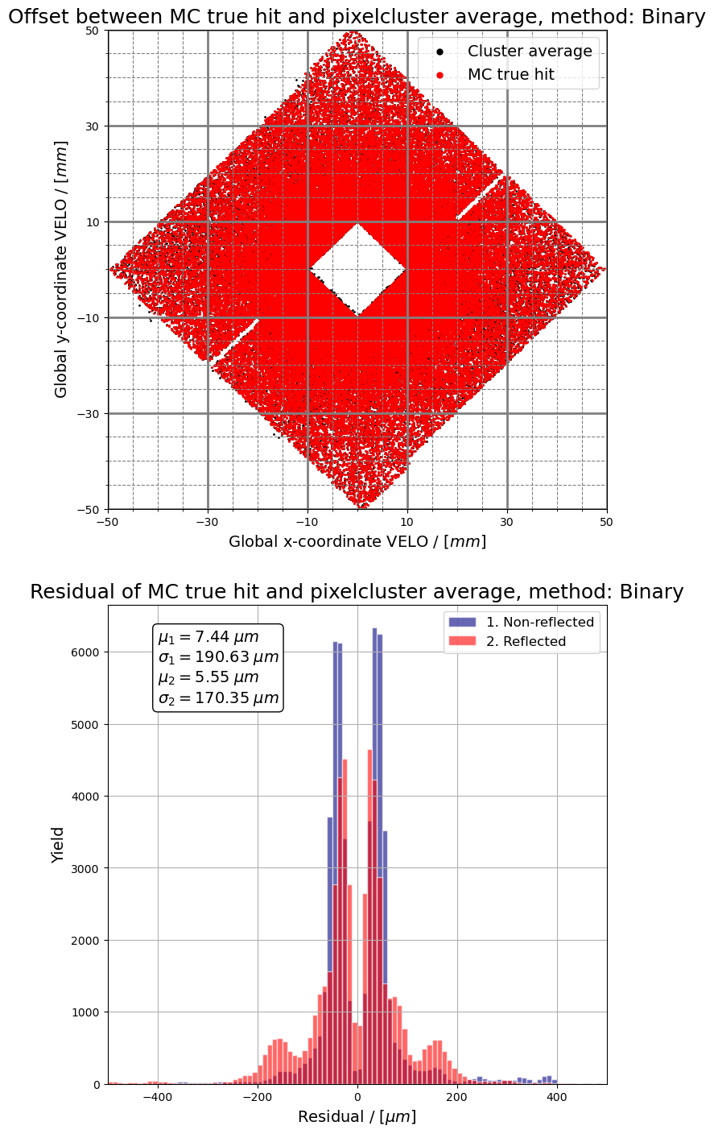
Global Coordinates

Slide 28
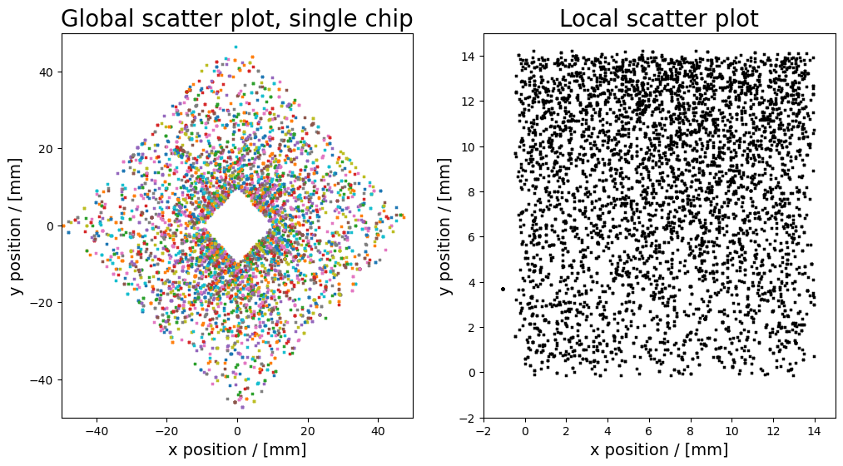
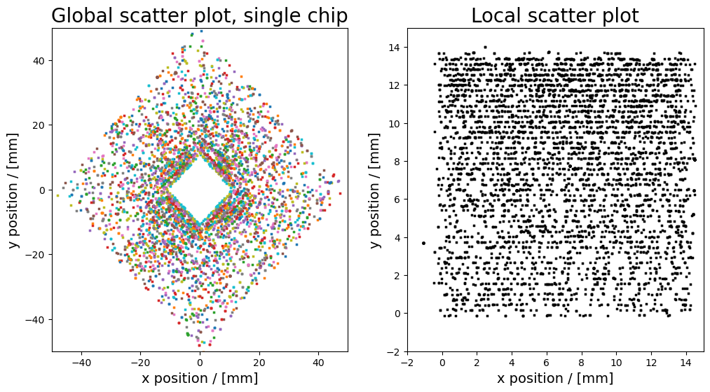
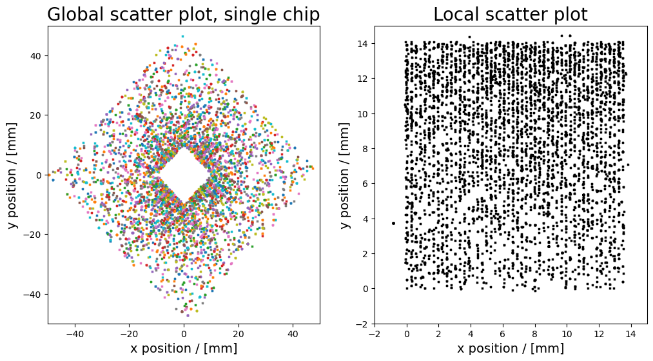
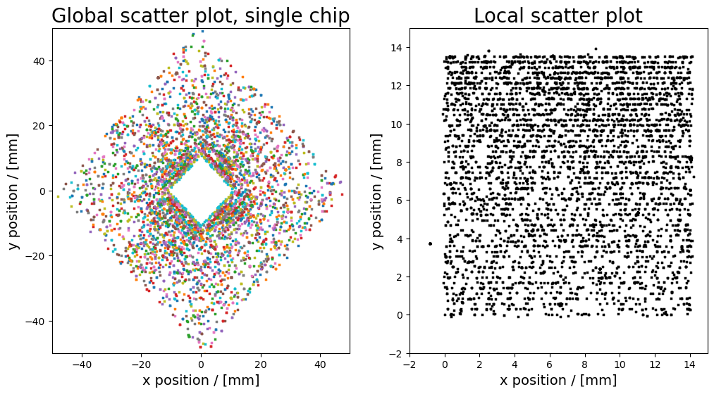
Micro alignment
every 5th row/column plotted
Before
After

Slide 29
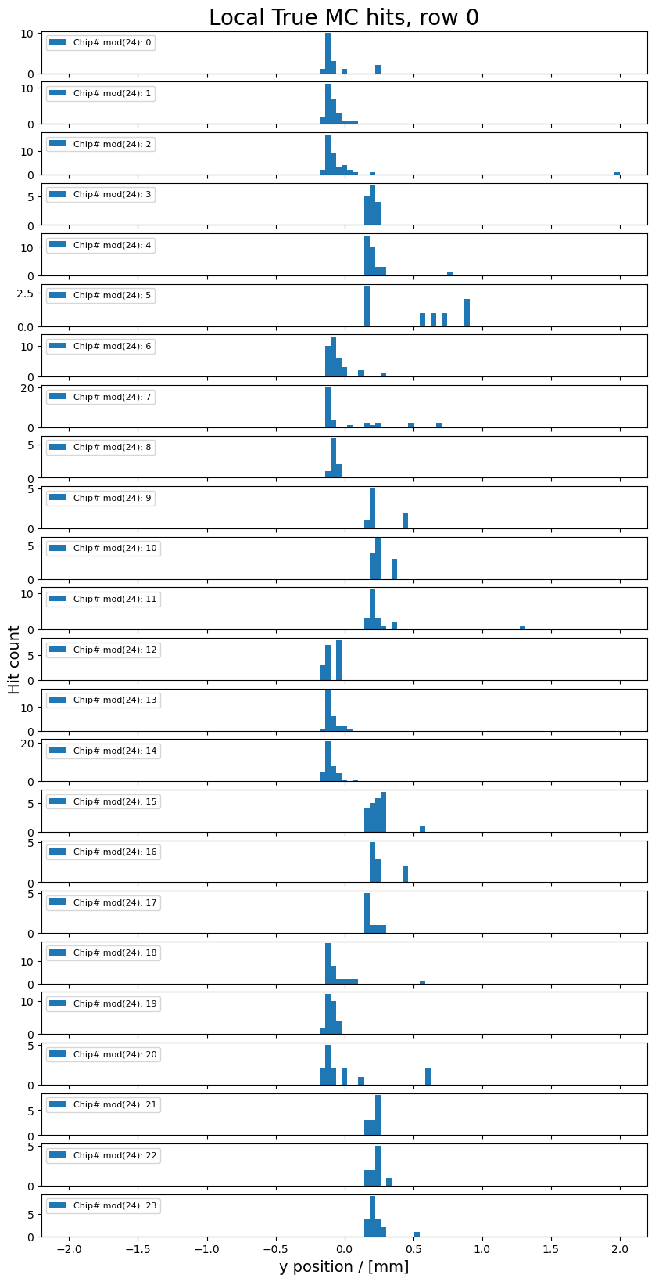
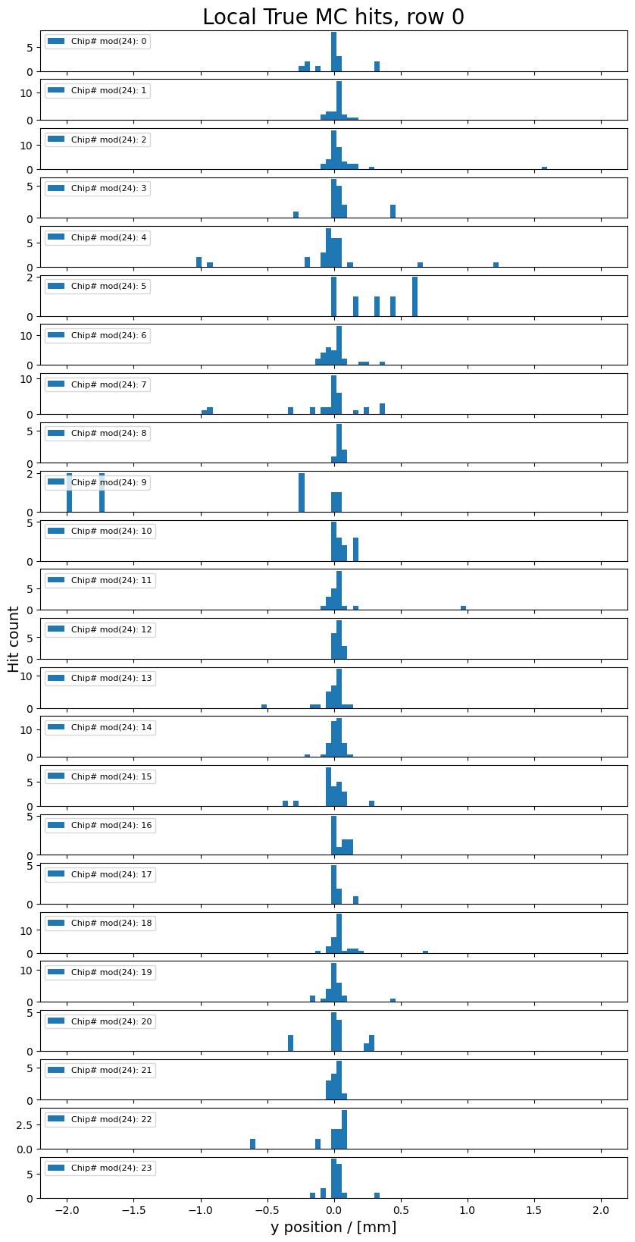
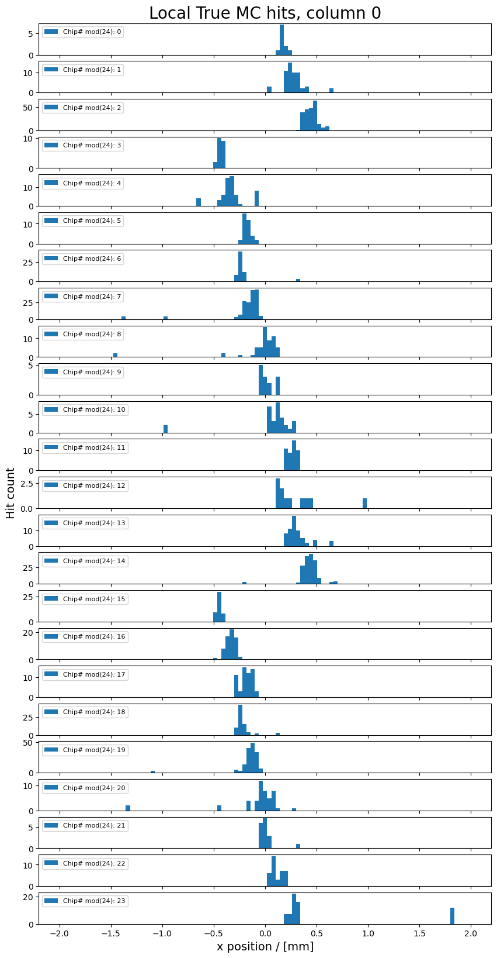
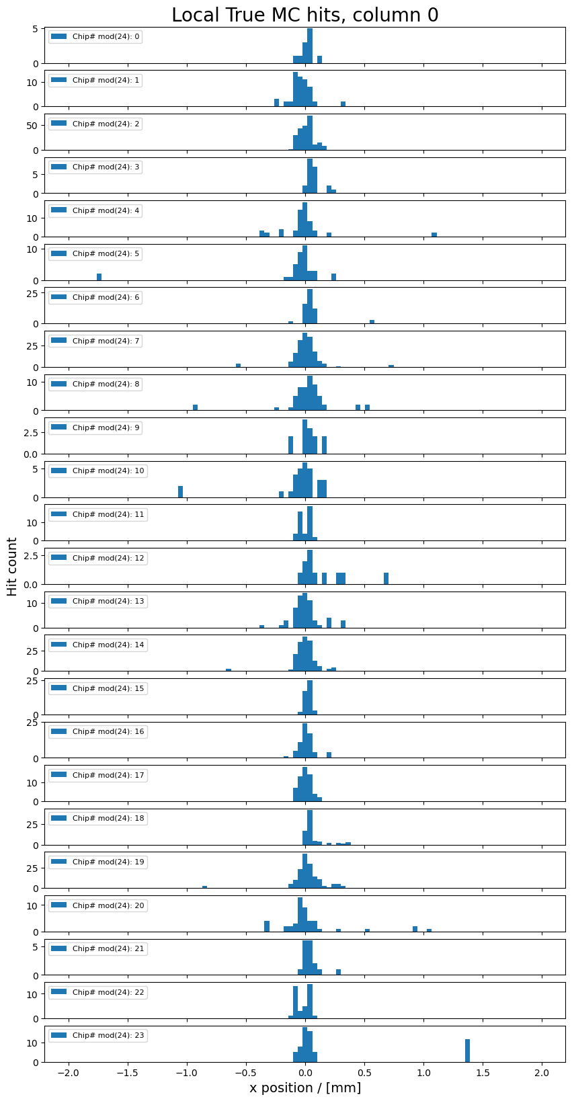
Micro alignment
Before After
Before After

Slide 30
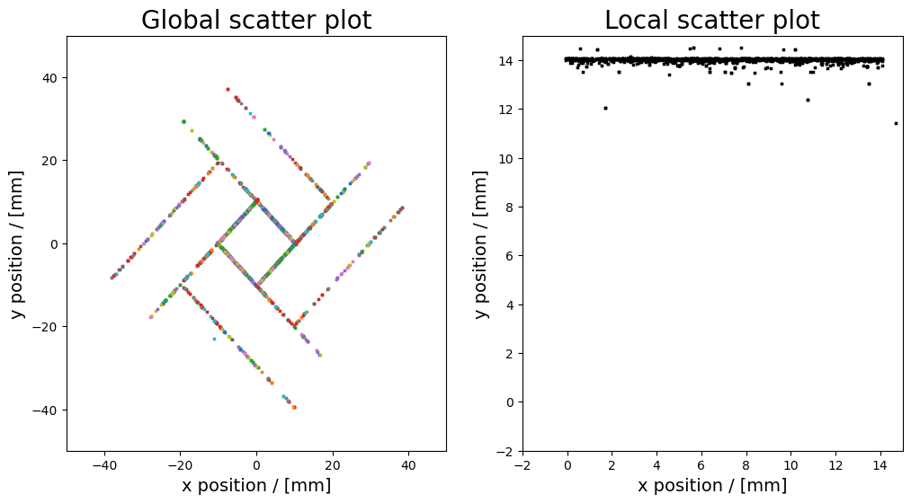
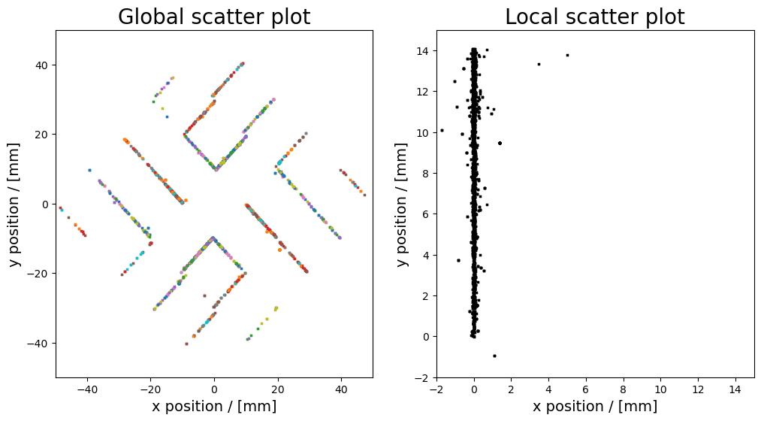
Micro alignment
255th row
0th column

