Slide 1







Nikhef detector R&D for future e⁺e⁻ colliders
2001 Involved in the Tesla electron-positron collider project at DESY and the symposium
2002 Start of R&D on GridPix detectors since the first working prototype detector made by Harry van de Graaf, Jan Timmermans et al. GridPix = Gaseous detector with grid and silicon readout chip.
2002-2024 Gradual development of the GridPix detector for a Pixel TPC with 6 theses and an EUDET grant (2004-2008) by Alessandro Forniani (2005), Max Chefdeville (2009), Martin Fransen (2012), Spiros Tsigaridas (2017), Cornelis Ligtenberg (2021)

Slide 2
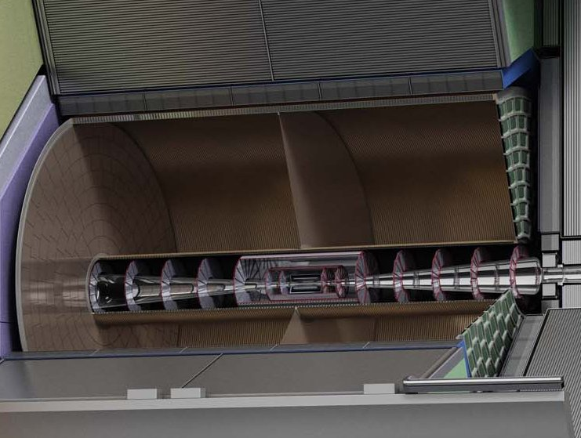
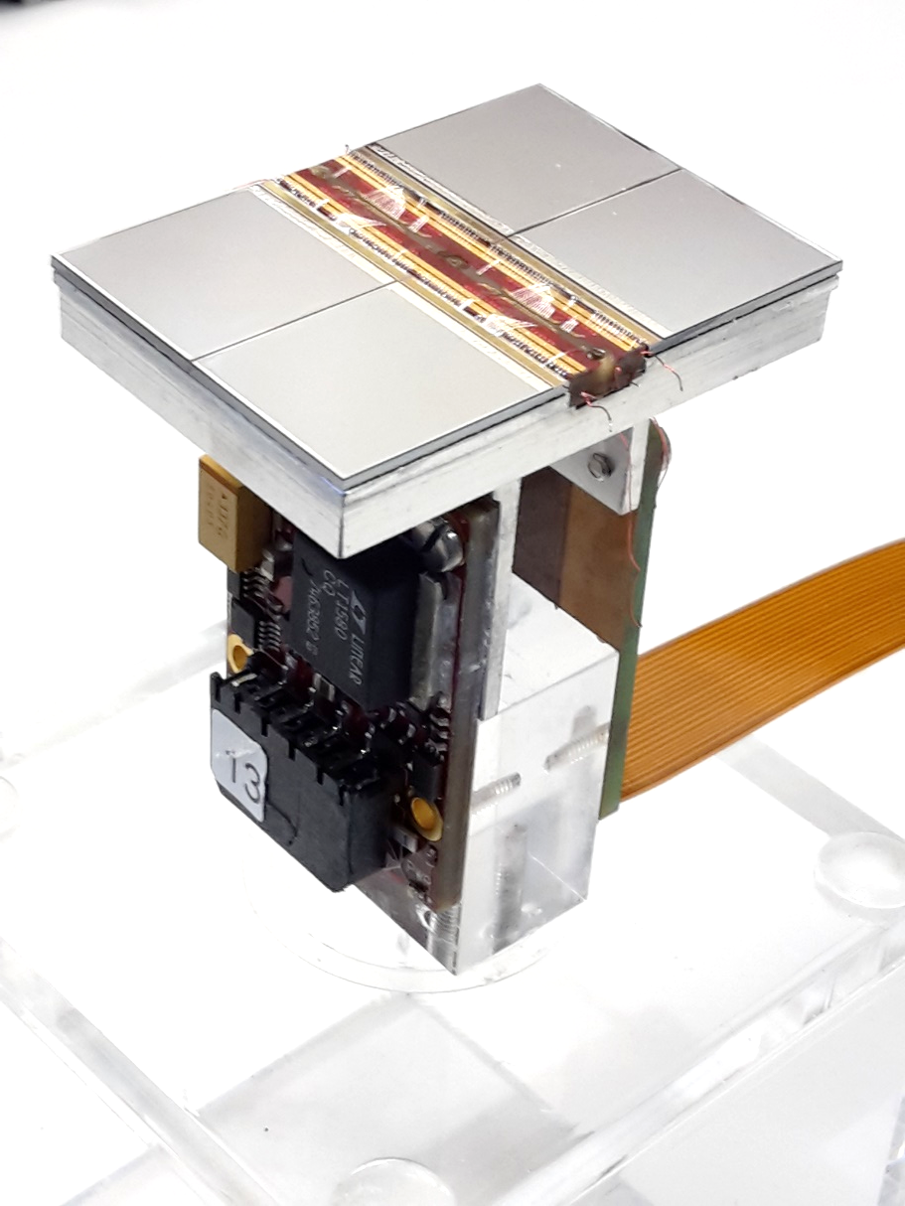
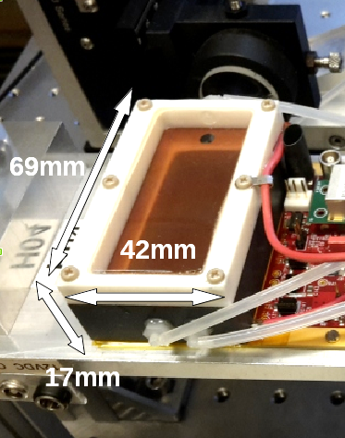
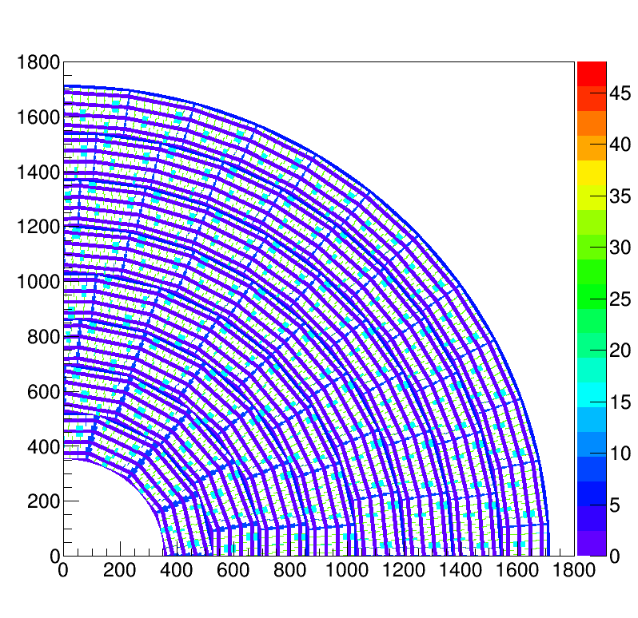
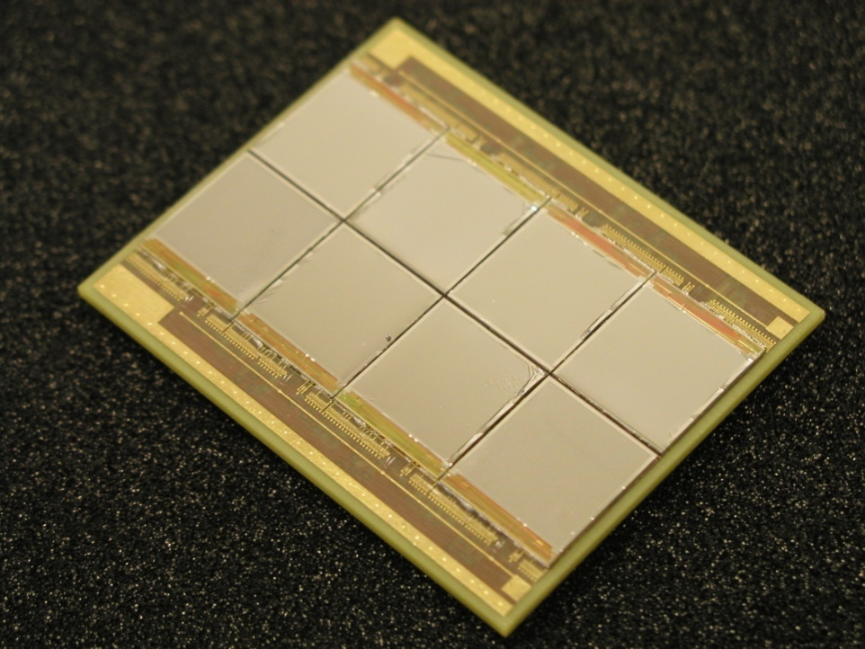
Pixel TPC
(Octopuce)
(TimePix1) TPX3 chip Quad Module TPC plane
(2007-14) 2017 2018 2019

Slide 3
Pixel TPC
Material budget is
  0.01 X₀ TPC gas
  0.01 X₀ inner cylinder
  0.03 X₀ outer cylinder
  < 0.25 X₀ endplates (incl readout)
Note the very low budget in the barrel region. Material budget can be respected by different technologies like GEM, MicroMegas and Pixels
TPC is sliced between silicon detectors VTX, SIT and SET
pixel readout is a serious option for the TPC readout plane @ ILC/FFC-ee/CLIC/CEPC colliders

Slide 4
Nikhef detector R&D for future e⁺e⁻ colliders
2007 LCTPC collaboration since 2007: R&D collaboration for a TPC at a linear collider
2007 Participation in the ILD experiment: Nikhef expressed interest in the TPC, silicon tracking and the forward calorimeter. ILD developed a detector concept with a (Pixel) TPC for a linear electron-positron collider (thesis Ligtenberg)
2021 ILD works on a detector concept at a circular electron-positron collider (FCCee/CEPC). Nikhef contributes actively to a Pixel TPC for the CEPC (FCCee)
2012-2015 CLIC accelerator: the Rasnik alignment method to the beam adjustment system and thesis Glenn Vanbavinckhove (2012) on Optics for colliders (LHC,CLIC)

