Slide 1
UK e-Science CA update
Jens Jensen
EU Grid PMA, Berlin
Jan 2015

Slide 2
Great Leap Forward - Overview
New CA code: CertWizard, caportal
CertWizard meant to support workflow (unlike browsers)
caportal: browser support via javascript
3x Command line client (& bulk) support
One part of CA, CertSorcerer (IC), Manchester
New CP/CPS – rewrite everything
Except data protection
Common Policy for all CAs
Short CPS

Slide 3
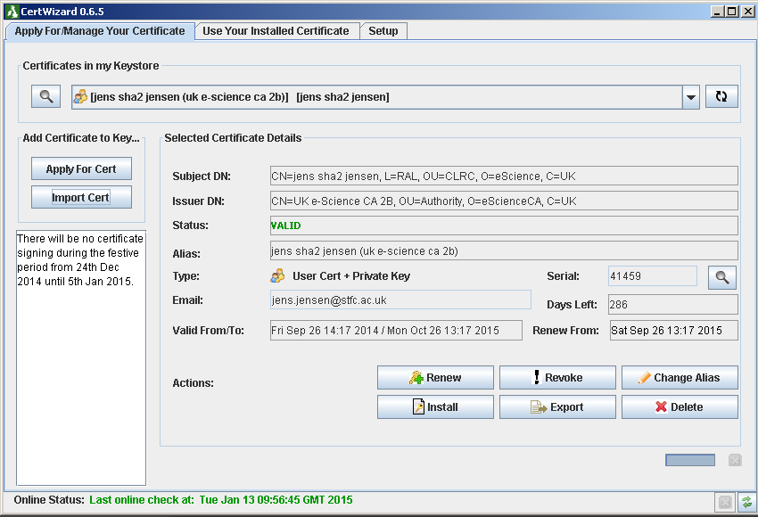
Auto-checks your certificate status; rekey post expiry

Slide 4
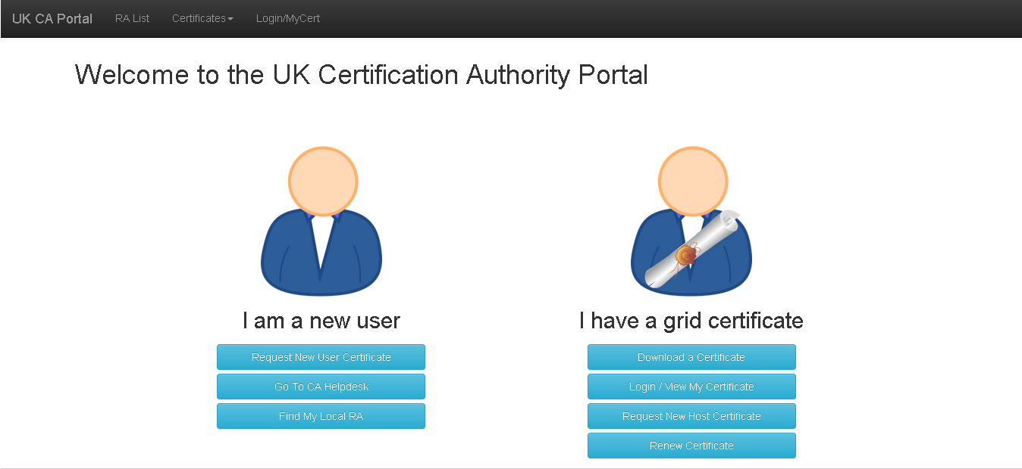
Request and key generated in javascript and pasted into and out of files

Slide 5
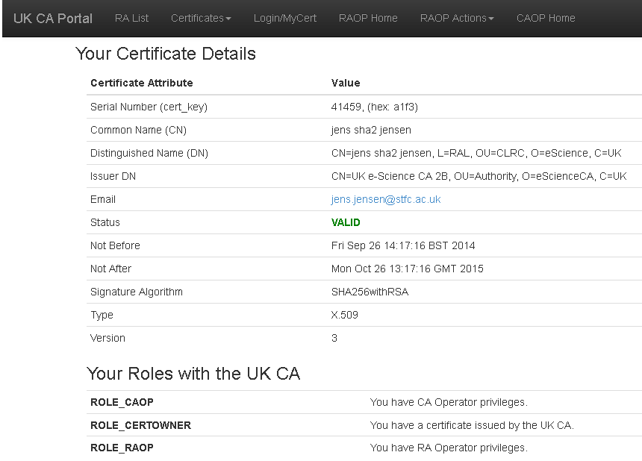

Slide 6
Great Leap Forward - Overview
Modernise extensions
(We had nsCertType and MD5-signed CRLs)
Support post-expiry rekeying
Re-engineer BC/DR
Close off OpenCA-based code (old)
For: Users, RAs, CA ops
Address issues found in self audits
(September 2009), January 2014
C/D were cert and CRL profile (GFD.225)

Slide 7
Great Leap Forward - Overview
Address HSM (lack of) support
Expensive, no strong business case
Considered buying new HSM
2A is generated in HSM, 2B is imported
(Case for discontinuing 2A?)
2A online, 2B semi-online
SARoNGS → IOTA
SARoNGS is generated in HSM, too; may rekey
Number of RAs non-decreasing

Slide 8
JCS - Overview
An opportunity to migrate certificates to JCS
Online signing
Certificate issuances becomes S.E.P.
Not a takeover, but a collaboration between STFC and JANET to do it if it can be done

Slide 9
JCS - Overview
JISC (JANET) Certificate Service
Migrate CA to JCS – if possible
Need to support
Personal certificates – how are users authenticated
Host certificates – at a cost of £0/cert
Service certificates – still needed?
Robot certs – <10 distinct robots
Need graceful migration
DNs will change, though
Discussions started 1 year ago

Slide 10
JCS - Overview
Timescale for full handover
If successful, could terminate UK e-Science CA by ~Jan 2018 (estimate)
JCS already active but not doing UK e-Science
UK e-Science CA will continue as long as needed
At least for the time being
But lack of funding makes JCS attractive

Slide 11
JCS – Identity Mgmt
Eventually should have UKAMF identity(?)
Need for CN and email for personal
Other methods
Interim: use existing RAs? (and current identity papers)
Will mean DN migration (subst root?)
Need something different for hosts
Will we use Moonshot at some point?
Need a suitable COI defined (and trustrouter)

Slide 12
JCS - Overview
Investigating linking UK e-Science CA to JCS
Trust/Link, CA’s API
Continue support via CW, CAPortal
Online signing
(DNs will change?)

Slide 13
Issues
Stakeholder communication
GridPP (and other RPs), PMA, TAG,
Migration
Support all types of certificates
Support existing interfaces
Support bulk requests
Processes change
Changes of names (cf. RA migration discussion)
Cost of obtaining certificates

Slide 14
Future Perspectives: Either Or (or in between)
Still running a CA by 2020…
As long as GridPP needs it
People migrating to JCS, or switch to federations?
What is the role of SARoNGS?
Everything handed over
Terminated by (say) 2018
CA Emeritus…

Slide 15
Draft Timescale
(Separate)

Slide 16
UK e-I Sec & AM WG
GridPP and DiRAC and bears, oh my
Shibboleth and Proxy and bears, oh my
Group management and authorisation
Documented by AC
New bioinformatics – need AAI

Slide 17
September 2009

Slide 18
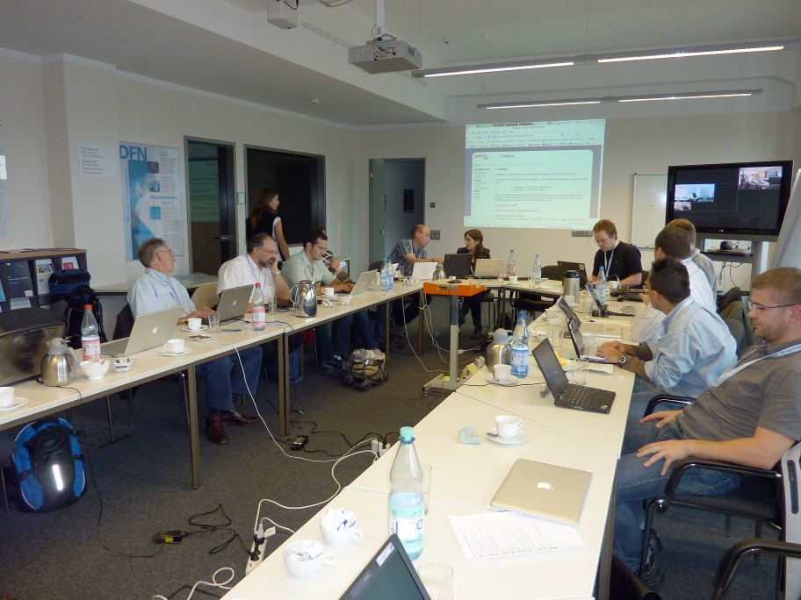

Slide 19
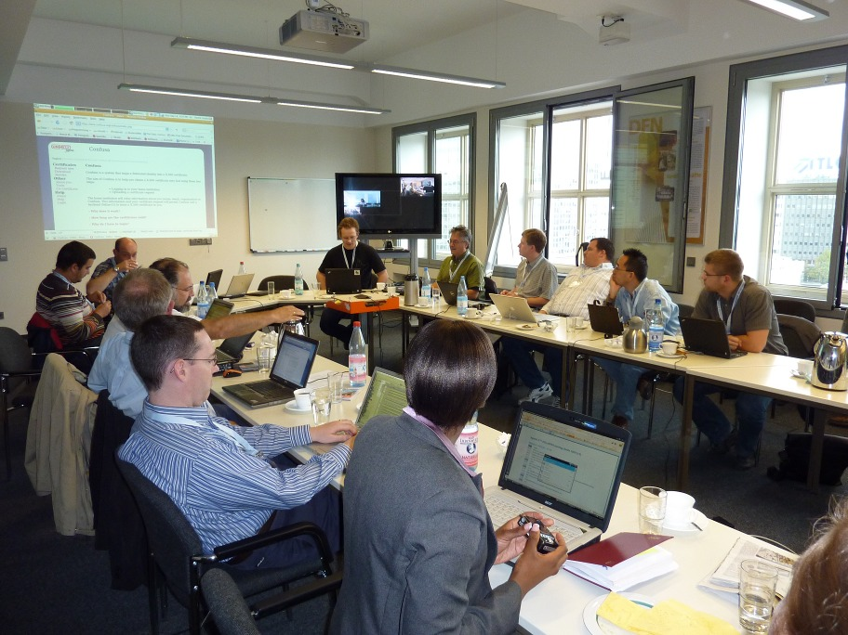

Slide 20
