Slide 1
Welcome (again) to Berlin EUGridPMA33 January 2015

Slide 2
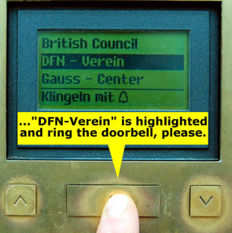
Welcome back in Berlin

Slide 3
Round Table and Introductions
Note taker
Please …
Presentations
Upload to the agenda page: https://www.eugridpma.org/agenda/33
use “manage”, and then enter the password
unless you have been invited to create an account
Agenda bashing
Add slot for IGTF RAT and communications challenge?
More items?

Slide 4
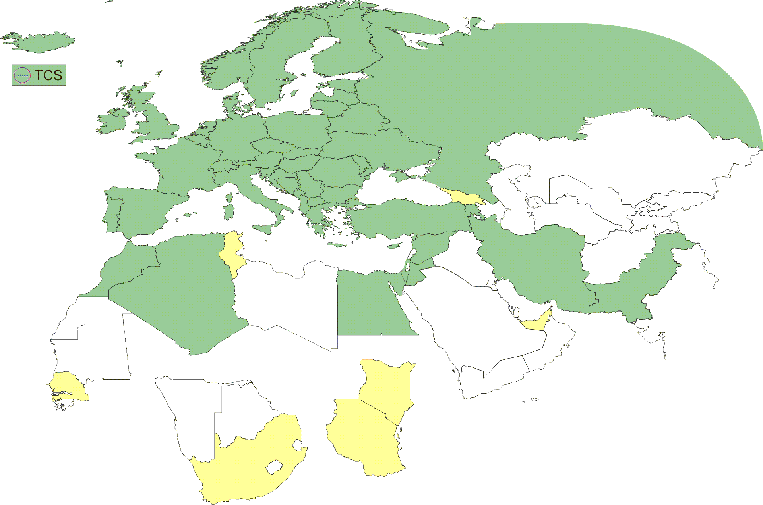
Geographical coverage of the EUGridPMA
26 of 28 EU member states (all except LU, MT)
+ AM, CH, DZ, EG, IL, IR, IS, JO, MA, MD, ME, MK, NO, PK, RO, RS, RU, SY, TR, UA, CERN (int), DoEGrids(US)* + TCS (EU)
Pending or in progress
ZA, KE, TZ, SN, TN, AE, GE

Slide 5
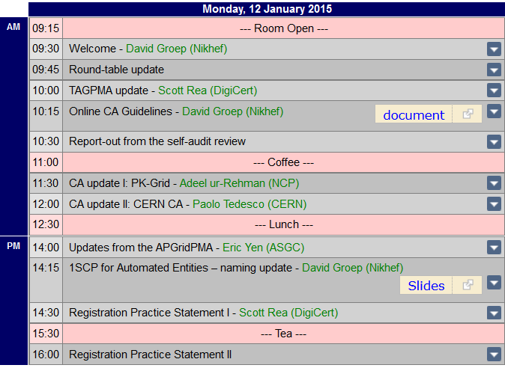
Agenda Monday (today)

Slide 6
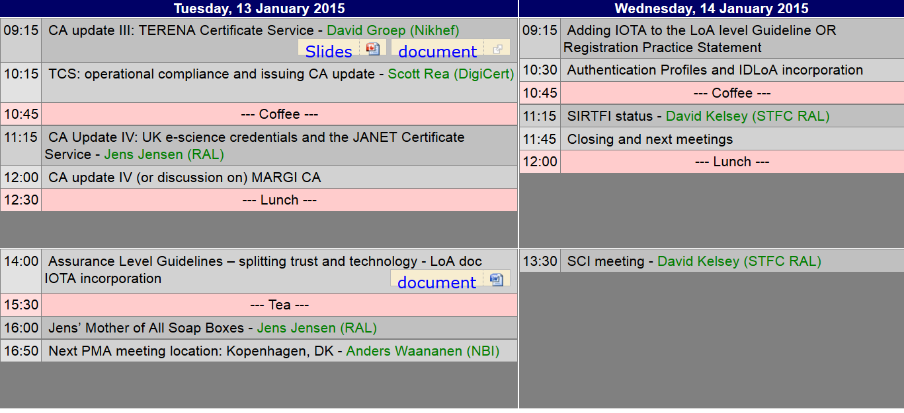
Tuesday and Wednesday

Slide 7
EUGridPMA Meeting Agenda
APGridPMA & ISGC: 16-20 March 2015 (Security Workshop on 15)
EUgridPMA 34 (tbc): Copenhagen May 11-13
TNC2015: 15-18 June 2015, Porto, PT (REFEDS on 14th)
Open request for EUGridPMA 35 in September (7-9?) 2015

Slide 8
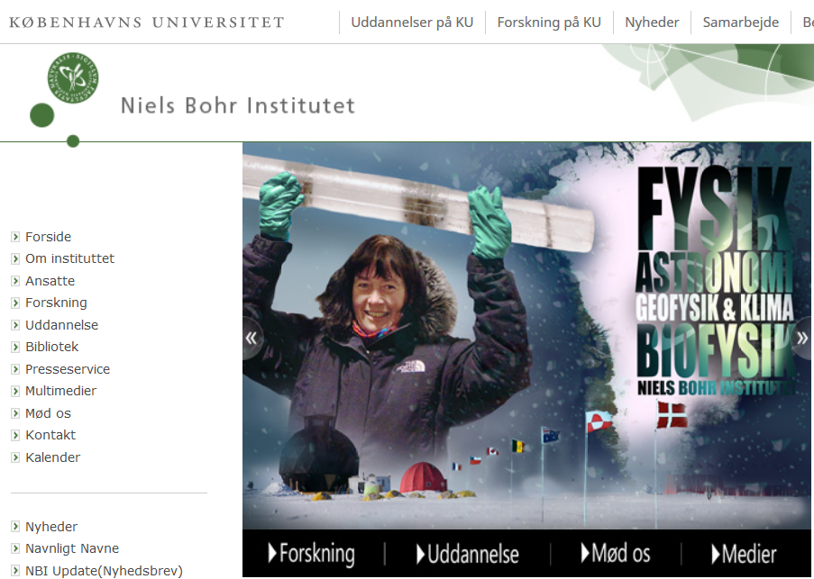
May 11 – 13 – Copenhagen, DK

Slide 9
