Slide 1
Security Incident Response Trust Framework for Federated Identity (Sir-T-Fi)
David Kelsey (STFC-RAL)
REFEDS, Indianapolis
26 Oct 2014

Slide 2
Outline
Input
FIM4R requirements
TNC2014 BoF – Romain Wartel
Security for Collaborating Infrastructures (SCI)
Sir-T-Fi
1st meeting - 18 June 2014
Mail list, wiki, document
2nd F2F meeting this week – Friday morning

Slide 3
Federated IdM for Research (FIM4R)
Includes photon & neutron facilities, social science & humanities, high energy physics, climate science, life sciences and ESA
Aim: define common vision, requirements and best practices
Vision and requirements paper published
https://cdsweb.cern.ch/record/1442597

Slide 4
FIM4R paper
Operational requirements include:
Traceability. Identifying the cause of any security incident is essential for containment of its impact and to help prevent re-occurrence. The audit trail needs to include the federated IdPs.
Appropriate Security Incident Response policies and procedures are required which need to include all IdPs and SPs.

Slide 6
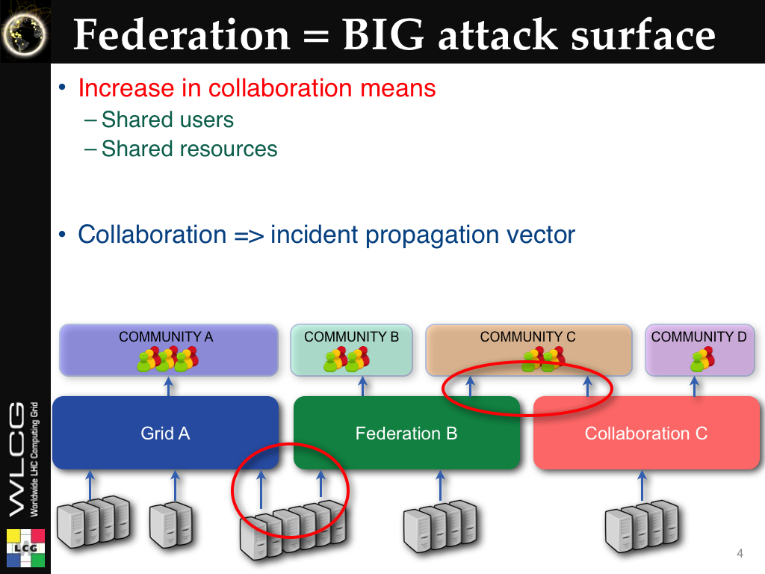

Slide 10
Security for Collaborating Infrastructures (SCI)
A collaborative activity of information security officers from large-scale infrastructures
  EGI, OSG, PRACE, EUDAT, CHAIN, WLCG, XSEDE, …
Developed out of EGEE – security policy group
We are developing a Trust framework
  Enable interoperation (security teams)
  Manage cross-infrastructure security risks
  Develop policy standards
  Especially where not able to share identical security policies
Version 1 of SCI document
http://pos.sissa.it/archive/conferences/179/011/ISGC%202013_011.pdf

Slide 11
SCI: areas addressed
Operational Security
Incident Response
Traceability
Participant Responsibilities
  Individual users
  Collections of users
  Resource providers, service operators
Legal issues and Management procedures
Protection and processing of Personal Data/Personally Identifiable Information

Slide 12
Sir-T-Fi – 1st Meeting
A Security Incident Response Trust Framework for Federated Identity (Sir-T-Fi)
After discussions at TNC2014
Meeting at TERENA offices 18th June
  David Groep, Leif Johansson, Dave Kelsey, Leif Nixon, Romain Wartel
  Remote: Tom Barton, Jim Basney, Jacob Farmer, Ann West
  Apologies from Ann Harding, Von Welch, Scott Koranda, Licia Florio, Nicole Harris

Slide 13
Meeting 18th June
Discussed general aims and thoughts
  For now only address security incident response
  Assurance profile to meet requirements on incident response
  Needs to be light weight - IdPs self assert
  Federation Operators act as conduits of information from IdP
  Need a flag of compliance (for relying parties)
    In IdP metadata
    Could be per user
  Use eduPersonAssurance or “SAMLAuthenticatonContextClassRef” in assertions from IdP
First modifications to SCI document
  Operational Security, Incident Response and Traceability

Slide 14
Sir-T-Fi since June
One phone/video meeting – 1st Oct
Mail list – sirtfi@terena.org
Wiki
https://refeds.terena.org/index.php/SIRTFI
Doc moved to Google Docs
Document evolving
  Make public once we have a reasonable first draft

Slide 15
Some text from document
Abstract
The Sir-T-Fi group (Security Incident Response Trust Framework for Federated Identity) is a collaborative activity of information security professionals from national identity federations and distributed IT infrastructures in the research & education sector. Its aim is to simplify the management of cross-infrastructure operational security risks, to build trust and develop policy standards for collaboration in security incident response.

Slide 16
Example Text (2)
Security Incident Response
Each Claims Processor must:
[IR1] Provide security contact information who will respond in a timely manner according to current best practice, e.g. one working day.
[IR2] Have an established Incident Response procedure. This must address: roles, authority, and responsibilities; identification and assessment of an incident; minimising damage, response and recovery strategies;
[IR3] The ability and the willingness to collaborate in the handling of a security incident with affected Claims Processors;
[IR4] Respect and should use the TLP (ref) information disclosure policy.

Slide 17
Next steps
Sir-T-Fi meeting on Friday morning
  How do we encourage deployment
ACAMP this week
Input from others, e.g.
http://www.cic.net/docs/default-source/technology/federated_security_incident_response.pdf
EU H2020 AARC
  Can provide test use cases
Activity is very much open
  People welcome to join
  Ask Nicole Harris if you wish to join mail list

Slide 18
Questions?

