Slide 1
LHCb VELO Upgrade II Progress meeting
1 JUL 2024
Yutaro Takahashi

Slide 2
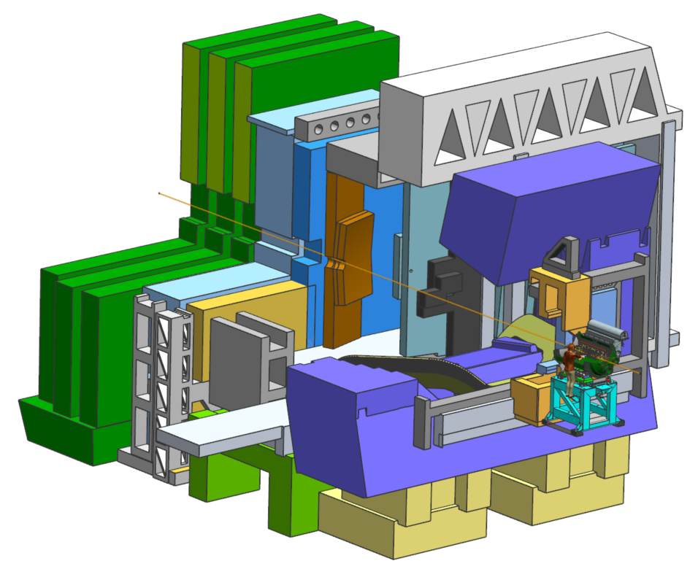
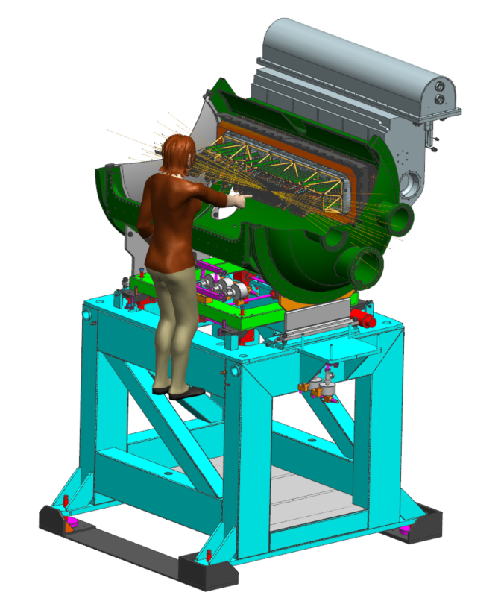
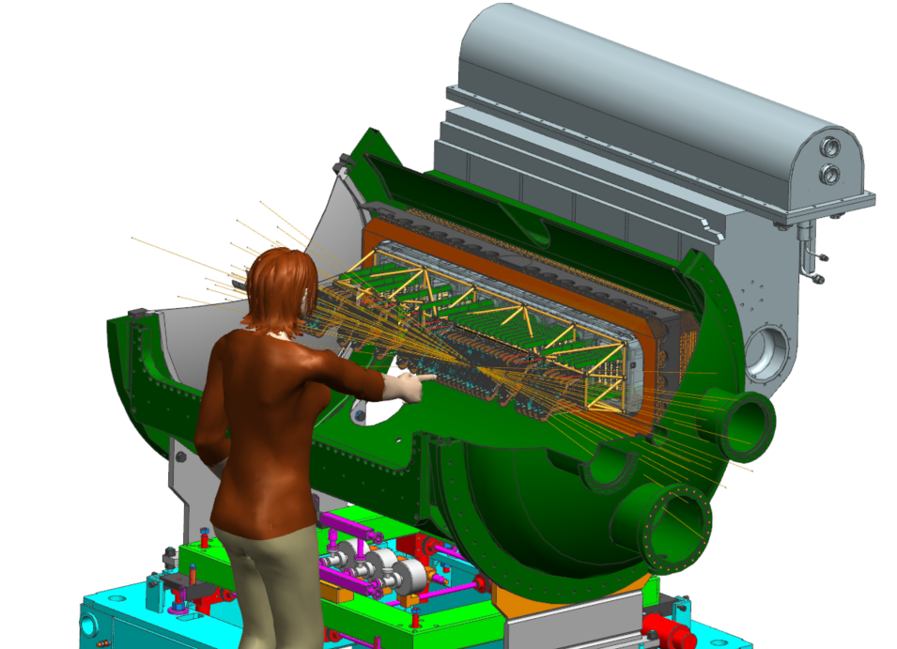
Roadmap pictures
Added beamline
Zoomed in version

Slide 3
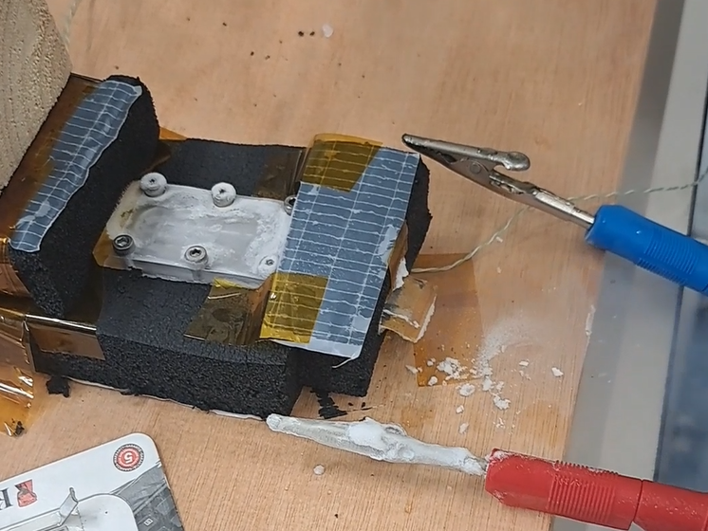
CO2 sublimation cooling
Update
New needle valve installed by Martijn.
Two tests performed to try to quantify cooling capacity.
Data to be analyzed
Early results
Difficult to reproduce previous “successful” result
Often Blocked channels
Exit Temperature not below -58°C
CO₂ at exit has high vapour content (not so much ice)
Increasing heat input leads to increased, but stable temperature.
3,6W => -55°C, 6,4W => -53°C, 10W => -50°C
Analysis
When the other channels get clogged, the ice formed can warp the soft gasket, leading to blockage of the channel by the gasket.
Some
Change setting needle valve to allow lower flows (< 0,2 g/s)
Try PTFE gasket (much stiffer)
\\ad.nikhef.nl\project\mt\project\LHCb\VELO Upgrade 2\CO2 Sublimation Cooling\20240625_Experiment_4

Slide 4
Station design with extra ring
Targets:
All modules to be placed at two independent angles (Rx and Ry)
Each station at different angle?
Minimum material
Challenges / Discussion
A gap the inner and outer ring leads to open outer ring and should not be used.
If the rotation point of the sensors is moved to the outside (to reduce material effects), this will influence the R₁ of the detector.
Can we go for only one angle per sensor?
Gap
Gap
Rotation point
Beamline

Slide 5
Layout
IP-2σ
IP
IP+2σ
Some updates
Number of stations is mainly determined by number of stations around IP.
Taking 2 sigma: ±89,4 mm (=> total: ~180 mm), the pattern of the first 6 stations is repeated over the total length, with the given pitch (Dz).
The acceptance can be optimized by evenly dividing the full IP region over the number of stations.
 | Number of stations around IP | Max. pitch [mm] | Optimized pitch [mm] | Optimized acceptance angle
Concentric | 16 | 18,8 | 18 (=180/10) | 280 mrad
L-shape | 15 | 21,1 | 20 (=180/9) | 290 mrad
L-shape with extra ring | 12 | 30,7 | 30 (=180/6) | 276 mrad
L-shape with extra ring + extra station | 13 |  | 25,7 (=180/7) | 319 mrad

Slide 6
Next week
Conceptual design of station with extra ring
(RGA setup)

