Slide 1
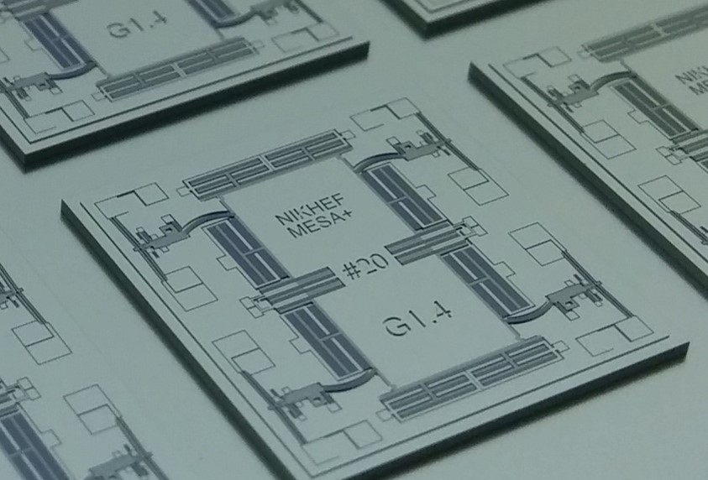
Detector R&D Group Meeting
MEMS Seismometer Development
B.A. Boom, Nikhef Amsterdam
Detector R&D 7 December 2016 borisb@nikhef.nl

Slide 2
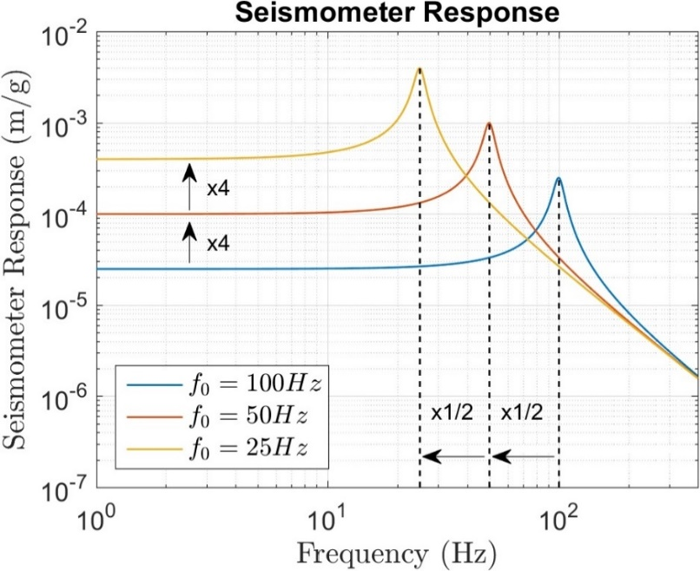
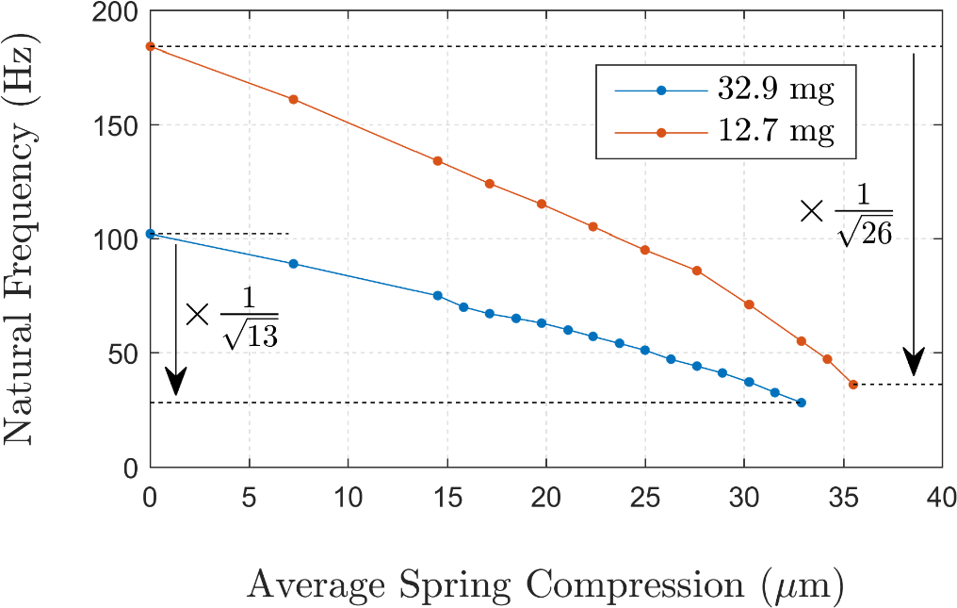
Backup Slide: MEMS Seismometer
Spring suspension
Seismometer sensitivity grows inversely proportional to the system natural frequency squared. A low natural frequency is desirable.
Thermal actuator
Proofmass
Seismometer response in m/g
$$H\left(ω\right)=\frac{g}{\sqrt{{\left(ω^{2}−ω_{0}^{2}\right)}^{2}+{\left(\frac{ωω_{0}}{Q}\right)}^{2}} },{ ω}_{0}=\sqrt{\frac{k}{m}}$$
MEMS Seismometers
Mass limited to few tens of milligrams
Lower $k$ by miniaturized anti-spring technology
Capacitors
3mm
150µm

Slide 3
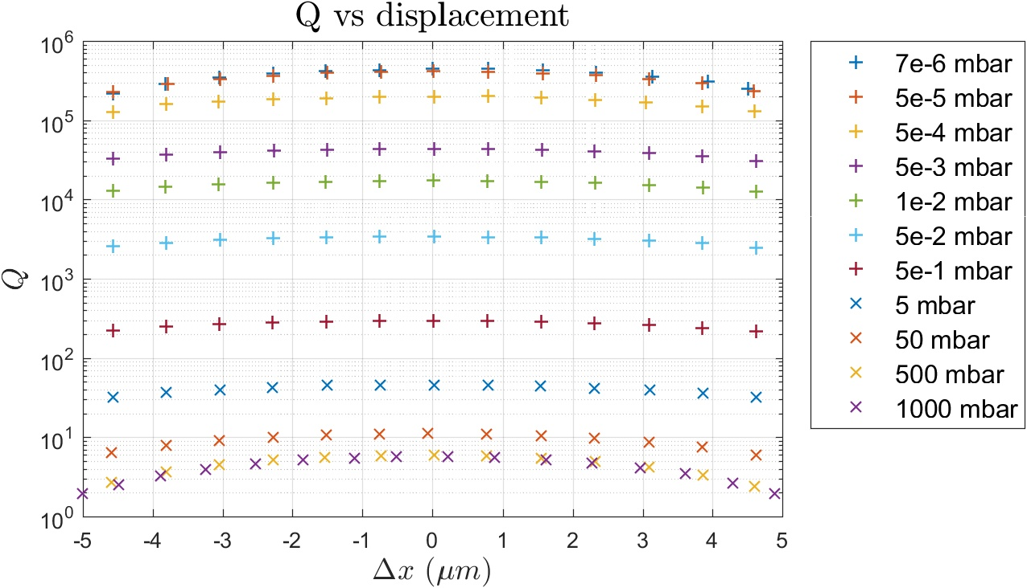
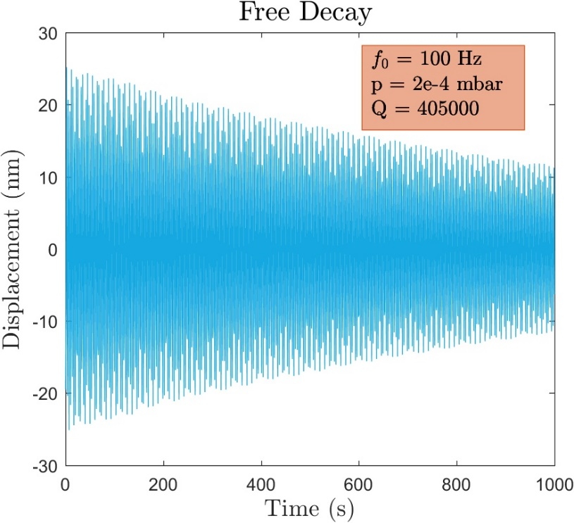
Importance of Quality Factor
Q determines the mechanical noise floor of the sensor
Q as function gap size
Strong dependence on gap for viscous regime (-55% @ dx=4.5)
Moderate dependence on gap for molecular gas damping regime (-25% @ dx=4.5)
Strong dependence on gap for non-gaseous damping (-55% @dx=4.5)

Slide 4
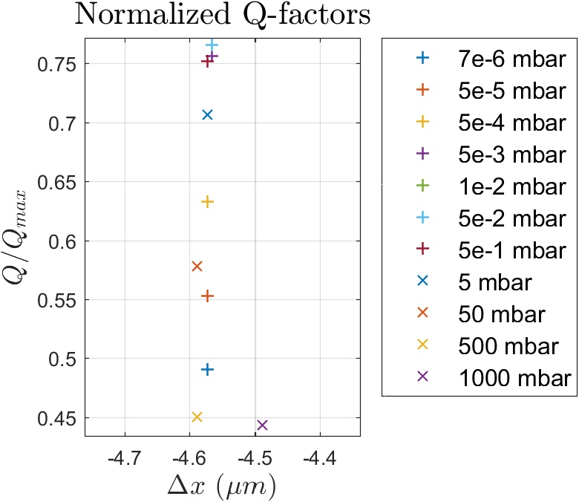
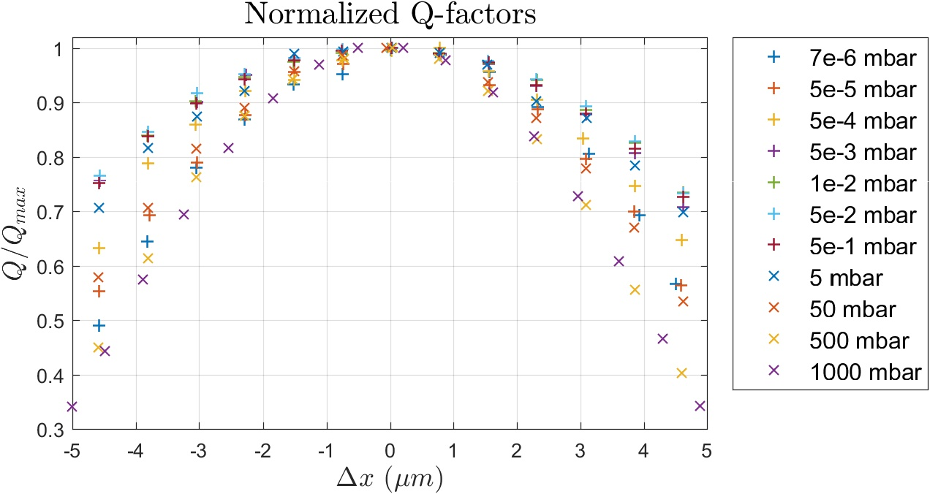
Normalized Q factors vs pressure
Q decreases with gap size for all pressures. The minimum observed change occurs around pressure aimed at for packaging
Q vs gap
Q factor is maximum in center of gap
Q factor depends on gap for all pressure ranges:
Also for non gaseous damping, why? → open question
At vacuum packaging pressures, gap dependence is minimum.
Conclusion for ~10⁻² mbar
Reducing the gap by 50% will change the Q by ~50%
This will double C₀
Throwing away half the sensing fingers halves the damping
→ Q is almost independent on the gap size in this pressure range

Slide 5
MEMS 2017 Conference
My submission got accepted for an oral presentation! ☺
Content
Operations
Relations

