Slide 1
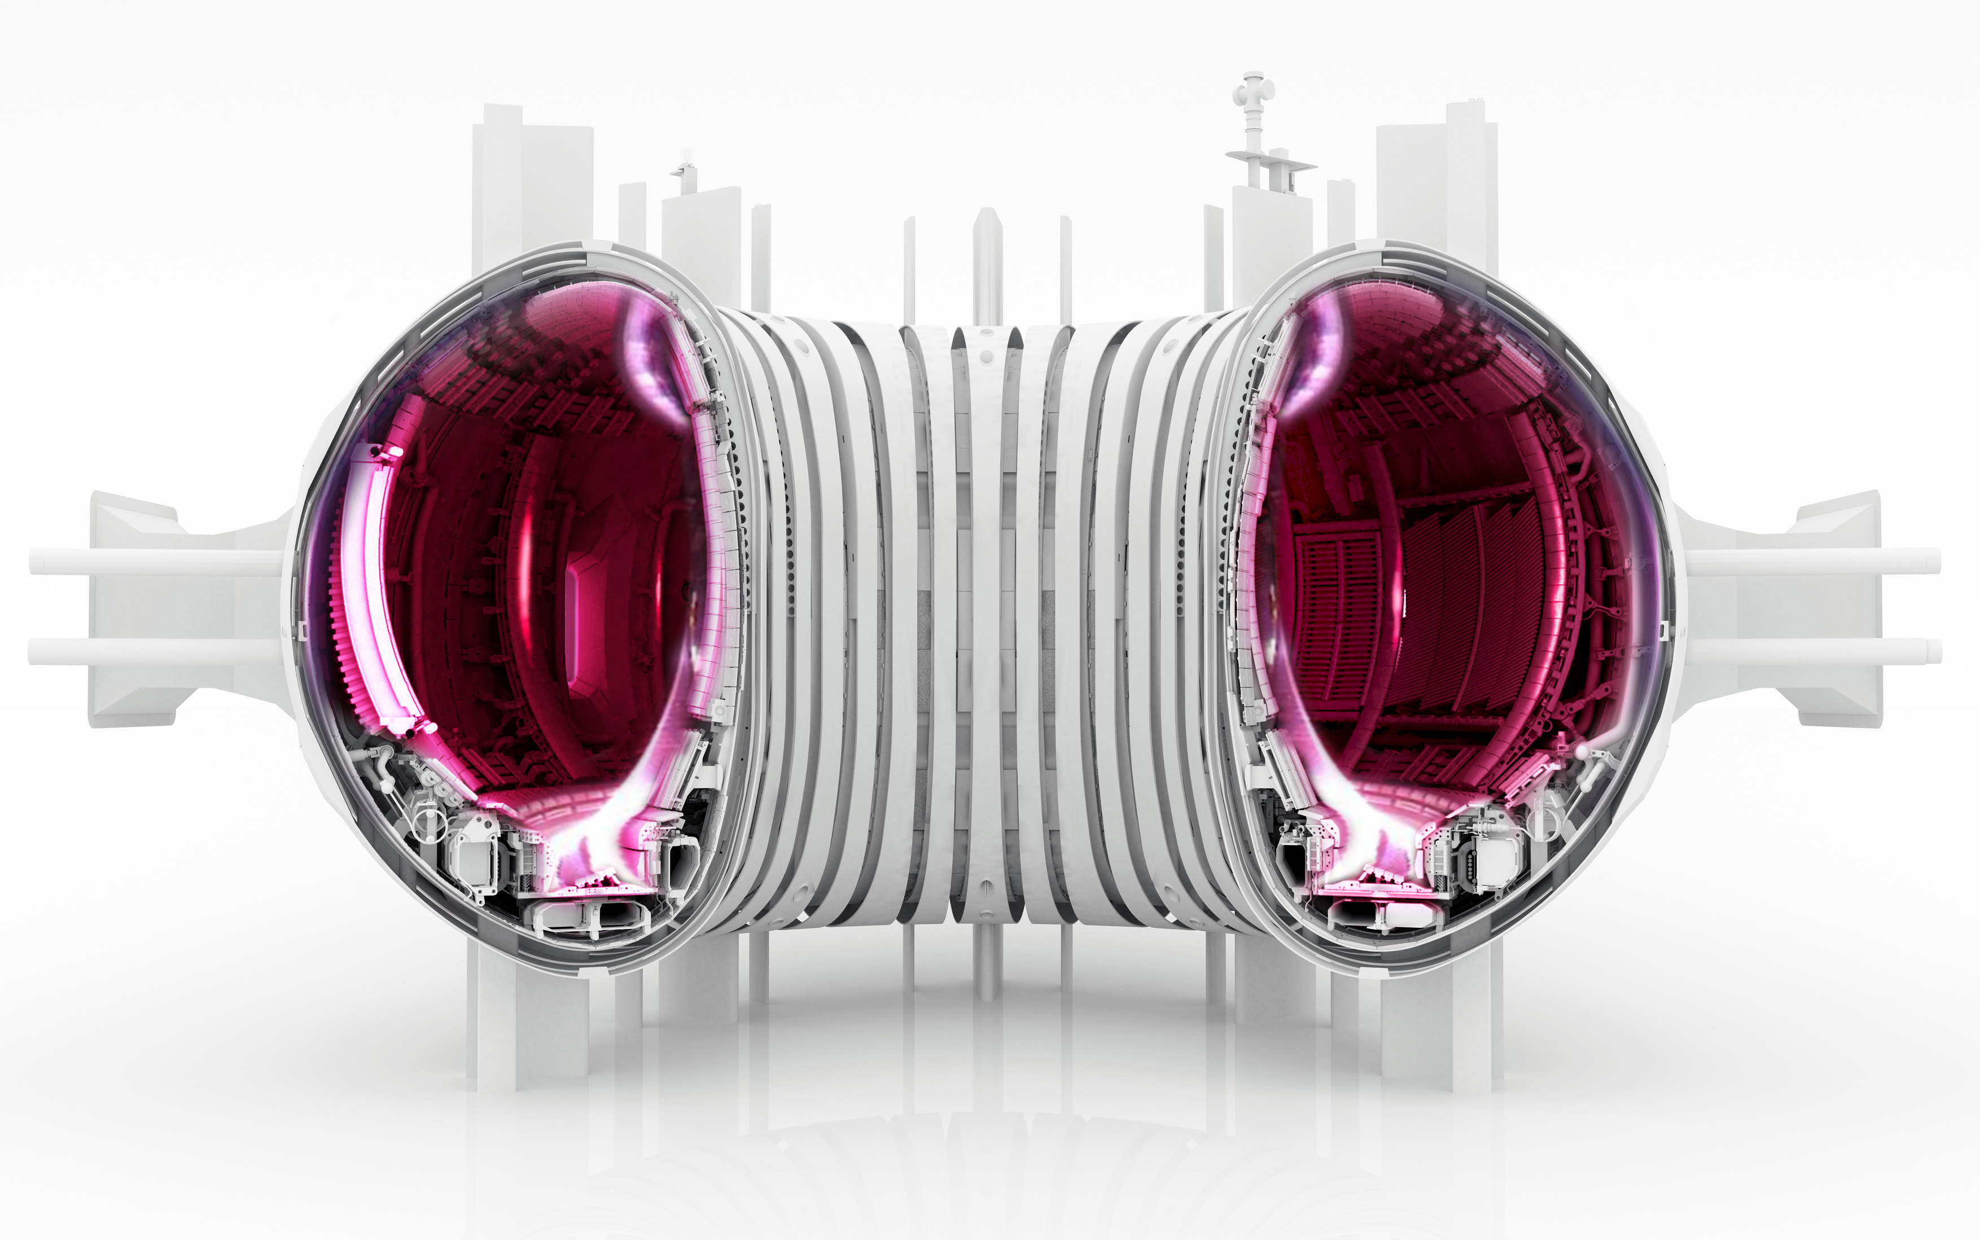
Multispectral imaging of plasma edge emission distributions
Wouter Vijvers
Dutch Institute For Fundamental Energy Research
Notes:
Contribute to DIFFER’s mission of developing sustainable energy sources
by taking a big step towards solving the main challenge in fusion research.
This step consists of understanding and stabilizing new shapes of the plasma in the fusion reactor, making use of novel measurement and control system.

Slide 2
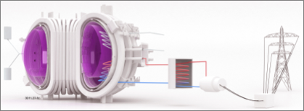
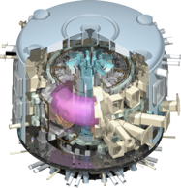
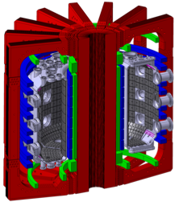
Roadmap to fusion energy
DEMO
ITER
2 GW
Current-day
machines
500 MW
Goal: contribute to development of an exhaust solution for DEMO
1-50 MW

Slide 3
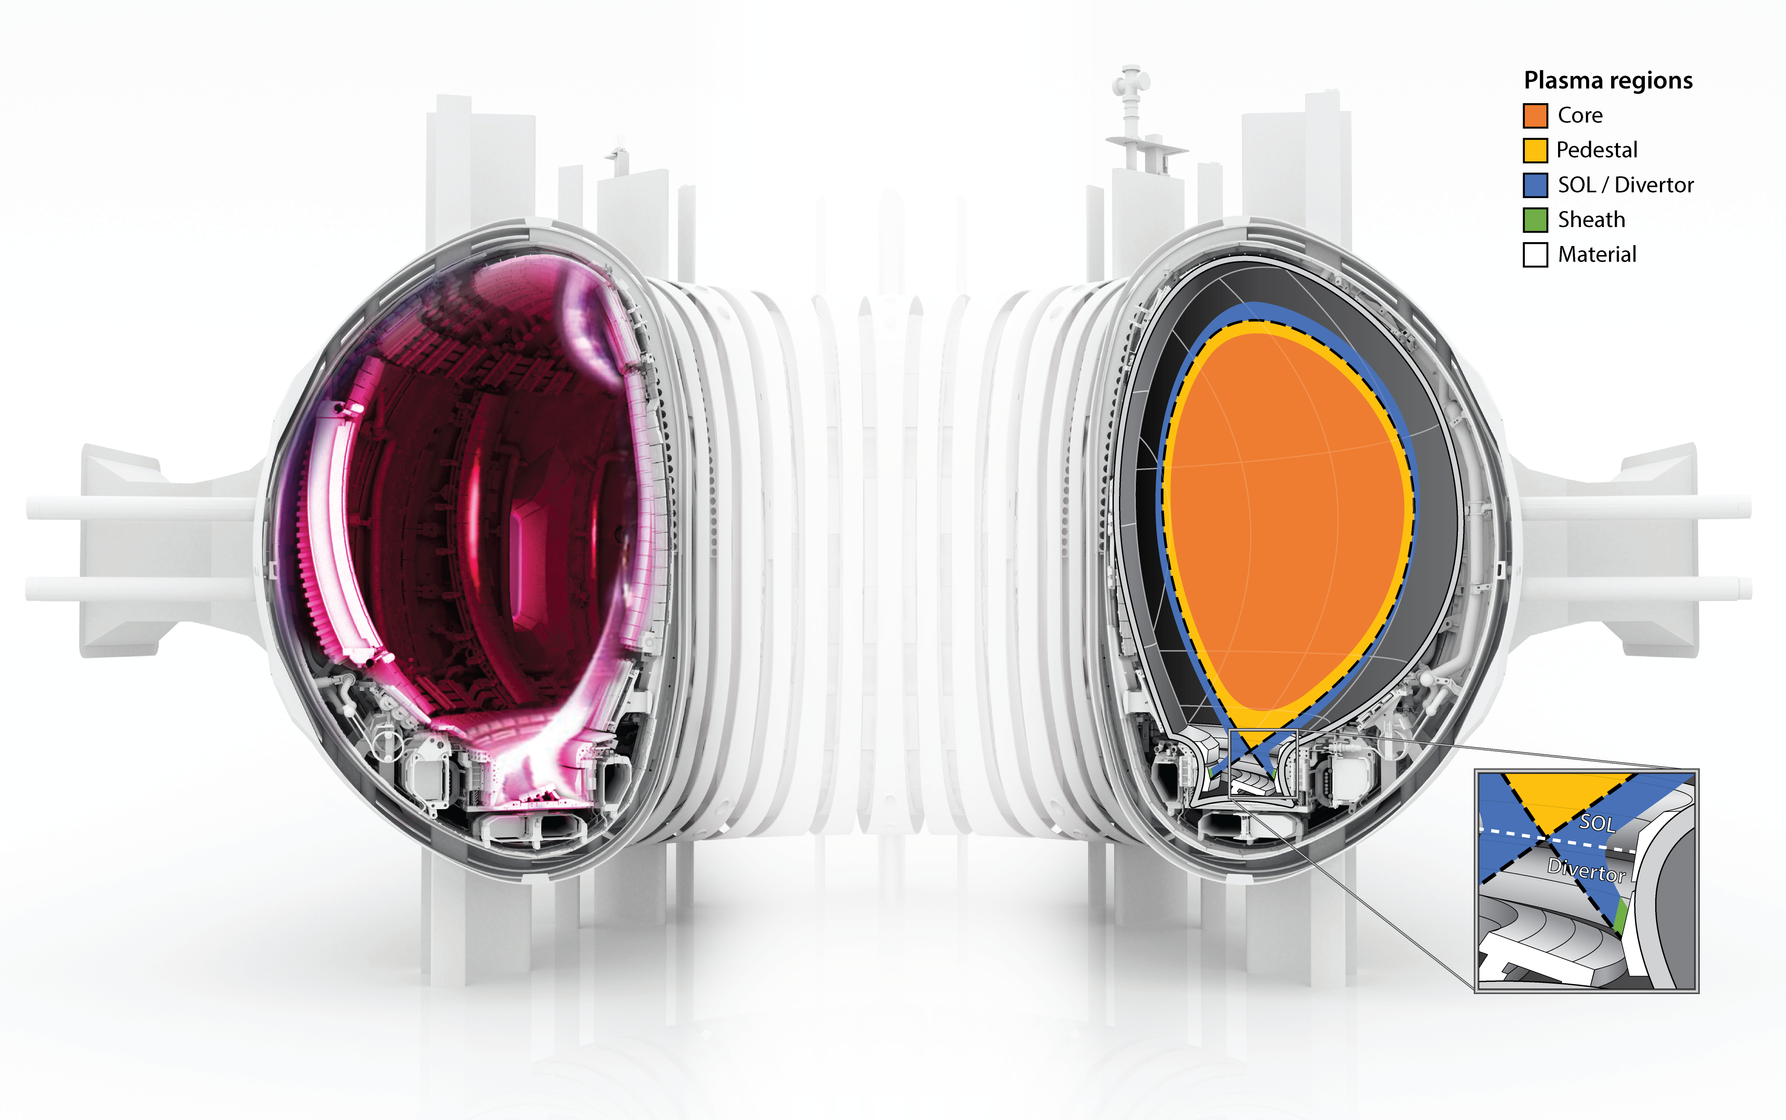
What is power exhaust and why is it important?
Heat confined to closed magnetic field lines in core
Part of heat flows into scrape-off layer (SOL)
SOL has open magnetic field lines that intersect divertor walls
Have to keep heat loads below material limits (q < qmax)
Biggest challenge in fusion research
SOL
Core

Slide 4
Why use imaging on fusion plasmas?
Imaging is “information dense” and enables us to cover a large range of length and time scales, potentially providing insight in a multitude of physics processes
Discharge evolution
Observable by imaging systems
Example movie of plasma in MAST tokamak (CCFE, UK)
Detachment front dynamics
Core MHD (impurities)
MARFE
Log(time scale) [s]
ELMs
Practical: passive, single access port, low infrastructure demands
SOL turbulence
Core turbulence (impurity transport)
Log(length scale) [m]

Slide 5
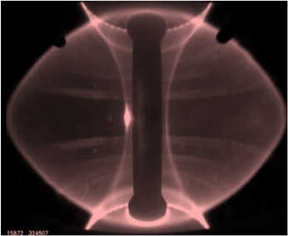
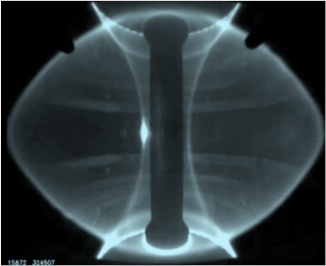
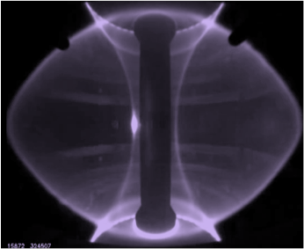
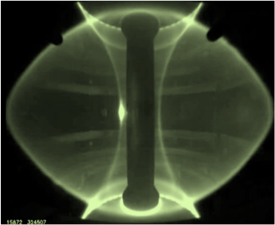
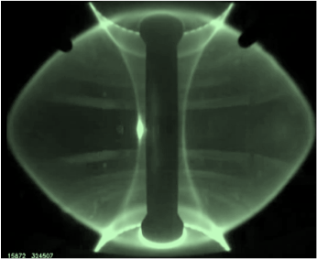
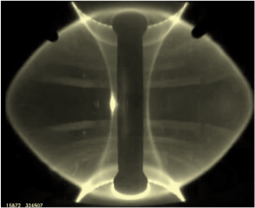
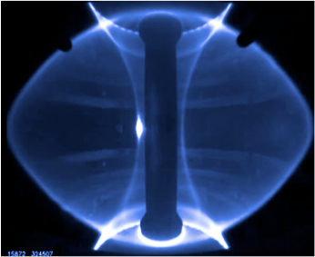
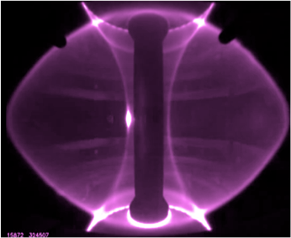
DIFFER aims to advance to quantitative multi-spectral imaging
Hydrogen spectrum
Helium spectrum
Spectral Information
Spectral Model
Plasma State
temperature
density
composition
recombination
…
We need at least 10 spectral channels for quantitative analysis (more is better)

Slide 6
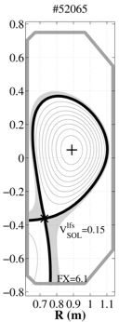
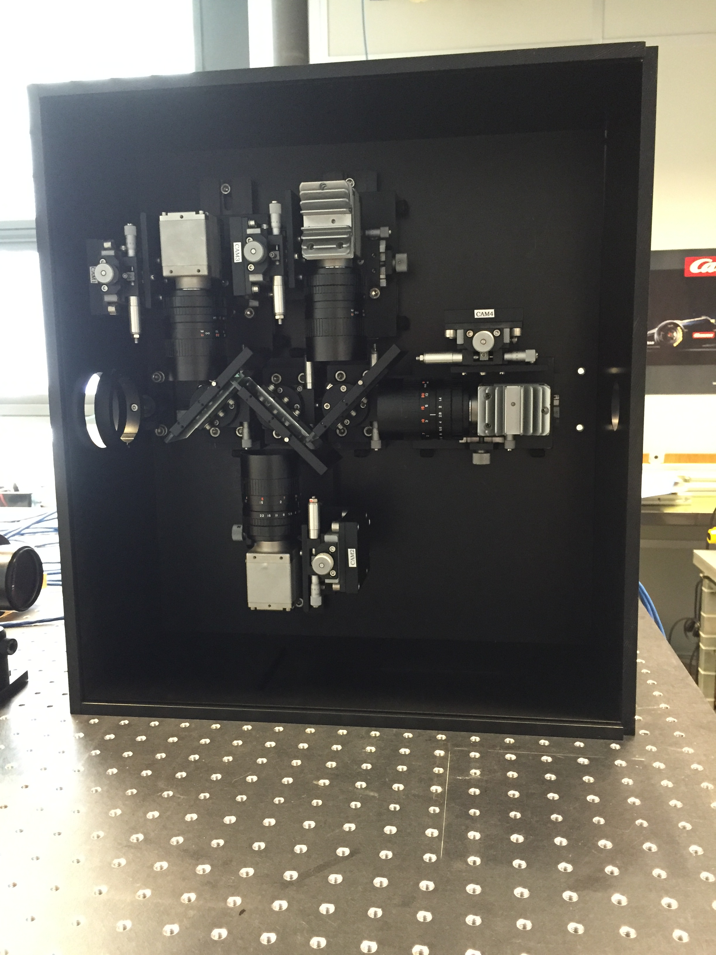
First results of 4-channel multi-spectral imaging system on TCV
Dγ (434 nm)
C¹⁺ (428 nm)
Dα (656 nm)
C²⁺ (465 nm)
Inverted D-alpha emissivity
MultiCam system:
4 cameras
3 beam splitters
4 interference filters
Tangential view
~1 eV
~3 eV

Slide 7
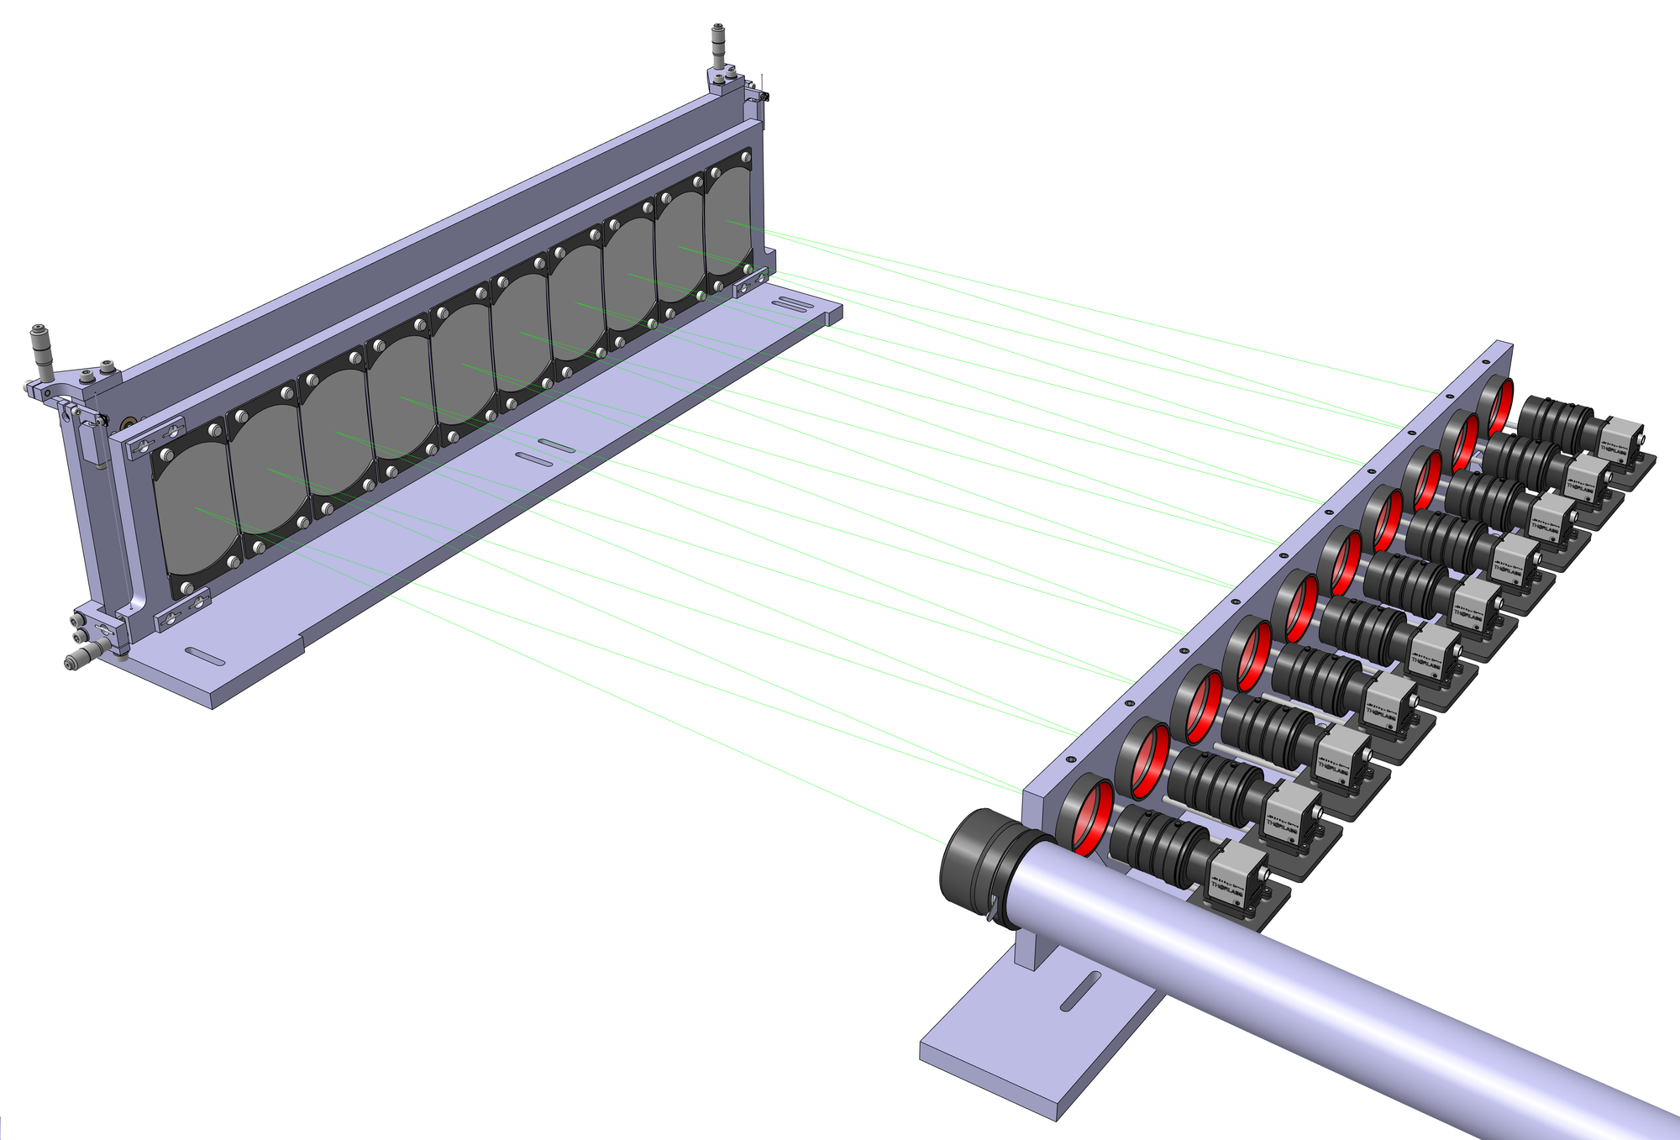
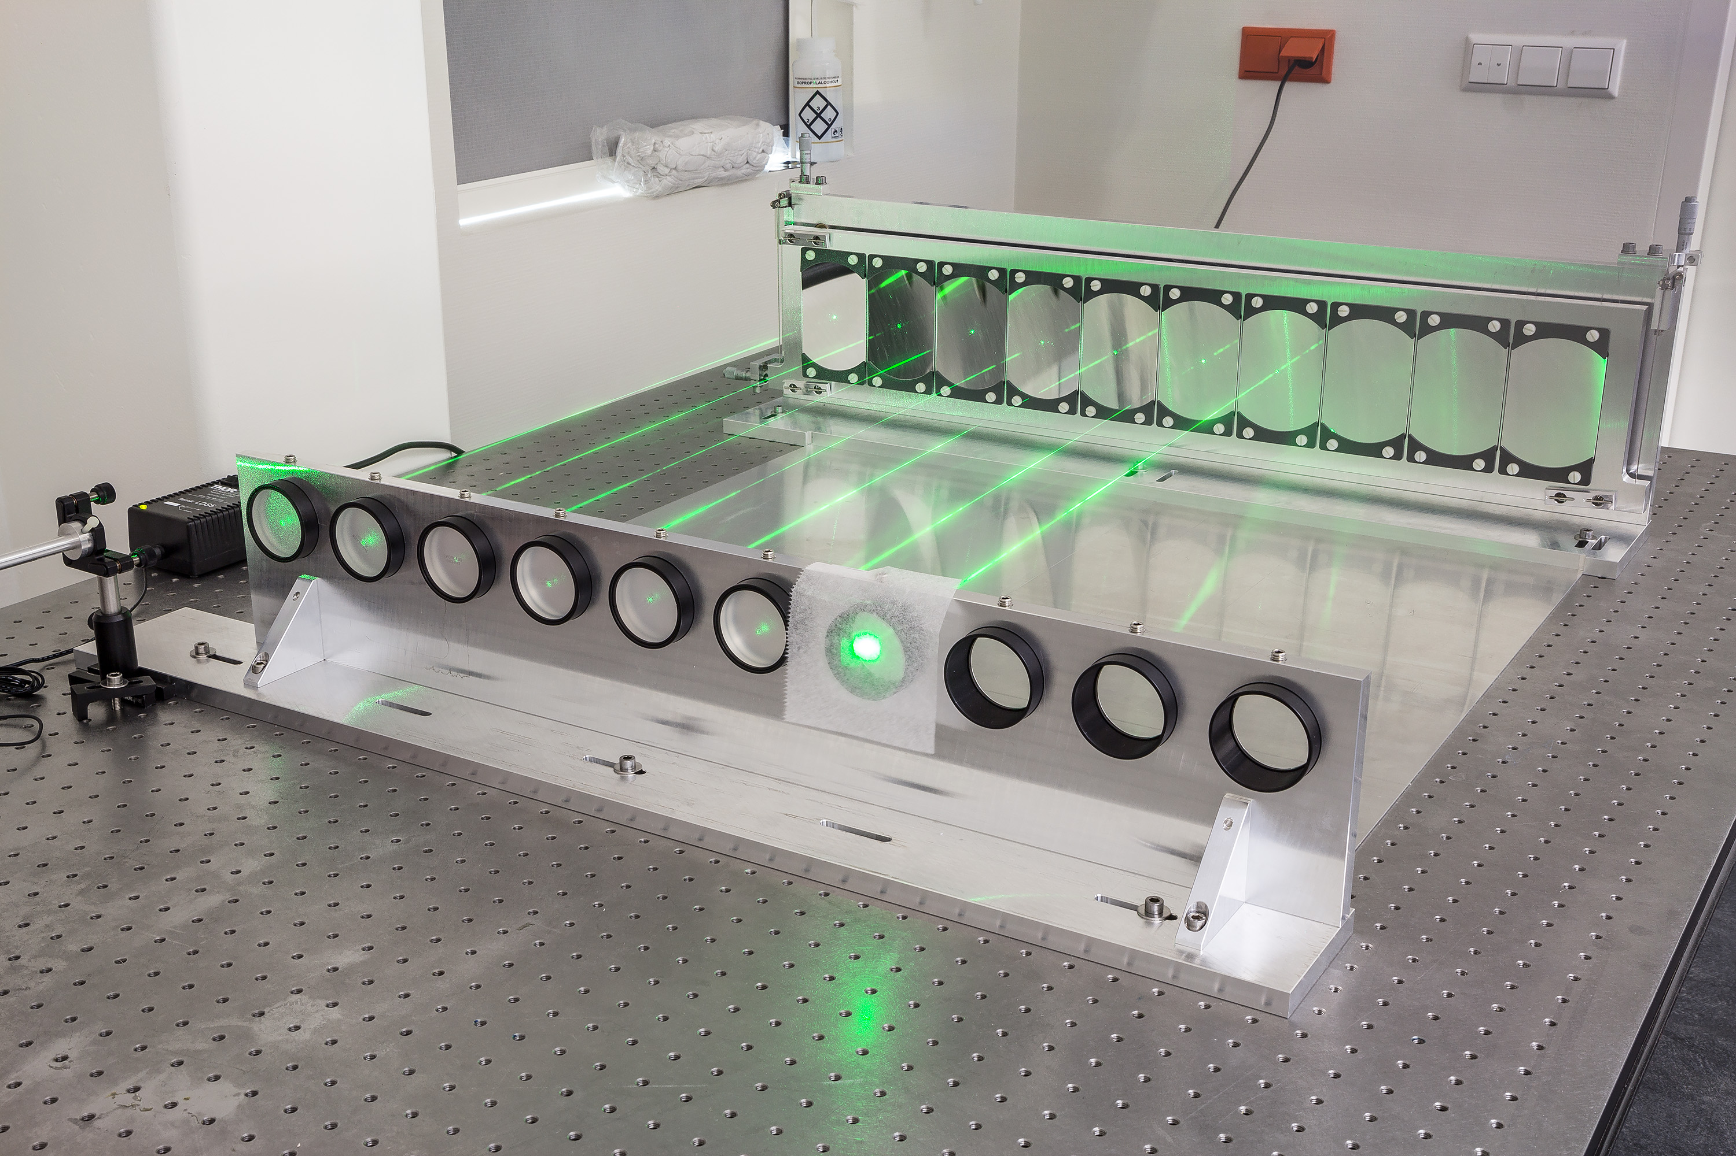
Multi-spectral Advanced Narrowband Tokamak Imaging System (MANTIS)
80 cm
Relay lenses + narrow bandpass filters/mirrors
Spherical relay mirrors
First light (2016)
…….
Cameras + lenses
Main lens
Goals:
Relay optic
>1 kHz time resolution
1 mm spatial resolution
develop real-time control strategies
generate extensive dataset for modellers
TCV

Slide 8
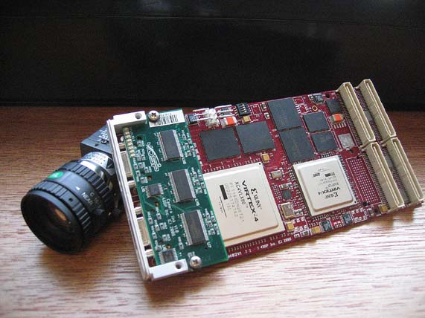
DIFFER aims for future work
Develop real-time acquisition and analysis system
Develop feedback controllers
Plasma shape (OFIT)
State of ”detached” plasma
Efficient processing and interpretation of large data volumes via modelling
Application of smarter image processing algorithms (e.g. EVM)
Expansion to other (industrial) applications
Expansion to other parts of the electromagnetic spectrum
FPGA framegrabber
Some examples
Heat fluxes walls
Molecular spectra
Heavy impurities in core
Lighter impurities in edge
Core and edge instabilities
(ECE-I)

Slide 9
Extra slides

Slide 10
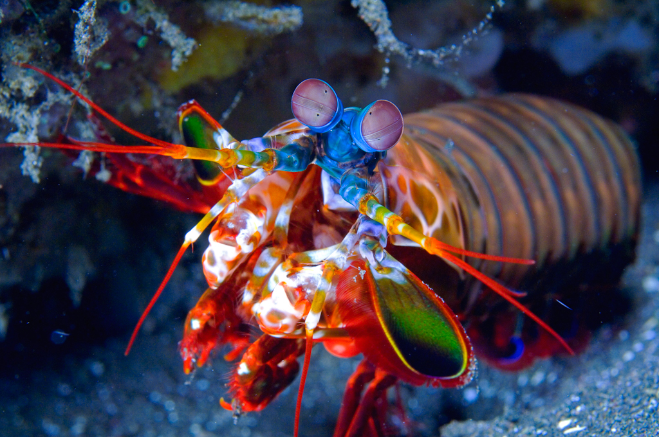
Summary
Mantis shrimp have eyes with up to 16 types of photoreceptors
Developing a detailed understanding of detachment physics is essential for design of a fusion power plant
Multi-spectral imaging employed to deliver detailed qualitative information on detachment in TCV
MANTIS under development to make step to quantitative imaging, enabling new physics studies and control strategies
Notes:
Investigate detachment in the SF- configuration

Slide 11
First assessment of image quality proves 10+ channels is feasible
Channel 1
Channel 2
Channel 3
Channel 4
Channel 5
Channel 6
Channel 7
Channel 8
Channel 9
Channel 10
Image quality does not degrade rapidly
Some optical aberrations cancel at even channels

Slide 12
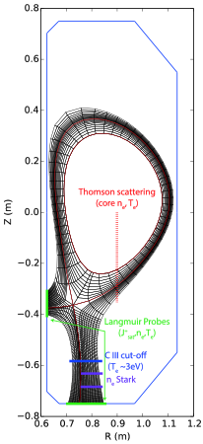
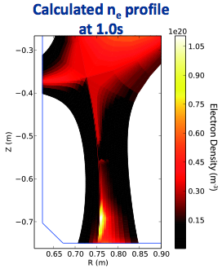
Interpretative modelling required to obtain 2D distributions
Onion-Skin Model solves plasma fluid equations for nested, independent, 1D flux tubes (coupled to 2D neutral transport code)
Constrained by experimental data
Model “fills gaps” between measured 1D profiles
Time-independent
[J. Harrison et al., Nuc. Mat. En. 000 (2016) 1–6]

Slide 13
Multi-spectral Advanced Narrowband Tokamak Imaging System (MANTIS)
Mantis shrimp have eyes with up to 16 types of photoreceptors

Slide 14
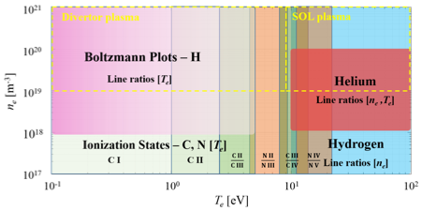
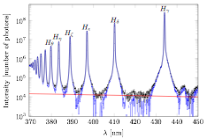
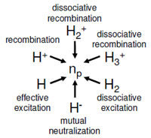
Development of spectral model
Theory
Spectroscopy in known conditions (Magnum-PSI)
Spectral Model
Collisional-radiative modelling (Yacora)
Full plasma + neutral transport model (Eunomia)

