Slide 1




a high Quantum Efficiency photocathode
Harry van der Graaf
ATTRACT meeting
Nikhef
Amsterdam, February 9, 2017

Slide 2
single (digital) soft photon detectors
time resolution
2D spatial resolution
detection efficiency: Quantum Efficiency QE

Slide 3
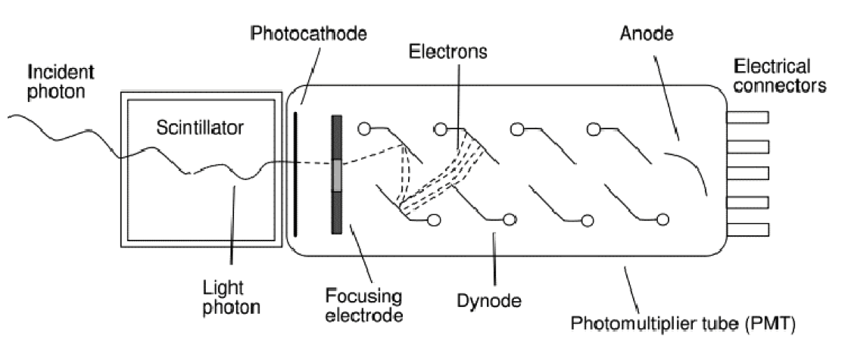
A very successful photon detector: the Photomultiplier (1934 -1936)
‘good’ quantum efficiency
rather fast
low noise @ high gain: very sensitive
little dark current, no bias current
radiation hard
quite linear
voluminous, bulky & heavy
no spatial resolution, not even 1D
expensive
quite radioactive
can’t stand B fields
Amplification by multiplication: low noise!

Slide 4
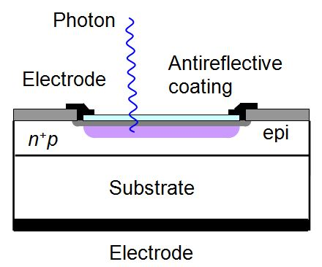
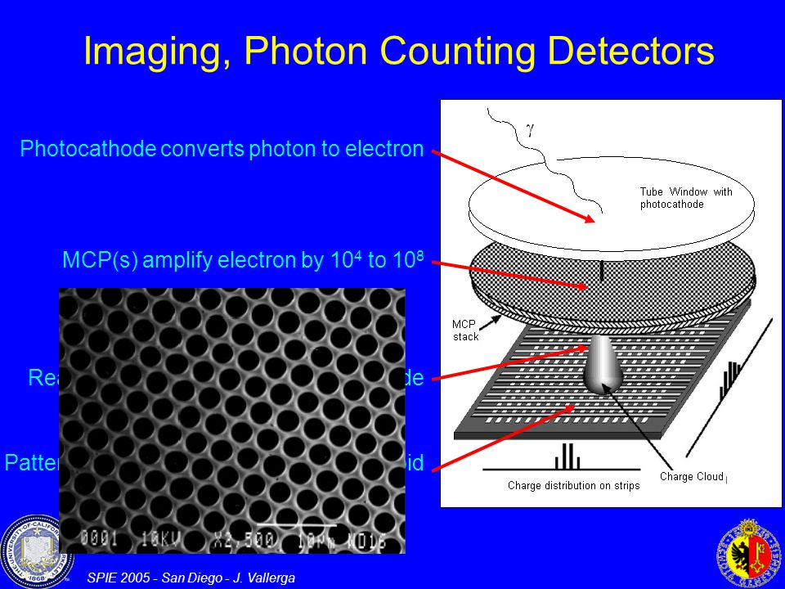
(new) developments
noise QE ΔT
✔
Si PMs
MCPs + pixel chip
Planacon Photonis
John Vallerga
Nicolas Wyrsch
the Tynode: Tipsy
MEMBrane project
✔
✔
✔
✔✔

Slide 5
The QE of MCP- or Tynode- based detectors
is (only) determined by the QE of
photocathodes

Slide 6
Principle
Window
glass, quartz, sapphire
Alkali layers
absorption
diffusion
emission
QE never exceeded 0.5
real practical solutions (Photonis, Hamamatsu) are classified

Slide 7
Tipsy’s only limitation: its efficiency equals the QE of photocathodes: 0.4 at best
Therefore: the High Quantum-Efficiency (QE) Photocathode
Window
glass, quartz, sapphire
graphene
[Alkali] monolayers
graphene
termination (Cs, H)
1 V
Active photocathode: drift field pushing electrons to emission vacuum surface
electric field created in between by potential defining graphene planes
all layers build up individually by atomic layer deposition ALD
electron emission stimulated by negative electron affinity by termination
First designed after ab initio simulations of 3D atomic building blocks
Proposal for theoretical concept study: let is first understand the present state-of-the-art

Slide 8
Timed Photon Counter – Tipsy 0.0 – Fabrication of First Prototype
Finalized layout of MgO domes
Sputtered TiN (2 nm)
ALD MgO (5 - 25 nm)
LPCVD SiN (500 nm)
Thermal oxide (500 nm)
PECVD oxide (> 2 um)
Si (525 um)
We intend to manually stack 5 of these tynodes and place the stack above a TimePix-1 chip
When in a close stack, we may achieve higher yields from close, extracting fields:
  There is a report¹ that, with a single Si membrane, yields of 200 has
  been reached due to a strong extracting field. We may have an even
  much higher extracting field!
1) Qin, Kim, Blick. APL 91, 183506 (2007).

Slide 9
Atomic Layer Deposition: ALD
In future: more single layer combinations expected to be possible
Integration with graphene monolayers
Tipsy’s ALD made MgO tynode + TiN conductive layer

Slide 10
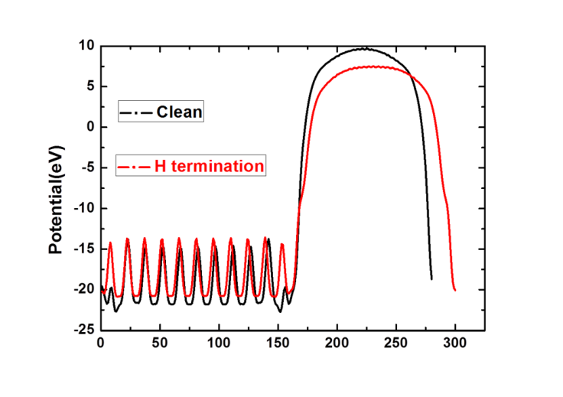
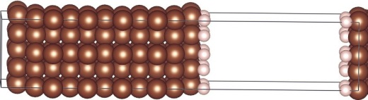
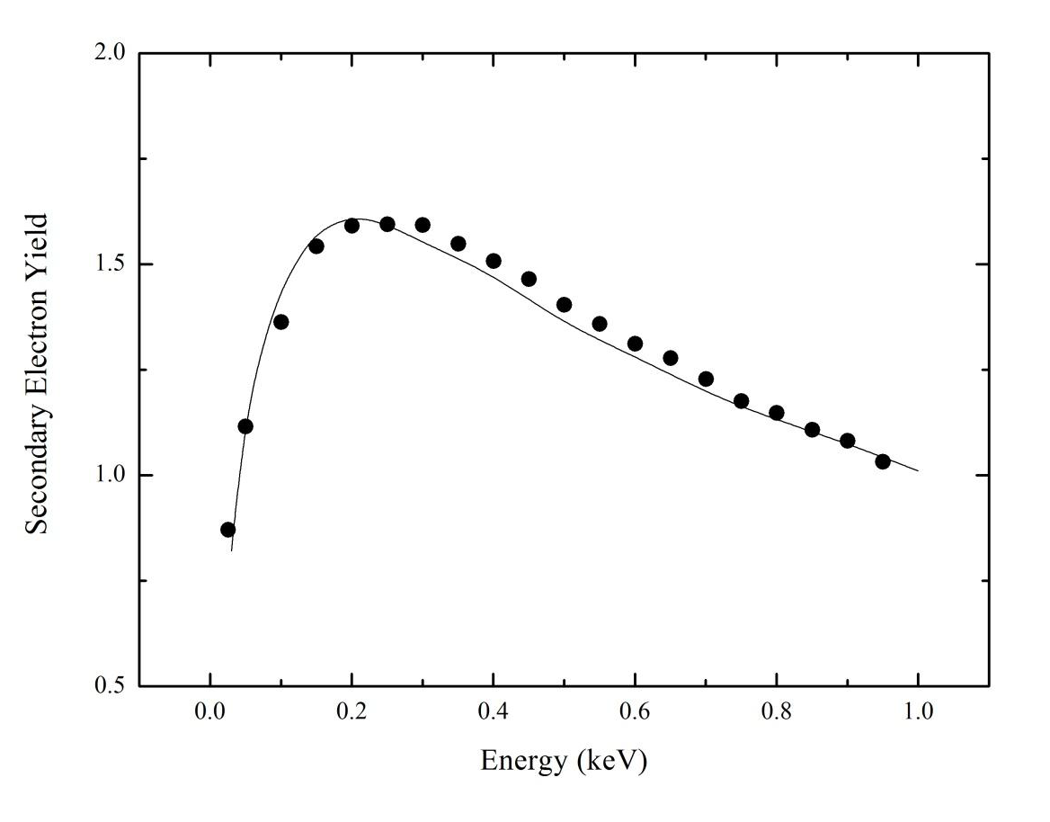
Density Functional Theory simulations
Electronic
structure,
work function,
optical data
Vienna Ab-Initio Simulation Program
VASP
Monte Carlo simulations

Slide 11
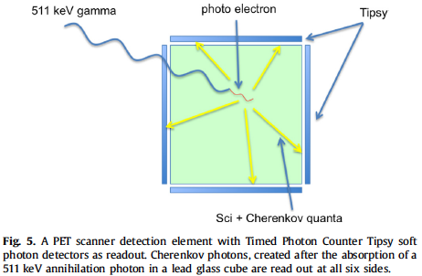
The Cherenkov-ToF-PET scanner

Slide 12
Future inner (central) tracker in collider experiments:
the Cherenkov tracker
very low detector mass
Tipsy layer at safe distance from interaction point
no extrapolation
Tipsy
Cylindrical layer
thin transparent foils
generating Cherenkov photons
The Vacuum Cherenkov CentralTracker

Slide 13
Tipsy’s only limitation: its efficiency equals the QE of photocathodes: 0.4 at best
Therefore: the High Quantum-Efficiency (QE) Photocathode
Window
glass, quartz, sapphire
graphene
[Alkali] monolayers
graphene
termination (Cs, H)
1 V
Active photocathode: drift field pushing electrons to emission vacuum surface
electric field created in between by potential defining graphene planes
all layers build up individually by atomic layer deposition ALD
electron emission stimulated by negative electron affinity by termination
First designed after ab initio simulations of 3D atomic building blocks
Proposal for theoretical concept study:
let is first understand the present state-of-the-art

Slide 14
The Tynode: a Transmission Dynode
with sufficient yield enabling the
construction of Tipsy 0.0
On behalf of the Membrane project:
Harry van der Graaf, Conny C.T. Hansson
Hong Wah Chan, Shuxia Tao, Annemarie Theulings, Violeta Prodanović, John Smedley, Kees Hagen, Yevgen Bilevych, Lina Sarro, Gert Nützel, Serge D. Pinto, Wouter de Landgraaf, Neil Budko, Behrouz Raftari
Supported by ERC – Advanced 2012 “MEMBrane” 320764
H. van der Graaf et al.: The Tynode: A new vacuum electron multiplier.
Nucl. Instr. & Methods, in press. http://dx.doi.org/10.1016/j.nima.2016.11.064. T
H. van der Graaf et al.: Potential applications of electron emission membranes in medicine.
Nucl. Instr & Methods, special Medical Physics issue on “Advances in detectors and
applications for Medicine”. A809 (2016) 171-174. http://dx.doi.org/10.1016/j.nima.2015.10.084.

