Slide 1



Integrated, scalable spectral sensors
A. Fiore, Ž. Zobenica, R.W. van der Heijden, T. Liu, M. Petruzzella, F. Pagliano, F.W.M. van Otten
Institute for Photonic Integration
Eindhoven University of Technology
Notes:
Eindhoven Uni of Technology, Fiore and van der Heijden

Slide 2
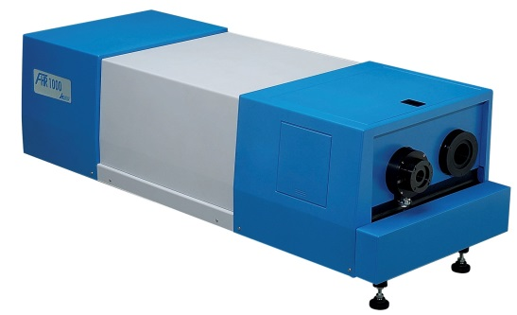
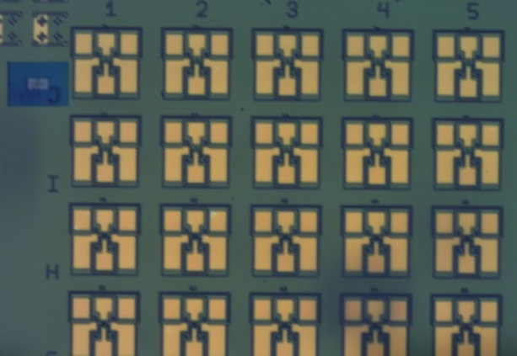
Our dream
Replace this:
With this:
1m
Microspectrometer
Table-top spectrometer
(or minispectrometer)
Bulky
Expensive (1’000-10’000 EUR)
High-performance
General purpose
Single-pixel
Integrated
Cheap (10-100 EUR)
High-performance
Dedicated to specific application
Arrays
Notes:
Using optics we can build fantastic sensors, for example sensors of wavelength or displacement. ..
... . What this talk will be about is bringing these key functionalities to a nano-opto-electro-mechanical or NOEMS system on chip.

Slide 3
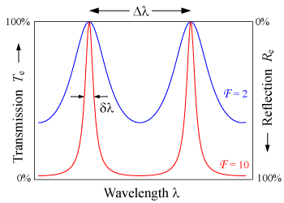
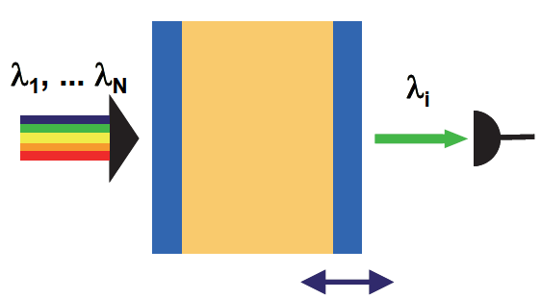
How to integrate a spectrometer
Getting spectral information by filtering
Fabry-Perot cavity
(resolution determined by the linewidth)
Key functionalities:
1) Filtering
2) Actuation
3) Detection
Notes:
To show what these functionalities are...
Using this cavity we can do two things: because it is a filter we can get info about the spectrum

Slide 4
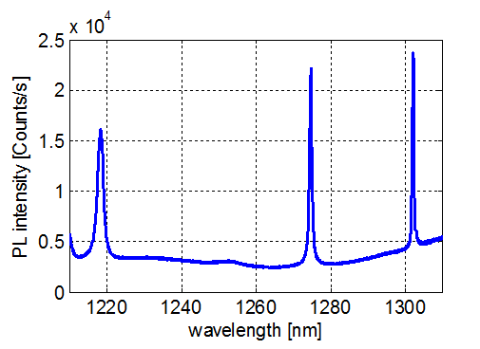
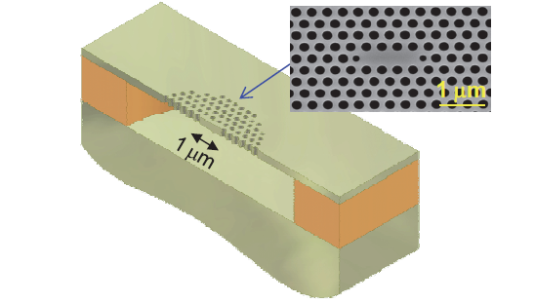
Filtering with photonic crystal cavities
Photonic crystal slab
  Very high Q factor possible (up to 10⁶)
  Small Volume ~ λ³ → Large free spectral range possible
  Light mass (~ 10 picograms) → high speed
Notes:
For the type of cavity in our sensing systems we chose a PhC slab cavity, because of its small size and high Q factor (small linewidth).

Slide 5
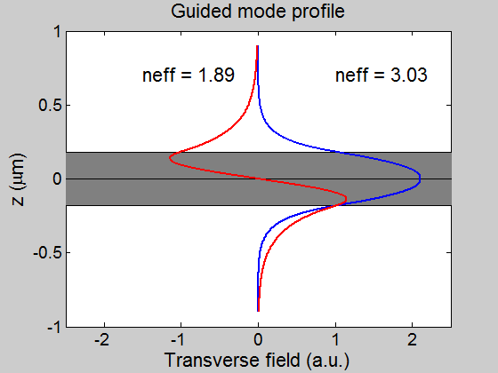
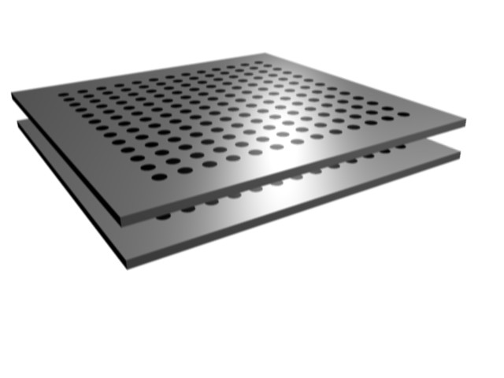
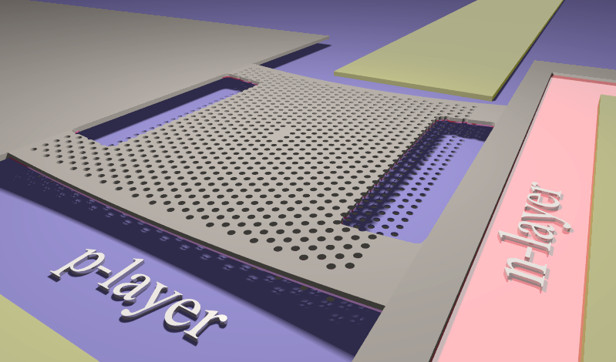
Cavity actuation
Double-membrane structures:
Change effective index
Electrostatic actuation:

Slide 6
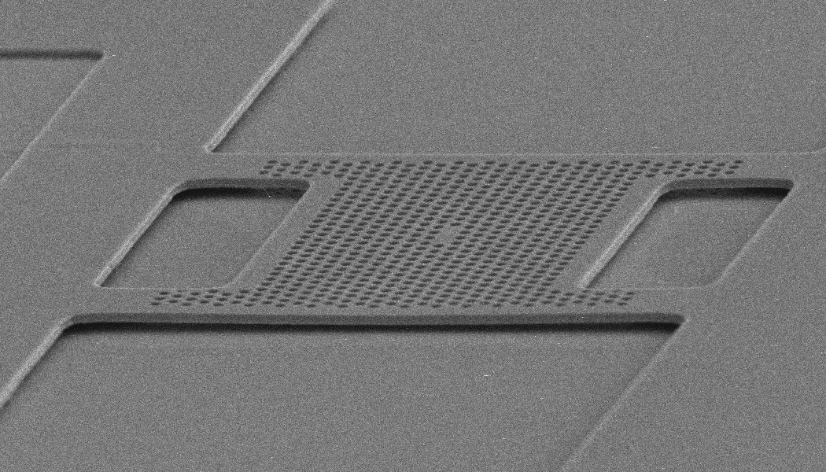
Nanomechanical cavities
Experimental tuning range:
20-30 nm

Slide 7
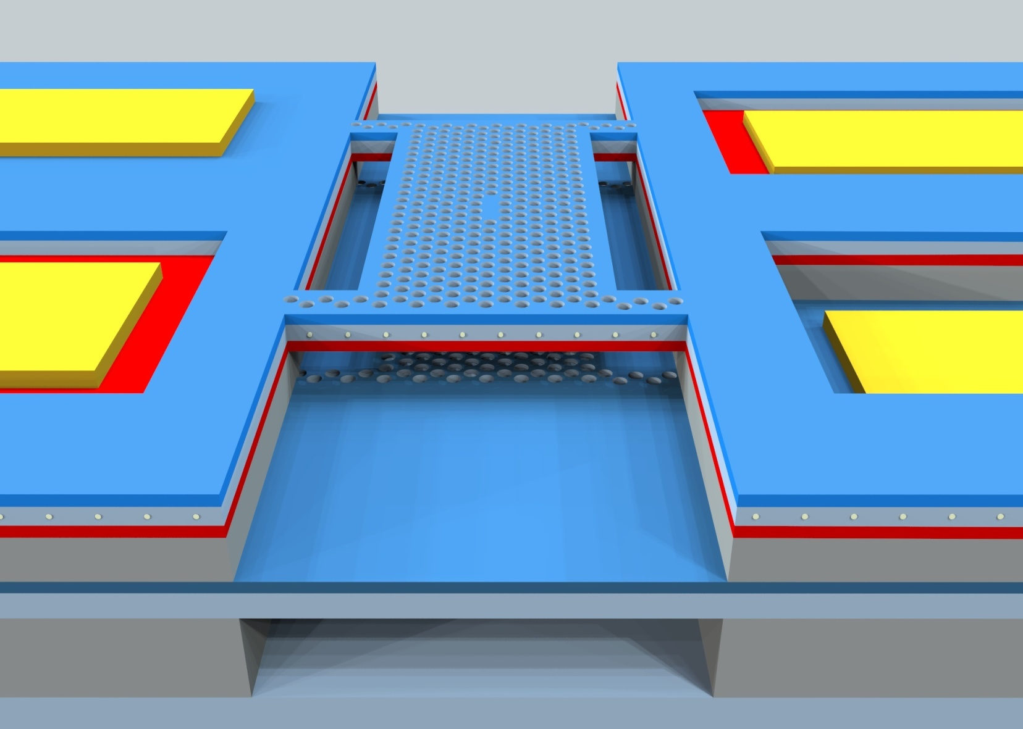

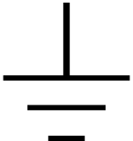
Integrated microspectrometer
I_{ph}
Sensing
R
V_{T}
On-chip
read-out
Integrated actuation
p+
QDs
n⁻
AlGaAs
p+
AlGaAs

Slide 8
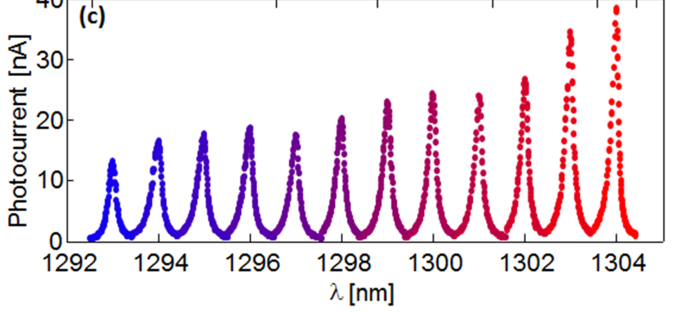
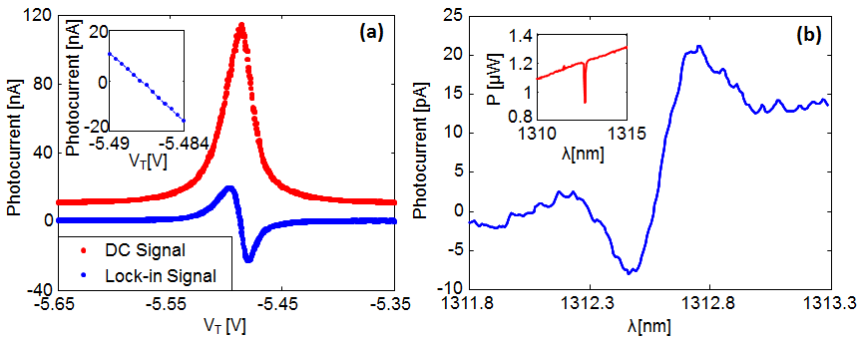
Microspectrometers: Results
Sharp optical resonances:
Tuning ⇒ Spectrum
HF absorption line (16 pm):
Example of application:
Gas sensing

Slide 9
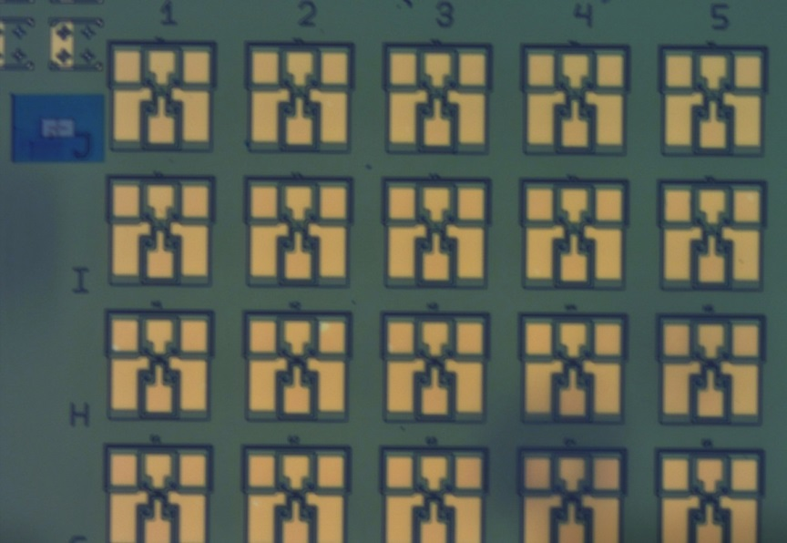
Microspectrometer: Perspectives
Present devices offer high resolution (100 pm) but low spectral range (20 nm)
Our next goal: Microspectrometer with 0.5-1 nm resolution, 200 nm spectral range in the 1500-2000 nm region
Applications:
Mobile healthcare (monitoring of glucose, triglycerides, …)
Gas sensing
etc
Notes:
Light source and spectrometer can be integrated and fitted in a smartphone
Imaging arrays can be fabricated
Concept can be extended to other types of optical detectors

Slide 11
PSN: Nano-opto-electro-mechanical systems
Electromechanically-tuneable photonic crystal cavity:
Optical resonance
Integrated photodiode
Tuning by electromechanical actuation:
Prof. Andrea Fiore

Slide 12
NOEMS: Application as microspectrometers
HF absorption line (16 pm):
Can measure emission or absorption lines
Resolution down to 100 fm/(Hz)^{0.5}
Fully-integrated, mass-manufacturable
Patent filed

Slide 13
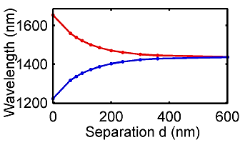
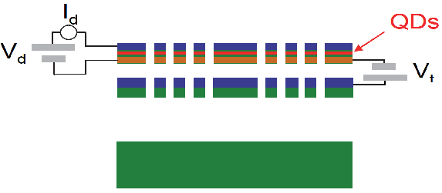
2) Nano-opto-electro-mechanical actuation
Double-membrane photonic crystal
Modes hybridize and form supermodes
Changing separation tunes the supermodes
Electrostatic actuation via p-i-n junction
s-mode
n⁻
n⁻
n⁻
d
as-mode
p+
↗
s
as
L.Midolo et al. APL 98, 211120 (2011)
Notes:
The challenge here is how to utilize these fantastic filters by spectrally shifting them? One solution is to couple two identical cavities by putting them close together vertically.

Slide 14
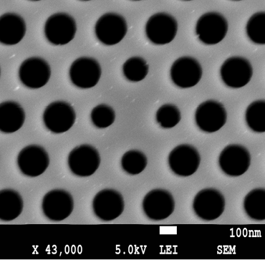
Nanomechanical tuning: experimental results
23 nm tuning of monopole mode in H0 cavity:
Notes:
And with a small voltage up to 5V our double membranes can be fully tuned. Just to compare, in Si based MEMS devices

Slide 15
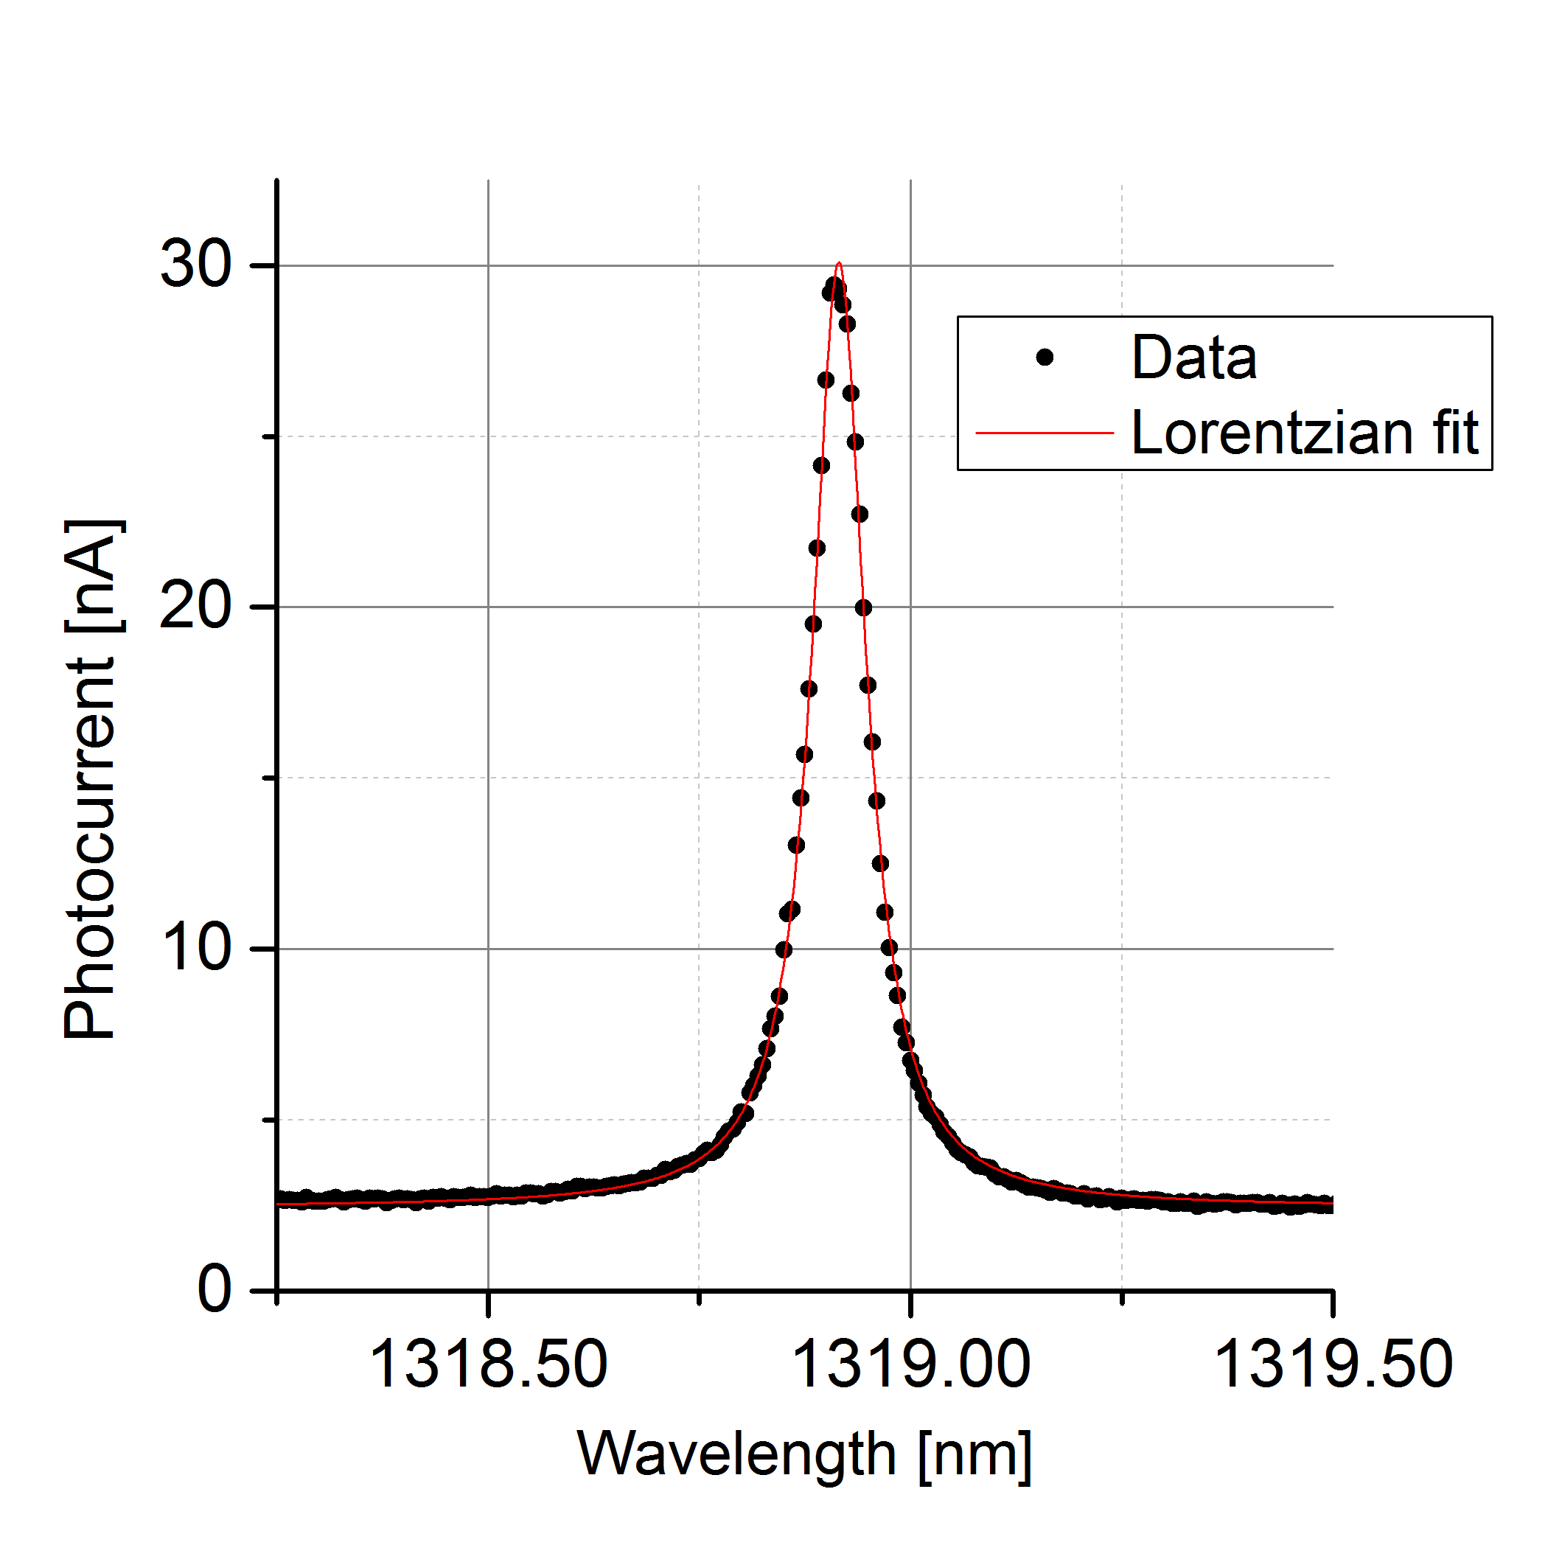
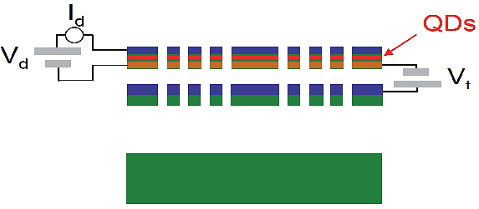


3) Detection
Absorber: Quantum dots inside the PhC slab
FWHM = 76 pm → Q = 17200
Vertical P-i-N photodiode
∆λ = 76 pm
(comparable to a table-top spectrometer)
Responsivity up to 20 mA/W
Light resonant with the cavity
I_{ph}
p+
n⁻
R
i (QDs)
Notes:
In a complete device, we have obtained a resonances with linewidths down to 76 pm...
... We achieve this Q using an L3 cavities custom optimized for the double membrane system
.. WG side coupling....

Slide 16
Concept:
Detector +
Tuneable Filter
I_{ph}
Sensing
R
V_{T}
On-chip
read-out
Integrated actuation
p+
QDs
n⁻
AlGaAs
p+
AlGaAs
Notes:
all together, very close on a chip.

Slide 17
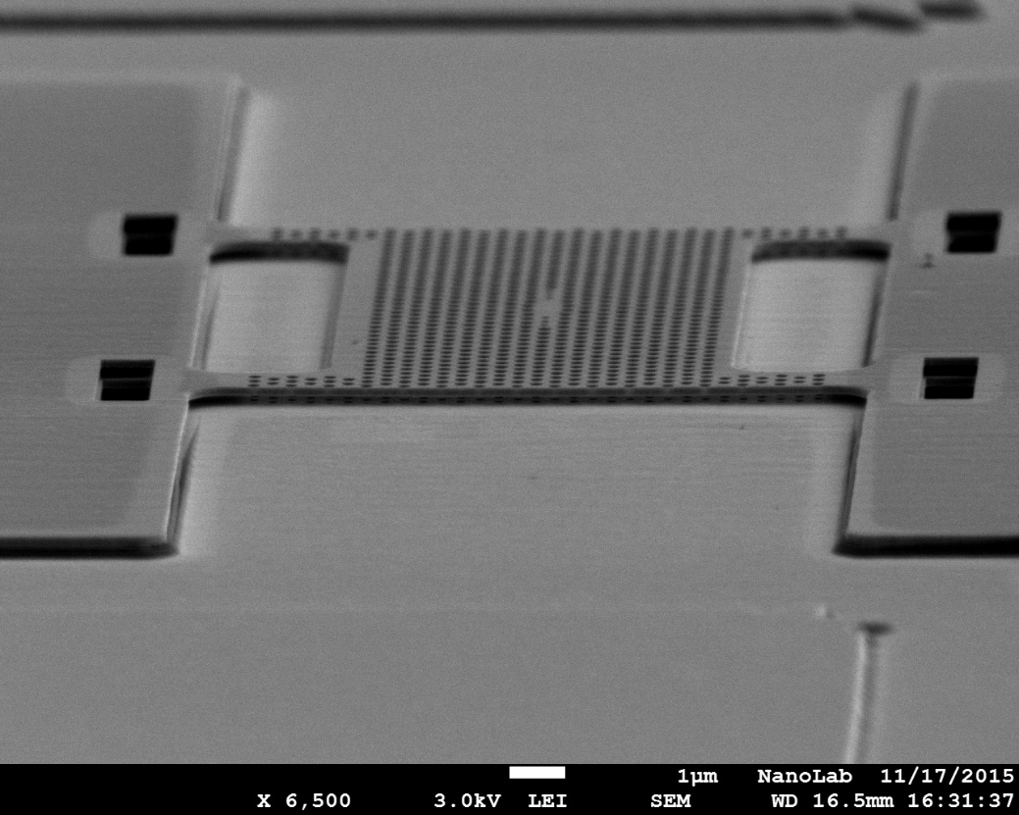
Fabricated structure
Notes:
all together, very close on a chip.

Slide 18
Sensing: Modes of operation
spectrum
Spectrometer action (tuneable filter):
- Changing Voltage changes λ
- Incoming light read as photocurrent
cavity
laser
Optomechanical displacement sensor:
Displacement transduced as a small change in photocurrent
cavity

Slide 19
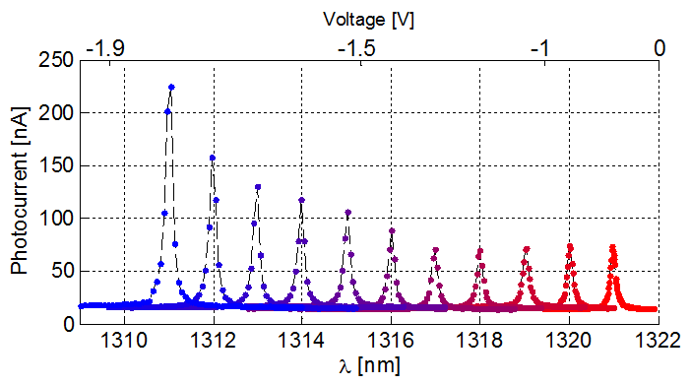
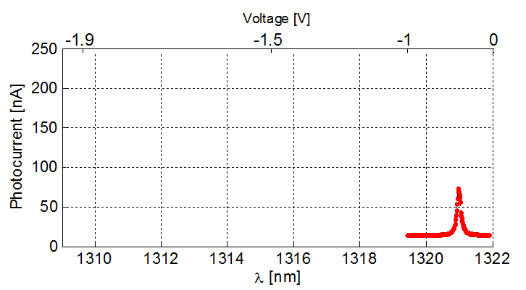
μ –spectrometer demonstration
laser
Measuring I_{ph} vs. V
Calibration V (λ)
Reconstructing spectrum I_{ph} vs. λ
cavity
λ_{L}
laser
laser
Resolution ∼ 150 pm
Responsivity changes due to changing field overlap with QDs
Notes:
.... We observe a change in responsivity with applied voltage. We understand this as a consequence of spatial mode redistribution with actuation, and therefore the overlap with the QDs changes.

Slide 20
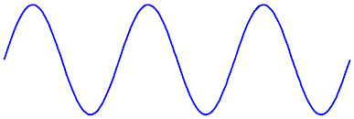
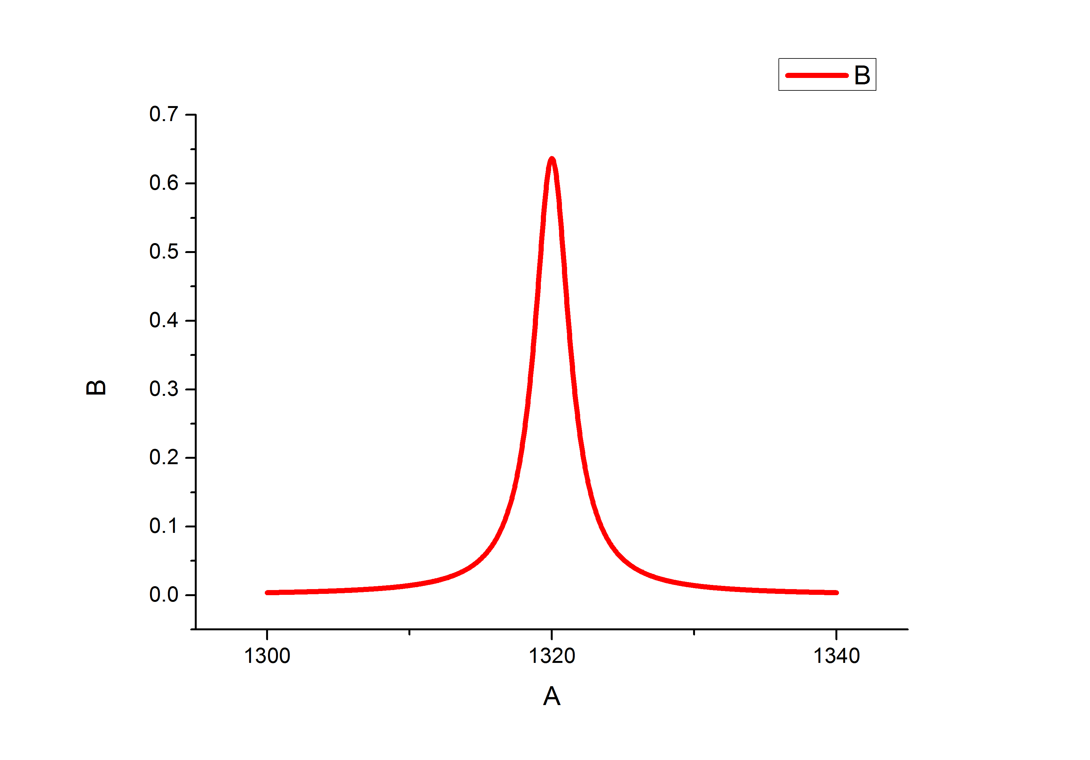
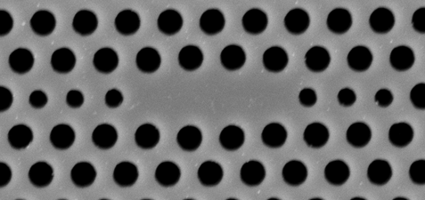

Signal to background limitation
Resonance modulation spectroscopy
S/BKG = I_{max}/ I_{BKG} < 20
I_{ph}
laser
laser
I _{max} -
Limited by the absorption of
the dots outside of the cavity resonance
No signal at frequency f !
I _{BKG}-
V_{T} –ΔV V_{T}+ΔV
V
Photocurrent at
frequency f
λ_{L}
AC signal
at frequency f
I_{ph}
R
ΔV sin(2πft)
V_{t}
Read
Oscillator
Lock-in
Amplifier
Notes:
Now, for our spectrometer sensor, we observe some signal out of resonance
Resonance modulation spectroscopy
..... By detecting the signal at frequency f we effectively measure the derivative of this curve. When the laser is further from the resonance, there will be no signal at f.

Slide 21
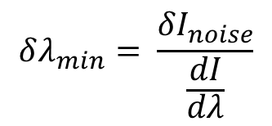

Demonstration of background suppression
Standard technique (DC):
S/BKG = 7 dB
Resonance modulation scheme
(DC + AC):
S/BKG = 30 dB
step =0.2mV
(≈0.5 pm)
Ultimate resolution is limited by noise:
*different device
$$δλ_{min}= \frac{{δI}_{noise}}{\frac{dI}{dλ}}$$
$$\sim 0.1 pm$$
Additional advantage:
Higher wavelength resolution on a single line

Slide 22
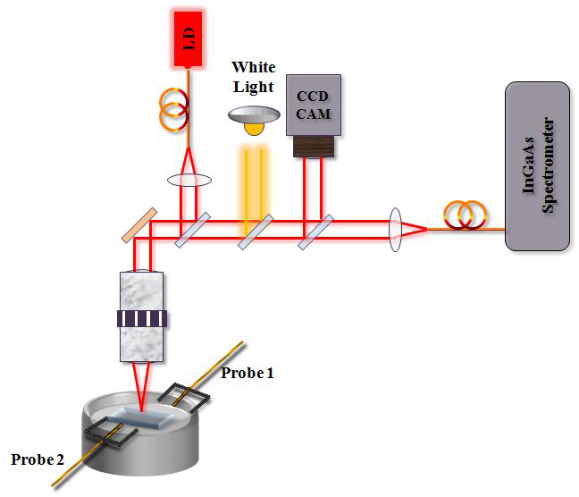
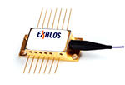
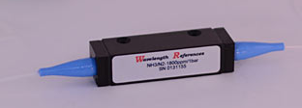
Application of microspectrometer in gas sensing
Measuring HF absorption lines in O-band
1312.591 nm
1318 nm
SLED
HF gas cell
filter
P(3) line: 1312.591 nm
16 pm linewidth, 6 dB depth (at 50 Torr pressure)
Use of resonance modulation scheme is crucial!
Notes:
Before I finish, l. Here we let the membrane freely move, and we measure displacement as noise in the output signal. To prove that we are sensitive to tiny displacements we measure the thermal Brownian motion of the membrane itself. 4 arm bridge acts as a light, 10 pg mechanical resonator, with a fundamental flexional out-of-plane mode at around 2MHz frequency.
... We reach very high sensitivity around 20 fm/sqrt(Hz)

Slide 23
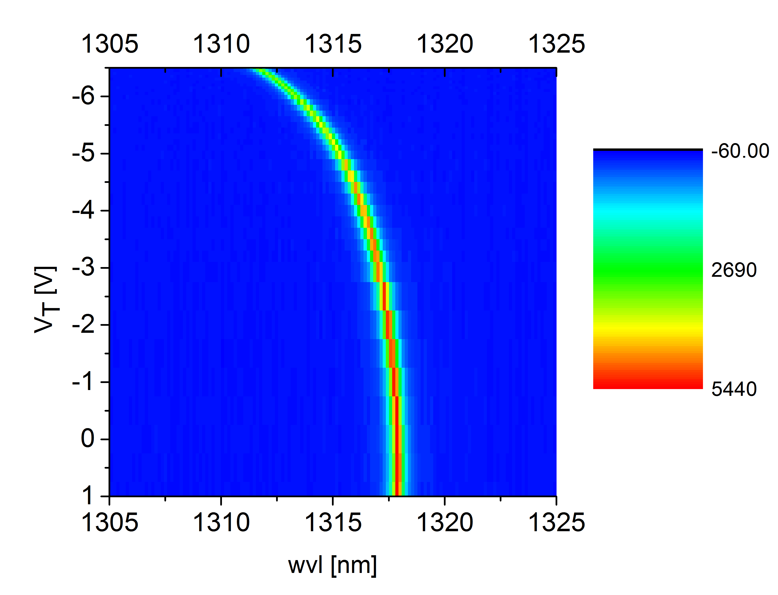
Gas sensing: Measurements
Excitation: SLED + HF cell + filter (1310 nm)
Detection: cavity mode sweeping
Calibration:
HF absorption line P(3) @ 1312.59 nm detected

Slide 24
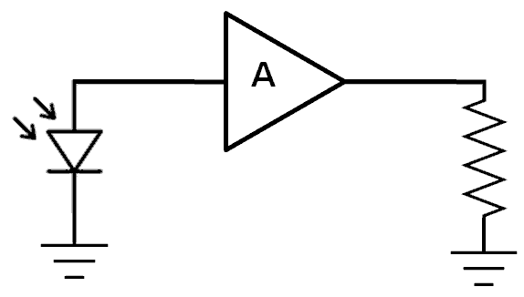
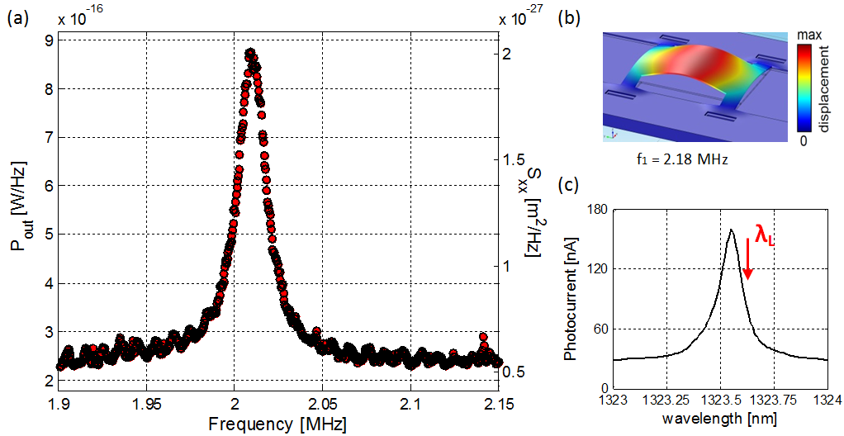
Displacement sensor demonstration
Measuring thermal motion:
ESA
Z=50Ω
m
Estimated amplitude of thermal motion:
z_{RMS} ≈ 20 pm (@RT)
Notes:
Before I finish, l. Here we let the membrane freely move, and we measure displacement as noise in the output signal. To prove that we are sensitive to tiny displacements we measure the thermal Brownian motion of the membrane itself. 4 arm bridge acts as a light, 10 pg mechanical resonator, with a fundamental flexional out-of-plane mode at around 2MHz frequency.
... We reach very high sensitivity around 20 fm/sqrt(Hz)

Slide 25
Displacement sensor demonstration
m
Estimated amplitude of thermal motion:
z_{RMS} ≈ 20 pm (@RT)
← Sensitivity < 100 fm/(Hz)^{1/2}
Notes:
Before I finish, l. Here we let the membrane freely move, and we measure displacement as noise in the output signal. To prove that we are sensitive to tiny displacements we measure the thermal Brownian motion of the membrane itself. 4 arm bridge acts as a light, 10 pg mechanical resonator, with a fundamental flexional out-of-plane mode at around 2MHz frequency.
... We reach very high sensitivity around 20 fm/sqrt(Hz)

Slide 26

Conclusions
μ-spectrometer with resolution down to 80 pm over a range of up to 23 nm
Resonance modulation scheme with high rejection ratio (30dB) and resolution (<1 pm when used as a wavemeter)
Application as gas sensor (HF detection)
Fully integrated optomechanical displacement sensor
All this in an integrated device, few tens of μm in size, suitable for mass production
Notes:
To conclude, we have shown a fully integrated photonic crystal –QD microspectr. ...
.. we have demonstrated to the best of knowledge the first fully integrated optomechanical displacement sensor by measuring the Brownian motion of our device.

Slide 27
Questions?

Slide 28
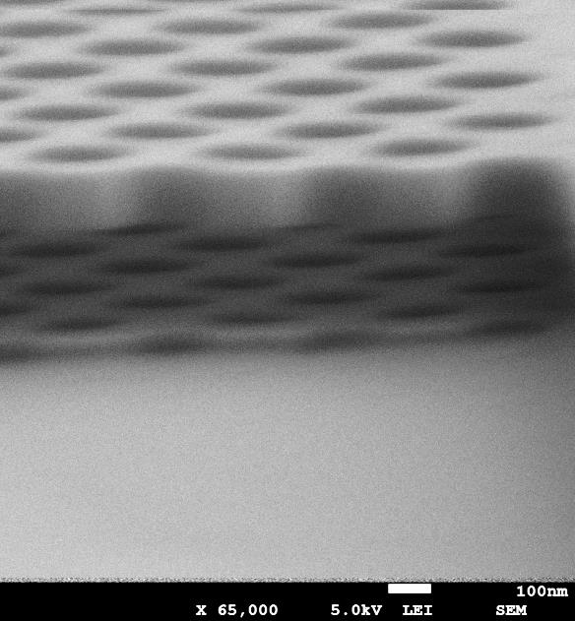
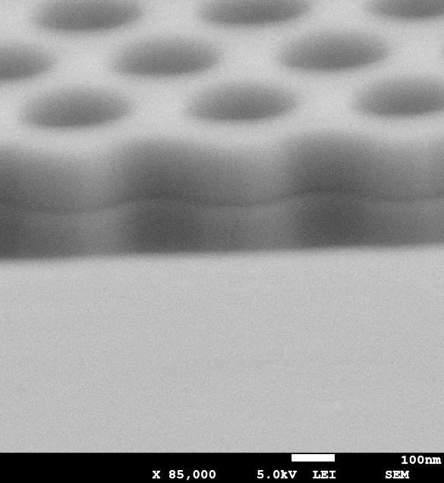
Tuning: pull-in limitation
Tuning is limited by pull-in effect
to 2/3 of nominal distance
s-mode
as-mode
Simulation: Tuning from d = 240nm to 160nm
provides: Δλ =28 nm
M.Cotrufo
Pull-in effect is not reversible
Notes:
Instead of having a spectral shift of up to 200 nm, due to the pull-in instability, the tuning of 1/3 of the nominal distance is possible

Slide 29


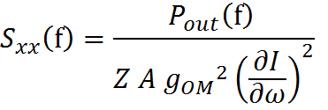

Displacement sensor demonstration- Measuring Brownian motion
Experimental:
Model:
Transduction currently limited
by diode speed (f_{cut-off} < f₁ )
Displacement PSD:
To be addressed: Non-ohmic contacts

Slide 30
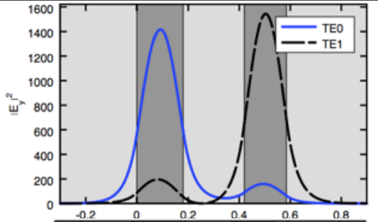
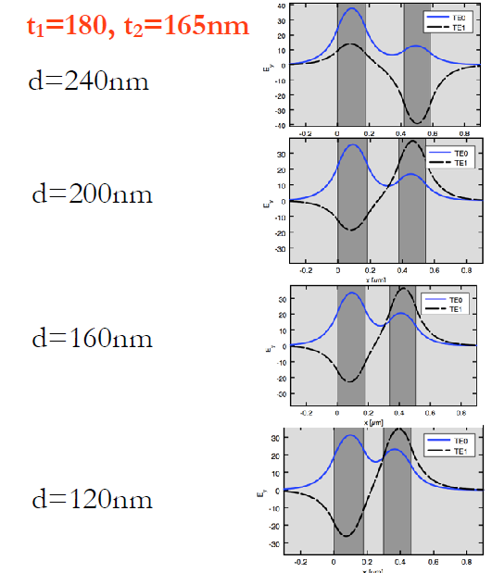
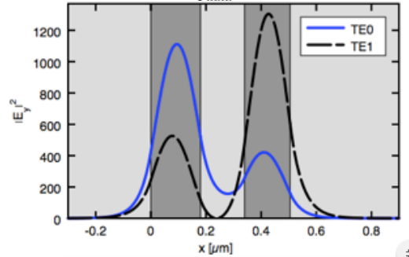
Mode distribution in an asymmetric system
|E|²

Slide 31
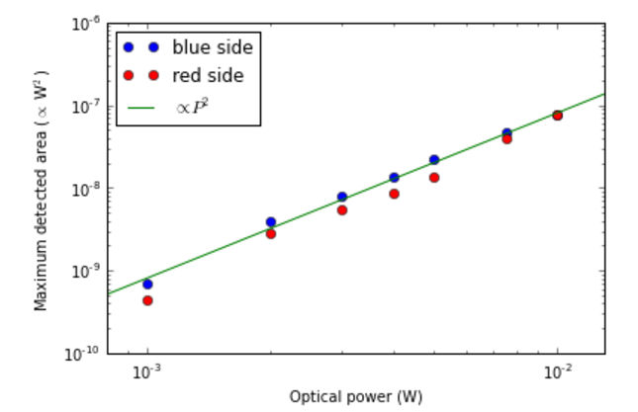
Surface under the curve vs. laser power
R. Leijssen

Slide 32
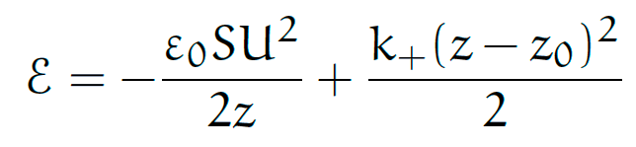
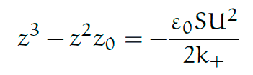
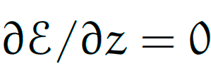
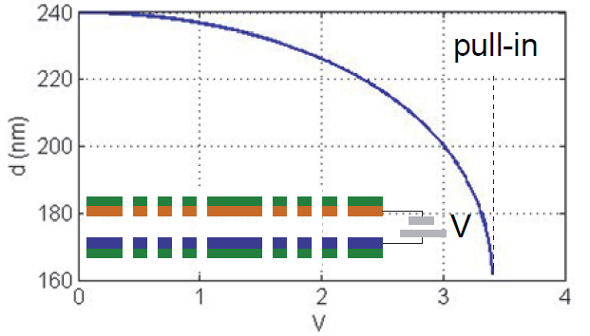
Pull-in
Tuning is limited by pull-in effect
to 2/3 of nominal distance
s-mode
as-mode
Electrostatic
Elastic
Simulation: Tuning from d = 240nm to 160nm
provides: Δλ =28 nm

Slide 33
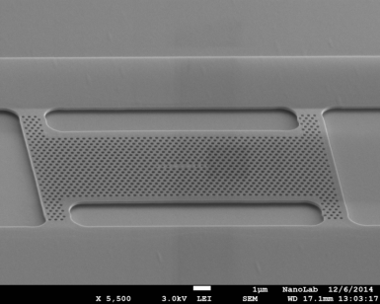
Current status: μ-spectrometer progress
Tuning range (Δλ) > 50 nm → (7nm extended to 25 nm)
Resolution (δλ) < 100 pm → (76 pm)
Free spectral range (FSR) > 50 nm → (up to 30 nm for H0 cavity)
Responsivity = 0.05 A/W → (up to 0.02 A/W)
Rejection ration > 15 dB → (30 dB)

Slide 34
non-resonant pumping
PL
non-resonant pumping
PL
resonant pumping
(λ sweep)
resonant pumping
(λ_{L} constant)
I_{ph}
I_{ph}
R
R

Slide 35
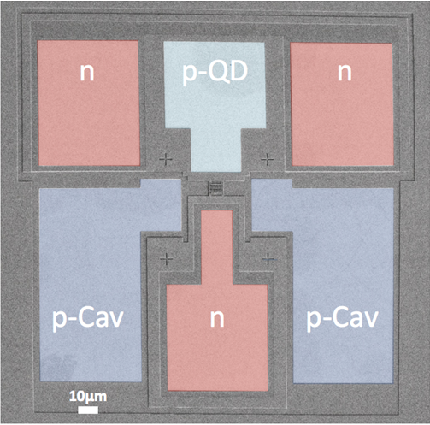
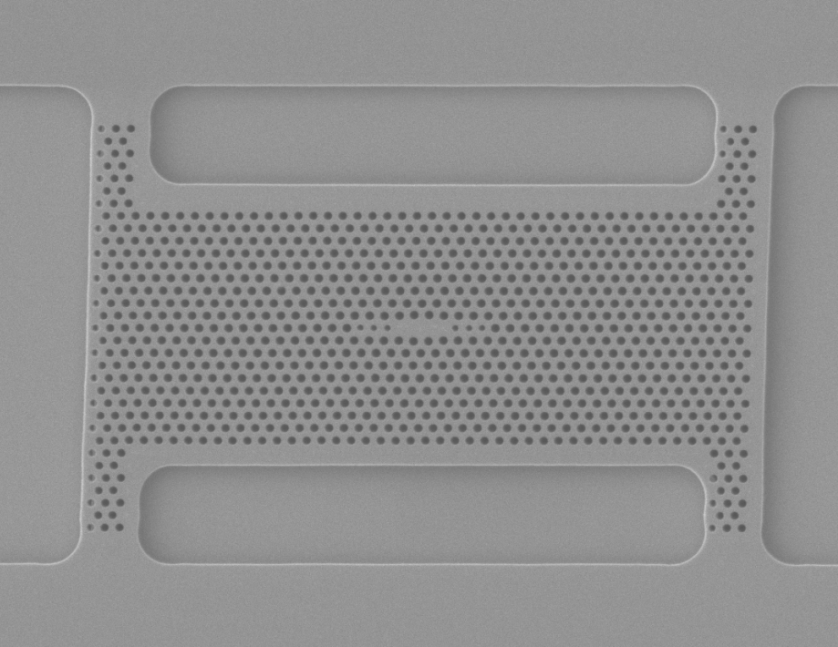
Fabrication of full devices:
Over 50 fabrication steps:
Multiple wet and dry etching steps
3 Optical lithography steps
(for defining contact pad positions)
Metal evaporation
Electron beam lithography
(for patterning the photonic crystal)
Double membrane device with an L3 modified cavity
Double membrane device with
highlighted contact pads
* M. Petruzzella

