Slide 1
GridPix CHIP3 plots. Gas mixture: Ne+CF4(10%)+isobutane(10%) TPC drift field ~300 V/cm
June 2024

Slide 2
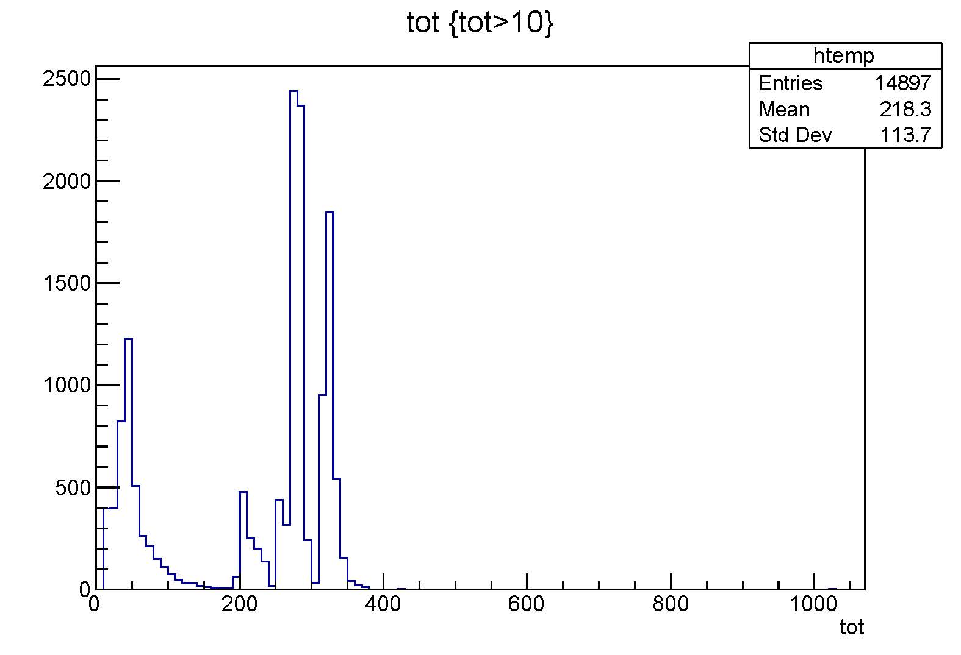
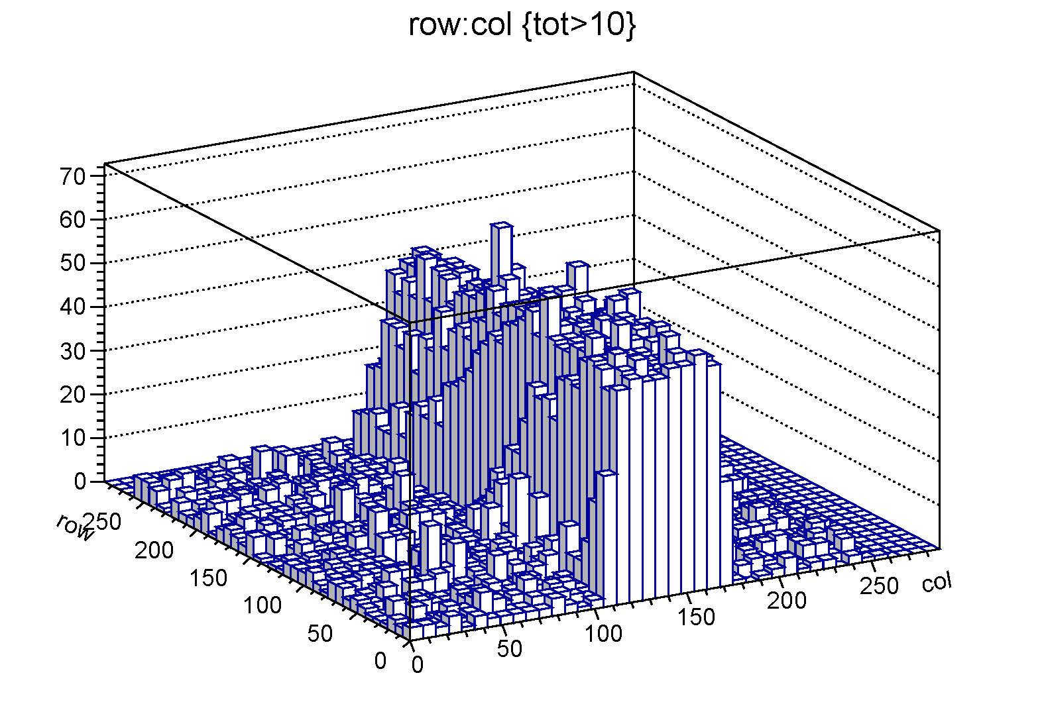
ToT and ToA-Row-Col “Noise”. HV ON, no Fe55 (all runs: 40 sec)

Slide 3
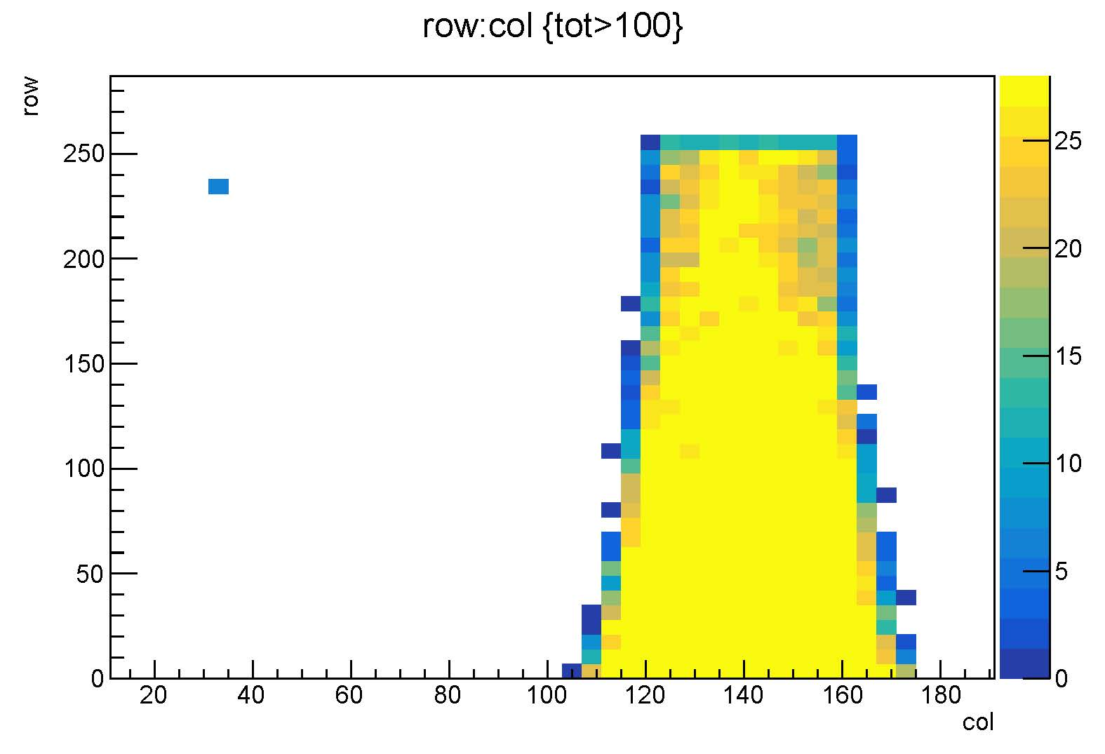
One of the first plot (Row-Col) after delivery and SW tuning

Slide 4
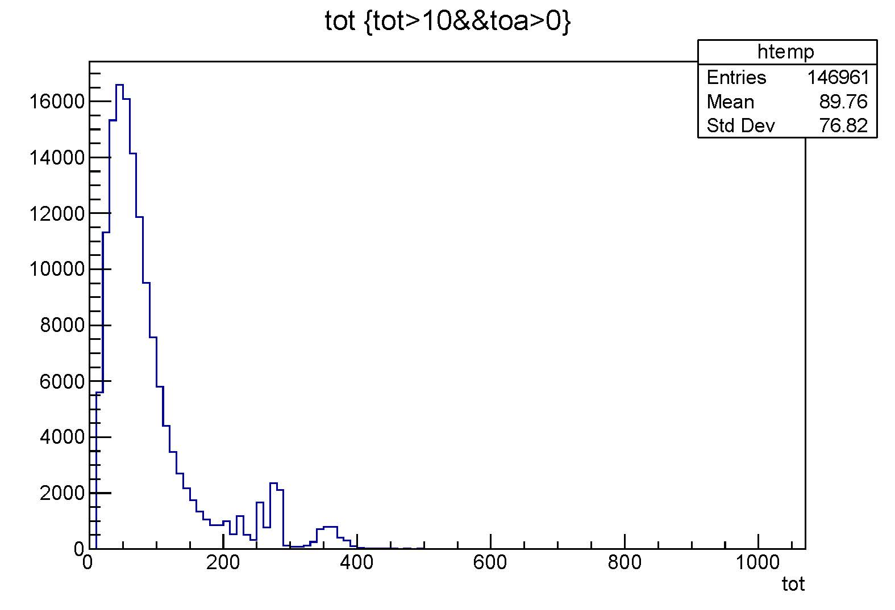
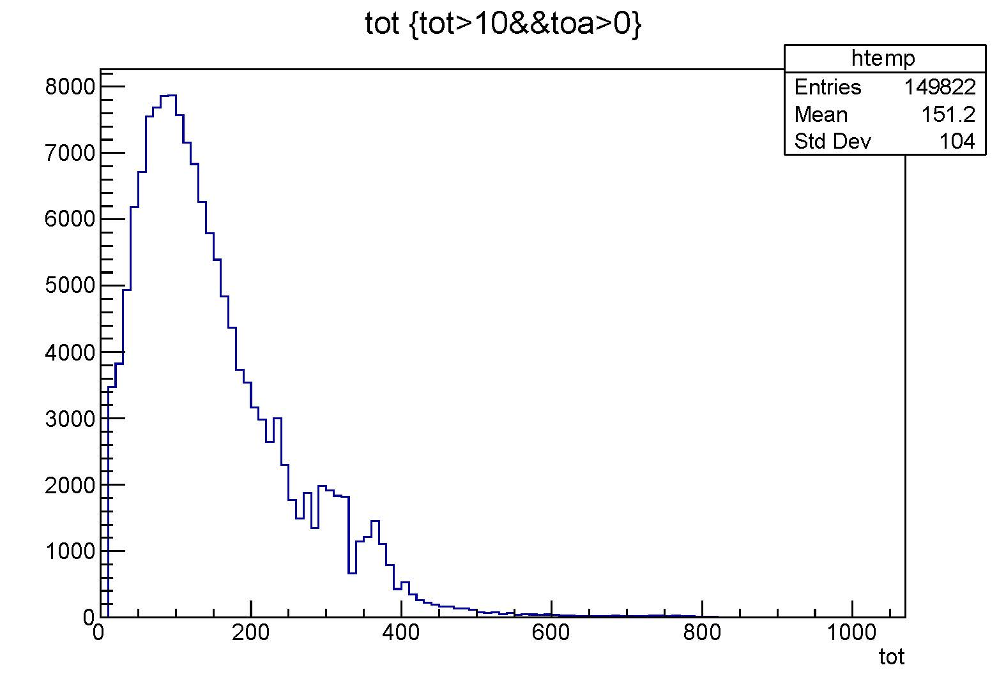
ToT for V mesh = 410V (left) and 440V. Fe55

Slide 5
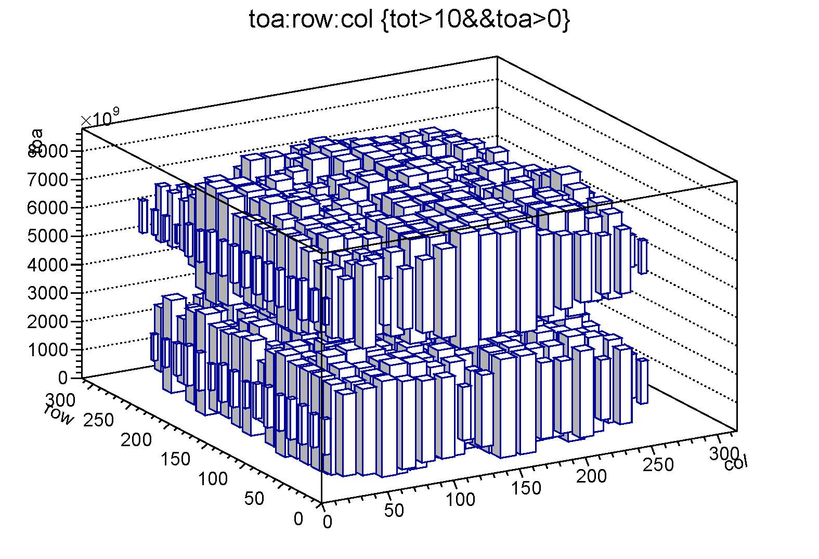
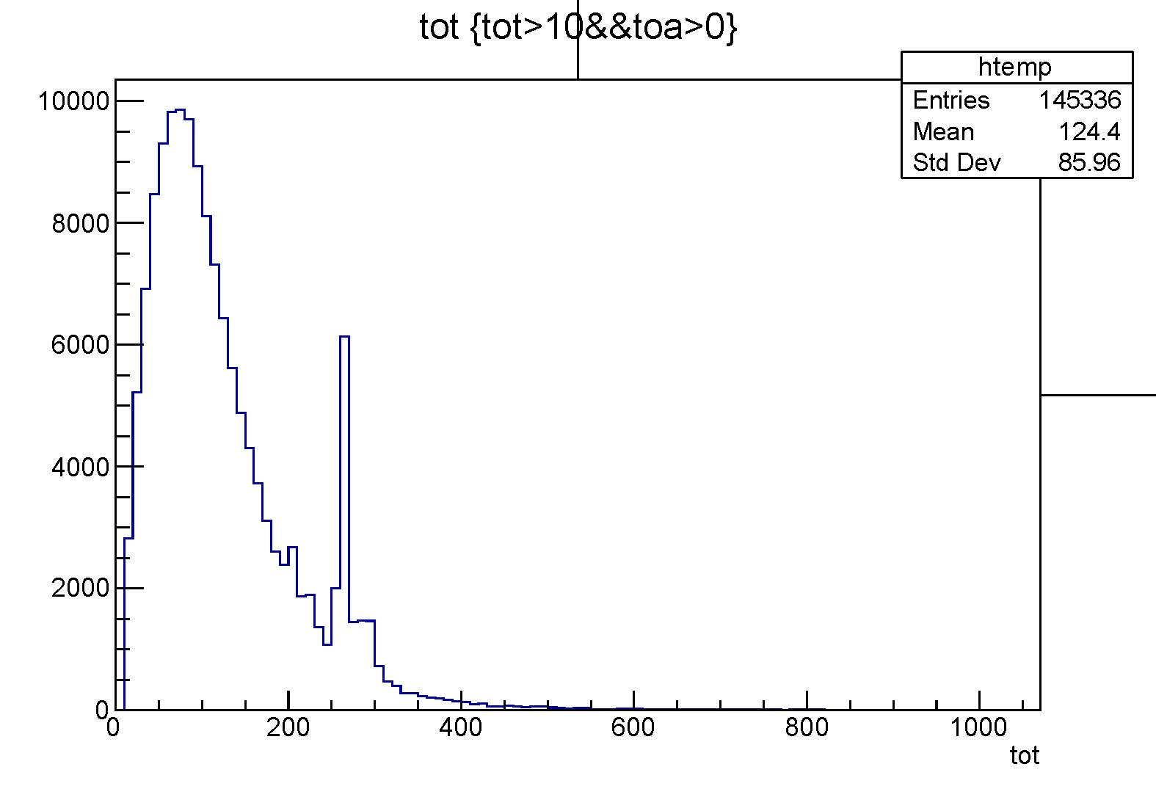
ToT and ToA-Row-Col for V mesh = 430V. Fe55

Slide 6
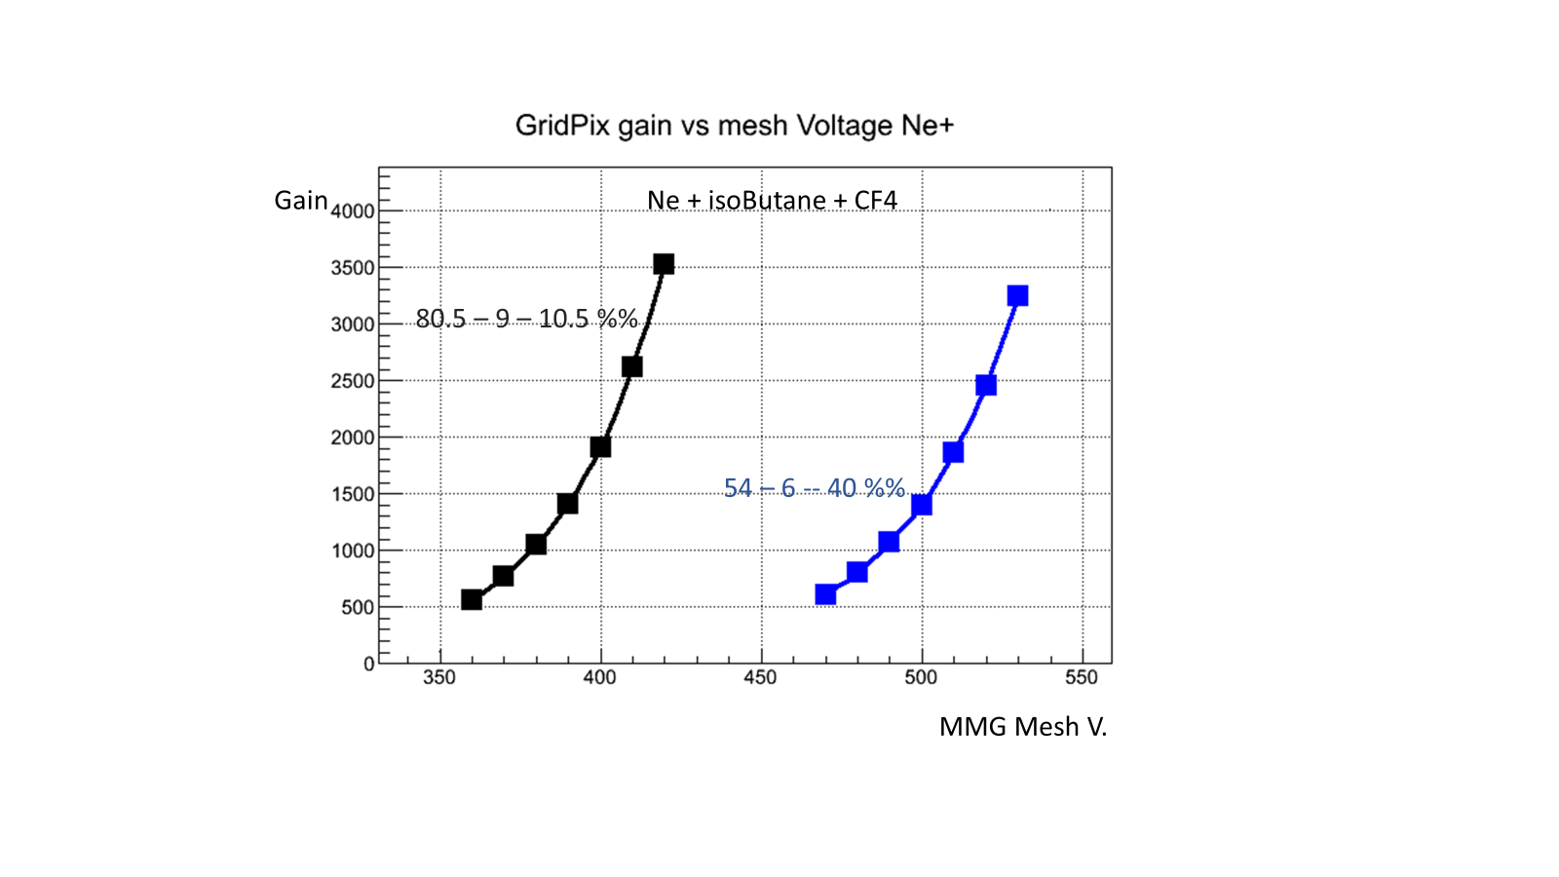

Slide 7
