Slide 1
MMG gain vs voltage with gas mixtures useful for TPC with GridPix readout
N. Smirnov
Physics Department, Yale University.
July, 2023.

Slide 2
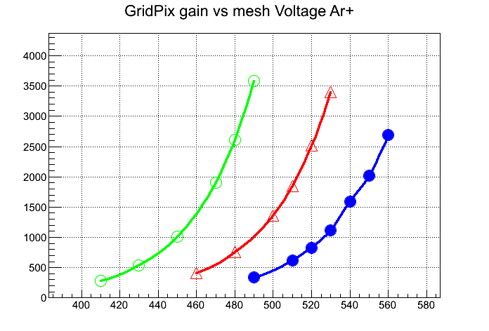
Gain
Ar + isoButane + CF4
72 – 8 -- 20 %%
80.5 – 9 – 10.5 %%
63 – 7 -- 30 %%
MMG Mesh V.

Slide 3
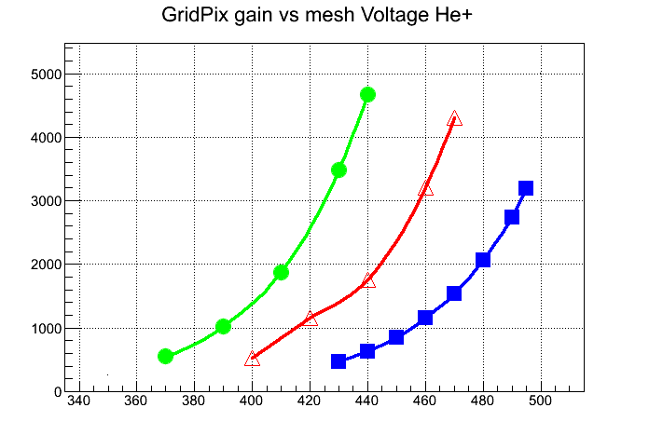
Gain
He + isoButane + CF4
72 – 8 -- 20 %%
80.5 – 9 – 10.5 %%
63 – 7 -- 30 %%
MMG Mesh V.

Slide 4
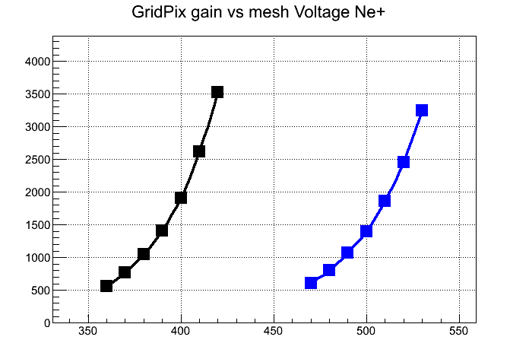
Gain
Ne + isoButane + CF4
80.5 – 9 – 10.5 %%
54 – 6 -- 40 %%
MMG Mesh V.

