Slide 1
A search for triple-Higgs production with the ATLAS detector at the LHC
MSc thesis presentation
Jochem Bakker
Friday July 12, 2024
Supervisors:
Tristan du Pree,
Carlo Pandini,
Osama Karkout

Slide 2
Outline of this talk
The Standard Model and the Higgs mechanism
HHH production at the LHC
The HHH(6b) Analysis
The self-coupling interpretation
Fitting setup and results: constraints on $κ_{3 }\text{an}\text{d} κ_{4}$

Slide 3
Particle physics:
What are fundamental building blocks of our universe?
How are they formed?
What laws govern their behaviour?

Slide 4
Atoms
Ancient Greeks: all matter is composed of atoms
1897: J.J. Thomson discovers the electron
1911: Rutherford atomic model with electrons that orbit nucleus

Slide 5
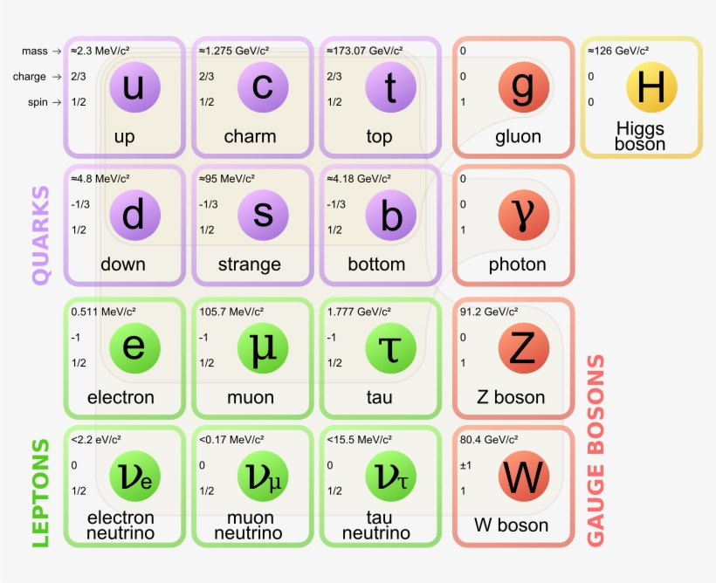
The Standard Model (SM)

Slide 6
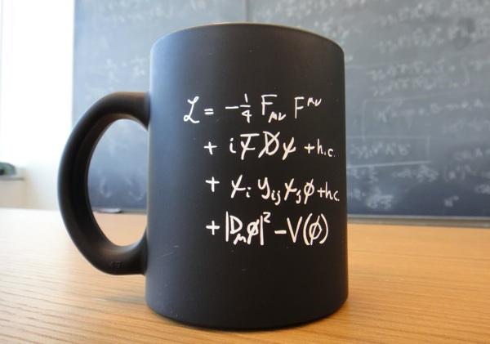
The Lagrangian $ℒ_{SM}$
Mathematical description of the SM: Lagrangian $ℒ_{SM}$
Fermions, gauge bosons and their interactions
The Higgs sector

Slide 7
The Higgs mechanism
The Higgs particle $Φ$ was proposed in 1964 to give rise to the mass of massive bosons and fermions
Potential: $V\left(Φ\right)=μ^{2}\left(Φ^{†}Φ\right)+λ{\left(Φ^{†}Φ\right)}^{2}$
Spontaneous symmetry breaking if $μ^{2}<0$
Higgs mass: $m_{H}=\sqrt{2λv^{2}}$
Higgs particle discovered in 2012!
$m_{H}=125$ GeV

Slide 8
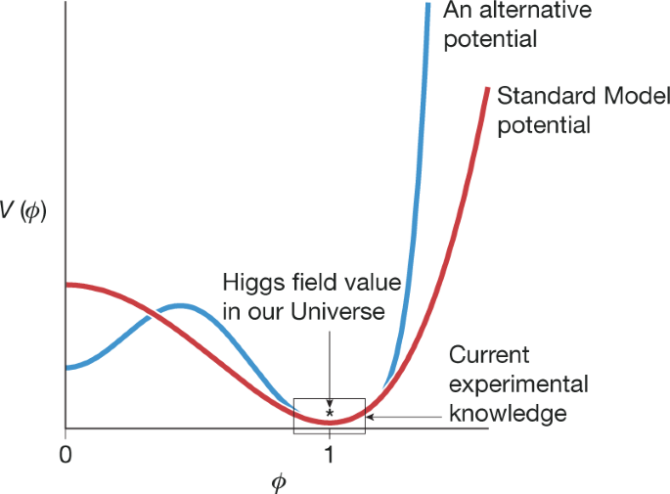
The Higgs potential
Rewriting:
$$V\left(h\right)=\frac{1}{2}m_{H}^{2}h^{2}+λ_{3}vh^{3}+\frac{1}{4}λ_{4}h^{4}+const.$$
Exact shape to be determined
Can provide solution in baryogenesis problem: why do we observe more matter than anti-matter?

Slide 9
The Higgs self-coupling
$$V\left(h\right)=\frac{1}{2}m_{H}^{2}h^{2}+λ_{3}vh^{3}+\frac{1}{4}λ_{4}h^{4}+const.$$
Kappa framework:
$$κ_{3}=\frac{λ_{3}}{λ_{SM}}$$
$$κ_{4}=\frac{λ_{4}}{λ_{SM}}$$
$$λ_{SM}=λ_{3}=λ_{4}∼0.13$$

Slide 10
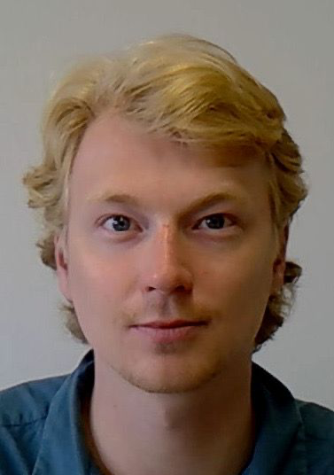
Di-Higgs and triple-Higgs production
We want to probe $κ_{3 }\text{an}\text{d} κ_{4}$. At Nikhef we research
HH production
$σ_{HH}∼30$ fb
HHH production
$σ_{HHH}∼0.1$ fb
$$κ_{3}$$
$$κ_{4}$$
$$κ_{3}$$
$$κ_{3}$$
$$κ_{3}$$

Slide 11
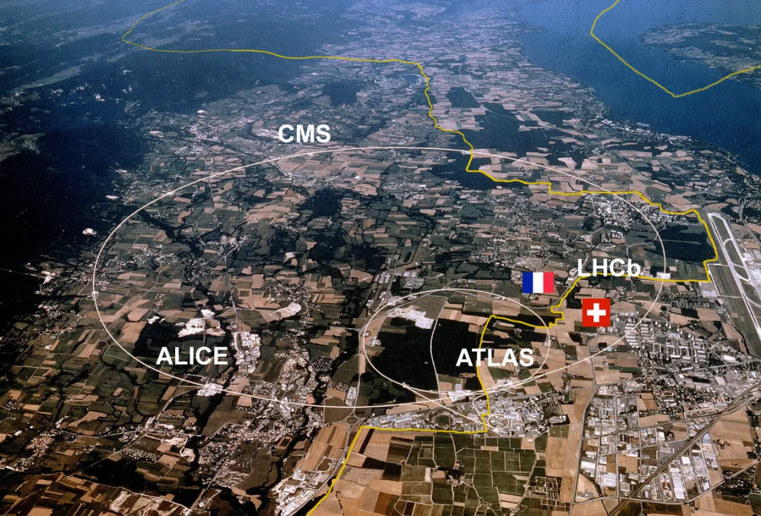
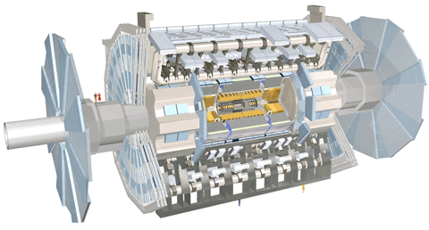
The Large Hadron Collider (LHC)
27 km long ring where protons are accelerated in opposite direction and collided
Four detectors placed at the collision points
This analysis conducted with LHC Run-2 data
Center of mass energy: $\sqrt{s}=13$ TeV
Integrated luminosity: 126 fb⁻¹

Slide 12
HHH events at the LHC
Expected SM HHH events at the LHC Run-2: $𝒪$(10)
But what if $κ_{3 }\text{an}\text{d} κ_{4}$ alter from their SM-prediction (1)?
$$κ_{3}$$
$σ_{HHH}^{SM}∼0.1$ fb
$$κ_{3}$$
$$κ_{4}$$
$$κ_{3}$$

Slide 13
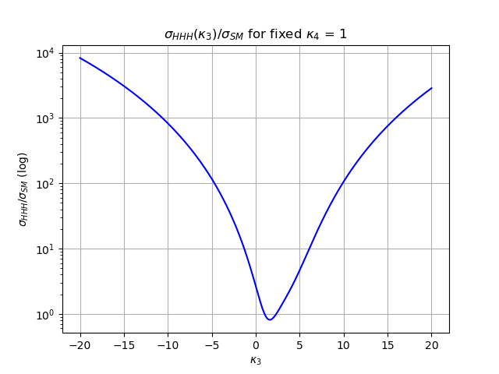
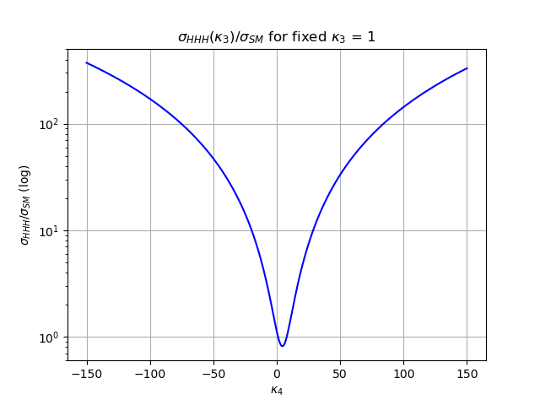
Varying the Higgs self coupling
HHH cross section ratio as a function of $κ_{3 }\text{and} κ_{4}$ (analytical formula):
$$\frac{σ_{HHH}\left(κ_{3},κ_{4}\right)}{σ_{HHH}^{SM}}=1+0.0309{(κ}_{3}−{1)}^{4}−0.2079{(κ}_{3}−{1)}^{3}$$
$+ 0.0407$ ${(κ}_{3}−{1)}^{2}{(κ}_{4}−1)+0.7384{(κ}_{3}−{1)}^{2}$
$$+ 0.0156{(κ}_{4}−{1)}^{2} −0.1450{(κ}_{3}−1){(κ}_{4}−1)$$
$$−0.1078{(κ}_{4}−1) −0.6887{(κ}_{3}−1)$$
~100 fb
~0.1 fb
$$κ_{3}$$
$$κ_{4}$$
$σ_{HHH}$ can be enhanced for non-SM values of $κ_{3 }\text{and} κ_{4}$!

Slide 14
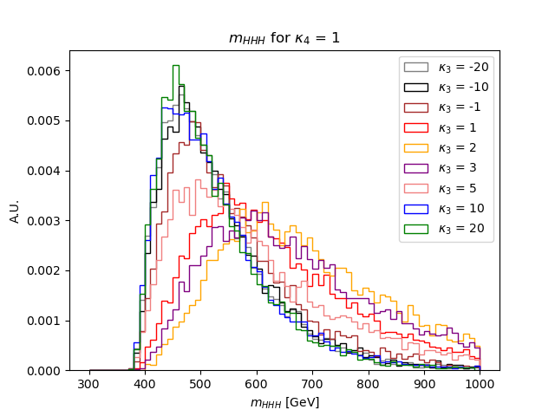
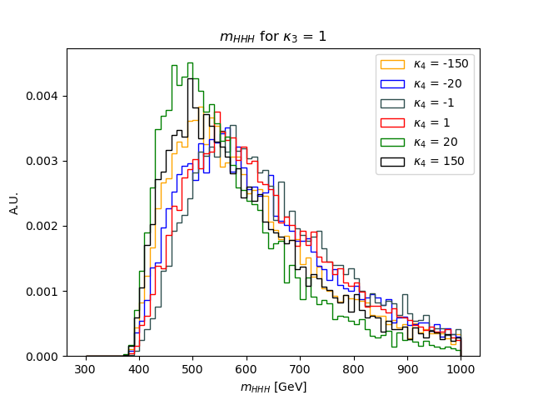
How does the kinematic of HHH change when 𝜅₃ and 𝜅₄ vary?
Parton level study for first look at HHH signal
I generated samples for different values of $κ_{3}$ and $κ_{4}$ (MadGraph model)
Especially for $κ_{3}$ significant changes in the $m_{HHH}$ distributions
SM
SM
varying 𝜅₃
varying 𝜅₄

Slide 15
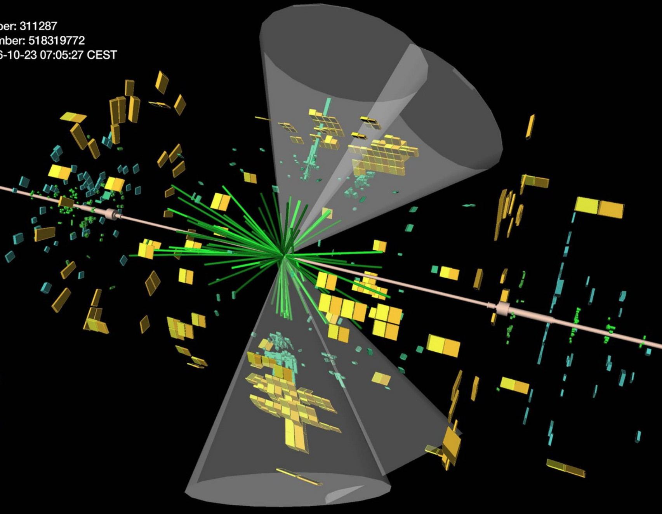
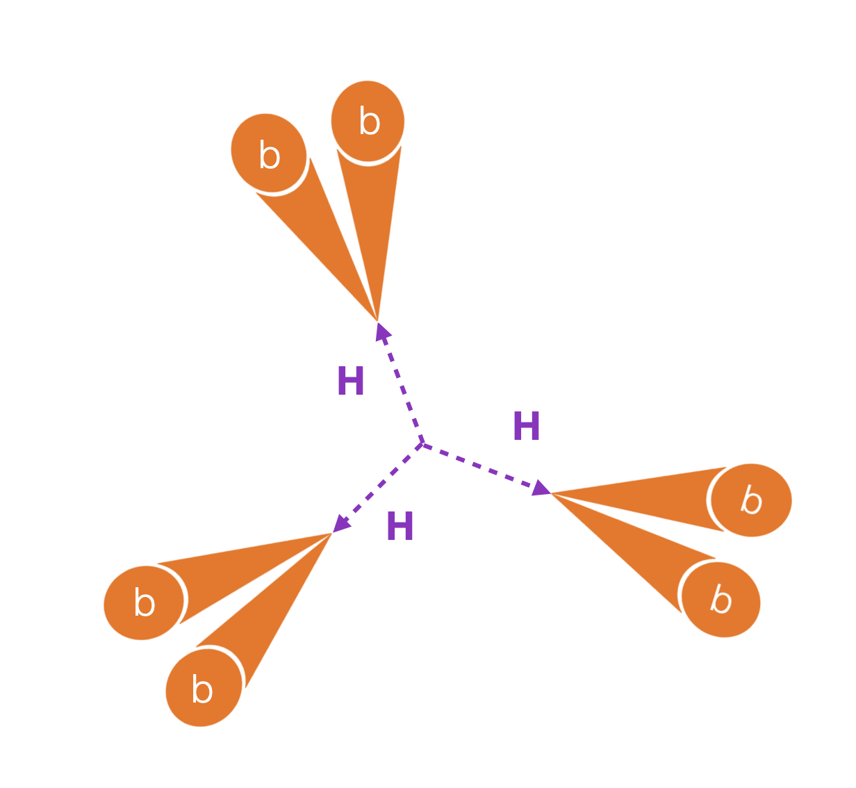
Higgs decay in the ATLAS detector
BR($H→b\overline{b}$) ~ 58% → 6b final state
b-quarks form b-jets. We want to detect these with the ATLAS detector

Slide 16
Event selection and categorization
At least 6 jets
At least 4 b-jets, at least 4 jets with $p_{T}$ > 40 GeV
Selected events
4 b-jets
5 b-jets
≥6 b-jets
This procedure is applied to both background events and signal events.
How are these samples formed?

Slide 17
Background modeling
Main source of background: QCD multi-jet production
Signal is expected in the 6b-region: SR $→$ blinded
6b-background modeled with 4b and 5b data: data-driven approach
Assumption: kinematic differences 4b $→$5b and 5b $→$ 6b the same

Slide 18
HHH signal for varying 𝜅₃ and 𝜅₄
We want to simulate the signal for varying 𝜅₃ and 𝜅₄
Computationally too extensive to simulate signal for complete 𝜅₃ and 𝜅₄ phase-space
We simulate the signal for 9 basis vector 𝜅₃,𝜅₄ -combinations (same MadGraph model)
Using the parametric formula we can now calculate the weights of any 𝜅₃,𝜅₄-combination
Basis vector:

Slide 19
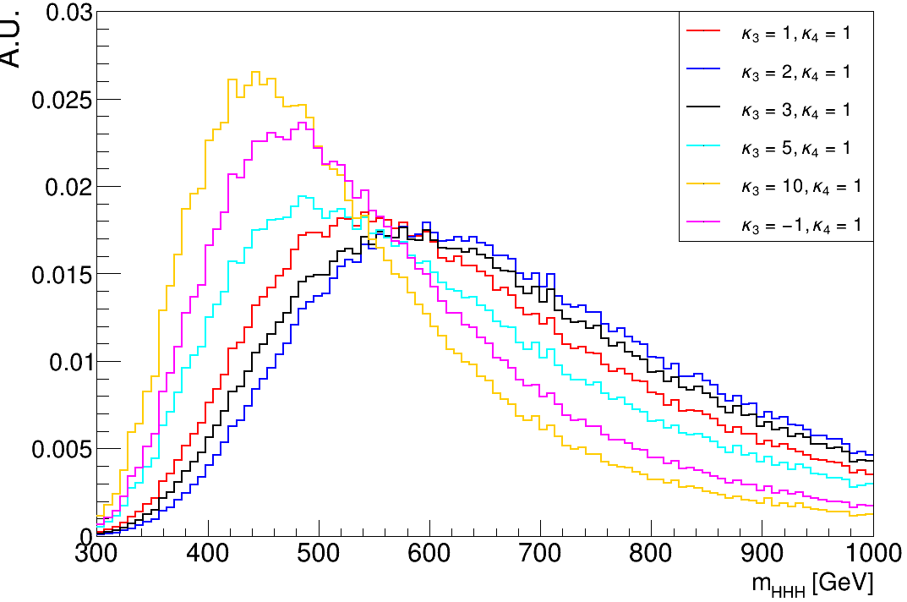
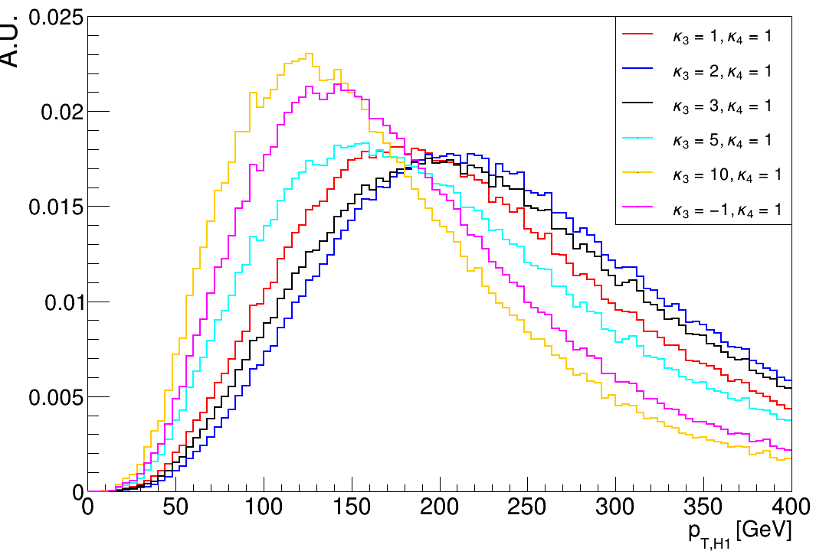
HHH(6b) kinematic distributions with varying 𝜅₃
$$mHHH$$
$$p_{T,H1}$$
SM
SM
Events after the full analysis selection show the same behaviour as in parton level studies

Slide 20
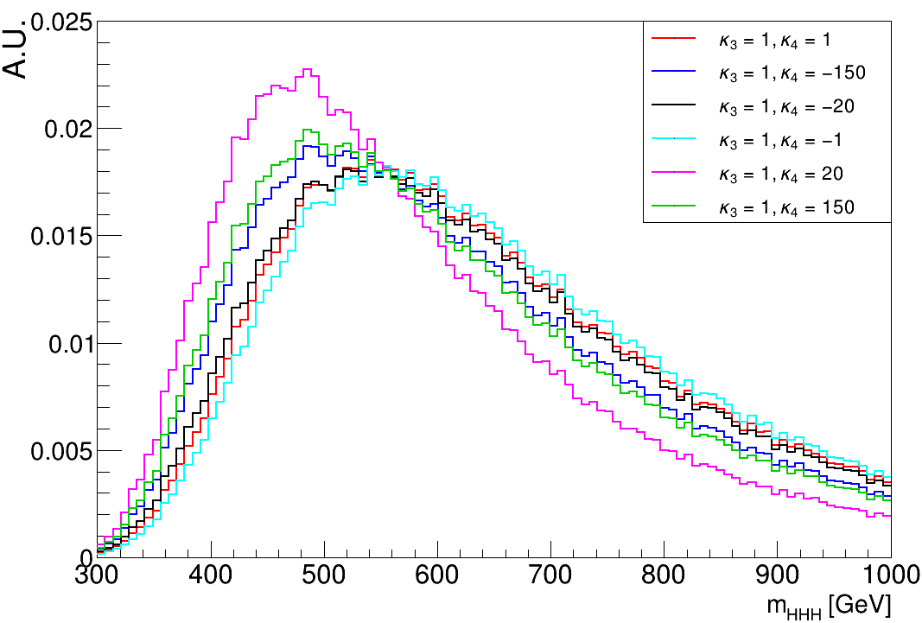
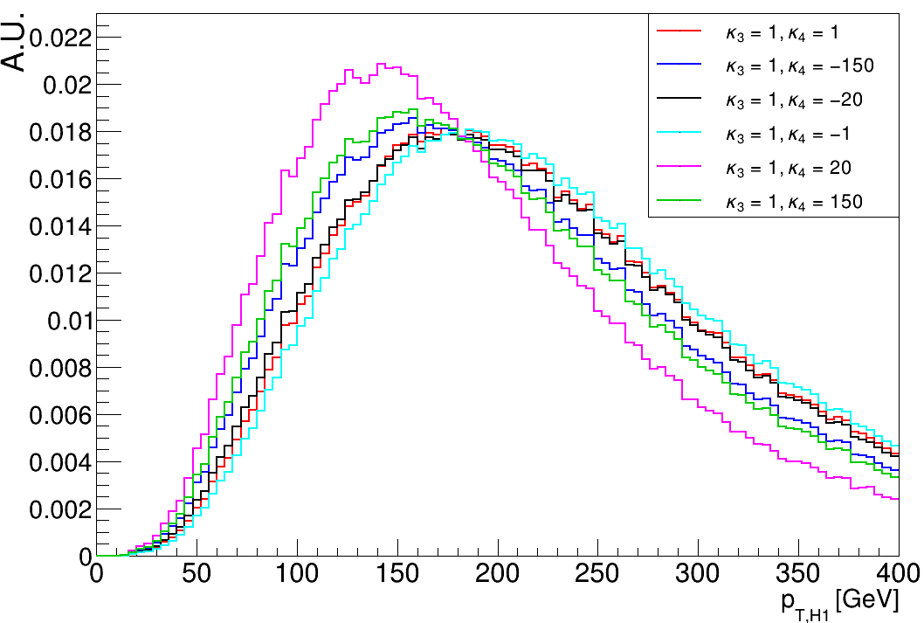
HHH(6b) kinematic distributions with varying 𝜅₄
$$mHHH$$
$$p_{T,H1}$$
SM
SM
Events after the full analysis selection show the same behaviour as in parton level studies

Slide 21
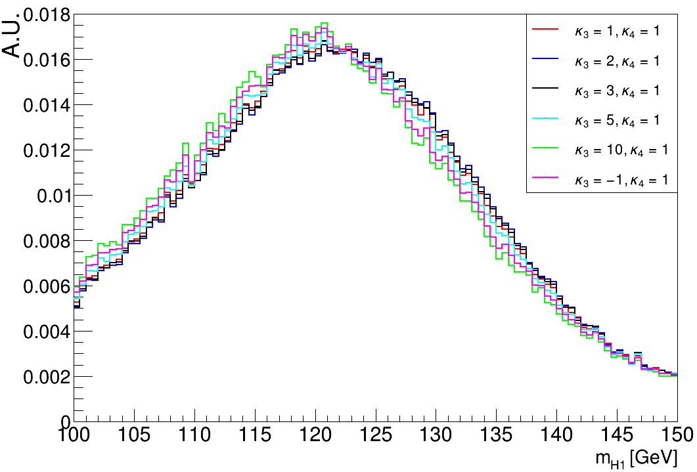
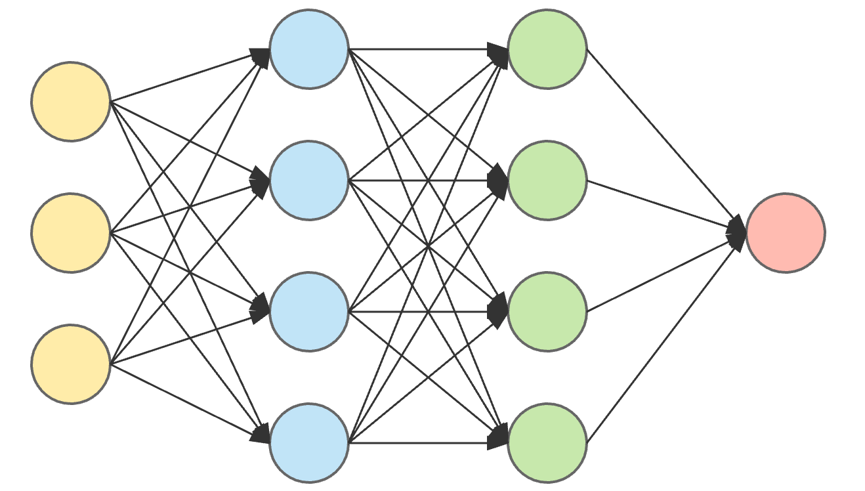
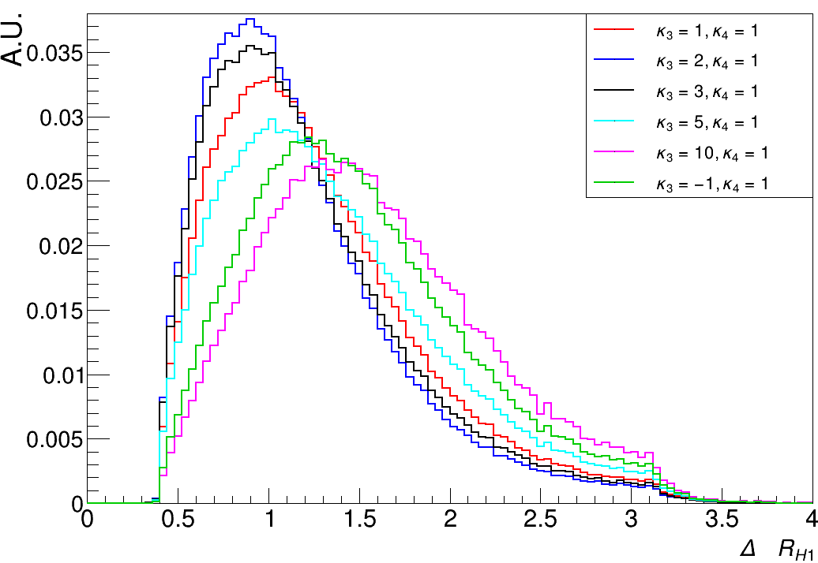
Discriminating signal from background
Discriminating variable: Deep Neural Network (DNN)
Input:
$$mH1$$
+
Output:
NN score
between 0 and 1
$$ΔRH1$$
+ …

Slide 22
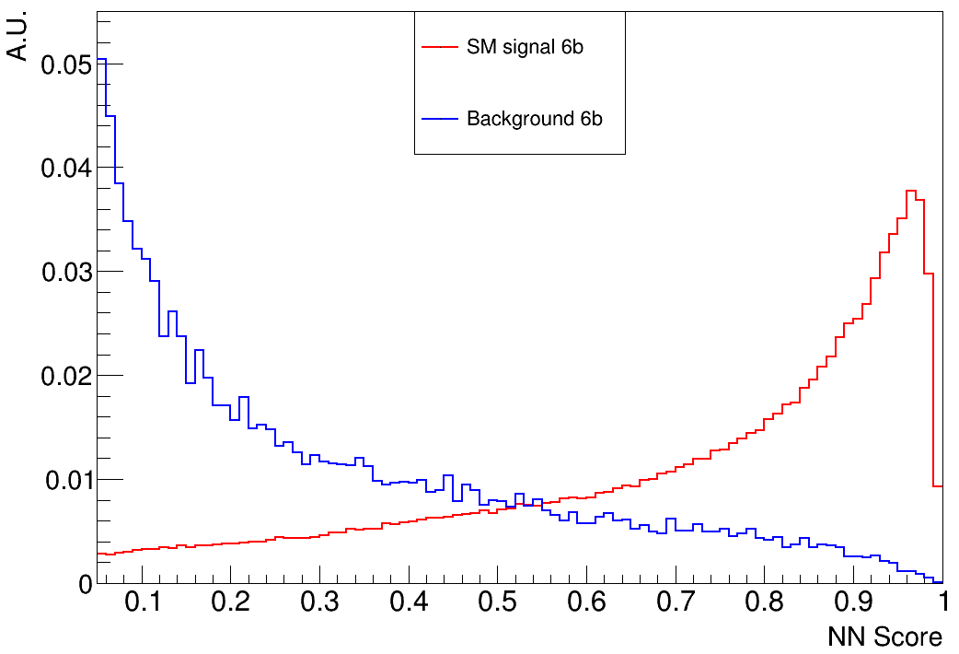
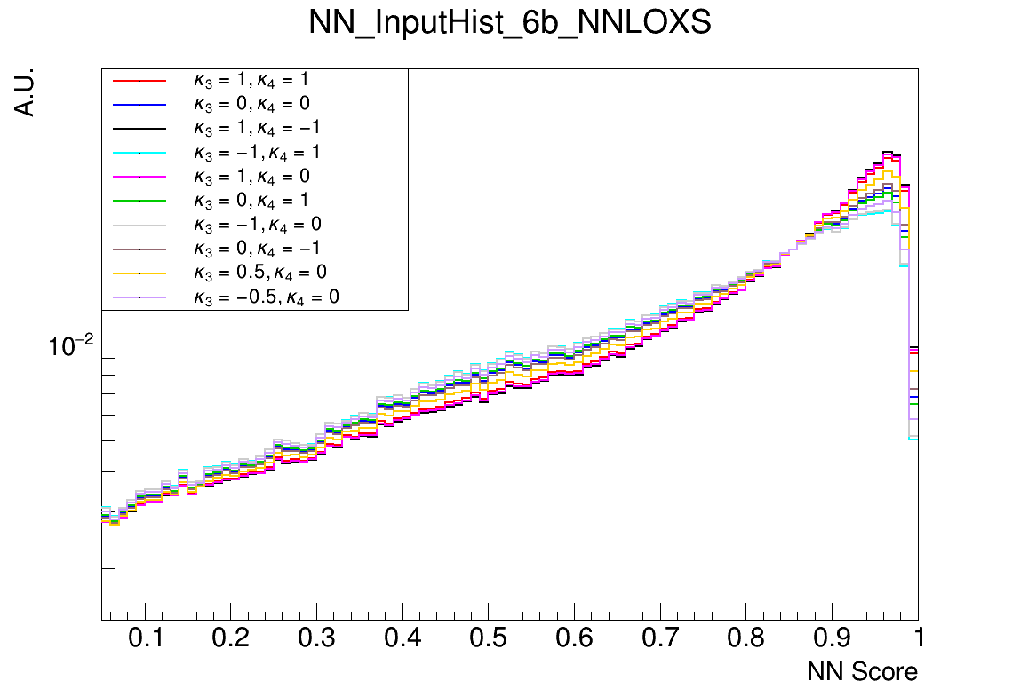
Signal vs background in HHH(6b) analysis
Data-driven approach to estimate background
SM signal vs background (6b region):
Basis vector signal samples (6b region):

Slide 23
Likelihood analysis
$$−\ln{λ\left(μ\right)}$$
Expected events in bin $i$: $E\left(n_{i}\right)=μs_{i}+b_{i}$
Likelihood function: $L\left(μ\right)=\prod_{j=1}^{N}{ \frac{{\left(μs_{j}+b_{j}\right)}^{n_{j}}}{n_{j}!}e^{(μs_{j}+b_{j})}}$
Likelihood ratio: $λ\left(μ\right)=\frac{L\left(μ\right)}{L\left(\hat{μ}\right)}$
Test statistic: $t_{μ}=−\ln{λ\left(μ\right)}$
$$\min\left(t_{μ}\right)+0.5$$
$$\min\left(t_{μ}\right)$$
$$\hat{μ}−σ$$
$$\hat{μ}$$
$$\hat{μ}+σ$$
$$μ$$
Minos errors
$$68\% CL (1σ): min\left(t_{μ}\right)+0.5$$
$$95\% CL (2σ): min\left(t_{μ}\right)+2$$

Slide 24
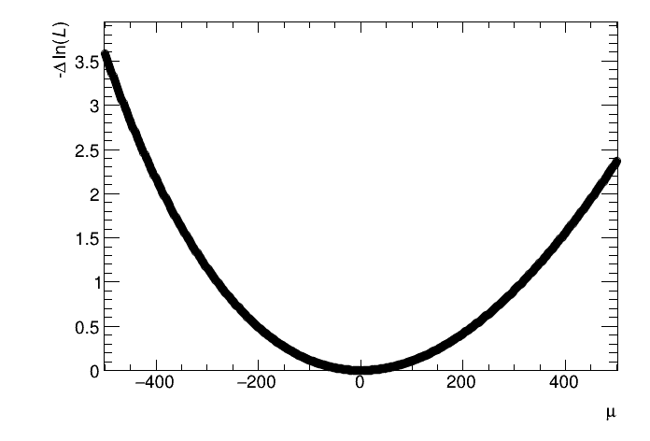
Fitting SM signal: upper limit on $σ_{HHH}$
Likelihood scan for signal strength $μ$
Asimov fit performed for
SM signal simulation ($κ_{3}=κ_{4}=1)$
SR: 6b-region, CR: 5b-region
Statistical uncertainties only
Upper limit: $μ<$ 447
$σ_{HHH}<447⋅σ_{HHH}^{SM}∼45$fb

Slide 25
Likelihood $\left(κ_{3},κ_{4}\right)$-analysis
Instead of $μ$, signal now depends
on $\left(κ_{3},κ_{4}\right)$: parametric formula
Likelihood function: $L\left(κ_{3},κ_{4}\right)$
Likelihood ratio: $λ\left(κ_{3},κ_{4}\right)$
Each basis vector signal histogram
is fitted with expression $f\left(κ_{3},κ_{4}\right)$
Basis vector signal histograms (6b region):

Slide 26
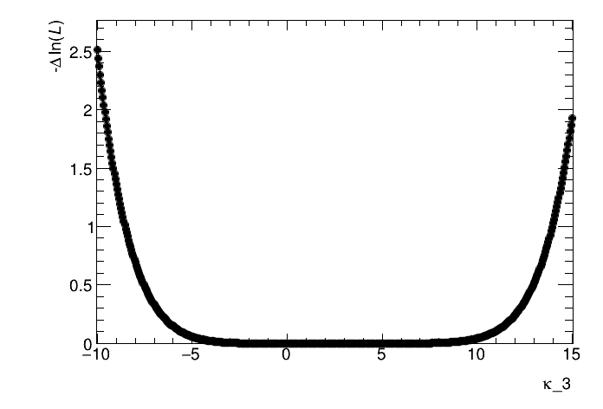
1D scan$κ_{3}$
Likelihood scan for $κ_{3}$,
$κ_{4}$fixed to 1
Asimov fit
SR: 6b-region, CR: 5b-region
Statistical uncertainties only
Result ($2σ$ CL):
$$−9.6<κ_{3}<15.1 (κ_{4}=1)$$

Slide 27
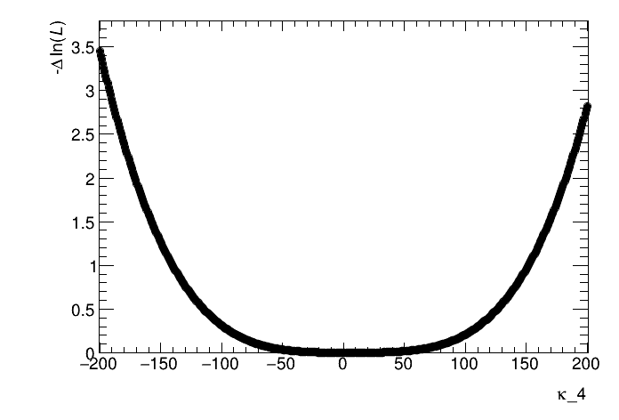
1D scan$κ_{4}$
Likelihood scan for $κ_{4}$,
$κ_{3}$fixed to 1
Asimov fit
SR: 6b-region, CR: 5b-region
Statistical uncertainties only
Result ($2σ$ CL):
$$−171<κ_{3}<183 (κ_{4}=1)$$

Slide 28
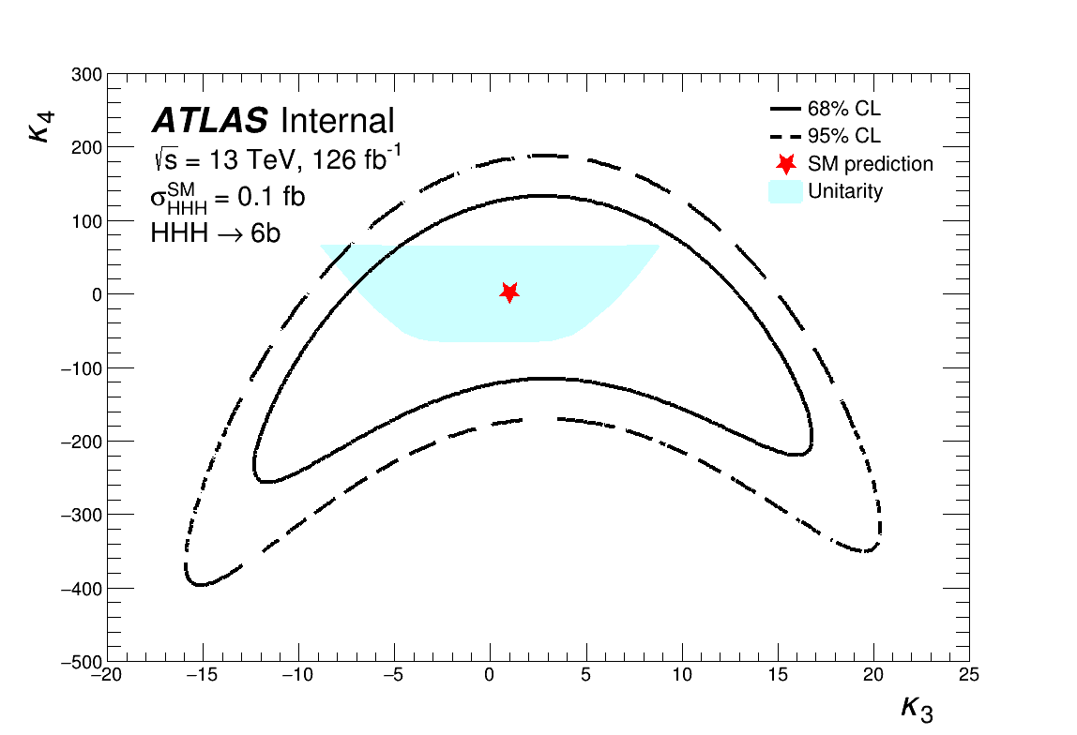
The $\left(κ_{3},κ_{4}\right)$2D scan
Result ($2σ$ CL):
$$−16.0<κ_{3}<20.5$$
$$−352<κ_{4}<189$$
Unitarity region:
Constraint from the
$HH→HH$scattering amplitude
Probability < 1

Slide 29
Conclusions
2D-scan results: $\left[−16.0<κ_{3}<20.5\right],[−352<κ_{4}<189$]
Foundation for the HHH analysis is there, only SM process that can probe $κ_{4}$
Triple-Higgs is still a very rare process and is far from significant ‘discovery’
Future colliders can improve the analysis a lot!

Slide 30
Outlook
Unblinding of HHH(6b) analysis soon!
Systematic uncertainties not (yet) included
Also include 5b- and 4b- regions in signal region?
Event categorization in $m_{HHH}$?
Perform the analyis for future colliders (FCC-hh: $\sqrt{s}=100$ TeV)

Slide 31
Thanks for listening!

Slide 32
BACKUP

Slide 33
HHH phenomenology
https://arxiv.org/abs/1912.02760

Slide 34
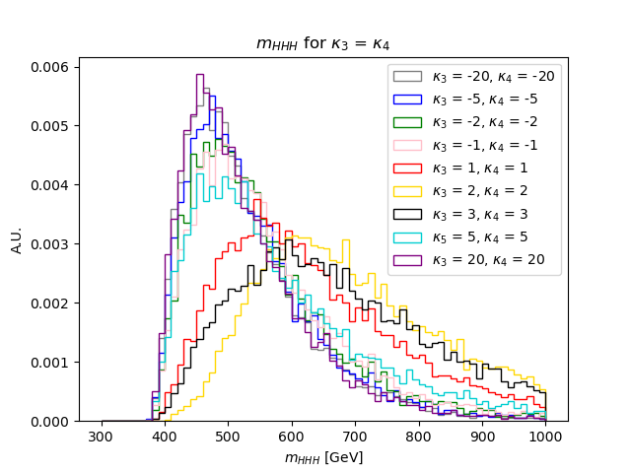
m_{HHH} Truth-level
𝜅₄ variations
𝜅₃ variations
𝜅₃ = 𝜅₄, varying both

Slide 35
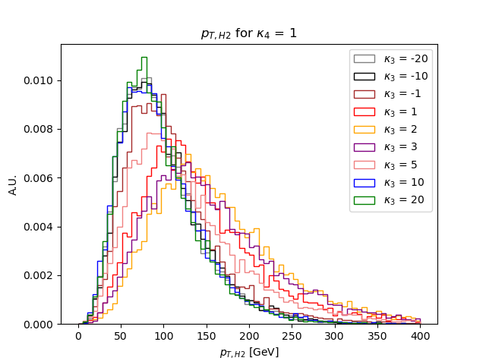
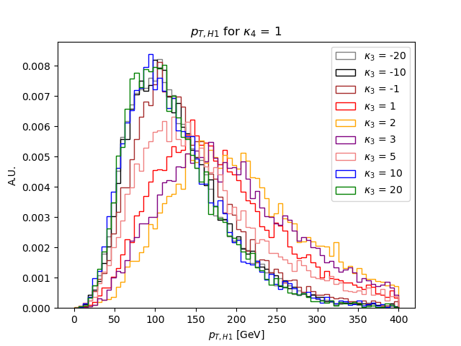
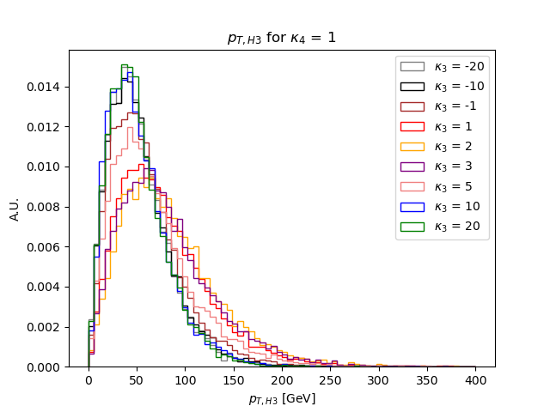
p_{T, H1 ,} p_{T, H2,} p_{T, H3} Truth-level
H2, 𝜅₃ variations
H1, 𝜅₃ variations
H3, 𝜅₃ variations

Slide 36
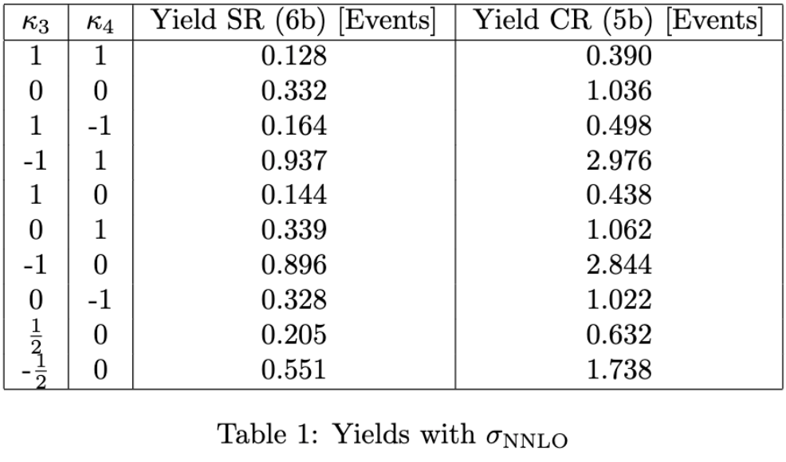
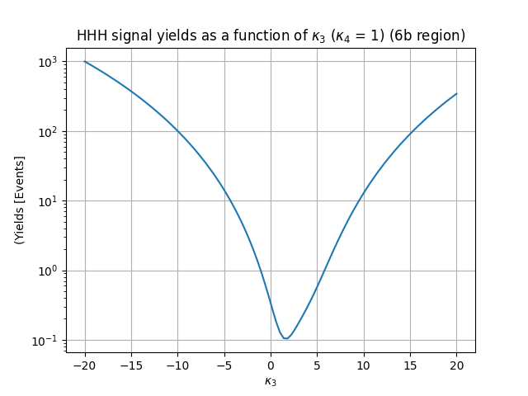
Yields table with 𝜎_{NNLO}

Slide 37
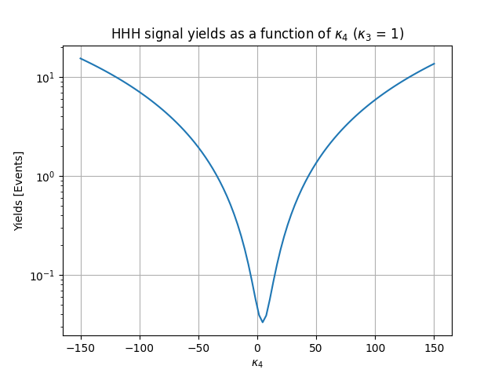
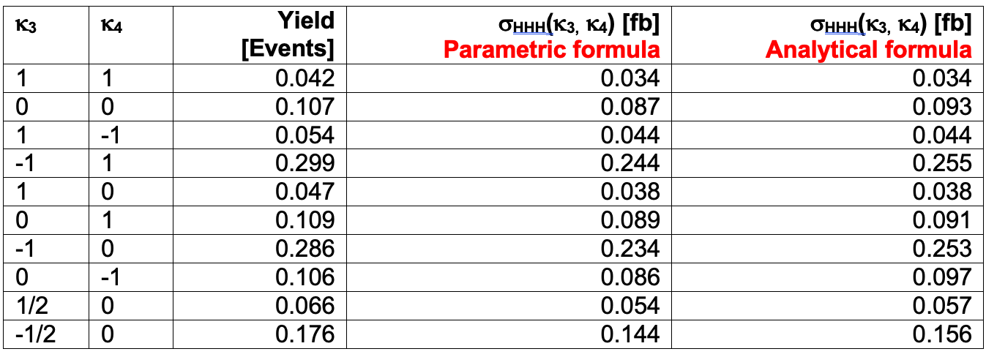
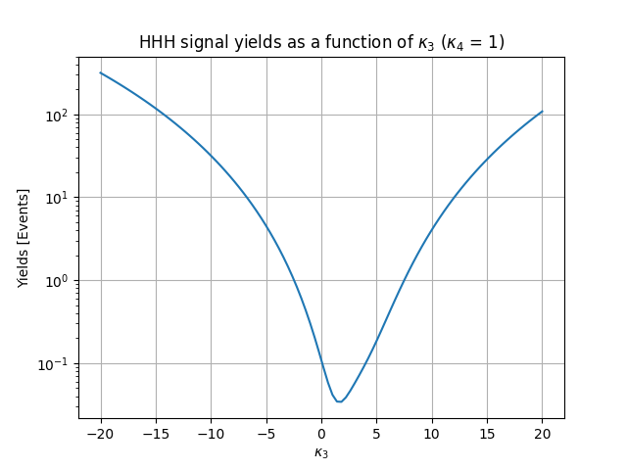
MC Signal Yields in
6b-region for varying 𝜅₃, 𝜅₄
varying 𝜅₄
Signal-yield ~ 𝜎_{HHH}* BR(H->bb) * Luminosity * Analysis acceptance
BR(H->bb) = 0.58 (3 times)
Luminosity ~ 126/fb
Analysis acceptance ~ e.g. kinematic selection (pT cuts at 20/40 GeV), ~ e.g. b-tagging WP (77%) → 6 b-tags → O(20%) efficiency
varying 𝜅₃
MC Yield for 𝜅₃, 𝜅₄- basis vector combinations

Slide 38
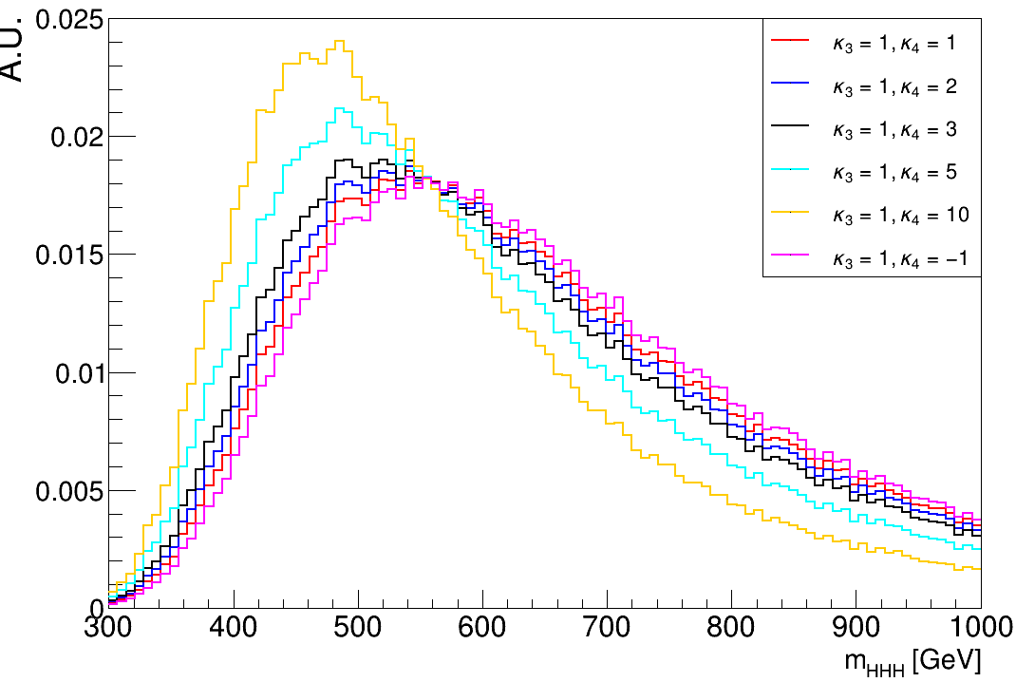
How does the shape of the kinematics change? m_{HHH}
varying 𝜅₃
varying 𝜅₄
6b region of MC sample with 𝜅₃,𝜅₄-weights

Slide 39
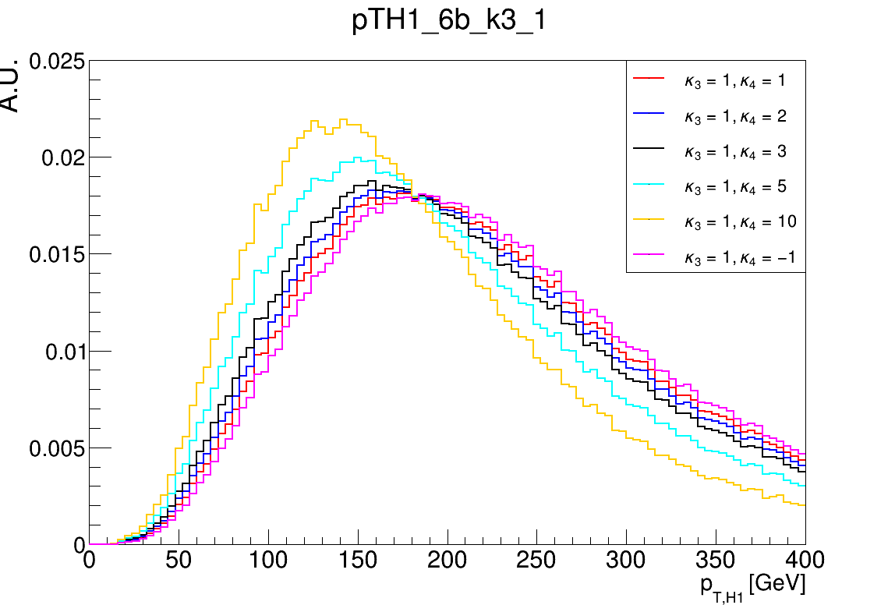
How does the shape of the kinematics change? p_{T,H1}
varying 𝜅₃
varying 𝜅₄
6b region of MC sample with 𝜅₃,𝜅₄-weights

Slide 40
Step 1 fitting result: fitting 𝜇
Upper limit INT Note
Upper Limit: 𝜇 < ~1624*𝜎_{SM} ≈ 1624 * 0.03404 fb ≈ 55.3 fb
LO, @ 13 TeV

Slide 41
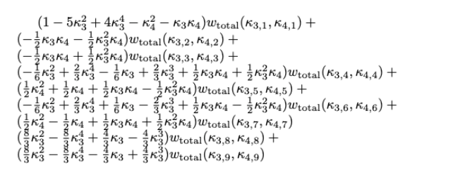
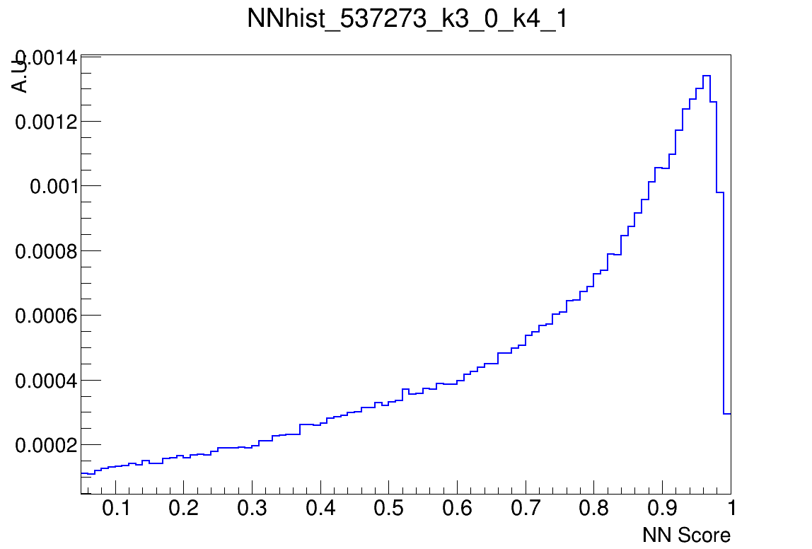
Step 2 fitting setup
Parametric formula to be fitted:
Fit the 9 basis vector signal NN histograms from the MC sample with TRExFitter
NN histogram example (𝜅₃= 0, 𝜅₄= 1)
Setup in .config file

Slide 42
Fitting regions
Discriminating variable is the NonResDNN
SR: 6j
CR: 5j
DATA
hist_data_6j_6j.root
5b data scaled by low-score 5b/6b ratio
DATA
hist_data_5j_5j.root
5b data: (5b-4b) difference is added to account for 4b/5b shape differences
BACKGROUND
hist_dummy_6j.root
5b data (could be anything)
BACKGROUND
hist_dummy_5j.root
5b data (could be anything)
SIGNAL
hist_537273_k3_x_k4_y_6j.root
Signal samples in 6b region
SIGNAL
hist_537273_k3_x_k4_y_6_5j.root
Signal samples in 5b region

Slide 43
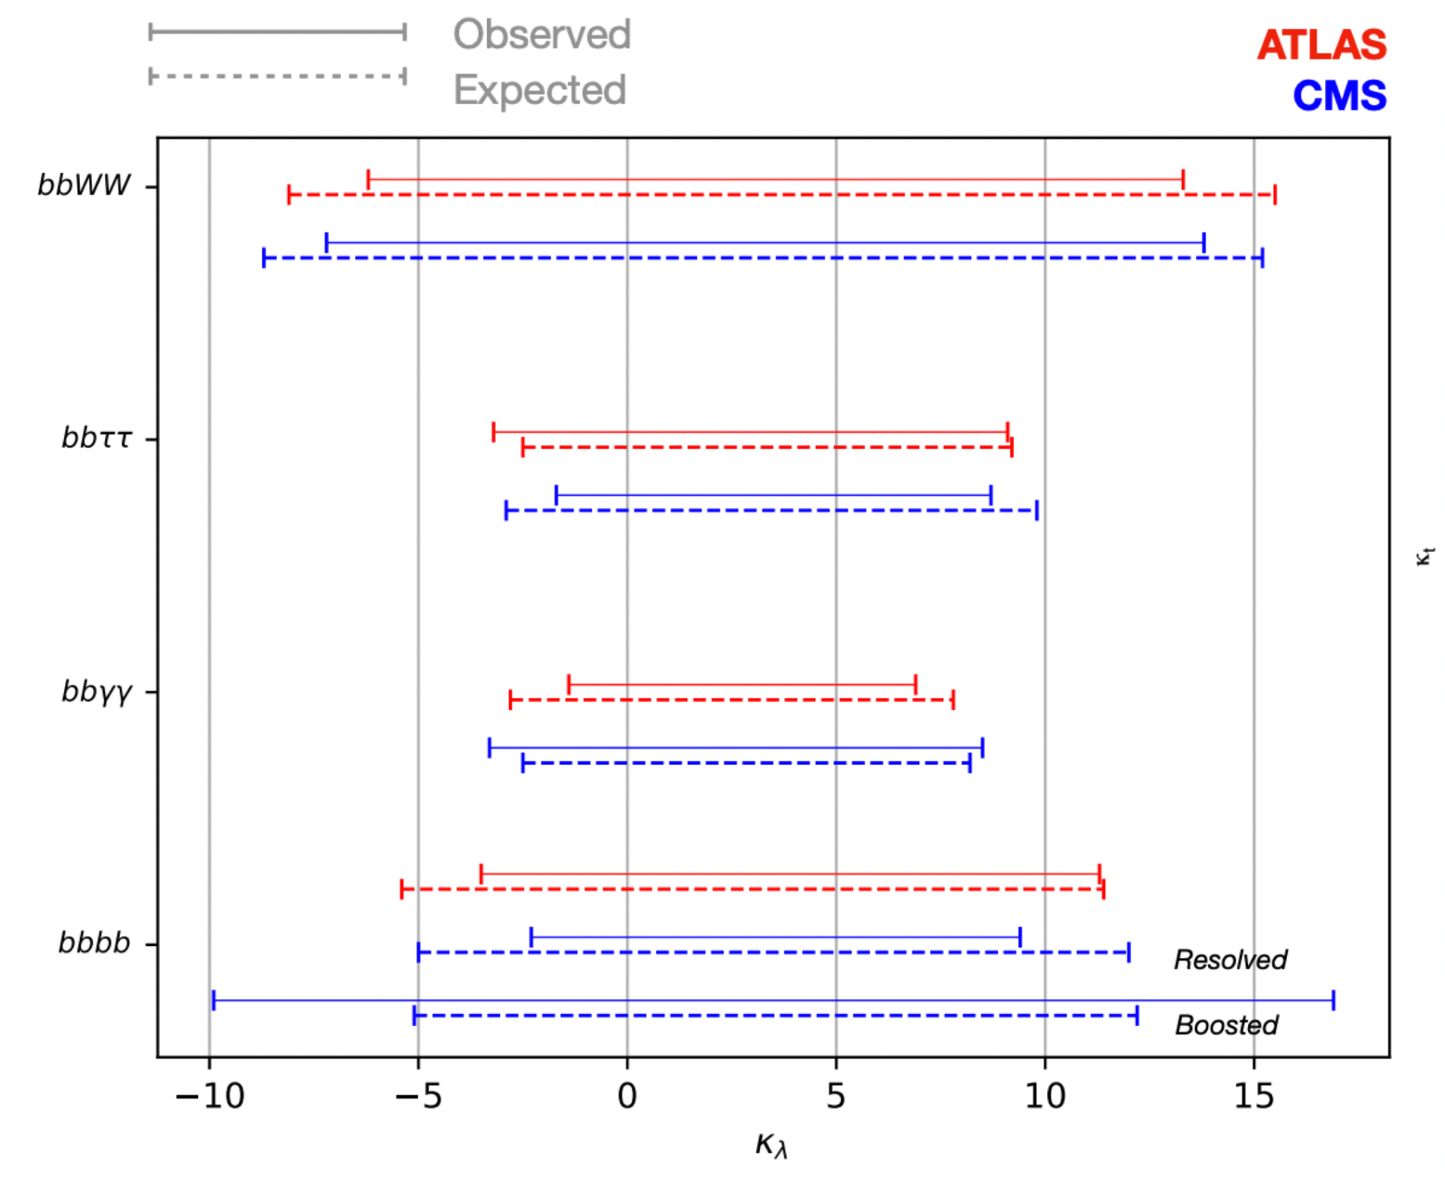
Constraints of competing analyses

Slide 45
