Slide 1

Topical lectures cosmic rays
Sijbrand de Jong
IMAPP, Radboud Universiteit Nijmegen
& Nikhef

Slide 2
Schedule
Monday 23 April 2015
10.00-10:10 H331 Introduction (SdJ)
10.10-11.00 H331 Cosmic Rays history (SdJ)
11.00-12.00 H331 FOM courses explaned (Lydia van der Vlist)
12.00-13.00 Lunch
13.00-14.00 H331 Cosmic Rays basics (SdJ)
14.00-15.00 H331 Supernovae as accelerators (Jacco Vink)
15.00-15.15 H331 explanation of project (SdJ)
15.15-15.30 Coffee/tea
15.30-17.00 SPECTRUM Working session project
17.00-17.30 H331 Presentations and discussion of proposals

Slide 3
Schedule
Tuesday 24 April 2015
09.00-10.00 H331 working session project / setup
10.00-10.15 Coffee/tea
10.15-11.15 H331 Radio detection of Cosmic Rays (Olaf Scholten)
11.15-11.30 H331 check of setup project
11.30-12.30 H331 Cosmic Rays atmospheric interaction (SdJ)
12.30-13.30 Lunch / check of setup project
13.30-14.15 H331 HiSPARC (Bob van Eijk)
14.30-15.15 H331/SPECTRUM Working session project
15.15-15.30 Coffee/tea
15.45-16.30 H331/SPECTRUM Working session project
16.30-17.30 H331 presentations (3’) and discussion project

Slide 4
Schedule
Wednesday 25 April 2015
09.00-10.00 H331 Transport of Cosmic Rays (Jörg Hörandel)
10.00-11.00 H331 Working session project
11.00-11.15 Coffee/tea
11.30-12.30 H331 The challenges of UHE Cosmic Ray research (SdJ)
12.30-13.30 Lunch / check of setup project
13.30-15.15 SPECTRUM Working session project
15.15-15.30 Tea break
15.30-16.00 SPECTRUM Working session project
16.00-17.00 H331 presentations (5’) and discussion project
17.00- Drinks !

Slide 5
Overview
History, what are cosmic rays ?
Basics of what we know about cosmic rays
(details follow later)

Slide 6
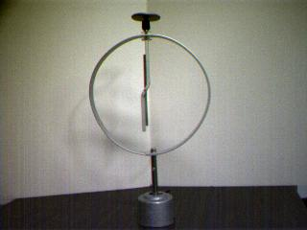
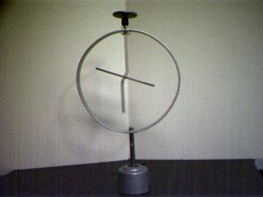
What are Cosmic Rays ?
Clue 1: Discharge of electroscopes
Known to discharge
more rapidly if irradiated with
light,
cathode rays
X-rays
+
+
+
+
+
+
+ + + + + +

Slide 7

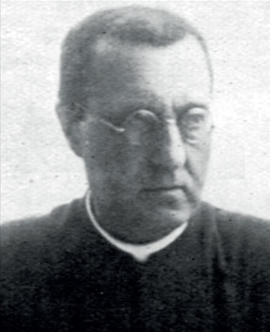
What are Cosmic Rays ?
Clue 1:
1901 Wilson: discharge similar on the ground and below ground
Rutherford: natural radioactivity is responsible
3.5 ions/cm³
1910 Theodore Wulf: Builds best electroscopes
Test at Eiffel tower
If due to radioactivity from ground,
300 m height means flux/15
on top compared to ground level
6 ions/cm³

Slide 8
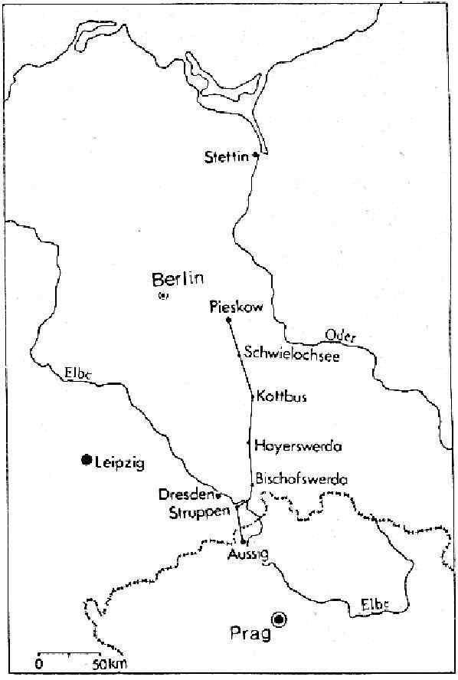
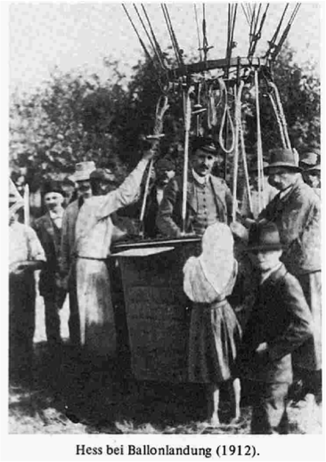
What are Cosmic Rays ?
Clue 1:
1912 Hess: Balloon flight
Maximum height 5350 m !
August 7, 1912
06:12 landing
Pieskow (Brandenburg)
06:12 take off
Aussig/Usti (Bohemia)

Slide 9
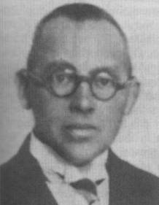
What are Cosmic Rays ?
Clue 1:
1912-1914 Hess & Kolhöster: Balloon flights
Hess concludes:
“The result of these
observations seems to be
explained in the easiest
way by assuming that an
extremely penetrating
radiation enters the
atmosphere from above”
Combined measurements
of Hess and Kolhöster
(1912-1914)
Radiation intensity

Slide 10
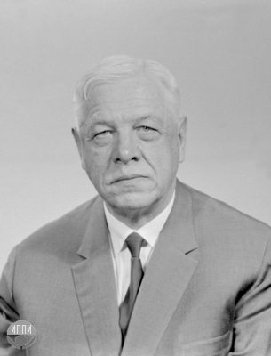
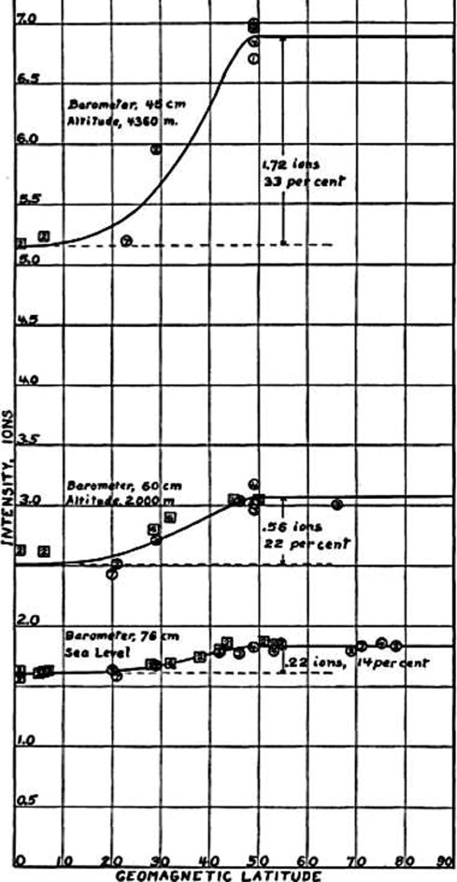
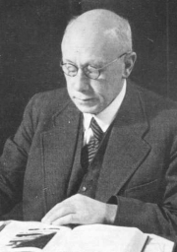
What are Cosmic Rays ?
Clue 2:
1912-1930 Millikan: gamma-rays (hence “cosmic rays”)
Bothe, Kolhöster: work with Geiger counters, charged particles
Skobeltzyn: They bend in magnetic field in cloud chambers
1928 Clay: radiation intensity depends
on geomagnetic latitude
Intensity in ions/cm³
Geomagnetic Latitude

Slide 11
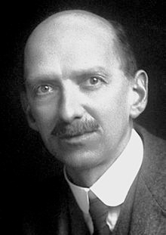
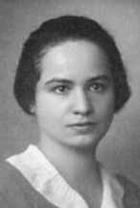
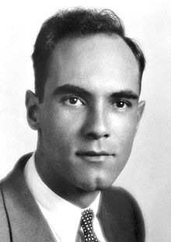
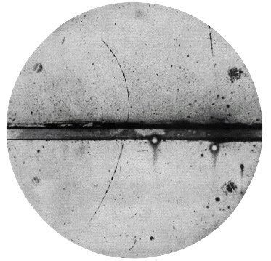
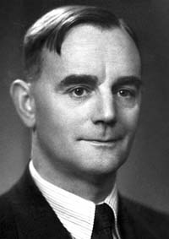
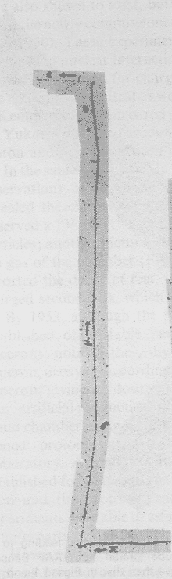
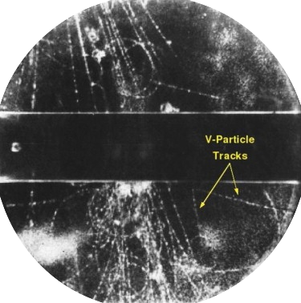
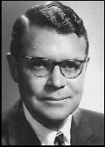
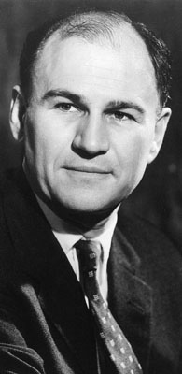
Cosmic Rays !
1920’s: Charles Wilson invents cloud chamber
1930’s: Marietta Blau uses photographic emulsions
Wilson
Blau
1932-1953:
Discovery in cosmic rays of:
e⁺ positron (1st antiparticle)
μ muon
π pion
K kaon
Λ Lambda
Ξ Ksi
Σ Sigma
…
e
Anderson
μ
Powell
Butler Rochester
τ⁺
π ⁺
π ⁺
π ⁻
π
π ⁻ captured by nucleus

Slide 12

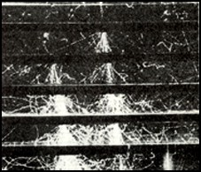
Cosmic Rays !
Occhialini and Blackett: triggered cloud chamber
Particle showers

Slide 13
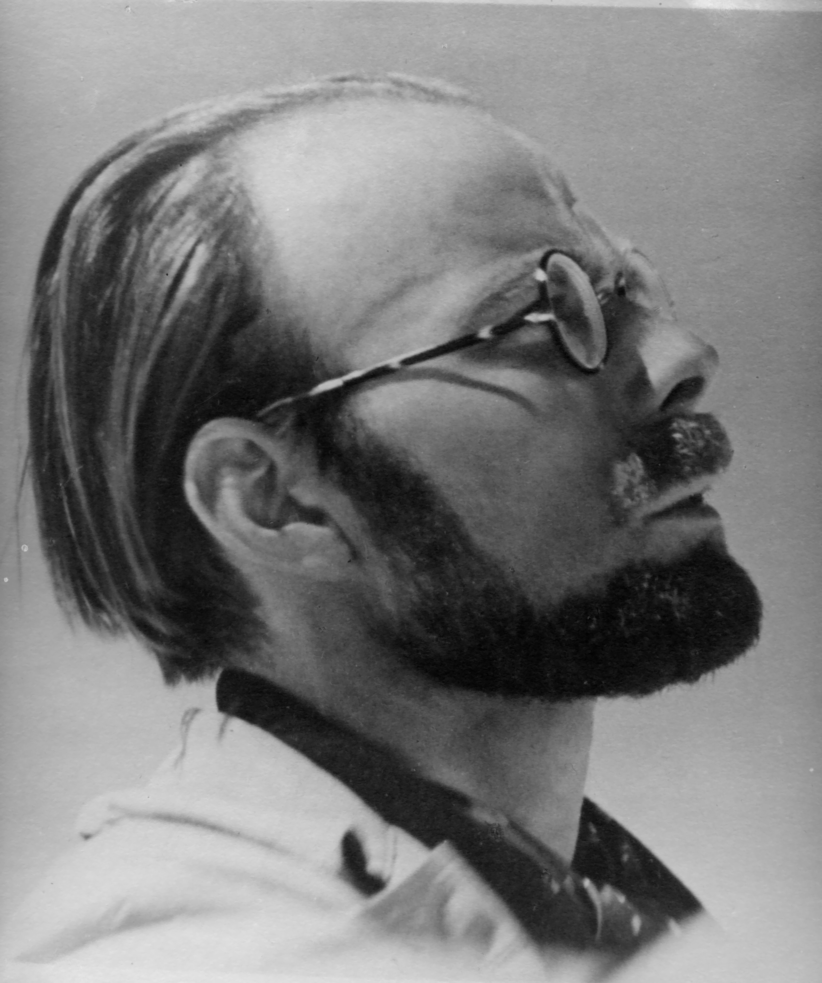
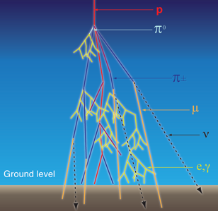
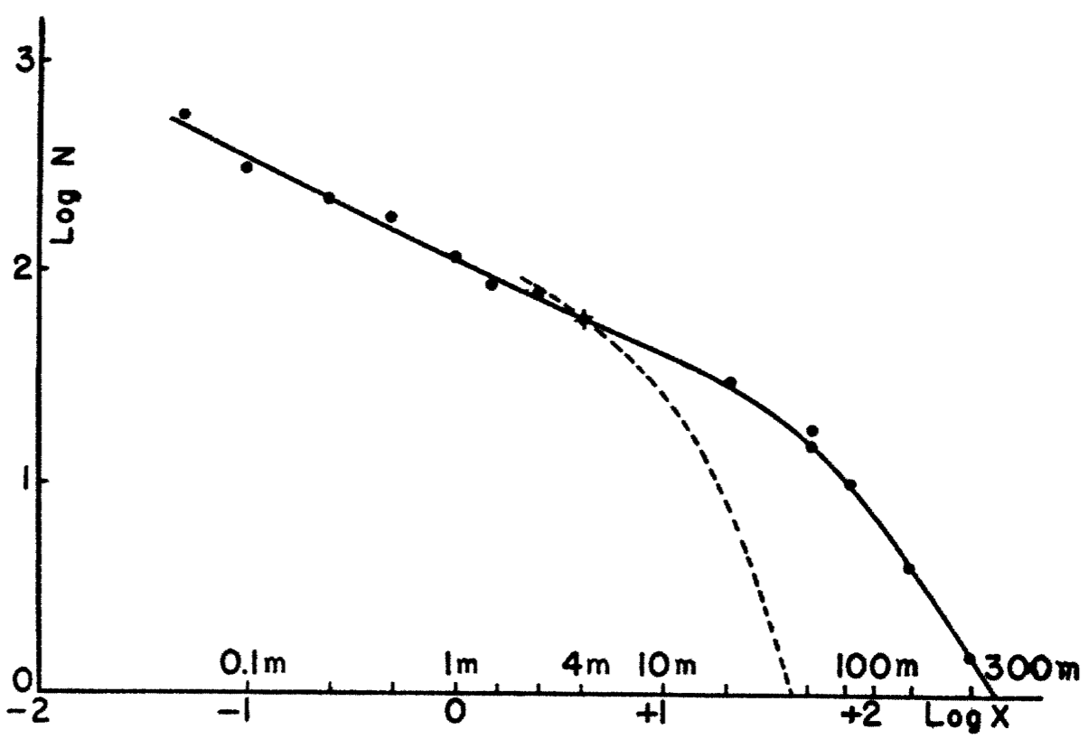
Extensive Air Showers !
Pierre Auger
Extensive Air Showers
Large range coincidences
measured
Expected
Random
coincidences

Slide 14
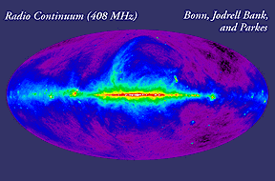
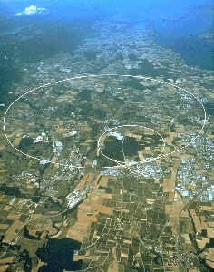
Particle Physics and Cosmic Rays Physics
(From Etienne Parizot)
Study of cosmic rays
1953
astrophysics
particle physics

Slide 15
High-energy cosmic rays
p
γ
ν
15

Slide 16

Cosmic Rays
Radiation from space dominated by light
Properties: energy & direction
Energy spectrum from the direction of the Sun: He !
Cosmic Rays = Atomic Nuclei
4 Cosmic Rays/cm²/s => 1 kg/year on Earth
(cf. 40 kton/year meteorites)

Slide 17
Cosmic Rays = Atomic Nuclei
Information carried by a cosmic ray:
What is it ? Which nucleus ?
What is its energy ?
What is its direction ?
What we really want to know:
What was its source ?
How was it accelerated ?
How did it propagate through space ?
What are its interactions in the atmosphere ?

Slide 18
Cosmic Rays Spectra
Flux density as a function of:
nucleus type
energy
direction

Slide 19
Cosmic ray angular spectrum
Isotropic !
(Bummer: one spectral dimension useless)

Slide 20
Speculation exercise #1
Mention all the reasons
why the angular spectrum would be isotropic

Slide 21
Intermezzo: parsec (pc)
1 pc = 3.26 lightyears
= 3.09 x 10¹⁶ m
Typical size galaxy: O(tens kpc)
Typical distance between galaxies:
O(several Mpc)

Slide 22
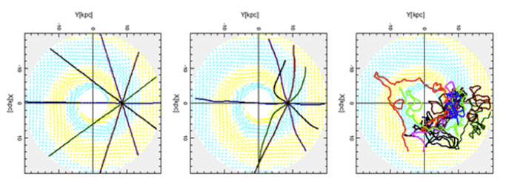
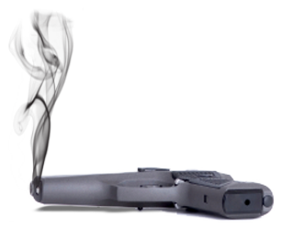
Cosmic ray angular spectrum
10²⁰ eV 10¹⁹ eV 10¹⁸ eV
Galactic magnetic field ~3x10⁻¹⁰ T
Bending: R=p/(qB)
Proton: R [pc] = 0.1 p [peV] / B [nT]

Slide 23
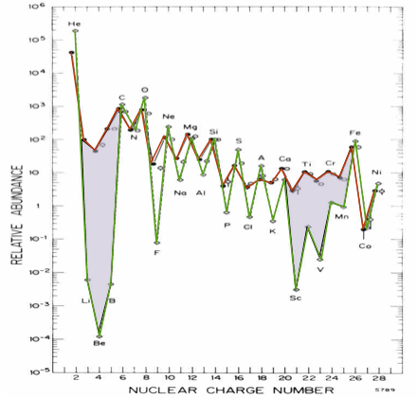
Cosmic ray composition spectrum
Cosmic Rays
1% electrons
99% nuclei
89% H
10% He
1% heavier
Solar system abundence

Slide 24
Speculation exercise #2
Cosmic Rays
Why is there
so much less Li-Be-B
in the solar system
than in cosmic rays ?
Solar system abundence

Slide 25
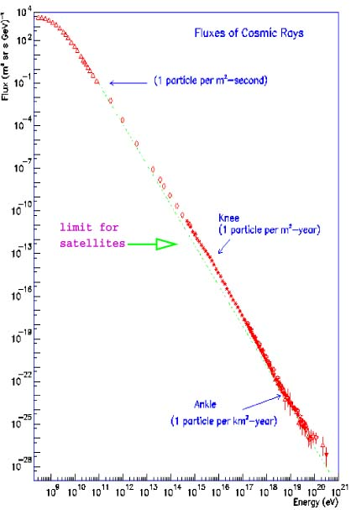
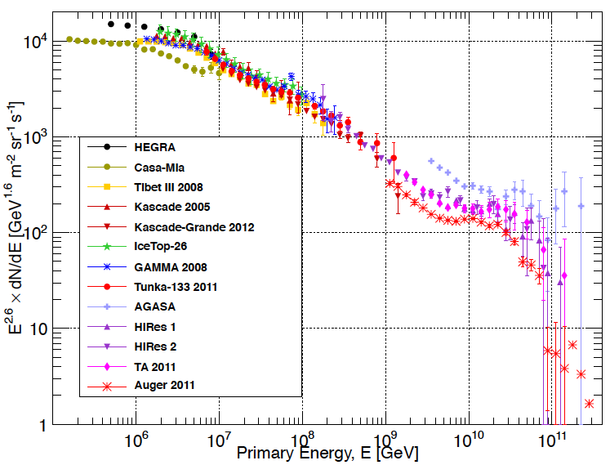


Cosmic ray energy spectrum
Galactic to
Inter-galactic
transition ???
1 /m²/sec
knee
Flux [/m²/sr/GeV]
Cut-off
knee
1 /m²/year
LHC
2e knee
10¹⁴ 10¹⁵ 10¹⁶ 10¹⁷ 10¹⁸ 10¹⁹ 10²⁰
Energy in [eV]
ankle
1 /km²/year
Non-thermal power spectrum ~E^{-2.7}
10¹⁴ 10¹⁷ 10²⁰
Energie [eV]

Slide 26
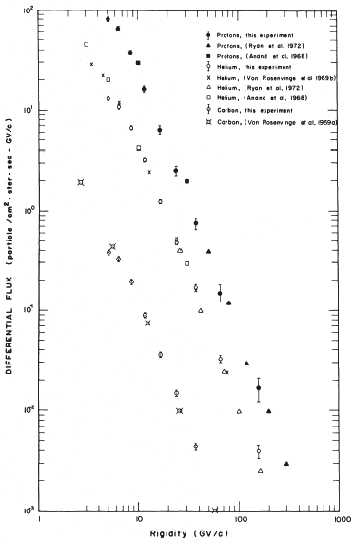
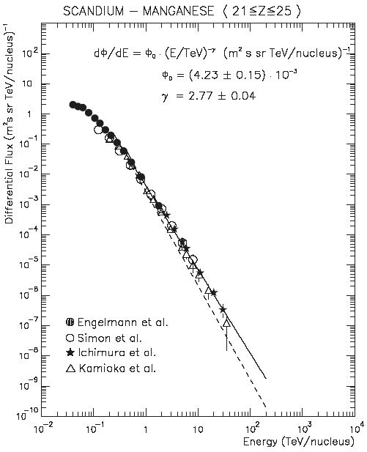
Cosmic ray energy spectrum
Wiebel-Sooth et al. (HEGRA),
Proc. ICRC Durban 4 (1997) 121.
p
Sc-Mn
He
C
Smith, Buffington, Smoot, Alvarez,
Astrophys J 180 (1973) 987
1 GeV/n 1 TeV/n

Slide 27
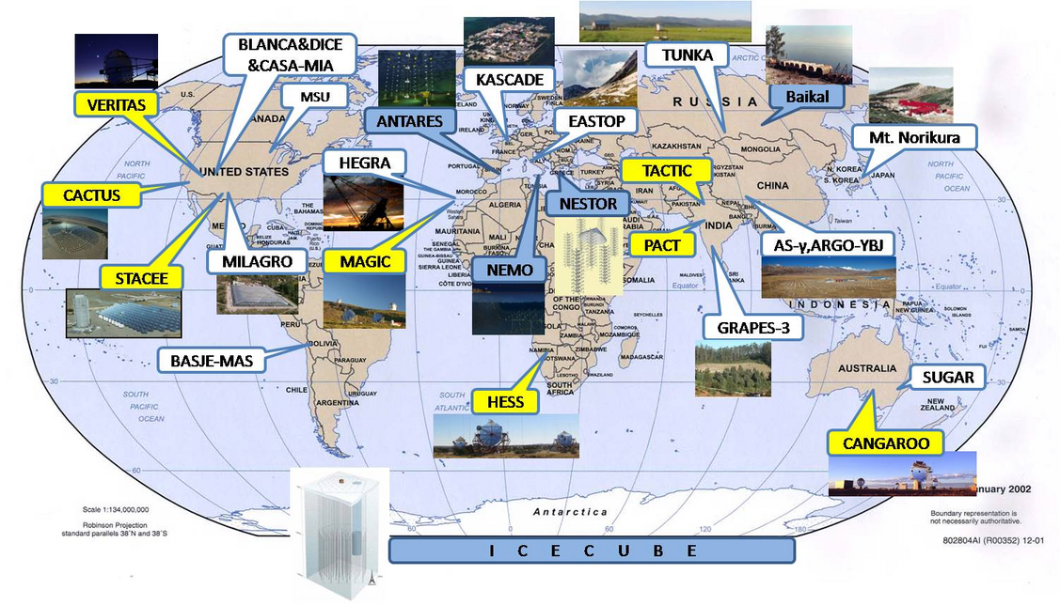
Cosmic ray energy spectrum
10 GeV/n 10 TeV/n 10 PeV/n

Slide 28
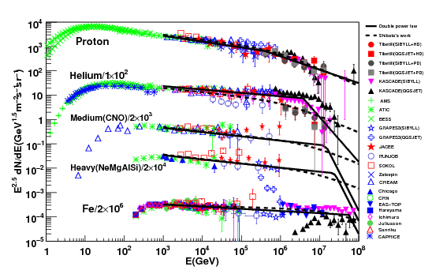
Cosmic ray energy spectrum
1 GeV/n 10 TeV/n 1 PeV/n 100 PeV/n
Note the E^{2.5}
multiplier

Slide 29
Speculation exercise #3
Why is the spectrum cut-off
below 1-10 GeV ?

Slide 30
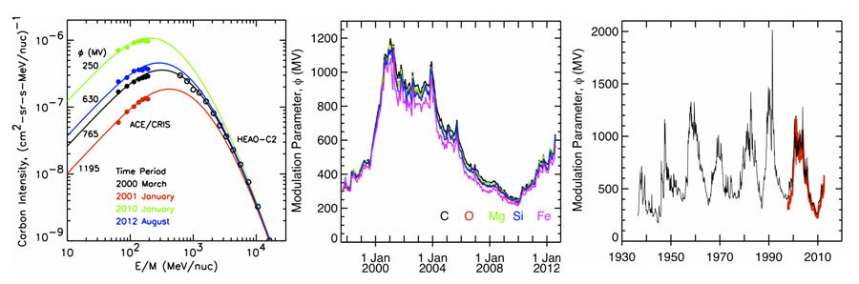
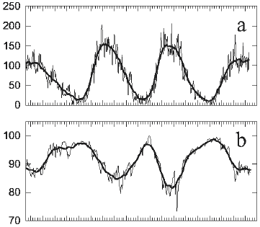
Cosmic ray energy spectrum: low energy
ACE/CRIS
Isotope
monitor
Sun spot activity
Cosmic Ray flux

Slide 31
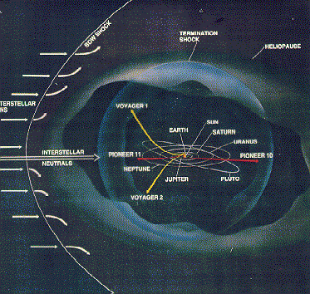
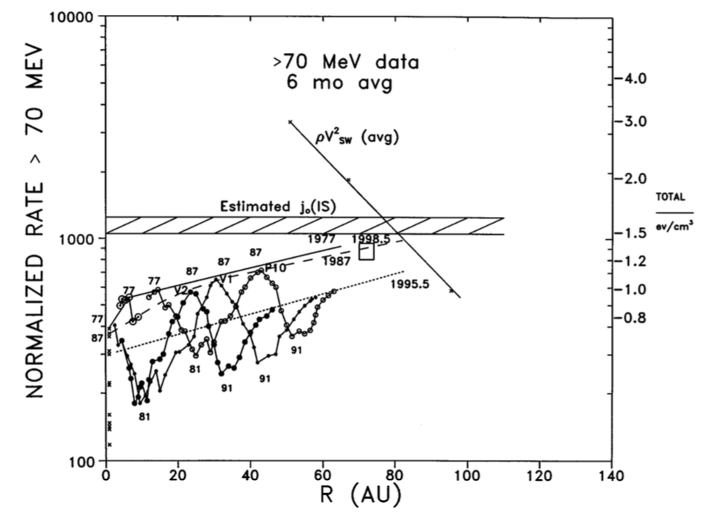
Cosmic ray energy spectrum: low energy
Local Interstellar
Cosmic Ray energy density
Solar wind
energy density
Pioneer and Voyager
Cosmic Ray energy density
Webber, AstroPhys. J 506 (1998) 329

Slide 32
Cosmic ray energy spectrum: medium energy
From interstellar space !

Slide 33
Cosmic ray energy spectrum: medium energy
1 /m²/sec
knee
1 /m²/year
Flux [/m²/sr/GeV]
Nearly perfect power law
10 GeV < E < 1 PeV
2e knee
ankle
1 /km²/year
10¹⁴ 10¹⁷ 10²⁰
Energie [eV]

Slide 34
Cosmic ray energy spectrum: high energy
Nearly perfect power law
10 PeV < E < 1 EeV
But different spectral index !
End of spectrum ?
1 /m²/sec
knee
1 /m²/year
Flux [/m²/sr/GeV]
2e knee
ankle
1 /km²/year
10¹⁴ 10¹⁷ 10²⁰
Energie [eV]
From intergalactic space !

Slide 35
Cosmic ray energy spectrum: galactic confinement
Galactic
Extra-galactic
1 /m²/sec
knee
1 /m²/year
Flux [/m²/sr/GeV]
halo
disk
bulge
2e knee
ankle
1 /km²/year
10¹⁴ 10¹⁷ 10²⁰
Energie [eV]

Slide 36
Speculation exercise #4
The knee:
Why is their a gradual
transition and
not an abrupt one ?
1 /m²/sec
knee
1 /m²/year
Flux [/m²/sr/GeV]
halo
2e knee
disk
ankle
1 /km²/year
bulge
10¹⁴ 10¹⁷ 10²⁰
Energie [eV]

Slide 37
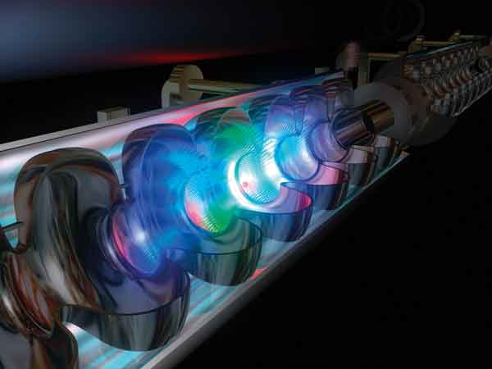
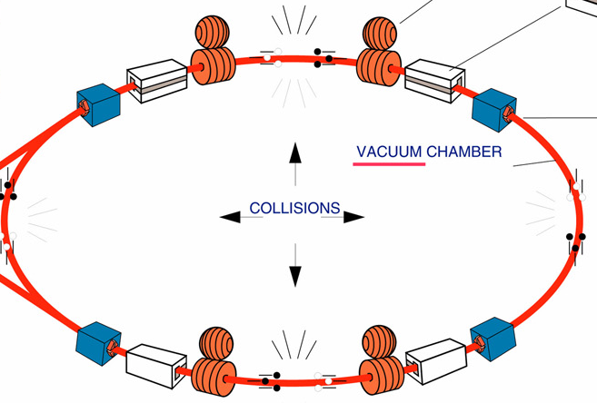
Cosmic ray energy spectrum: sources
Acceleration mechanism:
Linear accelerator
(plasma) wake fields ???
“Circular” accelerator
Shock waves

Slide 38
Shock wave acceleration
P_{in}
=
P_{out}
Shock is often magnetic field variation
No work in rest frame
No change in velocity/momentum

Slide 39
Shock wave acceleration
P_{in}
<
P_{out}
V_{shock}
Acceleration

Slide 40
Shock wave acceleration
Energy gain per collision:
Move to shock frame when coming in:
E’=γ(E_{in}-P_{in} V_{shock})
P’=γ(P_{in}-E_{in} V_{shock}/c²)
E_{out}=γ(E’+(-P’) V_{shock})
P_{out}=γ((-P’)+E’ V_{shock}/c²)
E_{out} =γ [ γ(E_{in}-P_{in} V_{shock})-γ(P_{in}-E_{in} V_{shock}/c²) V_{shock}]
=γ² [ E_{in} (1+V²_{shock}/c²)-2P_{in} V_{shock} ]
=γ² E_{in} [1-2 V_{particle}V_{shock}/c² ]
ΔE/E= -2 V_{in}V_{shock}/c²
P_{in}
<
P’
P_{out}
V_{shock}
V_{shock} << V_{in} << c
P_{in}= E_{in} V_{in}/c²

Slide 41
Shock wave acceleration
P_{in}
>
P_{out}
V_{shock}
Deceleration

Slide 42
Shock wave acceleration
You encounter more shock waves
moving against your direction than in your direction
The effect goes proportional to your velocity (V_{in})
<ΔE/E> ≈ (4/3) (V_{in}/c)²
Second order stochastic Fermi acceleration

Slide 43
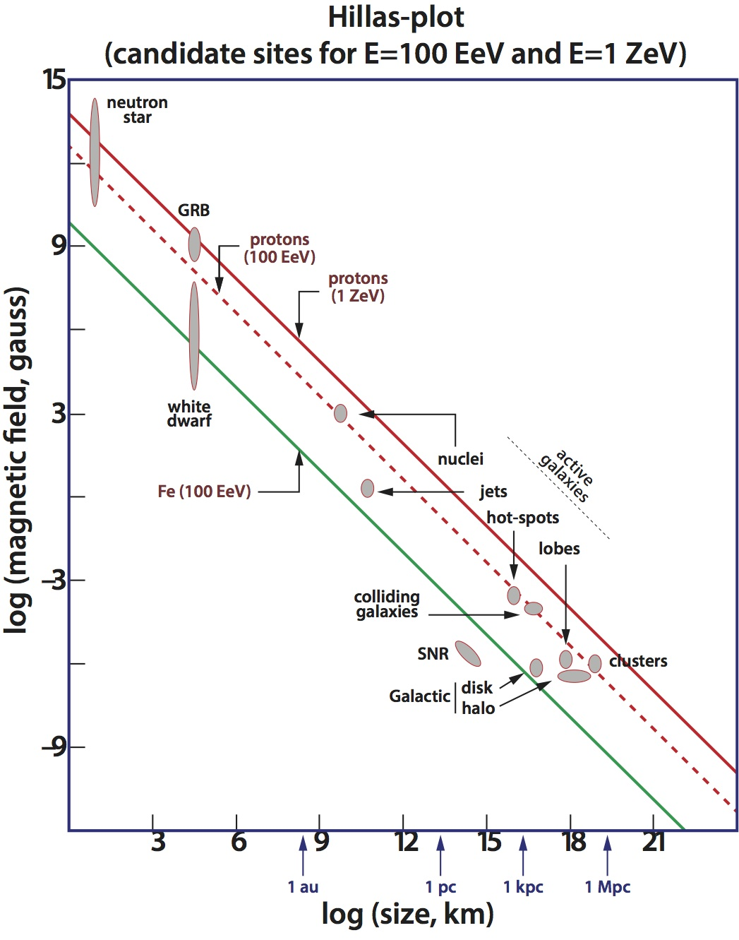
Cosmic ray energy spectrum: sources
Acceleration mechanism:
Linear accelerator
“Circular” accelerator
Need (magnetic) confinement: field * size

Slide 44
Cosmic ray energy spectrum: sources
Suspected sources
based on the means:
Accelerator, magnetic field
Galactic:
Supernovae (see Jacco Vink)
Neutron stars
Accreting black holes
Gamma ray bursts
Extra-galactic:
Active Galactic Nuclei
(nuclei, jets, lobes, …)
Hillas
plot

Slide 45
Cosmic ray energy spectrum: sources
Injection at E₀ with rate dN₀/dt
Mean free path length between “magnetic walls”: L
Mean time between collisions: τ_{coll} ≈ 2L/c
(correct for angle between flight path and line between walls)
Acceleration rate: dE/dt = ΔE/τ_{coll} = (c/2L) (4β²/3) E = E/τ_{acc}
τ_{acc} = (3L/2c) β⁻²
Time to get to energy E: t(E) = τ_{acc} ln(E/E₀)
Escape rate independent of E: dP_{esc} = dt/τ_{esc}
Left after loss at energy E: ~ exp(-t(E)/τ_{esc})
In energy interval [E,E+dE] corresponding to injection time interval [t,t+dt]
N(E) dE = (dN₀/dt) (dt/dE) exp(-t(E)/τ_{esc}) dE
= (dN₀/dt) (τ_{acc}/E) exp(-τ_{acc} ln(E/E₀)/τ_{esc}) dE
N(E) = dN₀/dt (τ_{acc}/E₀) (E/E₀)^{-x} with x=(1+τ_{acc}/τ_{esc})

Slide 46
Cosmic ray energy spectrum: sources
N(E) = dN₀/dt (τ_{acc}/E₀) (E/E₀)^{-x} with x=(1+τ_{acc}/τ_{esc})
Observed x≈2, suggesting τ_{acc}/τ_{esc}≈ 1
But L = 1 pc => τ_{coll} = few years
= 10⁻⁴ m => β² = 10⁻⁸ τ_{acc} = 10⁸ yr
From transport (see later) we know τ_{CR} = τ_{esc} = 10⁷ yr
Hence, x≈11 !
Reason: this simple model does not hold,
more sophisticated treatment needed
(See Jacco Vink’s talk, or come back to it later)

Slide 47
Cosmic ray energy spectrum: transport
Leaky box model for the galaxy
injection spectrum: dN/dE ~ E^{-x}
galactic magnetic fields: confinement time τ_{confinement}= E^{-α}
resulting spectrum dN/dE ~ E^{-(x+α)}
=> Energy spectrum steepening
halo
disk
bulge

