Slide 1
WISE Community
EUGridPMA/AARC/GN5-1 meeting
Abingdon, UK, 29 May 2024
Wise Information Security for collaborating e-Infrastructures
In collaboration with and co-supported by
EU GN5-1 and AARC-TREE
https://wise-community.org

Slide 2
Issues for discussion today
Relationship WISE and AARC
SCI-WG and AARC PDK development
Future plans for WISE
Security half-day at TNC24, Rennes, France
side meeting on Monday morning
dedicated to community related material for SIG-ISM and WISE.
make this workshop-like - interaction with the participants
Theme ““Past, Present and Future”.
Future whole Community meetings?
NSF Cybersecurity Summit – USA – Oct2024
In Europe?
Working group activities
SCI? (PII policy framework? Community policy template(s)?
Incident Response and Threat Intelligence?

Slide 3
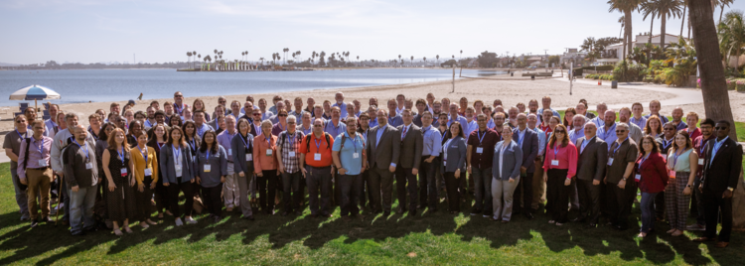
WISE Community – recent history
Met in person at the NSF Cybersecurity Summit 2019
And then at the summit in Oct 2023
Community members come from e-Infrastructures across the world
Governed by a steering committee
Two per year virtual meetings in 2020 and in 2021
Meetings in 2022
21 April (virtual)
Fall 2022 and Spring 2023 - no meeting
NSF Cybersecurity Summit Oct 2019 (San Diego CA)

Slide 4
WISE Mission
The WISE community enhances best practice in information security for IT infrastructures for research.
How do we operate to fulfil the WISE mission?
WISE fosters a collaborative community of security experts and builds trust between IT infrastructures, i.e. all the various types of distributed computing, data, and network infrastructures in use today for the benefit of research, including cyberinfrastructures, e-infrastructures and research infrastructures.
Through membership of working groups and attendance at workshops these experts participate in the joint development of policy frameworks, guidelines, and templates.

Slide 5
WISE Working Groups
Active Working Groups - 2 topics included in this meeting
Trust and policy issues related to the Security for Collaborating Infrastructures trust framework (SCI-WG)
Incident Response & Threat Intelligence Working Group (IRTI-WG)
Most action in GEANT SIG-ISM
Security Communications Challenge Coordination Working Group (SCCC-WG) – joint with GEANT SIG-ISM
Risk Assessment WISE (RAW-WG) – joint with SIG-ISM

Slide 6
Security for Collaborating Infrastructures - The WISE SCI working group (SCI-WG)

Slide 7
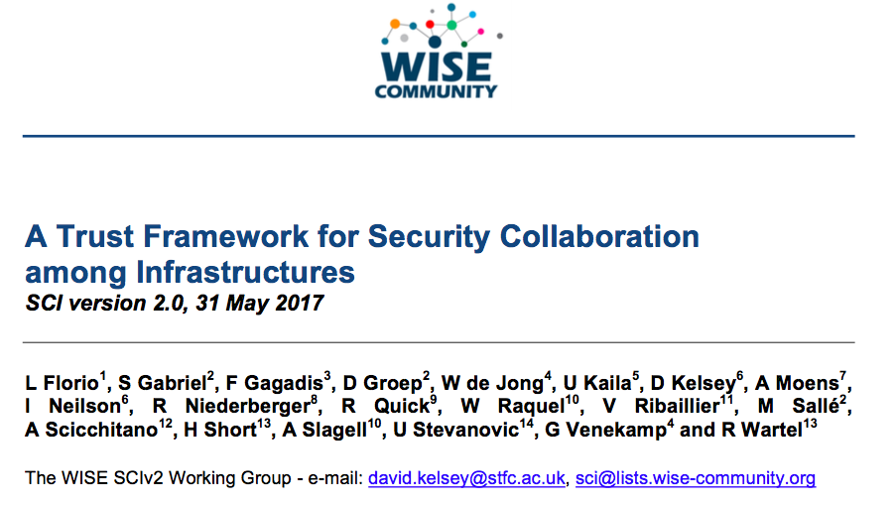
SCI Version 2 – published 31 May 2017 (TNC17) (version 1 was published at ISGC2013)

Slide 8
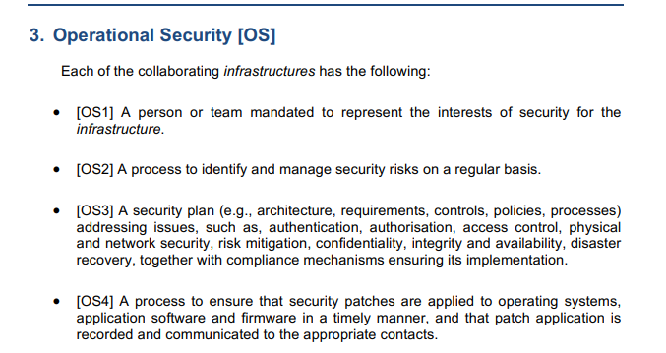
A Trust Framework for Security Collaboration among Infrastructures
https://wise-community.org/wp-content/uploads/2017/05/WISE-SCI-V2.0.pdf
29 Assertions across 5 Categories.
How to assess the level of compliance?

Slide 9
Children of SCI - Sirtfi (now updated to V2)

Slide 10
Snctfi (time for a version 2)

Slide 11
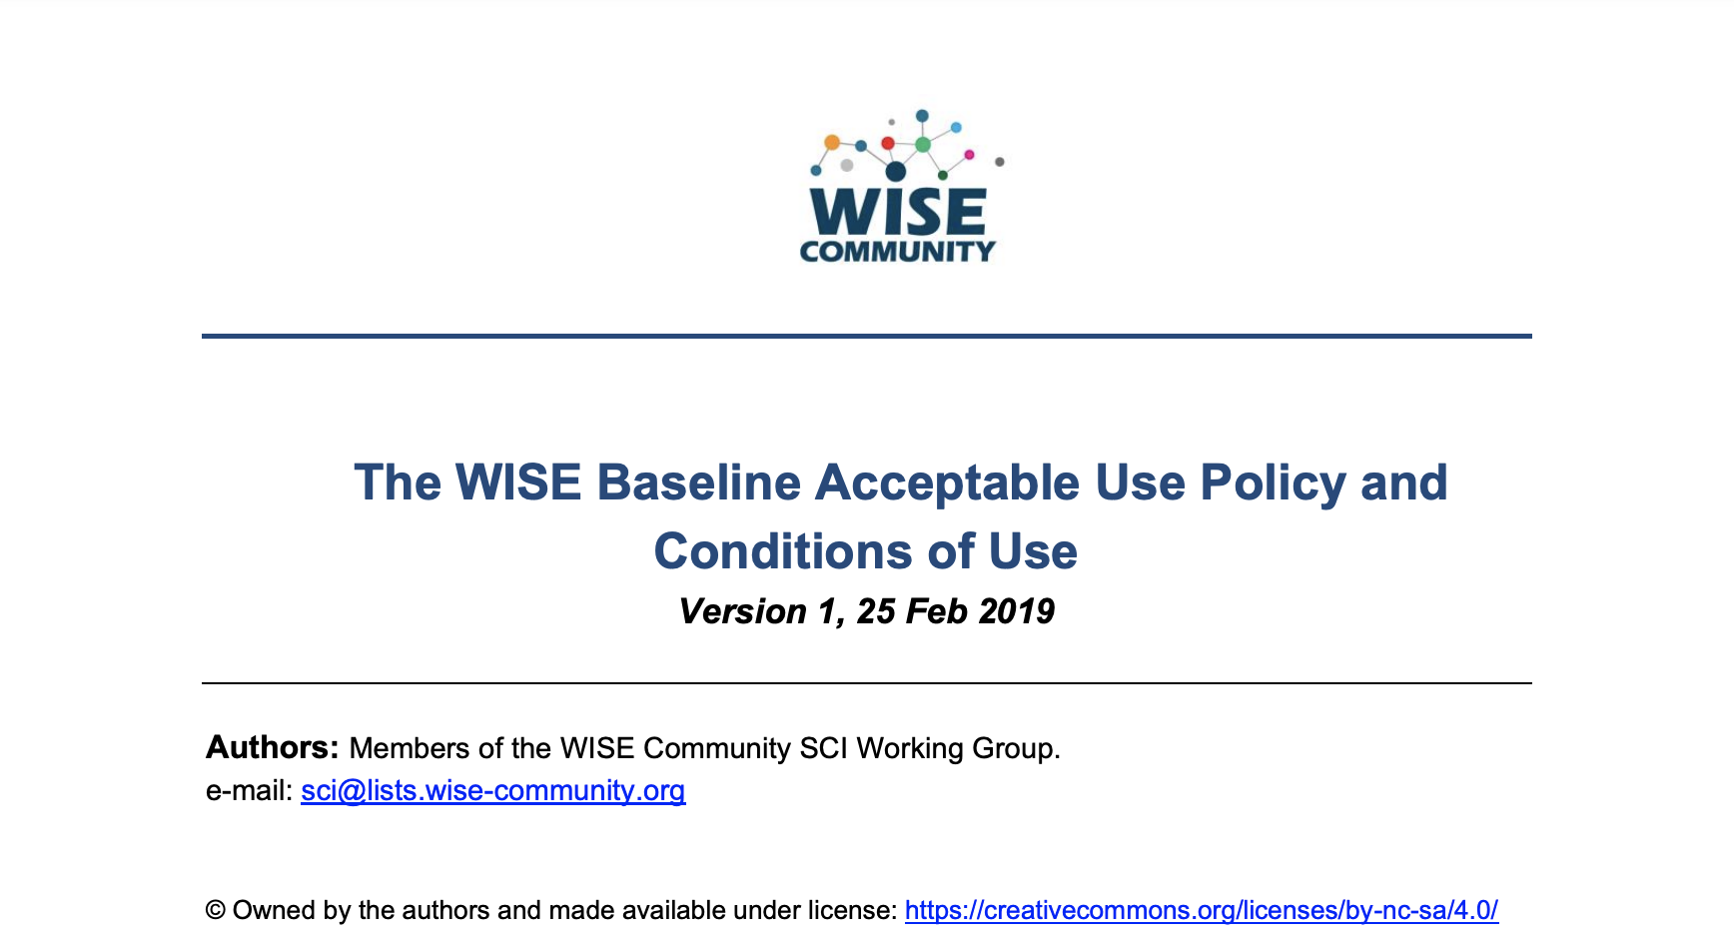
WISE Baseline AUP https://wise-community.org/wise-baseline-aup/
a common baseline
ease trust of users across infrastructures
community and infrastructure-specific augmentation

Slide 12
Developing the AARC Policy Development Kit
WISE SCI-WG - updating policy templates

Slide 13
Development of AARC PDK by WISE SCI-WG
Policy templates are useful to new Infrastructures and help build trust and interoperability (as compliant with SCI Trust Framework)
Involve experience from many Infrastructures and policy groups (including AEGIS) https://aarc-project.eu/about/aegis/
WISE SCI-wg collects feedback from Infrastructures
And use this if/when a new version of a template is required
Unlike AUP, new templates may contain optional components
Infrastructures just use the components that work for them

Slide 14
Service Operations Security Policy
Original AARC PDK Template: https://docs.google.com/document/d/1_cNMF3l3YVPqBBH0MPqx9DLAL1t3Z33_fJcjln8Xk48/edit#heading=h.idp93lqbm8kt
In the UK, the IRIS Infrastructure used the PDK template – but made many changes to simplify and improve its Service Operations Security Policy (approved May 2021)
The SCI working group used the IRIS version together with input from EOSC-hub, EOSC Future, EGI, ELIXIR, HIFIS and worked from October 2021 to April 2022
See https://wiki.geant.org/display/WISE/Policy+Development+Kit
The EOSC Security Baseline (Sep 2022) may serve as a better option for loosely coupled federations
https://wiki.eoscfuture.eu/display/PUBLIC/EOSC+Security+Operational+Baseline
EOSC FAQ Guidance at: https://wiki.eoscfuture.eu/display/EOSCF/EOSC+Security+Operational+Annotated+Baseline

Slide 15
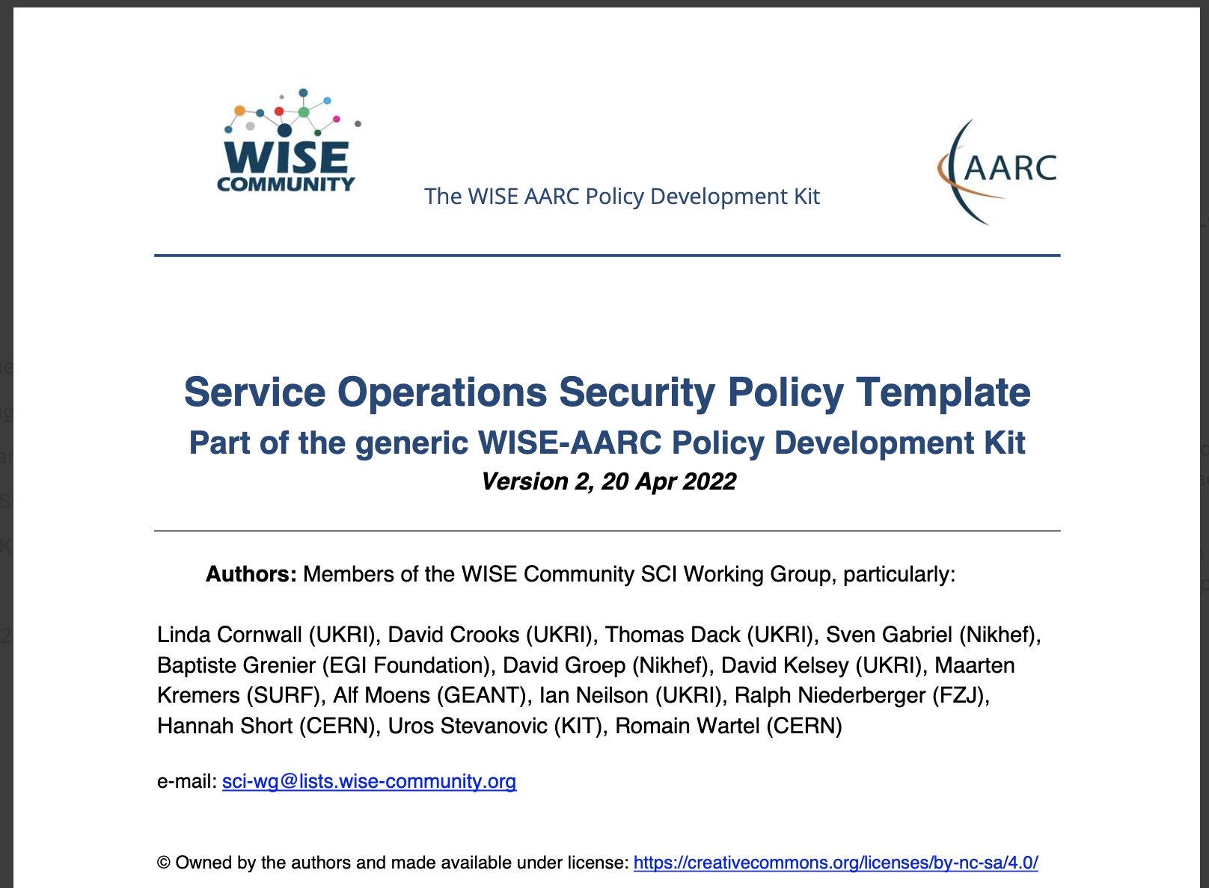
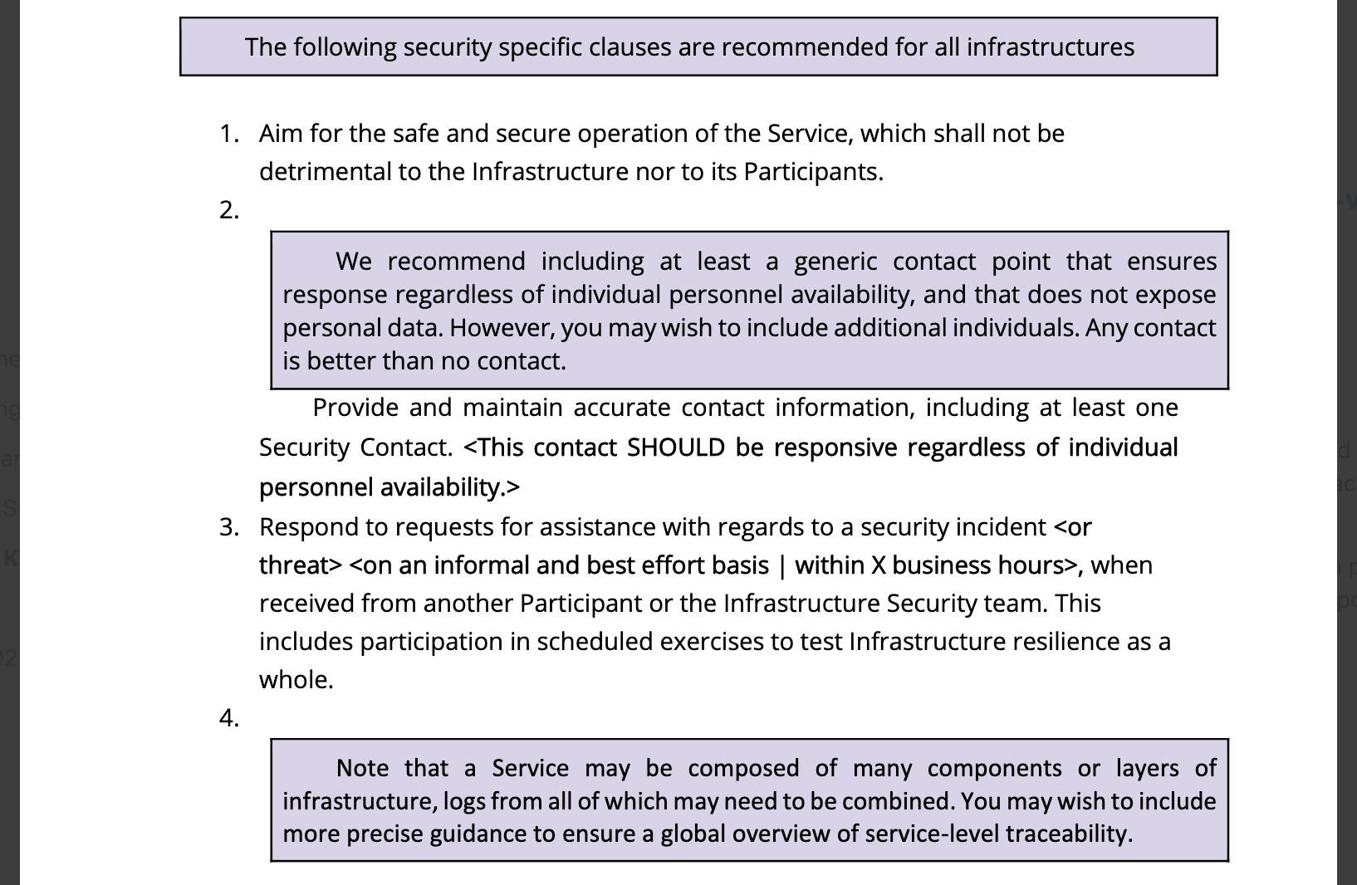
Service Operations Security Policy WISE PDK Template Version 2 See WISE-SCI-PDK-ServiceOpsSecPol-V2.pdf

Slide 16
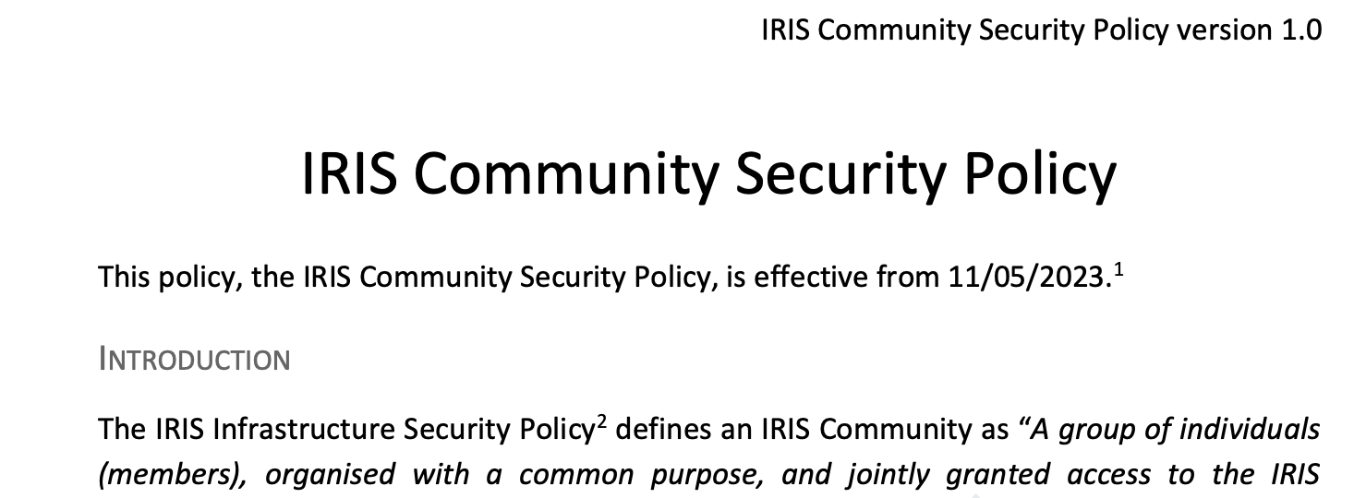
Community Security Policy – new PDK template (work in progress)
STFC IRIS (UK) has produced new policy (approved – May 2023)
Based on combining two policies (AARC PDK & EGI security policy)
Community Membership Management Policy & VO Operations Policy
To be used as input to WISE SCI work on an updated AARC template

Slide 17
More information - PDK
The original AARC PDK: https://aarc-community.org/policies/policy-development-kit/
AARC guidance documents on policy: https://aarc-project.eu/guidelines/#policy
WISE Community: https://wise-community.org/
WISE SCI-WG – Wiki - https://wiki.geant.org/display/WISE/SCI-WG
WISE SCI-WG PDK updates - https://wiki.geant.org/display/WISE/Policy+Development+Kit
Join WISE mail list: https://lists.wise-community.org/sympa/info/wise Join WISE SCI-WG: https://lists.wise-community.org/sympa/subscribe/sci-wg

Slide 18
Discussion?

