Slide 1
A TREE of Trust Policy Harmonisation & Interoperability
Aligning proxy good practices, easily accessible to users
David Groep
AARC TREE WP2 Lead
Nikhef Physics Data Processing programme and UM Dept. Advanced Computing Sciences
EUGridPMA61, IGTF, GN5-1, and AARC Policy Community meeting
Abingdon, UK, May 2024

Slide 2
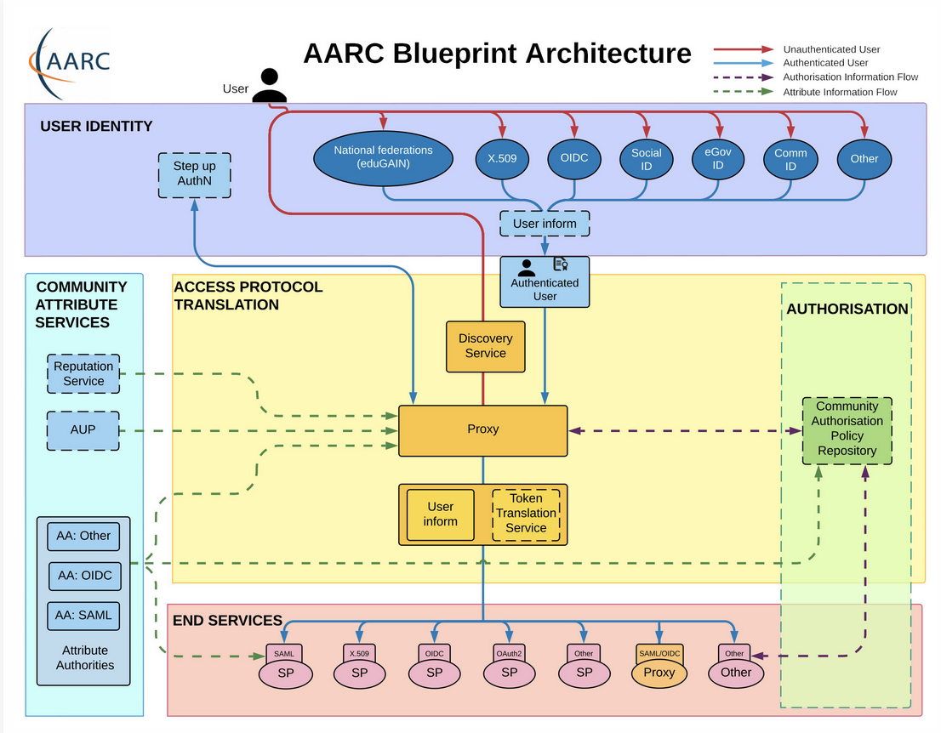
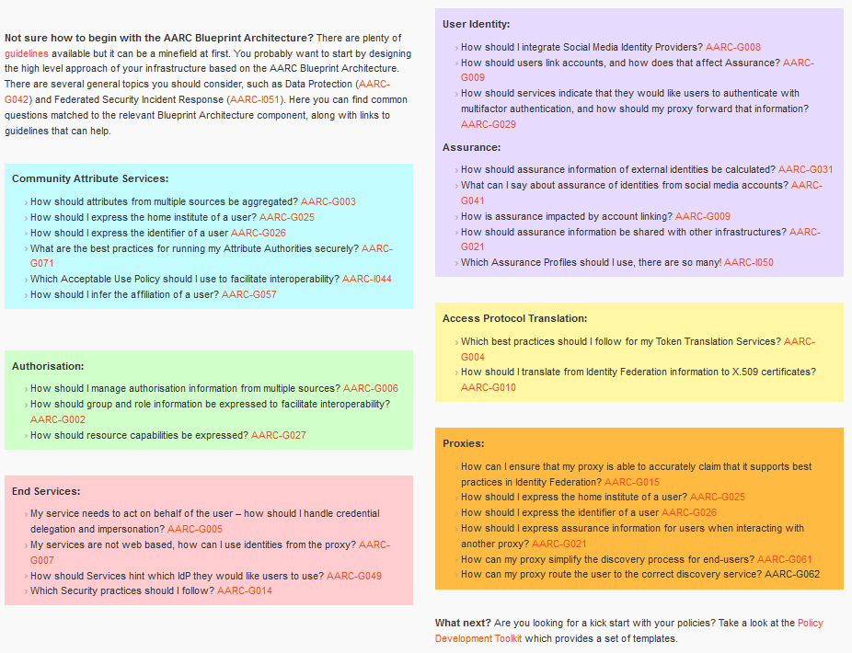
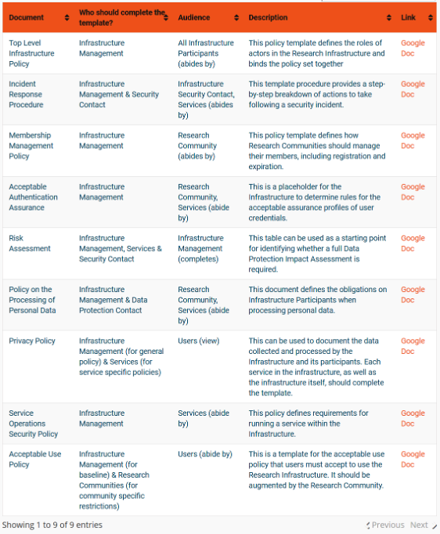

Interoperability – more than just the nice colours
https://aarc-community.org/guidelines/

Slide 3
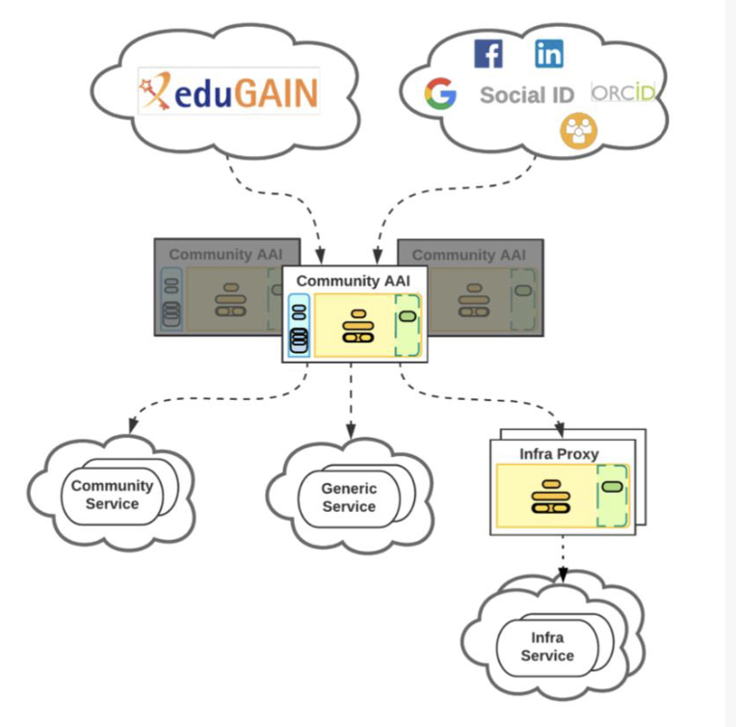
The Community AAI and the Infrastructure Proxy – structuring elements
Community AAI
The purpose of the Community AAI is to streamline researchers’ access to services, both those provided by their own infrastructure as well as the services provided by infrastructures that are shared with other communities.
Infrastructure Proxy
The Infrastructure Proxy, enables Infrastructures with a large number of resources, to provide them through a single integration point, where the Infrastructure can maintain centrally all the relevant Policies and business logic for making available these resources to multiple communities

Slide 4
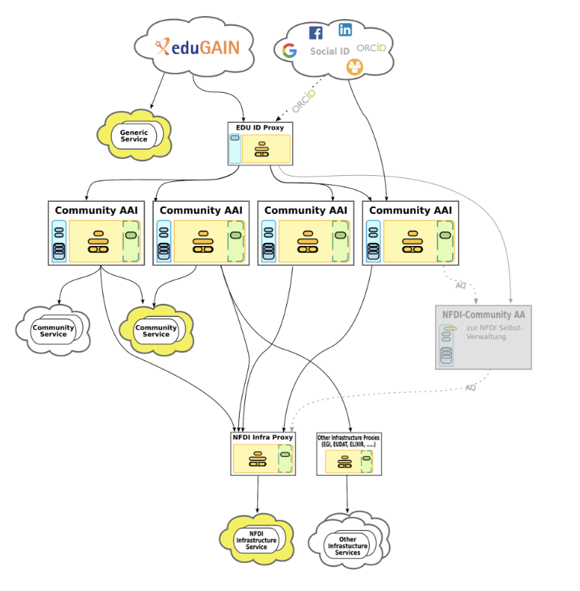
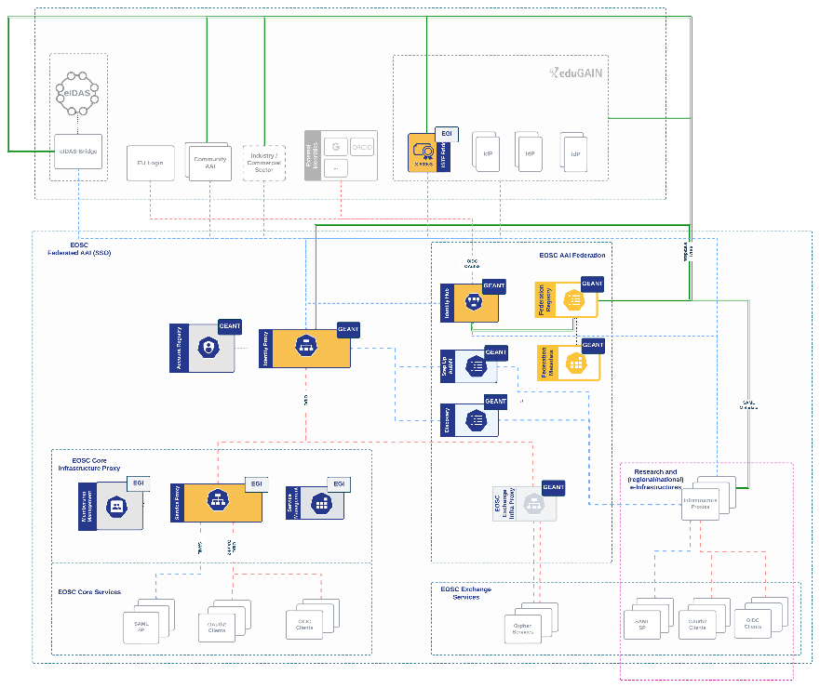
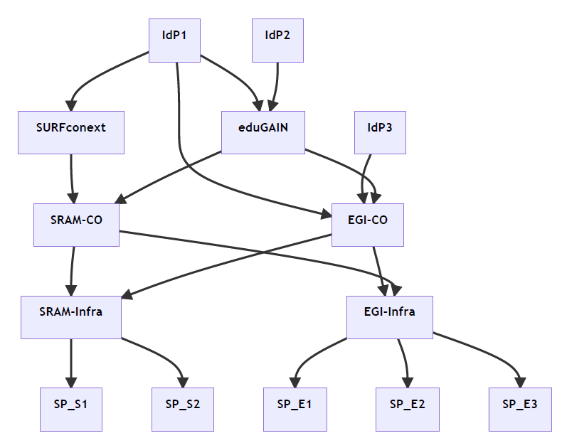
Our federated world is growing more complex
Images: SURF SSRAM and EGI by Maarten Kremers, NDFI AAI (Marcus Hardt), EOSC AAI for the EOSC Core and Exchange Federation for the EOSC European Node by Christos Kanellopoulos, Nicolas Liampotis, David Groep (June 2023 version)

Slide 5

AARC TREE: technical evolution for enhanced effectiveness!
Updated AARC BPA
Recommendations for a common long-term strategy for AAI services
Updated interoperability framework

Slide 6
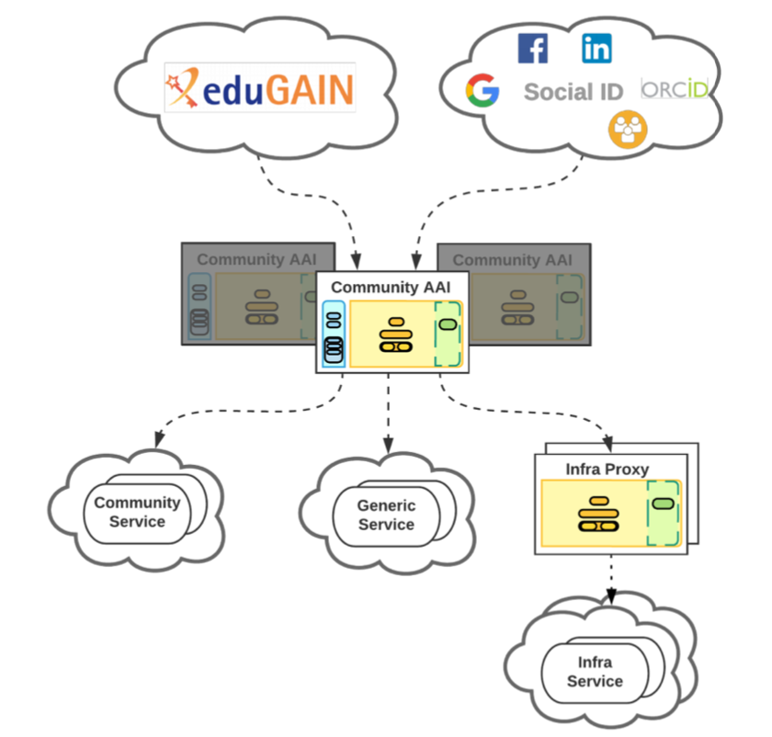
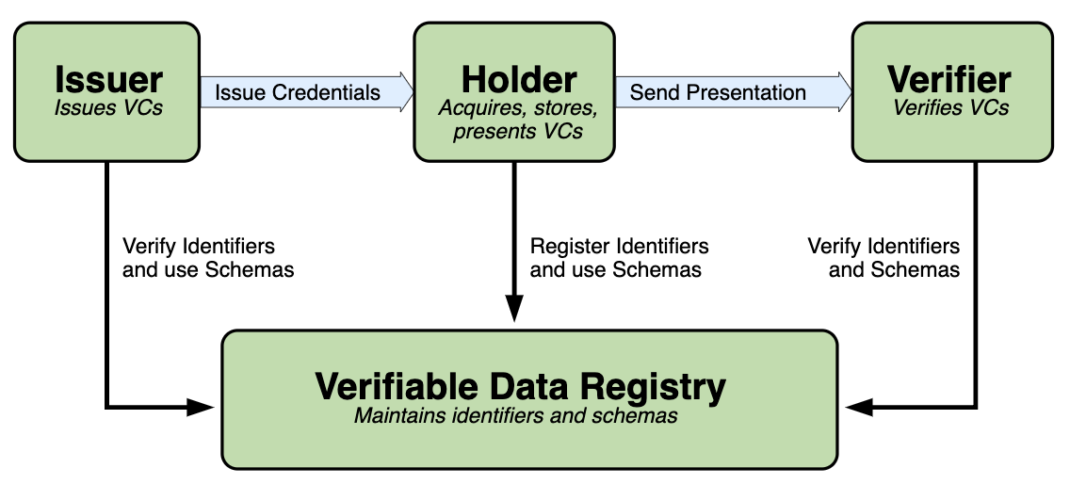
Evolve the BPA to address the more complex (and the simpler) worlds
Guidelines for expression of community user attributes
reduce inconsistencies between implementations
improve interoperability & end-user usability across research community communities and infrastructures
Extend AARC BPA
improve scalability
leverage emerging standards
like OpenID Federation
Authorisation guidelines
best practises to enable efficient &
effective sharing of federated resources
2025
Decentralised identities
guidance for digital wallets linked to BPA

Slide 7
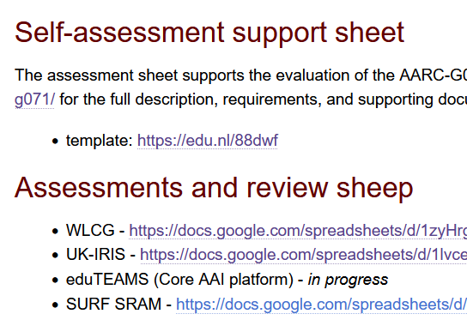
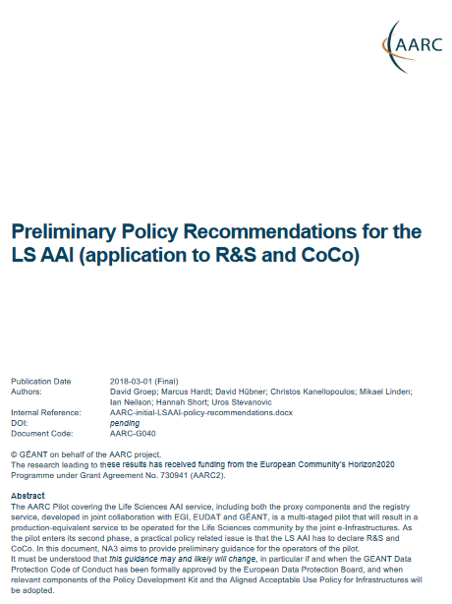

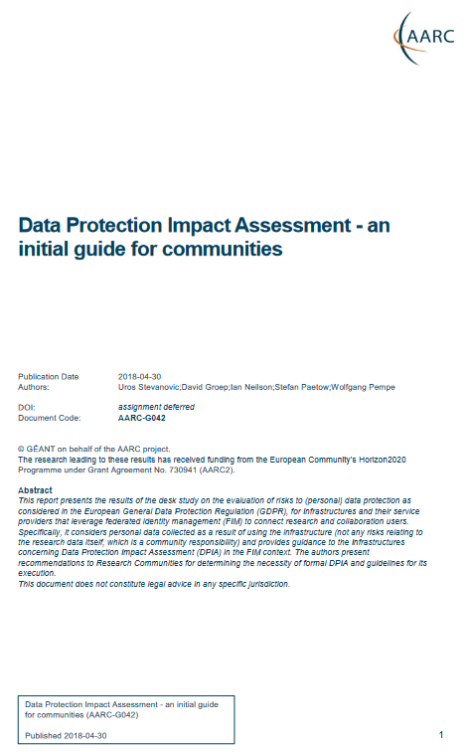

Policy and good practice underpinning the AARC Blueprint BPA
Infrastructure alignment and policy harmonisation: helping out the proxy
Operational Trust for Community and Infrastructure BPA Proxies
Increase acceptance of research proxies by identity providers through common baselines
Review infrastructure models for coordinated AUP, T&C, and privacy notices, improving
cross-infrastructure user experience (users need to click only once)
User-centric trust alignment and policy harmonization: helping out the community
Lightweight community management policy template
Guideline on cross-sectoral trust in novel federated access models
Assurance in research services through (eIDAS) public identity assertion
Anchored in the researcher user communities by co-creation with FIM4R

Slide 8
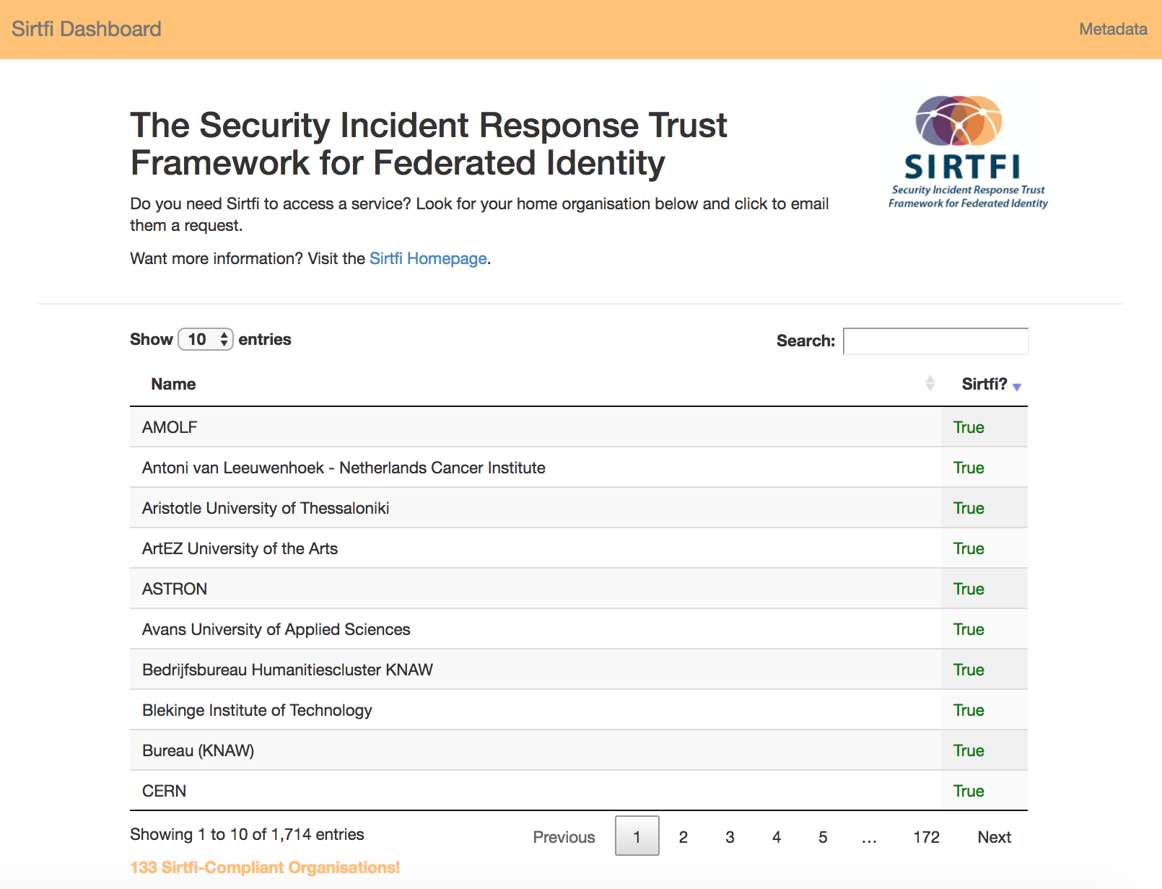

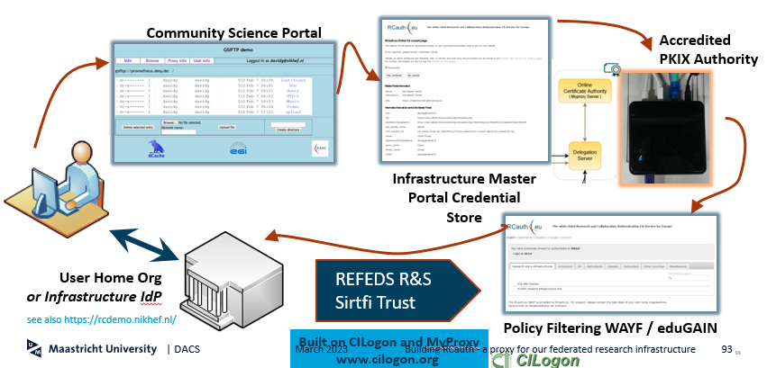
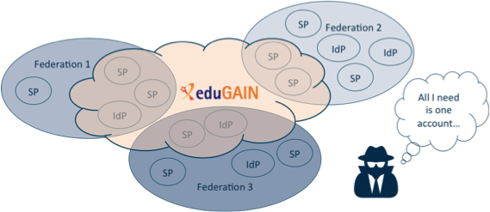



An AARC beyond the Policy Development Kit?
Current PDK is targeted at large and structured communities – and quite complex
https://aarc-community.org/policy

Slide 9
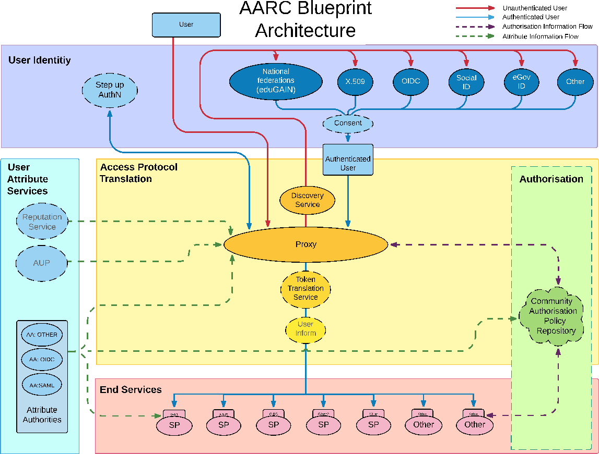
AARC G071 is there to help, but do we ‘get the trust across’?
Community membership management directories and attribute authorities
integrity of membership
identification, naming and traceability
site and service security
protection on the network
assertion integrity
Community membership management directories and attribute authorities
integrity of membership
identification, traceability
site and service security
network protections
assertion integrity
> Trust marks and expression
But when proxies are proxying proxies, can we proxy the trust?
Agree to a common baseline – that was successful before!
… set of (one or more) guidelines that represent a widely agreed and jointly-developed
operational trust baseline for infrastructure membership management and proxy components.
Now, feedback is needed of the current proxy operators (in AEGIS) and extend the baseline with guidance.
See https://www.igtf.net/guidelines/aaops/ and https://aarc-community.org/guidelines/aarc-g071/

Slide 10
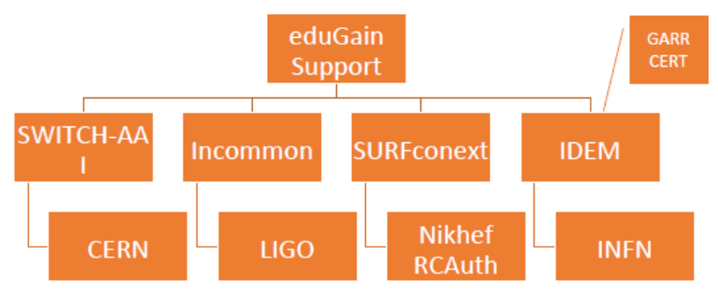
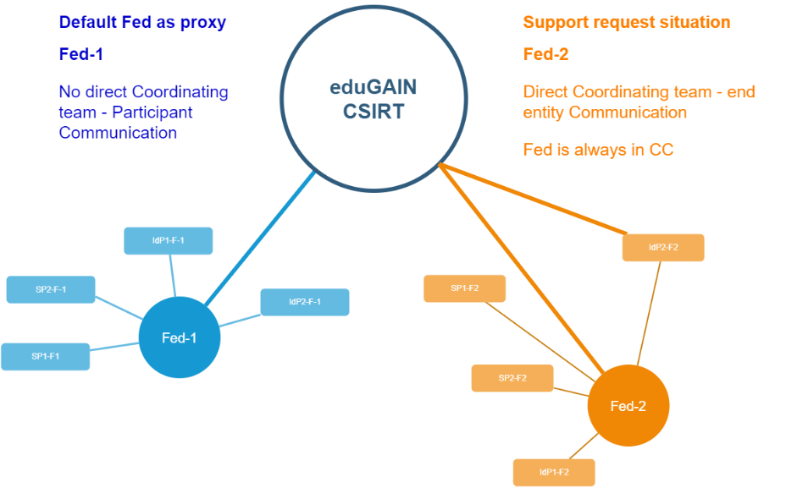
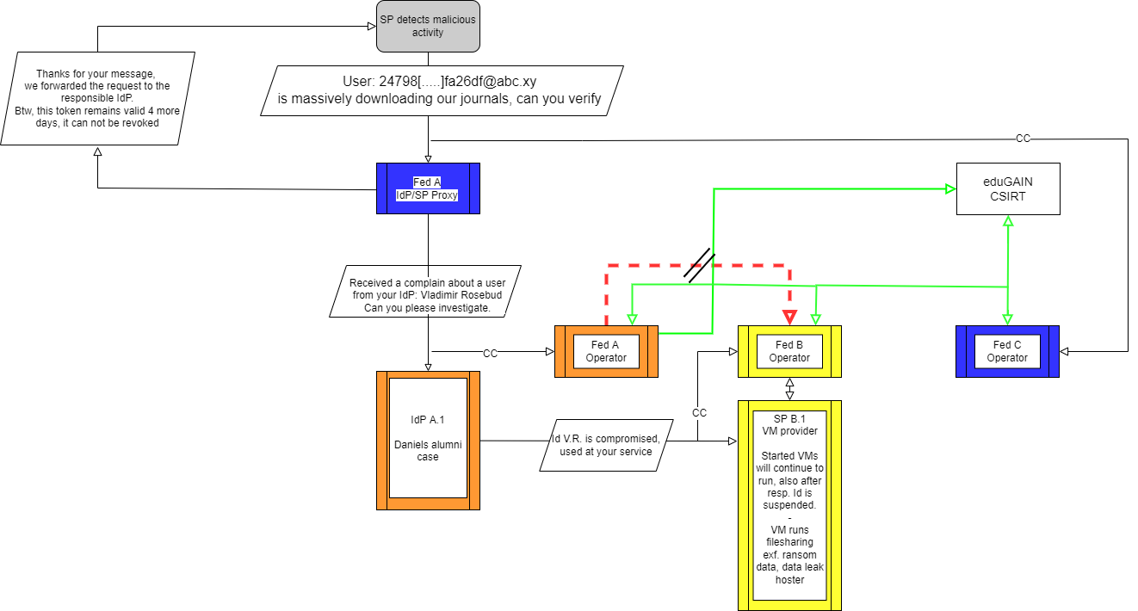

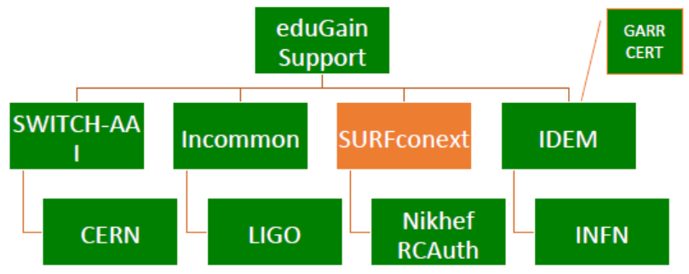




Response and traceability across IdP-SP Proxies and the limits of Sirtfi
Srtfi v1
Guidelines for a joint operational trust baseline for membership management and proxy components,
supplemented by policy guidance for sectoral federations with more specific policies where needed
‘How can we convey the trust in what is in and behind the proxy?’
‘How to provide timely traceability between services and identities through the proxy?’
Based on requirements from FIM4R, WISE, and the proxy operators in AEGIS.
|
|CSIRT
joint work with GN5-1 EnCo and eduGAIN CSIRT
images: AARC Sirtfi v1 exercise (Hannah Short), eduGAIN security TTX (Sven Gabriel, eduGAIN CSIRT)

Slide 11

Can we build on a trusted baseline and expectations to increase acceptance of research infrastructure proxies with R&E identity providers
Even though affiliation is the most relevant attribute from home IdPs, …
still need assurance statements and REFEDS Assurance Framework attribute freshness
unless ‘well hidden’, proxies are met with scepticism by IdPs to release personalised to R&S
do Entity Categories ‘traverse’ proxies? and can proxy ops rely on their ‘downstreams’?
a common baseline that proxies can endorse and manage for their connected services helps
review and enhance effectiveness of Snctfi ‘revamped’
the set of guidelines that describe a (self-) accessible baseline
for a set of service providers behind an AARC BPA Proxy
and thereby encourage trust in the proxies and their connected services

Slide 12
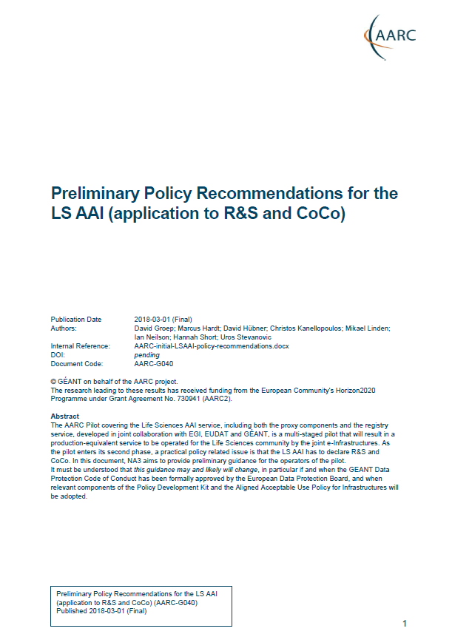
Proxies have their own challenges as well: AUPs, T&Cs, Privacy notices, …
For large ‘multi-tenant’ proxies:
some subset users in some communities use a set of services – how to I
present their Terms and Conditions, and their privacy policies, so that the users
  only see the T&Cs and notices for services they will access
  this does not to need to be manually configured for each community
  is automatically updated when services join
as well as for community and dedicated proxies:
when new (sensitive) services join, who needs to see the new T&Cs?
can we communicate acceptance of T&Cs to services even if ‘we’ are small and ‘they’ are large?
What is an acceptable user experience in clicking through agreements?
What is most effective in exploiting the WISE Baseline AUP? What do you need?
With Fewer Clicks to More Resources!
beyond AARC-G040

Slide 13
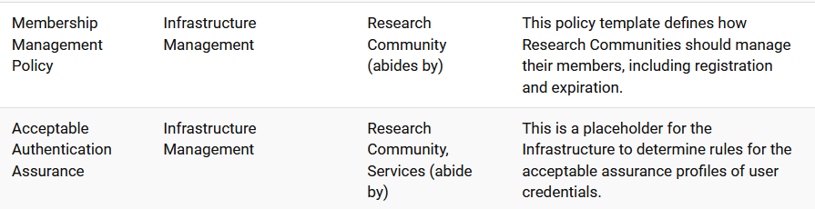
Helping out the community – a simpler policy toolkit for communities
What we heard and observe:
“small to mid-sized communities do not have the resources to maintain a bespoke community management policy”
Leaves both communities and operators of membership management services unclear about trust assurance level of members - current templates in toolkit too complex and prescriptive
community consultation on the ‘minimum viable community management’ – we are here!
template and implementation guidance (FAQ) on community lifecycle management
how to implement the community management in the (EOSC) AAI services

Slide 14
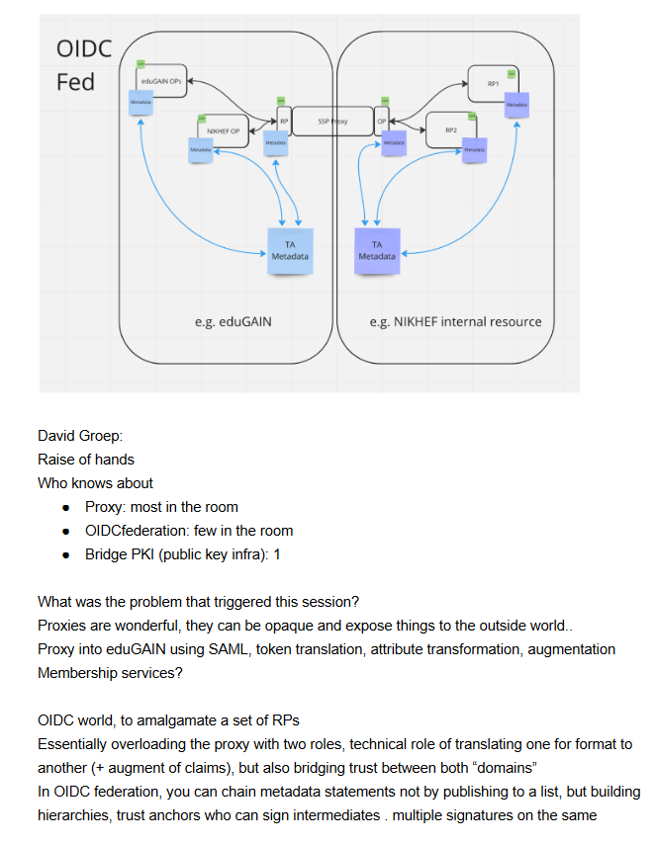
New trust models – what is the role of the proxy in OIDCFed?
In today’s BPA proxy links both sides by being
opaque, both for attributes as well as for trust
does it have to be that way?
separate claims/attribute transformation from trust bridging?
can OIDCfed structure convey trust transparently? Should it?
can we then be more flexible? or will it just confuse everyone?
easier to bridge trust across sectors this way?
e.g. linking .edu, .gov, and private sector federations?
See also ACAMP at TechEx23 and TIIME

Slide 15
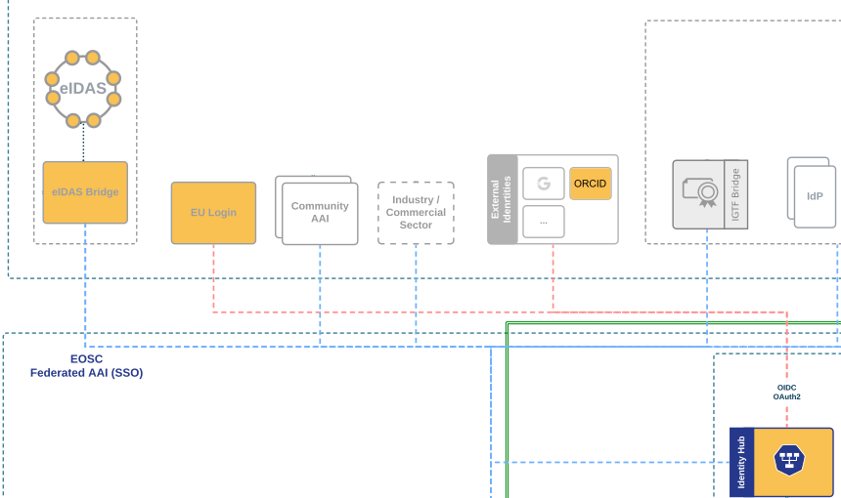
We’ll see more diverse sources of identity & assurance anyway
Most reliable (and most ‘available’) source of assurance may be the European government identity ecosystem.
Step-up to at least substantial level can now readily be done ‘at home’ by users
through their national eID schemes
Joint work on eIDAS, Erasmus Student Mobility,
and more makes this more accessible
Better attainable than relying on home institutions?
… but:
what to do with non-European users?
how to link the identities together

Slide 16
All about enabling research: FIM4R & communities are a key factor
Also in AARC-TREE we target a “co-creation process”
support FIM4R to increase the reach of workshops in the next 2 years
community review, ideas, and input on both policy and architecture
start from the high-level requirements and broad community input
whatever we build must be usable and available by researcher communities first of all, and align to interoperability standard and open, collaborative research goals
Really a global activity: we want to engage
everyone, in AARC TREE and beyond

Slide 17
Deliverables
 | Deliverable name | Short description | #WP | Lead | Type | Due
M2.1 | Guidance for notice management by proxies | Guideline submitted to AEGIS |  |  |  | M10
D2.1 | Trust framework for proxies and Snctfi research services | Trust framework, guidelines and best practice for BPA proxies and interaction with research services | WP2 | RAL | R | M15
M2.2 | eID assurance model suitability assessed | Report submitted to AEGIS |  |  |  | M18
D2.2 | AARC Policy Development Kit Revision | Evolved suite of guidelines and templates for research and infrastructure communities | WP2 | Nikhef | R | M24

Slide 18

One AARC (Policy) Tree …
Image generated by Adobe Firefly
prompt “image of a broad-leaved lemon tree with a person sitting below it leaning against the trunk in the sun”
But: do you really want two trunks??

Slide 19
Dedicated work package to collect requirements from (new) communities
  Conduct an AARC BPA adoption survey among the RIs,
  online survey accompanied by the arranged conversations with the individual RIs
  Collect information on current deployment of AARC BPA AAIs and adoption of guidelines
Result: Landscape analysis of AARC BPA adoption (around December 2024)
Landscape analysis of AARC BPA adoption
  Design and create survey (including technology and policy questions)
  based on FIM4Rv2 paper, Evolution, EOSC AAI TF requirements
  Engage FIM4R, AEGIS, EOSC AAI TF, National Ris, EU data spaces to capture requirements
  Discus with our ESFRIs to get expectations & requirements via consultations, workshops etc
Result: Use cases requirements described in a white paper (target Q1 2025)
Use cases requirements & consultations
Handover to Compendium

Slide 20
Compendium and Recommendations
Key result in the ‘2nd year’ (April 2025 - February 2026) is the Compendium
'compendium of AARC best practices’ with recommendations for a common long-term strategy for AAI services in pan-European Research Infrastructures in Europe
based on the use case input and researcher requirements
promotes coherent and interoperable architecture and policy
iterate and validate with the infrastructures at large
describe the road that collaborative research infrastructure AAI will take!

Slide 21

Welcome under the AARC (Policy) Tree
Image generated by Adobe Firefly
prompt “image of a broad-leaved lemon tree with a person sitting below it leaning against the trunk in the sun”
Let’s collect some good practices & share!

Slide 22
davidg@nikhef.nl

Slide 23
But when, oh when?
WP3 Use Case
Analysis
WP5 Compendium

Slide 24
A (very) distributed activity – let’s go and ensure a joint coherent output!
 | STFC | Nikhef | NDN | EGI | CERN | GRNET | KIT | SURF | MU | GEANT & KIFU | SUM
Work item | PM | PM | PM | PM | PM | PM | PM | PM | PM | PM | PM
Research Infra Alignment (Nikhef) |  |  |  |  |  |  |  |  |  |  | 21
Operational Trust for Proxies |  |  | ★ |  |  |  |  |  |  |  | 
‘Snctfi’ R&E Baselining & Integration | ★ | ★ |  |  | ★ |  |  | ★ |  |  | ★
Models for Cross-Infra AUP & Privacy Notices | ★ | ★ |  | ★ |  | ★ | ★ |  |  | ★ | 
User-centric Trust Alignment (RAL) |  |  |  |  |  |  |  |  |  |  | 26
Lightweight Community Management Policy |  |  |  | ★ | ★ |  | ★ | ★ |  | ★ | 
Guideline for Novel Federation Models | ★ |  |  | ★ |  |  |  |  |  | ★ | 
Assurance in Research through eID |  |  | ★ | ★ |  |  |  |  |  |  | 
FIM4R Policy Evolution |  | ★ | ★ |  |  |  |  |  |  |  | ★
 |  |  |  |  |  |  |  |  |  |  | 47

