Slide 1
Enabling Communities in GN5-2
Casper Dreef
Taskleader EnCo
61th EUGridPMA+ meeting
29 May 2024
Public

Slide 2
GN5-2
Proposal was submitted w19
Reviewed over summer
Changes in WP5 (T&I) – Specifically T6 Enabling Communities

Slide 3
EnCo task in GN5-1
Costs = €619.024,-
PMs = 71.3
Two main activities
Policy & Technology
Business Development

Slide 4
EnCo task in GN5-2
Costs = ~€1.100.000,-
PMs = ~150*
Activities
Policy & Technology
Business development
Wallets
T&I Mentorship programme (TIM)
Communications
TIIME conference coordination
Notes:
*Non-EU members not included

Slide 5
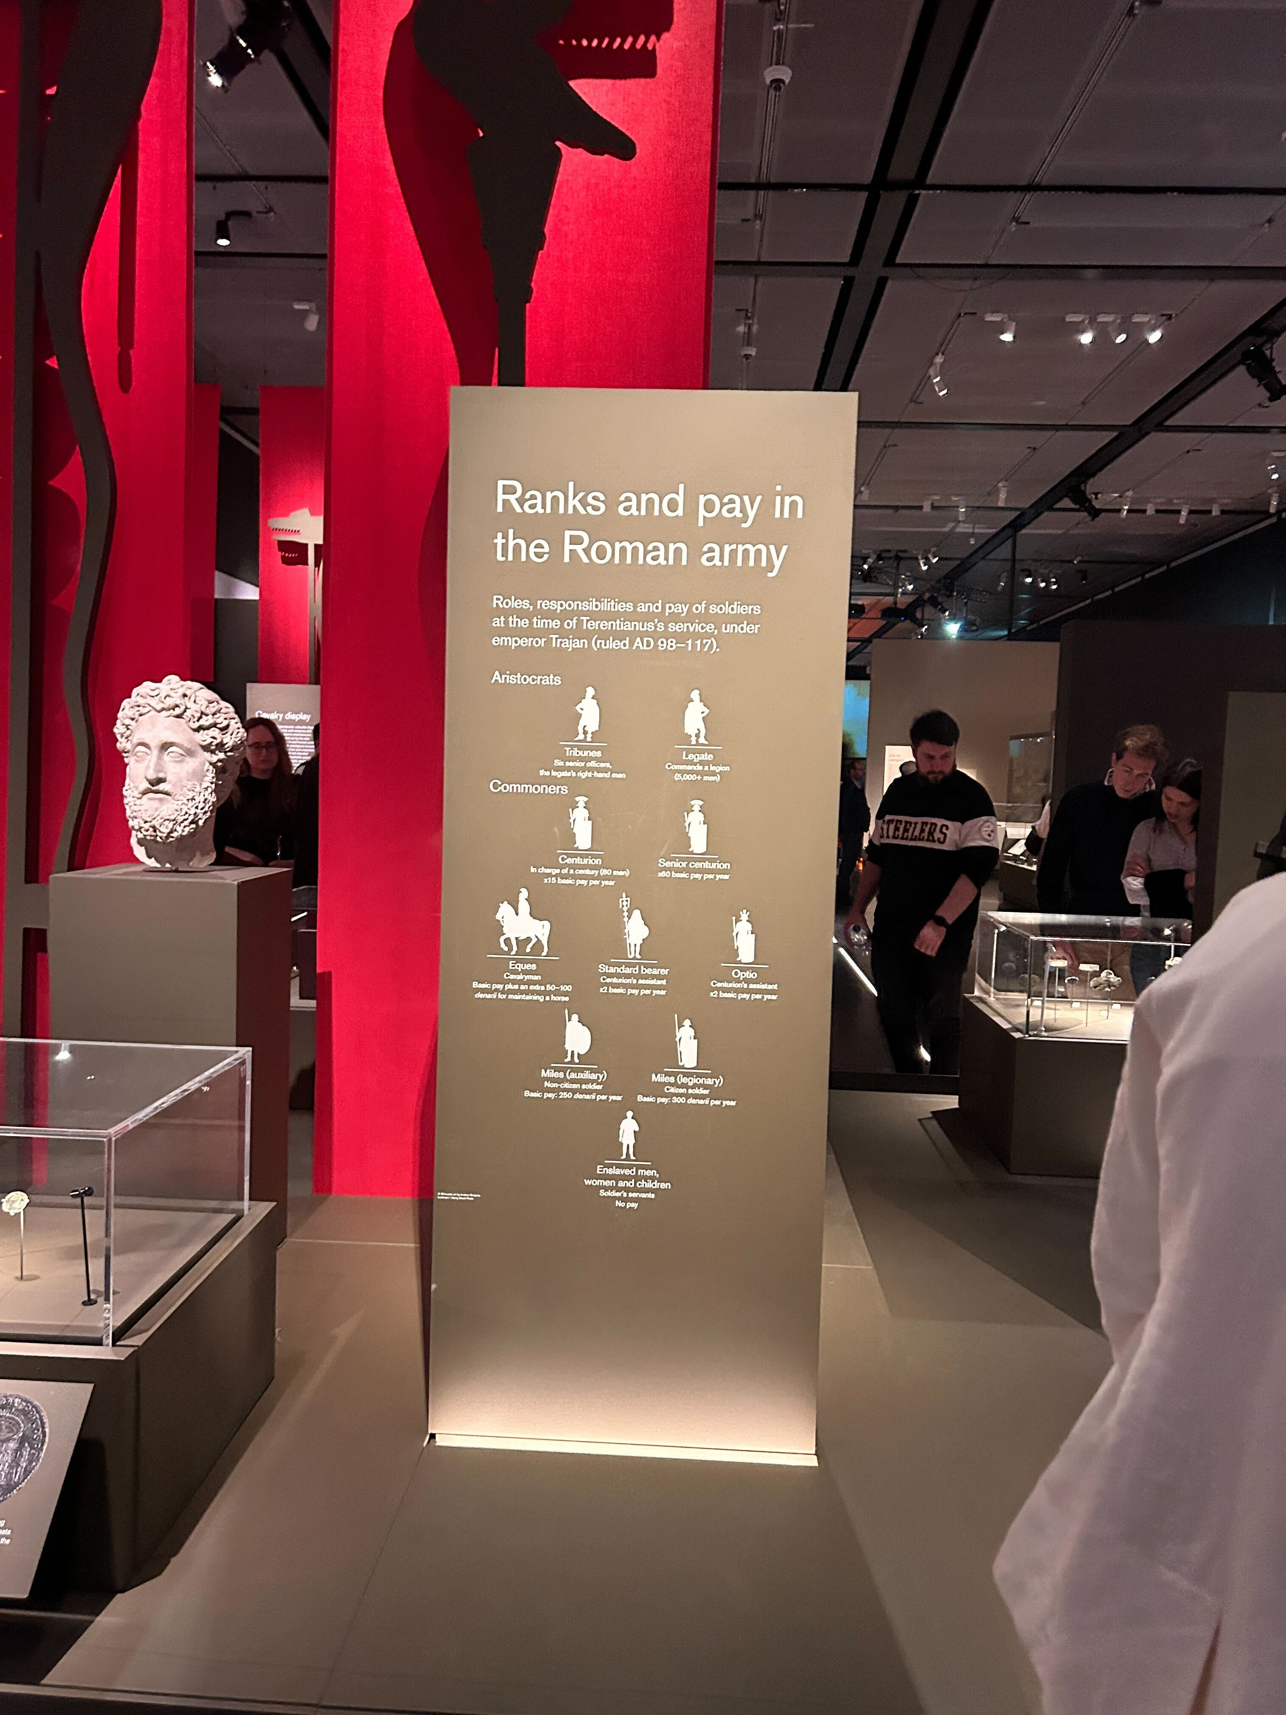
Policy & Technology subtask in GN5-2
Task members
Continuation of current activities
AARC TREE results continuation

Slide 6
Thank You
Any questions?
www.geant.org

