Slide 1


IGTF Fabric Updates
David Groep
davidg@nikhef.nl
status of our authorities, trust fabric news, and RHEL9’s (OpenSSL) hash function issues
part of the work programme of
GEANT 5-1 EnCo, and AARC TREE
the work has received co-funding
from the European Union
co-supported by Nikhef and the Dutch
National e-Infrastructure coordinated by SURF

Slide 2
Meanwhile in the EUGridPMA+ …
EUGridPMA and IGTF distribution matters
  constituency and developments
  GPG Package Signing Key updates
S/MIME baseline in CABF: separating authentication and email in TCS
Root migration update for EL9+ (or: why people bother the fetch-crl devs)

Slide 3
EMEA area membership evolution
Europe⁺: GEANT TCS, and CZ, DE, DK(+FI+IS+NO+SE), FR, GR, HR, HU, NL, PL, RO, SI, SK; AM, GE, MD, ME, MK, RS, RU, TR, UA, UK
Middle East: IR, PK
Africa: DZ, KE, MA
CERN, RCauth.eu
the Swiss moved to eMudhra
(but legacy DutchGrid transitional service still in use)

Slide 4
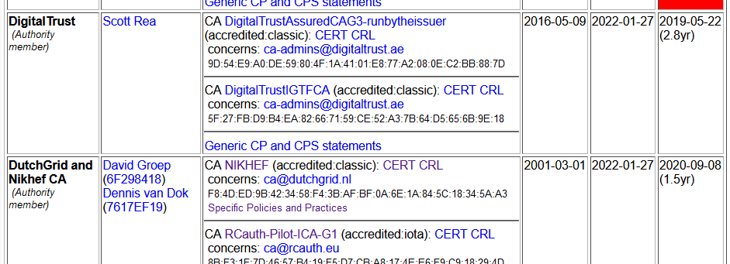
Membership and other changes
Identity providers: both reduction and growth
  migration to GEANT TCS continues: +DE
  https://wiki.geant.org/display/TCSNT/TCS+Participants+Sectigo
  CERN joining TCS via Renater (FR)
  Discontinued: -PT, -DE, -QV, -RS
  Suspended: -KE
Self-audit review
  Cosmin Nistor will update us in a moment
  real-time interaction between authority and reviewers helps, but …
Issues remain for now with support in .ch – but progress continues!

Slide 5
Distribution signing key update
error: Verifying a signature using certificate
D12E922822BE64D50146188BC32D99C83CDBBC71
(EUGridPMA Distribution Signing Key 3 <info@eugridpma.org>):
Key C32D99C83CDBBC71 invalid: not signing capable
In Fedora Core 38+ (and thus later in its derivatives, and maybe soon in Debian), RSA 1024 package signing no longer supported by default
(work-around with bespoke crypto-policies possible, not recommended)

Slide 6
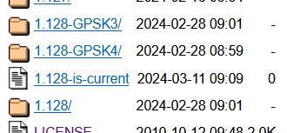
Distribution signing key update
In future releases we move
to a new GPG package key
RSA-2048
called GPG-KEY-EUGridPMA-RPM-4
distributed with 1.122+ releases
Retrieve new public key file from
https://dl.igtf.net/distribution/GPG-KEY-EUGridPMA-RPM-4
or from the public key servers: rsa/2048 dated 2023-07-29T12:06:23Z
fingerprint: 565f 4528 ead3 f537 27b5 a2e9 b055 0056 7634 1f1a

Slide 7
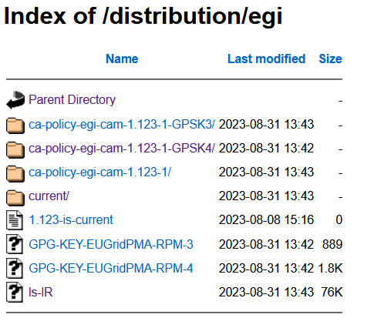
Specific downstream distribution (like EGI) follow
EGI uses the same signing key, since – for now – the packaging is integrated and co-supported by EGI
Plan is to move on the next major change, but not before Q2 2024
RHEL SHA-1 Root issue may be a good time to also make this change the default?

Slide 8
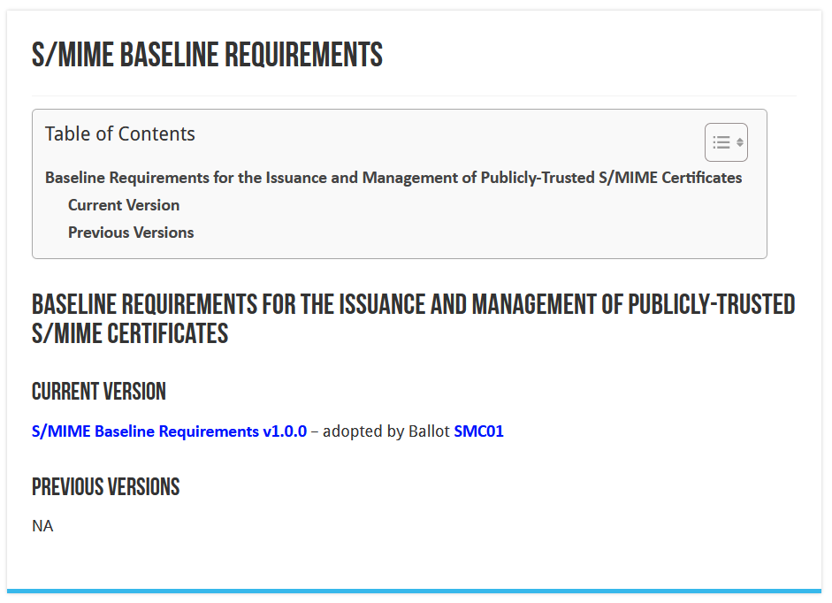
CA/BROWSER Forum

Slide 9
User awareness
This is a change in communications and documentation as well,
not only a set of technical changes
In request systems, have to clearly distinguish for users
which product to order. For example:
  “Personal” stays the same, but is called now “Email signing and Encryption”
  renaming “IGTF MICS Personal” to “Personal Authentication” and explain
  renaming “IGTF MICS Robot Personal” to “Personal Automated Authentication”
  forking “IGTF Classic Robot Email”
    Authentication-only (IGTF) profile “Classic Robot Email”
    Email signing profile “Organisation-validated S/MIME signing” (i.e. team-based or role-based)

Slide 10
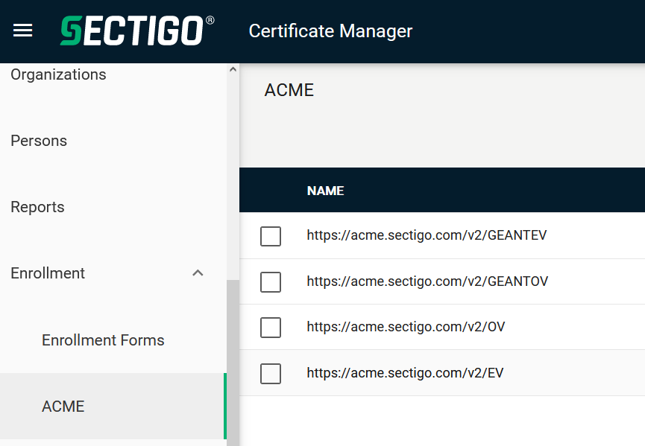
Other CABF things to keep in mind
Server SSL BR has already been updated
  the provision for using DC prefixing has been retained
But expect shorter validity periods in the future
  start preparing for 90-day max in your service deployment automation systems
  increased use of automation (ACME OV using client ID+secret)
[root@hekel ~]# certbot certonly \
--standalone --non-interactive --agree-tos --email davidg@nikhef.nl \
--server https://acme.sectigo.com/v2/GEANTOV \
--eab-kid DUniqueID_forthisclient --eab-hmac-key mv_v3ryl0n9s3cr3tK3y \
--domain hekel.nikhef.nl --cert-name OVGEANTcert

Slide 11
The challenge of self-signed roots and FF & RedHat’ s idea of what self-signed means …

Slide 12
Although it conceptually makes no sense …
We know SHA-1 is no longer secure – and all EECs and ICAs moved away – when used as a secure hash algorithm. But …
now, some projects and distros are (uselessly!) deprecating SHA-1
also for self-signed (root) certificates
This affects at least
  FF103+
  RHEL9+ (and rebuilds)
yet … in the cases we could find only for CA certs
that are not in the WebPKI (and distro) public trust list
This impacts both joint-trust and igtf-only trust when installed in a non-system location. But thy system locations are different is not obvious from the doc …

Slide 13
Rocky9+, AlmaLinux9+, RHEL9+ and
With RHEL9 also deprecating SHA-1, but at the same time
still having self-signed SHA-1 based root certs in the ca-certificates
package, depends on a RedHat/OSSL proprietary set of ‘bonus bits’ appended to the end of the ASN.1 certificate blob.
For the others, there is – for now – a policy override:
update-crypto-policies --set DEFAULT:SHA1
update-crypto-policies --set LEGACY
even if that is a rather course-grained and blunt tool

Slide 14
The ca-certificates package in RH9
Interestingly, EL9 does ship with a lot of SHA-1 root CAs:
this relies on the OSSL proprietary ‘trust bytes’ in a BEGIN TRUSTED CERTIFICATE blob
such blobs allow SHA-1 for self-signed roots, but are not standarised
Yet the ‘simple’ solution, to ship both the EL/OSSL proprietary ‘trust’ bytes as well as a regular PEM formatted root does not work (thanks to Brian Lin for testing that!)

Slide 15
The OSG experiment
OSG shipped the dual-blob mode for a few days
using something like https://www.nikhef.nl/~davidg/tmp/make-trusted.sh
first a “BEGIN TRUSTED CERTIFICATE”,
then in the same file “BEGIN CERTIFICATE”
However, it broke:
CANL-Java, extending BouncyCastle, cannot process this blob and will balk even if it does not recognise it
(https://stackoverflow.com/questions/55550299/java-can-not-load-begin-trusted-certificate-format-certificate)
open as a dCache Feature Enhancement on CANL Java by Paul Millar
will not be fixed overnight, of course. And we my find other issues thereafter

Slide 16
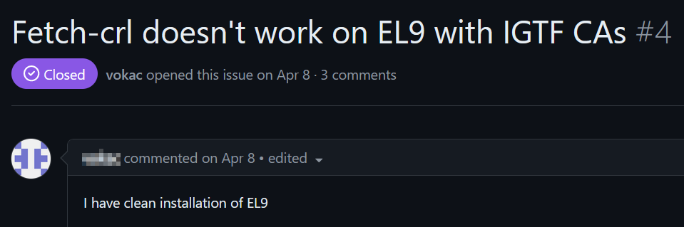
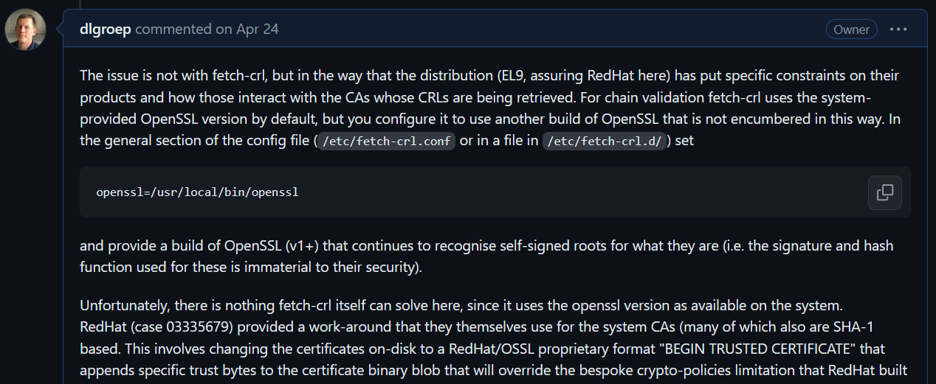
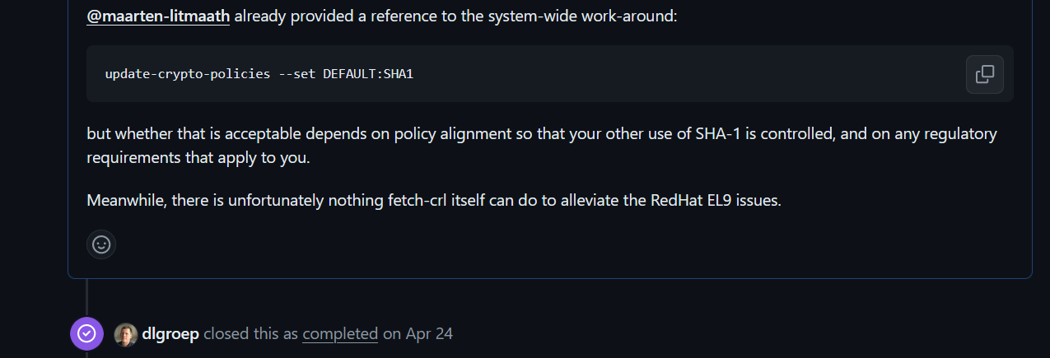
End-users don’t understand & open bugs on ‘random’ devs
https://github.com/dlgroep/fetch-crl/issues/4

Slide 17
But … maybe …
On 2023-12-20 13:25, Guido Pineda wrote:
> I am using fetch-crl version 3.0.22.
> We have a total of 89 trust anchors configured on our /etc/grid-security directory.
> I have tested fetch-crl with different versions of OpenSSL and here are the
> outcomes:
> For versions 1.1.1k and versions 3.2.0, the amount of errors when trying to verify
> the CRL's is only one [which was explainable]
> However, when using OpenSSL version 3.0.7, we get 10 errors
Due to self-compiling OpenSSL and does that ignore the RH crypt-policies?

Slide 18
Mitigations?
Still,
if you still have a SHA-1 root
and you are able to re-issue with the same key (and new serial)
and your EECs do not have dirname+serial in their AKI
your CAs should probably re-issuing its root because that is easier.
But for the large ones, esp. the DigiCert Assured ID Root from 2006 for instance, that will be hard.
And migrating to another (SHA-2 rooted) signing hierarchy will take at least 395 days ... and a lot of engineering on the RP and CA side
The root cause is with RH not understanding what a self-signed trust
anchor is, but that will not help us in the short term.

Slide 19
Reissuance of roots – state and progress
ASGCCA-2007 ArmeSFo
BYGCA CESNET-CA-Root
DZeScience DigiCertAssuredIDRootCA-Root
DigiCertGridRootCA-Root IHEP-2013
KEK
MARGI
RDIG RomanianGRID
SRCE SiGNET-CA
TRGrid seegrid-ca-2013
Fixed by now: GridCanada, CILogon basic/silver/OpenID, UKeScienceRoot-2007
Removed: DigiCertGridCA-1-Classic, DigiCertGridTrustCA-Classic, DFN-GridGermany, CNIC,
Pending withdrawal: LIPCA

Slide 20

Building OUR global trust fabric
Questions?
David Groep davidg@nikhef.nl
https://www.nikhef.nl/~davidg/presentations/
https://orcid.org/0000-0003-1026-6606

Slide 21

this work is co-supported by the Trust and Identity work package of the GEANT project (GN5-1)
in collaboration with many, many people in the AARC+ Community, including Christos Kanellopoulos, Nicolas Liampotis, Licia Florio,
Hannah Short, Maarten Kremers, Niels van Dijk, David Crooks, Dave Kelsey, Ian Neilson, Mischa Sallé, Jens Jensen, and so many others!
davidg@nikhef.nl

