Slide 1

61st EUGridPMA+
AARC Policy, IGTF, and GN5 EnCo
Abingdon meeting
May 2024
David Groep
hosted by STFC’s Rutherford Lab at Coseners

Slide 2
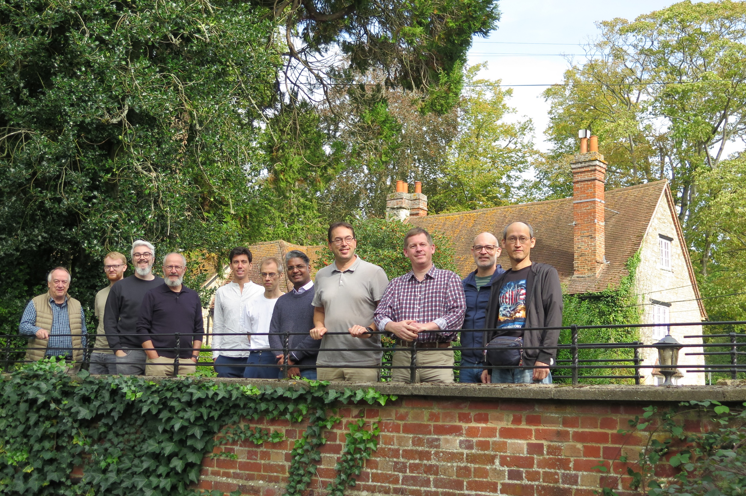
Getting to be our habitual place ☺
Thanks to Dave Kelsey and David Crooks
2 full days
open space
may it be interactive!

Slide 3
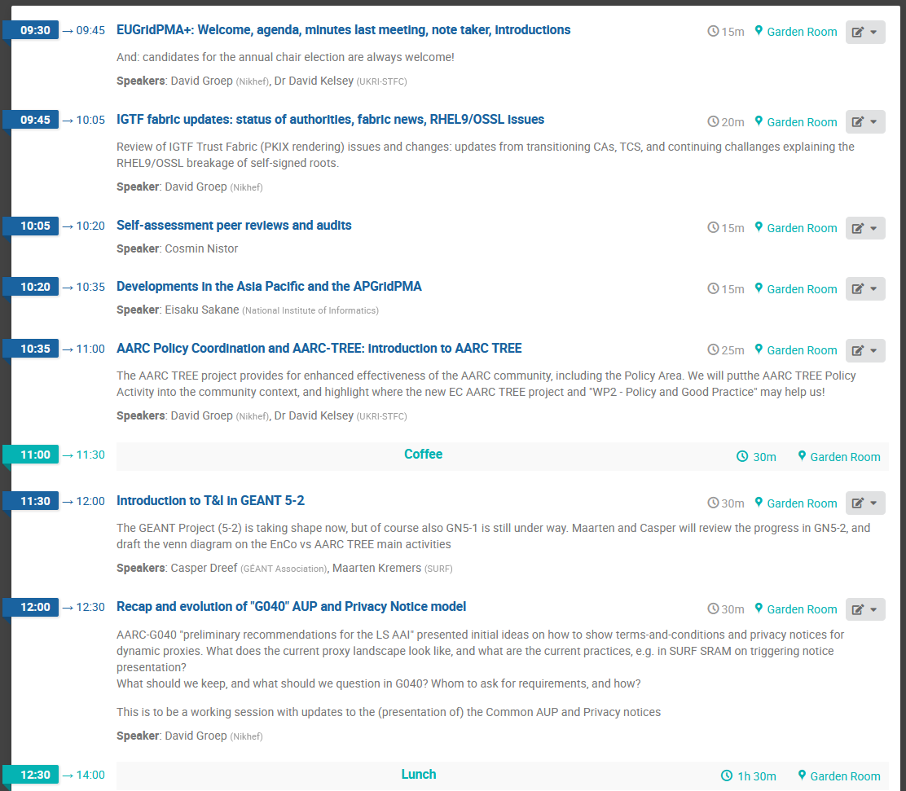
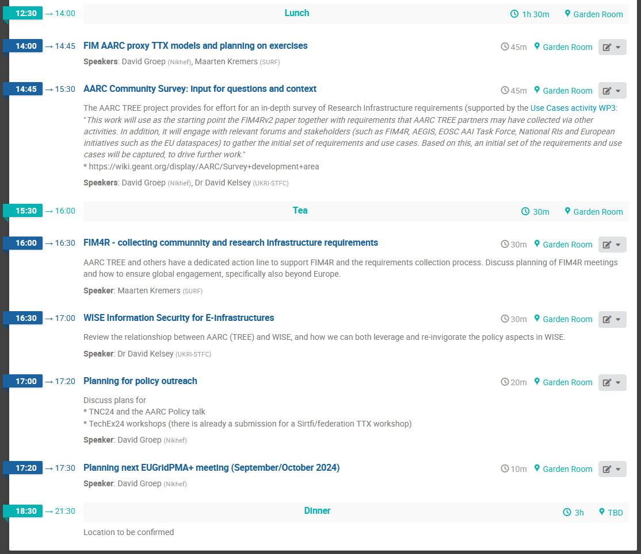

Slide 4
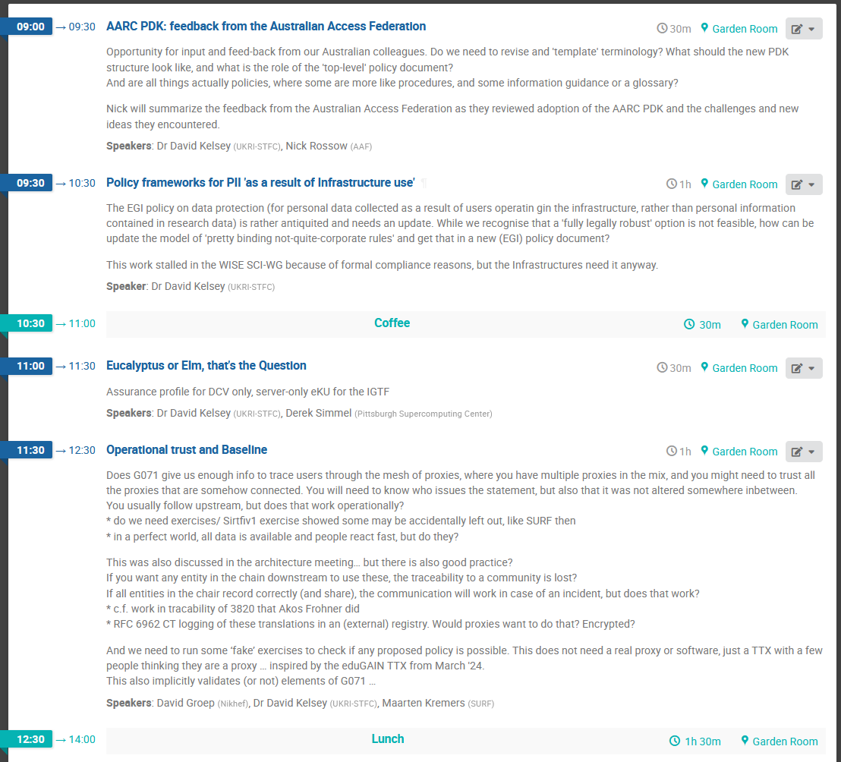
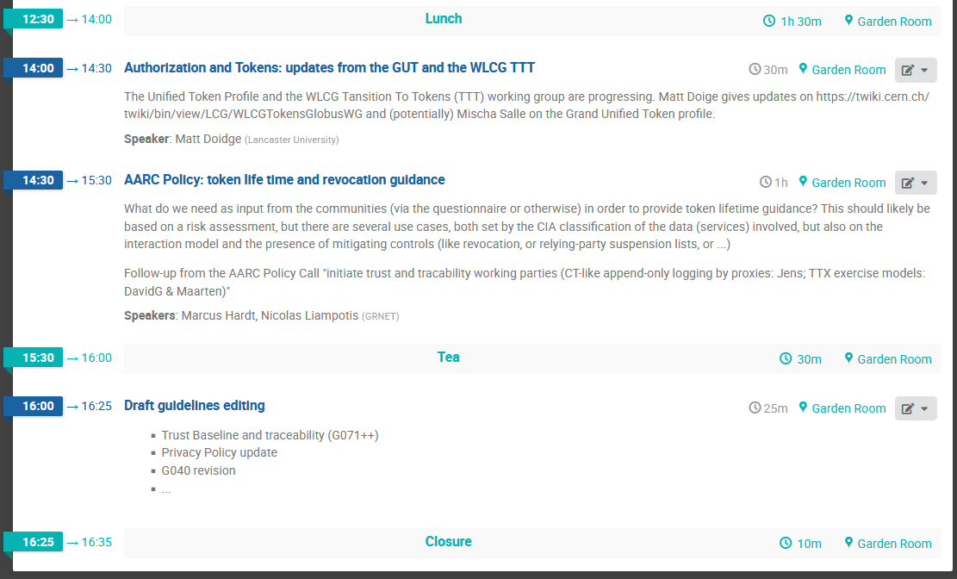

Slide 5
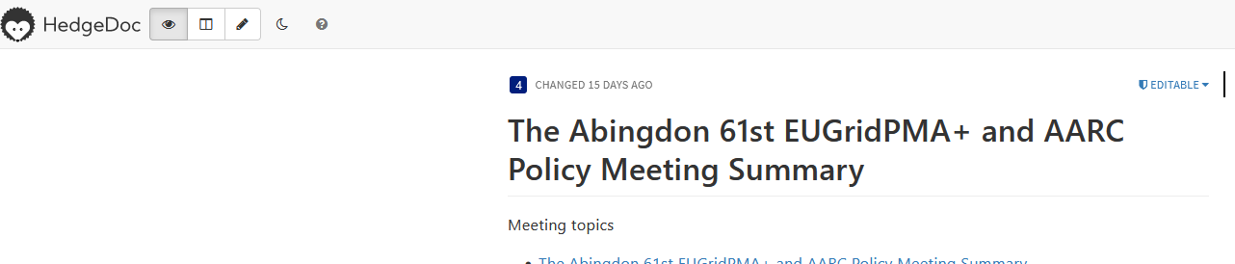
Logistics
Upload presentations to the agenda page (you should have a login, or invite email)
https://eugridpma.org/agenda/61
Work together on the minutes – and we don’t have a
secretary role defined, so hop over to:
https://eugridpma.org/minutes/61
login with your eduGAIN credentials. Non-edu? use the IGTF proxy IdP …!
For the benefit of those ‘only on-line’, use zoom (without audio!) to share your screen when presenting/editing - https://eugridpma.org/z/61

Slide 6
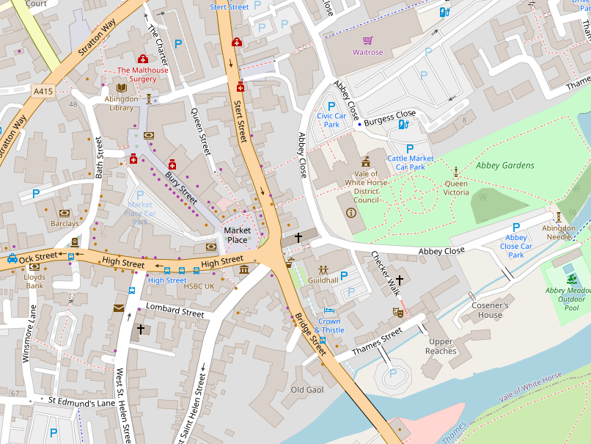
For this evening
Decide on a dinner plan
  Hands up who wants to join

Slide 7
Building a global trust fabric
Questions?

