Slide 1








Pixel TPC dEdx performance in ILD
Yevgen Bilevych, Klaus Desch, Sander van Doesburg, Harry van der Graaf, Fred Hartjes, Jochen Kaminski, Peter Kluit, Naomi van der Kolk,
Cornelis Ligtenberg,
Gerhard Raven, and
Jan Timmermans
LCTPC WP 28 March 2024

Slide 2
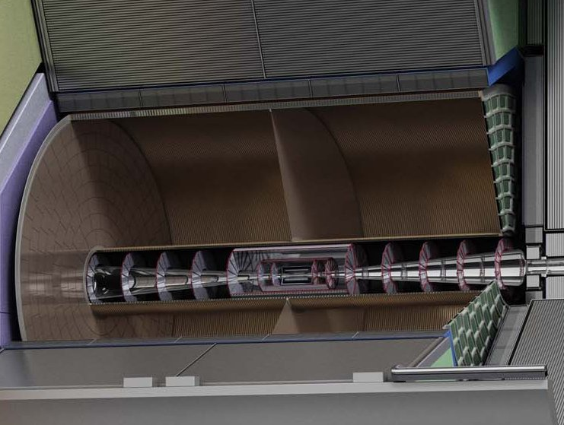



Pixel TPC
(Octopuce)
(TimePix1) TPX3 chip Quad Module TPC plane
(2007-14) 2017 2018 2019

Slide 3
DESY testbeam Module Analysis
Performance of dEdx
It is possible to study in data the energy loss of electrons
The Pixel TPC has measurements with 55 μm pixel size
This allows to measure the number of hits as a function of the distance along the track dN/dx (dE/dx) with high granularity
It is possible to use also the ToT (a measure of the deposited charge) but this is not explored
The advantage of hit counting is that one is NOT getting the fluctuations from the multiplication process. The ToT will include these avalanche fluctuations.
Using e.g. a pad readout the charge is used as a measure of dEdx
  This has a worse granularity and includes avalanche fluctuations

Slide 4
DESY testbeam Module Analysis
Testbeam performance of dEdx
B=0 T
B=1 T
Preliminary
B=0 T has a large Landau tail
B=1 T smaller Landau tail and a more gaussian distribution
An electron crossing 8 chips in the module has about 1000 TX3 hits

Slide 5
DESY testbeam Module Analysis
Analysis of dEdx performance
Combine chips to form a 1 m long track with 60 % coverage for electrons
Method 1) reject large clusters and then run dEdx @ 90% using slices of 20 pixels along track (xy) (gives nr of selected hits). A large cluster has more than 6 hits in 5 consecutive pixels.
Method 2) fit the slope of the N_{scaled} minimum distance (d) distribution with an exponential function (N_{scale}(d)=defines the inverse weights):
N(d)_{scaled} = N_{scale}(d) N_{observed}(d)
N(d)_{scaled} is then fitted for each track with N₀ exp(-slope d)
Calculate the “dEdx” variable for electrons and MIP (==70% of hits)
  method 1 = nr of selected hits
  method 2 = slope
  Resolution is σ = σ(dEdx)/dEdx (for σ we use the rms)

Slide 6
DESY testbeam Module Analysis
Distance distribution
Single chip
Quad module
Calculate minimum distance between the hits.
The slope of the distribution is related to the number of primary clusters /cm
The diffused peak at d<10 comes from clusters with more than 1 hit.
B=0 T
Preliminary
Thesis Kees Ligtenberg

Slide 7
DESY testbeam Module Analysis
Performance of dEdx
Method 2: Fit slope of the distance distribution
From 10 clusters onwards an exponential distribution is followed.
Below 10 the distribution will be down-weighted (N_{scale}(d) = 1/weight). The weights are:
Weights B=0 = { 35.0467 , 12.1497 , 4.52914 , 2.76311 , 1.99386 , 1.59795 , 1.3656 , 1.21409 , 1.11898 , 1.04385 };
Weights B=1 = { 22.5617 , 7.39573 , 2.43318 , 1.54528 , 1.23428 , 1.09727 , 1.04368 , 1.01625 , 1.00182 , 0.998178 };
Note the difference in weights in the B=0 and 1 T data sets. This is related to the fluctutations
B=0 T
Preliminary

Slide 8
DESY testbeam Module Analysis
dEdx performance method 1
Electron resolution
3.6%
1 m track 60% and coverage
Linearity MIP-e = 1.03
z drift=5-15 mm (flat)
MIP distribution is obtained by dropping 30% of the hits
Preliminary
MIP in plot was corrected … thanks Ulli

Slide 9
DESY testbeam Module Analysis
dEdx performance method 2
Electron resolution
2.9%
1 m track 60% and coverage
Linearity MIP-e = 1.07
Ideally this is 1. A number larger than 1 means that the resolution is +7% larger
Preliminary

Slide 10
DESY testbeam Module Analysis
Summary of performance of dEdx
The dEdx resolution for electrons from data by combining tracks to form a 1 m long track with realistic coverage ~60% coverage.
Preliminary
Method | B=0 Resolution (%) | B= 1 T Resolution (%)
(1) dEdx 90 tail | 6.0 | 3.6
(2) Fit slope | 5.4 | 2.9
The “dEdx 90 tail” method is truncation at 90% where large clusters are identified and removed (tail reduced)
For the “Fit slope” method (2) an exponential distribution (with the slope and amplitude as free parameters) is fitted to the distribution of distance between the hits (as discussed: after applying the weights)

Slide 11
DESY testbeam Module Analysis
dEdx Performance extrapolated to ILD detector
ILD detector
rInner = 329 rOuter = 1770 mm
electron resolution = 2.5%
at θ=π/2 (cost=0)
Assume Pixel TPC performance at B = 1 T at p = 5,6 GeV/c
Test beam B = 1 T
p=5,6 GeV/c
Method 2 fit slope of the distance distribution
electron resolution 2.9%
1 m track 60% and coverage

Slide 12
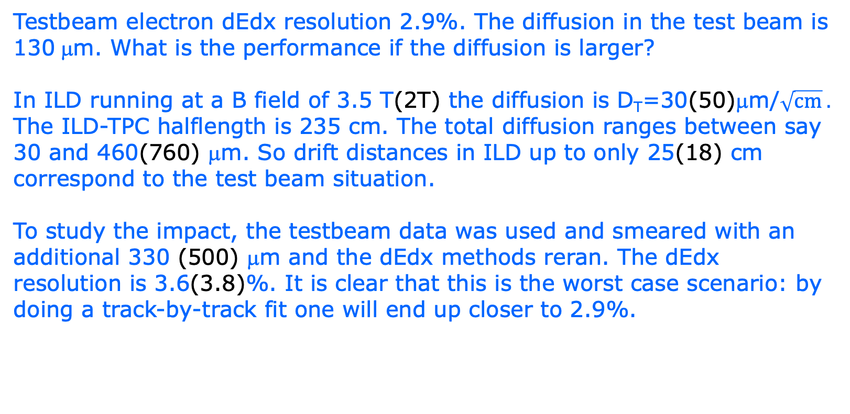
DESY testbeam Module Analysis
dEdx performance and the impact of diffusion
Testbeam electron dEdx resolution 2.9%. The diffusion in the test beam is 130 μm. What is the performance if the diffusion is larger?
In ILD running at a B field of 3.5 T(2T) the diffusion is D_{T}=30(50)μm/$\sqrt{cm} .$ The ILD-TPC halflength is 235 cm. The total diffusion ranges between say 30 and 460(760) μm. So drift distances in ILD up to only 25(18) cm correspond to the test beam situation.
To study the impact, the testbeam data was used and smeared with an additional 330 (500) μm and the dEdx methods reran. The dEdx resolution is 3.6(3.8)%. It is clear that this is the worst case scenario: by doing a track-by-track fit one will end up closer to 2.9%.
Question by Ulli in LCTPC

Slide 13
DESY testbeam Module Analysis
ILD dEdx performance
Contacted Ullrich Einhaus for dEdx studies in ILD
Extracted the ILC soft parametrisations for energy loss based on G4 and full simulation of the ILC TPC with T2K gas
Link generated in 2020 with ILC soft v02-02 and v02-02-01

Slide 14
DESY testbeam Module Analysis
dEdx performance
zoom on Low momenta

Slide 15
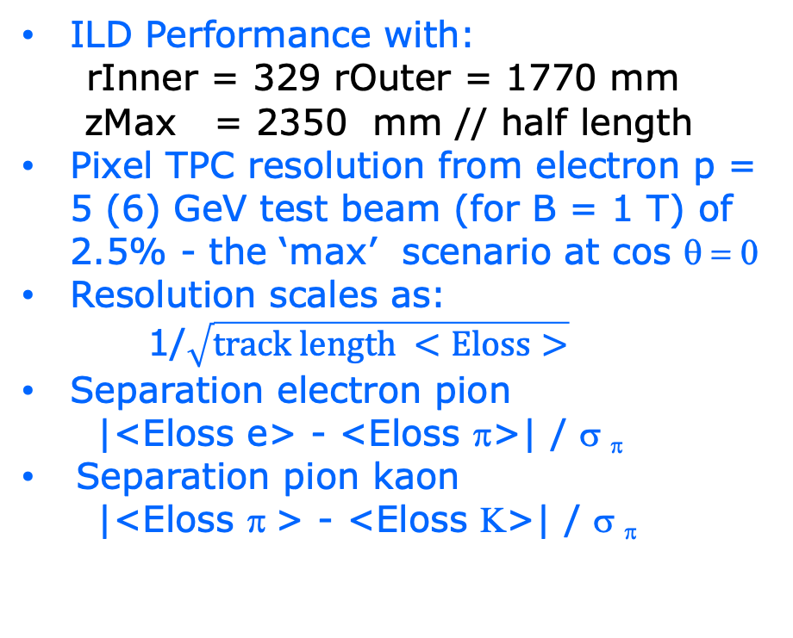
DESY testbeam Module Analysis
Pixel TPC dEdx performance
ILD Performance with:
rInner = 329 rOuter = 1770 mm
zMax = 2350 mm // half length
Pixel TPC resolution from electron p = 5 (6) GeV test beam (for B = 1 T) of 2.5% - the ‘max’ scenario at cos θ = 0
Resolution scales as:
1/$\sqrt{track length <Eloss>}$
Separation electron pion
|<Eloss e> - <Eloss π>| / σ _{π}
Separation pion kaon
|<Eloss π > - <Eloss Κ>| / σ _{π}
ILD Pixel TPC

Slide 16
DESY testbeam Module Analysis
Pixel TPC dEdx performance
Separation pion kaon
|<Eloss π > - <Eloss Κ>| / σ _{π}
Separation pion kaon for different cos(theta) values due to the track length dependence
For cos(theta)=0 till 0.95 the separation lies between the black and red curves. Only above 0.95-0.975 the separation drops till the blue curve.
‘max’ scenario with resolution 2.5%
Excellent performance over very large polar angle range
ILD Pixel TPC

Slide 17
DESY testbeam Module Analysis
Pixel TPC dEdx performance
Worst case ILD Performance with: 3.1% and 3.3 % (2T) at cos θ = 0
ILD Pixel TPC
Note the momentum range (50 GeV) B= 2T for Z running

Slide 18
Pixel TPC dEdx performance
dE/dx resolution for an electron with p=5,6 GeV/c of 1 m track length with 60% coverage is measured to be 2.9% (at B = 1 Tesla)
The extrapolated resolution for the ILD detector is 2.5% (w.c. 3.1 and 3.3% 2T)
This allows for particle identification and separation of Kaons from pions up to momenta of 45 GeV with more than 4-5σ for cos(θ) from 0 to 0.95
A test beam @ FermiLab with a quad in a TPC is planned (2024, US Grant EIC)
  an EIC R&D program for CO2 cooling is funded (2023) (Yale, Stony Brook, Purdue, Bonn, Nikhef)
  Focus is particle identification and tracking at the Electron-Ion-Collider
A pixel TPC has become a realistic viable option for experiments
  High precision tracking like ILD@ILC in the transverse and longitudinal planes, dE/dx by electron and cluster counting, excellent two track resolution, digital readout that can deal with high rates

Slide 19
Operation of a Pixel TPC at CEPC or FCC-ee

Slide 20
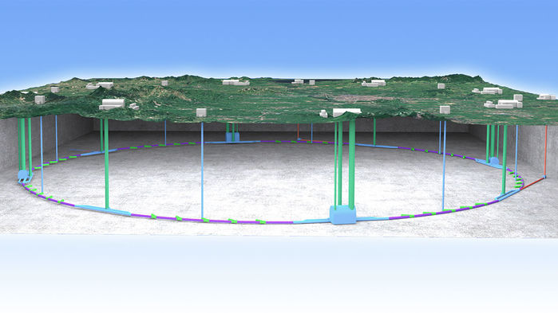
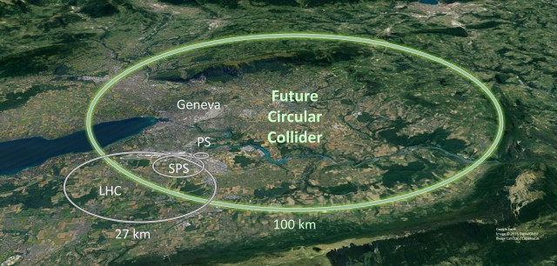
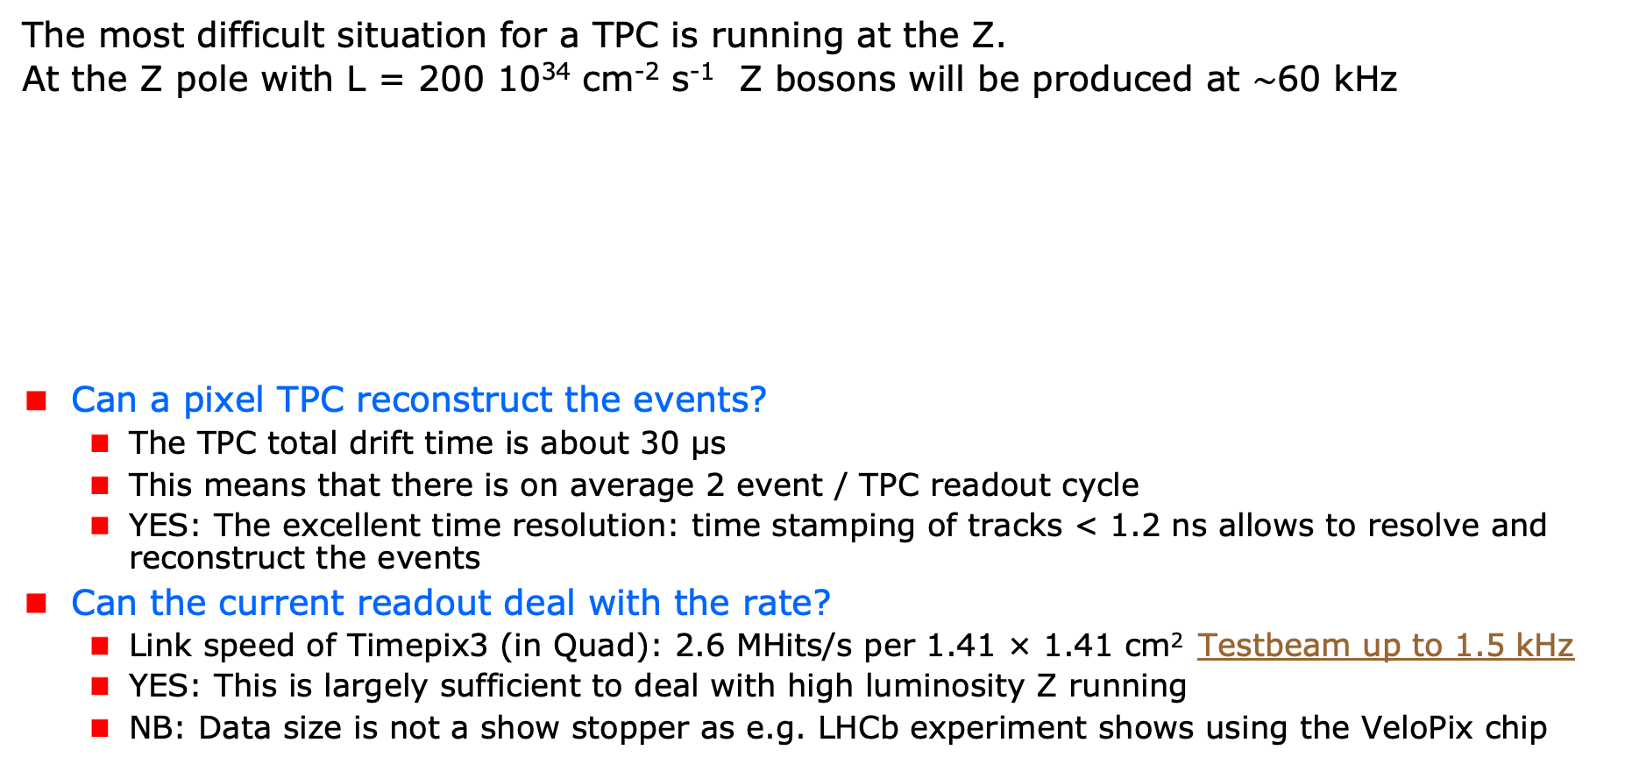
A Pixel TPC at CEPC or FCC-ee
The most difficult situation for a TPC is running at the Z.
At the Z pole with L = 200 10³⁴ cm⁻² s⁻¹ Z bosons will be produced at $\sim$60 kHz
Can a pixel TPC reconstruct the events?
  The TPC total drift time is about 30 μs
  This means that there is on average 2 event / TPC readout cycle
  YES: The excellent time resolution: time stamping of tracks < 1.2 ns allows to resolve and reconstruct the events
Can the current readout deal with the rate?
  Link speed of Timepix3 (in Quad): 2.6 MHits/s per 1.41 × 1.41 cm² Testbeam up to 1.5 kHz
  YES: This is largely sufficient to deal with high luminosity Z running
  NB: Data size is not a show stopper as e.g. LHCb experiment shows using the VeloPix chip
Picture IHEP

Slide 21
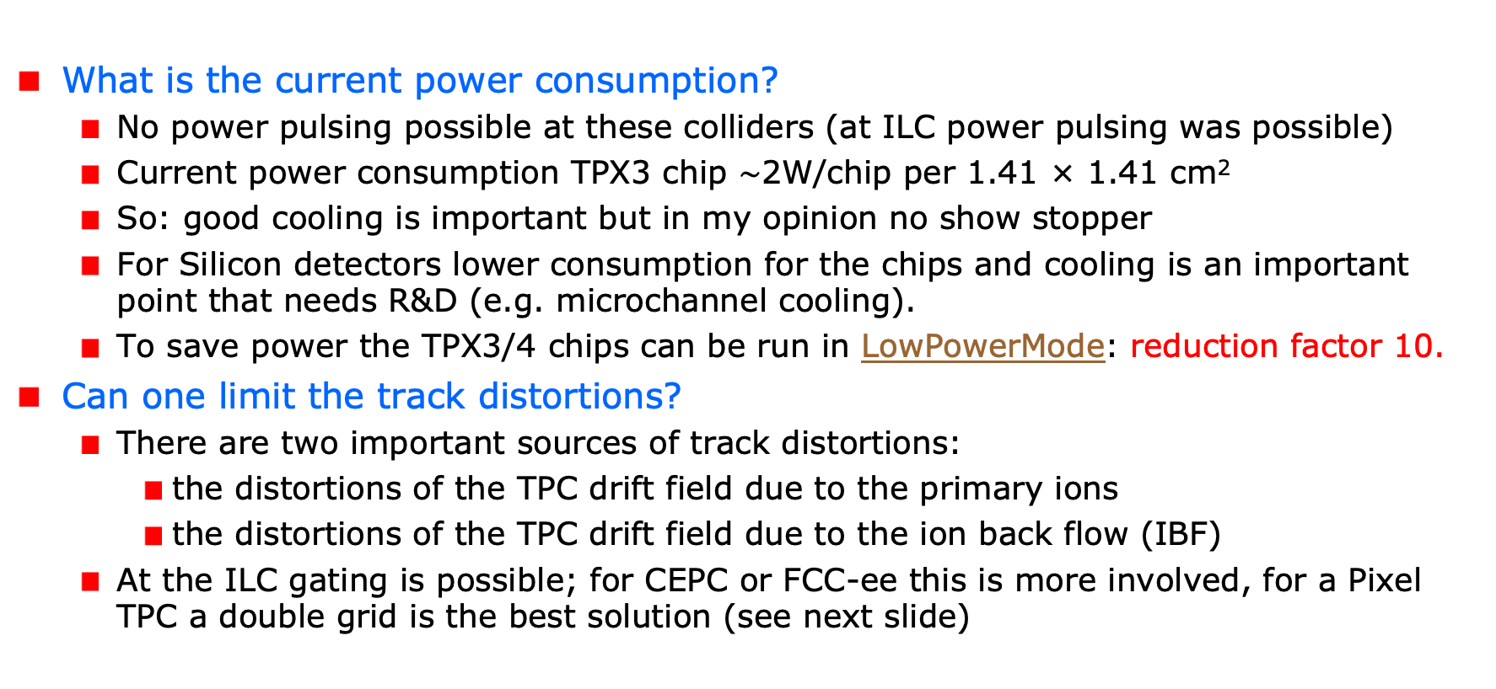
A Pixel TPC at CEPC or FCC-ee
What is the current power consumption?
  No power pulsing possible at these colliders (at ILC power pulsing was possible)
  Current power consumption TPX3 chip $\sim$2W/chip per 1.41 × 1.41 cm²
  So: good cooling is important but in my opinion no show stopper
  For Silicon detectors lower consumption for the chips and cooling is an important point that needs R&D (e.g. microchannel cooling).
  To save power the TPX3/4 chips can be run in LowPowerMode: reduction factor 10.
Can one limit the track distortions?
  There are two important sources of track distortions:
    the distortions of the TPC drift field due to the primary ions
    the distortions of the TPC drift field due to the ion back flow (IBF)
  At the ILC gating is possible; for CEPC or FCC-ee this is more involved, for a Pixel TPC a double grid is the best solution (see next slide)

Slide 22
A Pixel TPC at CEPC or FCC-ee
Is it possible to reduce the IBF for a pixel TPC?
  IDEA: by making chip with a double grid structure (see next slide)
  This idea was already realized as a TWINGRID NIMA 610 (2009) 644-648
  For GEMs for the ALICE TPC this was also the way – several GEMs on top of each other to reduce IBF
  For the Pixel the IBF can be easily modelled and with a hole size of 25 μm an IBF of 3 10⁻⁴ can be achieved and the value for IBF*Gain (2000) would be 0.6.
  YES: the IBF can be reduced to 0.6 but this needs R&D
  In the new detector lab in Bonn it is possible to make and study this device
What would be the size of the TPC distortions?
  Tera-Z studies by Daniel Jeans and Keisuke Fuji show that for FCC-ee or CEPC this means: distortions from Z decays up to < O(100) μm
  Beam strahlung gives (now) a factor 200 more background. Detector optimization and shielding is important for TPC and Silicon detectors to reduce pair background.
  It was argued that in an ILD like detector the distortions can be mapped out using the VTX-SIT/SET detectors.

Slide 23
Reducing the Ion back flow in a Pixel TPC
The Ion back flow can be reduced by adding a second grid to the device.
It is important that the holes of the grids are aligned. The Ion back flow is a function of the geometry and electric fields. Detailed simulations – validated by data - have been presented in LCTPC WP #326.
With a hole size of 25 μm an IBF of 3 10⁻⁴ can be achieved and the value for IBF*Gain (2000) would be 0.6.
Ion backflow | Hole 30 μm | Hole 25 μm | Hole 20 μm
Top grid | 2.2% | 1.2% | 0.7%
GridPix | 5.5% | 2.8% | 1.7%
Total | 12 10⁻⁴ | 3 10⁻⁴ | 1 10⁻⁴
transparancy | 100% | 99.4% | 91.7%

Slide 24
Pixel TPC tracking studies
ILD tracking Performance for a Pixel TPC based on test beam
10 cm track resolution
Single electron resolution 6 mm pad resolution
Each 10 cm we have a point with a resolution of < 19 (31) μm on the track

Slide 25
Pixel TPC tracking studies
ILD tracking Performance for a Pixel TPC based on test beam
The last 10 cm track provides very high resolution ‘point’ in the endcap (cos θ>0.8). This is due to the short drift distance and the high resolution pixel readout.
Question can we use the endcap ‘point’ and calibrate out the TPC distortions?

Slide 26
Pixel TPC tracking studies
Crude distortion model for beam-beam background
e.g. for FCCee or CEPC
Distortions have an amplitude of 10 cm* and are described by the following function:
= 10 (cm) (rInner/r)² z/zMax
z = drift distance r = radius
rInner and zMax from ILD
These are huge* distortions. Here we use the last 10 cm of the track. Clearly the Barrel at large radii has 3.5 mm distortions

Slide 27
Pixel TPC tracking studies
Crude distortion model for beam-beam background
e.g. for FCCee or CEPC
The endcap distortions are much smaller than the barrel and they range from 15-350 μm
So that region is rather quiet and can be used IMO to calibrate pixel TPC distortions.

Slide 28
Fitting out TPC distortions in ILD
It is possible to map out distortions using e.g. muons from Z decays
  E.g. by fitting the 3D space distribution as a function of time as was done by ALEPH and more recently by ALICE. Using this distribution the hits positions are corrected and the TPC track refitted.
However, ILD allows for more elaborate procedures. One can use the track predictions based of the silicon trackers SIT and SET to correct on a track-by-track level the TPC track.
  One can use as a constraint that the extrapolated positions and angles agree with the measured in the SIT and SET.
  Practically, one can e.g. correct the TPC track parameters
The ultimate way is a fitting technique similar to what is developed in ATLAS. In the ATLAS track fit the common systematics is fitted out for sets of Muon hits. For ILD the fit would fit free parameters in the distortion model, while using as a constraint the SIT and SET position and direction measurements.
  The simplest case is a model where the strength (amplitude) and radial dependence would be scaled and a model is used for the 3D extrapolations.

Slide 29
Conclusions: Pixel TPC at a circular collider
YES: a pixel TPC can reconstruct the Z events in one readout cycle
YES: the current readout of the Timepix3 chip can deal with the rate
The current power consumption is 1W/cm². By running the TPX chips in low power mode this can be reduced by a factor of 10. Still good cooling is important no show stopper; but needs extensive R&D.
Track distortions in the TPC drift volume are a concern at high lumi Z running:
  Track distortions from Z decays in TPC are O(100) μm
  It is possible to reduce the IBF for a pixel TPC by making a device with a double grid
  A double grid needs dedicated R&D that can be performed in the new lab in Bonn
The Z physics program at FCC-ee or CEPC with an ILD-like detector with a Pixel TPC (with double grid structures) sliced between two silicon trackers (VTX-SIT and SET) can be fully exploited. The reduction of beamstrahlung – and the fitting out of distortions - needs more study.
A pixel TPC can perfectly run at WW, ZH or tt energies where track distortions are several orders of magnitude smaller

