Slide 1








Pixel TPC tracking low power CEPC
Yevgen Bilevych, Klaus Desch, Sander van Doesburg, Harry van der Graaf, Fred Hartjes, Jochen Kaminski, Peter Kluit, Naomi van der Kolk,
Cornelis Ligtenberg,
Gerhard Raven, and
Jan Timmermans

Slide 2
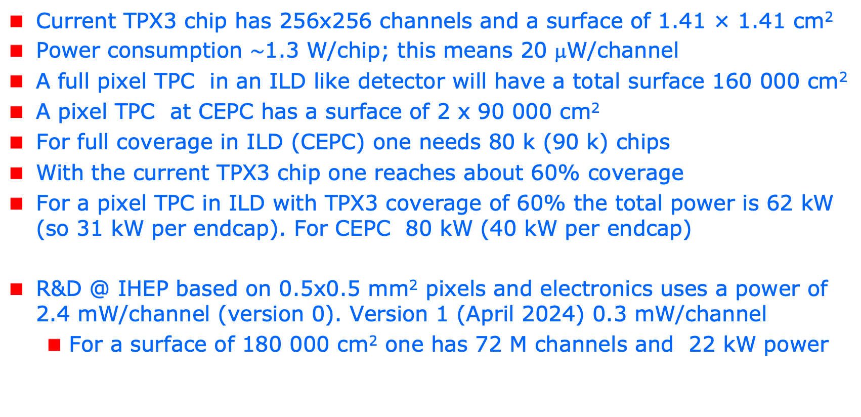
R&D topics: power consumption
Current TPX3 chip has 256x256 channels and a surface of 1.41 × 1.41 cm²
Power consumption $\sim$1.3 W/chip; this means 20 μW/channel
A full pixel TPC in an ILD like detector will have a total surface 160 000 cm²
A pixel TPC at CEPC has a surface of 2 x 90 000 cm²
For full coverage in ILD (CEPC) one needs 80 k (90 k) chips
With the current TPX3 chip one reaches about 60% coverage
For a pixel TPC in ILD with TPX3 coverage of 60% the total power is 62 kW (so 31 kW per endcap). For CEPC 80 kW (40 kW per endcap)
R&D @ IHEP based on 0.5x0.5 mm² pixels and electronics uses a power of 2.4 mW/channel (version 0). Version 1 (April 2024) 0.3 mW/channel
  For a surface of 180 000 cm² one has 72 M channels and 22 kW power

Slide 3
power consumption for TPX4
The most elegant solution to reduce the power consumption is - according to Nikhef electronics engineer V. Gromov - by
  reducing the currents (gain) in the pre-amplifier and discriminator; this will affect (worsen) the time resolution. An option to reduce the digital power is to lower the clock frequency to e.g. 10-25 Mhz
  Unfortunately, reducing the nr of channels does not help; increasing the nr of channels does help, because of the noise reduction (smaller pixels less noise).
For the TPX4 chip the power in standard operation is consumes 0.55 W/cm²
A special setting “low power mode” has been prepared for TPX4 reducing the power consumption by a factor of 5 (see next slide for the TPX4 settings).
Note that the TPX4 chip has a larger surface 4*256x256 pixels of 55x55 μm²

Slide 4
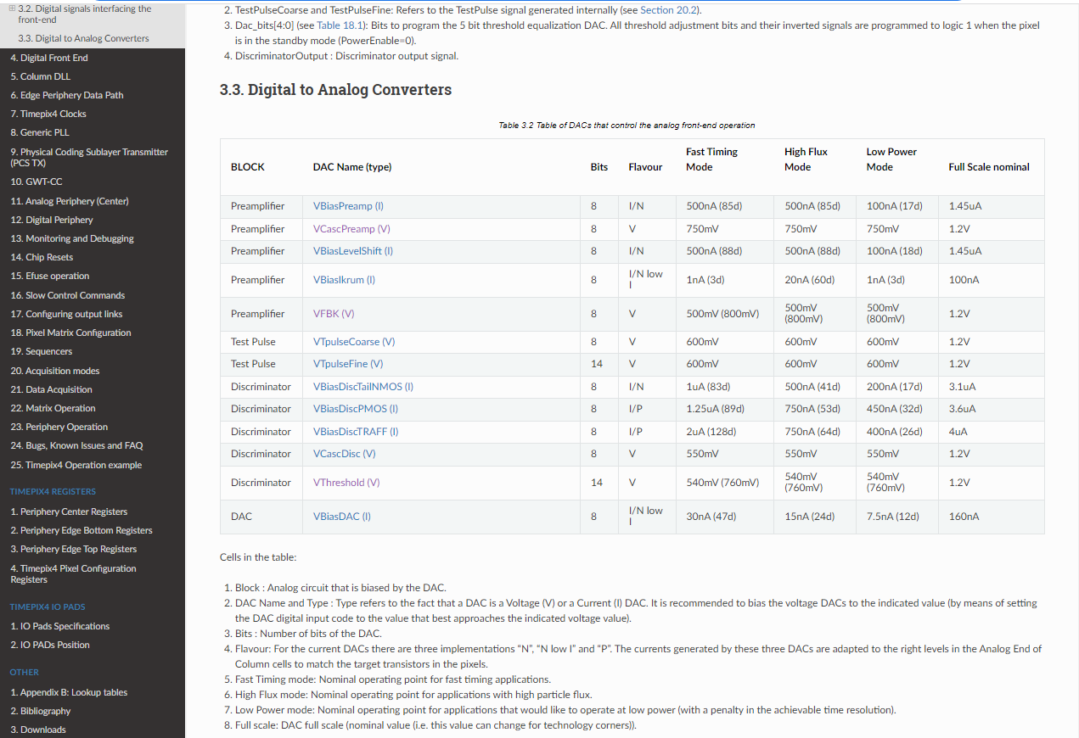
R&D: low power mode TPX4
VBiasPreamp I
VBiasLevelShift (I)
VBiasIkrum
VBiasDiscTailNMOS
VBiasDiscPMOS
VBiasDAC

Slide 5
R&D: TPX3 power consumption
The Medipix collaboration (CERN and Czech groups) carefully investigated the possibilities of the reduction of the power consumption for the TPX3 chip
The results can be found at
  Ref1 https://iopscience.iop.org/article/10.1088/1748-0221/14/01/C01024
  Ref2 https://iopscience.iop.org/article/10.1088/1748-0221/14/01/C01001
The analog power consumption 750 mW can be reduced by a factor 10 [Ref1]
If also the digital power consumption is 540 mW is reduced by lowering the clock frequency from 40MHz to 10 MHz, the total power consumption was show to be 216 mW per chip [ref2].
Standard settings uses 25 nsec bins and ‘low power’ 100 ns bins.
So running at lower power will worsen the time resolution: from bins of 25 ns/16 nsec (1.5625) to 100 ns/16 = 6.25 nsec bins.
Note that this will bring down the power per endcap for ILD to 5(6) kW (CEPC)
The low power dac settings can be found on slide 7

Slide 6
TPX3 power

Slide 8
Low power dacs for TPX3
# TPX3 DAC settings
# lines starting with # are skipped
#
# reg_nr reg_value
#
1 8 # TPX3_IBIAS_PREAMP_ON [0-255]
2 8 # TPX3_IBIAS_PREAMP_OFF [0-15]
3 128 # TPX3_VPREAMP_NCAS [0-255]
4 10 # TPX3_IBIAS_IKRUM [0-255]
5 128 # TPX3_VFBK [0-255]
6 420 # TPX3_VTHRESH_FINE [0-512]
7 6 # TPX3_VTHRESH_COARSE [0-15]
8 8 # TPX3_IBIAS_DISCS1_ON [0-255]
9 8 # TPX3_IBIAS_DISCS1_OFF [0- 15]
10 8 # TPX3_IBIAS_DISCS2_ON [0-255]
11 8 # TPX3_IBIAS_DISCS2_OFF [0-15]
12 20 # TPX3_IBIAS_PIXELDAC [0-255]
13 128 # TPX3_IBIAS_TPBUFIN [0-255]
14 128 # TPX3_IBIAS_TPBUFOUT [0-255]
15 128 # TPX3_VTP_COARSE [0-255]
16 256 # TPX3_VTP_FINE [0-512]
17 128 # TPX3_IBIAS_CP_PLL [0-255]
18 128 # TPX3_PLL_VCNTRL [0-255]

Slide 9
R&D: TPX3 power consumption
For the GridPix it is possible to test the
  Single chip new DAC settings plus lower clock frequency
  Quad new DAC settings plus lower clock frequency
  Module new DAC settings only
The current design of the concentrators in the 32 chip module is based on a 40 MHz clock. This cannot be changed. So this will need a re-design of the concentrators. The concentrator combines the data streams and controls of 16 chips.
For EIC I have prepared a set of low power dac settings
Main conclusion is that running the TPX3 Gridpixes in low power mode reduces the power consumption for a pixel TPC to say 5 (6) kW per endcap. Pretty good.

Slide 10
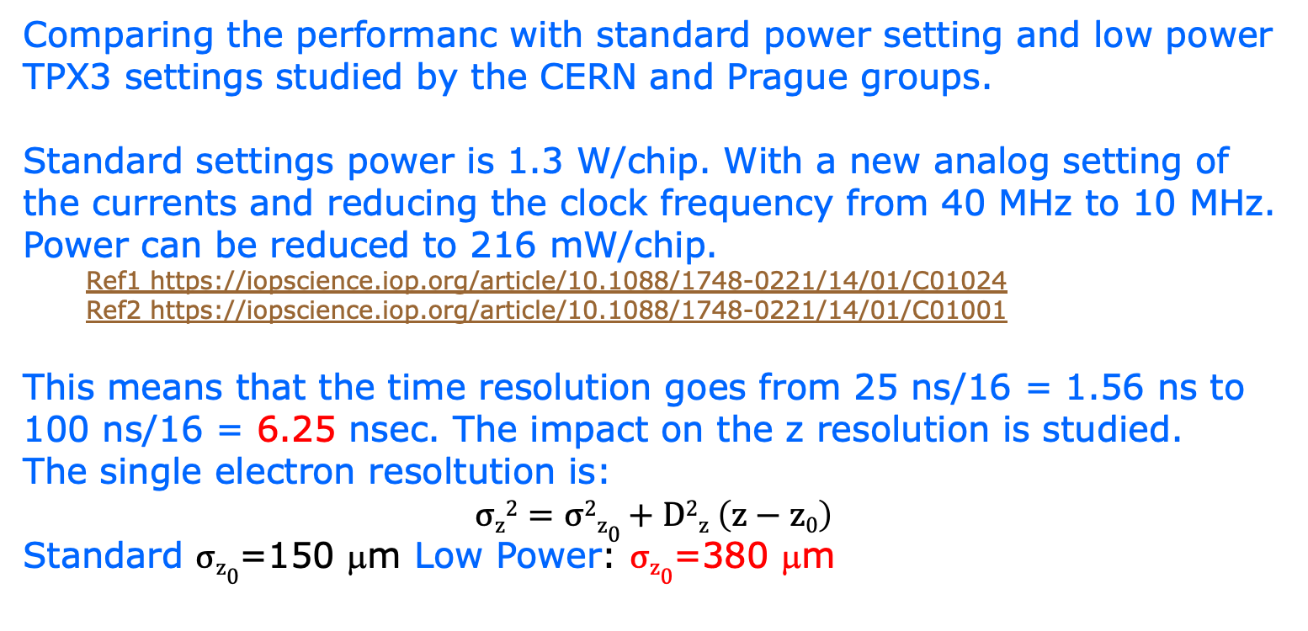
Pixel TPC tracking studies
Comparing the performanc with standard power setting and low power TPX3 settings studied by the CERN and Prague groups.
Standard settings power is 1.3 W/chip. With a new analog setting of the currents and reducing the clock frequency from 40 MHz to 10 MHz. Power can be reduced to 216 mW/chip.
  Ref1 https://iopscience.iop.org/article/10.1088/1748-0221/14/01/C01024
  Ref2 https://iopscience.iop.org/article/10.1088/1748-0221/14/01/C01001
This means that the time resolution goes from 25 ns/16 = 1.56 ns to 100 ns/16 = 6.25 nsec. The impact on the z resolution is studied.
The single electron resoltution is:
$$σz2=σ2z0+D2z \left(z−z0\right)$$
Standard $σz0$=150 μm Low Power: $σz0$=380 μm

Slide 11
Pixel TPC tracking studies
CEPC tracking Performance in z for a Pixel TPC based on test beam
The difference is only noticeable at short drift distances

Slide 12
Pixel TPC tracking studies
CEPC tracking Performance in z for a Pixel TPC based on test beam
10 cm track σ_{z}
Again only noticeable at large z values

Slide 13
Pixel TPC tracking studies
CEPC tracking Performance in z for a Pixel TPC based on test beam
last 10 cm track σ_{z}
Small difference at large cos(theta)
Conclusion Running in low power has tiny impact on the z resolution
- i.e. the process is dominated by diffusion

