Slide 1








Pixel TPC tracking and dEdx performance at CEPC
Yevgen Bilevych, Klaus Desch, Sander van Doesburg, Harry van der Graaf, Fred Hartjes, Jochen Kaminski, Peter Kluit, Naomi van der Kolk,
Cornelis Ligtenberg,
Gerhard Raven, and
Jan Timmermans

Slide 2
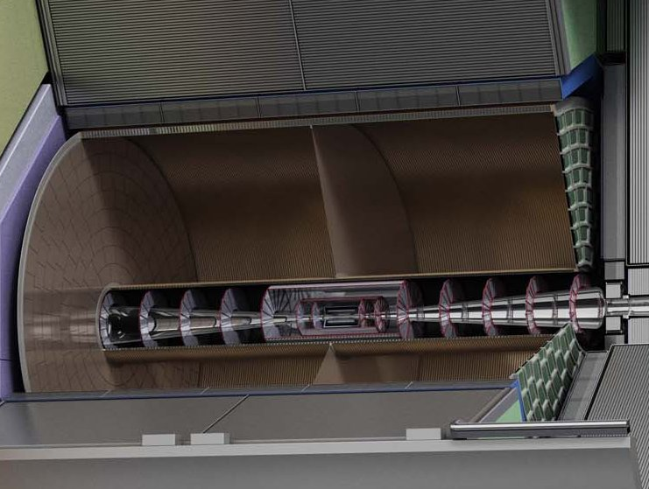



Pixel TPC
(Octopuce)
(TimePix1) TPX3 chip Quad Module TPC plane
(2007-14) 2017 2018 2019

Slide 3
Pixel TPC
Material budget is
  0.01 X₀ TPC gas
  0.01 X₀ inner cylinder
  0.03 X₀ outer cylinder
  < 0.25 X₀ endplates (incl readout)
Note the very low budget in the barrel region. Material budget can be respected by different technologies like GEM, MicroMegas and Pixels
TPC is sliced between silicon detectors VTX, SIT and SET
pixel readout is a serious option for the TPC readout plane @ ILC/FFC-ee/CLIC/CEPC colliders

Slide 4
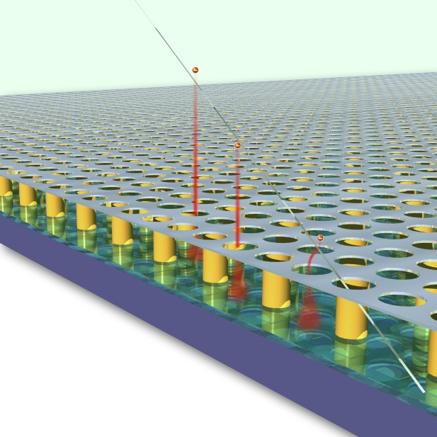
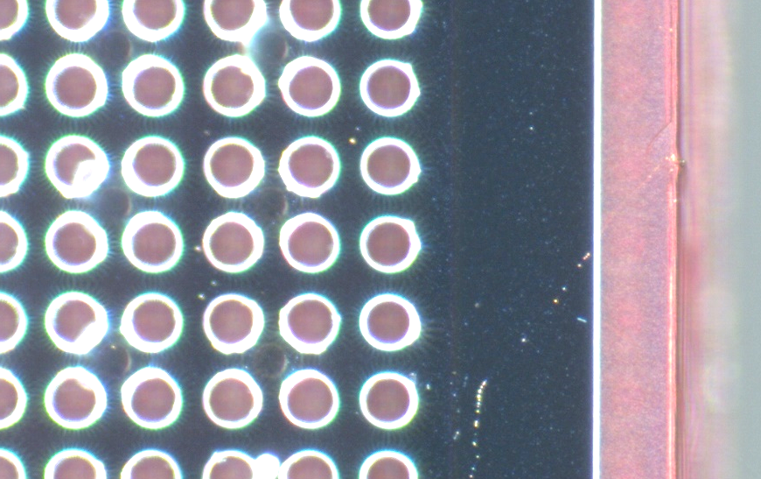
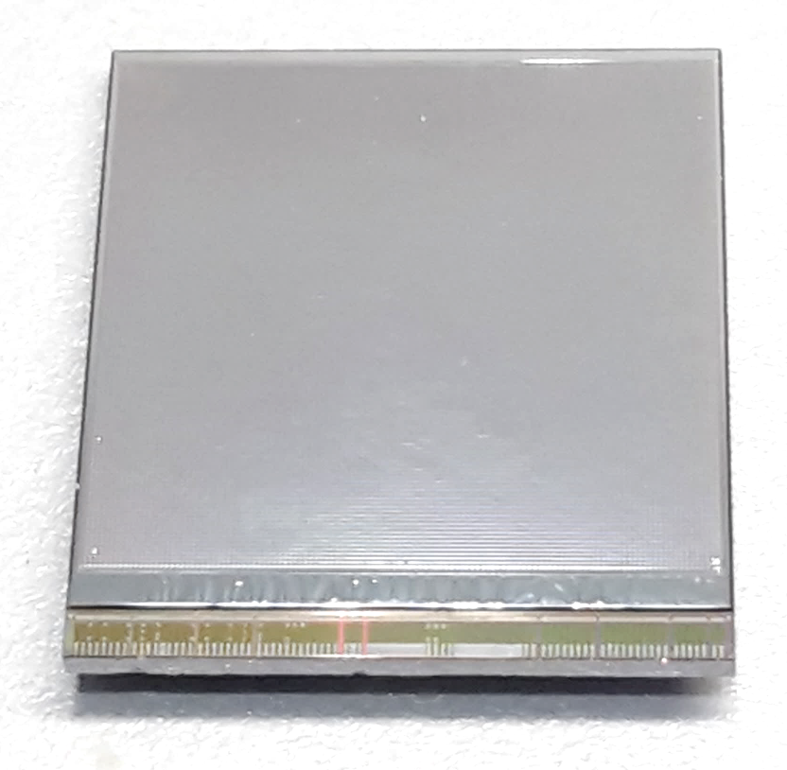
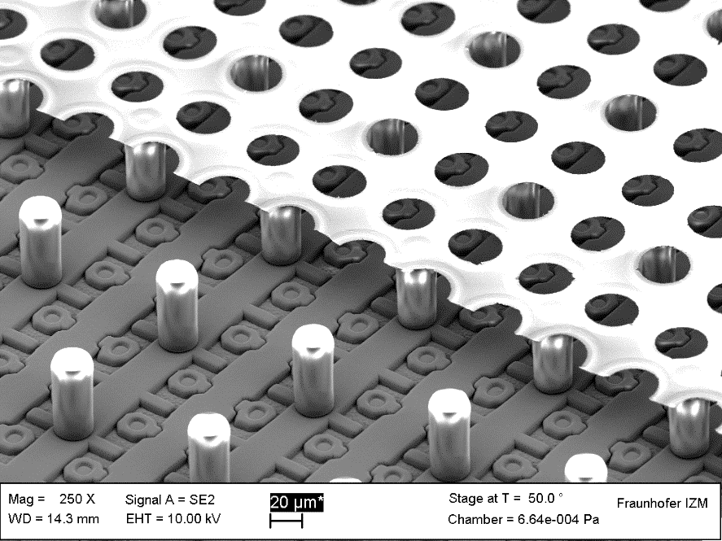
GridPix technology
Pixel chip with integrated Grid (Micromegas-like)
InGrid post-processed @ IZM
Grid set at negative voltage (300 – 600 V) to provide gas amplification
Very small pixel size (55 µm)
detecting individual electrons
dyke
55 µm
Aluminium grid (1 µm thick)
35 µm wide holes, 55 µm pitch
Supported by SU8 pillars 50 µm high
Grid surrounded by SU8 dyke (150 µm wide solid strip) for mechanical and HV stability
50 µm

Slide 5
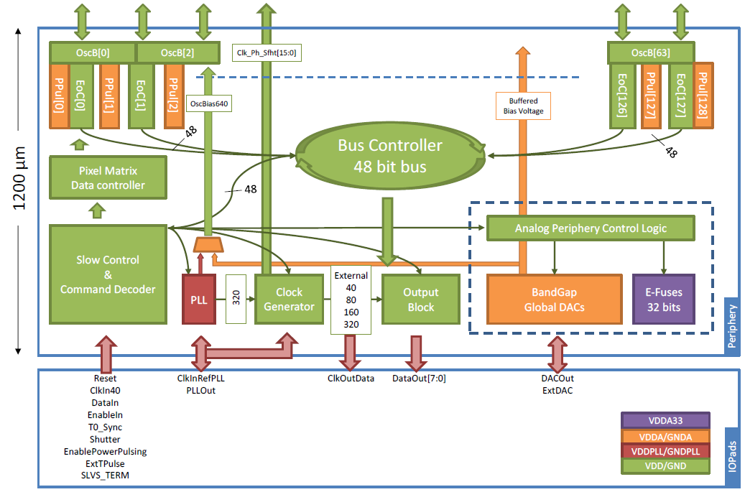
Pixel chip: TimePix3
256 x 256 pixels
55 x 55 µm pitch
14.1 x 14.1 mm sensitive area
TDC with 640 MHz clock (1.56 ns)
Used in the data driven mode
  Each hit consists of the pixel address and time stamp of arrival time (ToA)
  Time over threshold (ToT) is added to register the signal amplitude
  compensation for time walk
  Trigger (for t₀) added to the data stream as an additional time stamp
Power consumption
  ~1 A @ 2 V (2W) depending on hit rate
  good cooling is important
Sensitive area
14.1 mm
2+3 mm

Slide 6
QUAD as a building block
8-QUAD module (2x4 quads) with field cage
in red guard wires

Slide 7
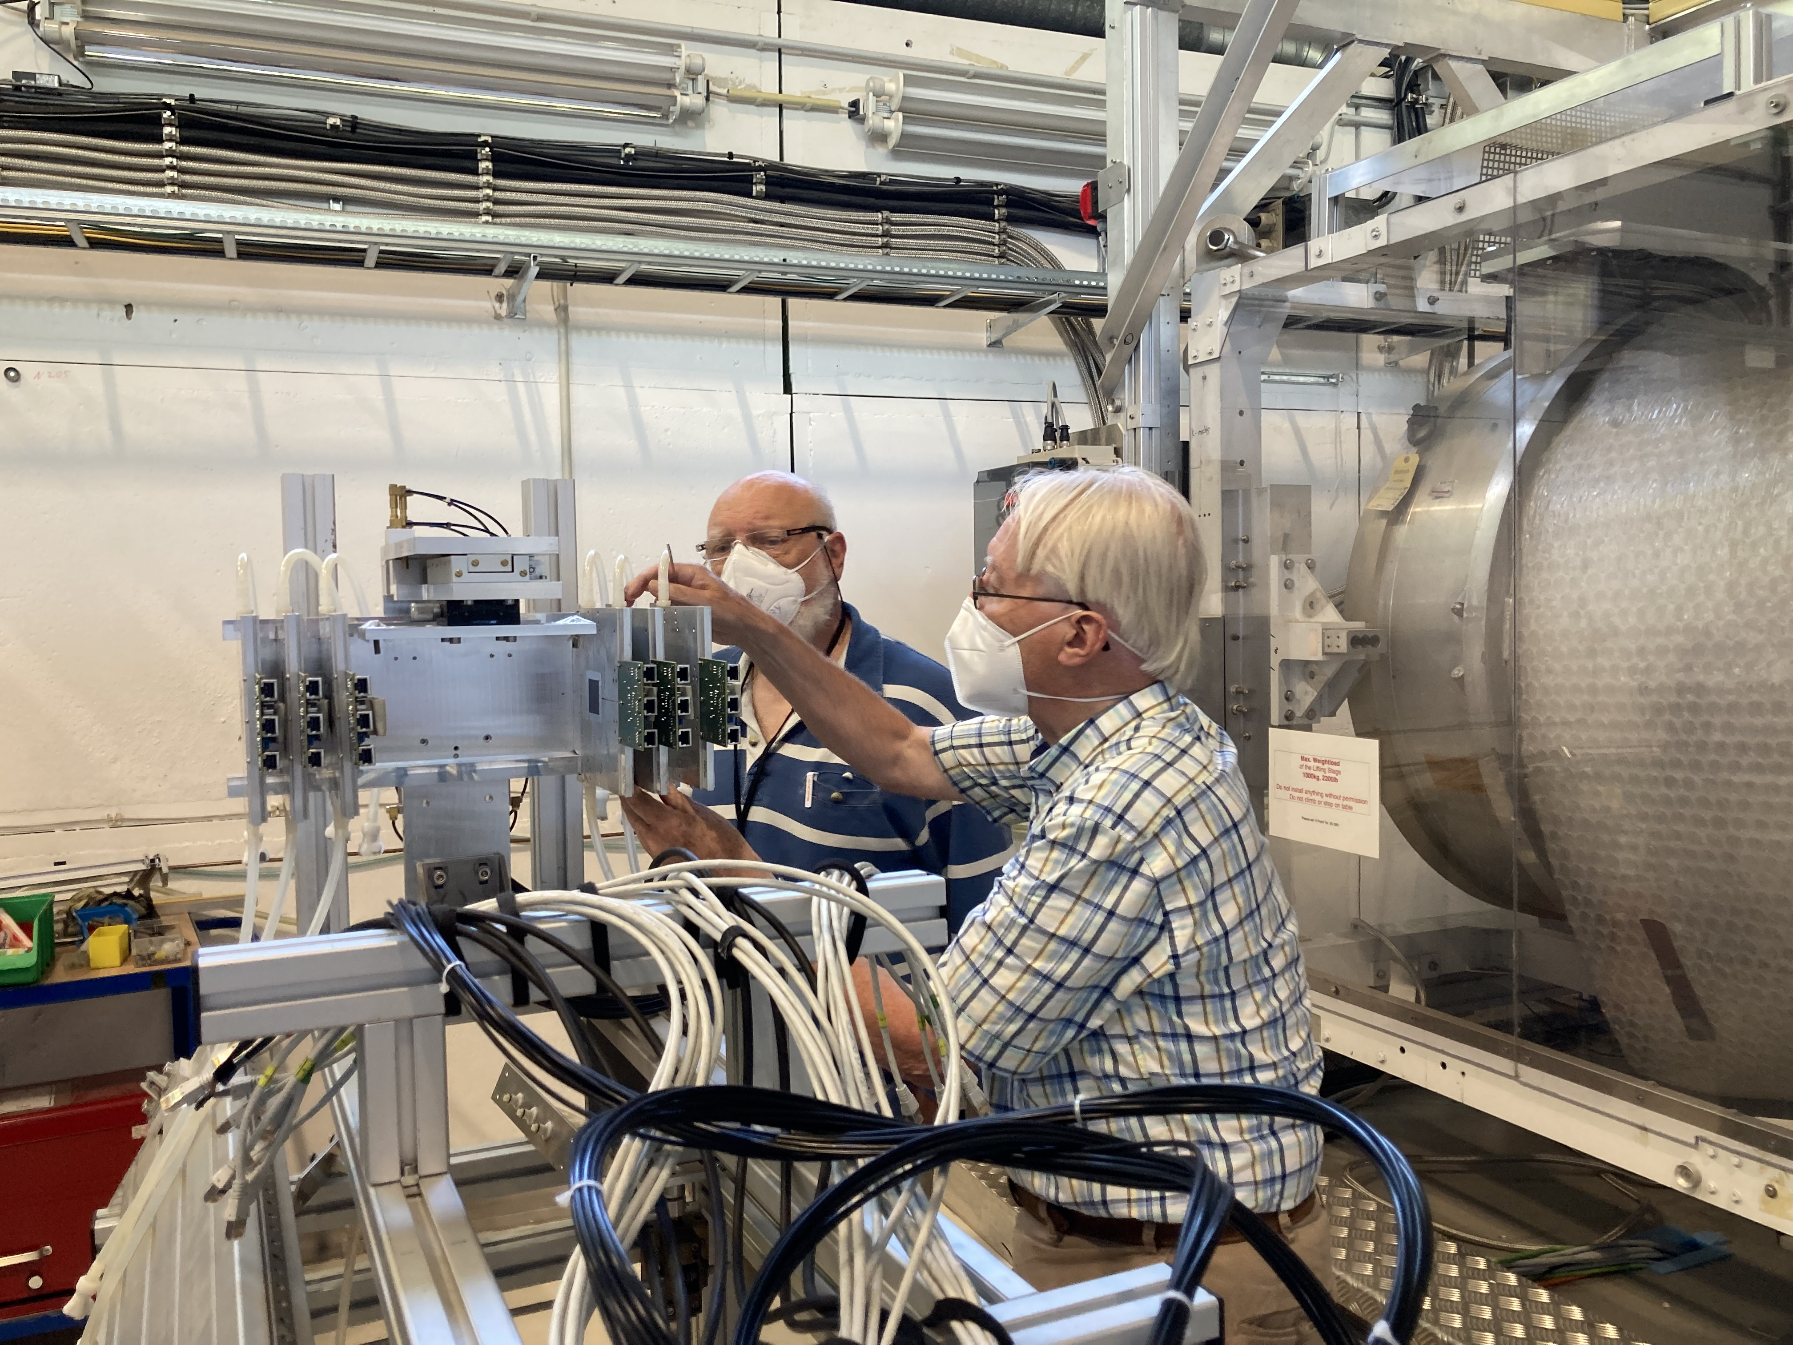
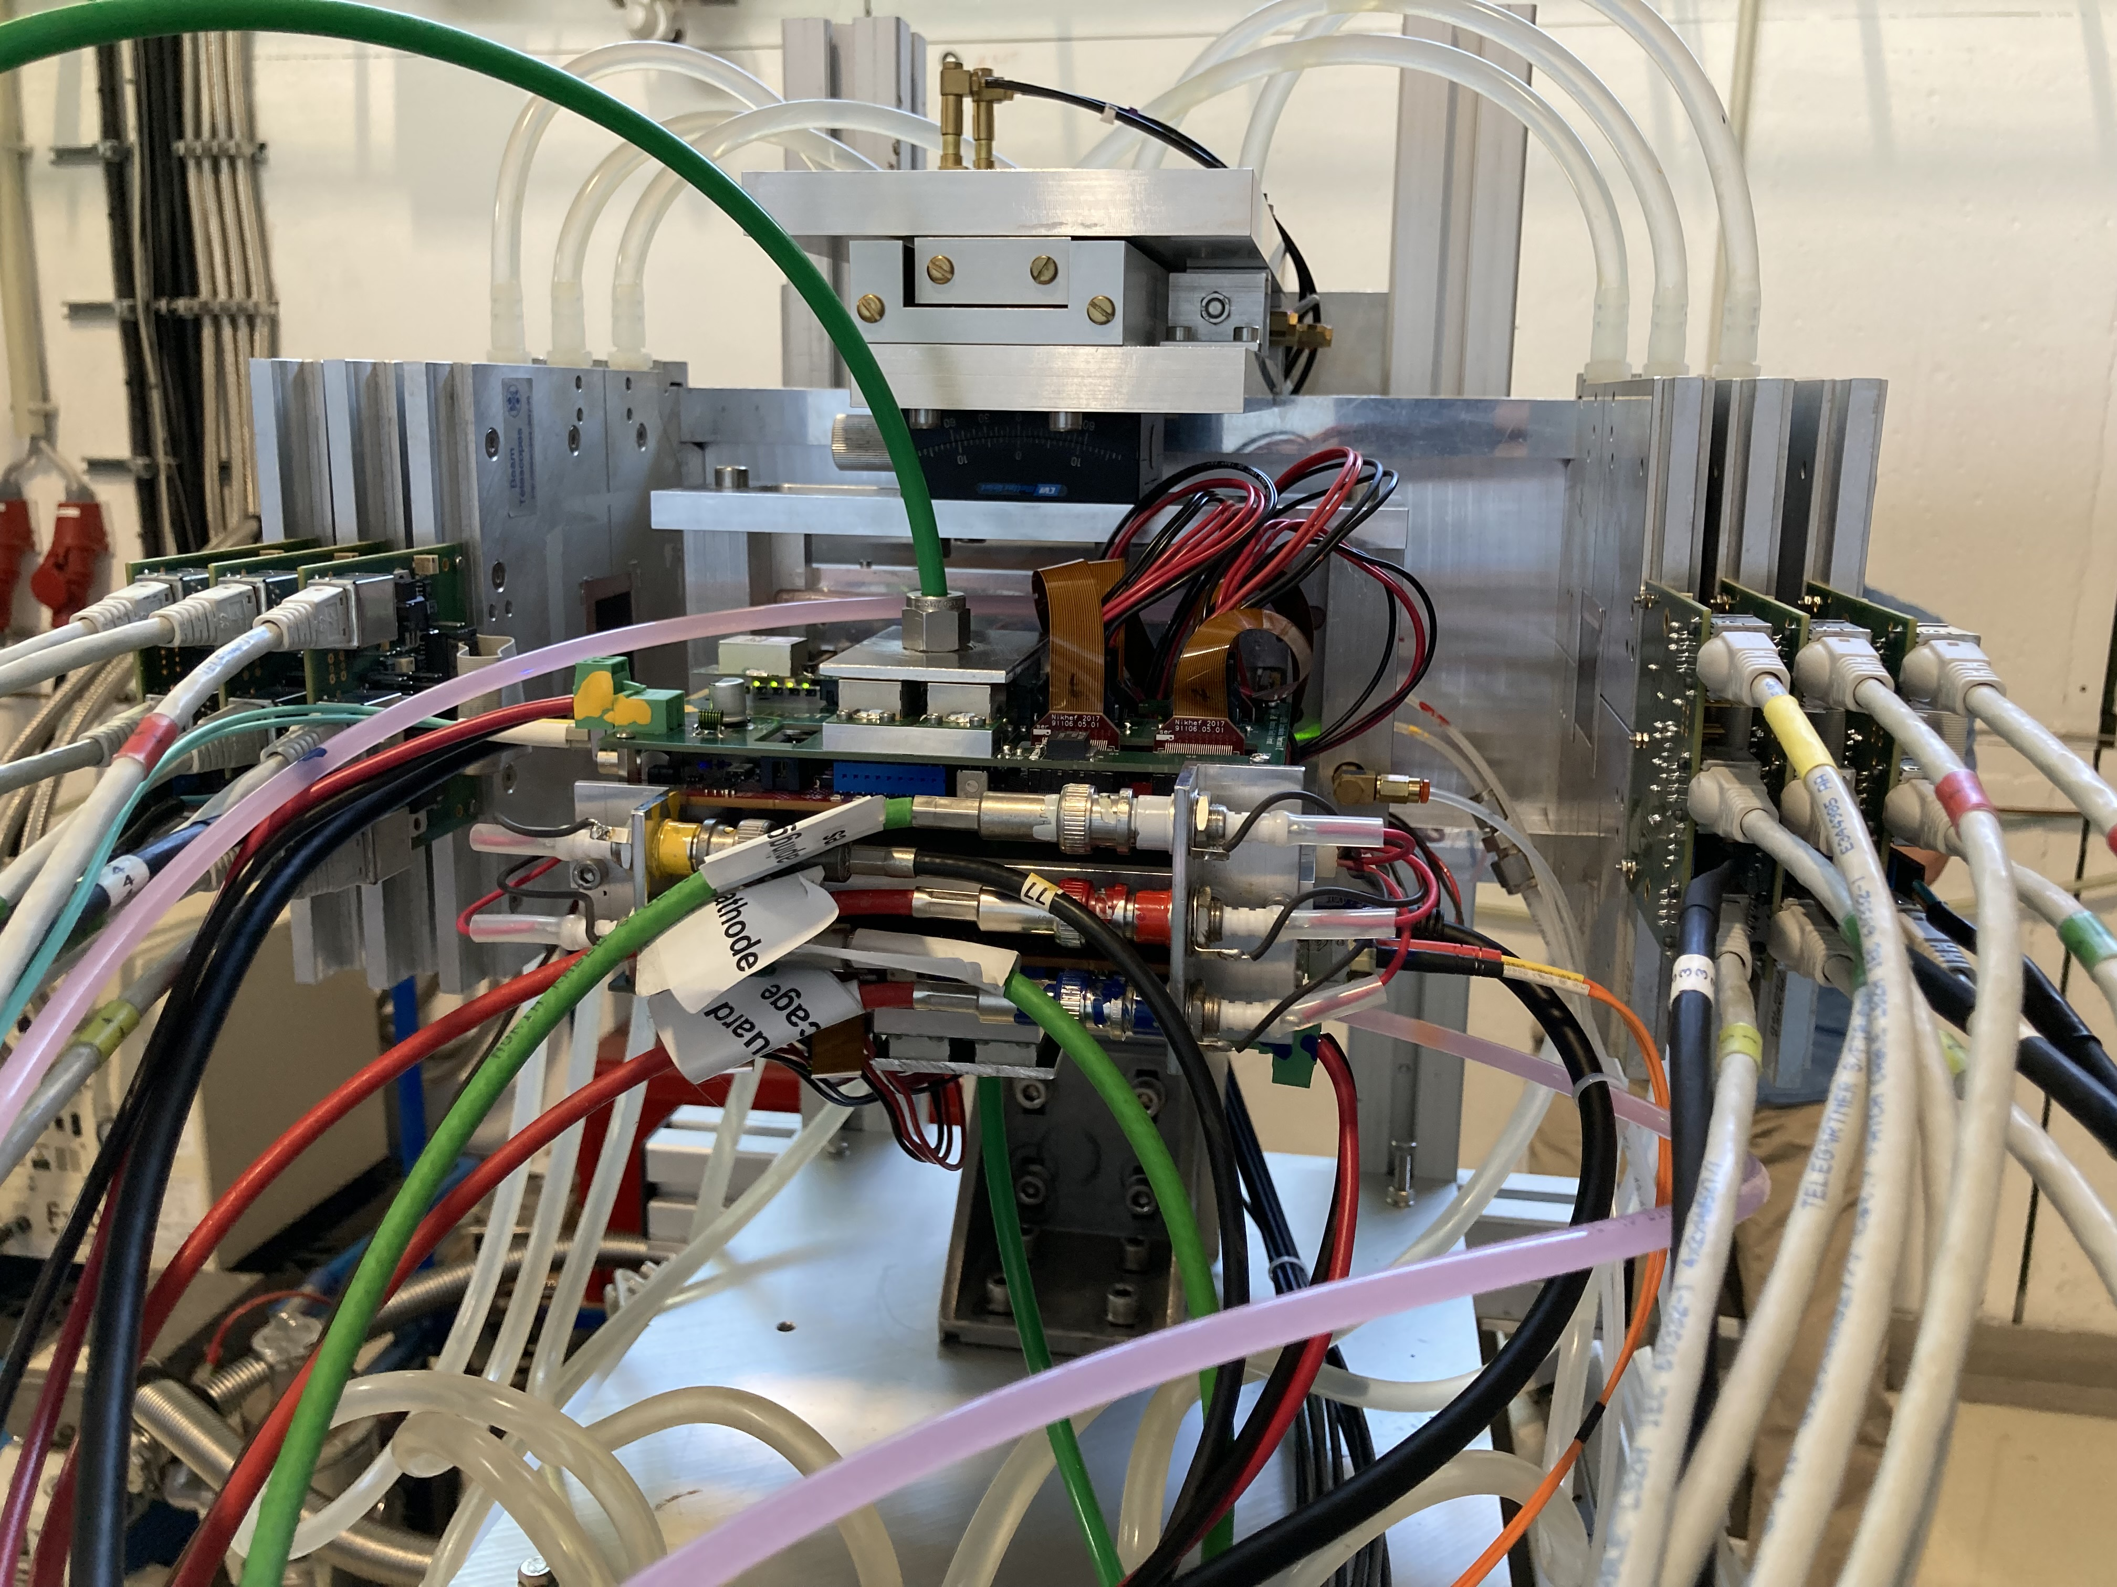
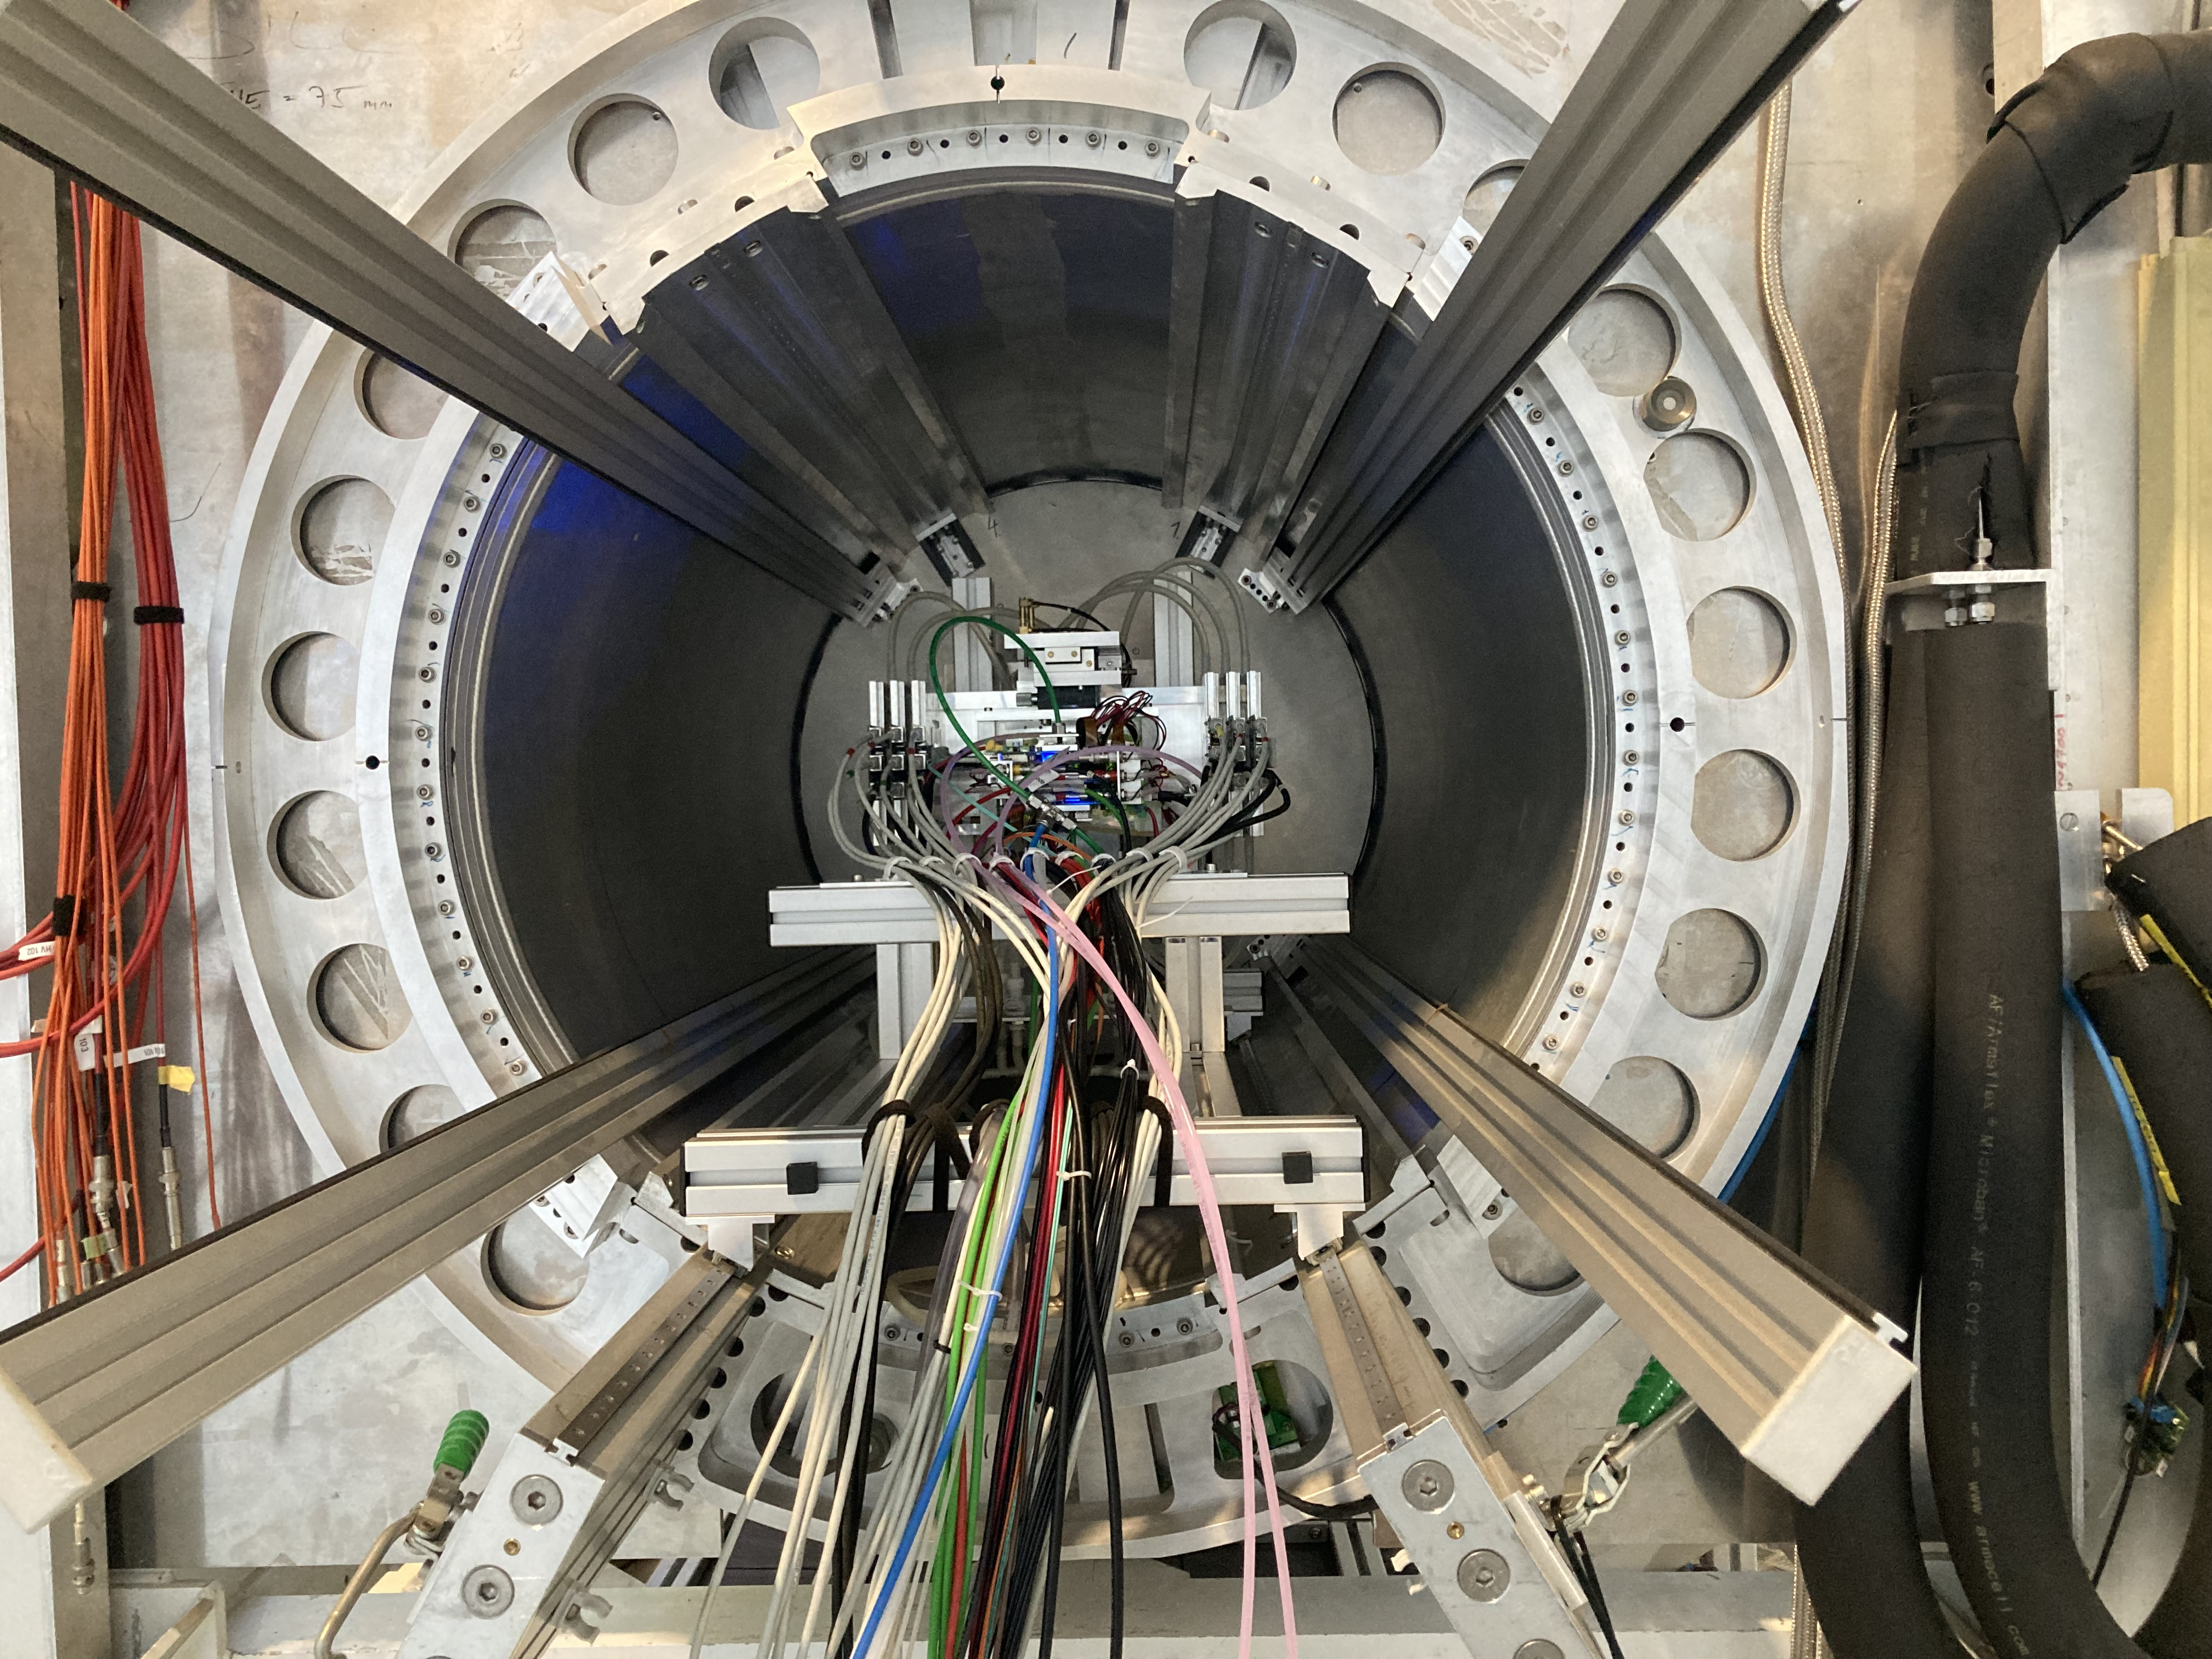
DESY testbeam June 2021
Mounting the 8 quad module between the silicon planes
sliding it into the 1 T PCMAG solenoid

Slide 8
DESY testbeam June 2021

Slide 9
DESY testbeam Module Analysis
Event display with module and telescope
TPX3 track 1130 hits
χ²_{xy} = 677.5/1128
χ²_{z} = 775.9/1069
Asymmetric tail outlier removal applied 1071 hits in z kept.
TPX3 track hits
Telescope track hits (off track green)
Preliminary
x global
x local
z global
y local
z global
y global
z local drift
y local

Slide 10
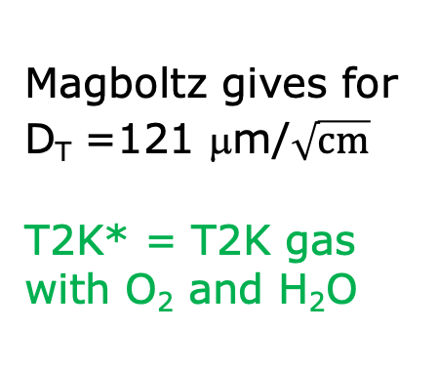
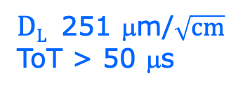

DESY testbeam Module Analysis
Run 6983-6990 B=1 T p=5 and 6 GeV
Fitted resolution
$$σxy,z2=σ2xy0,z0+D2xy,z \left(z−z0\right)$$
σ² _{xy0}= σ²_{pixel} + σ²_{xy tele} σ²_{pixel}= 55²/12 μm²
σ_{xy tele}=42 μm
$DT$ 120 μm/$\sqrt{cm}$
$DL$ 251 μm/$\sqrt{cm}$
ToT > 50 μs
Preliminary
Magboltz gives for D_{T} =121 μm/$\sqrt{cm}$
T2K* = T2K gas with O₂ and H₂O
B=1 T
T2K*
E_{d}=280 V/cm

Slide 11
DESY testbeam Module Analysis
Runs 6983-6988 B=1T p=5 GeV
Distribution of mean residuals in the plane
Method row
B=1 T situation
xy
z
method | rms (stat) xy | bins xy | rms (stat) z | bins z
row | 13 (2) μm | 896 | 19 (5) μm | 896
column | 11 (2) μm | 880 | 20 (5) μm | 880
Preliminary
Method column
We did not include the 4 corner chips and (11), 14, 8, 13 and 19.
These are affected by the field cage and the short in chip 11.

Slide 12
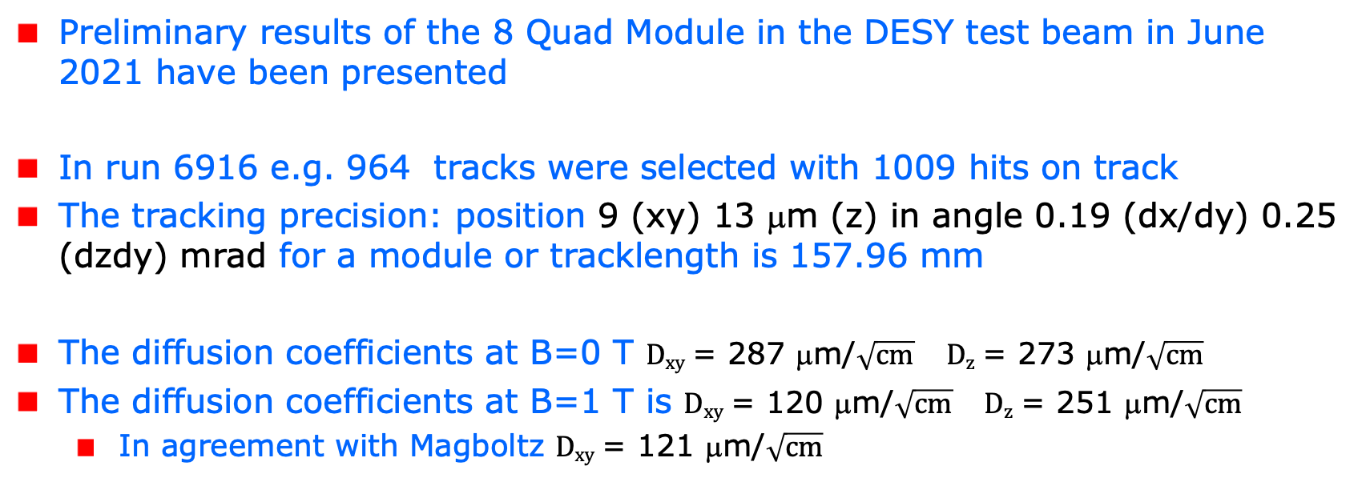
Conclusions on module performance
Resolution and precision
Preliminary results of the 8 Quad Module in the DESY test beam in June 2021 have been presented
In run 6916 e.g. 964 tracks were selected with 1009 hits on track
The tracking precision: position 9 (xy) 13 μm (z) in angle 0.19 (dx/dy) 0.25 (dzdy) mrad for a module or tracklength is 157.96 mm
The diffusion coefficients at B=0 T $Dxy$ = 287 μm/$\sqrt{cm}$ $Dz$ = 273 μm/$\sqrt{cm}$
The diffusion coefficients at B=1 T is $Dxy$ = 120 μm/$\sqrt{cm}$ $Dz$ = 251 μm/$\sqrt{cm}$
  In agreement with Magboltz $Dxy$ = 121 μm/$\sqrt{cm}$

Slide 13
Conclusions on module performance
Resolution and precision
Results for the module showed that:
  the HV of the guard wires was well tuned
  B=0 T rms residuals in the module plane xy 13 μm and z 15 μm
  The results are compatible with (very) high stats quad measurement
  B= 1 T rms residuals in the plane xy 13 μm and z 20 μm;
High tracking precision is demonstrated with small systematics
  deformations xy stay below 13 μm
Writing a NIM paper (including more results)
More details on the results LCTPC annual gathering

Slide 14
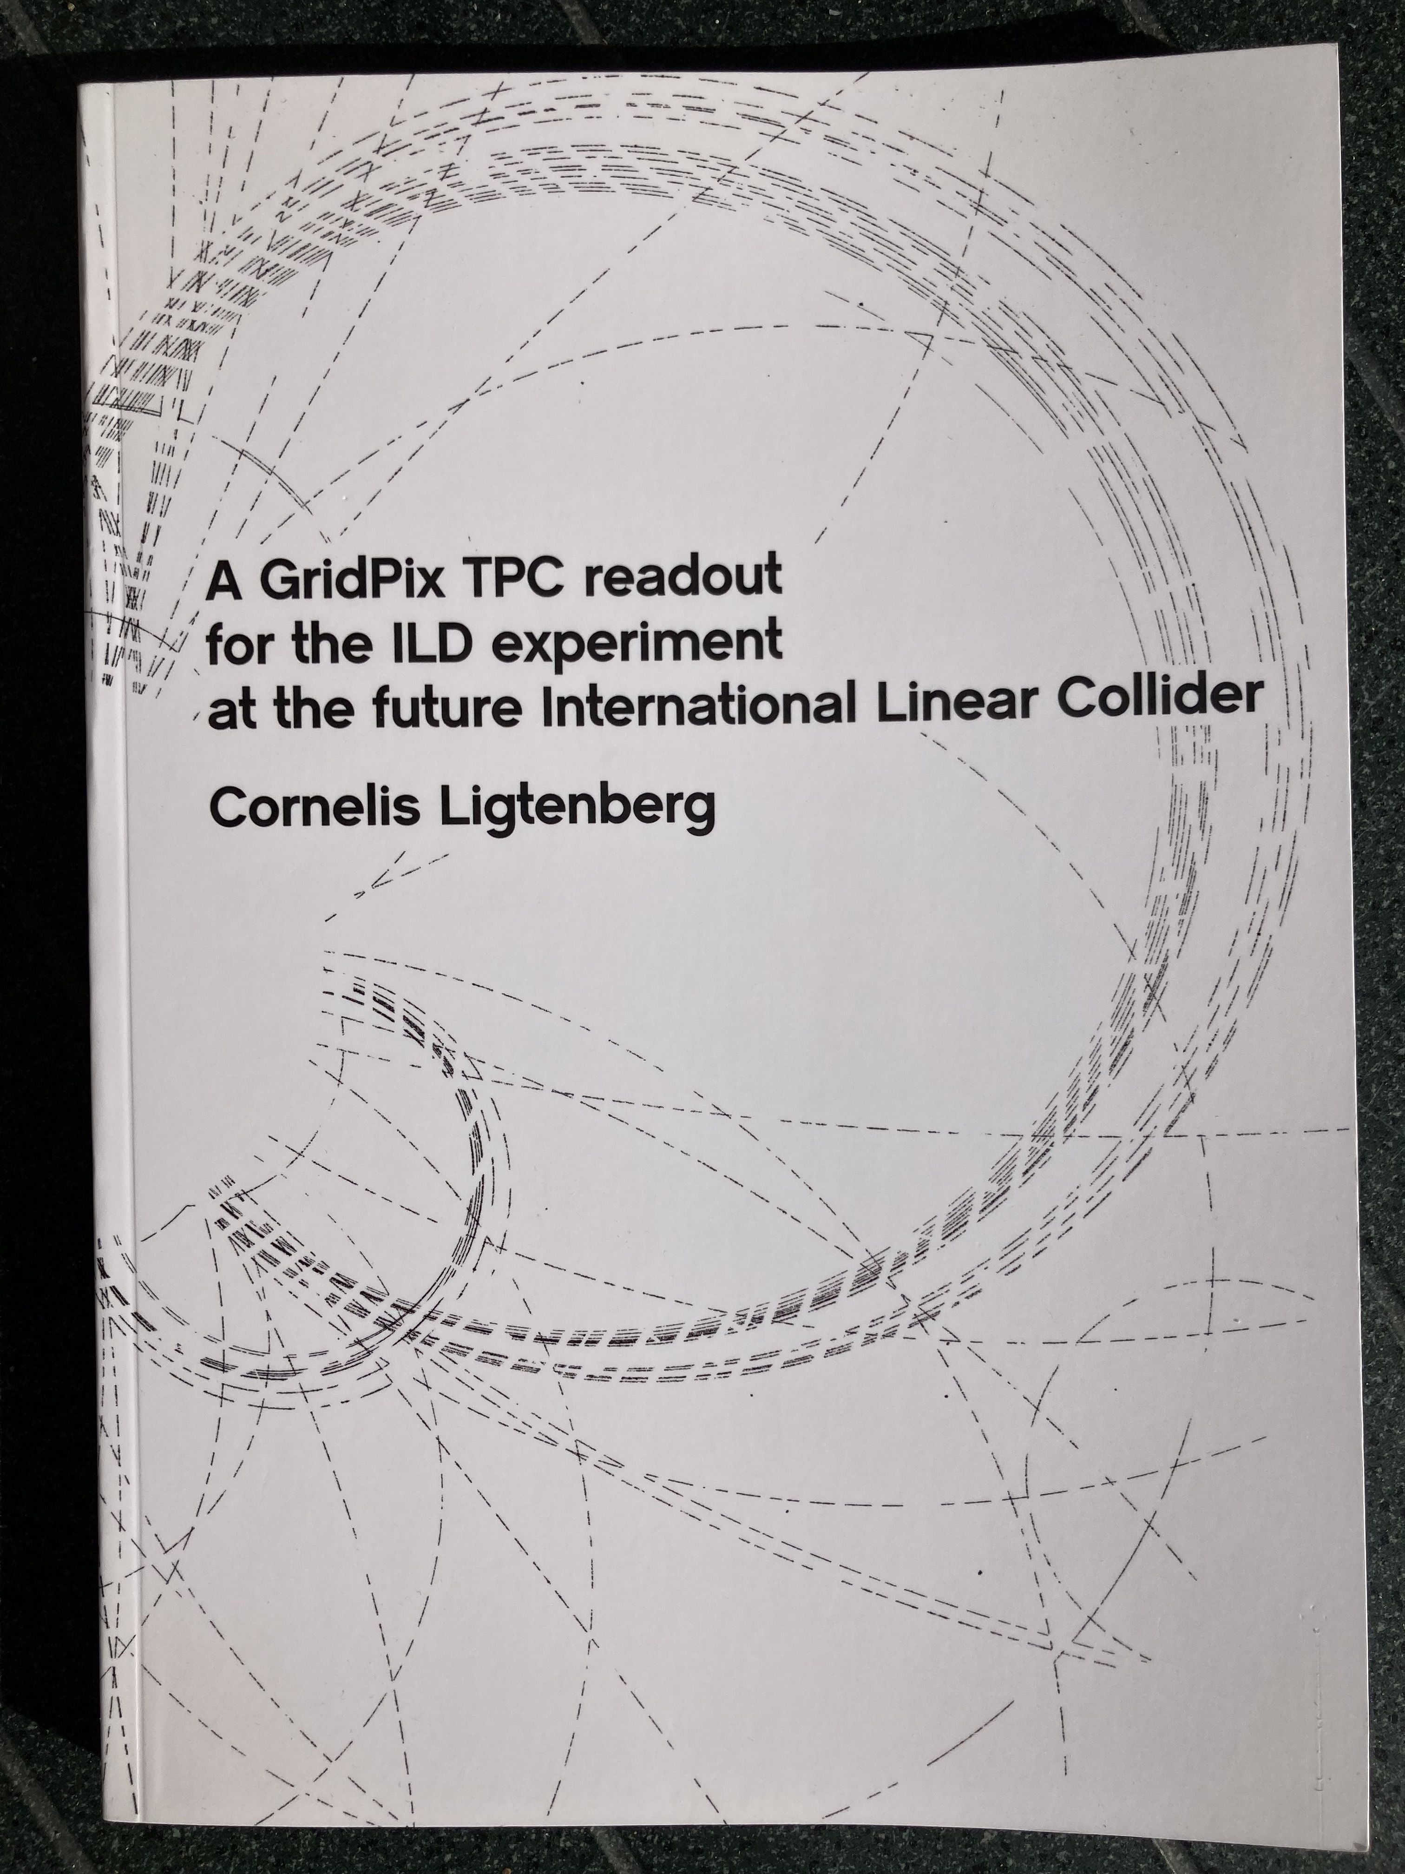
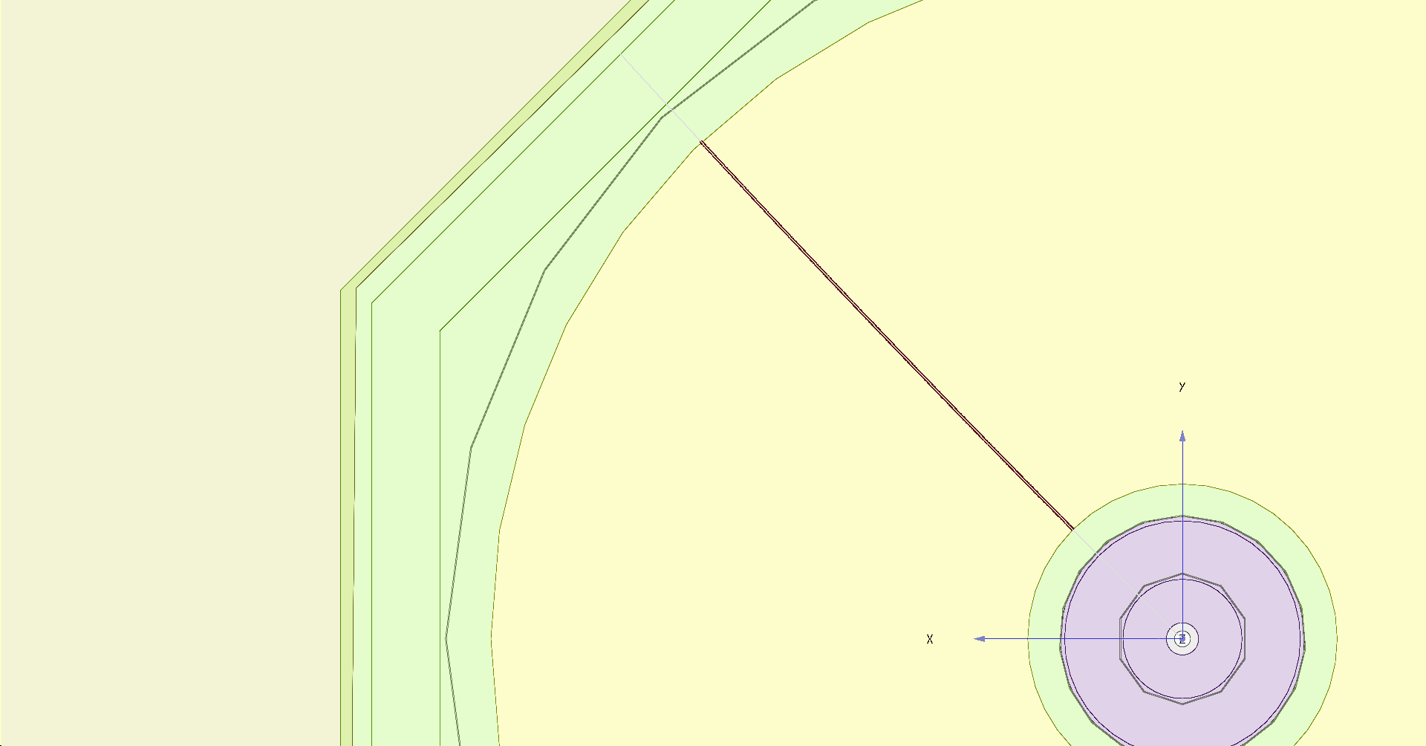
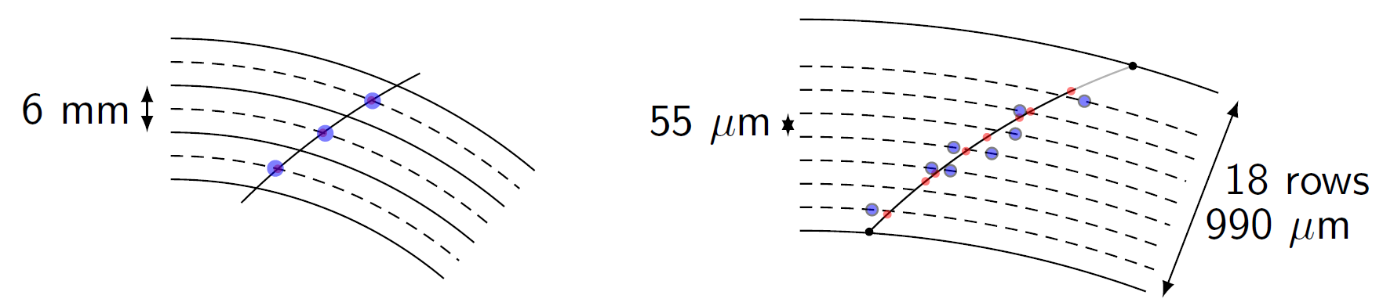
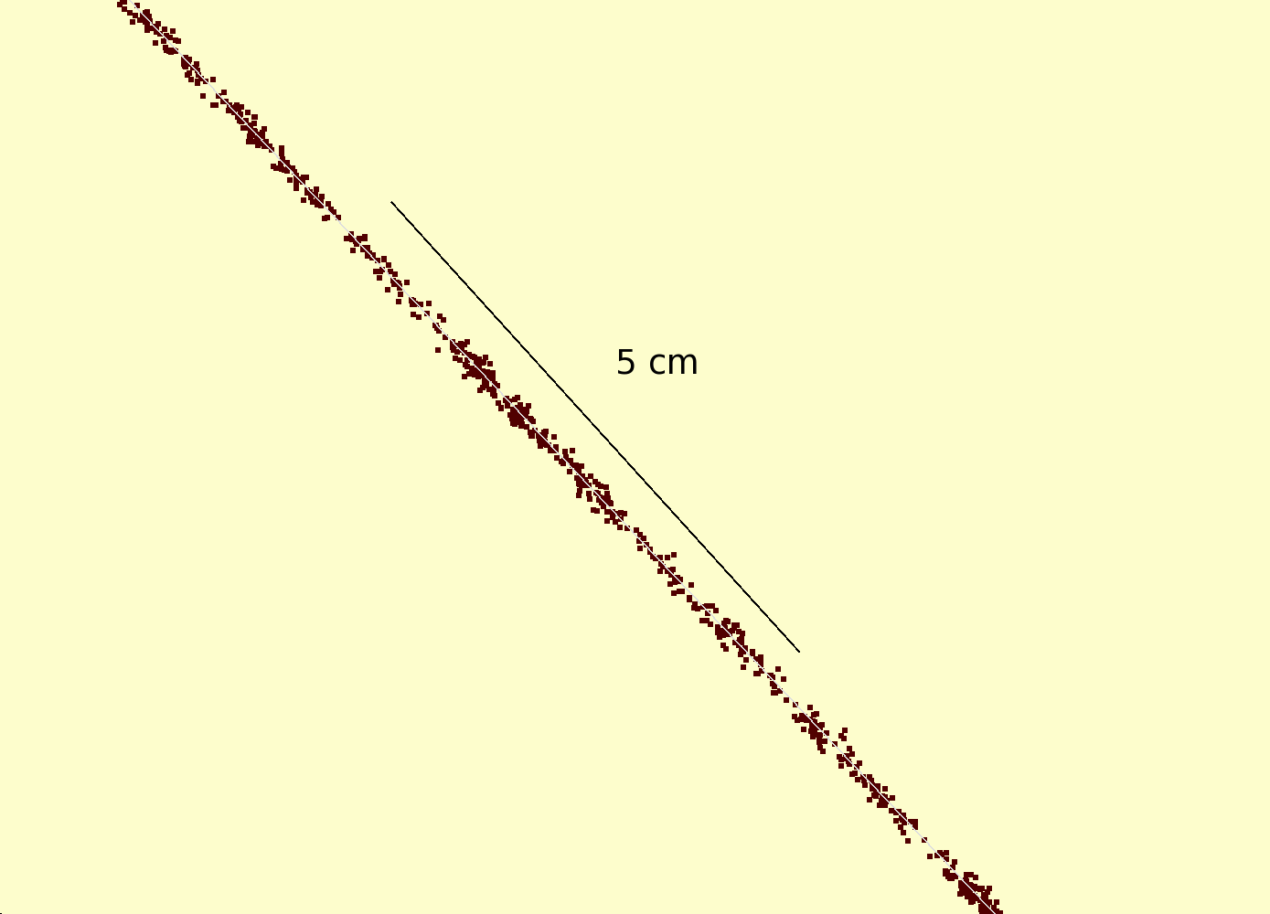
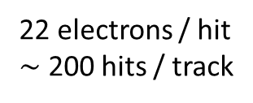
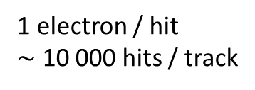
Simulation of ILD TPC with pixel readout
To study the performance of a large pixelized TPC, the pixel readout was implemented in the full ILD DD4HEP (Geant4) simulation
Changed the existing TPC pad readout to a pixel readout
Adapted Kalman filter track reconstruction to pixels
details: PhD thesis Kees Ligtenberg
pixels
pads
50 GeV muon track with
pixel readout

Slide 15
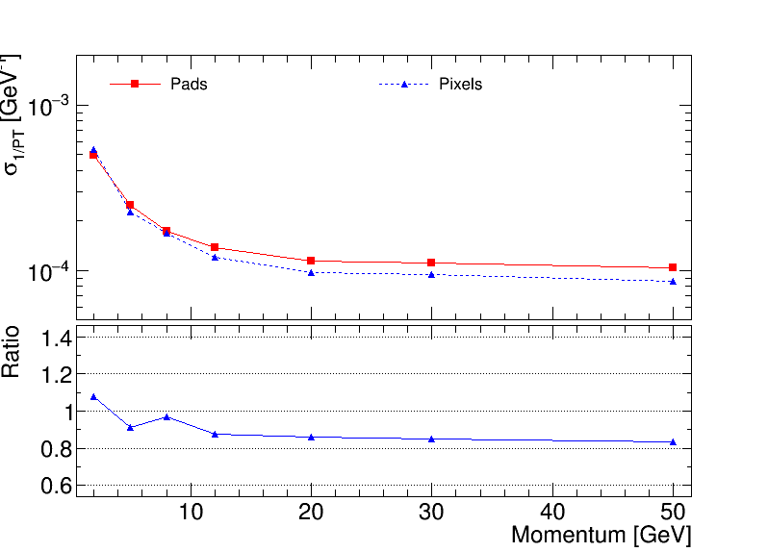
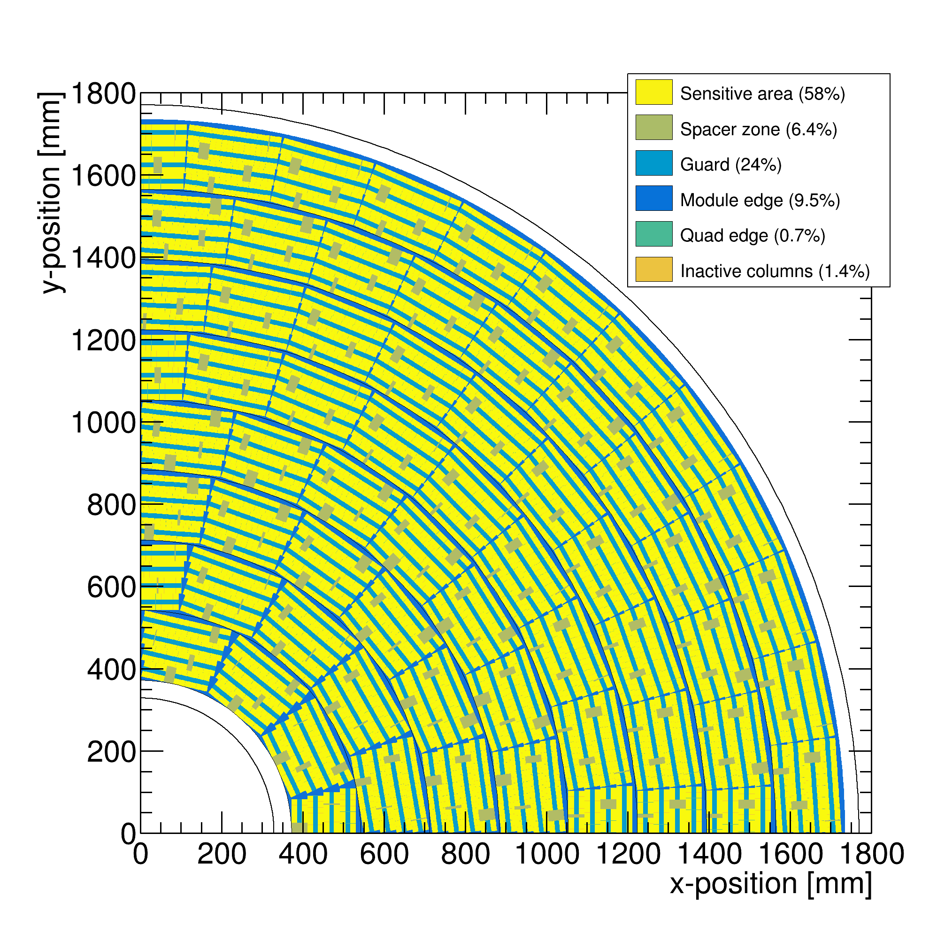
Performance of a GridPix TPC at ILC
From full simulation the momentum resolution can be determined
Momentum resolution is about 15% better for the pixels with realistic coverage (with the quads arranged in modules coverage 59%) and deltas.

Slide 16
Pixel TPC tracking studies
CEPC tracking Performance in xy for a Pixel TPC based on test beam
CEPC TPC T2K gas and dimensions Huirong Xi (talk)
10 cm track σ
Single electron σ xy 6 mm track σ
Each 10 cm we have a point with a resolution of < 22 (33) μm on the track
Comparable to performance of silicon detector (but TPC gas material).

Slide 17
Pixel TPC tracking studies
CEPC tracking Performance xy for a Pixel TPC based on test beam
The last 10 cm track provides very high resolution ‘point’ in the endcap (cos θ>0.8). This is due to the short drift distance and the high resolution pixel readout.
This point can be used to calibrate out the TPC distortions? There is no need for an additional forward silicon tracker.

Slide 18
Pixel TPC tracking studies
CEPC tracking Performance in z for a Pixel TPC based on test beam
10 cm track σ_{z} last 10 cm of track σ_{z}
Each 10 cm we have a point with a resolution of < 140 μm on the track
In the endcap in the last 10 cm point 30 μm

Slide 19
Pixel TPC tracking studies
Comparison to a drift chamber IDEA with 1.8 cm cells
with 66 points with resolution σ(xy) 100 μm and σ(z) 2000 μm
Pixel TPC
Conclusion resolutions of a (Pixel) TPC for the same “cell” size are smaller by a factor of: xy 1.2 to 10 (2 T) , 2 to 10 (3 T) and in z 3-10.

Slide 20
DESY testbeam June 2021

Slide 21
DESY testbeam Module Analysis
Performance of dEdx
It is possible to study in data the energy loss of electrons
The Pixel TPC has measurements with 55 μm pixel size
This allows to measure the number of hits as a function of the distance along the track dN/dx (dE/dx) with high granularity
It is possible to use also the ToT (a measure of the deposited charge) but this is not explored
The advantage of hit counting is that one is NOT getting the fluctuations from the multiplication process. The ToT will include these avalanche fluctuations.
Using e.g. a pad readout the charge is used as a measure of dEdx
  This has a worse granularity and includes avalanche fluctuations

Slide 22
DESY testbeam Module Analysis
Testbeam performance of dEdx
B=0 T
B=1 T
Preliminary
B=0 T has a large Landau tail
B=1 T smaller Landau tail and a more gaussian distribution
An electron crossing 8 chips in the module has about 1000 TX3 hits

Slide 23
DESY testbeam Module Analysis
Analysis of dEdx performance
Combine chips to form a 1 m long track with 60 % coverage for electrons
Method 1) reject large clusters and then run dEdx @ 90% using slices of 20 pixels along track (xy) (gives nr of selected hits). A large cluster has more than 6 hits in 5 consecutive pixels.
Method 2) fit the slope of the N_{scaled} minimum distance (d) distribution with an exponential function (N_{scale}(d)=defines the inverse weights):
N(d)_{scaled} = N_{scale}(d) N_{observed}(d)
N(d)_{scaled} is then fitted for each track with N₀ exp(-slope d)
Calculate the “dEdx” variable for electrons and MIP (==70% of hits)
  method 1 = nr of selected hits, method 2 = slope
  Resolution is σ = σ(dEdx)/dEdx (for σ we use the rms)

Slide 24
DESY testbeam Module Analysis
dEdx performance method 1
Electron resolution
3.6%
1 m track 60% and coverage
Linearity MIP-e = 1.03
z drift=5-15 mm (flat)
MIP distribution is obtained by dropping 30% of the hits
Preliminary

Slide 25
DESY testbeam Module Analysis
dEdx performance method 2
Electron resolution
2.9%
1 m track 60% and coverage
Linearity MIP-e = 1.07
Ideally this is 1. A number larger than 1 means that the resolution is +7% larger
Preliminary

Slide 26
DESY testbeam Module Analysis
Summary of performance of dEdx
The dEdx resolution for electrons from data by combining tracks to form a 1 m long track with realistic coverage ~60% coverage.
Preliminary
Method | B=0 Resolution (%) | B= 1 T Resolution (%)
(1) dEdx 90 tail | 6.0 | 3.6
(2) Fit slope | 5.4 | 2.9
The “dEdx 90 tail” method is truncation at 90% where large clusters are identified and removed (tail reduced)
For the “Fit slope” method (2) an exponential distribution (with the slope and amplitude as free parameters) is fitted to the distribution of distance between the hits (as discussed: after applying the weights)

Slide 27
DESY testbeam Module Analysis
dEdx Performance extrapolated to CEPC detector
CEPC TPC
rInner = 600 rOuter = 1800 mm
electron resolution = 2.65%
at θ=π/2 (cost=0)
Assume Pixel TPC performance at B = 1 T at p = 5,6 GeV/c
Test beam B = 1 T
p=5,6 GeV/c
Method 2 fit slope of the distance distribution
electron resolution 2.9%
1 m track 60% and coverage

Slide 28
DESY testbeam Module Analysis
dEdx performance for T2K gas
Contacted Ullrich Einhaus for dEdx studies in ILD
Extracted the ILC soft parametrisations for energy loss based on G4 and full simulation of the ILC TPC with T2K gas
Link generated in 2020 with ILC soft v02-02 and v02-02-01

Slide 29
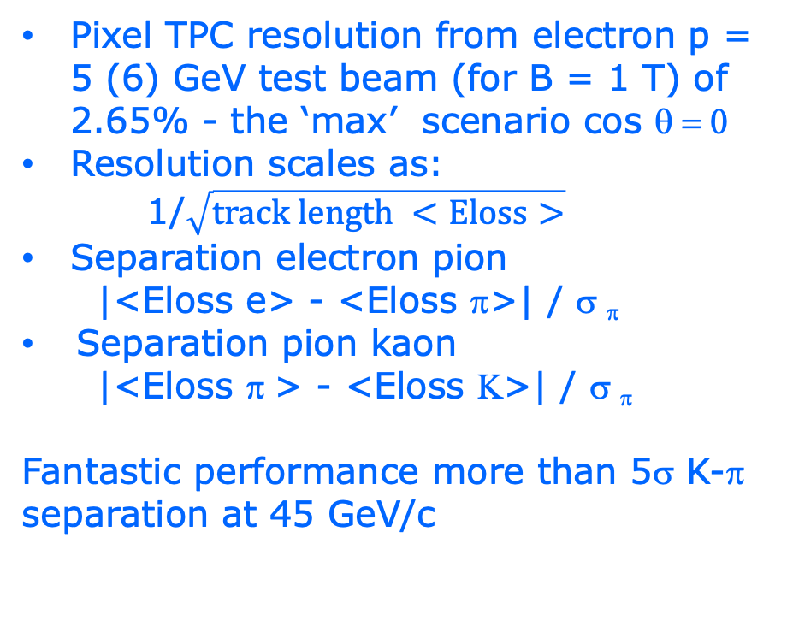
DESY testbeam Module Analysis
CEPC Pixel TPC dEdx performance
Pixel TPC resolution from electron p = 5 (6) GeV test beam (for B = 1 T) of 2.65% - the ‘max’ scenario cos θ = 0
Resolution scales as:
1/$\sqrt{track length <Eloss>}$
Separation electron pion
|<Eloss e> - <Eloss π>| / σ _{π}
Separation pion kaon
|<Eloss π > - <Eloss Κ>| / σ _{π}
Fantastic performance more than 5σ K-π separation at 45 GeV/c

Slide 30
DESY testbeam Module Analysis
Pixel TPC dEdx performance
Worst case (diffusion) CEPC Performance with: 3.4% and 3.5% (2T) at cos θ = 0
Worst case: p = 45 GeV/c π-K separation 4.0 (3T) and 3.9 σ

Slide 31
Pixel TPC dEdx performance
dE/dx resolution for an electron with p=5,6 GeV/c of 1 m track length with 60% coverage is measured to be 2.9% (at B = 1 Tesla)
The resolution for the CEPS detector is 2.65% (w.c. 3.4% @ 3T and 3.5% @ 2T)
This allows for particle identification and separation of Kaons from pions up to momenta of 45 GeV with more than 5 σ (worst case 4 σ and 3.9 σ (2T)) for cos θ = 0. The separation increases up to cos θ = 0.85 (see back up slide).
A test beam @ FermiLab with a quad in a TPC is planned (2024, US Grant EIC)
  an EIC R&D program for CO2 cooling is funded (2023) (Yale, Stony Brook, Purdue, Bonn, Nikhef)
  Focus is particle identification and tracking at the Electron-Ion-Collider
A pixel TPC has become a realistic viable option for experiments
  High precision tracking like ILD@ILC in the transverse and longitudinal planes, dE/dx by electron and cluster counting, excellent two track resolution, digital readout that can deal with high rates

Slide 32
Operation of a Pixel TPC at CEPC or FCC-ee

Slide 33
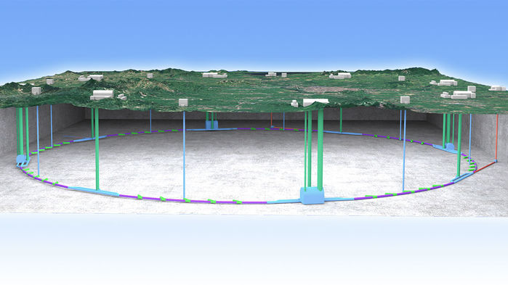
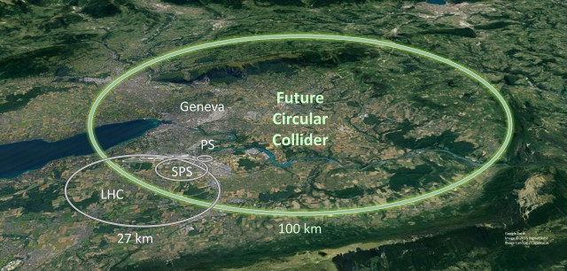
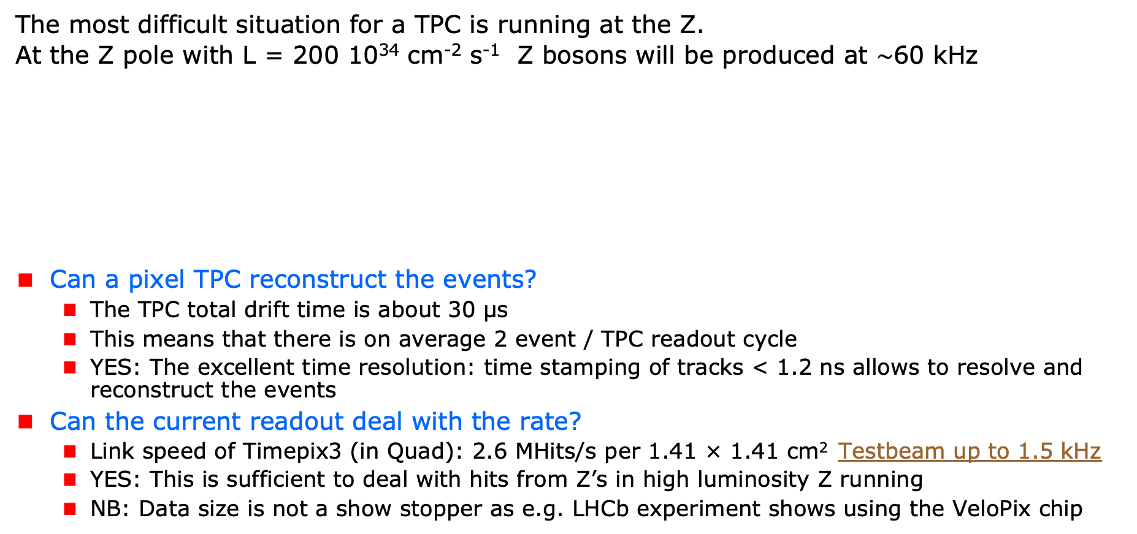
A Pixel TPC at CEPC or FCC-ee
The most difficult situation for a TPC is running at the Z.
At the Z pole with L = 200 10³⁴ cm⁻² s⁻¹ Z bosons will be produced at $\sim$60 kHz
Can a pixel TPC reconstruct the events?
  The TPC total drift time is about 30 μs
  This means that there is on average 2 event / TPC readout cycle
  YES: The excellent time resolution: time stamping of tracks < 1.2 ns allows to resolve and reconstruct the events
Can the current readout deal with the rate?
  Link speed of Timepix3 (in Quad): 2.6 MHits/s per 1.41 × 1.41 cm² Testbeam up to 1.5 kHz
  YES: This is sufficient to deal with hits from Z’s in high luminosity Z running
  NB: Data size is not a show stopper as e.g. LHCb experiment shows using the VeloPix chip
Picture IHEP

Slide 34
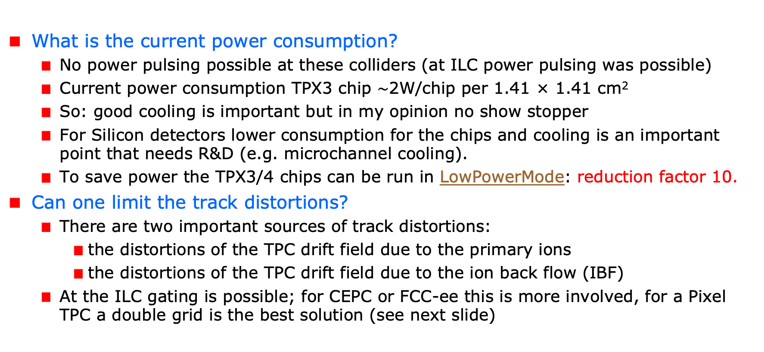
A Pixel TPC at CEPC or FCC-ee
What is the current power consumption?
  No power pulsing possible at these colliders (at ILC power pulsing was possible)
  Current power consumption TPX3 chip $\sim$2W/chip per 1.41 × 1.41 cm²
  So: good cooling is important but in my opinion no show stopper
  For Silicon detectors lower consumption for the chips and cooling is an important point that needs R&D (e.g. microchannel cooling).
  To save power the TPX3/4 chips can be run in LowPowerMode: reduction factor 10.
Can one limit the track distortions?
  There are two important sources of track distortions:
    the distortions of the TPC drift field due to the primary ions
    the distortions of the TPC drift field due to the ion back flow (IBF)
  At the ILC gating is possible; for CEPC or FCC-ee this is more involved, for a Pixel TPC a double grid is the best solution (see next slide)

Slide 35
A Pixel TPC at CEPC or FCC-ee
Is it possible to reduce the IBF for a pixel TPC?
  IDEA: by making chip with a double grid structure (see back up slide)
  This idea was already realized as a TWINGRID NIMA 610 (2009) 644-648
  For GEMs for the ALICE TPC this was also the way – several GEMs on top of each other to reduce IBF
  For the Pixel the IBF can be easily modelled and with a hole size of 25 μm an IBF of 3 10⁻⁴ can be achieved and the value for IBF*Gain (2000) would be 0.6.
  YES: the IBF can be reduced to 0.6 but this needs R&D
  In the new detector lab in Bonn it is possible to make and study this device
What would be the size of the TPC distortions?
  Tera-Z studies by Daniel Jeans and Keisuke Fuji show that for FCC-ee or CEPC this means: distortions from Z decays up to < O(100) μm
  Beam strahlung gives (now) a factor 200 more background. Detector optimization and shielding is important for TPC and Silicon detectors to reduce pair background.
  It was argued that in an ILD like detector the distortions can be mapped out using the VTX-SIT/SET detectors.

Slide 36
Fitting out TPC distortions in ILD/CEPC
It is possible to map out distortions using e.g. muons from Z decays
  E.g. by fitting the 3D spatial distribution as a function of time as was done by ALEPH and more recently by ALICE. Using this distribution the hits positions are corrected and the TPC track refitted.
However, with silicon trackers around the TPC, more elaborate methods can be used. One can use the track predictions based of the silicon trackers SIT and SET to correct on a track-by-track level the TPC track.
  One can use as a constraint that the extrapolated positions and angles agree with the measured in the SIT and SET.
  Practically, one can e.g. correct the TPC track parameters
The ultimate way is a fitting technique similar to ATLAS. In the ATLAS track fit the common systematics is fitted out for sets of Muon hits. For ILD/CEPC the fit would fit free parameters in the distortion model, while using as a constraint the SIT and SET position and direction measurements.
  The simplest case is a model where the strength (amplitude) and radial dependence would be scaled and a model is used for the 3D extrapolations.

Slide 37
Conclusions: Pixel TPC at a circular collider
YES: a pixel TPC can reconstruct the Z events in one readout cycle
YES: the current readout of the Timepix3 chip can deal with the Z hit rate running
  The current MDI design FCCee/CEPC gives a lot of beam-beam background more that a factor 100 more hits from the beam than from the Z. This far from optimal. An improved MDI is needed.
The current power consumption is 1W/cm². By running the TPX chips in low power mode this can be reduced by a factor of 10. Still good cooling is important no show stopper; but needs extensive R&D.
Track distortions in the TPC drift volume are a concern at high lumi Z running:
  Track distortions from Z decays in TPC are O(100) μm
  It is possible to reduce the IBF for a pixel TPC by making a device with a double grid
  A double grid needs dedicated R&D that can be performed in the new lab in Bonn
The Z physics program at FCC-ee or CEPC with an ILD-like detector with a Pixel TPC (with double grid structures) sliced between two silicon trackers (VTX-SIT and SET) can be fully exploited. The reduction of beamstrahlung by an improved MDI – and the fitting out of distortions - needs more study.
A pixel TPC can perfectly run at WW, ZH or tt energies where track distortions are several orders of magnitude smaller

Slide 38
Backup plots

Slide 39
DESY testbeam Module Analysis
Distance distribution
Single chip
Quad module
Calculate minimum distance between the hits.
The slope of the distribution is related to the number of primary clusters /cm
The diffused peak at d<10 comes from clusters with more than 1 hit.
B=0 T
Preliminary
Thesis Kees Ligtenberg

Slide 40
DESY testbeam Module Analysis
Performance of dEdx
Method 2: Fit slope of the distance distribution
From 10 clusters onwards an exponential distribution is followed.
Below 10 the distribution will be down-weighted (N_{scale}(d) = 1/weight). The weights are:
Weights B=0 = { 35.0467 , 12.1497 , 4.52914 , 2.76311 , 1.99386 , 1.59795 , 1.3656 , 1.21409 , 1.11898 , 1.04385 };
Weights B=1 = { 22.5617 , 7.39573 , 2.43318 , 1.54528 , 1.23428 , 1.09727 , 1.04368 , 1.01625 , 1.00182 , 0.998178 };
Note the difference in weights in the B=0 and 1 T data sets. This is related to the fluctutations
B=0 T
Preliminary

Slide 41
DESY testbeam Module Analysis
Pixel TPC dEdx performance
Separation pion kaon
|<Eloss π > - <Eloss Κ>| / σ _{π}
Separation pion kaon for different cos(theta) values due to the track length dependence
For cos(theta)=0 till 0.95 the separation lies between the black and red curves. Only above 0.95-0.975 the separation drops till the blue curve.
‘max’ scenario with resolution 2.5%
Excellent performance over very large polar angle range
CEPC Pixel TPC

Slide 42
Reducing the Ion back flow in a Pixel TPC
The Ion back flow can be reduced by adding a second grid to the device.
It is important that the holes of the grids are aligned. The Ion back flow is a function of the geometry and electric fields. Detailed simulations – validated by data - have been presented in LCTPC WP #326.
With a hole size of 25 μm an IBF of 3 10⁻⁴ can be achieved and the value for IBF*Gain (2000) would be 0.6.
Ion backflow | Hole 30 μm | Hole 25 μm | Hole 20 μm
Top grid | 2.2% | 1.2% | 0.7%
GridPix | 5.5% | 2.8% | 1.7%
Total | 12 10⁻⁴ | 3 10⁻⁴ | 1 10⁻⁴
transparancy | 100% | 99.4% | 91.7%

