Slide 1


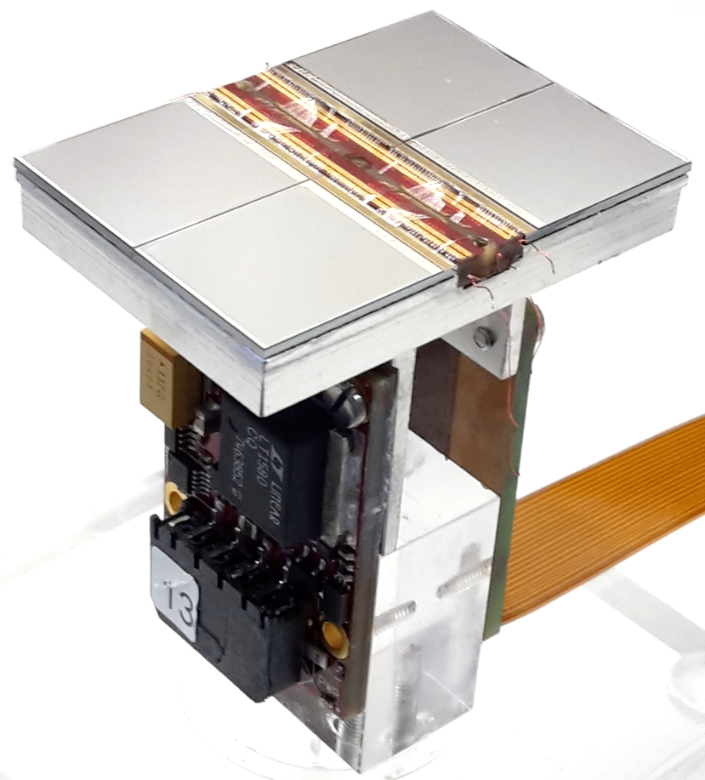





Pixel TPC rates and gas
Yevgen Bilevych, Klaus Desch, Sander van Doesburg, Harry van der Graaf, Fred Hartjes, Jochen Kaminski, Peter Kluit, Naomi van der Kolk,
Cornelis Ligtenberg,
Gerhard Raven, and
Jan Timmermans

Slide 2
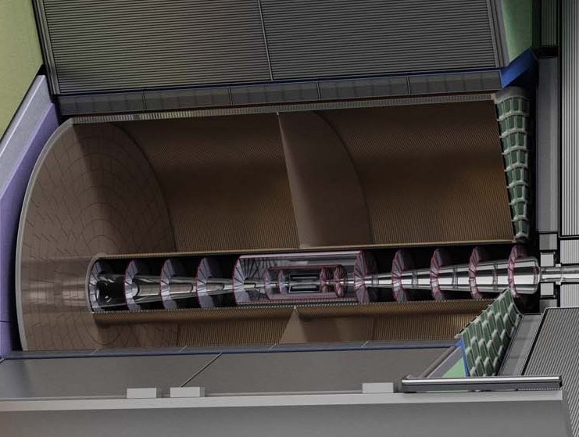
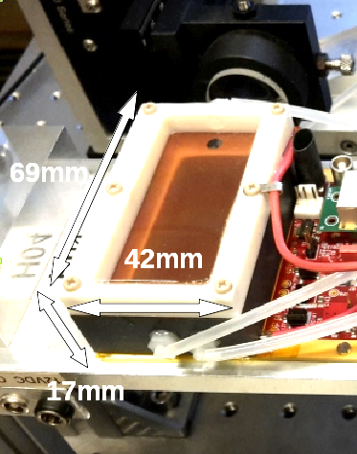


Pixel TPC
(Octopuce)
(TimePix1) TPX3 chip Quad Module TPC plane
(2007-14) 2017 2018 2019

Slide 3
Running a Pixel TPC at high rates
For example Z run @ CEPC
The occupancy and hit rates running CEPC at the Z.
Take the numbers from beam-beam background from She Xin LCTPC annual meeting Jan 2024.
Ions per BX = 18.2 k primary ions/electrons per BX; BX = 1/23 ns
Assume rate R goes like R₀ /R²
Integrated R₀/R(60) - R₀/R(180) = 18.2 k ions. So R₀ 1.638 M hits cm. So hits in 1 cm radius from 60 to 61 cm you have 447 k hits /cm. In the full ring 2 π R (60 cm). So hit density 1.19 k hits /cm/cm/ BX
The mean drift time 30 μs (zMax = 2.9 m so <z> = 1.45m) with a drift velocity of v_{d} = 50 (75) μm/ns
So mean total hits is 1.5 MHits/cm/cm in 30 μs.
Per single pixel mean number of hits is 28.17 (pixels 55x55 μm and 60% coverage) in 30 μs. This means a single pixel TPC readout rate of 0.94 M hits/sec. This is high but the readout can handle that.

Slide 4
Running a Pixel TPC at high rates
For example Z run @ CEPC
The occupancy and hit rates running CEPC at the Z.
For the occupancy the dead time is relevant. For TPX3 the dead time is: 475 ns. This means that the occupancy is 26%. So the current TPX3 could deal with this HUGE rate.
For Pads of size 1 mm x 6 mm this means an occupancy >> 1 of 71.4 hits per pad per BX ...
Small pads/ large pixels of 500x500 μm will also run into an occupancy problem we have 2.975 hits per pixel per BX....

Slide 5
Running a Pixel TPC at high rates
For example Z run @ CEPC
Comparison of the background rate with Z rate.
Beam background Ions per BX = 18.2 k primary ions/electrons per BX
Assume Z at CEPC high luminosity rate of 50 kHz (BX rate = 1/23 ns)
With a track multiplicity of 20, 100 hits/cm and a 150 cm long track we get 300 kHits (single electrons/ions) per Z
The hit rate from Z decays is 15 G hits per sec.
The Z hit rate is 345 primary ions/electrons per BX.
So the number of background hits at the CEPC is a factor 52 times higher than the Giga Z hit rate
Obviously the pixel TPC occupancy is very low and the pad occupancy higher than 1. A readout with 500x500 μm would work for the Zs but not for the beam background
Therefore it is VERY important to design a MDI reduces the background

Slide 6
Running a Pixel TPC at high rates
For example Z run @ CEPC
Studies for Daniel Jeans show and locate precisely the problem. Here some plots from the draft ILD document
Comparing the ILD and the FCC MDI

Slide 7
Running a Pixel TPC at high rates
For example Z run @ CEPC
Studies for Daniels Jeans show and locate precisely the problem
Comparing the ILD and the FCC (CEPC) MDI: backgrounds are a factor 50 higher for FCC (CEPC)

Slide 8
Running a Pixel TPC at high rates
For example Z run @ CEPC
Studies for Daniels Jeans show and locate precisely the problem
Comparing the ILD and the FCC (CEPC) MDI: backgrounds are a factor 50 higher for FCC (CEPC)
The large backgrounds come from photon back scattering at |z| 1 cm magnet Lumi Cal -> see plot
For ILD this is moved further out w.r.t. IP and detector centre.
Need to shield better these back scatters. Or move more outwards some elements etc. etc.

Slide 9
Running a Pixel TPC with He
For example Z run @ CEPC or FCCee
The idea is use in the TPC not the T2K gas. But another gas mixture that gives less hits. And a gas that is less sensitive to the beam background.
One could think of a He or Ne based gas.
The advantage would be: the number of electrons /cm is lower by a factor of about 8 (Ne 2.5) w.r.t. the T2K gas. The probability that the photons (from the beam-beam background) interact with Helium is also a factor of 9 (Ne 5) lower.
I am not absolutely sure but this could bring a factor 80 (12.5) beam background reduction.

Slide 10
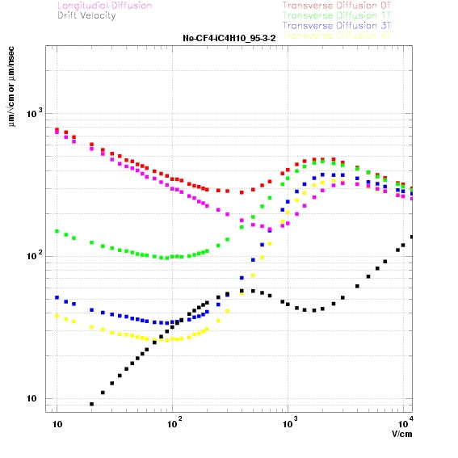
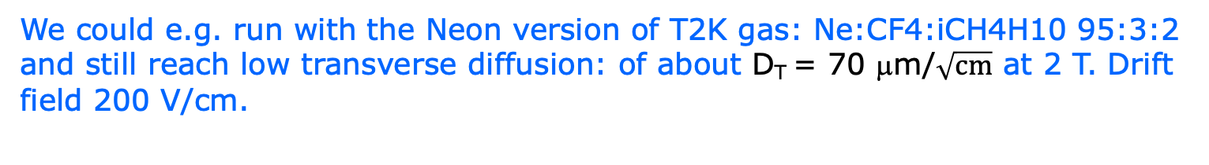
Running a Pixel TPC with He
For example Z run @ CEPC or FCCee
We could e.g. run with the Neon version of T2K gas: Ne:CF4:iCH4H10 95:3:2 and still reach low transverse diffusion: of about D_{T} = 70 μm/$\sqrt{cm}$ at 2 T. Drift field 200 V/cm.
PDG clusters/cm primary total
Ne:CF4:iCH4 16.04 46
T2K 26 100

Slide 11
T2K Pixel TPC tracking studies
CEPC tracking Performance in xy for a Pixel TPC based on test beam
CEPC TPC T2K gas and dimensions Huirong Xi (talk)
10 cm track σ
Single electron σ xy 18 mm track σ
Each 10 cm we have a point with a resolution of < 33 μm at 2 T on the track
Comparable to performance of silicon detector (but TPC gas material).

Slide 12
Ne Pixel TPC tracking studies
CEPC tracking Performance in xy for a Pixel TPC based on test beam
CEPC TPC Ne:CF4:iCH4H10 95:3:2 gas with D_{T} = 70 μm/$\sqrt{cm}$ at 2 T.
10 cm track σ
Single electron σ xy 18 mm track σ
Each 10 cm we have a point with a resolution of < 70 μm on the track

Slide 13
Ne Pixel TPC tracking studies
CEPC TPC Ne:CF4:iCH4H10 95:3:2 gas with D_{T} = 70 μm/$\sqrt{cm}$ at 2 T.
last 10 cm track σ
At the last 10 cm of the track the performance is maximally a factor 1.5 worse for the Neon based “T2K” gas mixture

Slide 14
Ne Pixel TPC tracking studies
CEPC TPC Ne:CF4:iCH4H10 95:3:2 gas with D_{T} = 70 μm/$\sqrt{cm }$at 2 T
Expected performance
Clearly the momentum resolution for the standalone TPC track will increase w.r.t. the T2K gas by a factor of 1.5 to 2 (due to lower number of hits and diffusion)
The impact on the momentum resolution is smaller if one refits including the VTX and SIT detectors (at the start of the track).
The dEdx/dNdx performance might be quite spectacular, because of the smaller fluctuations (less secondary clusters); cluster counting will be possible.
The reduction of the beam background due to this gas needs to be checked (back of the envelop gives 12.5).
- It is possible to get more precise numbers. The comparison is however “unfair” we assume that in the T2K gas the systematics due to beam backgrounds is zero. And clearly that is too optimistic.

Slide 15
T2K Pixel TPC tracking studies
Ar:CF4:iCH4H10 95:3:2 gas with D_{T} = 50 μm/$\sqrt{cm }$at 2 T
Wrote a simulation using the ILD geometry and resolutions.
Assumes no multiple scattering
Resolution is σ(1/p) in GeV⁻¹
Allows to study the cos θ dependence TPC resolution improves due to track length up to cos θ=0.8*. Above: with shorter radial length high resolution points (small diffusion at the end of track)
Combining VTX-SIT-TPC-SET BIG gain wrt VTX-SIT-SET only
This is IMO not in ILD simulation.

Slide 16
Ne Pixel TPC tracking studies
Ne:CF4:iCH4H10 95:3:2 gas with D_{T} = 70 μm/$\sqrt{cm }$at 2 T
Comparing the TPC σ(1/p) for Ar and Ne at cos θ=0 one sees a factor of 2 larger momentum resolution.
However in the combination the TPC still brings a lot to the momentum resolution!
Combined σ(1/p) at cos θ=0 is 3.9 (Ne 5.7) 10⁻⁵ GeV⁻¹
Running at the Z this means a momentum resolution of 0.25% at 45 GeV/c for Neon.

Slide 18
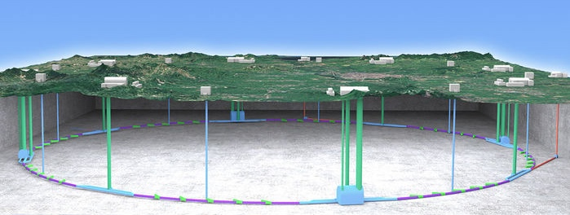
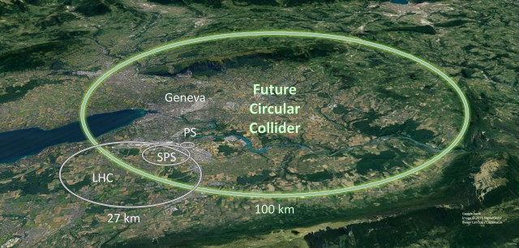
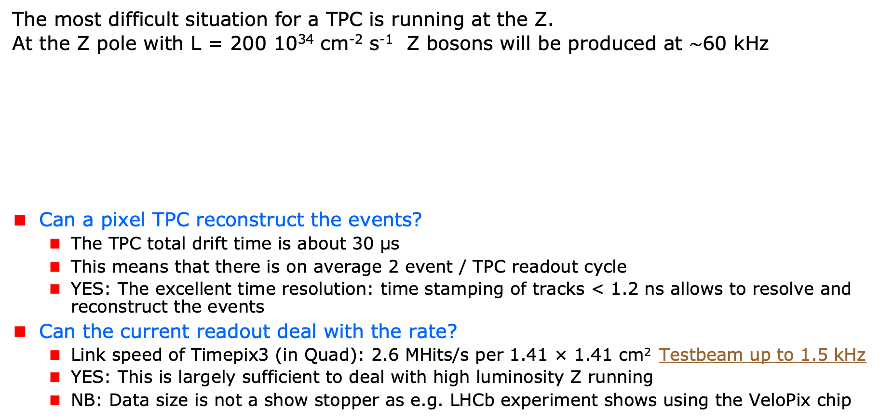
A Pixel TPC at CEPC or FCC-ee
The most difficult situation for a TPC is running at the Z.
At the Z pole with L = 200 10³⁴ cm⁻² s⁻¹ Z bosons will be produced at $\sim$60 kHz
Can a pixel TPC reconstruct the events?
  The TPC total drift time is about 30 μs
  This means that there is on average 2 event / TPC readout cycle
  YES: The excellent time resolution: time stamping of tracks < 1.2 ns allows to resolve and reconstruct the events
Can the current readout deal with the rate?
  Link speed of Timepix3 (in Quad): 2.6 MHits/s per 1.41 × 1.41 cm² Testbeam up to 1.5 kHz
  YES: This is largely sufficient to deal with high luminosity Z running
  NB: Data size is not a show stopper as e.g. LHCb experiment shows using the VeloPix chip
Picture IHEP

