Slide 1
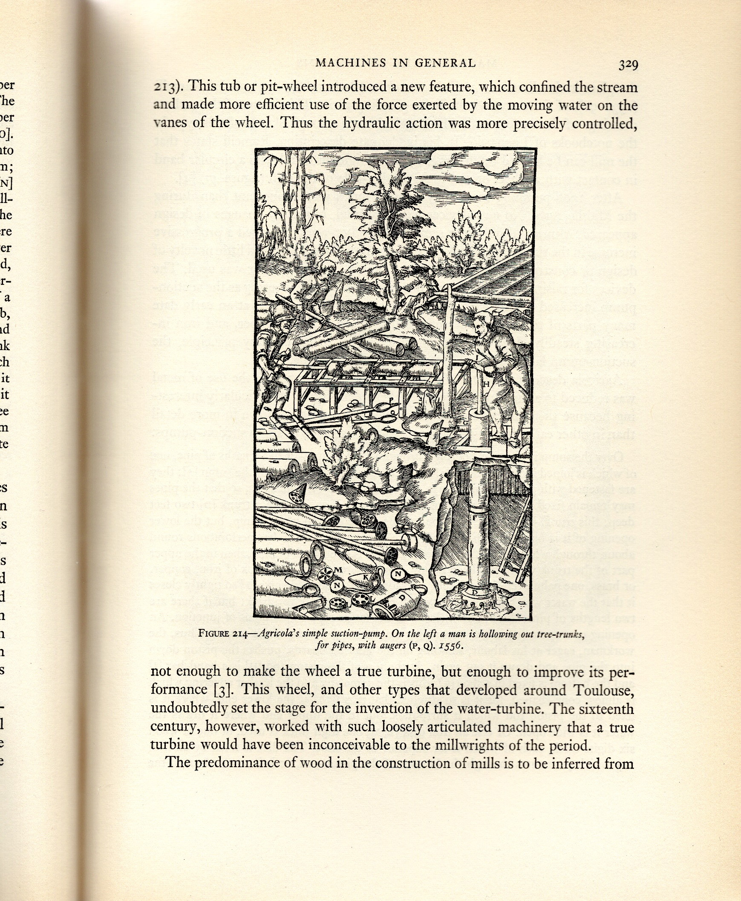
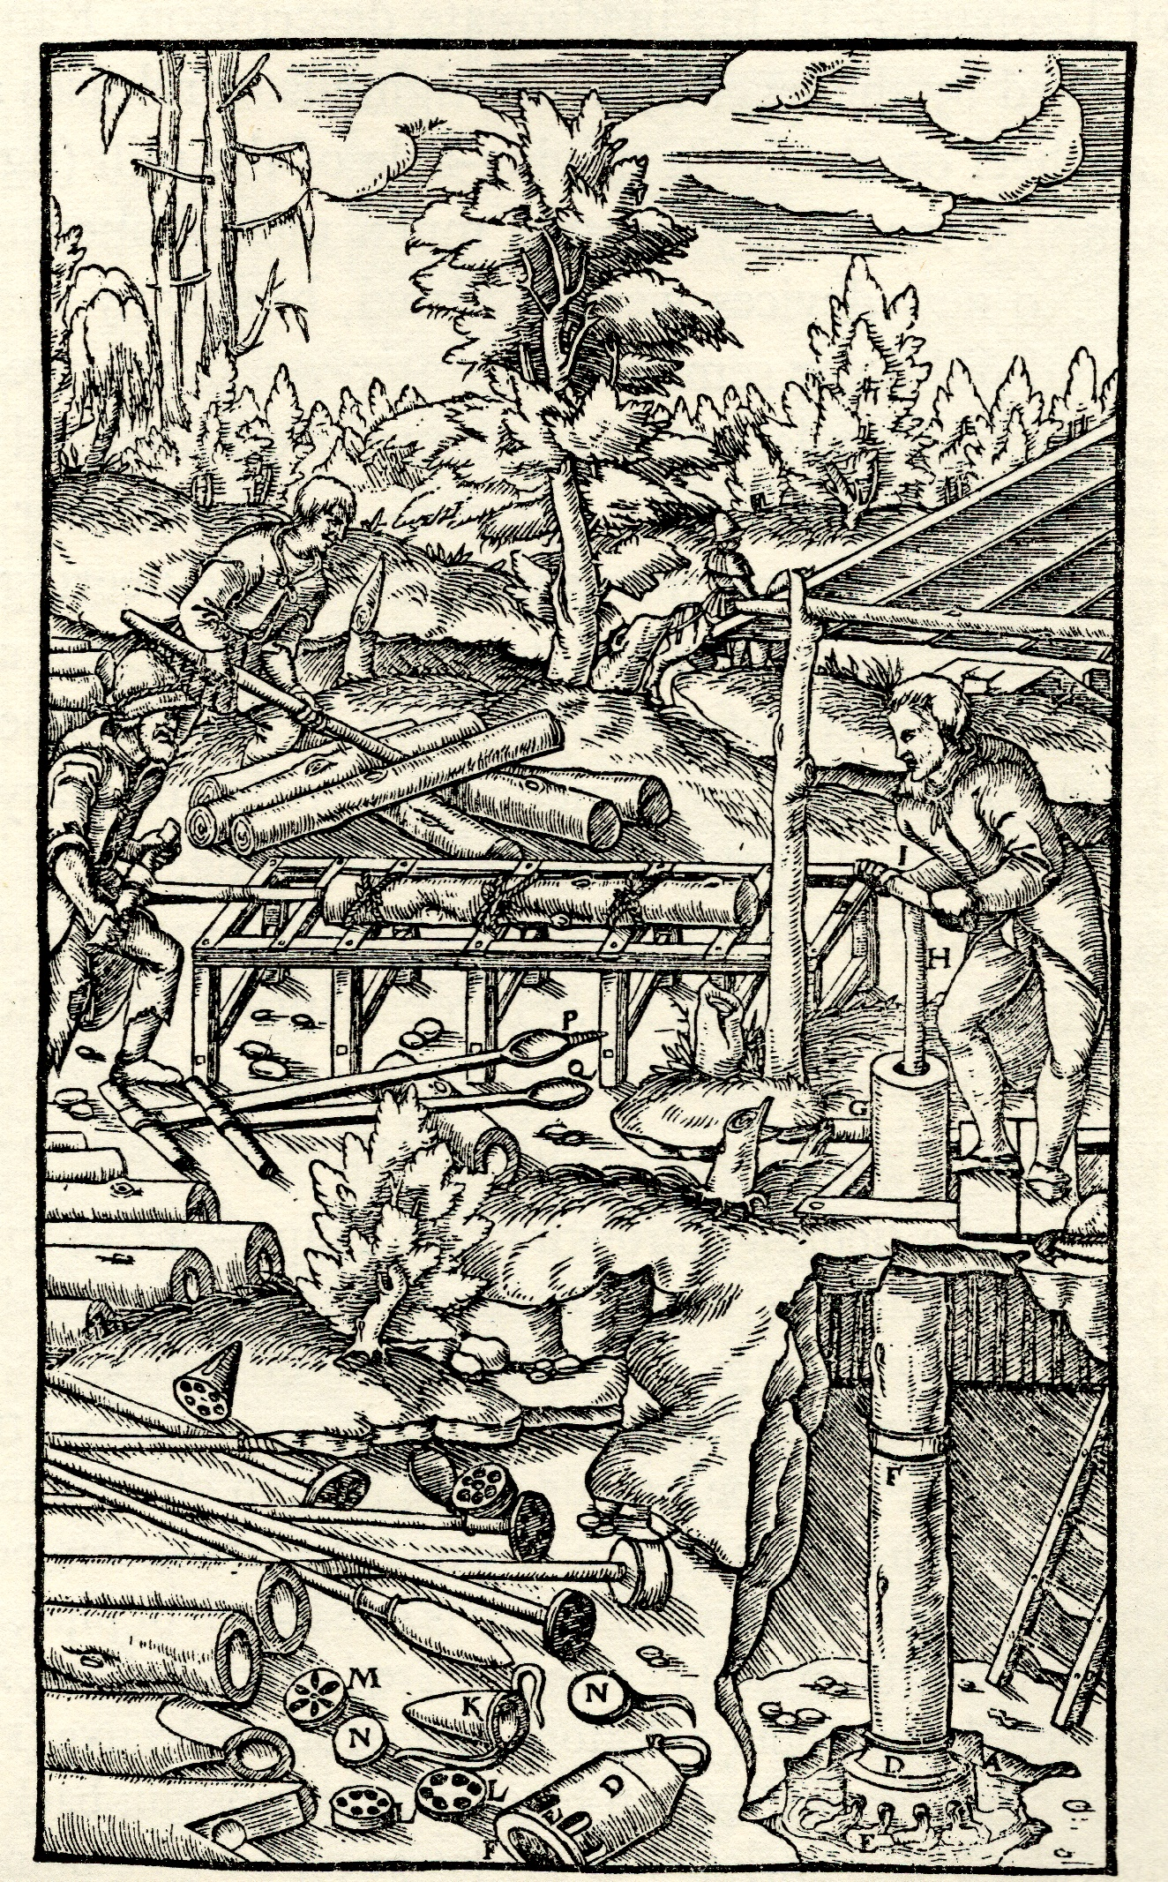
edited by Singer C. et all (1957) A history of technology. Volume III, Oxford at the clarendon press
M.Y.Barel - Nikhef – May 2024 - Jamboree

Slide 2
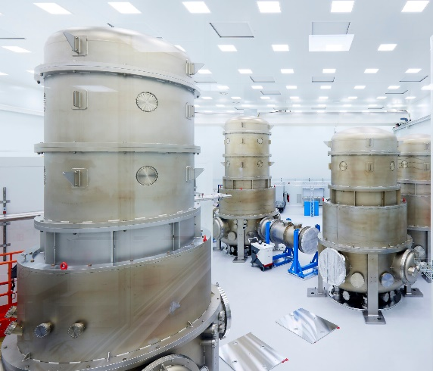
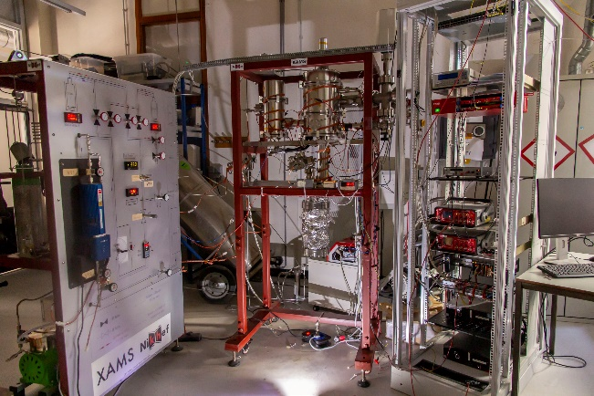
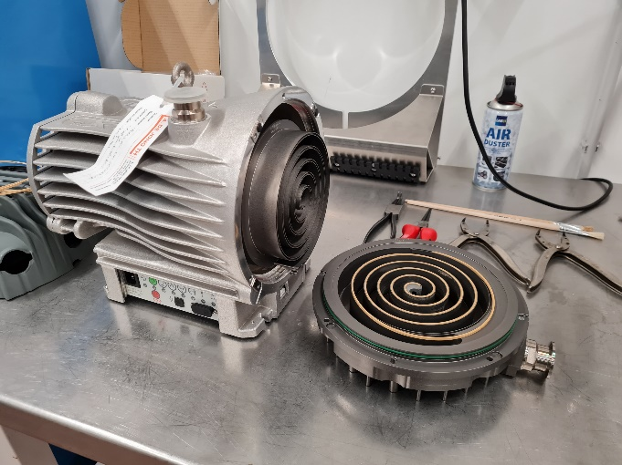
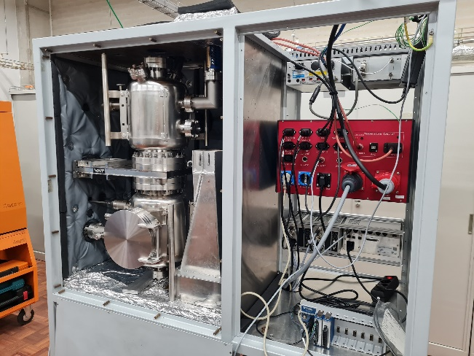
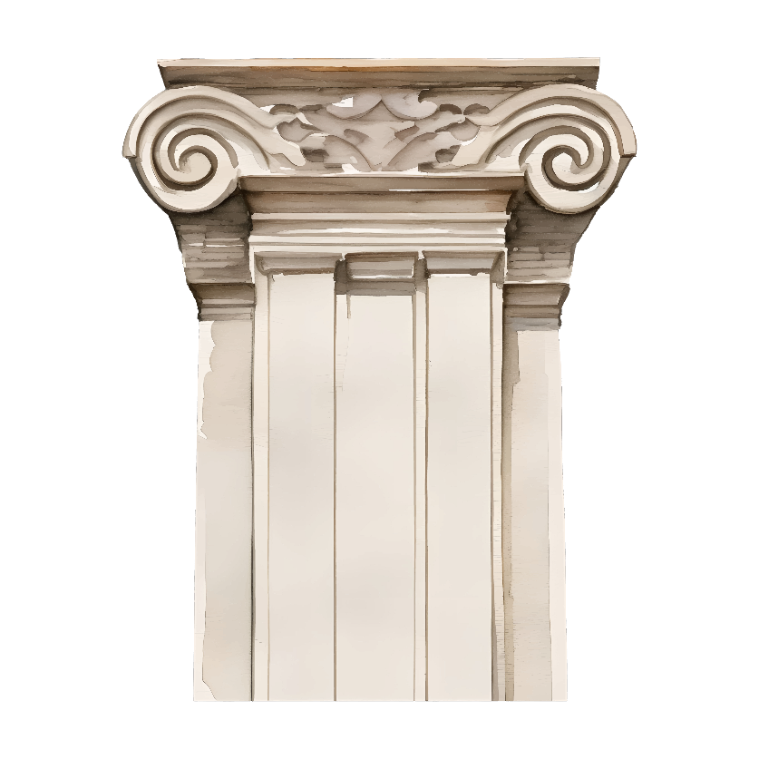
The vacuum lab supports
Sorry did not find it
M.Y.Barel - Nikhef – May 2024 - Jamboree
External design
Internal design
Leak detection
Maintenance & management
Research and qualification

Slide 3
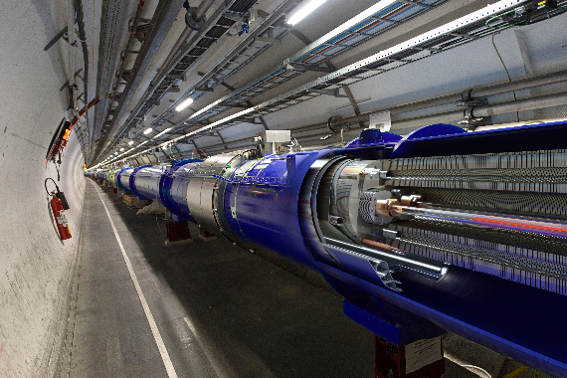
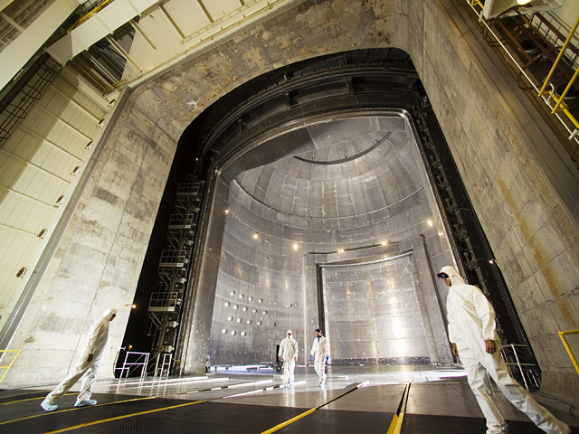
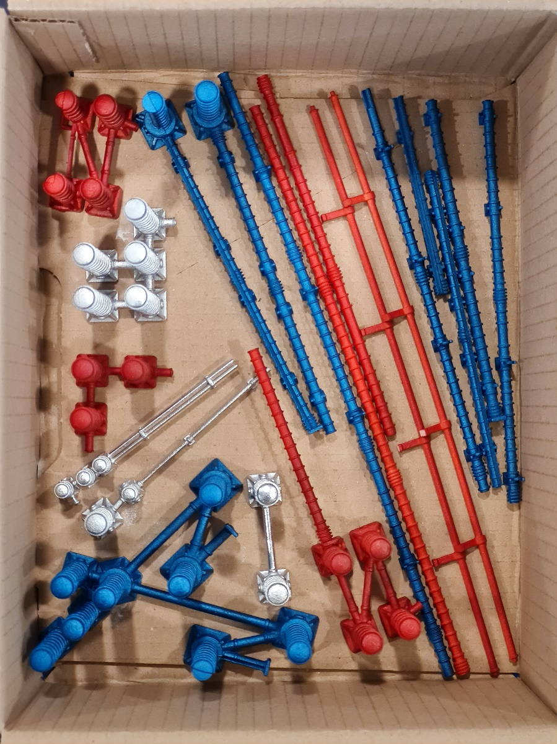
The extreme scale of Einstein Telescope
https://www1.grc.nasa.gov/facilities/sec/#gallery
M.Y.Barel - Nikhef – May 2024 - Jamboree
Dominguez, Daniel: CERN
Marco Kraan: Nikhef
LHC insulating vacuum
volume: 15 000 m³
Pressure range: 10⁻⁶ mbar
SEC vacuum chamber
volume: 22 653 m³
Pressure range: 10⁻⁶ mbar
ET beam pipe vacuum
volume: 6 x 15 700 m³
Pressure range: 10⁻¹¹ mbar

Slide 4
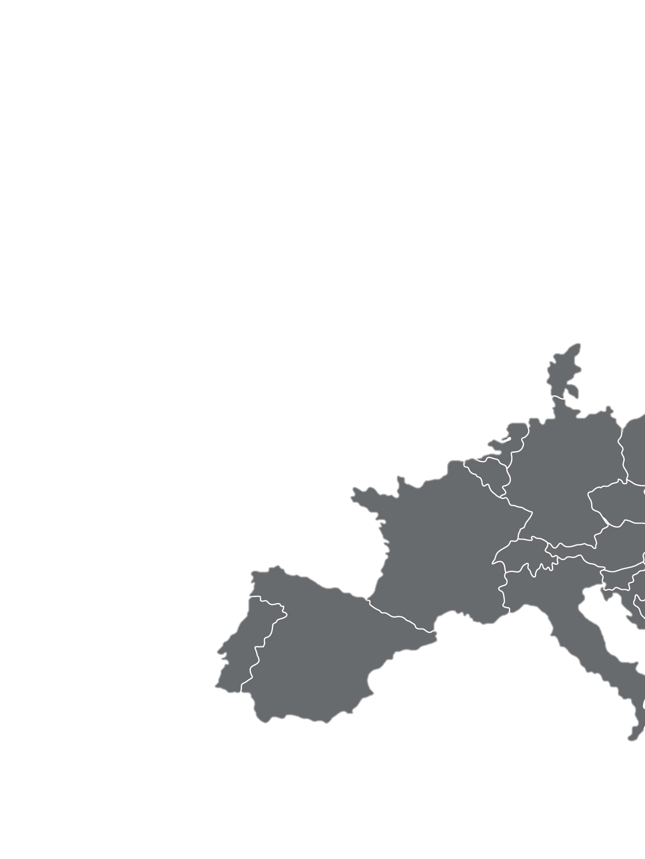
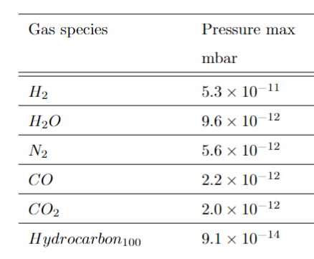
Who can measure extreme nothingness
 | Mbar
Atmospheric pressure | 1013
Low vacuum | 1E3 till 1
Medium vacuum | 1 till 1E-3
High vacuum | 1E-3 till 1E-7
Ultra high vacuum (UHV) | 1E-7 till 1E-11
Extremely high vacuum (XHV) | < 1E-11
Outer space | < 1E-14
https://www.overleaf.com/project/63bfe8cfea42cf35c7402c0e
M.Y.Barel - Nikhef – May 2024 - Jamboree
Background spectrum at Nikhef
CERN: vacuum, surfaces and coatings group
KIT: OMA setup (potentially)

Slide 5
Who can measure extreme nothingness
UHV compatible ≠ UHV clean
 | Mbar
Atmospheric pressure | 1013
Low vacuum | 1E3 till 1
Medium vacuum | 1 till 1E-3
High vacuum | 1E-3 till 1E-7
Ultra high vacuum (UHV) | 1E-7 till 1E-11
Extremely high vacuum (XHV) | < 1E-11
Outer space | < 1E-14
https://www.overleaf.com/project/63bfe8cfea42cf35c7402c0e
M.Y.Barel - Nikhef – May 2024 - Jamboree
Background spectrum at Nikhef
CERN: vacuum, surfaces and coatings group
KIT: OMA setup (potentially)

Slide 6
Item qualification - Upcoming
M.Y.Barel - Nikhef – May 2024 - Jamboree

Slide 7
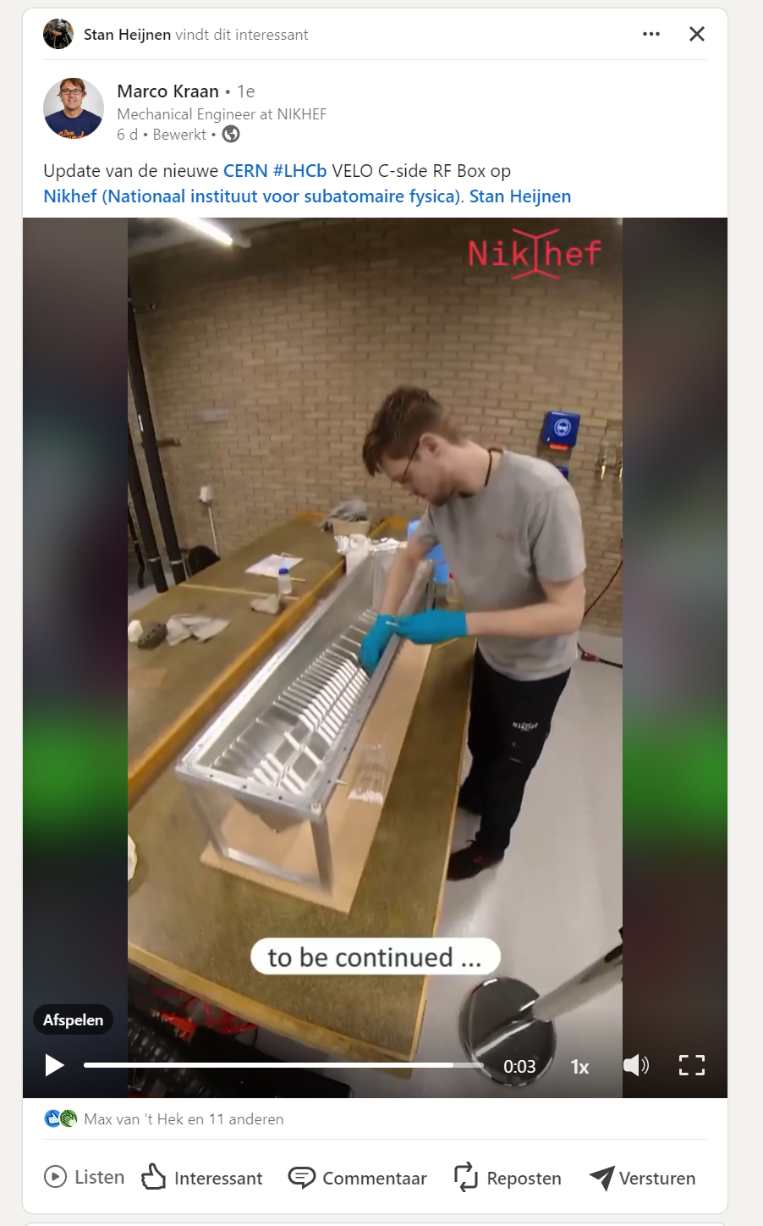
Item qualification - Upcoming
M.Y.Barel - Nikhef – May 2024 - Jamboree

Slide 8
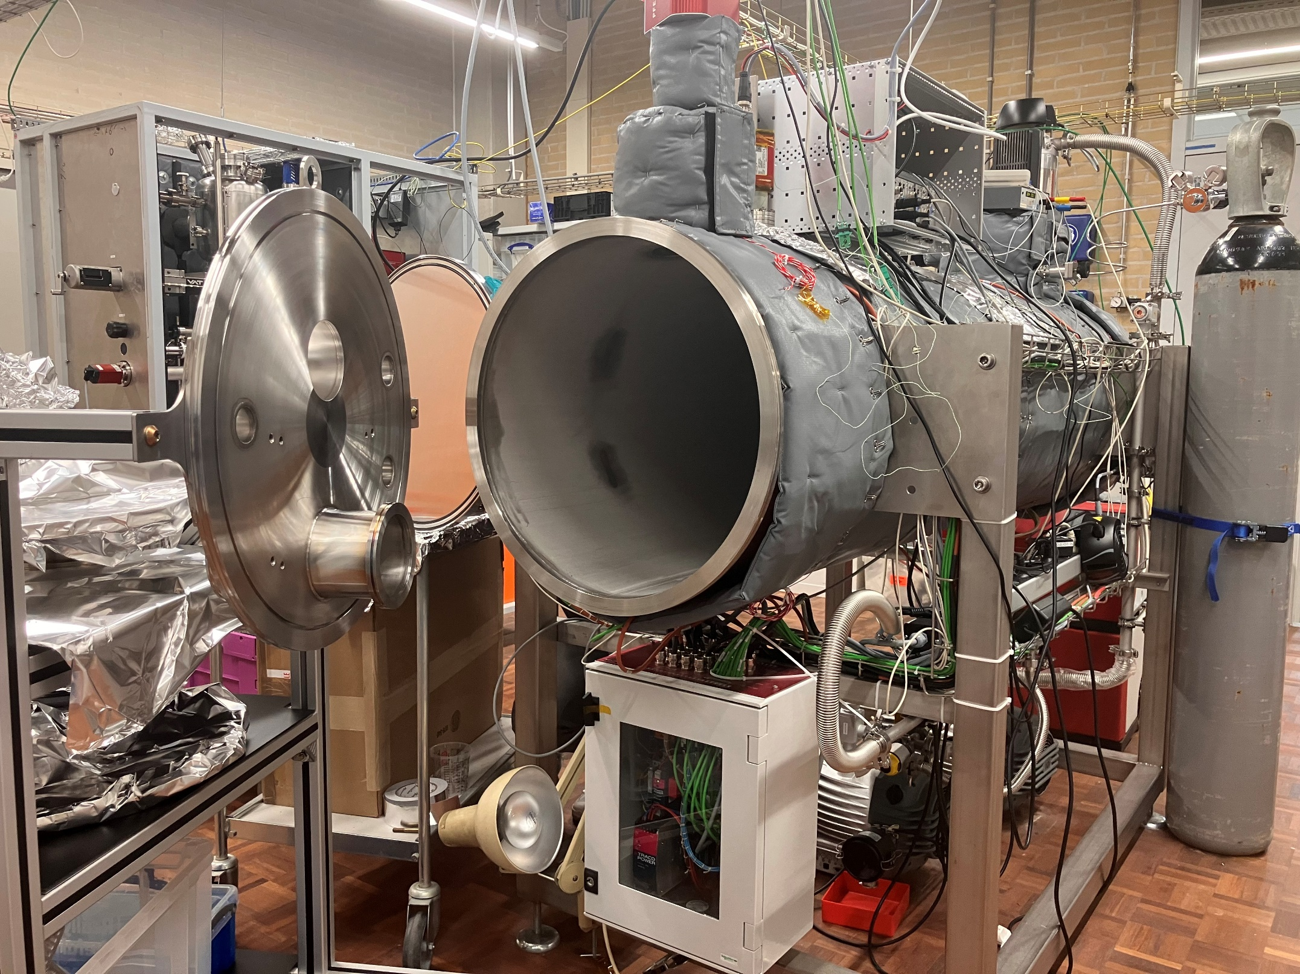
Item qualification - Upcoming
M.Y.Barel - Nikhef – May 2024 - Jamboree

Slide 9
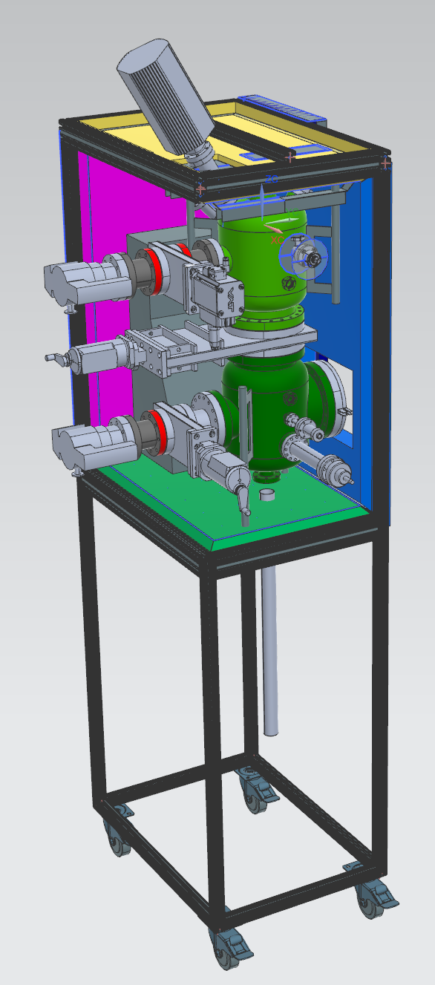
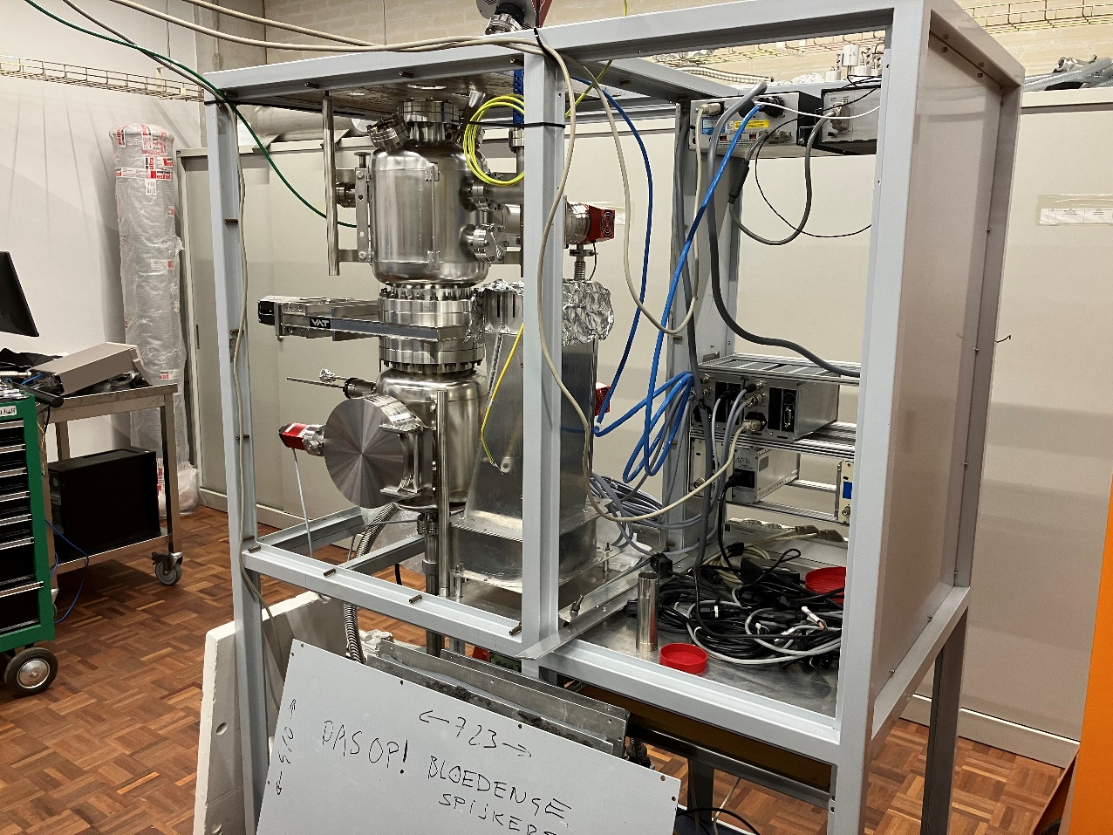
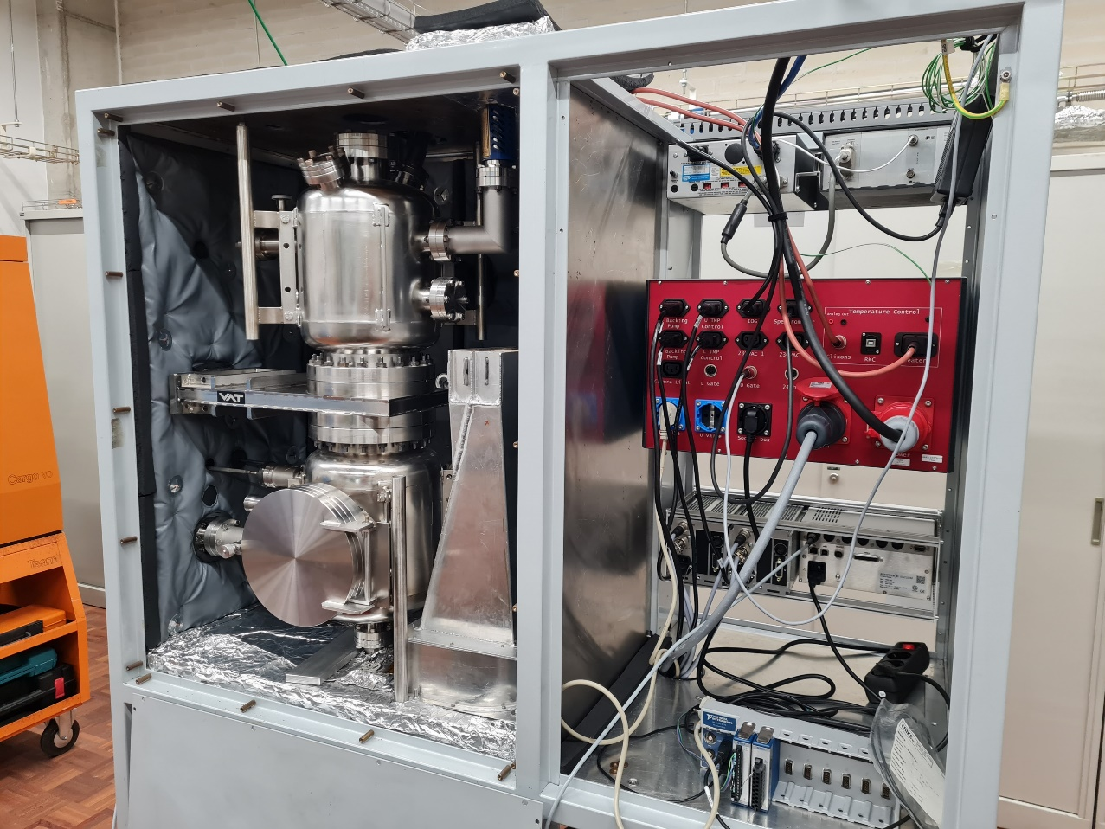
Developments: Improved accuracy
small RGA setup
Better insulation (in progress)
Vacuum fired chamber (done)
Electronics panel Interface (done)
M.Y.Barel - Nikhef – May 2024 - Jamboree

Slide 10
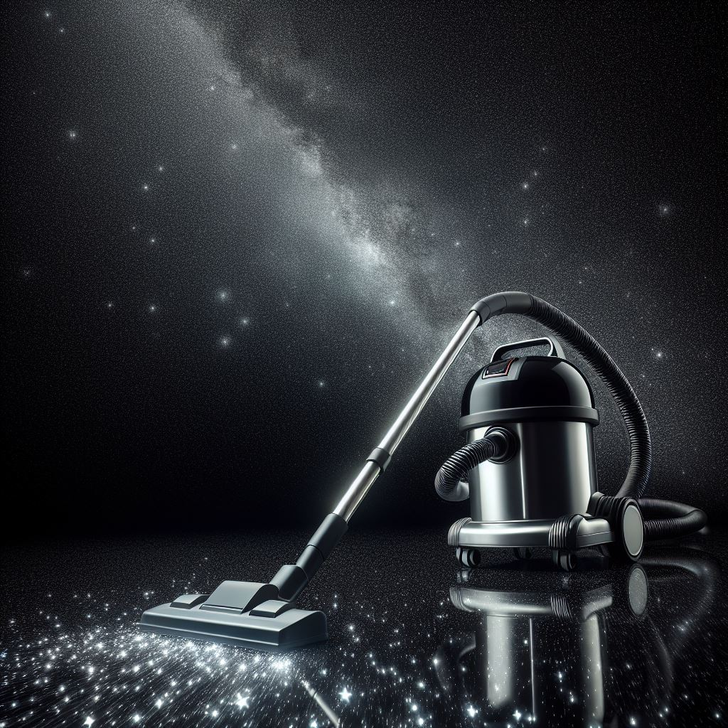
Why 2 setups? Visit the lab!
Let’s thank the invisible backbone:
So to all who contribute
to create nothing
Thank you
M.Y.Barel - Nikhef – May 2024 - Jamboree

Slide 11
Vacuum at Nikhef
24 04 2024
Marije Yolinde Barel

